Slide 1
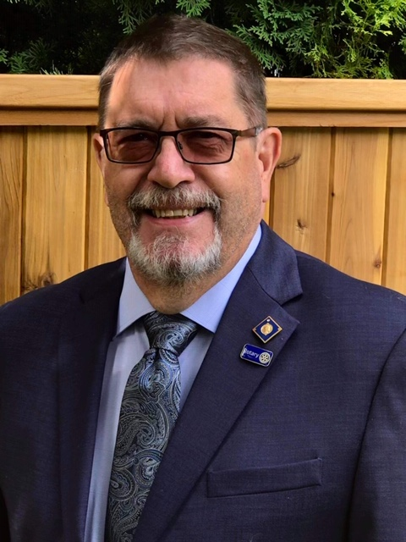
District 5050 Annual Giving,
Major Gifts, Paul Harris Society Chair
Thomas McMillan
Rotary Club of Abbotsford-Sumas
dedutch13@shaw.ca
604-852-5684

Slide 2
The Rotary Foundation
The Rotary Foundation (or in loving Rotary acronym, TRF) is a separate legal entity from Rotary International (RI) to maintain its charitable tax status.
The Foundation is managed by a 15 member Board of Trustees that is nominated by the RI President and appointed by the RI Board.

Slide 3
The Rotary Foundation
The MISSION of The Rotary Foundation
is to enable Rotarians to advance world
understanding, goodwill and peace through the improvement of health, the support of education, and the alleviation of poverty.
The GOAL of the Rotary Foundation is
to do good in the world.

Slide 4
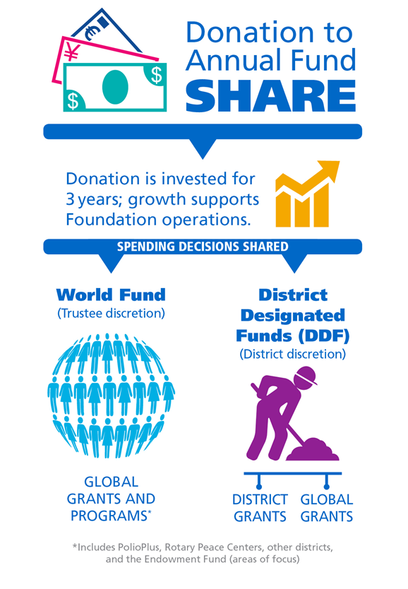

July 1, 2021 - 5%

Slide 5
HOW WE FUND PROGRAMS – SHARE
District 5050 Rotarian Contributions to the
Annual Programs Fund are returned 3 years later
TRF holds 5% to support operations (July 1, 2021)
2018-19 donations = $333,300
50% ($166,650)
District Designated Fund (DDF)
50% ($166,650)
World Fund
District 5050 Designated Fund (DDF)
50% to District Grants ($83,325)
50% to Global Grants ($83,325)
Notes:
To review: when we contribution to Annual Fund – SHARE, fifty percent (50%) of our contributions come back to our district through District Designated Funds (DDF) in three years to spend on educational and humanitarian activities chosen by us; even grants that may be used for projects in our local community.
The 5 percent that is earmarked to potentially pay for the Foundation’s operating expenses will come from the World Fund. It will be used only if it is needed to pay expenses when net investment returns are not sufficient, or to fully fund the operating reserve (up to three times annual operating expenses). If funds are not needed for these purposes, they will remain in the World Fund until the World Fund is measured to ensure sufficient funds for programs.
In the final step, the World Fund will be measured to ensure that it contains 50 percent of the three prior years’ worth of contributions, plus $5 million – a growth factor. Then and only then, surplus funds will be transferred to the Endowment Fund.
This funding model:
Builds our financial strength by ensuring that resources are available to meet current needs: programs and operating expenses.
Establishes a reserve to provide for unusual financial events (a rainy day fund): the operating reserve.
Ensures an increase in future programs through increased returns on the Endowment Fund.

Slide 6

Lets talk about you
your donations,
PHF recognition amount,
recognition points,
how to donate
how to direct your donation
Go to

Slide 7
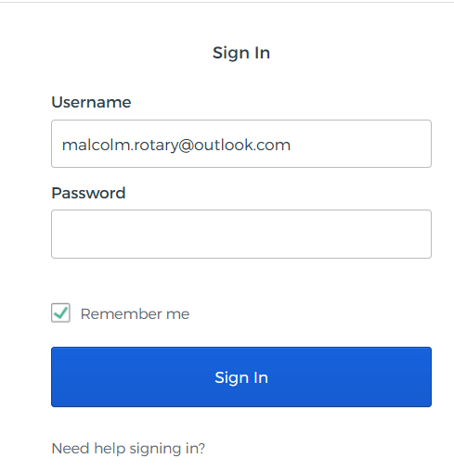
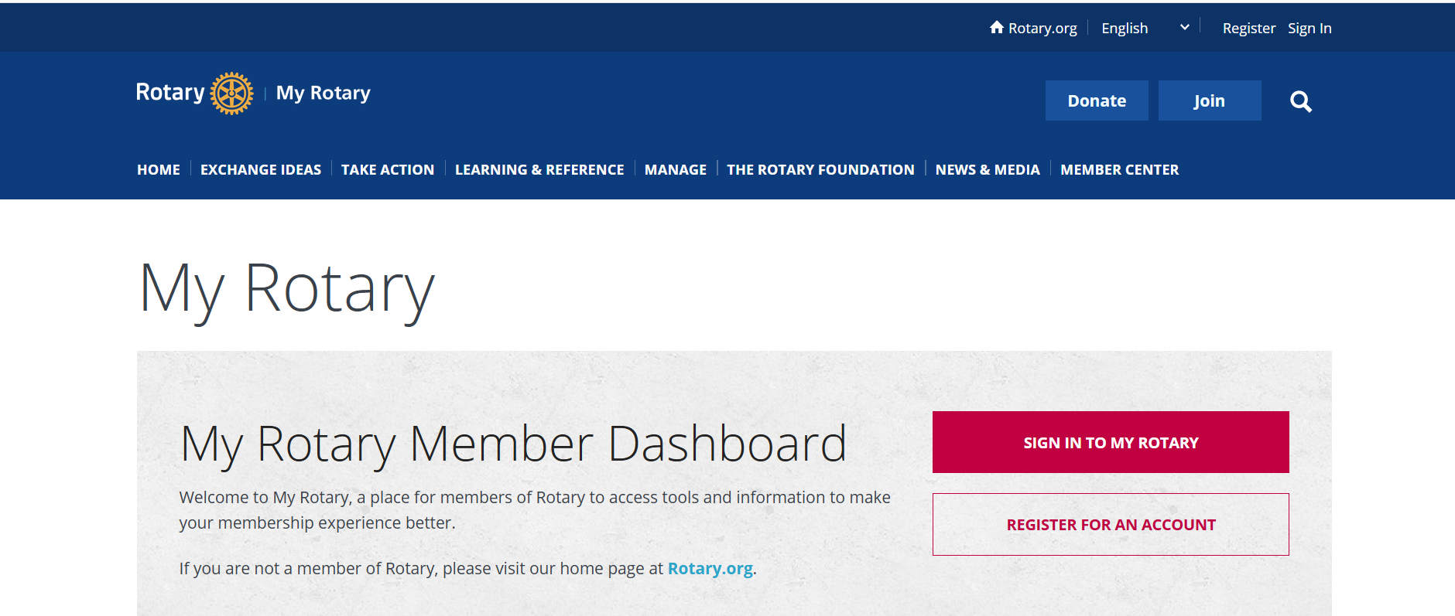


Slide 8
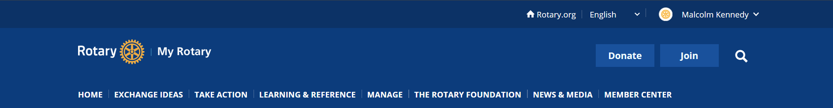
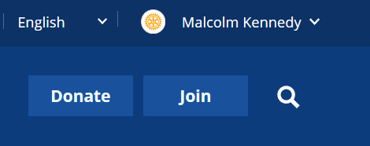

https://www.rotary.org

Slide 9
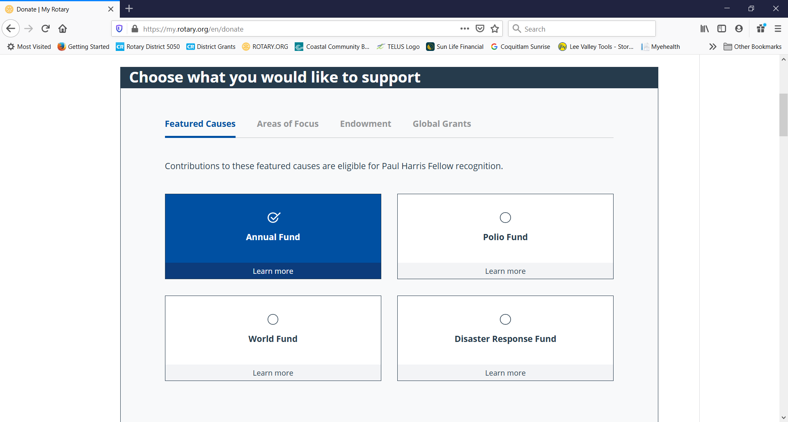
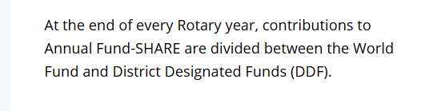

Slide 10
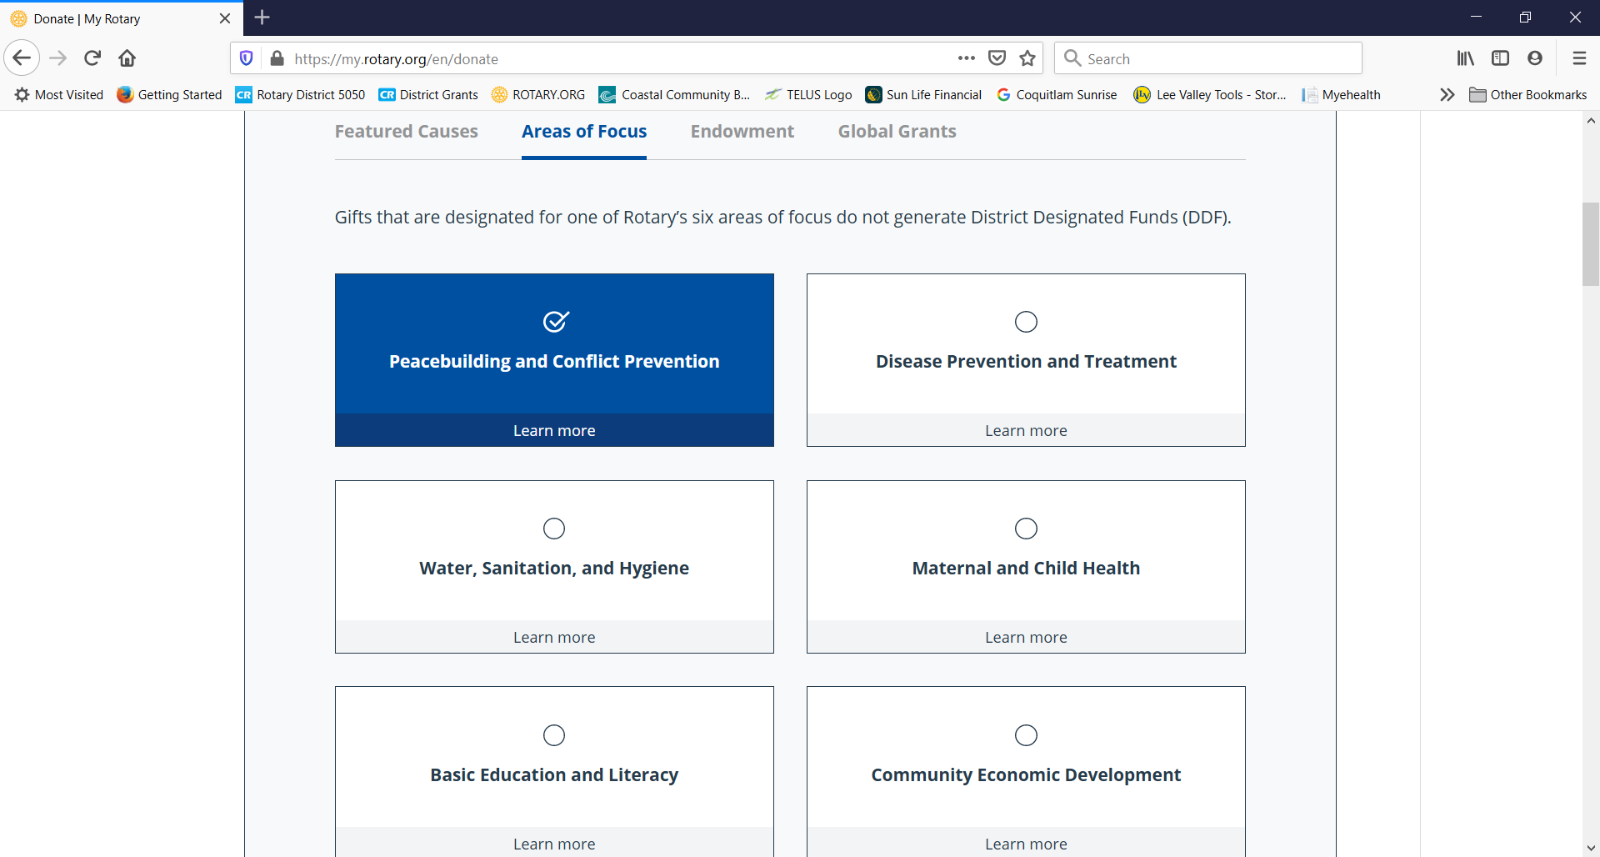

Slide 11
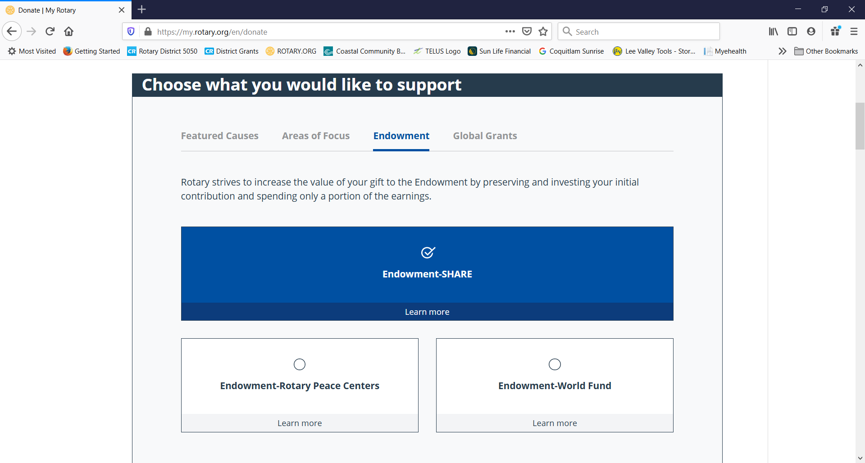

Slide 12
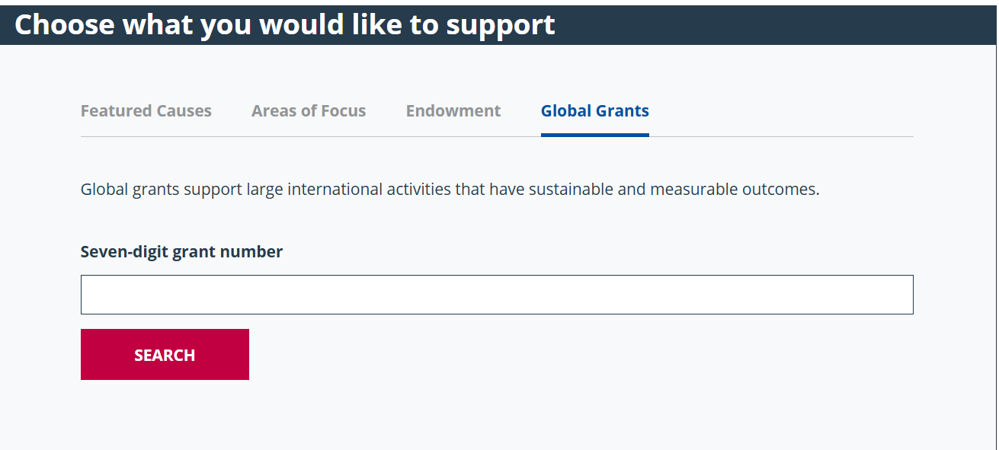

Slide 13
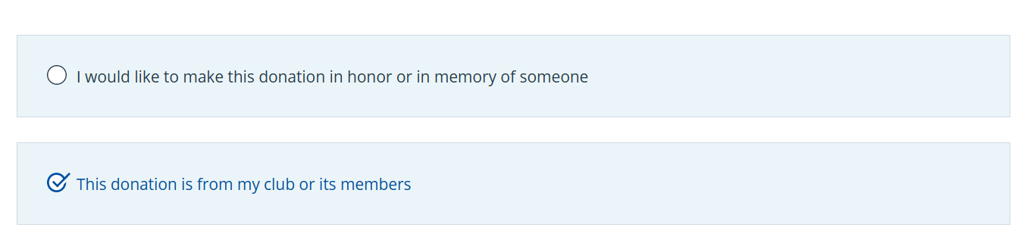
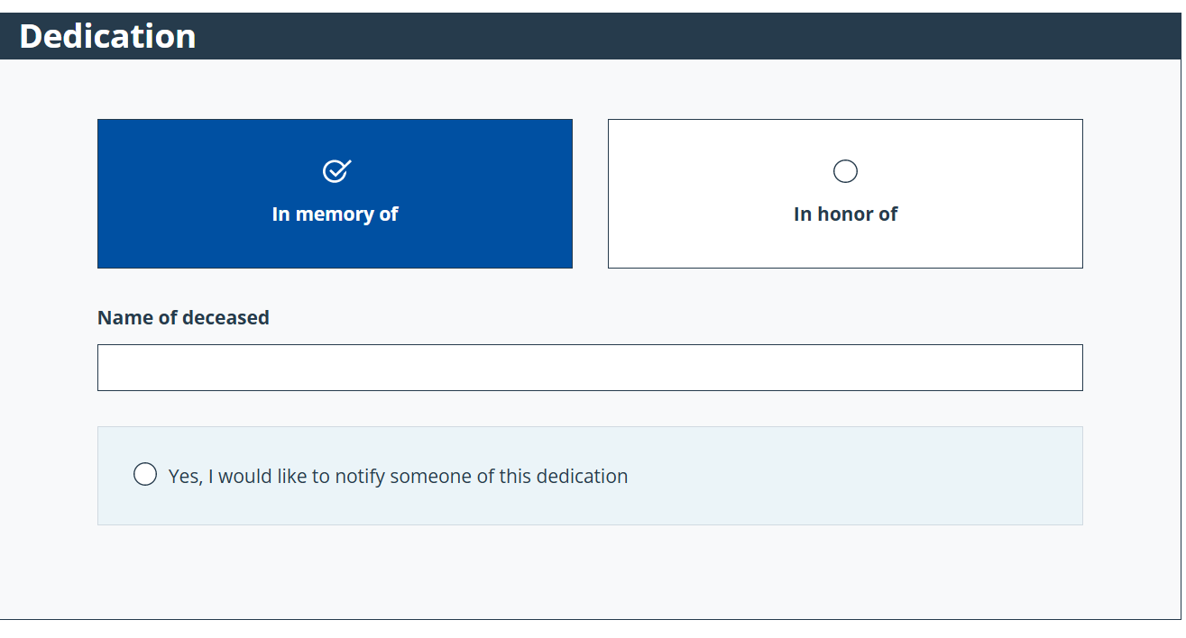

Slide 14
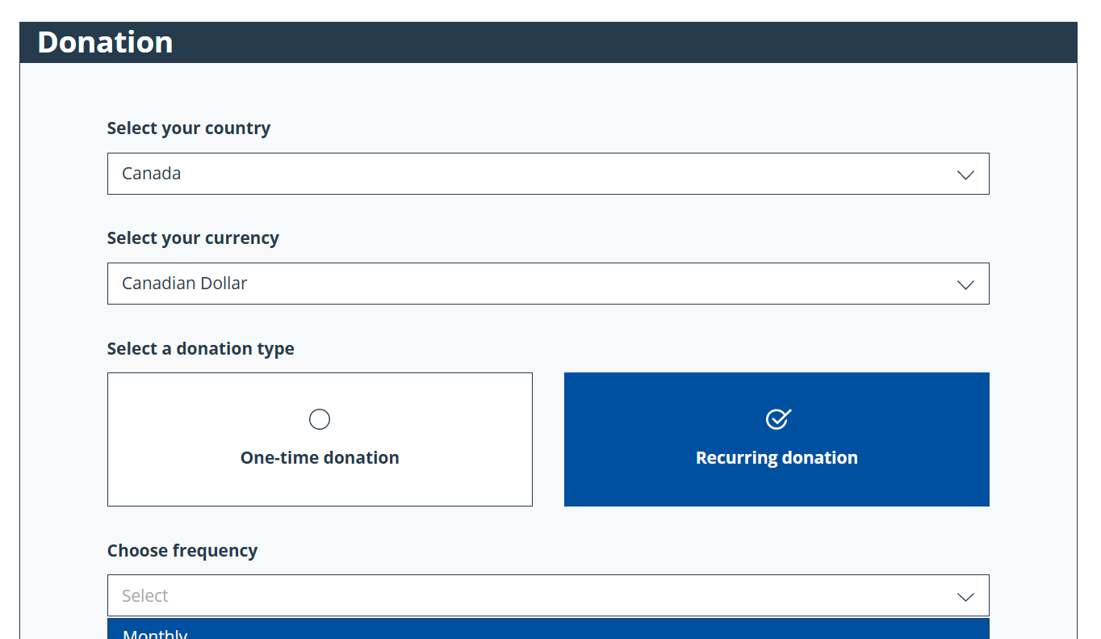
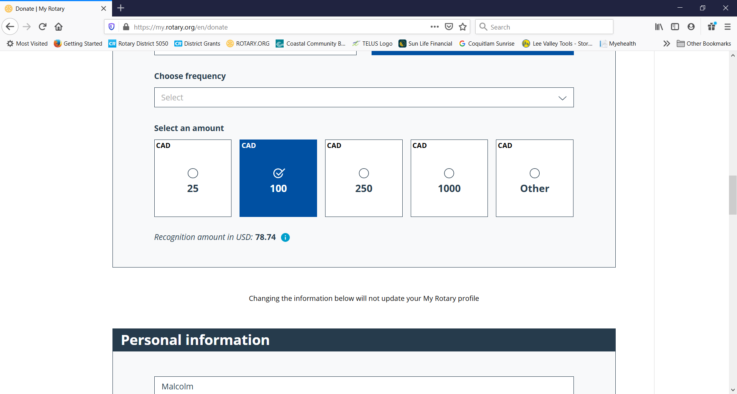
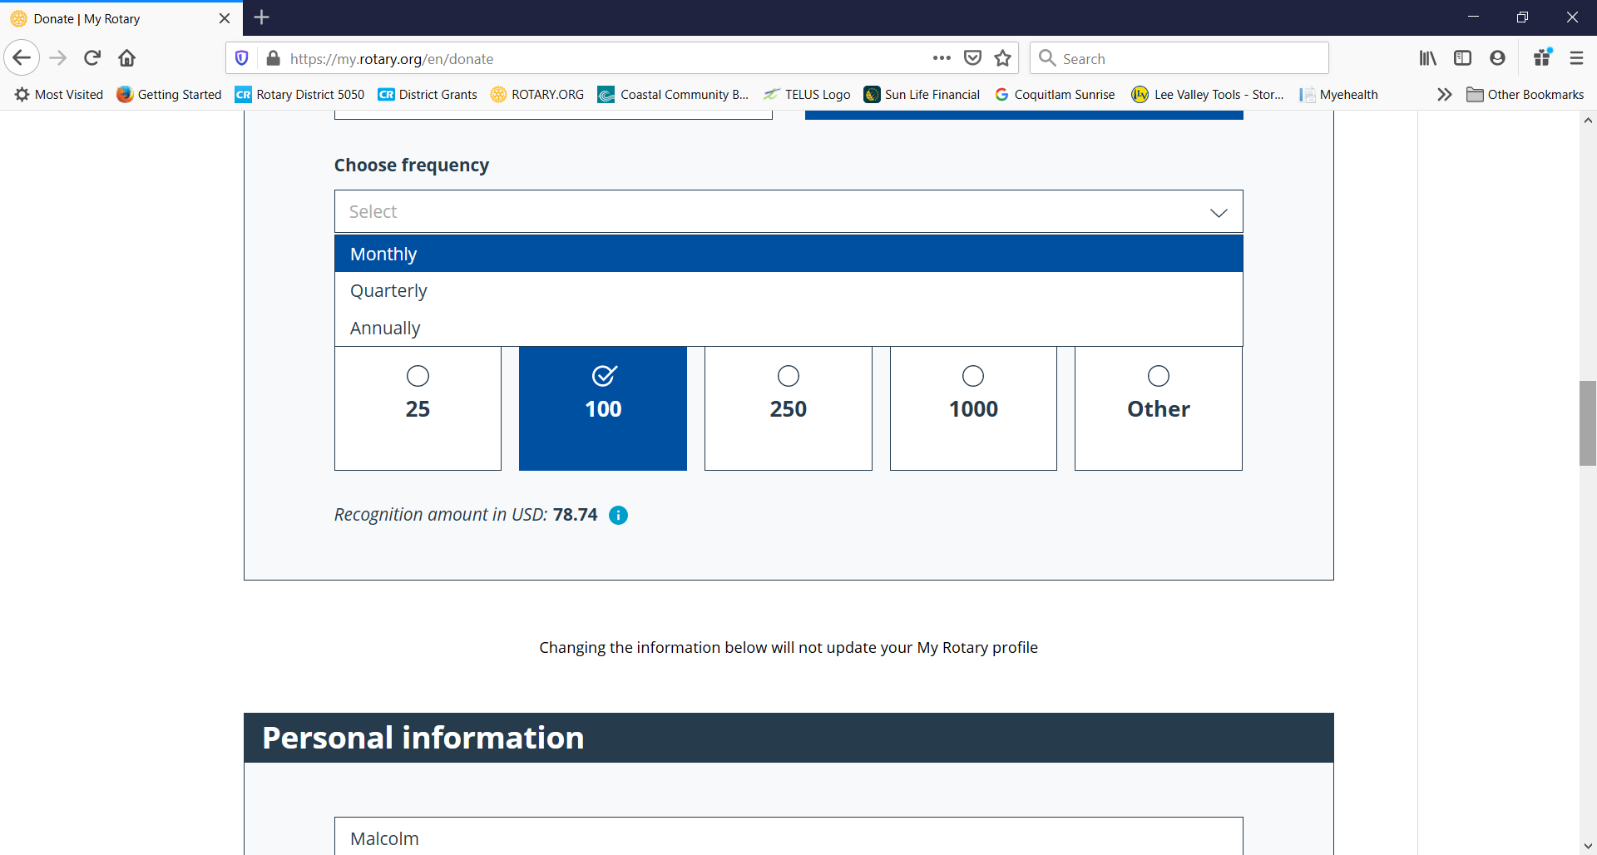

Slide 15
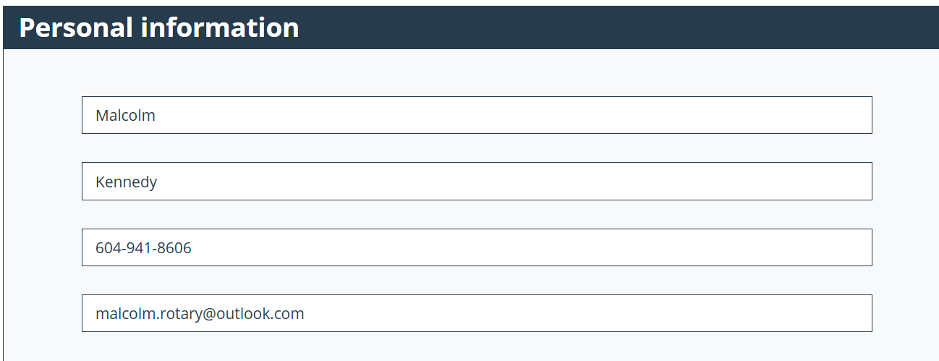
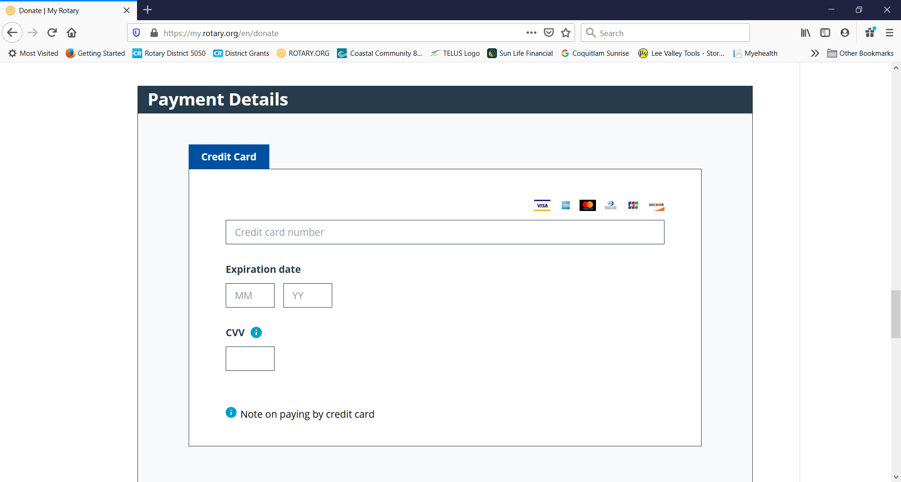

Slide 16
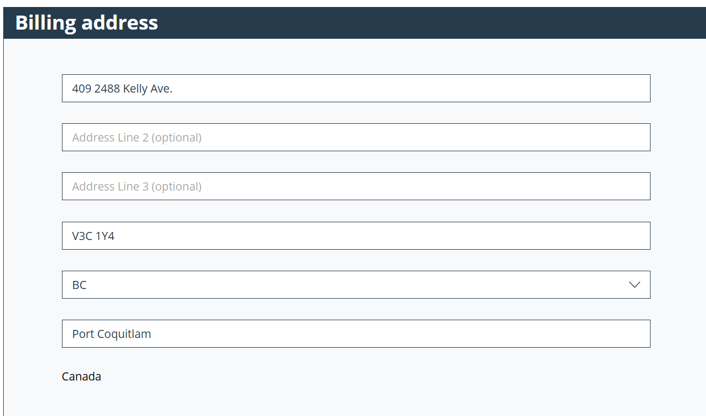
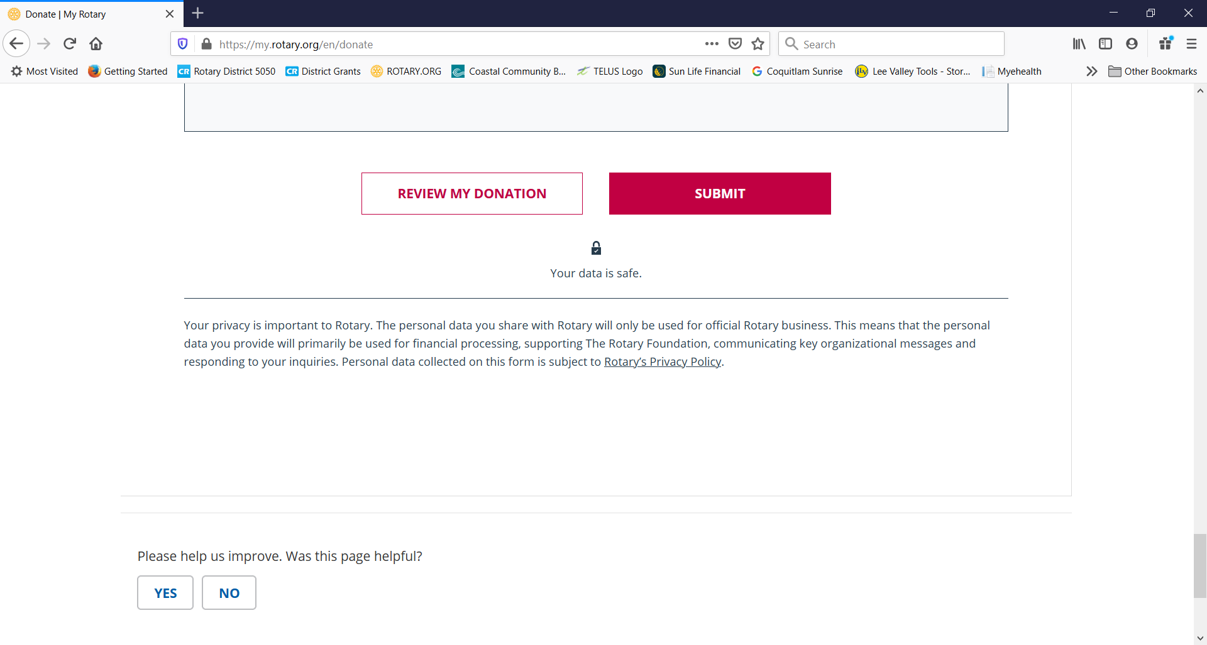

Slide 17
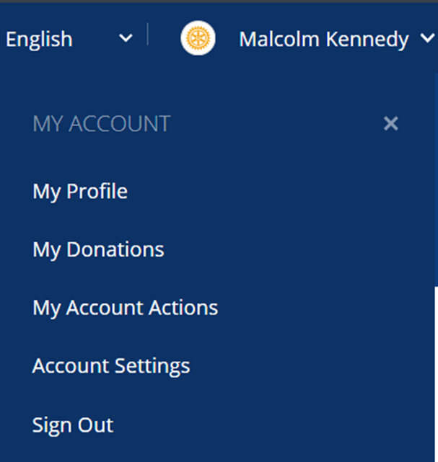

https://www.rotary.org

Slide 18
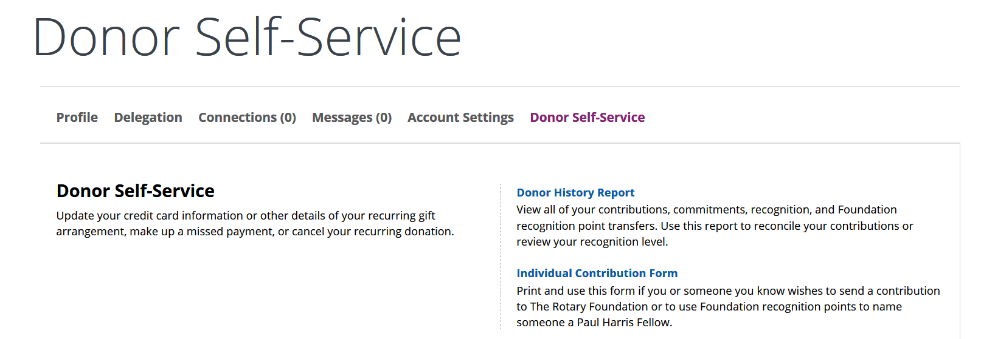

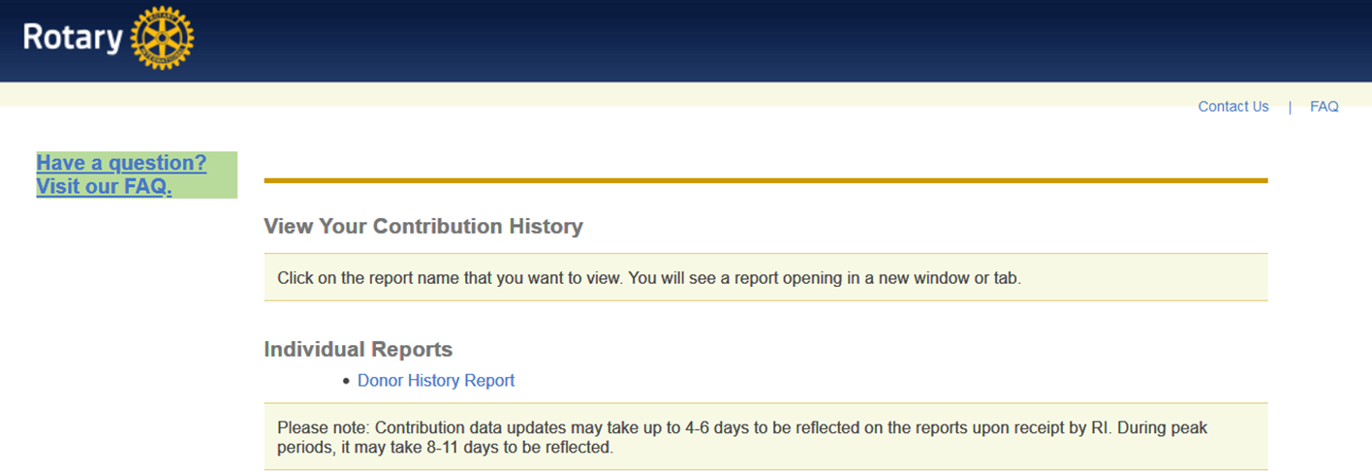


Slide 19
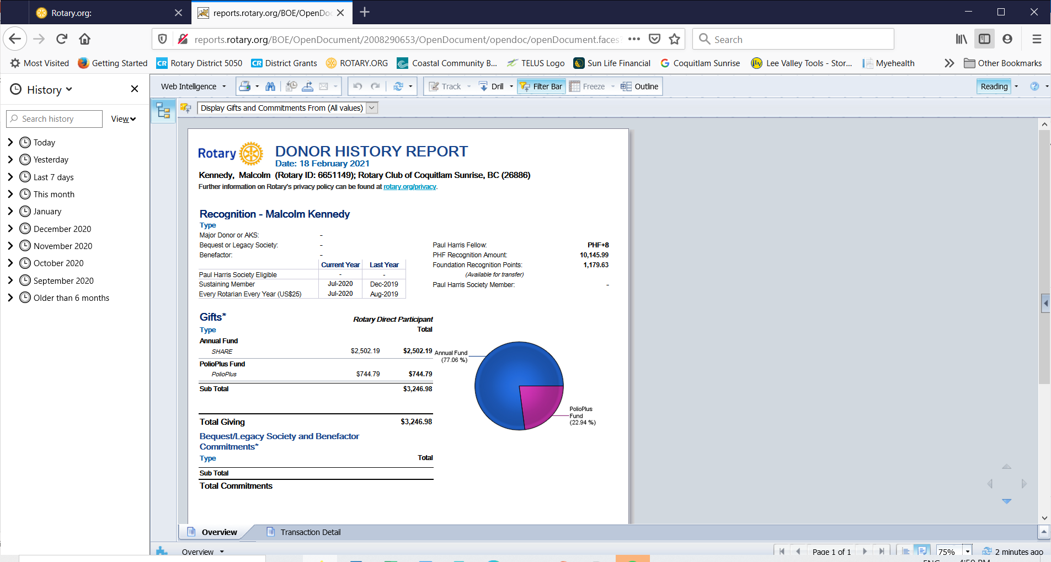


Slide 20
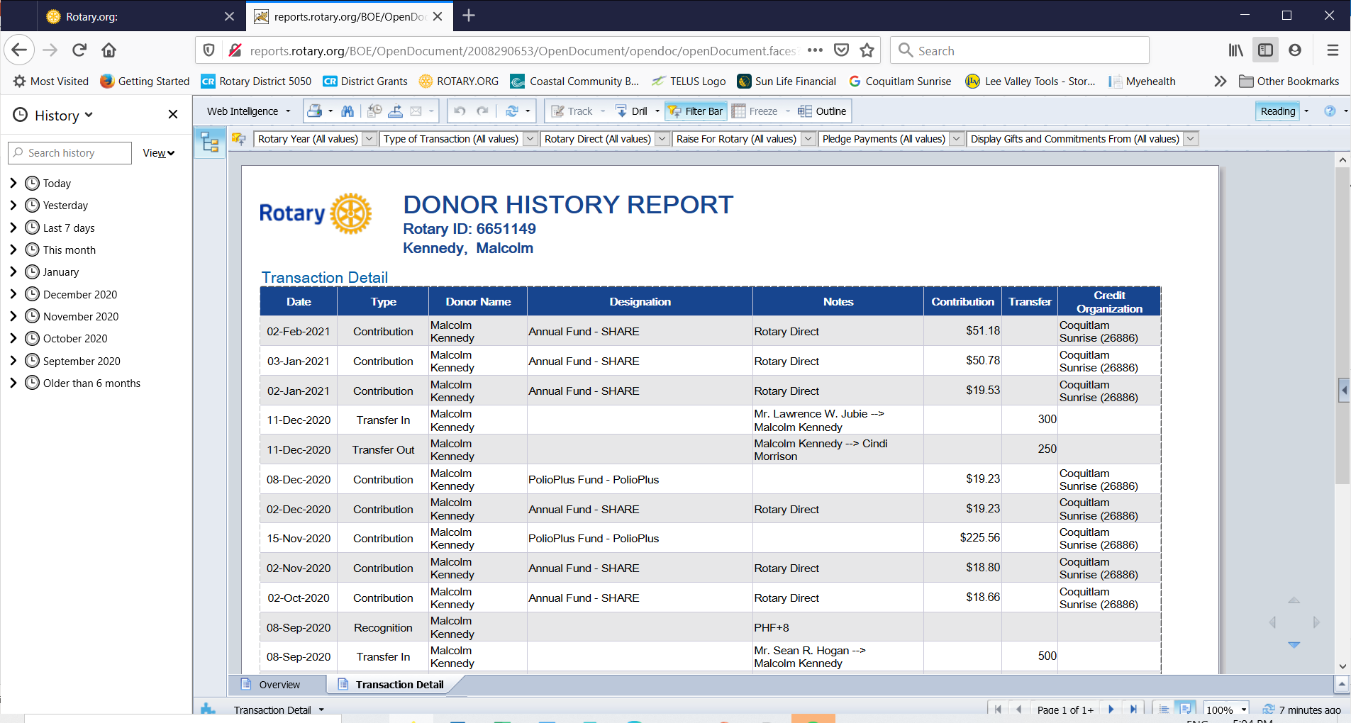

Slide 21
Donor Recognition
Paul Harris Fellow
Paul Harris Fellow recognition is extended to any individual who contributes, outright or cumulatively (or in whose name is contributed), $1,000 or more to the Annual Fund or PolioPlus or as sponsorship of a portion of a Foundation grant. The recognition consists of a certificate and pin.
The awards are automatic

Slide 22
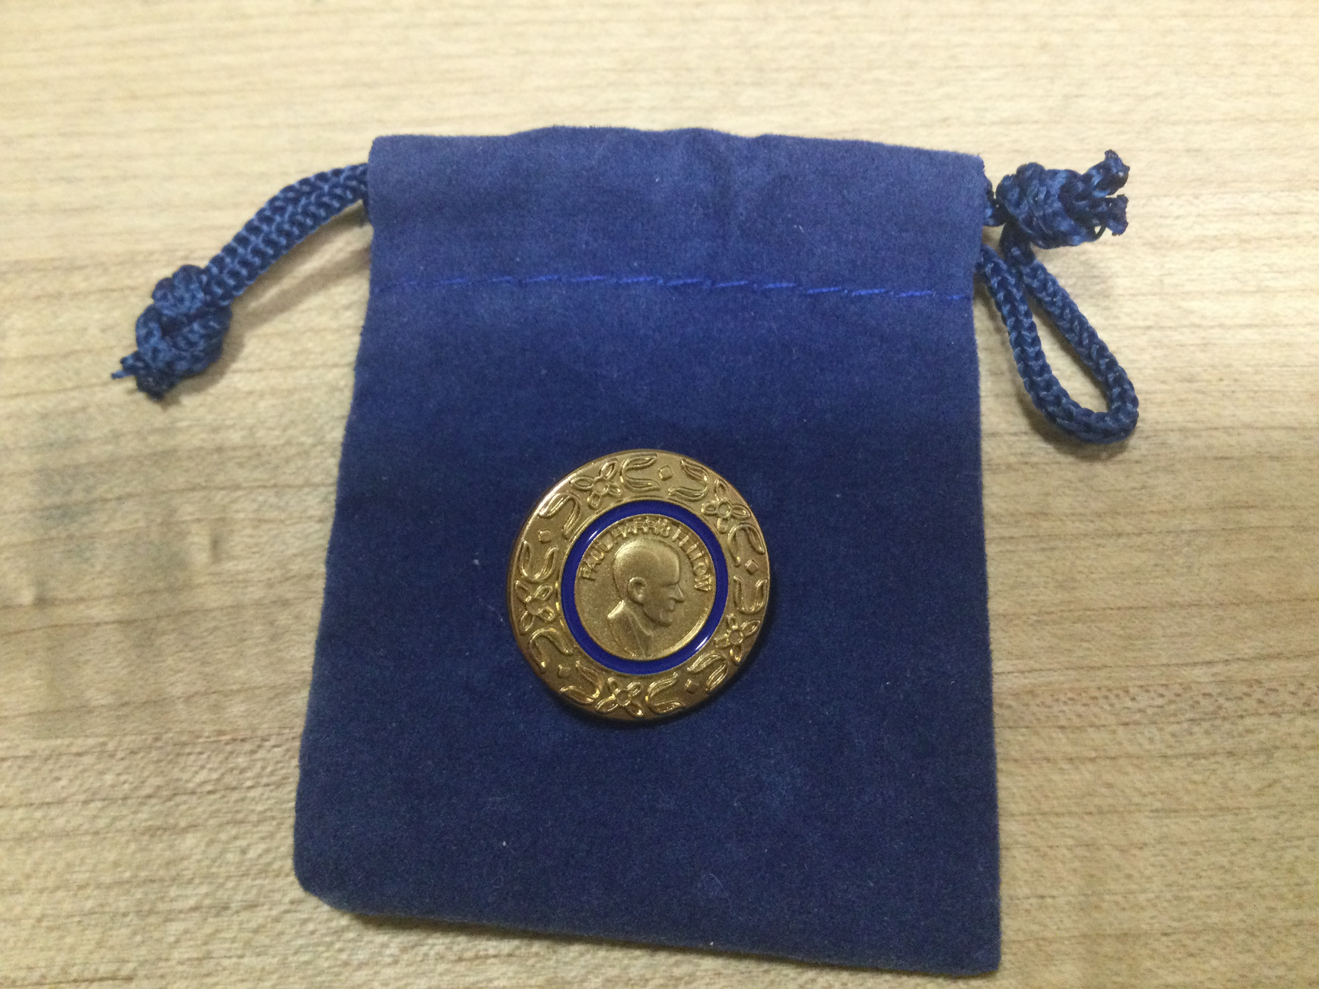

Slide 23
Multiple Paul Harris Fellow recognition is extended at subsequent $1,000 levels. Recognition consists of a pin with stones corresponding to the recipient’s recognition amount
Could be actual donations or recognition awarded by a third party (Club, spouse etc.)

Slide 24









$1,000 to 1,999.99 PHF - Original PHF pin
$2,000 to 2,999.99 PHF+1 - one sapphire
$3,000 to 3,999.99 PHF+2 - two sapphires
$4,000 to 4,999.99 PHF+3 - three sapphires
$5,000 to 5,999.99 PHF+4 - four sapphires
$6,000 to 6,999.99 PHF+5 - five sapphires
$7,000 to 7,999.99 PHF+6 - one ruby
$8,000 to 8,999.99 PHF+7- two rubies
$9,000 to 9,999.99 PHF+8 - three rubies

Slide 25

Donor Recognition
Major Donor
When your cumulative donations reach $10,000.
Level 1: $10,000 to $24,999
Level 2: $25,000 to $49,999
Level 3: $50,000 to $99,999
Level 4: $100,000 to $249,999

Slide 26
Donor Recognition
Individual recognition
Rotary Foundation Sustaining Member
When you give $100 or more per year to the Annual Fund.
Benefactor
When you include the Endowment Fund as a beneficiary in your estate plans or when you donate $1,000 or more to the fund outright.
Bequest Society
When you make a commitment for future gifts of $10,000 or more to The Rotary Foundation, you’ll be invited to join the Bequest Society.

Slide 27
Donor Recognition
Arch Klumph Society
When your cumulative donations reach $250,000.
Trustees Circle: $250,000 to $499,999
Chair’s Circle: $500,000 to $999,999
Foundation Circle: $1,000,000 to $2,499,999
Platinum Trustees Circle: $2,500,000 to $4,999,999
Platinum Chair’s Circle: $5,000,000 to $9,999,999
Platinum Foundation Circle: $10,000,000 and above

Slide 28
Donor Recognition
Legacy Society
When you promise a gift of $1 million or more to the Endowment, you’ll be listed in Rotary’s annual report and invited to exclusive Rotary International and Foundation events. Legacy Society members also receive special recognition items and all the benefits provided to Bequest Society members.

Slide 29
Club recognition
100% Paul Harris Fellow Club
For clubs in which all dues-paying members are Paul Harris Fellows. This is a one-time recognition.
100% Paul Harris Society Club
For clubs in which every dues-paying member contributes a minimum of $1,000 to the Annual Fund, PolioPlus, or global grants within a Rotary year

Slide 30
Club recognition
100% Foundation Giving Club
For clubs that achieve an average of $100 in per capita giving and 100 percent participation, with every dues-paying member contributing at least $25 to any or all of the following during the Rotary year: Annual Fund, PolioPlus Fund, approved global grants, or Endowment Fund.

Slide 31
Club recognition
100% Rotary’s Promise Club
For clubs in which every dues-paying member supports the Endowment. The commitment may be for a future gift to The Rotary Foundation in an estate plan or an outright gift of $1,000 or more to the Endowment.

Slide 32
Club recognition
Every Rotarian, Every Year Club
For clubs that achieve a minimum Annual Fund contribution of $100 per capita during the Rotary year, and every dues-paying member must personally contribute at least $25 to the Annual Fund during the year.
Top Three Per Capita in Annual Fund Giving
For the three clubs in each district that give the most, per capita, to the Annual Fund. Clubs that give at least $50 per capita are eligible.

Slide 33
UNDERSTANDING FOUNDATION RECOGNITION POINTS
What are Foundation recognition points and how can I accumulate them?
Foundation recognition points are awarded to donors who contribute to The Rotary Foundation through the Annual Fund or PolioPlus, or who contribute to sponsorship of a Foundation grant. Donors receive one recognition point for every U.S. dollar contributed to these funds. Since 2011
Donors can transfer Foundation recognition points to others to help them qualify as a Paul Harris Fellow or Multiple Paul Harris Fellow.

Slide 34
How do I transfer Foundation recognition points?
A minimum of 100 Foundation recognition points must be transferred at a time, and you must complete and sign the Recognition and Transfer Request.
The points may not be transferred from individuals to a club or district.
Individual donors are the only ones authorized to transfer recognition points from their individual account.
Club presidents are the only ones authorized to transfer recognition points from a club account.

Slide 35
……Every Rotarian is encouraged to participate in a Rotary Foundation project
I urge your club to apply for a
District Grant and/or a
Global Grant
……. and make a personal gift to the Rotary Foundation Annual Fund every year

Slide 36

$100 USD Donation Benchmark
to The Rotary Foundation
from Every Rotarian Every Year
Rotary Direct
Visit www.rotary.org

Slide 37
The Rotary Foundation is a not-for-profit corporation supported solely by voluntary
contributions from Rotary members and
friends of the Foundation who share its
vision of a better world.
This support is essential to make possible projects, funded with Foundation grants, that bring
sustainable improvement to communities
in need.

Slide 38

Annual Giving, Major Gifts,
Paul Harris Society Chair
Thomas McMillan
Rotary Club of Abbotsford-Sumas
dedutch13@shaw.ca
604-852-5684

