Slide 1
District 5050 Rotary Membership Seminar

Slide 2
Engagement
equals
Retention
Notes:
Engaged members stay in their clubs and leave for reasons out of their or the club’s control

Slide 3
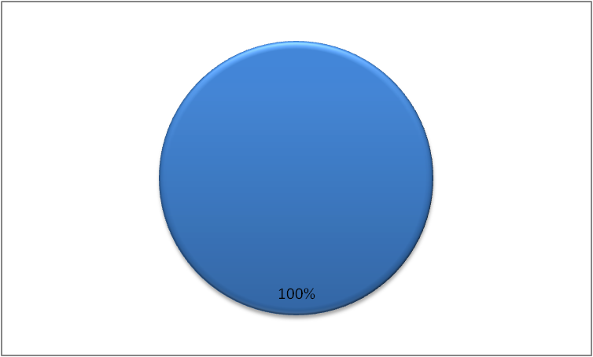
Notes:
The number of Rotarians
How many of you have brought in a new member to this club or another club?

Slide 4
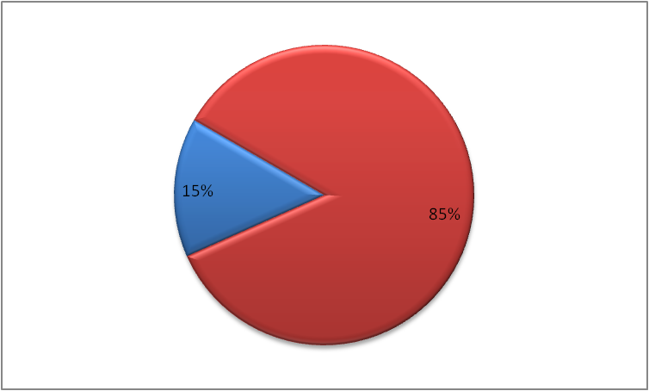
90%
10%
X
X
Notes:
Only 10% have brought another person into Rotary

Slide 5
Recruitment vs Retention
Which is more important?
Where do you start?
Notes:
Let’s look at some of numbers

Slide 6
Membership Realities
2005 - 1,200,000 Members
2013 – 1,200,000 Members
Between 2005 and 2013 RI lost…
1,200,000 Members!
Notes:
This is reflected in most clubs – over time they lose as many as they bring in

Slide 7
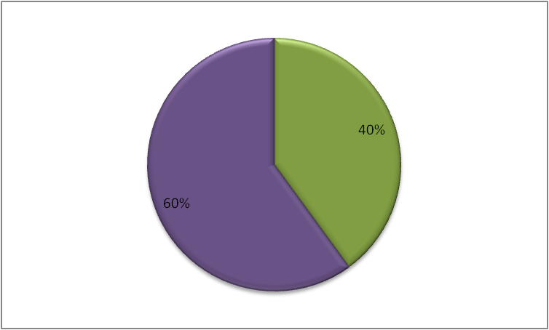
Rotary is made up of
40 % New Members
(less than 5 years)
35% will leave in their
first three years
62% will leave in their
first five years

Slide 8
Why Rotarians say they leave Rotary
Attendance requirements
Relocating to a new community
Health
Too much fundraising
Not enough value
Retired
Business pressure
Notes:
Results from
Rotary surveys and focus groups

Slide 9
Why Rotarians REALLY leave Rotary
Closed minds of leadership
Disorganized, poorly managed meetings
Costs
Inadequate involvement
Not satisfied with fellowship
Notes:
Would it be useful to know the real reasons you lose a member?
How can you find out the REAL reason you lose a member
Is your club willing or able to make accommodations to retain members

Slide 10
Want to retain members?
then
Understand why members
leave!
Notes:
So how do you find this information

Slide 11
Surveys show –
many members are looking for:
Networking opportunities both social and professional
Business opportunities and contacts
Fellowship both friendship and connections
Community Service – Hands on projects in their local communities
International Service – Hands on projects
Notes:
How successful is your club at determining what your members want from their membership
It is not just about what your members give o but also about what they are getting

Slide 12
Do you know why
your
members have left?
Notes:
There are reasons out of our control
However, most often it is within the control of the club.

Slide 13
A Thought for the Day…
“If Rotarians put as much focus on Membership as they do on their
Community Service projects…
What would our Membership look like?”
Notes:
This includes effective recruitment and engagement
Ongoing evaluations and opportunity for feedback
Checking in with members on how they are feeling about the club and their involvement

Slide 14
Keeping Members
What is the best way to retain members?
Ensure that every member contributes to the Rotary Foundation.
Keep members involved in club activities and projects.
Have great guest speakers at club meetings.
Focus on fellowship and social activities for members.
Who is responsible for membership retention?
Club president
Membership Chair
The members sponsor
All club members
Notes:
ALL OF THE ABOVE – OF COURSE

Slide 15
Thank You!
Notes:
Questions & comments

