Slide 1
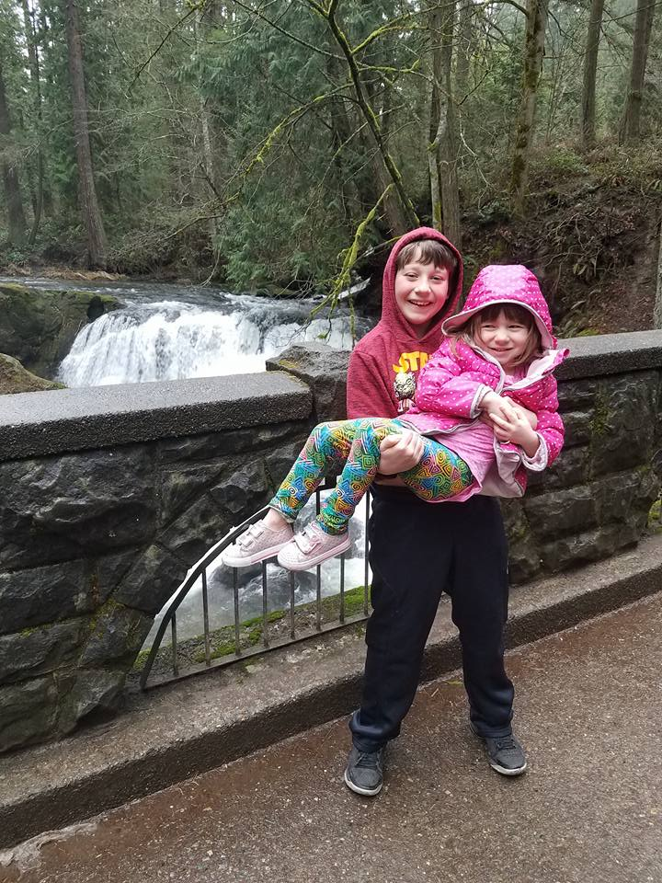
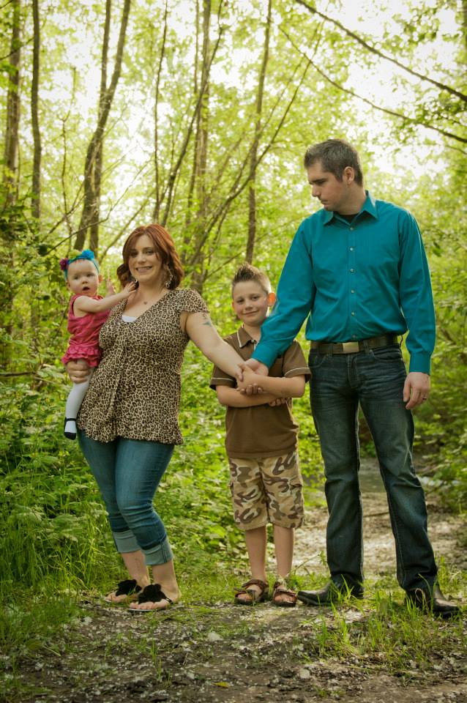

Slide 2
Content Marketing

Slide 3
What is content marketing?
Content marketing is a strategic marketing approach focused on creating and distributing valuable, relevant, and consistent content to attract and retain a clearly-defined audience — and, ultimately, to drive profitable customer action.
How does this relate to your club or business?

Slide 4
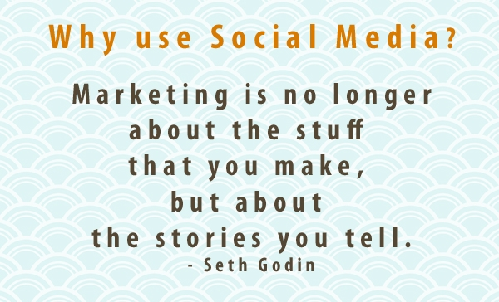

Slide 5
Attract. Retain.
Content marketing’s purpose is to attract and retain customers by consistently creating and curating relevant and valuable content with the intention of changing or enhancing consumer behavior. It is an ongoing process that is best integrated into your overall marketing strategy, and it focuses on owning media, not renting it.
Is there a specific brand or organization you can think of that owns the media in their sector?

Slide 6
Consistency is key.
Basically, content marketing is the art of communicating with your customers and prospects without selling.
It is non-interruption marketing. Instead of pitching your products or services, you are delivering information that makes your buyer more intelligent.
The essence of this content strategy is the belief that if we, as businesses, deliver consistent, ongoing valuable information to buyers, they ultimately reward us with their business and loyalty.

Slide 7
Social media is changing the way we communicate and the way we are perceived, both positively and negatively. Every time you post a photo, or update your status, you are contributing to your own digital footprint and personal brand.
Amy Jo Martin

Slide 8
Best Practices in Social Media Marketing
Best practices – do more than just “sell” on your social outlets.
The average Facebook user likes less than 20 pages.
Keep things interesting and engaging to maintain your fans.
Promote the local community
Fun and engaging posts
Holidays
Create a mixture of hard sell, soft sell and informational posts

Slide 9
Why do you follow specific brands on social media?

Slide 10
Sail Trilogy – a Sample in Great Social Media
Happy Aloha Friday from Olowalu! #sailtrilogy#maui #lethawaiihappen

Slide 11
Sail Trilogy Instagram
Hashtags / Know Your Users
Create an emotional connection
Have some fun!

Slide 12
Instagram
#InstaTagTip 1: Use multiple #hashtags, but under 10 is best!
#InstaTagTip 2: Use your SEO keywords
#InstaTagTip 3: Create custom hashtags
#InstaTagTip 4: Create an Instagram campaign using hashtags
#InstaTagTip 5: Don’t forget about the classics
Hashtags 101: Instagram Hashtag Best Practices

Slide 13
What About Those Hashtags

Slide 14
Giveaways
Giveaways are an easy and effective way to engage your audience, gain new followers and create a more loyal fan base.
Elements of a dynamic giveaway

Slide 15
Giveaway Policies
If you use Facebook to communicate or administer a promotion (ex: a contest or sweepstakes), you are responsible for the lawful operation of that promotion, including:
a. The official rules;
b. Offer terms and eligibility requirements (ex: age and residency restrictions); and
c. Compliance with applicable rules and regulations governing the promotion and all prizes offered (ex: registration and obtaining necessary regulatory approvals)
Promotions on Facebook must include the following:
a. A complete release of Facebook by each entrant or participant. (add to official rules and you are covered.)
b. Acknowledgement that the promotion is in no way sponsored, endorsed or administered by, or associated with, Facebook. (add to official rules and you are covered.)
Do not ask fans to “share” for entry. You can encourage them to share, but cannot require it. This can get your page shut down or disabled for days/weeks or pulled altogether. Promotions may be administered on Pages or within apps on Facebook. Personal Timelines and friend connections must not be used to administer promotions (ex: “share on your Timeline to enter” or “share on your friend's Timeline to get additional entries”, and "tag your friends in this post to enter" are not permitted).

Slide 16
Facebook Terms of Service & Guidelines
Facebook Terms of Service
Facebook Page Guidelines
Facebook Page Promotion Terms
Any data you obtain from us must comply with Facebook Platform Policies.
Branded content must comply with Branded Content Policies.

Slide 18
Content Calendar

Slide 19
Content Calendar Template
Content Calendar Templates: https://offers.hubspot.com/social-media-content-calendar
Example of Content Calendar

Slide 21
Facebook & Instagram
Advertising

Slide 22
Facebook Ads Manager
Advertising on Facebook
Boosting a Post
Setting Up an Ad Campaign on Facebook
11 Examples of Facebook Ads That Actually Work (And Why)
Where to find templates for appropriate graphic sizes
Advertising on Instagram

Slide 23
Facebook Ad Policies
Ads must not promote the sale or use of the following:
Illegal, prescription, or recreational drugs;
Tobacco products and related paraphernalia;
Unsafe supplements, as determined by Facebook in its sole discretion;
Weapons, ammunition, or explosives; or
Adult products or services (except for ads for family planning and contraception).

Slide 24
Instagram Advertising
https://www.facebook.com/business/help/976240832426180

Slide 26
Posts that Push

Slide 27
Social Media Branding
Showcase your company’s/club’s culture
Know your audience
Be authentic
http://sproutsocial.com/insights/social-media-branding/

Slide 28
What is your next post?
Will you use a photo or video?
Be concise
http://sproutsocial.com/insights/social-media-branding/

Slide 30
Twitter

Slide 31
Twitter Basics
What is Twitter & Why is it Important for Business?
https://www.thebalance.com/top-reasons-why-your-small-business-should-use-twitter-2948523
How to Use Twitter Lists
http://sproutsocial.com/insights/twitter-lists/

Slide 32
What Do I Share on Twitter?
How To Find Great Content To Share On Twitter (And Get More Followers)

Slide 33
Hashtags for Twitter
Unique Hashtags for Events
Short, easy to remember
Follow best practices when using hashtags on Twitter

Slide 34
Monitor Your Hashtags
Monitor for hashtags on HootSuite or through Google Alerts
Google Alerts come in handy in a variety of situations, and they're easy to set:
Go to google.com/alerts in your browser.
Enter a search term for the topic you want to track. ...
Choose Show Options to narrow the alert to a specific source, language, and/or region. ...
Select Create Alert.

Slide 36
Additional Resources
http://www.pewinternet.org/2016/11/11/social-media-update-2016/
http://sproutsocial.com/insights/new-social-media-demographics/#all
http://sproutsocial.com/insights/social-media-branding/
http://bluebirdsocialmedia.com
http://www.facebook.com/bluebirdsocialmedia
Email – abby@bluebirdsocialmedia.com
Text or Call – 360-201-9446

