Slide 1
Public Image and Marketing Boot Camp
September 10, 2016
Silver Reef Casino Hotel and Spa, Ferndale, WA

Slide 2
Personalizing the Rotary Story
Public Image and Marketing Boot Camp

Slide 3
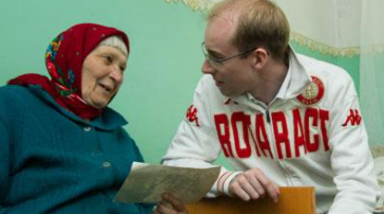
Personalizing the Rotary Story
Storytelling brings people together
A powerful technique for building relationships.
An age-old concept that brings people together and keeps them engaged.
It doesn’t matter where in the world you’re based or how large the organization is.

Slide 4
Personalizing the Rotary Story
Good stories bring words to life
That’s why it’s mission-critical that clubs and their members take the time up front to fully develop their approaches to storytelling.
Some clubs take time for a member to tell their Rotary story at a club meeting.

Slide 5
Personalizing the Rotary Story
Storytelling is your brand
It is not about your club. It’s about current and potential members, and the value that they get when engaging with Rotary.
The most powerful brand stories are the ones that are personal in nature and that people can relate to.

Slide 6
Personalizing the Rotary Story
How you communicate
Storytelling is more than what you write on your webpage. It’s more than your blog posts and about pages. It’s how you communicate your messaging – your values.
Your brand’s stories reflect your values. They’re infused in every piece of copy, or messaging from members of your club to non-members.

Slide 7
Personalizing the Rotary Story
Stop trying to ‘Sell’ Rotary
Stop thinking like a marketer and trying to sell Rotary.
Instead, focus on developing human interest. Answer the question of why people should care about what Rotary and your club has to say.

Slide 8
Personalizing the Rotary Story
Create an emotional connection
That means being persuasive and appealing to emotion. Don’t be boring by letting the words on your page or through your conversation hide the personalities behind your club.
Each club is unique; let its personality shine through.

Slide 9
Personalizing the Rotary Story
Be relatable
Pretend that you’re talking to a new friend over drinks or coffee. If you talk down to your audience, they’re going to stop listening immediately.

Slide 10
Personalizing the Rotary Story
Know your audience
Appreciate that not everyone is ready or able to join a Rotary club. They can still support our work by:
Volunteering
Attending events
Following on social media
Other ways?

Slide 11
Personalizing the Rotary Story
Target your message to your audience
Tell your story through traditional means (radio, TV, print) and through digital/online means (blogs, your website, social media – Facebook, Twitter, YouTube, LinkedIn, etc.) Your audience will respond in unique ways and a targeted message will be more powerful than trying to perfect a catchall.

Slide 12
Personalizing the Rotary Story
Stories are more than the words
Storytelling is more than what you say explicitly. It’s how you communicate your message and how you connect with your target audiences.

Slide 13
Exercise and Expectations (homework)
Exercise – 10 minutes
Arrange to have 1 or 2 people tell their story about how they became a member and when they transitioned from simply being a member of a Rotary Club to becoming a Rotarian.
Break people into pairs and ask them to talk about what Rotary means to them.
Depending on time, ask 1 or 2 people in the audience to tell their Rotary Story (time – all: 1 min max.)
Notes:
The facilitator will have 2 members pre-selected to share their story e.g. Ken and Denis to kick off the exercise.
Depending on time, the facilitator will ask for 1 or 2 volunteers to share their story after the exercise – limiting it to 1-2 minutes (max).

Slide 14
QUESTIONS?
Thank you for your time, commitment, and support.

Slide 15
Developing Your Strategic Plan
Developing Your Strategic Plan
Public Image and Marketing Boot Camp
Notes:
Introduce yourself:
Your Club:
What this session is about: Developing your Strategic Plan, using membership as the central them to tell the story through

Slide 16
Stronger, more effective clubs
Greater
Visibility and
influence
Greater impact
Increased financial sustainability and operational effectiveness
Notes:
From the R.I. Strategic Planning Document: Great organizations don’t happen by chance. They take careful planning across all channels to ensure individual tasks are aligned to the goals of the organization and systems or processes are in place that ensure they’re carried out as intended.
Membership is our single greatest asset… As membership increases, clubs are more vibrant, Rotary has more to show the world, and more resources to help communities, clubs, and RI flourish—all in an environment where people and organizations, don’t have unlimited resources.
Our world is changing at an unprecedented rate. It is imperative to look at our relevance and purpose five to ten years down the line. How will we do that? The answer lies within our Strategic Plan. The plan provides clubs and districts a road map to advance Rotary in communities around world.
Through improved member engagement, which leads to improved retention and through growth. Both organic and through referrals from existing members.

Slide 17
Creating a Strategic Plan
We must be prepared!
We must keep up!
We must adapt!
Notes:
We must keep up = By continuing to learn and
We must adapt = as our members and the world around us changes, we must adapt to remain relevant.
We must be prepared = Through thoughtful and careful planning where we align the day to day activities we perform to the mission and vision of our club and of Rotary. We must be prepared with a vision that will take Rotary into the next 100 years.
Our strategic plan should include the framework for our club to keep up…to adapt…and to be prepared.
It’s critical for us to recognize that Rotary must keep up with an ever changing world. The fast-paced nature of our society creates even greater competition for our time, energy and resources. Therefore, as leaders in this organization, our energy must be focused on members having absolute certainty of the benefits and value of being a Rotarian.

Slide 18
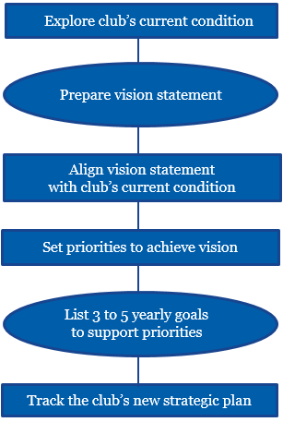
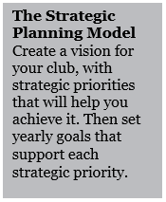
Agenda for the Session
Creating your strategic plan
Where are you now?
Where do you want to be?
How do you get there?
How are you doing?
Notes:
Over the course of the next hour, we’re going to guide you through the steps of the strategic planning process. You’ll leave with the tools needed to help your club develop a strategic plan that outlines how you will market Rotary and your club in order to instill pride in your existing members and strengthen their engagement, while attracting new members that will help your club thrive long into the future.
Talk about the strategic planning process as outlined on the slide.
Vision – where you’re going…what you would like your club to look like.
Current condition – use data … or information…to identify your strengths, your weaknesses, your opportunities and your threats (SWOT Analysis)
Set priorities – identify what’s important to your club…taking into account its uniqueness…its culture. Every club is unique. Celebrate that!
Set goals for the organization…without measurable goals, how do you know if you’re moving towards your vision?
Track the clubs new strategic plan so you can ensure you’re on the right course and can redirect if/when needed

Slide 19
Building Blocks of Your Strategy
MISSION
VALUES
VISION
Your Reason For Being
Your core Beliefs
Where you’re going
Notes:
Mission – This is why you exist as an organization i.e. what is Rotary (or your club’s) core purpose? Another way to look at it is, what would you like to be remembered by?
Values: These are your core beliefs…what you stand for.
Vision – This is where you want to go as a club.

Slide 20
Prepare Vision Statement
Core Vision Examples
We provide service to others, promote integrity, and advance world understanding, goodwill, and peace through our fellowship of business, professional, and community leaders.
Our vision is to be the most internationally diverse club in the community.
Our vision is to be the service club most supportive of youth in our community.
This is your “North Star”
Notes:
Mission – This is why you exist as an organization i.e. what is Rotary (or your club’s) core purpose? Another way to look at it is, what would you like to be remembered by?
Vision – This is where you’re going
Two types of Visions: quantitative and superlative …these examples are superlative.
Think 3 – 5 years from now, what will your world look like?

Slide 21
Explore Your Club’s Future State – Your Vision
Where do you want to be?
List 5 – 10 characteristics that you like your club to have three to five years from now.
Notes:
Ask the group…in one sentence, what would you like your club to look like 3 – 5 years from now?
What is your club doing to get there? DO you have a coherent plan that is being followed and measured? Are you doing a health check on it? Are you making course corrections when needed? Or…is this just a formal check the box activity that gets done and filed away?

Slide 22
Rotary: Current State
Membership trends
The data tell us that the problem isn’t attracting people to Rotary—For example, last year, clubs brought in over 160 thousand new members.
The problem is keeping them. 133 thousand members left during this past year. We are losing about 10% of our membership on average in the last several years.
Notes:
Relate this to the Membership survey from Mike Reddington.
We need to break away from the funneling effect…its harder to get new members than to keep existing members. Ironically, the things that attract new members overlap with many of the reasons why members remain engaged: a visible and meaningful impact on our community, fellowship…how we market ourselves - our public image!

Slide 23
Rotary: Current State
Membership trends
Enhancing the Rotary membership experience at the club level is the most significant opportunity to strengthen Rotary overall.
Years of research and pilots suggest that giving clubs flexibility can have a positive impact on member attraction, retention and engagement. For Rotary to remain relevant, we must make it a priority to create innovative and flexible membership opportunities!
Notes:
While we are all aligned to the overarching umbrella of Rotary as an organization, each club needs to embrace and celebrate its uniqueness…Its personality…its culture.

Slide 24
Explore Your Club’s Current Condition
Where are you now?
Using S.W.O.T. analysis, list the Strengths, Weaknesses, Opportunities and Threats facing your club and community
Use the available resources to help you
Rotary Club Central
Rotary Club Health Check
Membership Assessment Tools
People within the District e.g. Membership and Strategy
Notes:
Data:
Internal: your members
Strengths: Diversity, talent rich club, strong fellowship, openness to new ideas.
Weaknesses: Lack of diversity amongst the club members and club activities e.g. projects might be extremely narrow in their focus. Size – making it harder to do big projects.
External: your community, competing interests, business conditions
Opportunities: such as new businesses, a growing population i.e. potential new members or ways to improve engagement amongst existing members
Threats: Economic decline, competing services i.e. anything that poses a risk to attracting new members or inhibiting member engagement.

Slide 25
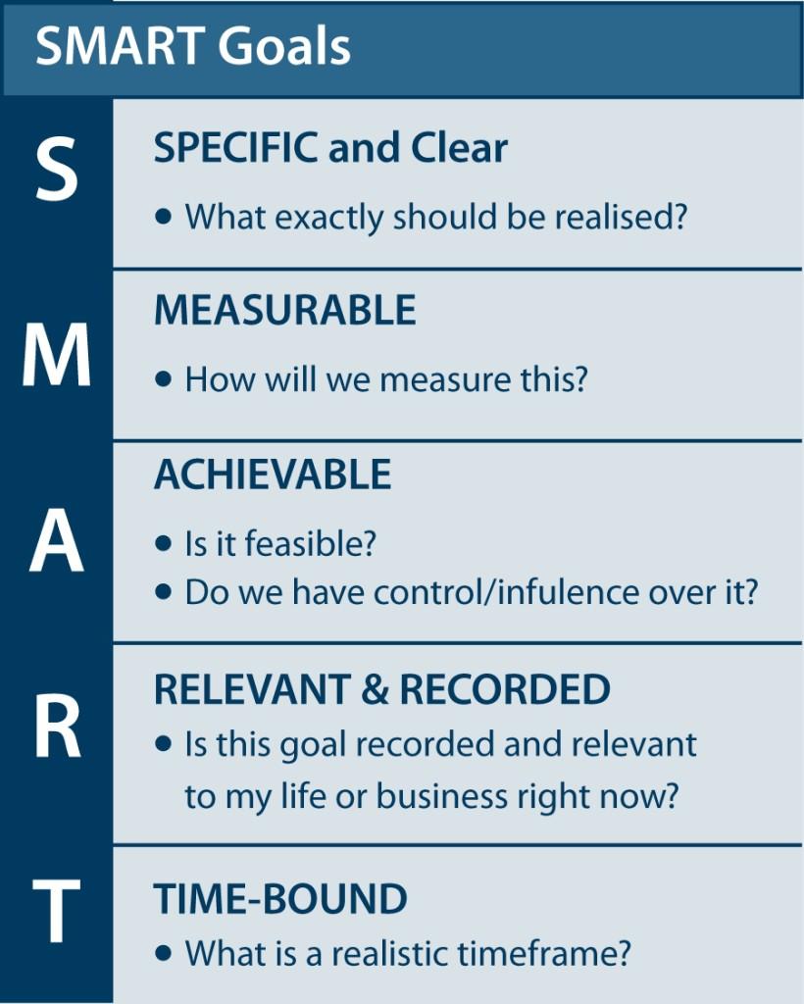
How Will You Get There?
Set strategic priorities that will help your club achieve its vision – what are your membership goals?
Grow Membership by X% or X#
Annual goals
Tasks/Activities i.e. Tactics
Timeline
Resources Needed
Member(s) Assigned
Notes:
S.M.A.R.T.
Specific:
Measurable:
Actionable and Achievable (both):
Relevant and Recorded (both):
Time-bound:

Slide 26
Prepare Core Values
Our Core Values
Our values are an increasingly important component in strategic planning because they drive the intent and direction of the organization’s leadership.
Fellowship and global understanding
We build lifelong relationships
Ethics and integrity
We honor our commitments
Diversity
We connect diverse perspectives
Vocational expertise, service, and leadership
We apply our leadership and expertise to solve social issues
Notes:
The values are 5 – 7 things that you believe in. Value statement should describe what the value looks like.
These are the Values of Rotary – your club might also want to develop a set of values that are important to your club!
Your values are the guardrails that keep you aligned to your Mission along the way to realizing your Vision.

Slide 27
Tactics
Identify the tasks/activities that will support your goals
Retention
Fellowship activities (provide some examples of what clubs are doing)
More varied projects that appeal to member’s various interests
Better balance/alignment of club tasks to individual interests & time
Attract New Members
Social media messages are targeted to groups/individuals
Club president/Member chair meet with local business/community leaders
Promote the club at community events e.g. Relay for Life, State/County Fair, etc.
Notes:
Tactics are the actionable steps we’ll take to bring the Goals to life.
What is the action item, who is responsible, what is the timeline, how we’ll measure progress, how will we know if we need help or to change direction and what will success look like.
The tactics are the specific tasks or activities…things…your club and its members will do to achieve your goals and realize your vision.

Slide 28
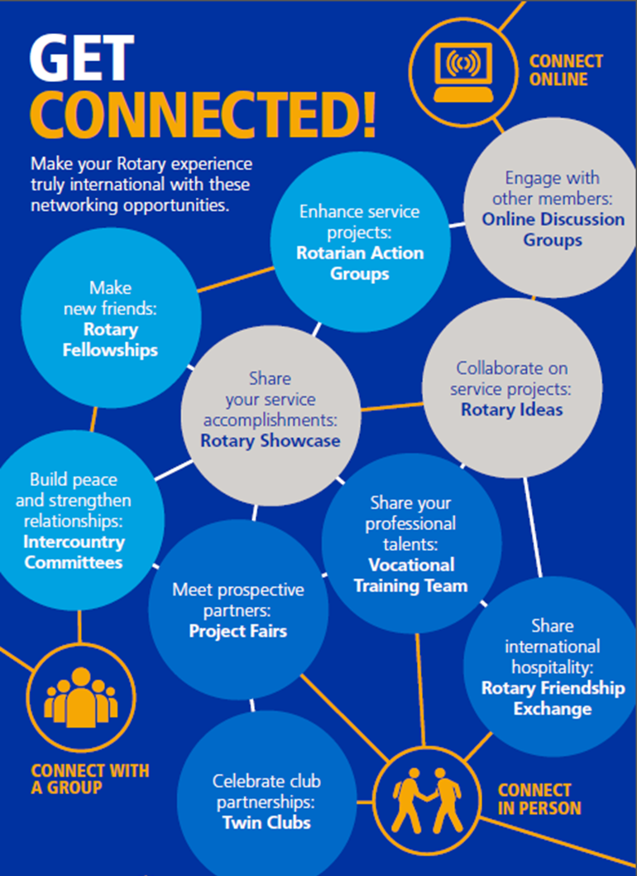
Tactics
Get Connected
Tools such as Rotary Showcase help you tell your club’s story and share the impact of your projects. Other products like Rotary Ideas and Discussion Groups are enhancing the Rotary experience.
Notes:
And, in helping clubs to promote their activities and connect with others, there’s been a significant effort to “GET CONNECTED”. Tools such as Rotary Showcase help you tell your club’s story and share the impact of your projects. Other products like Rotary Ideas and Discussion Groups are enhancing the Rotary experience.
Learn from each other, leverage the enormous talent pool with your club and across Rotary. There is a very rich source of resources available for the asking. Don’t think you have to do everything yourself…or that your club is an island. Partner and learn from others. If you need help or expertise…reach out and ask.

Slide 29
How Are You Doing?
Create Discipline
Have your strategic planning team regularly monitor progress on reaching its goals and suggest plan updates as needed.
Review your strategic plan, including its vision statement and priorities, each year with club members to see if they would like any revisions.
Make sure club decisions support the goals of the plan, and discuss observations with the strategic planning team.
Allot enough resources to achieve the plan.
Repeat the strategic planning steps every three to five years to produce a new plan or keep the current one.
How each tactic is being measured – you won’t improve what you don’t measure!
Notes:
And, in helping clubs to promote their activities and connect with others, there’s been a significant effort to “GET CONNECTED”. Tools such as Rotary Showcase help you tell your club’s story and share the impact of your projects. Other products like Rotary Ideas and Discussion Groups are enhancing the Rotary experience.

Slide 30
Exercise and Expectations (homework)
Exercise – 30 minutes
Break into teams with fellow club members, or clubs in geographic proximity
Using the template provided, complete the strategic planning worksheet.
You will have 7 minutes to complete each section.
https://www.rotary.org/en/search/all/strategic%2Bplanning%2Bguide

Slide 31
QUESTIONS?
Thank you for your time, commitment, and support.

Slide 32
Understanding Your Audience
Understanding Your Audience
Public Image and Marketing Boot Camp
Notes:
Before we can start communicating our clubs’ messages, it’s important to understand who it is we’re communicating to – who we want to reach.
Who is our customer? Or in marketing terminology, who are our target audiences?
To start with I have to say there is no such thing as the General Public. Each person we want to talk to is part of a specific group or audience that has individual opinions, needs, thoughts, points of view –
Our job in communicating our Rotary Message is to identify who our audiences are...... and what they need.
Those we want to reach are divided into two distinct groups– Internal and External Audiences

Slide 33
Agenda for the Session
Internal Audience
Who are they?
Exercise; Crafting a message to engage your membership
External Audience
Who makes up your external audience
Who are your targets
Exercise; Create a profile of the perfect characteristics for new member recruits
Notes:
Before we can start communicating our clubs’ messages that we’ve identified, it’s important to understand who it is we’re communicating to – who we want to reach.
Who is our customer? Or in marketing terminology, who are our target audiences?
To start with I have to say there is no such thing as the General Public. Each person we want to talk to is part of a specific group or audience that has individual opinions, needs, thoughts, points of view – Our job in communicating our Rotary Message is to identify who our audiences are and what they need.
Those we want to reach are divided into two distinct groups– Internal and External Audiences

Slide 34
Internal Audience – people we know
Club Members
Long-time Rotarians
New Members
Members Dedicated to Service in your Local Community
Members Interested in International Service
Notes:
Who are your current members? What matters to them? Why do they – you – belong? Why did you join and are you still getting from Rotary what you visualized when you joined?
Some members are longtime Rotarians who have served on committees, been president maybe more than once, attended the District functions and now they are happy to come for the social aspect. They don’t want to spearhead any more new projects. But that doesn’t mean they’re not vital contributors to the good of Rotary. Their experience and history with our clubs can be called upon to contribute advice or mentorship to new members.
Some members are newer and interested in participating in activities that improve the lives in their local community – they’re action oriented. They want to be more involved. They might have a specific interest in something local and want to devote their energy to meeting the needs they have identified.
Some members are dedicated to worldwide needs – Polio Plus or building water wells in Nepal are examples of where their passion lies.
So how can these three groups of people who all come to the same meeting feel they are fulfilling their personal needs while helping Rotary accomplish its goals?
Some of our members might be unhappy because they wish our club would do more internationally. Some are the opposite – they say how come we spend so much energy worrying about people in need in third world countries when there are so many people in our own community that need help? And the long-time members might feel they’ve paid their dues and just want to enjoy the comradeship of each other. This is a challenge.

Slide 35
Internal Audience – more people we know
Volunteers and Supporters
Non Members who help at club events
Notes:
In addition to fully paid up, pin-wearing members, there are supporters and volunteers who I always consider key internal target audience members. These are people who, in some cases, don’t have time to come to meetings or don’t want to commit to a long term relationship with an organized service club, but who support one or more aspect of what our club does. Our club has a number of supporters who want to be kept informed about our special events or fundraising dinners that support causes or projects that interest them. These folks show up too to volunteer when we need extra help flipping burgers or serving as a parade marshal. This very special group of non-member internal audiences are key to our success and some of them become members when the time is right for their busy lives.

Slide 36
Describe your Clubs – Exercise 20 minutes
Reassemble into your groups
Pick a Scribe and a Spokesperson
Step 1; Using action words (adjectives or verbs are best) brainstorm a list that expresses key characteristics of your clubs. Don’t judge, just write.
(5 mins.)

Slide 37
Describe your Clubs – Step 2
Hone Your Message
Step 2; Working together reduce your list to only four or five words.
Combine words that duplicates or similar
Eliminate any boring words
Seek consensus in the group
Be ruthless
(5 mins)

Slide 38
Describe your Clubs – last step
Write your club Statement
Using the 4-5 words your group has chosen, Write a statement that describes your club
Write an “is” statement; XXRotary is yada, yada, yada….
Play with the words and have fun
Collaborate
Avoid becoming stuck, just keep going
(5 mins)
Spokesperson reports back

Slide 39
External Audience
Potential New Members
Identify what your club needs and why;
to increase your numbers in order to fulfil the community-focused or international objectives of your club?
to round out the expertise that already exists?
more business-oriented members?
another accountant to take some of the load off your current treasurer?
the energy of more young up and coming community volunteers?
more seniors?
more women?
To attract Rotaract “graduates”?
To engage the volunteers and supporters who already work with you?
Identify what these potential new members need
Strategize how their needs mesh with your club’s goals

Slide 40
Who is your Target Member - Exercise 20 minutes
Back into your groups
Same Scribe and Spokesperson
Step 1; Using action words (adjectives or verbs are best) brainstorm a list that expresses key characteristics of the new members you want to add to your club. Use the club description you just wrote as inspiration. Again, no judging, just writing (5 mins.)
Step 2; Working together reduce your list to only four or five words. (4 mins., you see where this is going…)

Slide 41
Who is your Target Member - Exercise 20 minutes
Still in your groups
Same Scribe and Spokesperson
Using the 4-5 words your group has chosen, Write a statement that describes your perfect new member (5 mins.)
Spokesperson reports back

Slide 42
QUESTIONS?
Questions and Discussion

Slide 43
Engaging Your Audience
Engaging Your Audience
Public Image and Marketing Boot Camp

Slide 44
Agenda for the Session
Working with the Media
Traditional Media
Social/Digital Media
Video Marketing
Interactive Exercises
Networking Plus
Notes:
The goal of this session is to give you some ideas on how to reach your audiences through traditional media as well as via the many internet platforms.

Slide 45
Traditional Media
Newspapers
Radio
Television
Magazines
Notes:
There was a time – not that long ago, that the only way to reach your audience with your messages was through traditional media outlets; newspapers, radio, television, magazines. Your choices were to buy advertising or launch a publicity campaign by contacting their newsrooms in the hopes that a reporter would write a story about you or cover your event in person.

Slide 46
Social Media
Facebook
Twitter
You Tube
Websites
Other
Notes:
Today, thanks to the internet, communicating to and with your customers or supporters is much easier. You don’t have to depend on someone else to feature your information. You can do it yourself. It’s’ an absolute snap to just pop a message out on Facebook, or twitter or on your website and everyone tuned into your platform will see what you have to say.

Slide 47
Advantages of Traditional Media
More believable
No dollar cost unlike advertising
Stories run larger than paid ads
Radio and TV stories run longer than paid commercials
Notes:
But just because social media is faster and seems easier, traditional media is also an important part of any communications mix. Stories in local papers or on radio or TV reach audiences who aren’t necessarily plugged into the internet – and reach them in different ways.
Stories in the newspaper or on radio or TV are more believable too. When someone else says something about you or your organization, it carries more weight because someone else is saying or writing it. It’s called third party advocacy. So, in spite of the ease of social marketing, traditional media shouldn’t be ignored in your communications plans.

Slide 48
Disadvantages of Traditional Media
Final content is out of your hands
Stories are only news once
Notes:
The disadvantage of depending on the traditional media for your publicity is that you have no control over the wording of the story – over what is said. You meet with the reporter, give him or her the details you want in the story, then hope a) that it gets used at all and b) that the angle of the story is positive and the facts are correct.

Slide 49
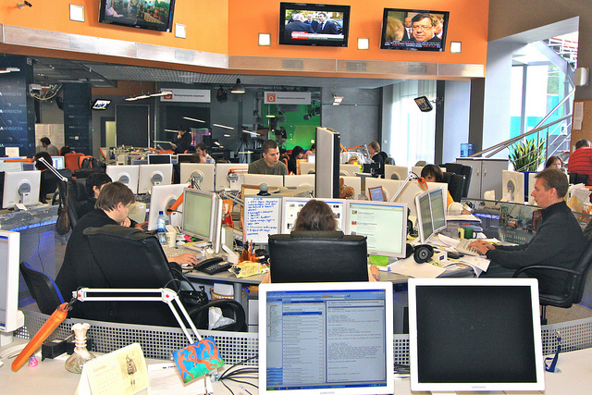
Gary Hollick,
What’s new in newsrooms
How to interest news editors in your story
Notes:
Past District Governor and principal at Red Frog Media, Gary Hollick has worked with traditional media for much of his career and has a handle on what’s new in the newsrooms and how our clubs can reach news editors in a way that will attract their attention and interest.

Slide 50
Ken Miller
Social Media
Facebook
Twitter
You Tube
Websites
Other
Notes:
Our November 5th Boot Camp will involve a full day on social marketing. Today Ken Miller is going to walk us through some of the basics of social media and touch on some of the most commonly used or familiar methods of getting our messages out via the internet…… just to get us started.
Ken Miller is from D5010 which is Alaska and the Yukon and has many years of experience in digital marketing as a consultant and small business owner.

Slide 51
Agenda for the Session
Google
Google your club
Google Analytics
Track sessions or users
Google My Business
Google Search and Maps
Google Alerts
Monitor the web
Google+

Slide 52
Agenda for the Session
Facebook
FB page
Correct branding
Correct information
Contact Us
FB ads
Boosted post or FB Ad Manager
FB events
Use for club event promotion
FB donations
Can setup donate now button

Slide 53
Agenda for the Session
Twitter
Twitter page
Consistent Rotary Branding
Twitter followers
Promote thru ads & postings
Twitter ads
Use for events, followers and website visits
FB to Twitter linking
Saves time – Buffer, Hootsuite, FB

Slide 54
Exercise
Exercise – 10 minutes
In groups of 4 score one club’s performance on a scale of 1-20 and discuss within group.
One or two groups share score and findings.

Slide 55
Agenda for the Session
Online/social media scoresheet
Club has simple online/social media dashboard?
Club website has correct Rotary branding?
Website has new post in last 2 weeks?
All website links work and have been tested in last 3 months?
Google Analytics set up and tracked?
Google My Business set up?
Google Alerts set up?
Google+ set up?
FB page has correct Rotary branding?
FB page has “contact us” button

Slide 56
Agenda for the Session
Online/social media scoresheet
Facebook page has everything filled out under Page Info?
Facebook page has post in last week?
Facebook page has at least two posts per week?
Facebook page has address and phone contact #?
Facebook page has boosted/ promoted post in last month?
Facebook page has event in last 6 months?
Twitter page has correct Rotary branding?
Twitter page matches FB page?
Twitter is connected to FB page for postings?
Twitter page has at least two posts per week?

Slide 57
QUESTIONS?
Questions and Discussion

Slide 58
Jesse Sidhu
Video Marketing
Snap Chat
Instagram
And more
Facilitated Discussion
Notes:
Jesse is the Creative Director at Eventcheckin.ca. He will be referring to the video marketing and will touch upon some of the newer methods (I.e. Snap chat, Instagram, etc.).

Slide 59
Social Media / Video Marketing
Notes:
Denis Boyd is a Past District Governor. He is coordinating the Net Plus site

Slide 60
Social Media / Video Marketing
Notes:
Denis Boyd is a Past District Governor. He is coordinating the Net Plus site

Slide 61
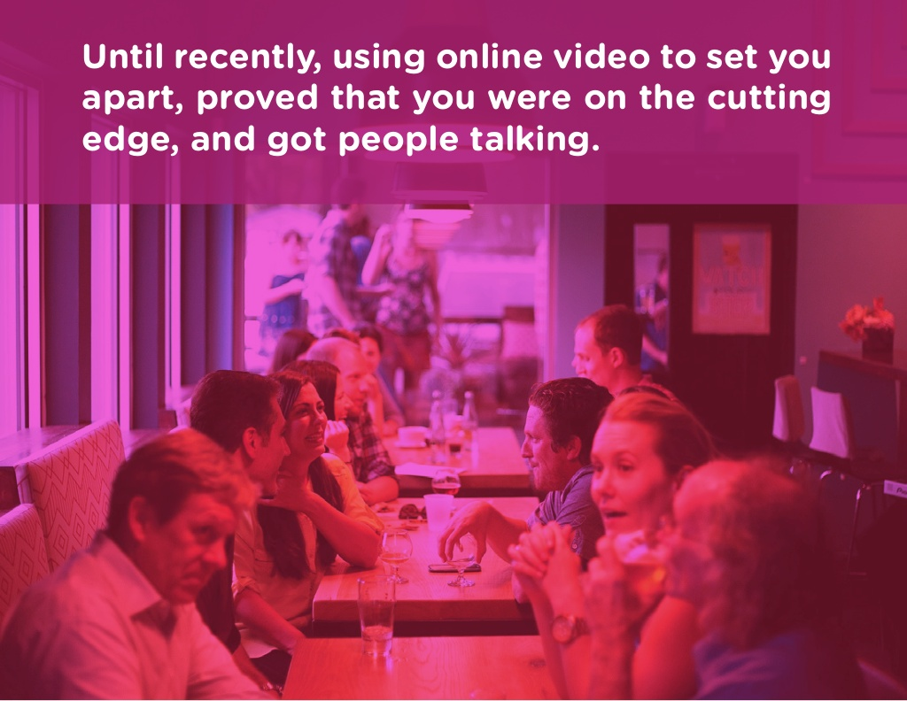
Social Media / Video Marketing
Notes:
Denis Boyd is a Past District Governor. He is coordinating the Net Plus site

Slide 62
Social Media / Video Marketing
Notes:
Denis Boyd is a Past District Governor. He is coordinating the Net Plus site

Slide 63
Social Media / Video Marketing
Notes:
Denis Boyd is a Past District Governor. He is coordinating the Net Plus site

Slide 64
Social Media / Video Marketing
Notes:
Denis Boyd is a Past District Governor. He is coordinating the Net Plus site

Slide 65
Social Media / Video Marketing
Notes:
Denis Boyd is a Past District Governor. He is coordinating the Net Plus site

Slide 66
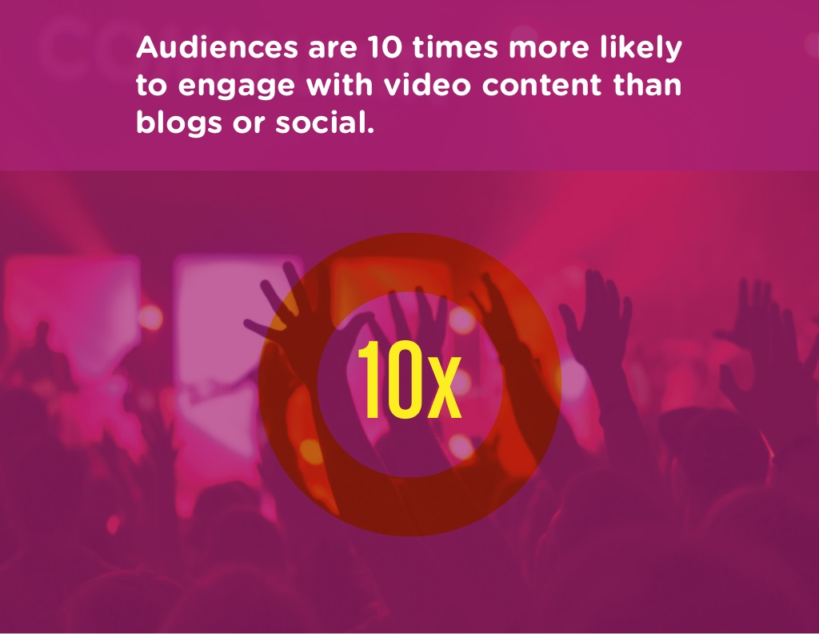
Social Media / Video Marketing
Notes:
Denis Boyd is a Past District Governor. He is coordinating the Net Plus site

Slide 67
Social Media / Video Marketing
Notes:
Denis Boyd is a Past District Governor. He is coordinating the Net Plus site

Slide 68
Social Media / Video Marketing
Notes:
Denis Boyd is a Past District Governor. He is coordinating the Net Plus site

Slide 69
Rotary Networking Plus
www.rotarynetworkingplus.com
Notes:
Denis Boyd is a Past District Governor. He is coordinating the Net Plus site

Slide 70
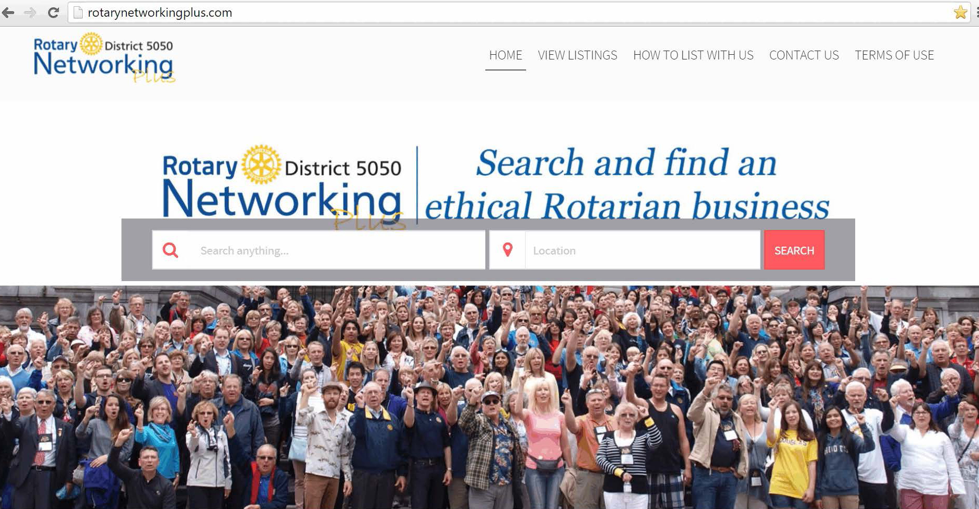
Rotary Networking Plus
www.rotarynetworkingplus.com
Notes:
Denis Boyd is a Past District Governor. He is coordinating the Net Plus site

Slide 71
QUESTIONS?
Questions and Discussion

Slide 72
Resources
https://www.rotary.org/myrotary/en/learning-reference/learn-topic/membership
http://portal.clubrunner.ca/50004 (membership > membership resources)
http://www.district5050.org/ (membership > membership resources)

