Slide 1
Setting up your club’s Facebook Page
Five easy steps
On top right of blue Facebook bar, click on down arrow
Click on Create Page OR navigate to www.facebook.com/pages/create.php
Choose Company, Organization or Institution
Choose a Category – Community Organization or Non-Profit
Enter the name for your Rotary Club
Page Guidelines: www.facebook.com/page_guidelines.php

Slide 2
Setting up the Page
Have you considered…
What is your club’s brand?
A short blurb about your club in About
Two photos – JPG/PNG file
Cover photo (820 x 312) and Profile photo (170 x 170)
Call to action – attend meeting, call, web search?
Turn on messaging
On your smart phone, download the Pages Manager App
Publish page when you’re ready to go public

Slide 3
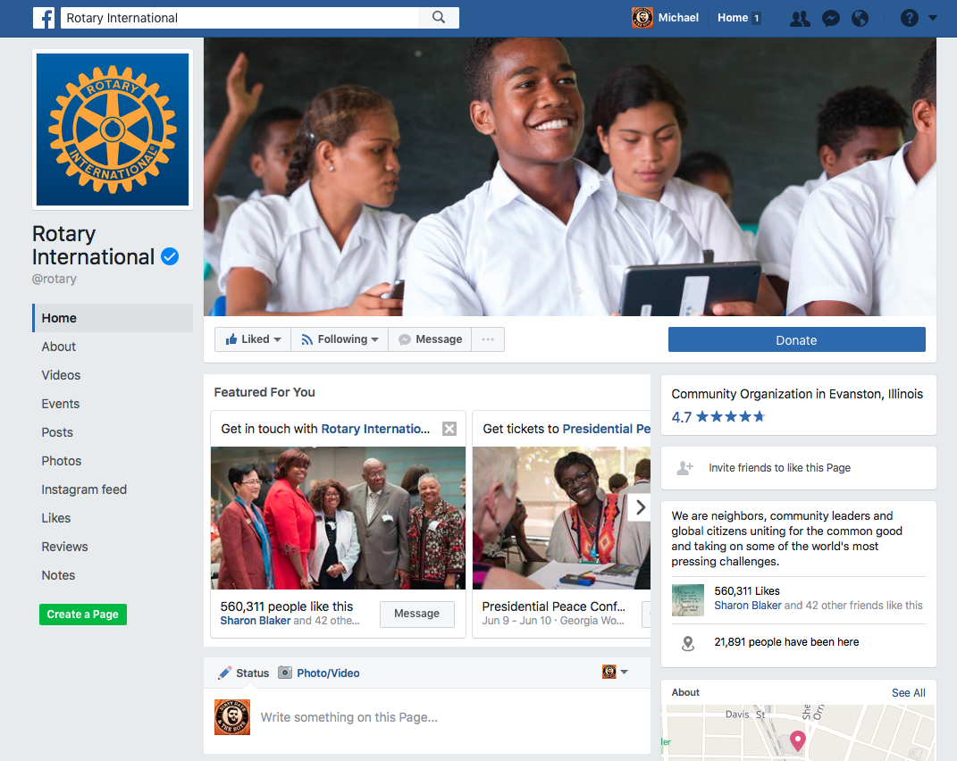
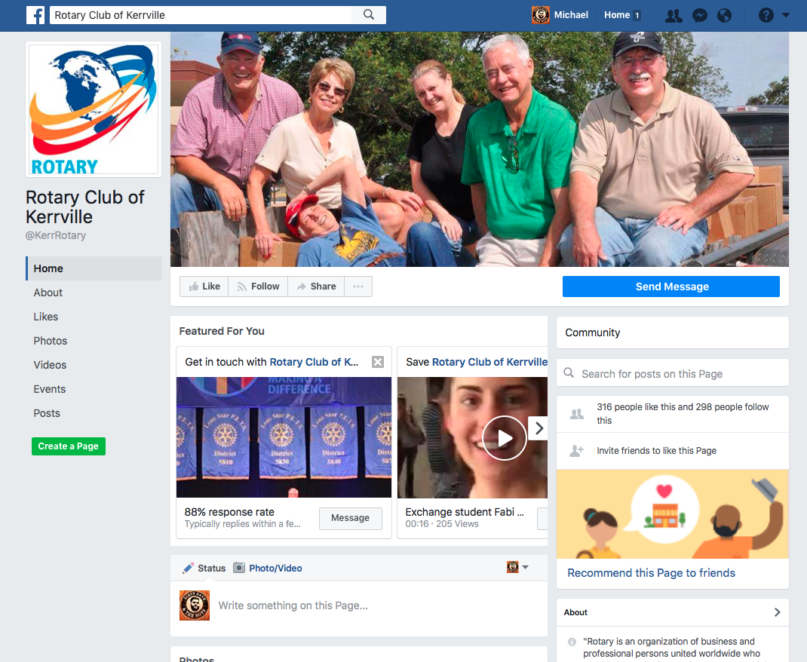
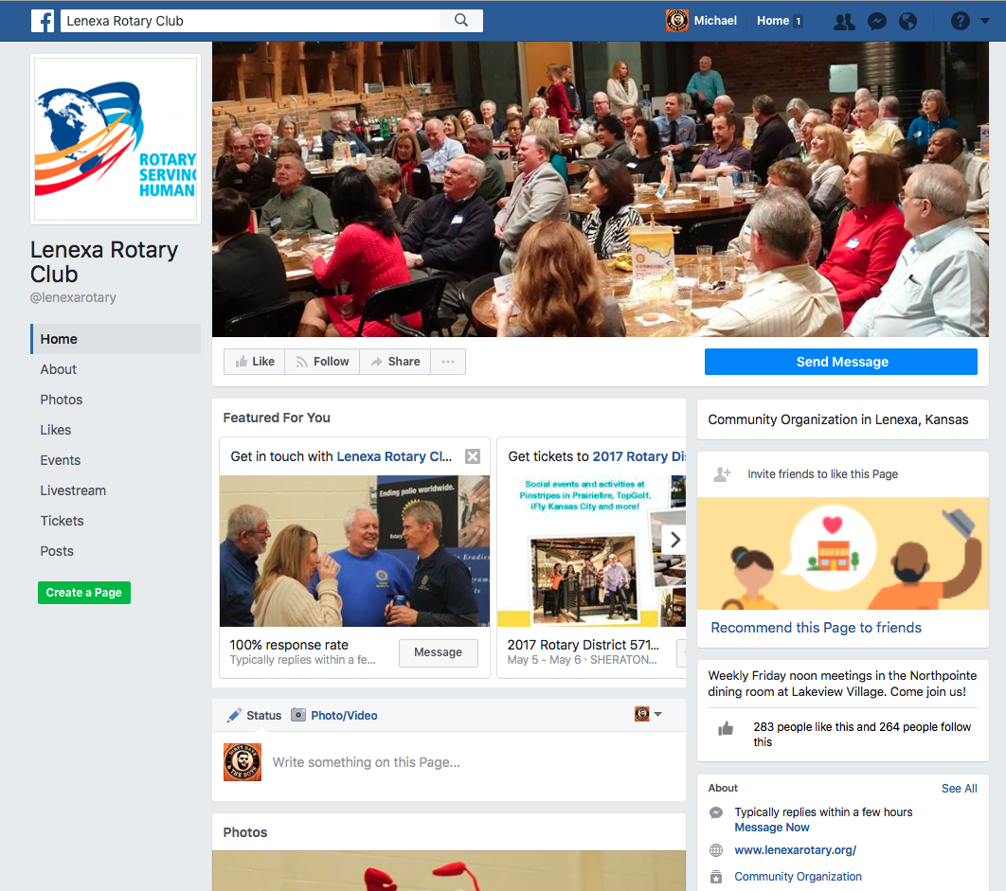
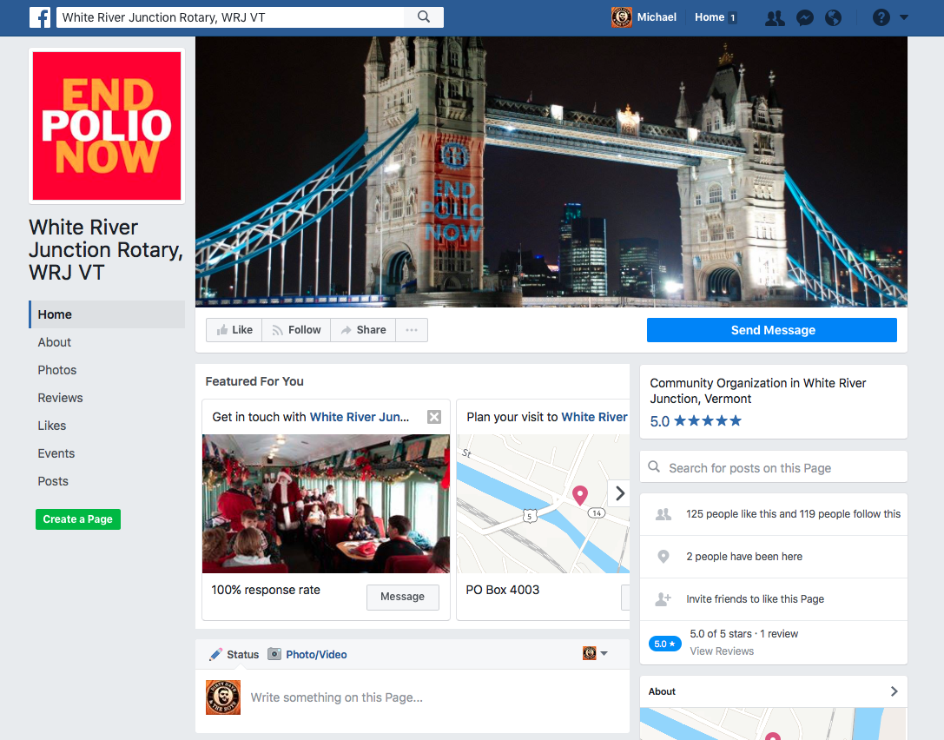
Facebook Pages – Examples from Rotary around the world

Slide 4
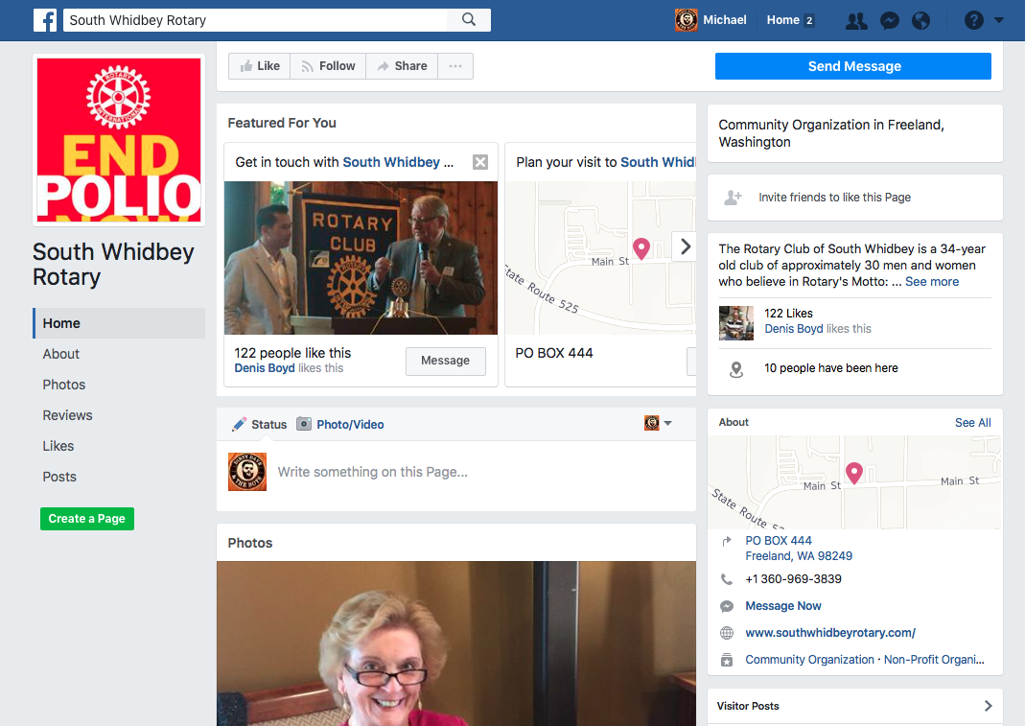
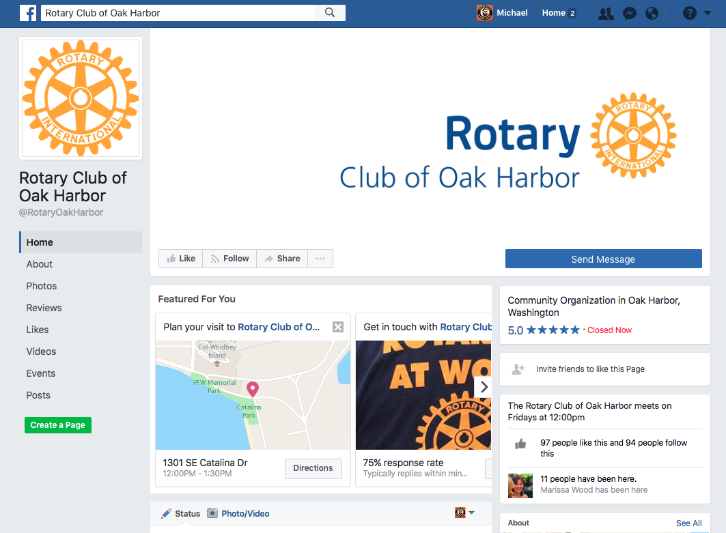
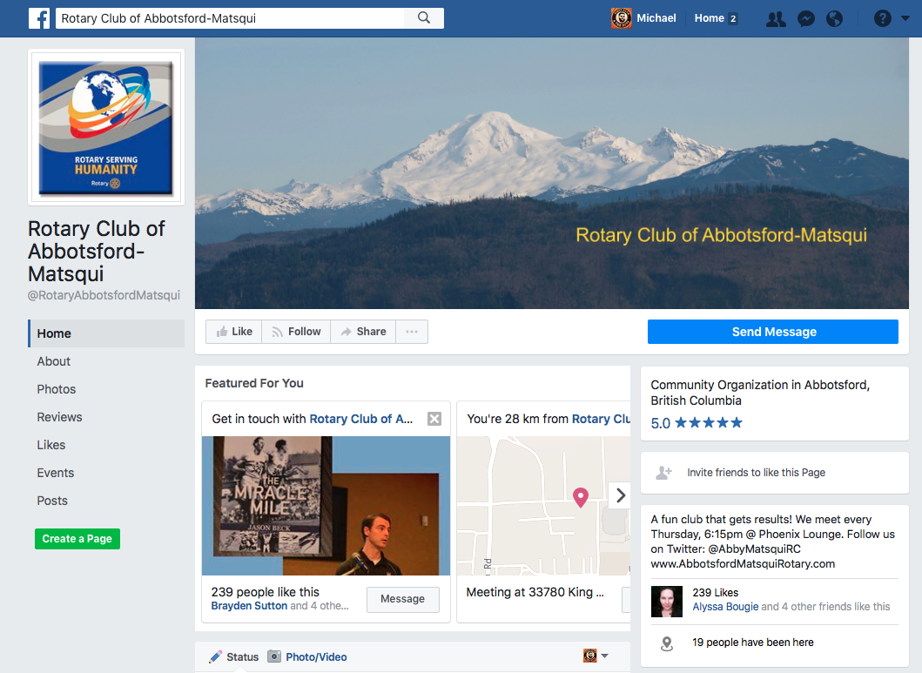
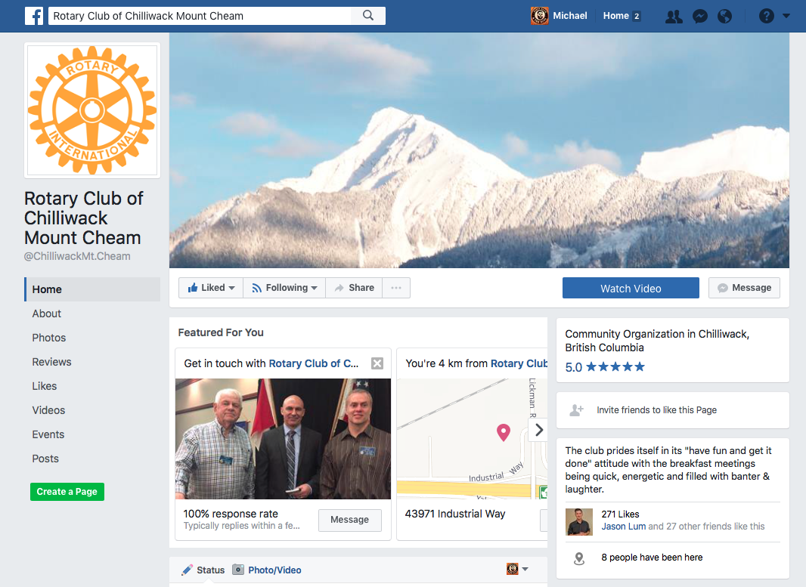
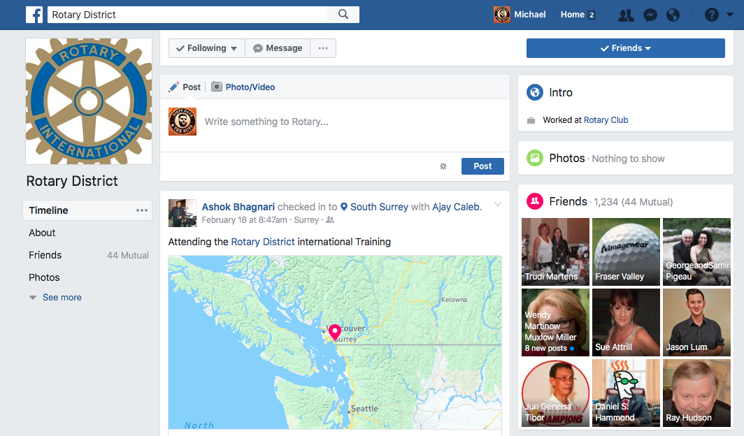
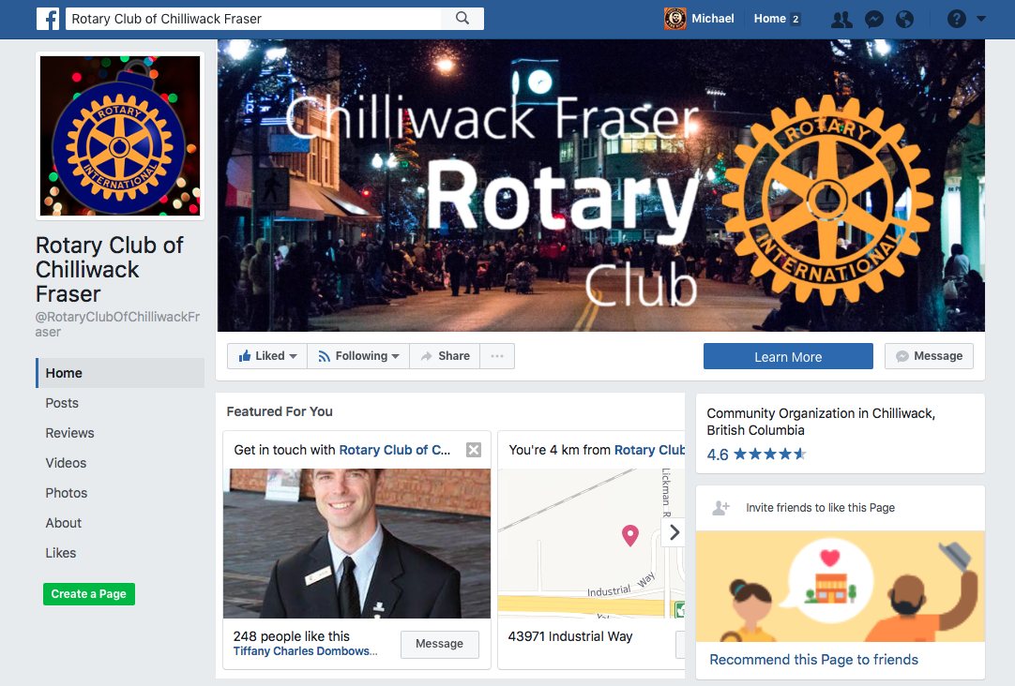
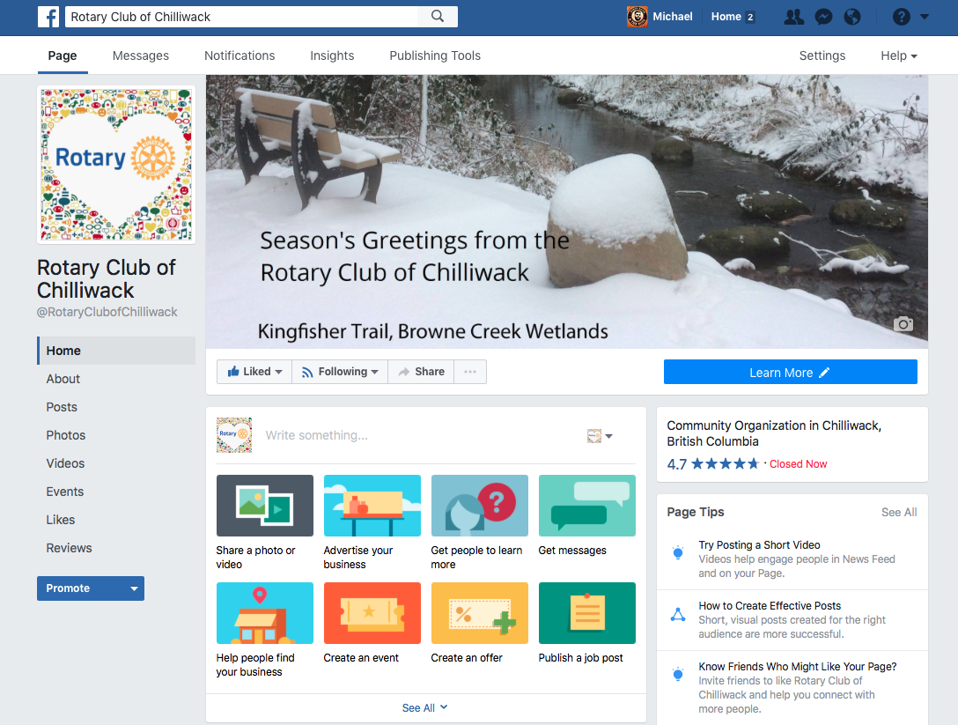
Facebook Pages – Examples from District 5050

Slide 5
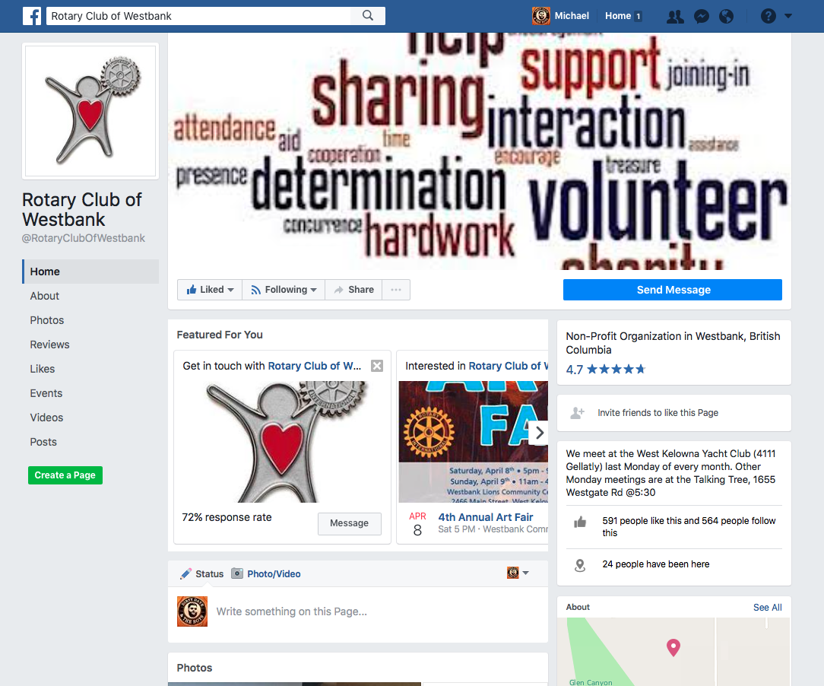
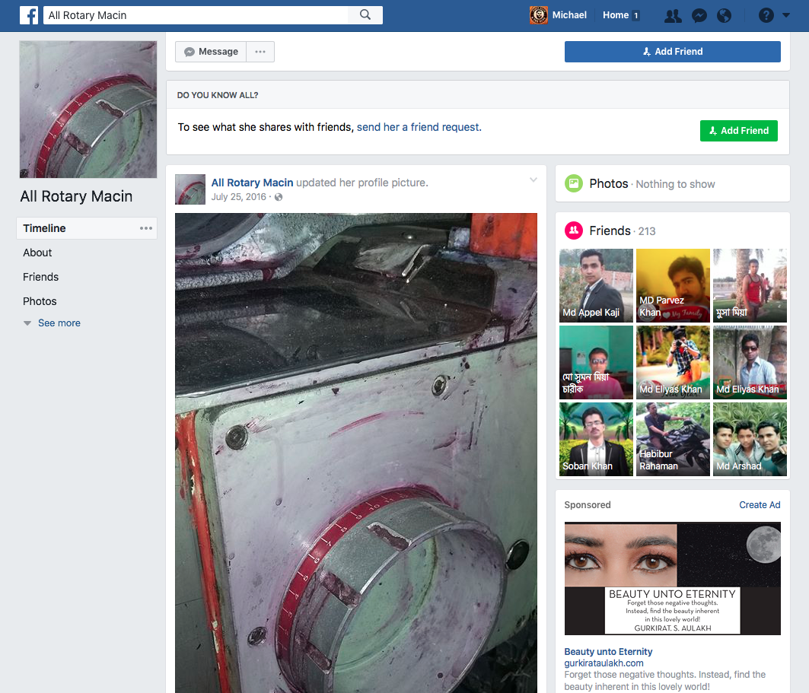
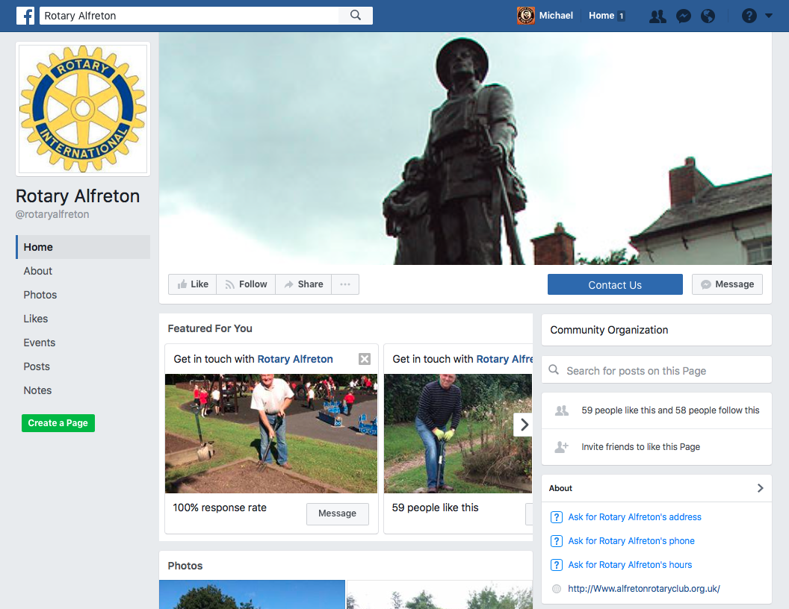
Facebook Page – Examples that need some work

Slide 6
Administrative Settings
Who’s in charge here?
Your page needs at least one Administrator
Other roles are available:
Editor
Moderator
Advertiser
Analyst
Consider having multiple Admins or Editors
Advertisers and Analysts are only needed if you are using outside parties to set up ads for you

Slide 7
Post and Engage
What’s next?
Invite your club members and contacts to Follow your page
Post links to your Facebook page on your website and in your emails
Make a few posts
Boost posts to increase reach
Use Page Insights to track engagement

Slide 8
Wrap up
Have questions that can’t be answered here?
Email: mberger@currencymarketing.ca
Twitter: @CurrencyMike
Phone: 604-799-6744
Sources for this presentation available by request

