Slide 1
ClubRunner Tutorial
Rotary District 5050

Slide 2
ClubRunner
This Powerpoint and more have been uploaded to the District 5050 ClubRunner Support Site Page under the Public Image tab
www.district5050.org

Slide 3
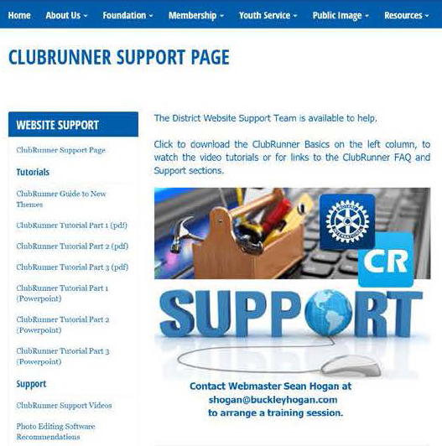
ClubRunner
Tutorial download in both Powerpoint and Adobe Acrobat
ClubRunner support videos
Photo editing software
Links to content, resources and website

Slide 4
ClubRunner Tutorial
Log In: Admin Page

Slide 5
ClubRunner Tutorial
Login at top right of home page
Returns to home page. Click “Member Area”
Enter username and password

Slide 6
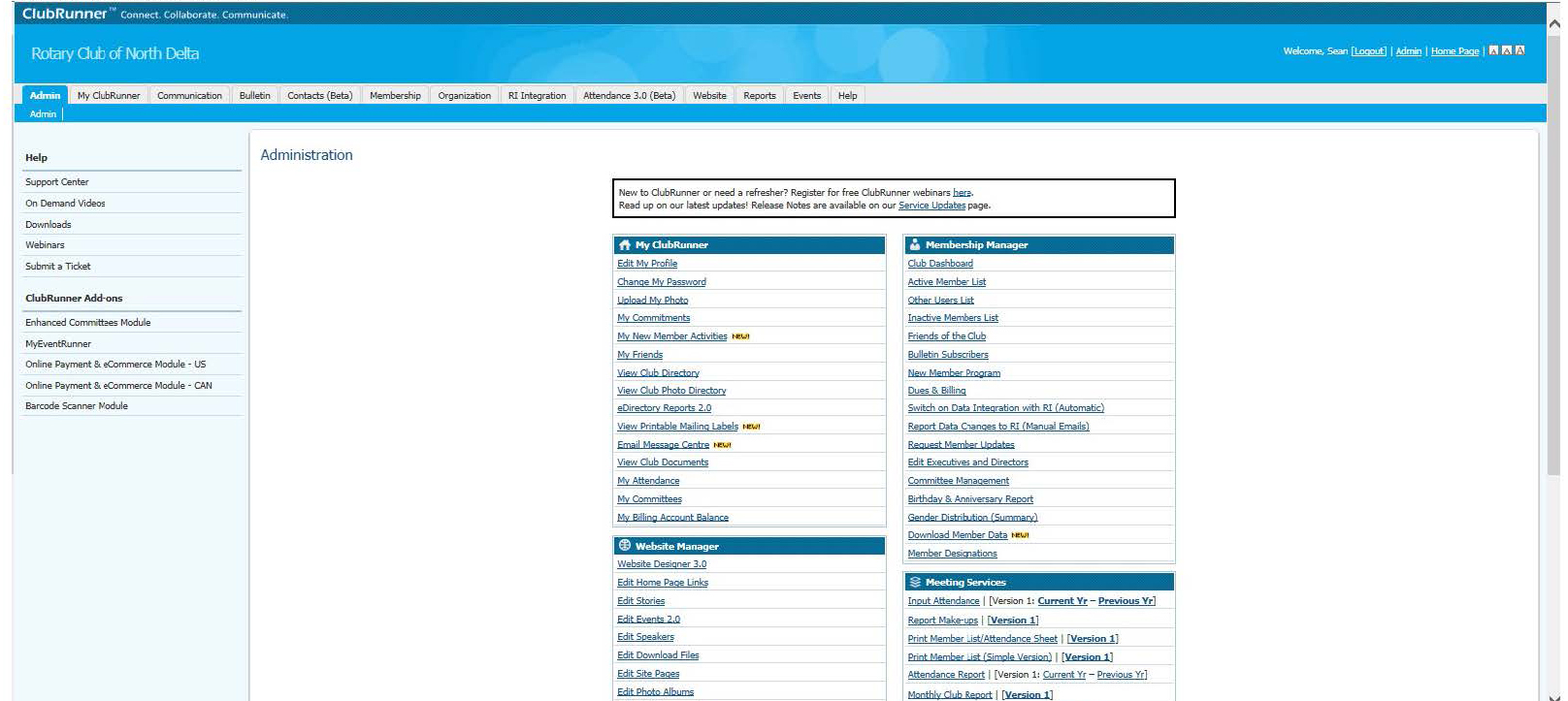
ClubRunner
Admin Page
To return to Admin Page, click Admin on the menu, then click Admin again on the
sub-menu

Slide 7
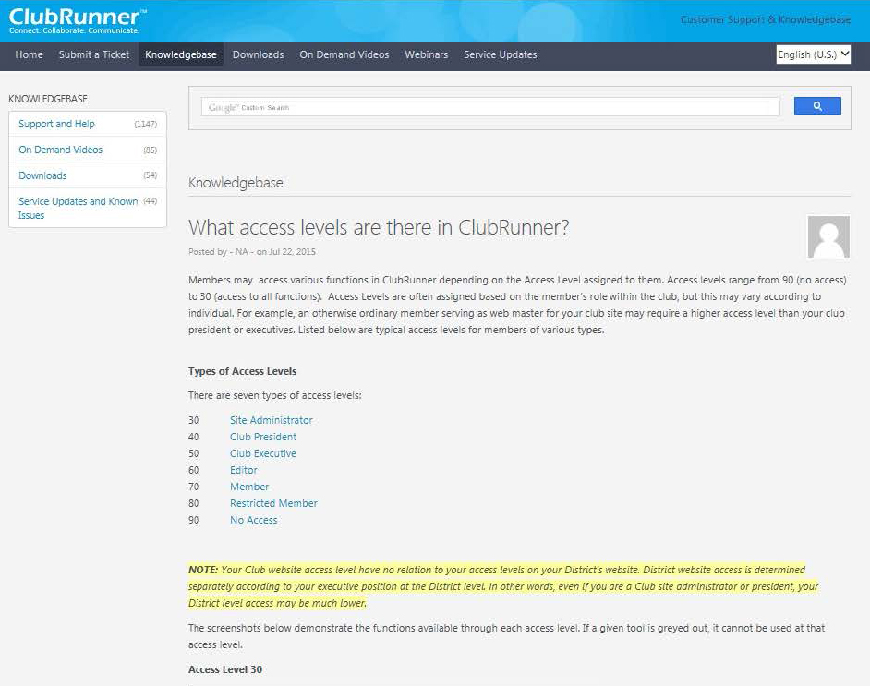
ClubRunner
ClubRunner access levels
30 – full admin access
70 – limited access
(general membership)

Slide 8
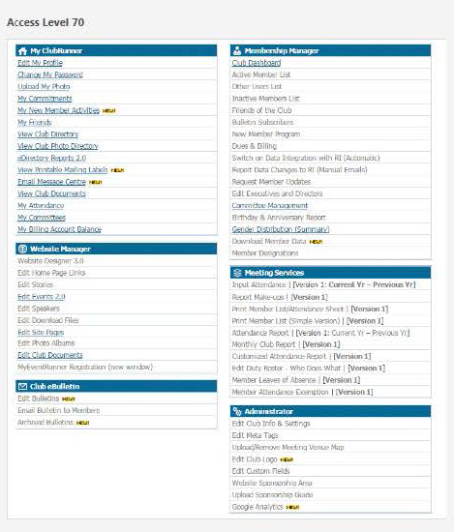
ClubRunner
Access Level 70
Most items grayed out

Slide 9
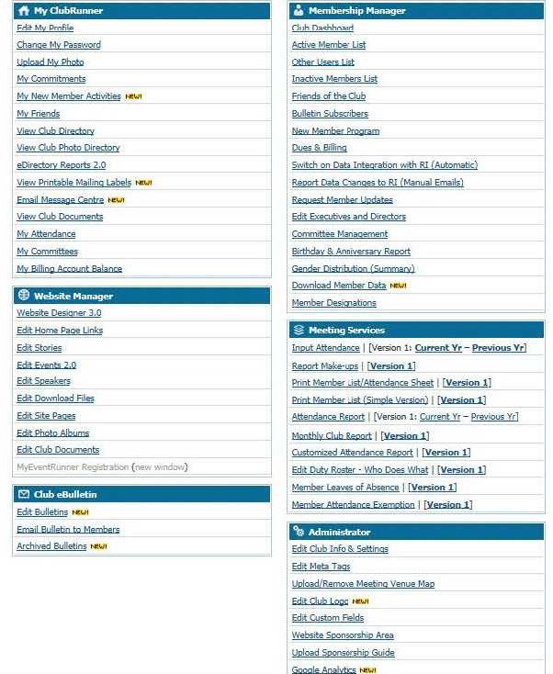
ClubRunner
Access Level 30
All items active

Slide 10
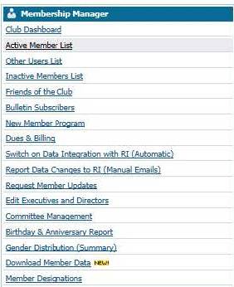
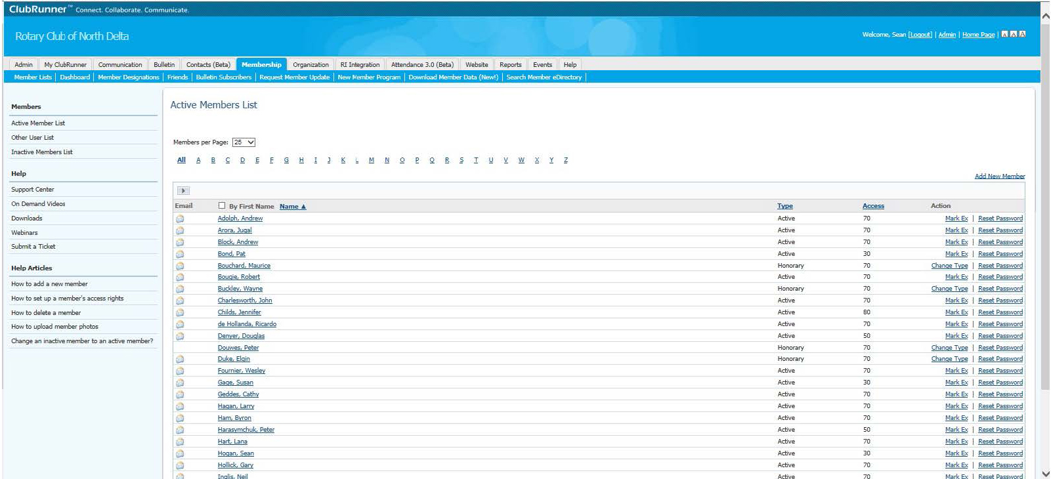
ClubRunner
Change Access Level
Active Member List
Click name
Current Access Level

Slide 11
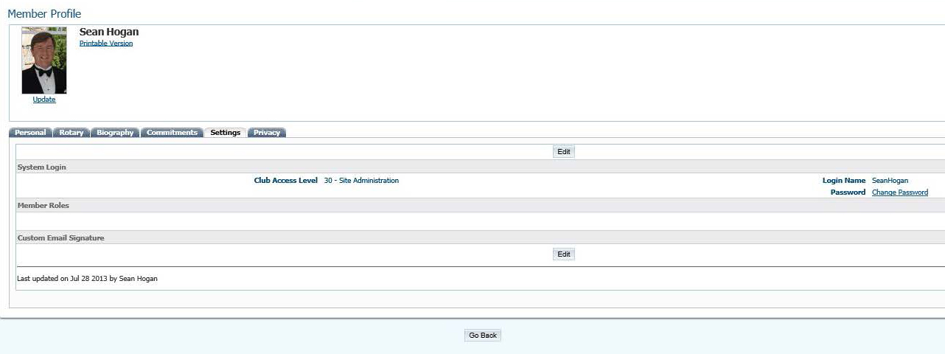
ClubRunner
Member Profile
Choose settings tab
Edit button

Slide 12
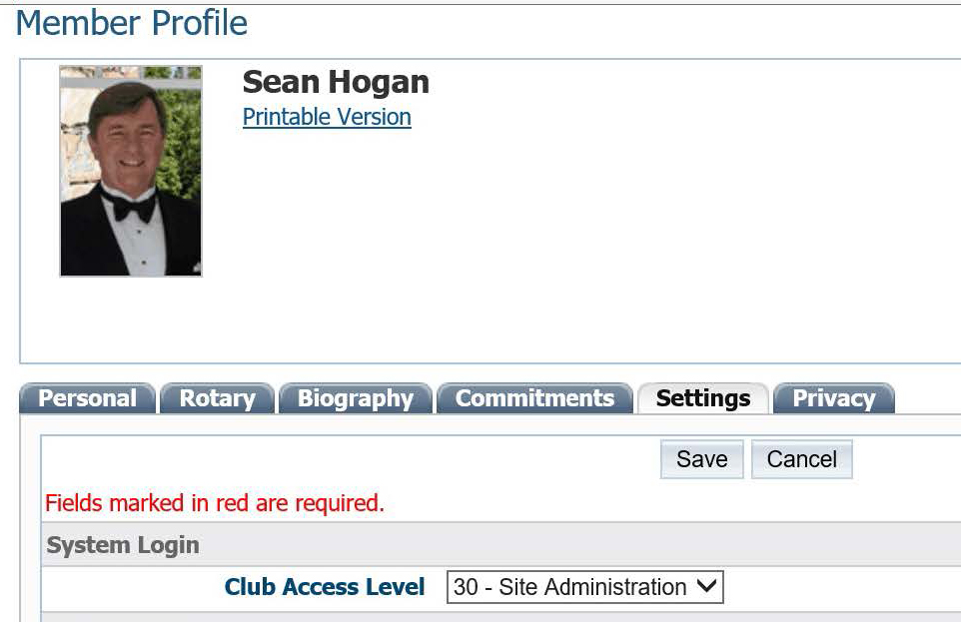
ClubRunner
Member Profile
Change access level and save

