Slide 1
ClubRunner Tutorial
Website Designer

Slide 2
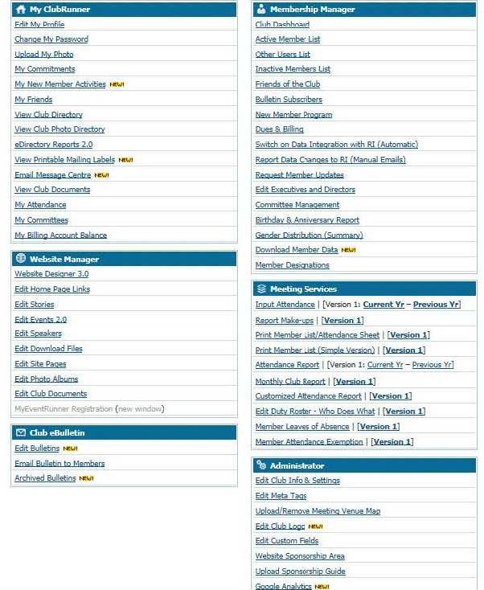
ClubRunner
Website Designer

Slide 3
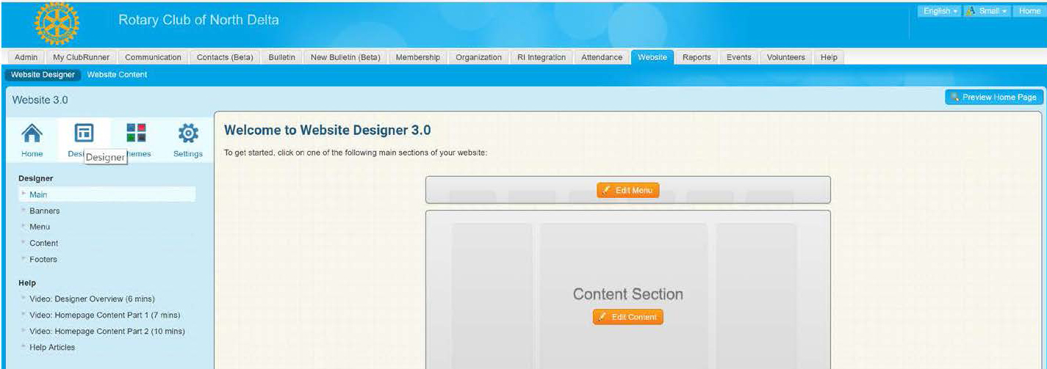
ClubRunner
Website Designer – Template
Click the Designer button
Click “Edit Content”

Slide 4
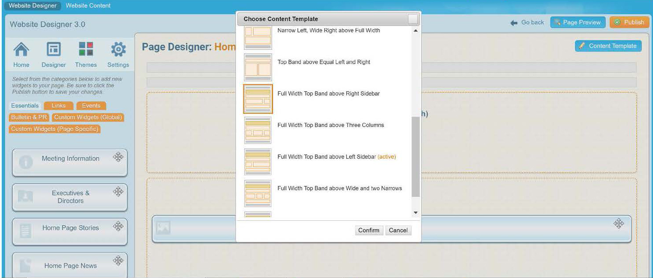
ClubRunner
Website Designer – Template
Click “Content Template”
Select one of the themes starting with “Full Width Top Band”
Note: ClubRunner has discontinued templates using banners so only use the themes with “Full Width Top Band”.

Slide 5
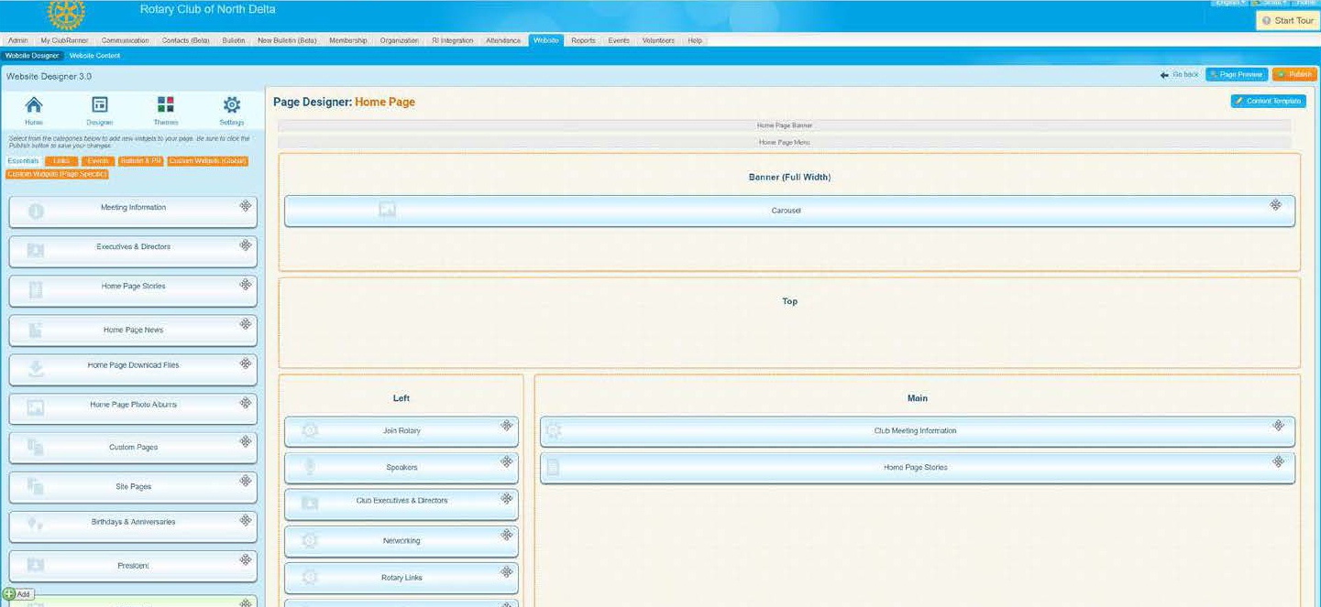
ClubRunner
Elements of Designer Section
Widget “bank”
Carousel or banner
Side Column Widgets
Main Section
Note: this example is Full Width Top Band above Left Sidebar

Slide 6
ClubRunner
Elements of Designer Section
Carousel or banner
Main Section
Club meeting info section
Side Column Widgets
Home page stories section

Slide 7
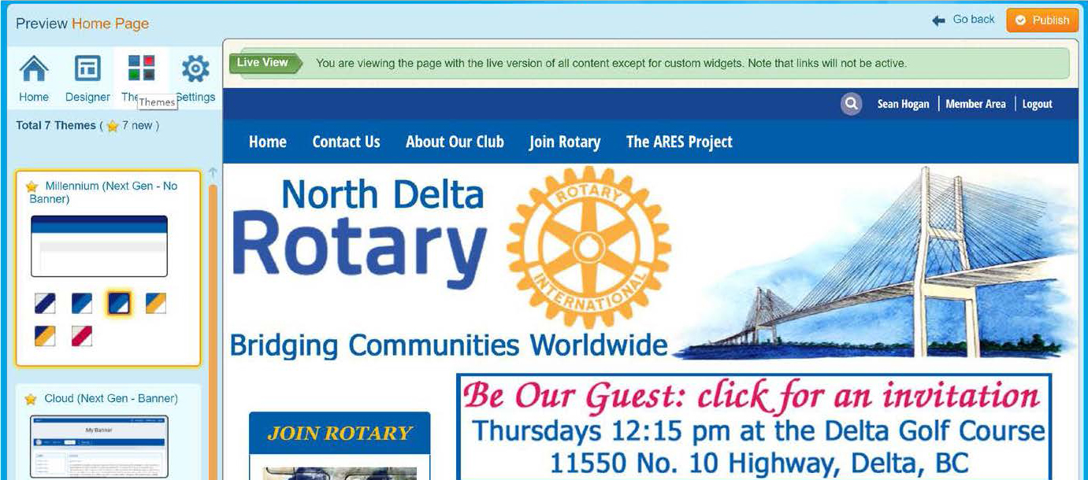
ClubRunner
Website Designer – Themes
Use the Themes option to choose the look of your page. Once you have the one you like, click the Publish button

Slide 8
ClubRunner Tutorial
Carousel / Banner Design

Slide 9
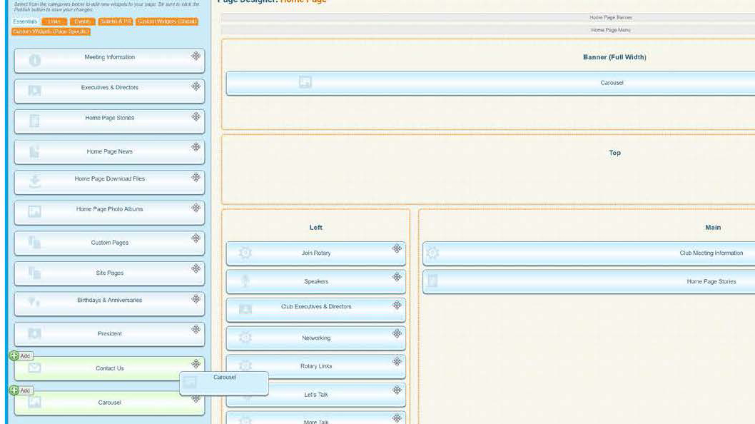
ClubRunner
Creating a Carousel (Banner): Step 1
Two steps are involved – setting up the Carousel in the Website Designer and then creating the pictures to display.
From the Essentials tab in the Widget area, drag “Carousel” to “Banner (Full Width)”

Slide 10
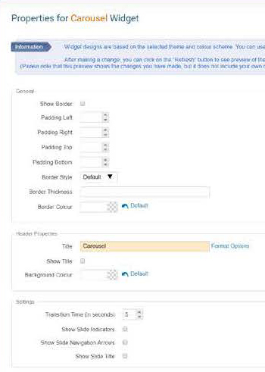
ClubRunner
Creating a Carousel (Banner): Step 1
Hold mouse over “Banner (Full Width)” to modify content (pencil) and settings (gear)
In Content – choose a photo album (more on this later)
In Settings, consider options in bottom

Slide 11
ClubRunner
Creating a Carousel (Banner): Step 2
The pictures used for the carousel should all be the same dimensions – ie1600 pixels wide by 400 px height.
Use a photo editing software to crop or build pictures. You can use your own images or visit images.rotary.org or use Google images.

Slide 12
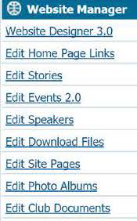
ClubRunner
Creating a Carousel (Banner): Step 2
On Admin page, select Edit Photo Albums from the Website Manager section
Find the album you selected earlier or create a new one. Click “Photos”

Slide 13
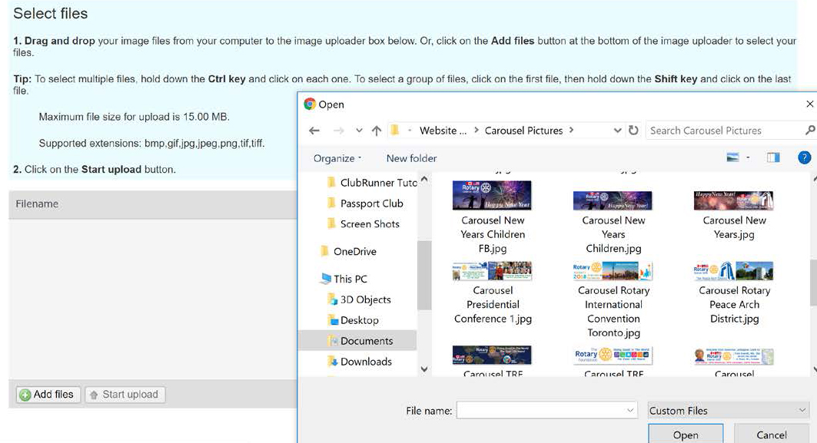
ClubRunner
Creating a Carousel (Banner): Step 2
Use one picture if you want a single banner, or add photos to create a carousel slide show
Click Add Files and then navigate to the folder in your computer to upload pictures.

Slide 14
ClubRunner
Creating a Carousel (Banner): Step 2
Arrange the pictures in the order that you want them to show
Tip: if you later add pictures or reorganize the order, you will need to delete an existing photo (you can upload it again) for the changes to take effect.

