Slide 1
ClubRunner Tutorial
Edit Member Profile

Slide 2
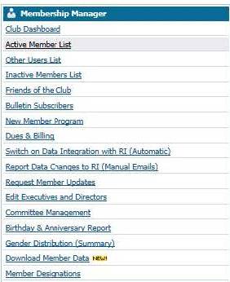
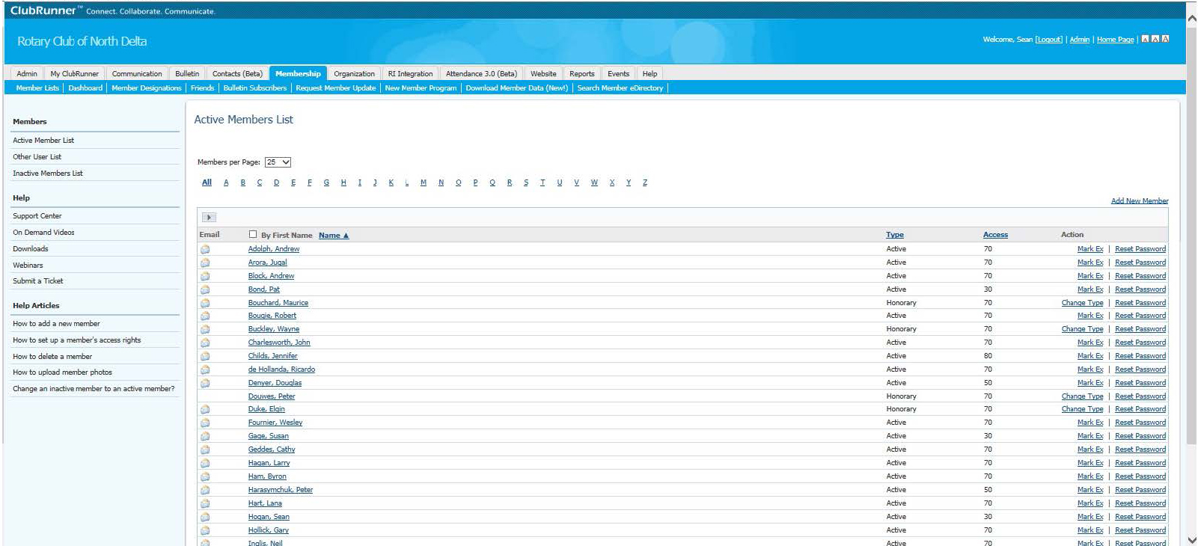
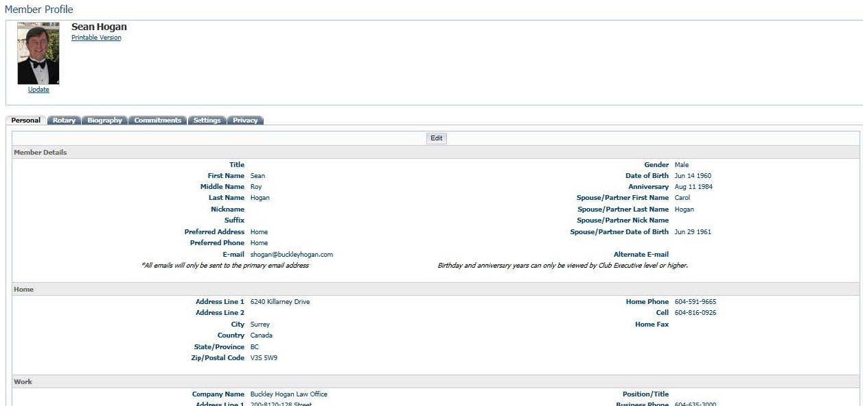
Admin Page
ClubRunner
Edit or Create Member Profile Info
Click name
Member Profile
Edit button
Choose tab option

Slide 3
ClubRunner Tutorial
Email

Slide 4
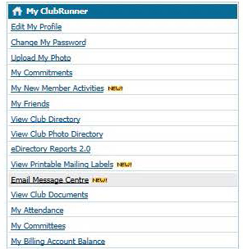
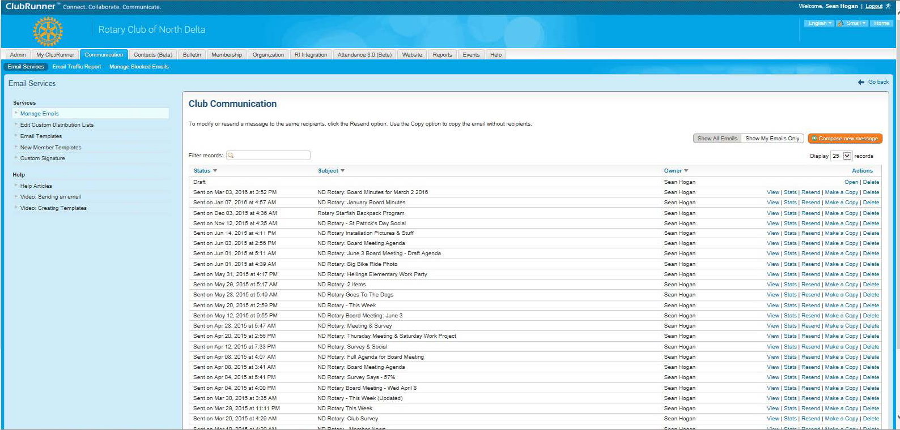
ClubRunner
Email
Select from Admin options or menu item
Make custom email lists

Slide 5
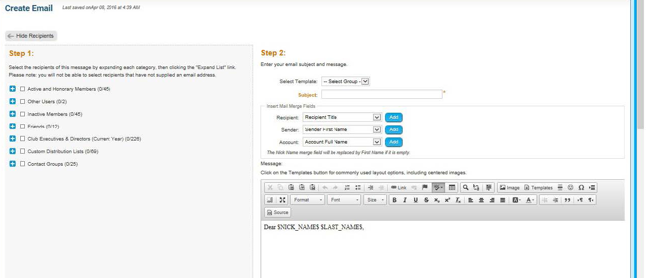
ClubRunner
Subject line required
Tip: Consider starting subject line with “Rotary:”
Choose recipient group
Tip: customize by using Hello $NICK_NAME$,

Slide 6
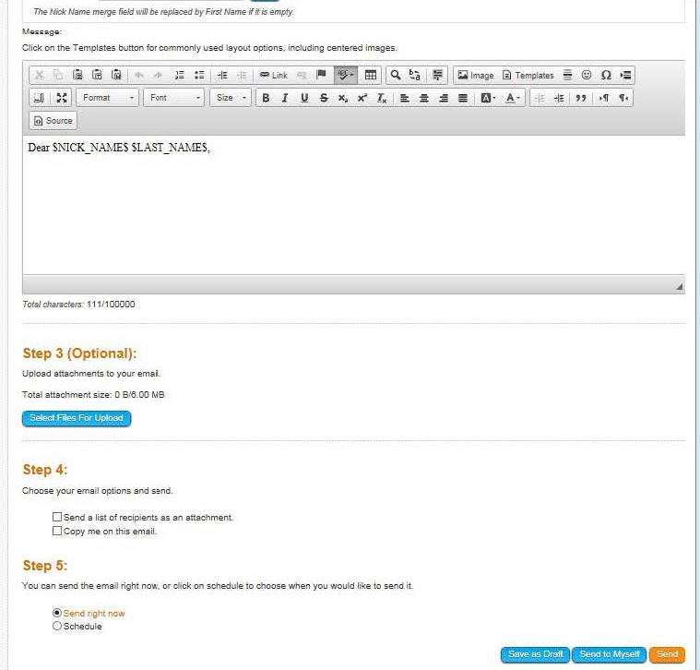
ClubRunner
Consider using Georgia or Tahoma font with size 16 or 18
To upload attachments

Slide 7
ClubRunner Tutorial
ClubRunner Support

Slide 8
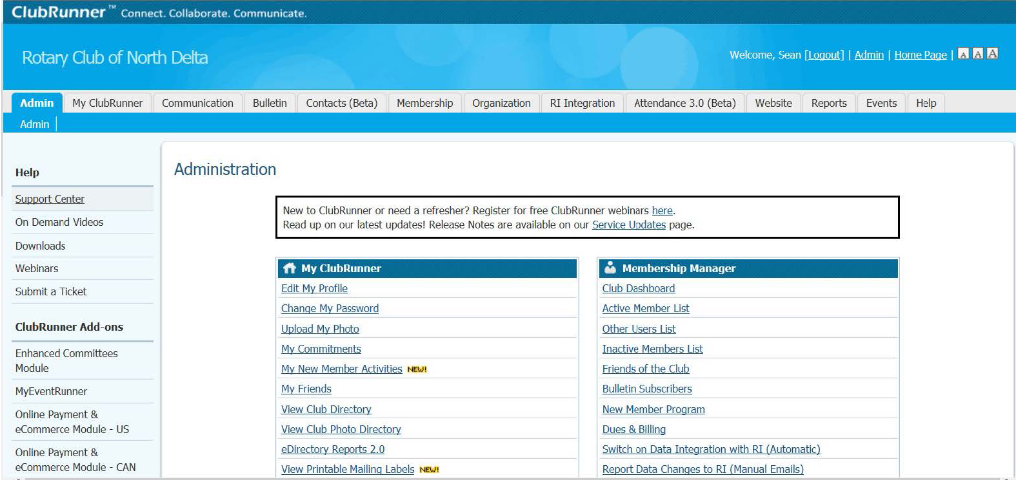
ClubRunner
ClubRunner Help & Support Center

Slide 9
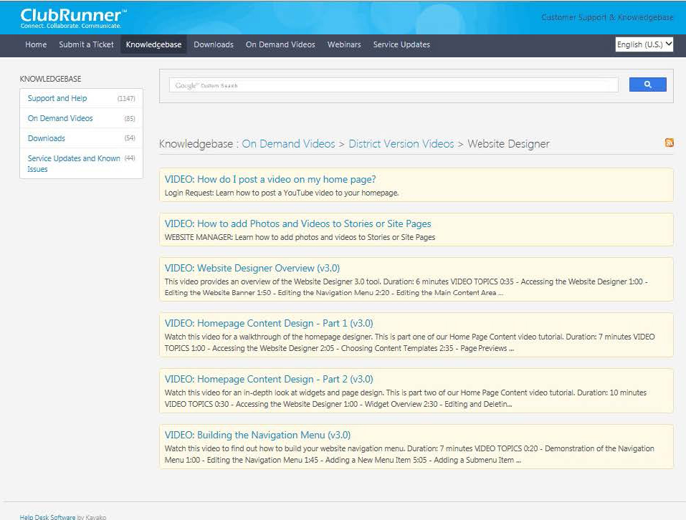
ClubRunner
Videos

Slide 10
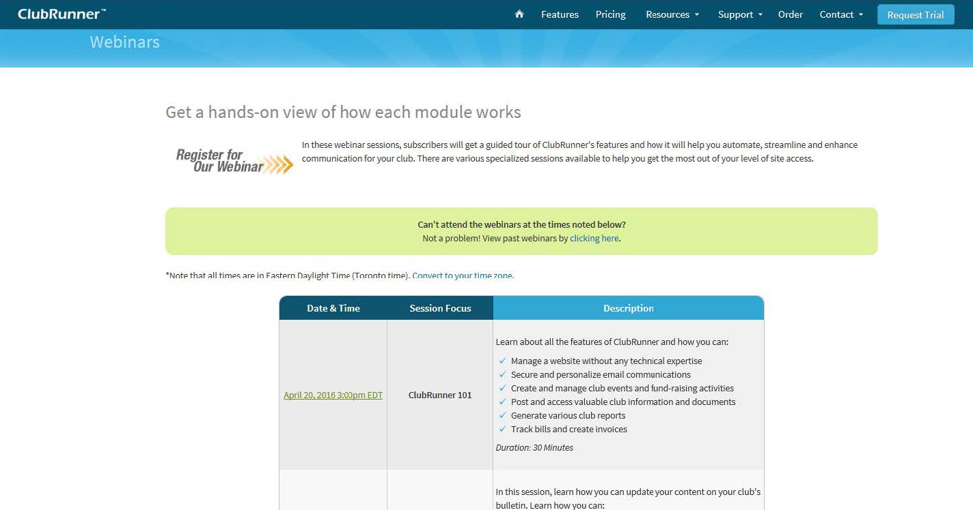
ClubRunner
Webinars: Watch live or recorded
Recorded
Live

Slide 11
ClubRunner Tutorial
Thank You!

