Slide 1
Rotary’s Partnership with Dolly Parton’s Imagination Library
Sarah Groves- District Membership Chair 2019-2021

Slide 2
DPIL
What Is it?
Dolly Parton’s Imagination Library is a book gifting program that gifts free books to children from birth to age five in participating communities within the United States, United Kingdom, Canada, Australia and Republic of Ireland.

Slide 3
“Dolly Parton’s Imagination Library is in its second three-year partnership as an official Service Partner with Rotary International, and our goal is to increase the number of local Rotary Clubs who collaborate with us to help bring the Imagination Library to their communities.”

Slide 4
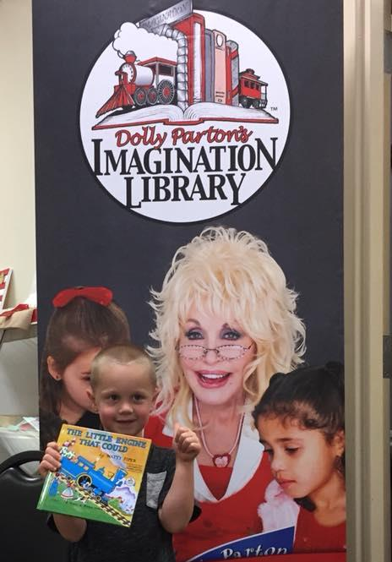
DPIL in a Nutshell
Open to children aged birth to 5 years old
Get a book a month mailed directly to their door
No cost to the family
Local affiliates handle cost and day to day operations

Slide 5
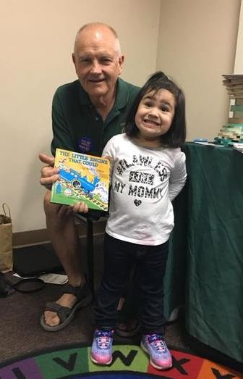
Becoming a Local Champion
“Do I Want To Do This”
Funding:
You will need to identify financial support to sustainably cover the wholesale cost of the books and mailing
How much funding do I need?
Decide on the geographical area you think you would like to cover – such as a county, city, school district or zip code(s)
Get the 0-5 population from a census website. Try FactFinder
Enter the 0-5 population into the Cost Estimator on our website.
Cost is $2.11 per book
Partnering with a Non-profit (501c3):
We mail IL books at special non-profit mailing rates, and a non-profit partner needs to be involved to qualify for these rates.

Slide 6
Putting the Pieces in Place
1. Contact the Dollywood Foundation Regional Director who covers your area
Find your Regional Director.
Let them know your intentions
Ask any questions
Get our Memorandum of Agreement and Affiliate Information Sheet
Pam Hunsaker- West Region
4009 Citation Dr
Columbia MO 65202
573-817-0117
phunsaker@imaginationlibrary.com
Jeanne Smitiuch- Canada
11 Waxwing Way
Brantford, ON N3R 6W5
1-519-771-2543
jsmitiuch@imaginationlibrary.ca

Slide 7
The Pieces
Cont.
2. Begin building a support team
Key roles you should consider:
Chairperson – a person to coordinate the effort
Fundraising – to sustainably identify and collect local funds
Enrollment – plan where and how to enroll children, oversee registration brochure distribution (if using) and marketing campaigns
Database – entering new registrations, accepting pending online registrations, updating addresses, utilizing reports in the Book Order System (BOS)
Community Outreach – collaborate with other local organizations and coalitions. Also may collect undeliverable books from local post office.
Family Engagement – plans efforts to encourage parents to better engage their children through DPIL books and read more often.

Slide 8
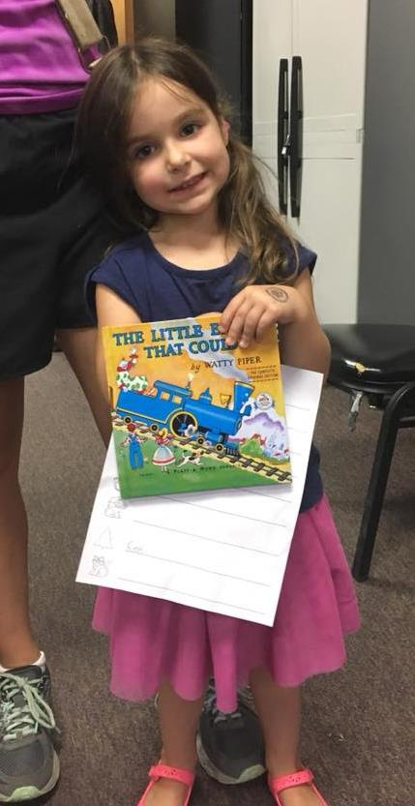
The Pieces
Cont.
3. Get Fundraising effort underway
Engage your support team for contacts
Consider putting together an advisory council to assist.
Identify potential funding partners and begin meeting with them.
*TIP – At this point you should have a good plan outlined: an idea of the funds you will need, community details/facts and partners who are willing to help – this will all help make your ask more clear and direct.
4. Complete and Submit Partnership Docs
Return completed Memorandum of Agreement (MOA) and Affiliate Information Sheet (AIS) to your Regional Director
Submit USPS form 3623 or 3624 (if non-profit hasn’t already done so) to local post office and return the non-profit authorization code to your Regional Director

Slide 10
If you read just 1 book with your child every day they will have read 1825 books by their 5th birthday!

Slide 11
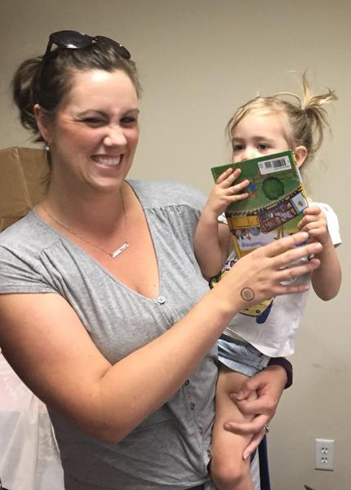
Colville’s DPIL
740+
$1500+ per month
Two person team
Fundraiser
Data Entry
Local Support
Funding
Sign Ups

Slide 12
2018 – 100th Million Book Dedicated to the Library of Congress

Slide 13
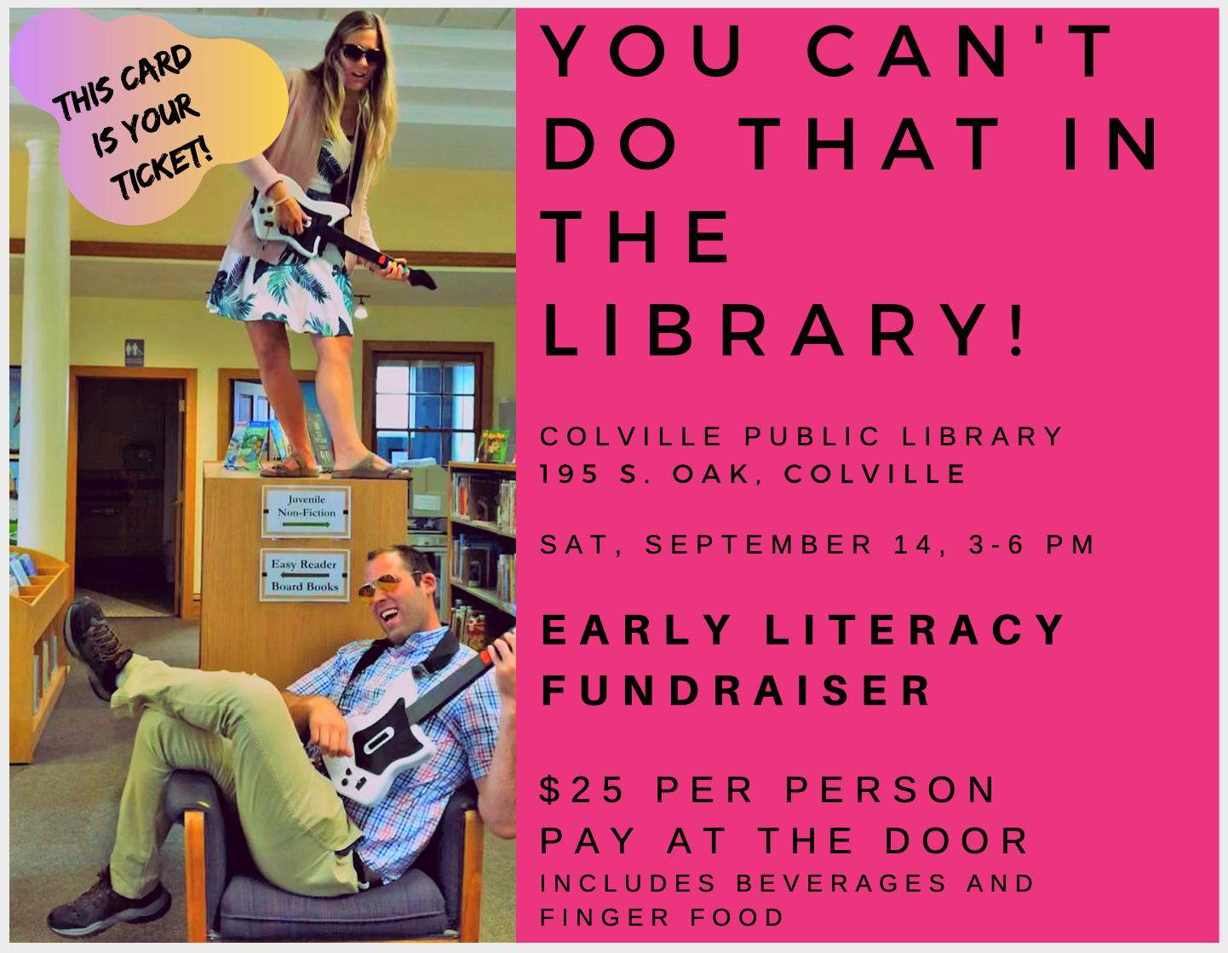
Local Support
Where does the money come from?
Rotary Club of Colville
District 5080 Matching Grant
Kettle Falls Rotary Club
Providence Hospital
Libraries of Stevens County Foundation
Colville School District
John Ochs-Steve Cox Memorial Fund
Individual Donations

Slide 14
https://imaginationlibrary.com/bos/united-states/main.php

Slide 15
Questions?

