Slide 2
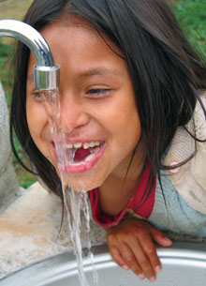
If
“If you don’t like the way the world is, change it.
You have an obligation to change it. You just do it one step at a time.”
-- Martin Wright Edelman

Slide 3
Donations to The Rotary Foundation (TRF) are made by individuals, Rotarians or not.

Slide 4
At the time of the donation, the donor can specify that his/her money is to be used for a specific program, like PolioPlus, or a Global Grant. This is called Restricted Giving. Note that the Global Grant must be approved prior to sending the money, and the grant number must be specified on the donation form.

Slide 5
The donor can also specify that his/her money will go to the Endowment Fund, i.e. the money will be kept indefinitely by The Rotary Foundation, and only the earnings from the money will be spent on Foundation Programs.

Slide 6
If the donor does not specify what his/her money is to be used for, this is called Annual Giving or Annual Fund giving . The money is kept by The Rotary Foundation for 3 years with the earnings being used by The Rotary Foundation (TRF) for operating expenses. Note that the donor gets Paul Harris Credit recognition for donations to Restricted Giving, and to Annual Giving, but not to the Endowment Fund.

Slide 7
After 3 years, the money goes 50% to the World Fund, and 50% back to the District of the donor, as District Designated Funds (DDF).

Slide 8
100% of the earnings from the Endowment Fund will go to the World Fund unless the donor specifies that the interest on his/her donation goes to SHARE and is therefore split between the World Fund and District Designated Funds (DDF).

Slide 9
The World Fund is used by The Rotary Foundation (TRF) to fund programs like PolioPlus and the matching portion of Global Grants.

Slide 10
Funds that come back to the District as District Designated Funds (DDF), can be spent on many Foundation Programs like PolioPlus, Global Grants, and District Grants. The District Governor, Foundation Chair, and District SHARE Committee decide on the allocation of funds. Note that the amount of DDF a District gets for a given year depends on the amount of Annual Giving 3 years before.

Slide 12
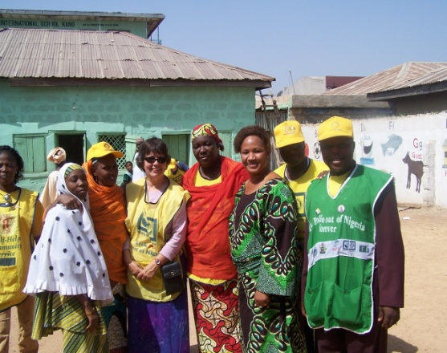
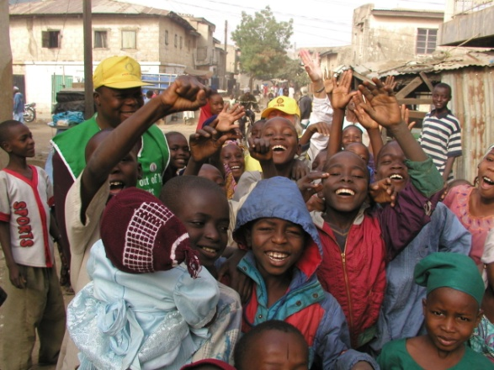
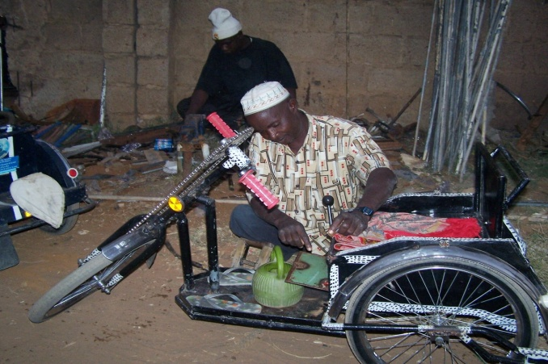
If
Go to the people:
live with them, learn from them,
love them
start with what they know
build with what they have.
But the best leaders,
when the job is done,
the task accomplished,
the people will say:
“We have done it ourselves”
--Lao Tzu

