Slide 1
RC/O [your club]
2019-2020 Club Manual
[your name], President

Slide 2
Table of Contents
1.0 rotary international 1.1 history of rotary international 1.2 what is rotary today 1.3 rotary international ideals 1.4 RI theme 1.5 RI president’s message 1.6 RI presidential citation objectives 1.7 rotary.org & “My Rotary” 1.8 RI branding initiative 1.9 RI convention (2019) 1.10 RI Convention (2020) 2.0 the rotary foundation (“TRF”) 2.1 What is TRF 2.2 TRF and RI areas of focus 2.3 how TRF supports the fight against polio 2.4 TRF SHARE system 2.5 TRF recognition 2.6 TRF is a top rated charity 2.7 TRF ways to give 2.8 TRF donor forms | 3.0 Zone 25/26 3.1 meet our zone 25/26 director 3.2 zone 25/26 map 3.3 zone 25/26 website 4.0 district 5240 4.1 district 5240 theme 4.2 district 5240 map 4.3 district resources – website 4.4 district/regional awards 4.5 district contacts 4.6 district resources – box.com 4.7 practical relevant leadership skills (PRLS) 4.8 rotary youth leadership awards (RYLA) 4.9 district conference 4.10 district training assembly 4.11 STEPS 4.12 foundation gala 4.13 district awards banquet

Slide 3
Table of Contents (cont.)
5.0 Our Club 5.1 president’s message 5.2 your club leadership 5.3 club links 5.4 club’s governing documents 5.5 club budget 5.6 club’s 1-year tactical organizational plan 5.7 club’s 5-year strategic organizational plan 5.8 club awards criteria 5.9 job description – president 5.10 job description – treasurer 5.11 job description – secretary 5.12 job description – committee chairs 5.13 president’s expectations for all directors / chairs 5.14 club service 5.15 international service 5.16 community service 5.17 vocational service 5.18 youth service | 5.19 foundation 5.20 member services 5.21 branding, communications & public image 5.22 membership 5.23 grants 5.24 club equipment assessment 5.25 fundraiser - #1 5.26 fundraiser – #2 5.27 fundraiser – #3 5.28 important club dates

Slide 4
1.0 Rotary International (“RI”)

Slide 5
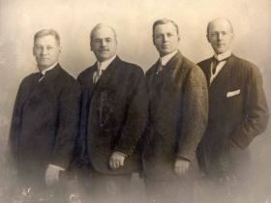
1.1 History of Rotary International
The first four Rotarians (from left): Gustavus Loehr, Silvester Schiele, Hiram Shorey, and Paul P. Harris, circa 1905-12. | Paul P. Harris, an attorney, wanted to create a professional group with the same friendly spirit he felt in the small towns of his youth. On 23 February 1905, Harris, Gustavus Loehr, Silvester Schiele, and Hiram Shorey gathered at Loehr’s office in Room 711 of the Unity Building in downtown Chicago. This was the first Rotary club meeting. They decided to call the new club “Rotary” after the practice of rotating meeting locations. Within five years clubs had formed across the country, from San Francisco to New York. In August 1910, Rotarians held their first convention in Chicago. The 16 clubs that existed at that time united to form the National Association of Rotary Clubs. In 1912, the name changed to International Association of Rotary Clubs to reflect the addition of clubs in other countries. The name Rotary International was adopted in 1922. By July 1925, Rotary had grown to more than 2,000 clubs and an estimated 108,000 members on six continents. Rotary’s reputation attracted presidents, prime ministers, and a host of other luminaries to its ranks — among them author Thomas Mann, diplomat Carlos P. Romulo, and composer Jean Sibelius. As Rotary grew, members pooled their resources and used their talents to serve their communities. The organization's dedication to this ideal is best expressed in its motto: Service Above Self.

Slide 6
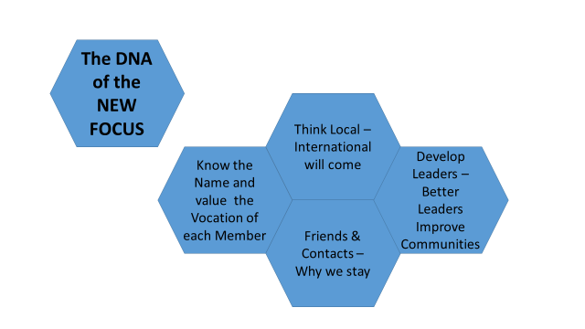
1.2 What is Rotary Today
It's a leadership organization... We're made up of local business, professional and civic leaders. We meet regularly, get to know each other, form friendships, and through that, we're able to get things done in this community.

Slide 7
1.3 Rotary International Ideals
four-way test | object of rotary
In 1932, Rotarian Herbert J. Taylor created The Four-Way Test. The test, which has been translated into more than 100 languages, asks the following questions: Of the things we think, say or do: Is it the TRUTH? Is it FAIR to all concerned? Will it build GOODWILL and BETTER FRIENDSHIPS? Will it be BENEFICIAL to all concerned? | The Object of Rotary is to encourage and foster the ideal of service as a basis of worthy enterprise and, in particular, to encourage and foster: FIRST: The development of acquaintance as an opportunity for service; SECOND: High ethical standards in business and professions; the recognition of the worthiness of all useful occupations; and the dignifying of each Rotarian’s occupation as an opportunity to serve society; THIRD: The application of the ideal of service in each Rotarian’s personal, business, and community life; FOURTH: The advancement of international understanding, goodwill, and peace through a world fellowship of business and professional persons united in the ideal of service.

Slide 8

1.4 RI Theme (2019 – 2020)
RI President-elect Mark Daniel Maloney’s theme for 2019-20, Rotary Connects the World, asks Rotarians to strengthen the many ways that Rotary Connects the World, building the connections that allow talented, thoughtful, and generous people to unite and take meaningful action through Rotary service.

Slide 9
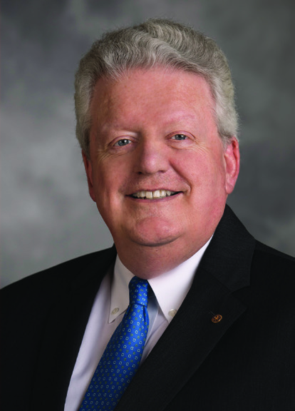
1.5 RI President’s Message
Rotary is built on connection. When Paul Harris came to Chicago as a young lawyer, he formed Rotary for one compelling reason: to help him connect to others in a new city. More than a century later, we have at our disposal countless ways to form friendships and networks, most of which Paul Harris never dreamed. Yet Rotary’s ability to connect us remains unique — and unrivaled. Through its distinct mission and structure, Rotary International provides a way to connect to our communities, to network professionally, and to build strong and lasting relationships. Our membership connects us to a global community through our countless projects and programs, our leadership in polio eradication, and our work with and through the United Nations. Our service connects us to people who share our values, who want to take action for a better world; it connects us to people we would never otherwise meet, who are more like us than we could have imagined; and it connects us to people Together, we see a world where people unite and take action to create lasting change — across the globe, in our communities, and in ourselves who need our help, allowing us to change lives in communities around the world. As a new decade begins, we are shaping Rotary’s future. In 2019-2020, Rotary will implement its new strategic plan, respond to the innovation of the Council on Legislation, and serve in our revitalized areas of focus. But the real work of shaping Rotary’s future lies in our clubs, where our organization must do the most to adapt to today’s changing realities. While the club remains the core of the Rotary experience, we are now far more creative and flexible in deciding what a club can be, how it can meet, and even what can be considered a Rotary meeting. We need to be organized, strategic, and innovative in how we approach membership, forging wider and deeper connections to our communities and forming new club models to attract and engage more — and more diverse — members. Rotary is indeed a family. Yet too often, the structure of membership or the demands of leadership seem to place Rotary out of reach for today’s younger professionals. Rotary can and should be an experience that complements our families instead of competing with them. When our Rotary clubs are warm, welcoming places where service and family go hand in hand, we give family-oriented young professionals the opportunity to embrace Rotary service and model positive civic engagement. And when we make the expectations of Rotary offices realistic and manageable for busy professionals, we develop the skills and networks of a new generation of Rotarians — who will become Rotary leaders. In 2019-2020, it will be our challenge to strengthen the many ways that Rotary Connects the World, building the connections that allow talented, thoughtful, and generous people to unite and take meaningful action through Rotary service. Sincerely, Mark Daniel Maloney President, Rotary International, 2019-2020

Slide 10
1.6 RI Presidential Citation Objectives
The Rotary Citation recognizes Rotary clubs that support our strategic priorities by completing certain activities. Clubs have the entire Rotary year to achieve the citation’s goals. Rotary can automatically verify many of your club’s achievements as long as you keep your club and member information up-to-date in My Rotary. To be eligible for the Rotary Citation, clubs need to begin the year as active clubs that are in good standing and remain so throughout the year. Achievements will be compared with membership figures from 1 July 2019 and will be recognized after the 1 July 2020 numbers are final, on 15 August 2020. UNITE PEOPLE Achieve at least 5 of the following goals: ◻ Appoint an active club membership committee comprised of no less than five members and report the chair to Rotary International ◻ Achieve a net gain in membership ◻ Maintain or improve your club’s retention of current and new members: ◻ Improve your club’s retention rate by 1 percentage point or ◻ If your club’s retention rate was 90 percent or more in 2018-2019, maintain it ◻ Achieve a net gain in female members or members under the age of 40 ◻ Conduct a study of your members’ occupations, and work to align your membership with the mix of businesses and professions in your community ◻ Sponsor or co-sponsor a new Rotary club or Rotary Community Corps ◻ Sponsor or co-sponsor an Interact or Rotaract club ◻ Host an event for Rotary alumni, and highlight Rotary’s networking opportunities ◻ Sponsor a Youth Exchange student or RYLA participant | TAKE ACTION Achieve at least 5 of the following goals: ◻ Appoint an active club Foundation committee comprised of no less than five members and report the chair to Rotary International ◻ Increase the number of members involved in service projects Contribute at least $100 per capita to the Annual Fund of The Rotary Foundation Hold an event to raise funds for, or to increase awareness of,Rotary’s work toward polio eradication ◻ Conduct a significant local or international service project in one of Rotary’s six areas of focus Post successful club projects, with details about activities, volunteer hours, and funds raised, on Rotary.org Continue or establish a partnership with a corporate, governmental, or nongovernmental entity and work on a project together Use Rotary’s brand guidelines, templates, People of Action campaign materials, and related resources Arrange for the club’s members to talk with the media to tell your club’s and Rotary’s story

Slide 11
1.6 (cont.) RI Presidential Citation With Distinction Objectives
This year, clubs can receive the Rotary Citation with Presidential Distinction when they achieve the Rotary Citation plus one to three additional goals. FOR ROTARY CLUBS Achieve these goals in addition to earning the Rotary Citation to receive SILVER (1 goal), GOLD (2 goals), or PLATINUM (3 goals) distinction ◻ Connect leaders. Achieve a net gain of five or more members ◻ Connect families. Organize a family-oriented service project that connects families of your members, youth program participants, and others ◻ Connect professionally. Initiate or continue a leadership, personal, or professional development program to enhance members’ skills ◻ Connect community. Show how your club’s members are People of Action by promoting your club and its service activities on social media at least four times per month

Slide 12



1.7 rotary.org & “My Rotary”
https://www.rotary.org/
My Rotary is a “one stop shop” for a wealth of information for you as a member and leader of your Club.
Step 1: create an account
https://www.rotary.org/en → My Rotary → Sign In / Register → Create Account (requires your RI member number which is located within the address label on your Rotarian Magazine or may be obtained from your club secretary)
Step 2: explore
Exchange Ideas: join/create a discussion group with other Rotarians around the world; search for other Rotarians; get the latest information on Rotary International events; connect with other clubs
Take Action: find innovative tools, information, and ideas to start a service project; search projects of other clubs (“Rotary Showcase”); learn about the various grants available to you; join action groups
Learning & Reference: visit the Learning Center to browse articles and documents covering everything Rotary from its history to the latest tips on how be an engaged member
Manage: manage and view reports concerning your personal account or your club; access marketing materials; create conforming Rotary logos
The Rotary Foundation: learn about TRF; make direct donations; access forms to transfer recognition reports
AND MUCH MORE.

Slide 13
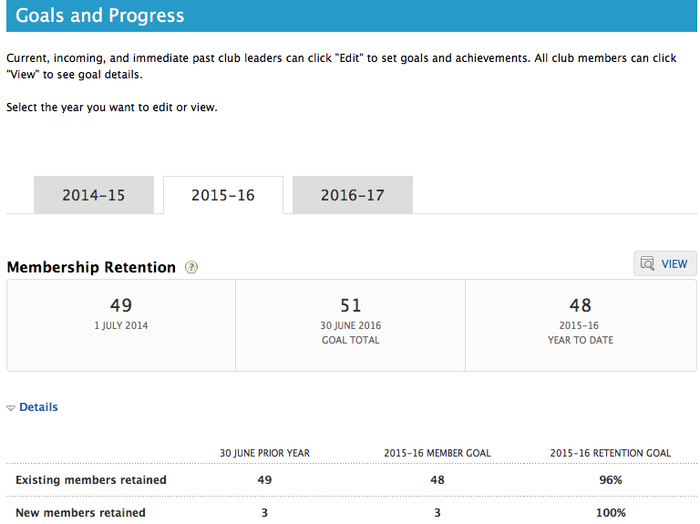
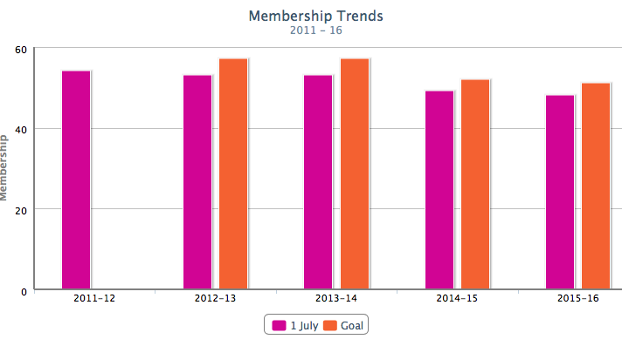
1.7 (cont.) rotary.org & “My Rotary” (cont.)
PERSONAL PROFILE ADMIN.
https://www.rotary.org/en → My Rotary
View and edit your personal profile including your picture, contact information, professional & personal bios.
View your personal Rotary resume including TRF and new member sponsor achievements.
ACCESS MAY BE LIMITED BY CLUB ROLE
View and edit your club’s finances including the invoice and balance report.
View and edit club/member data including adding, removing and editing members and officers; recording new member sponsors; updating meeting information; entering and tracking potential new member leads.
Delegate your club roles and related website access: In order to do this place the cursor over your name at the top of the webpage. A drop down menu will appear with an option for “Delegation”. Click on this option to view and delegate your roles to another club member.
CLUB ADMINISTRATION
https://www.rotary.org/en → My Rotary → Manage → Club Administration
ACCESS MAY BE LIMITED BY CLUB ROLE
View and/or edit your club’s membership statistics including 5-year membership trends; gender and age trends; membership related goals.
View and/or edit your club’s service statistics including cumulative hours and dollars spent on projects; a listing of your club’s service project; tracking presidential citation goals.
View and/or edit your club’s TRF statistics including 5-year TRF giving; TRF related goals; per capita giving; Annual Fund and PolioPlus giving.
View personal and/or club reports including donor history; club recognition summary; and more. Go to https://www.rotary.org/en → My Rotary → Manage → Rotary Club Central → Reports
ROTARY CLUB CENTRAL
https://www.rotary.org/en → My Rotary → Manage → Rotary Club Central

Slide 14
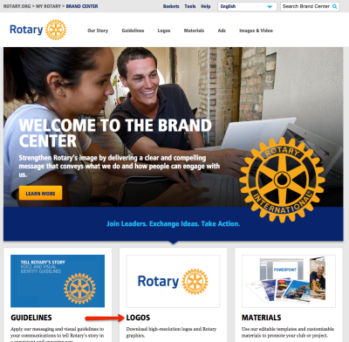
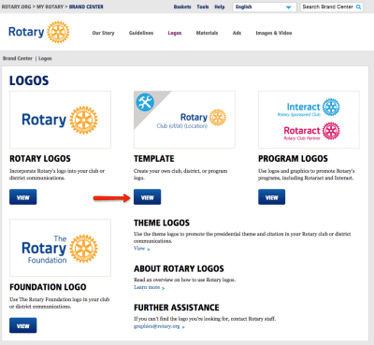

1.8 RI Branding Initiative
Help protect our brand by following the guidelines provided to you and your clubs.
https://brandcenter.rotary.org/en-GB

Slide 15


1.9 RI convention (2019)
June 1 - 5, 2019
http://www.riconvention.org/en/hamburg

Slide 16

1.10 RI convention (2020)
Honolulu, Hawaii USA June 6 - 10, 2020

Slide 17
2.0 The Rotary Foundation (“TRF”)

Slide 18


2.1 What is TRF
https://www.rotary.org/myrotary/en/rotary-foundation
The Rotary Foundation transforms your gifts into projects that change lives both close to home and around the world. As the charitable arm of Rotary, we tap into a global network of Rotarians who invest their time, money, and expertise into our priorities, such as eradicating polio and promoting peace. Foundation grants empower Rotarians to approach challenges such as poverty, illiteracy, and malnutrition with sustainable solutions that leave a lasting impact.
The Foundation was created in 1917 by Rotary International's sixth president, Arch C. Klumph, as an endowment fund for Rotary "to do good in the world." It has grown from an initial contribution of US$26.50 to more than $3 billion spent on life-changing, sustainable projects.
The mission of The Rotary Foundation of Rotary International is to enable Rotarians to advance world understanding, goodwill, and peace through the improvement of health, the support of education, and the alleviation of poverty.

Slide 19






2.2 TRF and RI Areas of Focus
We direct our efforts in six areas to enhance our local and global impact. Our most successful and sustainable projects and activities tend to fall within these areas.
Promoting Peace
Fighting Disease
Providing Clean Water
Saving Mothers and Children
Supporting Education
Growing Local Economies

Slide 20
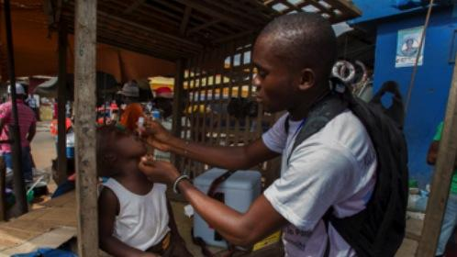

2.3 How TRF Supports the Fight Against Polio
DDF
World Fund
    District Designated Funds directly to Polio
    2 to 1 match by Bill & Melinda Gates Foundation
    World Fund support and matches

Slide 21
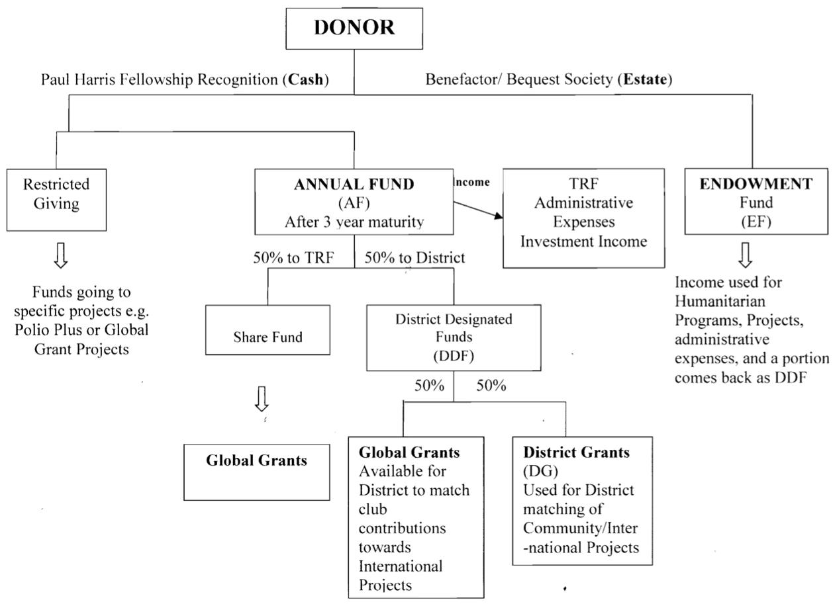
2.4 TRF SHARE System
NOTE:
Make your tax deductible charitable donations go farther by giving to TRF (AF). For every $1 you give to TRF, nearly $0.25 will come back to your club in the form of District Grants to be used for your club’s specific grant projects. This is in addition to the 3 years interest bearing benefits to TRF and supporting Global Grants.

Slide 22
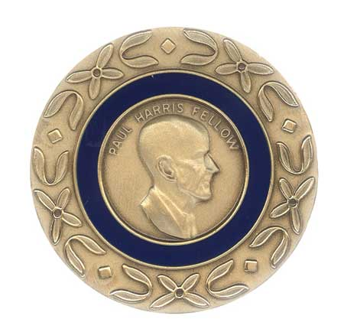
2.5 TRF Recognition
Every Rotarian Every Year - $25+/year
Sustaining Member - $100+/year
Double Sustaining Member - $200+/year
Paul Harris Fellow - $1,000 or 1,000 pts. (up to PHF+8 total) (both earned and donated points apply)
Paul Harris Society - $1,000+/year
Major Donor - $10,000+
(only actual monetary contributions apply)
Arch Klumph Society - $250,000+
Benefactor - $1,000+ in Will/Trust
Bequest Society - $10,000+ in Will/Trust
NOTE:
For every dollar you give to TRF, you get one (1) TRF Recognition point applied towards your own recognition milestones and one (1) additional TRF Recognition point to donate to someone else towards Paul Harris Fellow recognition of the recipient.

Slide 23
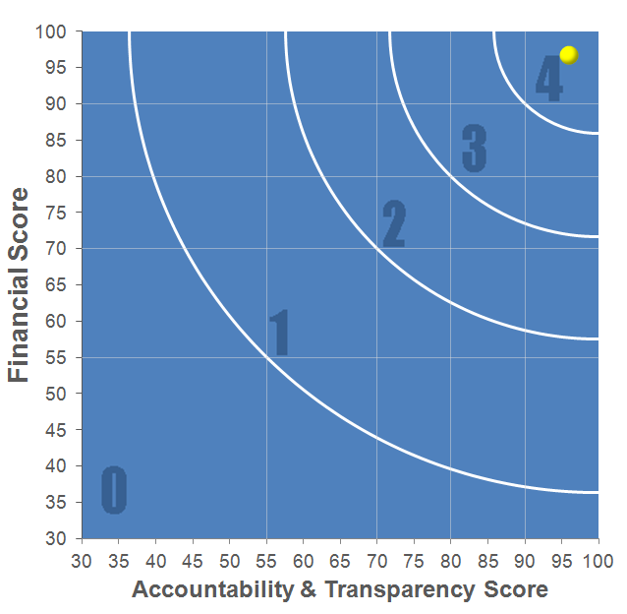
2.6 TRF is a Top Rated Charity!
According to CharityNavigator.org (an organization that rates charities by evaluating their financial health and accountability), The Rotary Foundation is a 4 (out of 4) Star Charity. It’s highest rating. The Rotary Foundation is also found on Charity Navigator’s “10 of the Best Charities Everyone’s Heard of” list.

Slide 24


2.7 TRF Ways to Give
DONOR ADVISED FUNDS
SECURITIES
PLANNED GIVING
NAMED GIFT
REAL ESTATE
AIRLINE MILES
RECURRING GIVING (ROTARY DIRECT)
ROTARY CREDIT CARD
PERSONAL PROPERTY
EMPLOYEE MATCHING GIFT
CHECK, DRAFT, OR WIRE PAYMENTS
https://www.rotary.org/myrotary/en/take-action/give/ways-give

Slide 25
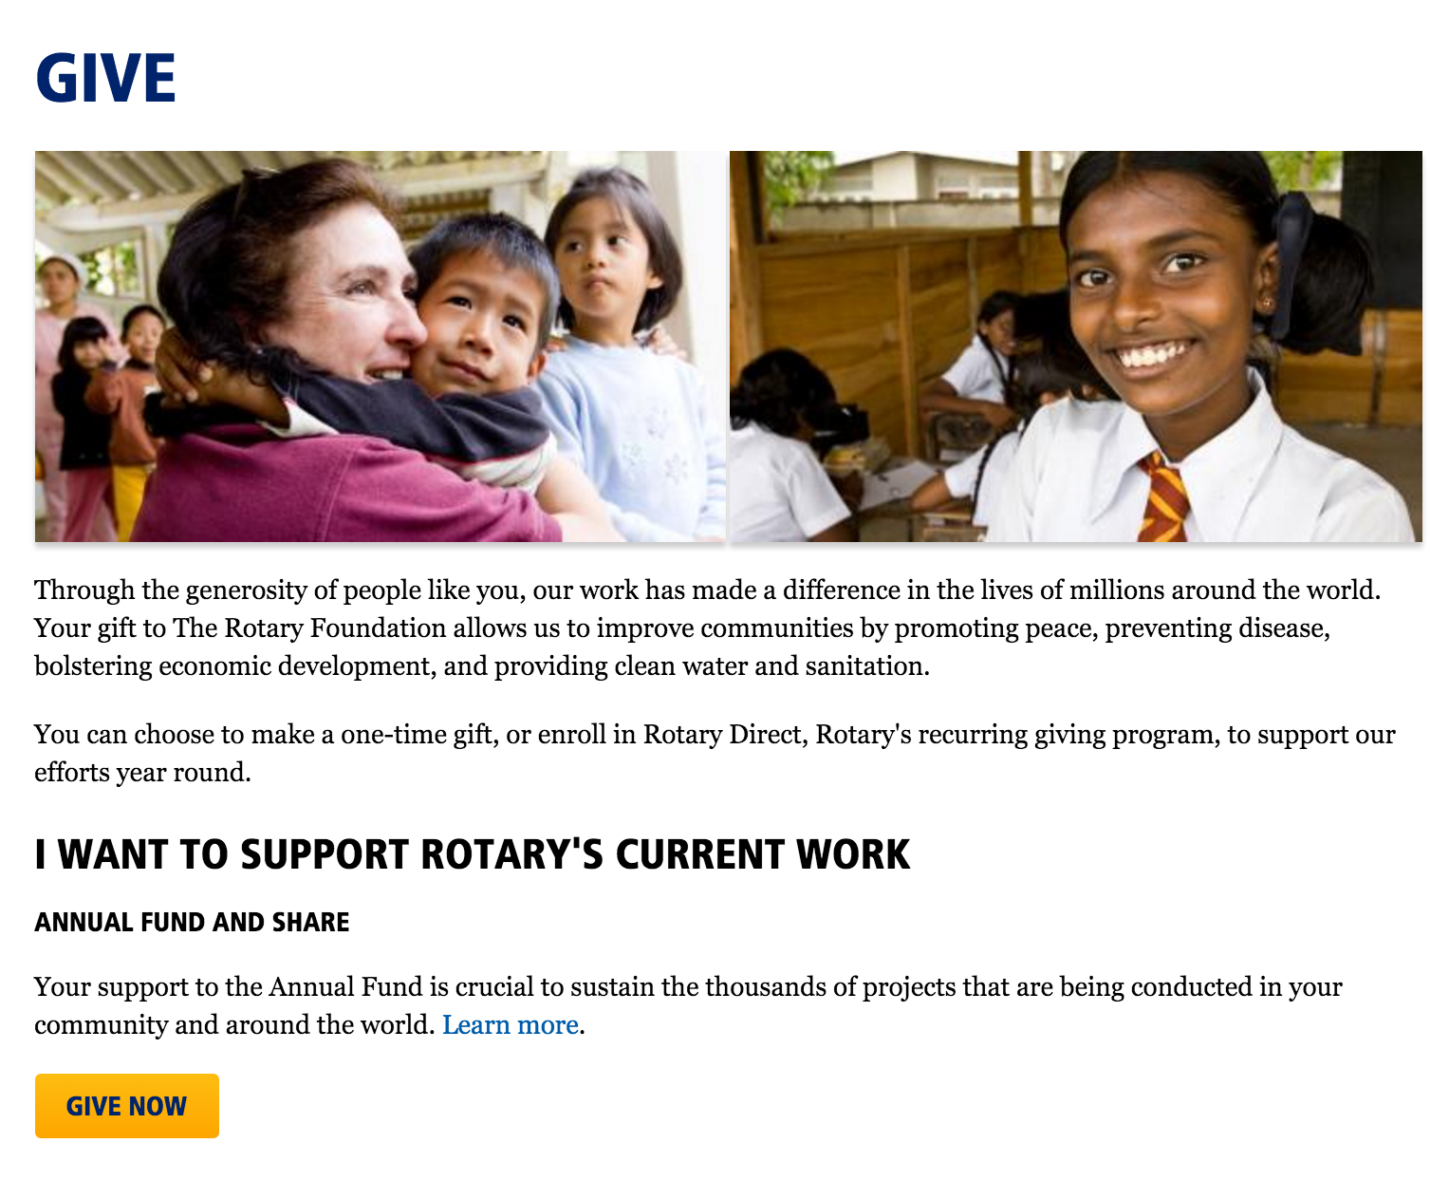
2.8 TRF Donor Forms
https://www.rotary.org/myrotary/en/take-action/give

Slide 26
3.0 Zone 25/26

Slide 27
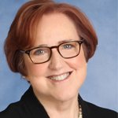
3.1 Meet Our Zone 25/26 Director
A Rotarian since 1993, Johrita is currently a proud member of the Rotary Club of Anaheim, California. She served as District Governor for District 5320 in 2010-11 and has been selected to serve as the Rotary International Director for Zones 26/27 (formerly 25/26) for the years 2019-21.
As District Governor, Johrita held the first District 5320 Million Dollar Dinner for The Rotary Foundation. Under her leadership, District 5320 became the second district in the world to become a 100% Paul Harris Club District.
Johrita is Co-Founder and Chief Visionary Officer of Solari Enterprises, Inc., a full-service property management company employing 300 team members who specialize in the management of more than $1B of affordable multifamily housing. She works together with her husband and daughters to create a working environment with a high level of ethics and integrity. She has served in many capacities on community and industry boards.
Rotary plays an important role in the Solaris’ lives. Johrita, her husband Bruce, and their two daughters, Gianna and Tressa, are all past club presidents and active supporters of The Rotary Foundation. Johrita served as chair for the 2013 Southern California/Nevada PETS and was a training leader at the 2014 and 2015 International Assemblies. She also chaired the 2015 Rotary Institute for Zones 25/26. She is currently a member of Rotary’s Peace Major Gifts Initiative Committee.
Johrita and Bruce are Paul Harris Fellows, Major Donors, and members of the Arch Klumph Society.
They live in Villa Park, California, U.S.A.
RI Director 2019-2021 Johrita Solari
http://zone2526.org/

Slide 28
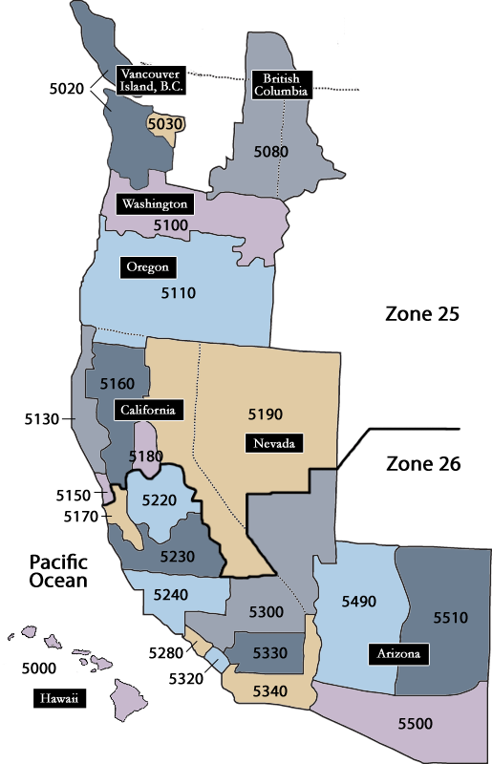
3.2 Zone 25/26 Map
60,000 Members
1,300 Clubs
23 Districts

Slide 29
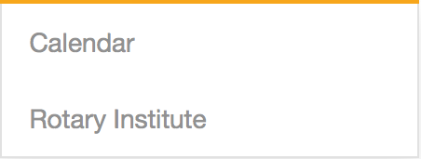

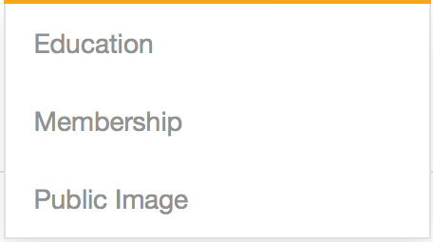
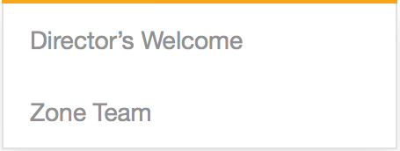
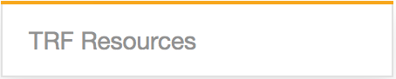
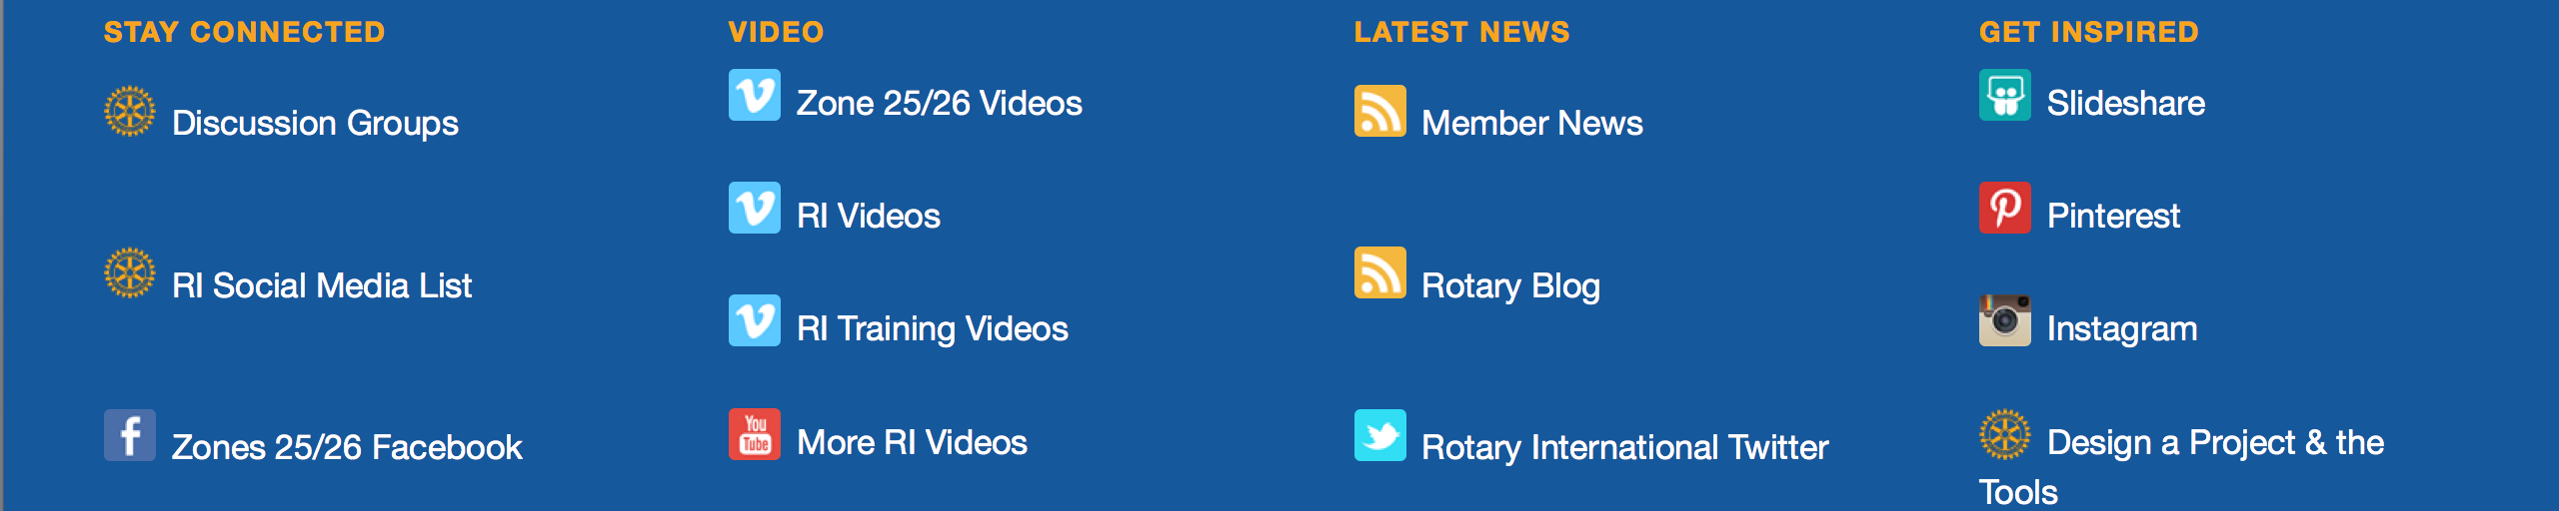
3.3 Zone 25/26 Website
http://www.zone2526.org/
Tons of resources and information at your finger tips.

Slide 30
4.0 District 5240

Slide 31
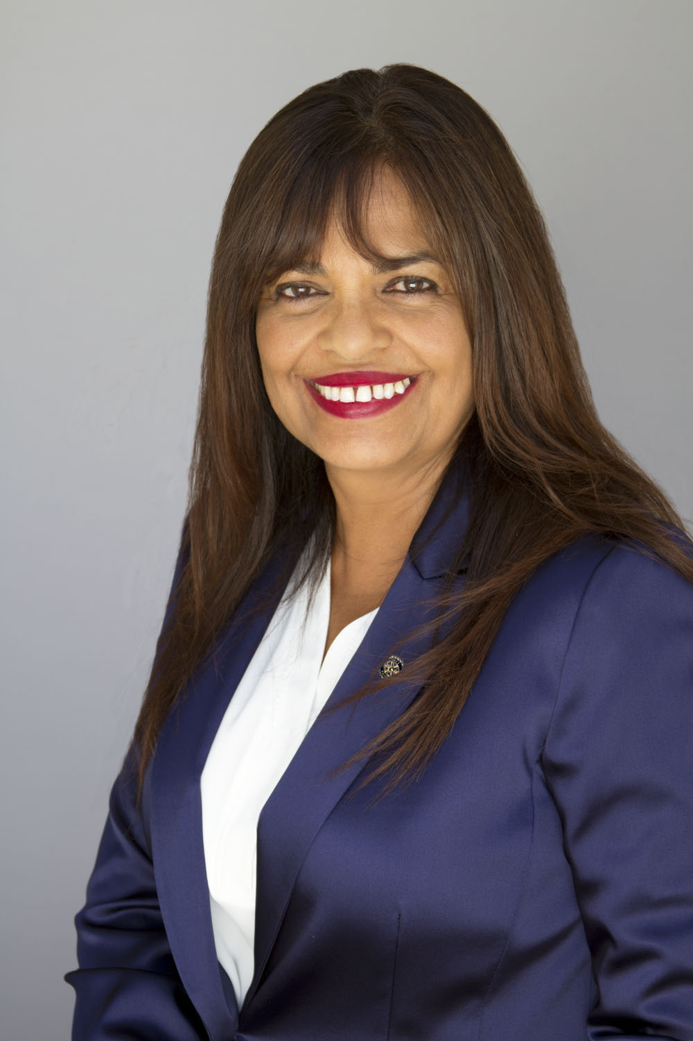

4.1 District 5240 Theme (RY 2016-2017)
Savi Bhim

Slide 32

4.2 District 5240 Map

Slide 33
4.3 District Resources - Website
http://www.rotarydistrict5240.org/
The District 5240 website requires a login to gain full access. To register online go to: http://www.rotarydistrict5240.org/ → Member Login
Homepage: Governor’s monthly message; Quick links to District and District Foundation newsletters, events calendar, stories from around the District; and general District and Rotary International news.
District Tab: Administration → District staff contact information; Past and present District financial records and forms; District and Rotary International legal documents. Avenues of Service. Education and Training. Foundation and Grants. Peace Page. Membership and Rention → Lots of tools available. Public Image → create your club logo and promote your club. Rotary Year [YEAR] Information → Information specific to a particular year including important documents such as awards criteria, convention links, reverse calendar, club president roster, and social media links. District Archives.
Links Tab: District Business Newtwroking. PRLS Website. Make Up Meetings Online. RI Zone 25/26. District Conference. Rotary Global Rewards. RYLA. Rose Parade Float. World Peace Conference. Polio Headlines. Rotary International. Rotoract Info. PETS.
Events Tab: District Events Calendar → District Want to see which amazing District and Club events are coming up? How about leadership and training seminars? Then check out the Events Calendar. Governnor’s Visit Calendar. Important Dates.

Slide 34
4.4 District/Regional Awards
A great way to engage, guide, motivate, and recognize your Rotary Club and its members is through the “2019-2020 District/Regional Rotary Awards Program” (“District Awards”). The District Awards are strategic tool to drive your Rotary Club to the next level and impact positive change, which if accomplished will result in due recognition for your Rotary Club. Making regular progress on the awards criteria will help build pride in your Rotary Club and public awareness of Rotary service in your community. Update the awards information as you accomplish criteria and share your accomplishments with your Rotary Club and with your community.
The District Awards are based on your Rotary Club’s April 15, 2020 submission on the following pre-determined individual key performance areas:
1) Club Service; 2) Community Service; 3) International Service; 4) Vocational Service; 5) Youth
Service; 6) Membership; 7) Foundation; and 8) Branding.
District Awards will first be awarded in May 2020 to the top performing small (1-35), medium (36-70), and large (71+) size club (as reported to Rotary International on July 1, 2019) in each of the eight categories listed above within each Rotary Club’s predesignated Region (i.e., Region 1, 2, 3 or 4). In addition, your Rotary Club will qualify for a Bronze, Silver, or Gold award based on successful completion of 6-of-8, 7-of-8, or 8-of-8, respectively, of the individual key performance areas.
Those Rotary Clubs receiving a Regional award will then be eligible for a Districtwide award under the same category to be awarded in June 2020. Only those Rotary Clubs receiving a Gold award (i.e., qualifying in each of the eight key performance areas) will be eligible for the District’s best club award for the top performing small, medium, large, and overall Rotary Club.
View the District Awards criteria here (left side of the webpage under 2019-2020 INFORMATION):
https://rotarydistrict5240.org/sitepage/rotary-year-2019-20-information

Slide 35
4.5 District Contacts
Have a Rotary or District question, but not sure who to ask? Need a Rotary related program or speaker?
Refer to the online District 5240 organizational chart to identify the right person and their direct contact information.
View the Organizational Chart here:
https://rotarydistrict5240.org/DistrictOrganizationChart/2019

Slide 36


4.6 District Resources – Box.Com
Browse documents or use links emailed to you by District 5240 to access a comprehensive collection of relevant documents.
View the District Box.com information here:
https://rotary5240.app.box.com/s/ia2kmall0n8tahghzoy9e1nxa0exz5x5

Slide 37
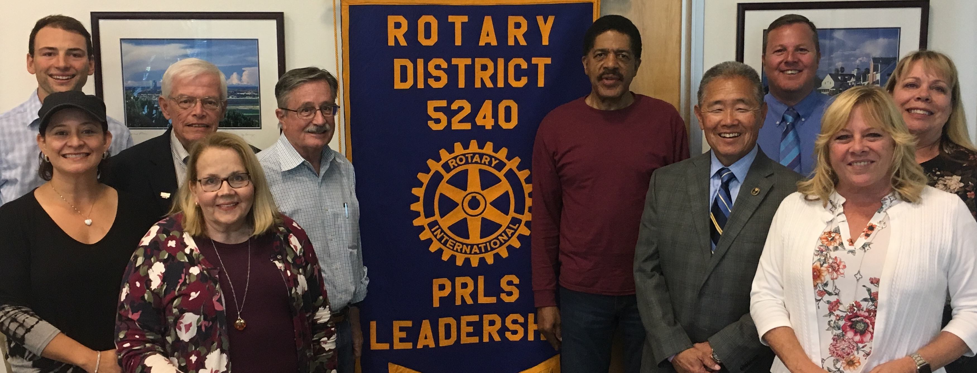
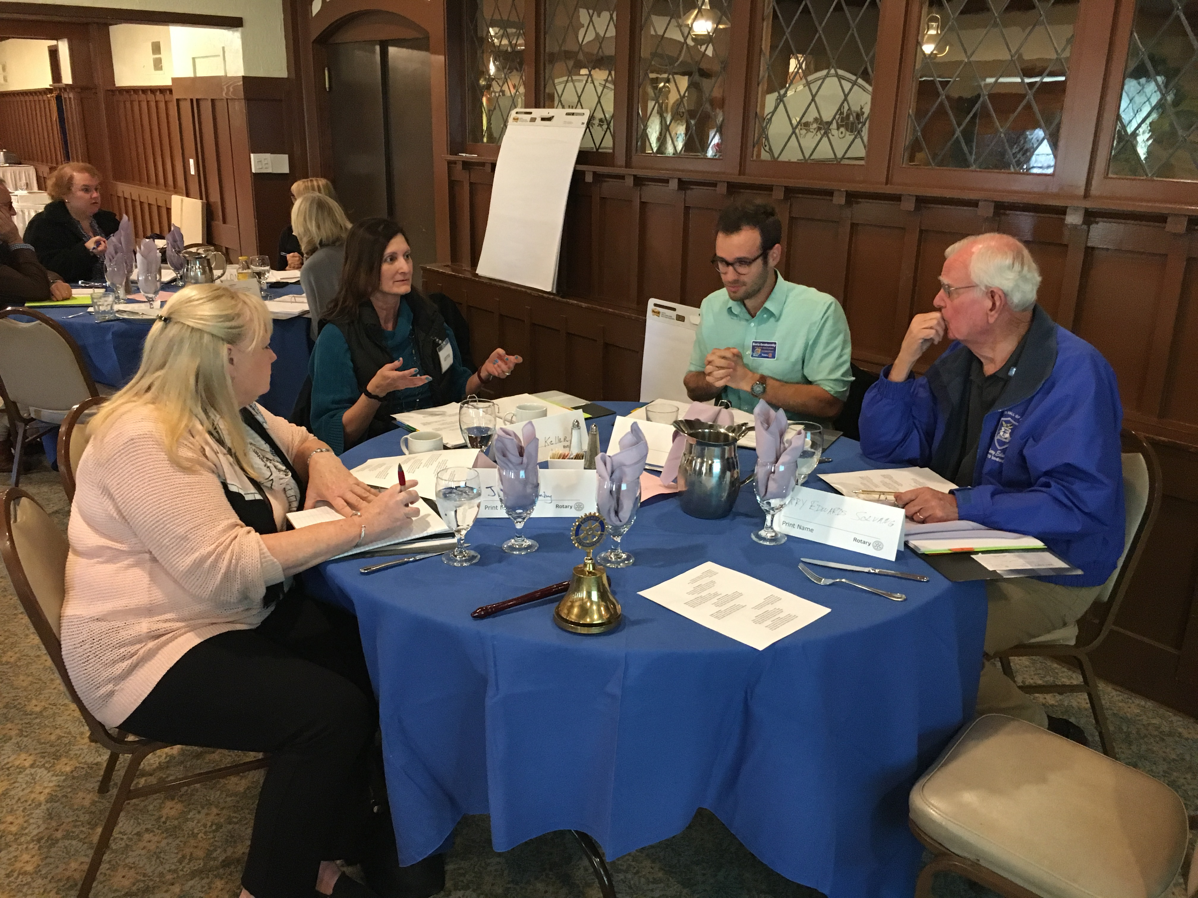
4.7 Practical Relevant Leadership Skills (PRLS)
The goal of PRLS, begun in 1993, is to provide a set of training sessions wherein current and future Rotary leaders could learn to become more effective in their leadership roles. Basic PRLS has been renamed Intro to Rotary and consists of a half day with 3 modules: Rotary Then and Now, Leadership and Leading a Meeting and Communications and Speaking in Public. This program was specifically developed to train individuals whose goals include a future leadership position in Rotary. They learn skills that will make them more effective in that role. The subsequent sessions are carefully designed to improve individual leadership skills that are broad based and not just Rotary- specific. Participants have found substantial value in the many practical applications of information presented throughout the curriculum. The program's blend of curricular theory and practical application skills helps prepare students for success in any leadership role. The PRLS program offers practical training in professional circumstances that can benefit anyone on both a personal and professional level.
http://rotarydistrict5240.org/SitePage/prls

Slide 38

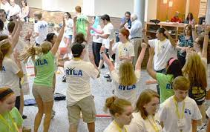
4.8 Rotary Youth Leadership Awards (RYLA)
Each year, thousands of young people take part in the Rotary Youth Leadership Awards (RYLA) program worldwide. Young people are chosen for their leadership potential to attend an all-expenses-paid camp to discuss leadership skills and to learn those skills through practice. Rotary clubs and districts select participants and facilitate the event's curriculum.
RYLA aims to:
Provide an effective training experience for selected youth and potential leaders;
Encourage leadership of youth by youth;
Encourage youth to make a difference in their communities through volunteer work and social responsibility; and
Demonstrate Rotary's respect and concern for youth.
RYLA was officially adopted by Rotary International in 1971, and is one of the most significant and fastest-growing programs of Rotary service. RYLA programs often lead to the formation or strengthening of Rotaract and Interact clubs. RYLA participants often go on to become Youth Exchange students or Ambassadorial Scholars. For more information about RYLA in your area, contact your local Rotary club or your district RYLA chair person. More information is available at the Rotary International website.
http://www.ryla5240.org/

Slide 39
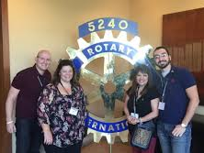
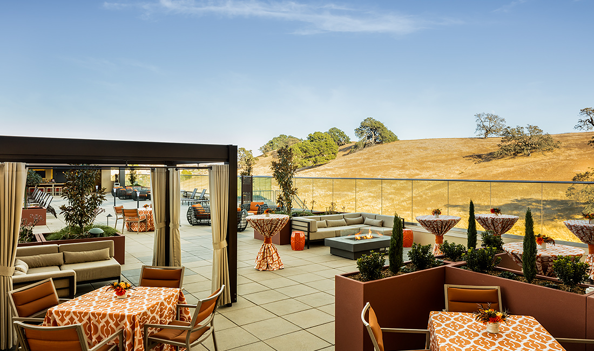

4.9 District Conference
October 12, 2019
Chumash Casino Resort, Santa Ynez CA
The purpose of the District Conference is to provide opportunities for networking, inspirational addresses, and discussions of Rotary-related matters. The event should recognize the service programs, projects, and public relations achievements in the district in order to inspire Rotarians to become more involved in service. The conference should also give Rotarians and clubs a vision of Rotary beyond the club level and provide a memorable fellowship experience. Many Rotarians have said that they were never truly enthusiastic about Rotary until they saw an inspirational presentation at a district conference.

Slide 40

4.10 District Training Assembly
Date:
Location:
Because clubs change leadership each Rotary year, preparing these leaders for their year of service is essential to your club’s and Rotary’s future. The District Training Assembly is an annual event hosted by District 5240 to ensure your club leaders have the knowledge and skills necessary to carry out their responsibilities and that all Rotarians are up-to-date on Rotary. Typically a half-day event, specialized courses and instruction will be provided for nearly every position of leadership as well as general education programs for new Rotarians. This event offers members the capacity to network, learn and share their ideas.

Slide 41

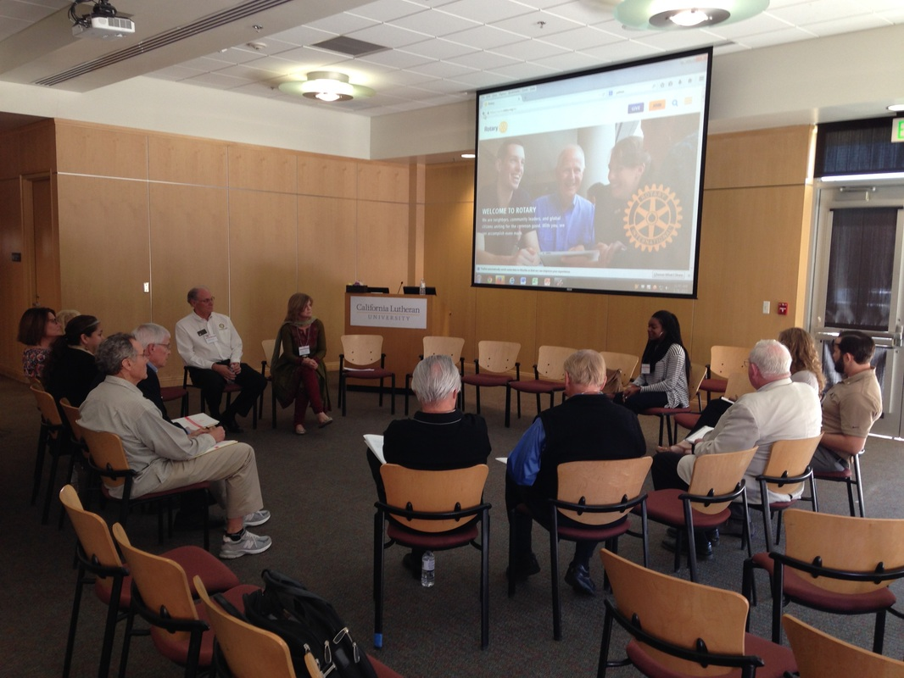
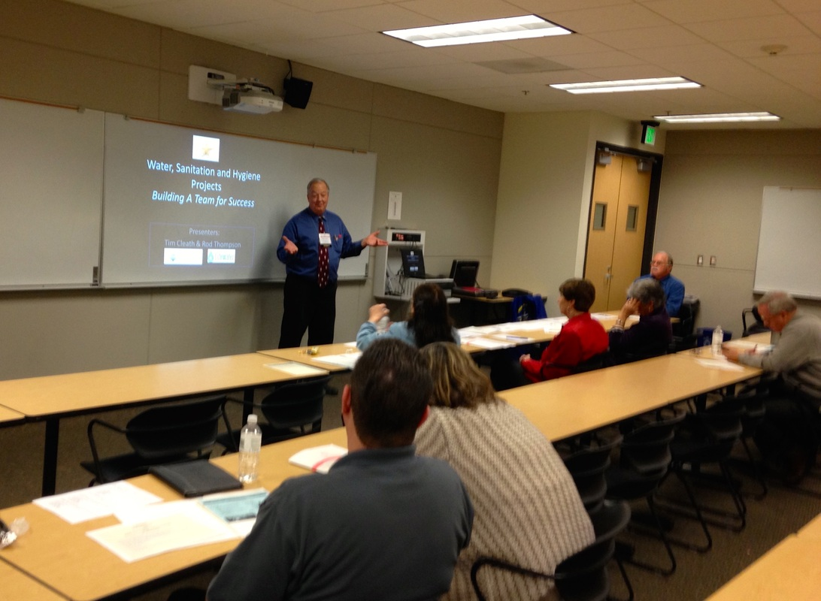
4.11 STEPS
Date:
Location:
The Symposium to Eliminate Poverty Sustainably (STEPS) is a conference focused on successful, sustainable local projects benefiting members of our own communities, with financial help from international partnerships and the Rotary Foundation. This cutting edge day will provide you the tools and connections for starting new projects and partnerships both in your own back yard and globally. Our Keynote speakers will inspire you to discover terrific opportunities to break the cycles of poverty (economic, educational, health…) in our own communities. Our breakout speakers will emphasize the importance of needs assessment, the planning process, and discuss proven strategies for successful projects. Attendees will leave with the inspiration and ability to help guide their own Rotary clubs to initiate, plan and implement sustainable community-based projects.

Slide 42

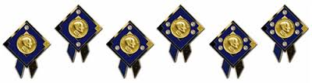

4.12 Foundation Gala
Date:
Location:
It continues to be our District’s tradition to honor and recognize not only our generous donors, but also the many beneficiaries of our gifts to The Rotary Foundation each year. The Foundation Gala is put on each year by District 5240 to do just that. Often featuring phenomenal keynote speakers such as past and future Rotary International Presidents, you will leave this event feeling confident and inspired to continue the great work of The Rotary Foundation.

Slide 43
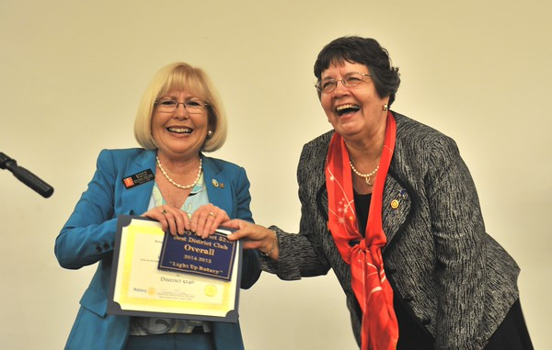
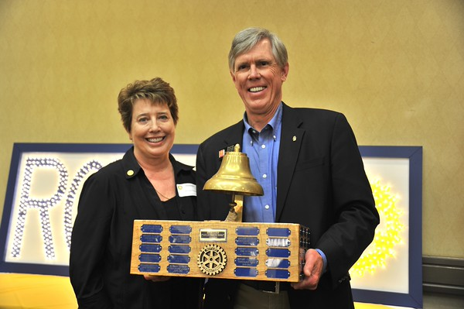
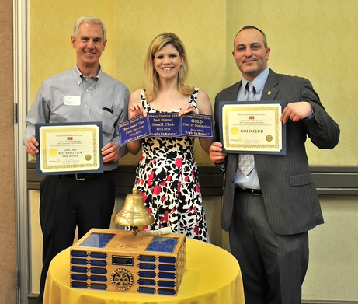
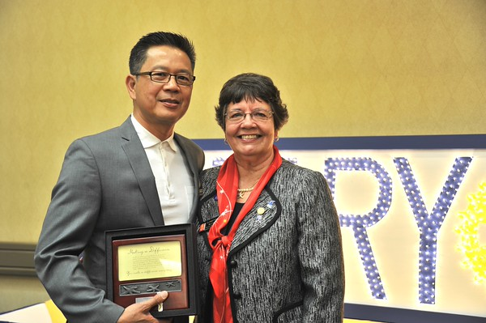
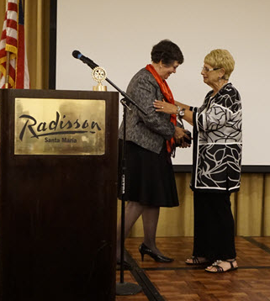
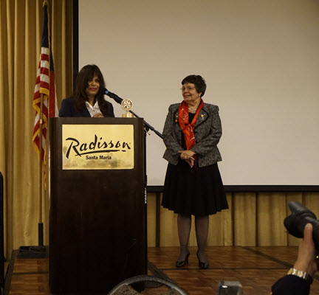
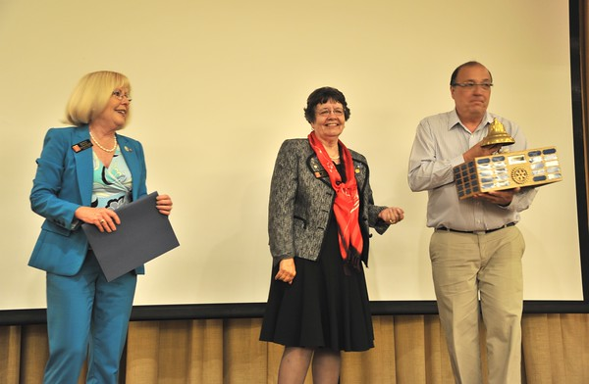
4.13 District Awards Banquet
Date:
Location:
Each year, District 5240 hosts a District Awards Banquet to formally recognize outstanding clubs and individuals from throughout the district. Held towards the end of each Rotary Year, these awards represent a culmination of the clubs’ accomplishments from among the district awards criteria circulated at the beginning of the applicable year. “Best Club” awards are presented to standout clubs from each of the size categories as well as the “Best Overall Club.” Individual awards include: Samuel L. Greene Service Above Self Award; Dr. John Padilla Humanitarian Service Award; Citation for Meritorious Service from The Rotary Foundation; and District Rotarian of the Year. Lastly, this event concludes with the step-down of the current district governor and the passing of the pin to the incoming governor.

Slide 44
5.0 Our Club

Slide 45
5.1 President’s Message
  [THIS PAGE IS RESERVED FOR YOUR PRESIDENT’S MESSAGE; INCLUDE PHOTO OF YOURSELF. SEE RI PRESIDENT, ZONE, AND DG MESSAGES ABOVE FOR EXAMPLES.]

Slide 46
5.2 Your Club Leadership
Officers
President: [NAME]
Vice President: [NAME]
Secretary: [NAME]
Treasurer: [NAME]
Sargent At Arms: [NAME]
[OTHER]: [NAME]
Avenue of Service Directors
Club: [NAME]
International: [NAME]
Community: [NAME]
Vocational: [NAME]
Youth/New Gen.: [NAME]
Other Directors and Chairs
Membership: [NAME]
Communications: [NAME]
Foundation: [NAME]
Programs: [NAME]
Member Services: [NAME]
Grants: [NAME]
Club/Dist. Awards: [NAME]
Public Image: [NAME]
[OTHER]: [NAME]
[OTHER]: [NAME]
[OTHER]: [NAME]
Event Chairs
[EVENT 1]: [NAME]
Co-[EVENT 1]: [NAME]
[EVENT 2]: [NAME]
Co-[EVENT 2]: [NAME]
[EVENT 3]: [NAME]
Co-[EVENT 3]: [NAME]
Past and Future
Immediate Past Pres.: [NAME]
Pres. Elect: [NAME]
Pres. Elect Nominee: [NAME]
Allocations Committee
1: [NAME]
2: [NAME]
3: [NAME]
Club Foundation
1: [NAME]
2: [NAME]
3: [NAME]
According to our Bylaws, we are required to have _____ voting members. The next Board of Directors election will be held on or before: _____________.

Slide 47








5.3 Club Links
[WEBSITE LINK]
  [DESCRIBE FEATURES AND USE OF YOUR CLUB WEBSITE. SEE WEBSITE PAGES FOR RI, ZONE AND DIST. ABOVE FOR EXAMPLES. ALSO PROVIDE INFORMATION ON YOUR OTHER SOCIAL MEDIA ACCOUNTS (E.G. FACEBOOK, TWITTER, ETC.) AND ADD/REMOVE THE ICONS BELOW AS APPROPRIATE. CONSIDER EMBEDDING LIVE LINKS IN THE ICONS BELOW IF YOU PLAN TO DISTRIBUTE THIS MANUAL ELECTRONICALLY.]

Slide 48
5.4 Club’s Governing Documents
  [RESERVED FOR A LINK OR COPY OF YOUR CLUB CONSTITUTION, BYLAWS, CONTINUING RESOLUTIONS, ETC. PROVIDING A COPY OF YOUR THE GOVERNING DOCUMENTS CREATES TRANSPARENCY THAT YOUR MEMBERS WILL APPRECIATE.]

Slide 49
5.5 Club Budget
  [RESERVED FOR A LINK OR COPY OF YOUR CLUB BUDGET. PROVIDING A COPY OF YOUR BUDGET CREATES TRANSPARENCY THAT YOUR MEMBERS WILL APPRECIATE.]

Slide 50
5.6 Club’s 1-Year Tactical Organizational Plan
  [RESERVED FOR A COPY OF YOUR CLUB’S 1-YEAR TACTICAL ORGANIZATIONAL PLAN. PROVIDING A COPY OF YOUR PLAN CREATES TRANSPARENCY THAT YOUR MEMBERS WILL APPRECIATE.]

Slide 51
5.7 Club’s 5-Year Strategic Organizational Plan
  [RESERVED FOR A COPY OF YOUR CLUB’S 5-YEAR STRATEGIC ORGANIZATIONAL PLAN. PROVIDING A COPY OF YOUR PLAN CREATES TRANSPARENCY THAT YOUR MEMBERS WILL APPRECIATE.]

Slide 52
5.8 Club Awards Criteria
  [NAME OF AWARDS CHAIR]
  Distribute club awards criteria to the membership, including the Officers and Directors. Monitor member activities for awards purposes. Collect completed criteria worksheets. Make recommendations on award recipients to the club president. Order awards in a timely manner.
  [RESERVED FOR YOUR CLUB AWARDS CRITERIA. ESTABLISHING AND PUBLISHING YOUR CLUB’S AWARDS CRITERIA AT THE START OF THE RY GIVES MEMBERS FAIR NOTICE ON HOW TO QUALIFY.]

Slide 53
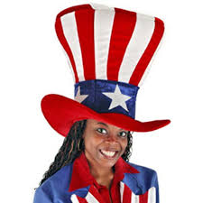
5.9 Job Description - President
https://www.rotary.org/myrotary/en/learning-reference/learn-role/president
As president, you lead and motivate your club, ensuring that club members feel valuable, inspired, and connected to each other.
What you do
Preside over club and board meetings
Appoint committee chairs and members
Conduct club assemblies
Create a budget and manage club finances, including an annual audit
Develop a safe environment for youth participants
Work with your district governor and assistant governor
Assure compliance with Bylaws and Resolutions
TIPS:
Be entertaining and organized
Lead by example
Never lose your cool
Don’t be afraid to ask for help or delegate
Always be prepared…for anything
Stay positive at all times
Be quick to offer positive recognition to members

Slide 54

5.10 Job Description - Treasurer
https://www.rotary.org/myrotary/en/learning-reference/learn-role/treasurer
As club treasurer you play an important role in your club’s ability to carry out service projects, fundraise, and support The Rotary Foundation.
What you do
• Manage club funds
• Collect and submit dues and fees
• Report on the state of your club’s finances
• Work with The Rotary Foundation
• Pay or view your club invoice. Your club invoice is based on the number of members in Rotary's database for your club as of 1 July and 1 January. Rotary International sends the club invoice by email and mail. Save paper by opting out of the paper (mailed) version.
TIPS:
Stay on top of your accounts receivable
Always be ready to issue/receive payment
Keep meticulous records
Always require reimbursement check forms to be completed before issuing funds

Slide 55

5.11 Job Description - Secretary
https://www.rotary.org/myrotary/en/learning-reference/learn-role/secretary
As club secretary you help your club run smoothly and effectively. You also monitor club trends to help identify strengths and areas for improvement, and share this information with club and district leaders.
What you do
Maintain membership records: Update your club membership data. Your club invoice is based on the number of members in Rotary's database for your club as of 1 July and 1 January. Rotary International sends the club invoice by email and mail. Save paper by opting out of the paper (mailed) version.
Record attendance at meetings and report monthly attendance figures to the district governor
Maintain minutes of club, board, and committee meetings
Work with incoming secretary to ensure smooth transition
TIPS:
Get complete Board agenda/packet out a week early
Report membership changes regularly to Dist & RI
Keep detailed minutes
Monitor/Update club goals in Rotary Club Central

Slide 56
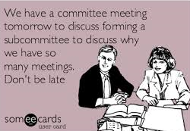
5.12 Job Description – Committee
https://www.rotary.org/myrotary/en/learning-reference/learn-role/club-committee
As a club committee member you help make your club a successful, thriving, and fun place. Whether you have been appointed as a committee chair or serve as a committee member, you can help your club improve your communities and develop leaders.
What you do
A club committee chair:
Oversees committee functions
Convenes regular committee meetings and activities
Supervises and coordinates the committee’s work
Reports activities to club board
TIPS:
Stay organized and control your meeting
Provide agendas/packets for every meeting
Keep meetings short & on topic
Keep detailed minutes and records

Slide 57
5.13 President’s Expectations for all Directors and Chairs
Every club director and chair will be responsible for generating a report on each project/event to include
  Business Plan
  Budget
  Contacts (e.g. vendors, suppliers, participants, sponsors, advertising, etc.)
  Calendar (reverse calendar)
  Event/Project Layout Design
  Notes and ideas whether implemented or not (e.g. what worked, did not work, or needs improvement)
  Photographs of project/event
  Publicity Plan (pre and post)
  Committee Meeting Minutes
  Complete their own reporting in Rotary Club Central
  Every avenue of service director will introduce at least one new project that is meaningful to them
  Build the foundation of our future this year
  Grow and diversify
  Network with other clubs to find worth while projects and endeavors
  Lead by example
  All directors must maintain binders with their work product which shall be the property of the club (supplies will be provided)

Slide 58

5.14 Club Service
[NAME OF DIRECTOR]
Club Service focuses on making clubs strong. A thriving club is anchored by strong relationships and an active membership development plan. - See more at: http://rotarydistrict5240.org/SitePage/club-service#sthash.PAfBe1DY.dpuf
President’s Notes (goals, ideas, concerns, objectives):
Every member refers at least one (1) speaker
Each month to feature a program on the applicable “Rotary Month”
Each month to feature a local non-profit speaker
Each month to feature a fun and interactive program (e.g. rat fink, off-site)
Every (or every other meeting) allow a Member or two to discuss their business (e.g. vocational minute)
Two to four Club Assemblies (spread out evenly over the year)
DG visit tentatively set for _________
Assess meeting venue incl. size, feel, seating arrangements, contract status, food, cost, A/V capabilities, dark dates
Rotary moments, trivia, and other fun contests
Interactor of the Month; Local Charity of the Month; Business Person of the Month; Employee of the Month
Vocational joke of the week (or just lawyer jokes)
Membership surveys and polls to find out where we can improve on a regular basis; preferred events, outings, projects, etc.
Club attendance and charging for meals (what must our attendance be to avoid absent meal charges)
5th [day of the week] meetings: [list dates if not regular meeting]
Dark Dates: [list dates not meeting]
Meetings falling on Holidays: [list dates if not regular meeting; consider planning something special in observance]

Slide 59
5.14 (cont.) Club Service (cont)
Director’s Notes (goals, ideas, concerns, objectives):
_______________________________________________________________________________
_______________________________________________________________________________
_______________________________________________________________________________
_______________________________________________________________________________
_______________________________________________________________________________
_______________________________________________________________________________
_______________________________________________________________________________
_______________________________________________________________________________
_______________________________________________________________________________
_______________________________________________________________________________
Your Notes (goals, ideas, concerns, objectives):
_______________________________________________________________________________
_______________________________________________________________________________
_______________________________________________________________________________
_______________________________________________________________________________
_______________________________________________________________________________
_______________________________________________________________________________
_______________________________________________________________________________
_______________________________________________________________________________
_______________________________________________________________________________
_______________________________________________________________________________

Slide 60

5.15 International Service
[NAME OF DIRECTOR]
International Service encompasses efforts to expand Rotary's humanitarian reach around the world and to promote world understanding and peace. - See more at: http://rotarydistrict5240.org/SitePage/international-service#sthash.kl5I8Jl3.dpuf
President’s Notes (goals, ideas, concerns, objectives):
Participate in hands on international project (e.g. Mexican orphanage)
Send or plan to send a Member on an National Immunization Day (“NID”) subsidized with club funds
At least two Members and/or family to attend RI Convention
Interface one meeting using live stream with a club in another English speaking country (e.g. Ireland, England)
Assess current projects to determine if continued support is appropriate: [list projects]
Consider new international projects
Participate in a Global Grant (either independently or in conjunction with another club)

Slide 61
5.15 (cont.) International Service (cont)
Director’s Notes (goals, ideas, concerns, objectives):
_______________________________________________________________________________
_______________________________________________________________________________
_______________________________________________________________________________
_______________________________________________________________________________
_______________________________________________________________________________
_______________________________________________________________________________
_______________________________________________________________________________
_______________________________________________________________________________
_______________________________________________________________________________
_______________________________________________________________________________
Your Notes (goals, ideas, concerns, objectives):
_______________________________________________________________________________
_______________________________________________________________________________
_______________________________________________________________________________
_______________________________________________________________________________
_______________________________________________________________________________
_______________________________________________________________________________
_______________________________________________________________________________
_______________________________________________________________________________
_______________________________________________________________________________
_______________________________________________________________________________

Slide 62

5.16 Community Service
[NAME OF DIRECTOR]
As club service projects committee chair, you help your club meet real needs in your community and around the world.
President’s Notes (goals, ideas, concerns, objectives):
Continue District Grant Project(s): [Name of projects]
Participate in a hands on distribution project pertaining to the poor and/or elderly (e.g. serve/deliver food)
Participate in a YMCA makeover or other similar hands on project (e.g. home repairs for elderly)
Involve Interact/Rotoract in all community service projects
Consider a local park clean up project
Create awards to honor selfless acts of heroism or kindness by local residents
Assess current projects to determine if continued support is appropriate: [list projects]
Conduct Community Needs Assessment and create new project(s) based on results
Participate in community service project led and planned by Interact/Rotoract

Slide 63
5.16 (cont.) Community Service (cont)
Director’s Notes (goals, ideas, concerns, objectives):
_______________________________________________________________________________
_______________________________________________________________________________
_______________________________________________________________________________
_______________________________________________________________________________
_______________________________________________________________________________
_______________________________________________________________________________
_______________________________________________________________________________
_______________________________________________________________________________
_______________________________________________________________________________
_______________________________________________________________________________
Your Notes (goals, ideas, concerns, objectives):
_______________________________________________________________________________
_______________________________________________________________________________
_______________________________________________________________________________
_______________________________________________________________________________
_______________________________________________________________________________
_______________________________________________________________________________
_______________________________________________________________________________
_______________________________________________________________________________
_______________________________________________________________________________
_______________________________________________________________________________

Slide 64

5.17 Vocational Service
[NAME OF DIRECTOR]
Vocational Service calls on every Rotarian to work with integrity and contribute their expertise to the problems and needs of society. - See more at: http://rotarydistrict5240.org/SitePage/vocational-service#sthash.0jlRiiEE.dpuf
President’s Notes (goals, ideas, concerns, objectives):
Coordinate off-site meetings at interesting local business
Improve upon “4 Way Test Essay Contest”
Create classifieds page on our website to list our business ads with links to our business websites
Participate in a “Rotary Day” or Rotarians at work (e.g. free community BBQ) to create Rotary awareness
Participate in a “Career Day” (e.g. at Middle School or one of the specialty classes at High School)
Assess current projects to determine if continued support is appropriate: [list projects]
Support local adult school programs with scholarships or other means
Director to create at least one new project

Slide 65
5.17 (cont.) Vocational Service (cont)
Director’s Notes (goals, ideas, concerns, objectives):
_______________________________________________________________________________
_______________________________________________________________________________
_______________________________________________________________________________
_______________________________________________________________________________
_______________________________________________________________________________
_______________________________________________________________________________
_______________________________________________________________________________
_______________________________________________________________________________
_______________________________________________________________________________
_______________________________________________________________________________
Your Notes (goals, ideas, concerns, objectives):
_______________________________________________________________________________
_______________________________________________________________________________
_______________________________________________________________________________
_______________________________________________________________________________
_______________________________________________________________________________
_______________________________________________________________________________
_______________________________________________________________________________
_______________________________________________________________________________
_______________________________________________________________________________
_______________________________________________________________________________

Slide 66


5.18 Youth Service
[NAME OF DIRECTOR]
Youth Service is Rotary's commitment to the future. By encouraging, mentoring, and empowering our youth today, we are creating a legacy that will allow Rotary to continue its mission to see that all men and women of this world are given the opportunity to lead their lives in health, safety and prosperity. - See more at: http://rotarydistrict5240.org/SitePage/youth-service#sthash.Y3qRyZ6z.dpuf
President’s Notes (goals, ideas, concerns, objectives):
Contribute to, promote and participate in YES! (e.g. counselors and planning)
At least one Member to attend RYLA as a counselor
Send minimum of three students to RYLA and obtain at least 25 applications
Generate a $1000 scholarship application or contest
At least one club program by our Interact Club (with their parents invited)
Participate in at least one joint community service project organized by the Interact Club
Obtain Interact Club membership base of 40 students
Have one joint board meeting with our Interact Club BOD
Organize Interactors in a Rotary Club-like fashion including running meetings
Help Interact start their own fundraiser
Send and fund at least one Interactor through PRLS (basic and masters)
Verify that we are in compliance with RI and Dist. policies concerning interacting with youth
Host an Interact party at the end of the school year
Interact Teacher Advisor to attend at least one of our meetings as a guest of honor
Encourage at least one parent of an Interactor to join our club (Parents are an untapped source of potential members)
Every member of our club to know the name of the Interact Club President
Every member attends at least one interact meeting
Assess current projects to determine if continued support is appropriate: [list projects]

Slide 67
5.18 (cont.) Youth Service (cont)
Director’s Notes (goals, ideas, concerns, objectives):
_______________________________________________________________________________
_______________________________________________________________________________
_______________________________________________________________________________
_______________________________________________________________________________
_______________________________________________________________________________
_______________________________________________________________________________
_______________________________________________________________________________
_______________________________________________________________________________
_______________________________________________________________________________
_______________________________________________________________________________
Your Notes (goals, ideas, concerns, objectives):
_______________________________________________________________________________
_______________________________________________________________________________
_______________________________________________________________________________
_______________________________________________________________________________
_______________________________________________________________________________
_______________________________________________________________________________
_______________________________________________________________________________
_______________________________________________________________________________
_______________________________________________________________________________
_______________________________________________________________________________

Slide 68

5.19 Foundation (TRF & Club)
[NAME OF CHAIR]
The club’s Foundation chair is responsible for coming up with innovative ways to increase giving amongst the members. They also track and manage the collection and disbursement of the funds to TRF and club foundations. They should be well versed in their knowledge of TRF and club foundation and all related programs and recognition with the ability to convey this knowledge to the club members.
President’s Notes (goals, ideas, concerns, objectives):
Goals: Achieve Every Rotarian [This] Year ($25+/member); Achieve 100% Sustaining Member status ($100+/member); Average per capita TRF giving of $300+; Achieve 50%+ benefactor status; Achieve at least 1 of each of the following (new) Major Donor; PH Society; Bequest Society
Track and manage happy bucks or similar intra-club program which generates TRF funds (or use the program to award PHF’s to members who don’t have any yet)
Track and report on goals and targets monthly at every Board meeting
Make the TRF our charity of choice [emphasize benefits to club/members (e.g district grant funds ~25% of every $1; tax deductibility; Gates Foundation 2:1 Matching for PolioPlus contributions; recognition; impact of Global Grant projects; sound performance/rating of the TRF; RI’s primary functions are achieved via TRF)
Host program on TRF
Team up with Allocations committee to push club to make a donation to TRF
Use club and member donated points to host a “Matching” donation night
Host a Paul Harris Fellow formal event (or make powerful pin presentations throughout the year)
Make it easy to give: get all commitments within first (month) billing cycle, distribute club held funds to TRF at least quarterly
Get involved in a Global Grant

Slide 69
5.19 (cont.) Foundation (cont)
Director’s Notes (goals, ideas, concerns, objectives):
_______________________________________________________________________________
_______________________________________________________________________________
_______________________________________________________________________________
_______________________________________________________________________________
_______________________________________________________________________________
_______________________________________________________________________________
_______________________________________________________________________________
_______________________________________________________________________________
_______________________________________________________________________________
_______________________________________________________________________________
Your Notes (goals, ideas, concerns, objectives):
_______________________________________________________________________________
_______________________________________________________________________________
_______________________________________________________________________________
_______________________________________________________________________________
_______________________________________________________________________________
_______________________________________________________________________________
_______________________________________________________________________________
_______________________________________________________________________________
_______________________________________________________________________________
_______________________________________________________________________________

Slide 70
5.20 Member Services (optional) (may also fall under club service)
[NAME OF CHAIR]
The primary role of the member services chair is to ensure that each and every club member loves their club. This is accomplished in part through planning social events, special meetings, and through listening to the members. It requires the infusion of fun, entertainment, and a personal touch to everything.
President’s Notes (goals, ideas, concerns, objectives):
Implement and manage Rotarian of the Month and speaker gifts (valuable gift such as: travel coffee mug, bottle of wine, free drinks for the night, other)
Invite spouses/significant others to attend one “meeting after the meeting” each month
Act as a conduit for Members to express any personal or Rotary concerns in a confidential setting
Plan DG visit
Organize a “Mystery Day” (e.g. we went to a car museum in Sylmar one time)
Organize a club Wine Tasting and/or Beer Tasting Tour (or local pub crawl)
Continue Hiking Group and expand it to the other clubs
Organize one kids/grandkids meeting with children’s entertainment as the program
Organize Holiday Party
Give members appropriate gifts/cards on B-Days; Anniversaries; Mother’s Day; Father’s Day; Grandparent’s Day; Boss’s Day; Veteran’s Day; Valentine’s Day
Plan at least three family socials (e.g. picnics at a park, outing to the movies or theme park)
Act as liaison to the meeting venue

Slide 71
5.20 (cont.) Member Services (cont)
Director’s Notes (goals, ideas, concerns, objectives):
_______________________________________________________________________________
_______________________________________________________________________________
_______________________________________________________________________________
_______________________________________________________________________________
_______________________________________________________________________________
_______________________________________________________________________________
_______________________________________________________________________________
_______________________________________________________________________________
_______________________________________________________________________________
_______________________________________________________________________________
Your Notes (goals, ideas, concerns, objectives):
_______________________________________________________________________________
_______________________________________________________________________________
_______________________________________________________________________________
_______________________________________________________________________________
_______________________________________________________________________________
_______________________________________________________________________________
_______________________________________________________________________________
_______________________________________________________________________________
_______________________________________________________________________________
_______________________________________________________________________________

Slide 72

5.21 Branding, Communications, & Public image
[NAME OF CHAIR(S)]
[DESCRIBE THE ROLE OF YOUR CLUB’S COMMUNICAITONS AND/OR PI/PR PERSON.]
President’s Notes (goals, ideas, concerns, objectives):
Purchase and set up video recording and broadcasting system meetings
Purchase, setup and manage wireless lapel microphone
Set up @[clubname]Rotary.org emails for all members and use them for all Rotary business
Update website, Facebook, Twitter, etc. weekly (including for fundraiser pages)
Conduct programs for the club to teach us how to maximize our social media tools.
Implement and ensure compliance with RI’s branding across the board
Maintain calendar online
Issue newsletters monthly or every other month
Take, create and maintain photos and club documents (establish Cloud service to store and organize club docs)
Post recorded meetings to website for make-ups
Use GetRotary.Org to chat and post our events
Update website with pictures and bios of members
Engage media for fundraisers, projects, and special meetings/awards

Slide 73
5.21 (cont.) Communications & Public Image (cont)
Director’s Notes (goals, ideas, concerns, objectives):
_______________________________________________________________________________
_______________________________________________________________________________
_______________________________________________________________________________
_______________________________________________________________________________
_______________________________________________________________________________
_______________________________________________________________________________
_______________________________________________________________________________
_______________________________________________________________________________
_______________________________________________________________________________
_______________________________________________________________________________
Your Notes (goals, ideas, concerns, objectives):
_______________________________________________________________________________
_______________________________________________________________________________
_______________________________________________________________________________
_______________________________________________________________________________
_______________________________________________________________________________
_______________________________________________________________________________
_______________________________________________________________________________
_______________________________________________________________________________
_______________________________________________________________________________
_______________________________________________________________________________

Slide 74

5.22 Membership
[NAME OF CHAIR]
[DESCRIBE THE ROLE OF YOUR CLUB’S MEMBERSHIP PERSON.]
President’s Notes (goals, ideas, concerns, objectives):
Current Membership= ____; New members target for healthy growth=____; Retention Rate=95 – 100 %.
Retention: work with member services chair to personalize the rotary experience for each member (create budget line item to treat members to things like B-day/Ann. cards and small tokens of appreciation like flowers, wine and nice Rotarian of the month gifts)
Target all age groups, but emphasize age groups under 40 (get younger)
Create a system to seamlessly and uniformly track and bring guests along to membership (use My Rotary -> Club Administration) (assign all new members a concierge [pre-commitment] and a mentor)(all new members get Rotary Info)(personalize inductions)
Create membership drive competition (be cautious not to make it contrived or new members will feel like numbers)
Add at least two new members who are relatives of a current Rotarian, including of other clubs (legacy Rotarians)
Add one individual from each of the following classifications: health & Fitness; medicine; local government; dental; education administration; law enforcement
Bring back at least three former members (alumni social; regular contact with alumni and spouses)
Add at least one parent of an Interactor/Rotoractor as a member
Make Membership easier and cheaper; create attractive membership incentives (e.g. membership to Country Club where we meet, discounted goods & services, club e-mail accounts and cloud access, website bios, business referrals)
Create an online guest tracking system to log and manage membership leads and guests (include specific information about their likes and dislikes) so they don’t fade out at the original source; remain in regular contact with each of them
Speak with members about their rotary experience and encourage all considering leaving to stay (everyone has something positive they can add to the club and no member should ever be taken for granted) (use Survey Monkey)
Engage family of club members so that they also appreciate the experience
Don’t be afraid to just ask people to join
Send PE or membership chair to Chamber of Commerce and/or local leadership classes to recruit (club to reimburse)

Slide 75
5.22 (cont.) Membership (cont)
Director’s Notes (goals, ideas, concerns, objectives):
_______________________________________________________________________________
_______________________________________________________________________________
_______________________________________________________________________________
_______________________________________________________________________________
_______________________________________________________________________________
_______________________________________________________________________________
_______________________________________________________________________________
_______________________________________________________________________________
_______________________________________________________________________________
_______________________________________________________________________________
Your Notes (goals, ideas, concerns, objectives):
_______________________________________________________________________________
_______________________________________________________________________________
_______________________________________________________________________________
_______________________________________________________________________________
_______________________________________________________________________________
_______________________________________________________________________________
_______________________________________________________________________________
_______________________________________________________________________________
_______________________________________________________________________________
_______________________________________________________________________________

Slide 76
5.22 (cont.) Membership (club elevator speech)
[RESERVED FOR THE SPEECH YOU WANT YOUR CLUB MEMBERS TO MEMORIZE FOR USE IN PROMOTING YOUR CLUB – I.E. ELEVATOR SPEECH. TRY TO ESTABLISH A DISTINGUISHING FEATURE OF YOUR CLUB IN THIS SPEECH AS WELL.]

Slide 77

5.23 Grants
[NAME OF CHAIR]
[DESCRIBE THE ROLE OF YOUR CLUB’S GRANTS COORDINATOR.]
President’s Notes (goals, ideas, concerns, objectives):
Attend Grant Qualification Seminar(s)
Timely submission of District Grants (by March 31)
Work with Int’l service and TRF foundation chairs to explore Global Grant opportunities
Explore City/County Grant opportunities (Special Event Grants; Community Service Event Grants)
Manage, draft and submit all grants on behalf of the club
Seek corporate partners

Slide 78
5.23 (cont.) Grants (cont)
Director’s Notes (goals, ideas, concerns, objectives):
_______________________________________________________________________________
_______________________________________________________________________________
_______________________________________________________________________________
_______________________________________________________________________________
_______________________________________________________________________________
_______________________________________________________________________________
_______________________________________________________________________________
_______________________________________________________________________________
_______________________________________________________________________________
_______________________________________________________________________________
Your Notes (goals, ideas, concerns, objectives):
_______________________________________________________________________________
_______________________________________________________________________________
_______________________________________________________________________________
_______________________________________________________________________________
_______________________________________________________________________________
_______________________________________________________________________________
_______________________________________________________________________________
_______________________________________________________________________________
_______________________________________________________________________________
_______________________________________________________________________________

Slide 79
5.24 Club Equipment Assessment
INVENTORY LOCATION YEAR PURCHASED
Video recorder Need New one 2000
Wi-Fi / hot spot [Name] has one the club can use n/a
Microphone In club’s storage unit 2010
Display monitor [Name] has it 2014
Projector
CPU
Speakers / Receivers
Banners
Name tags
Pins
T-Shirts / polos (do we want new ones?)
Bell
Flags
Canopies
Tables / Chairs
Table cloths
Printed materials
Electronic storage
Hard copy storage
Credit card processing (for dues/meals)
New member kits

Slide 80
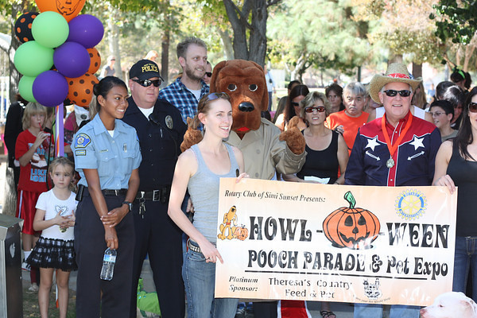
5.25 Fundraiser – [#1]
[NAME OF CHAIR]
Date of Event last year: Date of Event this year:
Gross receipts last year: $_____ Goal for this year: $_____
Net profit last year: $_____ Goal for this year: $_____
Attendance last year: ______ Goal for attendance this year: ______
Benefactor(s): _____________________________________________________________________
Major Sponsor(s): _____________________________________________________________________
Committee Team: _____________________________________________________________________
President’s Notes (goals, ideas, concerns, objectives):
_______________________________________________________________________________
_______________________________________________________________________________
_______________________________________________________________________________
Director’s Notes (goals, ideas, concerns, objectives):
_______________________________________________________________________________
_______________________________________________________________________________
_______________________________________________________________________________
Your Notes (goals, ideas, concerns, objectives):
_______________________________________________________________________________
_______________________________________________________________________________
_______________________________________________________________________________

Slide 81
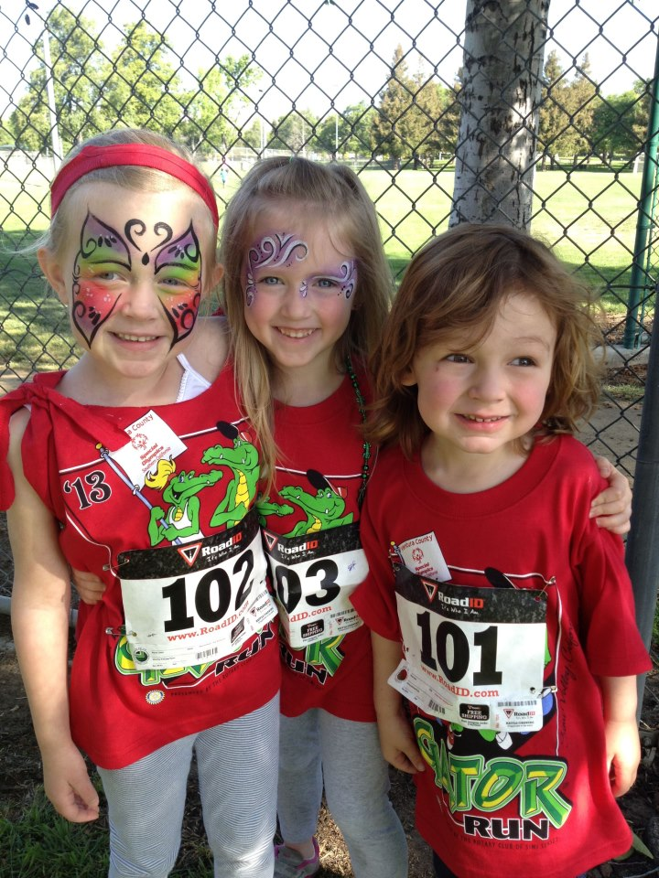
5.26 Fundraiser – [#2]
[NAME OF CHAIR]
Date of Event last year: Date of Event this year:
Gross receipts last year: $_____ Goal for this year: $_____
Net profit last year: $_____ Goal for this year: $_____
Attendance last year: ______ Goal for attendance this year: ______
Benefactor(s): _____________________________________________________________________
Major Sponsor(s): _____________________________________________________________________
Committee Team: _____________________________________________________________________
President’s Notes (goals, ideas, concerns, objectives):
_______________________________________________________________________________
_______________________________________________________________________________
_______________________________________________________________________________
Director’s Notes (goals, ideas, concerns, objectives):
_______________________________________________________________________________
_______________________________________________________________________________
_______________________________________________________________________________
Your Notes (goals, ideas, concerns, objectives):
_______________________________________________________________________________
_______________________________________________________________________________
_______________________________________________________________________________

Slide 82

5.27 Fundraiser – [#3]
[NAME OF CHAIR]
Date of Event last year: Date of Event this year:
Gross receipts last year: $_____ Goal for this year: $_____
Net profit last year: $_____ Goal for this year: $_____
Attendance last year: ______ Goal for attendance this year: ______
Benefactor(s): _____________________________________________________________________
Major Sponsor(s): _____________________________________________________________________
Committee Team: _____________________________________________________________________
President’s Notes (goals, ideas, concerns, objectives):
_______________________________________________________________________________
_______________________________________________________________________________
_______________________________________________________________________________
Director’s Notes (goals, ideas, concerns, objectives):
_______________________________________________________________________________
_______________________________________________________________________________
_______________________________________________________________________________
Your Notes (goals, ideas, concerns, objectives):
_______________________________________________________________________________
_______________________________________________________________________________
_______________________________________________________________________________

Slide 83
5.28 Important Club Dates
[List important club dates here in chronological order. Leave space to write in TBD dates.]

