Slide 1
MEMBERSHIP CHAIR
INITIAL MEETING
Lee Ginsburg – District 5240 Membership Chair 2020-2021
Chief of Staff 2021-2022
Husam Hishmeh – Membership Chair 2021-2022

Slide 2

“We are in this together”
Current DISTRICT TEAM
Lee Ginsburg – District Membership 2020-2021
Terry Moerler – Westlake Village Sunrise
Dapper Spar – Westlake Village
Audrey Brown – Westlake Village
Erika Neel – San Luis Obispo
Husam Hishmeh – Ventura East

Slide 3
Key elements for this year
The District MEMBERSHIP TEAM is here to support you
MEMBERSHIP is a key focus for this year
There are resources to assist you

Slide 4
Four Good Resourses
District Awards Criteria
Club Health Check
Membership Resource Guide
Club Membership Committee Checklist

Slide 5
Four good resources
District Awards Criteria – https://rotarydistrict5240.org/sitepage/rotary-year-2020-21-information
Club Health Check - 2540_rotary_club_health_check_en%20(1).pdf
Membership Resource Guide - https://zone2627.org/wp-content/uploads/2020/08/MembershipResourceGuide_August-2020.pdf
Club membership Committee Checklist - https://zone2627.org/wp-content/uploads/2020/03/Club_Membership_Committee_Checklist_en.pdf

Slide 6
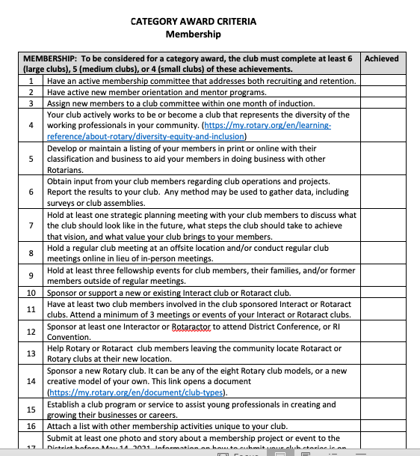
AWARDS CRITERIA

Slide 7

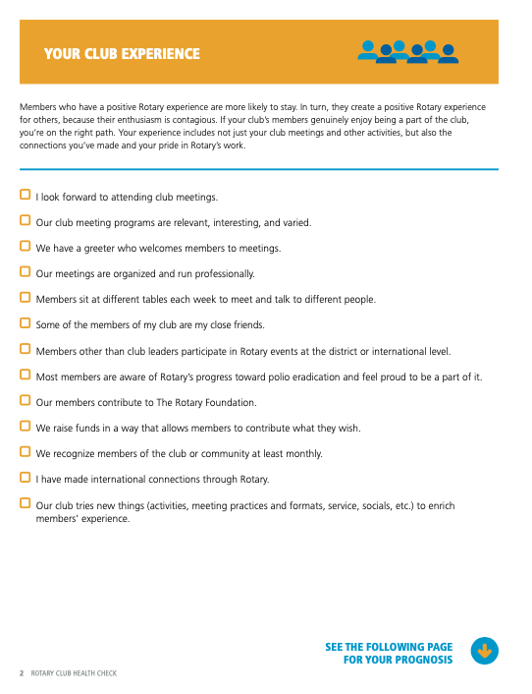
CLUB HEALTH CHECK

Slide 8
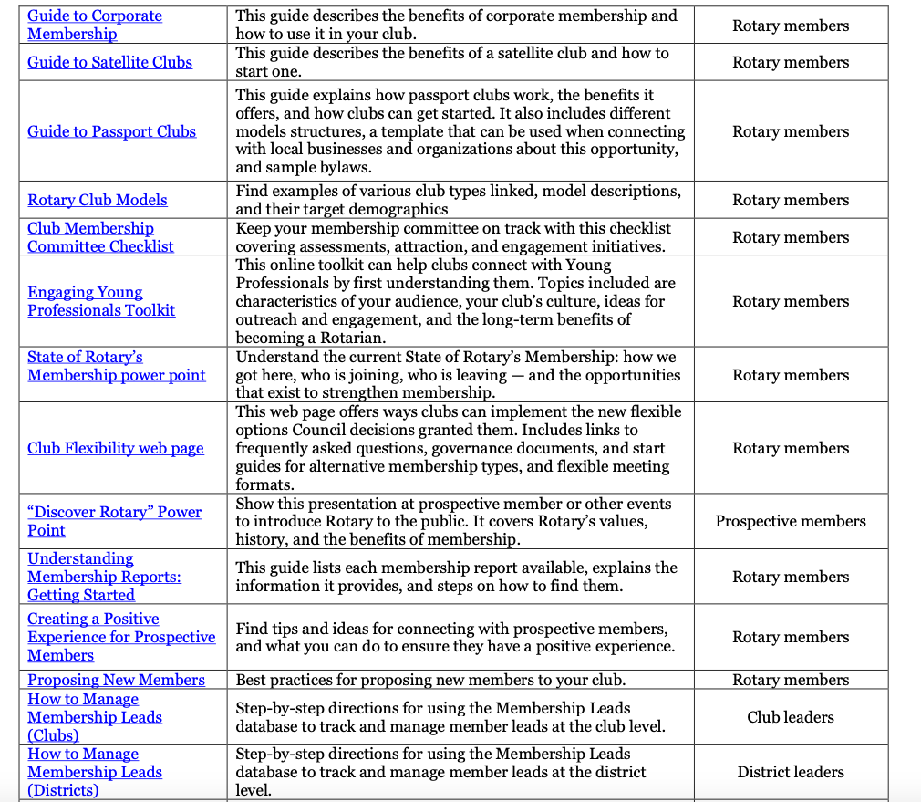
MEMBERSHIP RESOURCE GUIDE

Slide 9
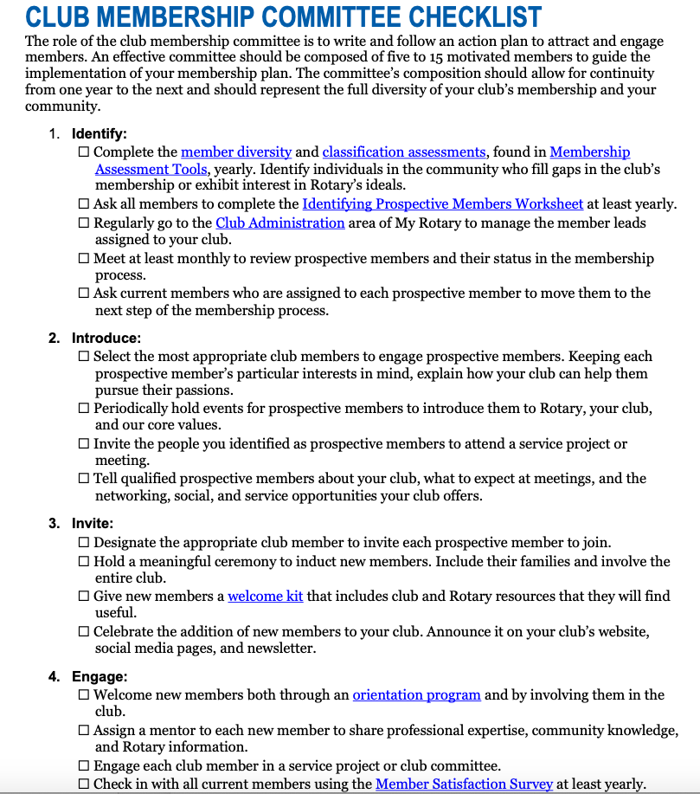
CLUB MEMBERSHIP COMMITTEE CHECKLIST

Slide 10

What to do now
Look at the status of your club
Review the four fundamental resources
Begin to think about a membership committee for your club
Use one or more resources to assist you to build an action plan
Identify what you need to know more about to address membership for your club

Slide 11
We are in this together
CALL ME
Husam Hishmeh
District Membership Chair 2021-2022
husam@dpzwest.com
‭(805) 701-4123

Slide 12

QUESTIONS

