Slide 1
The Rotary Foundation
Celebrating 100 Years of doing good
Let’s celebrate by taking our contributions to the next level
Become:
A Sustaining Member
A Paul Harris Fellow
A Paul Harris Society Member
A Major Donor

Slide 2
The Rotary Foundation
Celebrating 100 Years of doing good
What’s it take:
Sustaining Member - US$100 per year
Paul Harris Fellow - donations of US$1,000+
Paul Harris Society - US$1,000 per year
Major Donor - donation total US$10,000+
or
An Arch Klump Society Member
Donating US$250,000
(or a commitment to do so over 3 consecutive years starting this Rotary year.)

Slide 3
The Rotary Foundation
Celebrating 100 Years of doing good
You may wish to become a benefactor or Bequest Society member
Leave a legacy in your will

Slide 4
The Rotary Foundation
Celebrating 100 Years of doing good
And don’t forget PolioPlus
We still have some way to go
Make a donation of a minimum of $26.50 per member
In addition to your other giving

Slide 5
The Rotary Foundation
Celebrating 100 Years of doing good
Celebrate with us at the District Conference
All Club Members from clubs achieving 100% of any of the above
(or just one new Arch Klump Society member) are invited to a special
Bubbly celebration

Slide 6
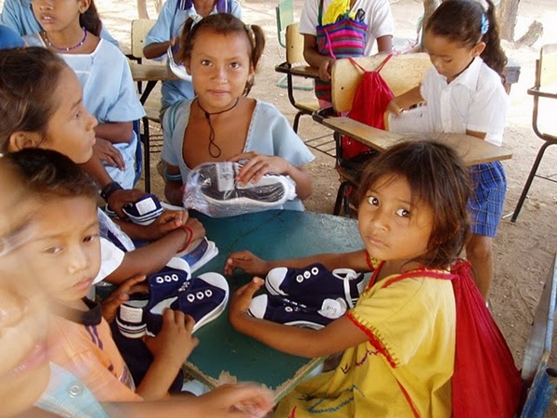
The Rotary Foundation
Celebrating 100 Years of doing good
But really -
it’s all about putting smiles on their faces

Slide 7
The Rotary Foundation
Celebrating 100 Years of doing good
If ever there was a year to give
A year to put a smile on their faces
A year to put a smile on your face
Then this is the year
Please support
The Rotary Foundation

Slide 8
The Rotary Foundation
Celebrating 100 Years of doing good
How to give
Go on-line www.rotary.org - My Rotary
- follow the links to Foundation - Donate
Sign up for Rotary Direct
Transfer shares to the Foundation
Write a cheque
See your club Foundation chair

