Slide 1
MAGIC ALL AROUND
21-25 JUNE 2025 • CALGARY, CANADA

Slide 2
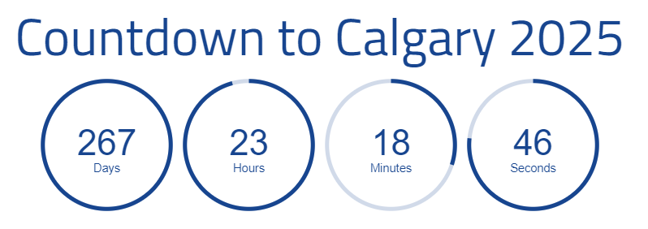
21-25 JUNE 2025 • CALGARY, CANADA
convention.rotary.org

Slide 3
Agenda
Keeping you Informed
The Rotary Conference Experience
Host Hospitality
Volunteering
Signature Events
Something to Ponder
Questions
21-25 JUNE 2025 • CALGARY, CANADA
convention.rotary.org

Slide 4
Keeping you Informed
Sun | Mon | Tue | Wed | Th | Fri | Sat
Stay abreast of updates…
Official Rotary Conference Website
Convention promotion Materials
Program and Events
Registration
Calgary 2025 HOC
Signature Events
Host Hospitality
Volunteering
Coming Soon, HOC
Facebook, Instagram, LinkedIn
HOC Meetings
Club Champion Meetings
HOC Newsletter
21-25 JUNE 2025 • CALGARY, CANADA
convention.rotary.org

Slide 5
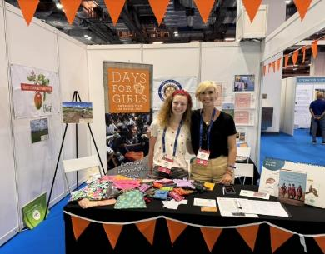
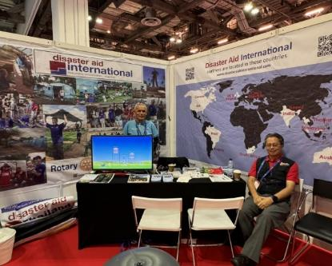
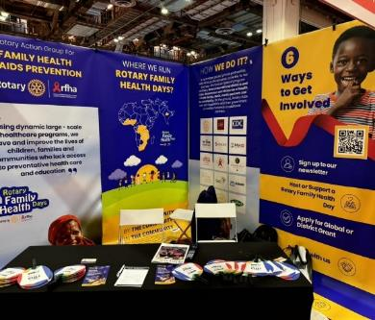
The Rotary Conference Experience
Experience an exhilarating journey of worldwide connections and inspiration.
Engage in riveting discussions, learn from distinguished speakers and explore innovative and refreshing breakout sessions.
Exchange best practices, ignite new ideas for innovative projects and form lifelong connections with like-minded community change makers from around the world.
21-25 JUNE 2025 • CALGARY, CANADA
convention.rotary.org

Slide 6
The Rotary Conference Experience
The amazing magic is fuelled by friendship in a spirit of collaboration and service above self.
Enjoying this one-of-a-kind, transformative event. Be part of the team experience, share in the magic, and help grow our Rotary Family.
Experience the vibrant city of Calgary, Alberta, Canada, where you will create magical lifelong memories by discovering the many sites to enjoy, a wide selection of things to do, and many culinary delights.
In other words, FUN for Everyone!
21-25 JUNE 2025 • CALGARY, CANADA
convention.rotary.org

Slide 7
The Rotary Conference Experience
 | June 21 | June 22 | June 23 | June 24 | June 25
Morning | Pre-Conference Activities | Opening Ceremony (Group A) | General Session | General Session | General Session
Midday |  | House of Friendship | Breakout Sessions | Breakout Sessions | Breakout Sessions
Afternoon |  | Opening Ceremony (Group B) | Breakout Sessions | Breakout Sessions | Closing Ceremony
Evening | Grandstand Spectacular | New Blood with Calgary Civic Symphony OR Rockin’ The Big Tent | Host Hospitality | Western Ranch Showcase
Connect…
Learn…
Challenge…
Experience…
We’re All Together
You Choose
Let’s Have Fun
21-25 JUNE 2025 • CALGARY, CANADA
convention.rotary.org

Slide 8
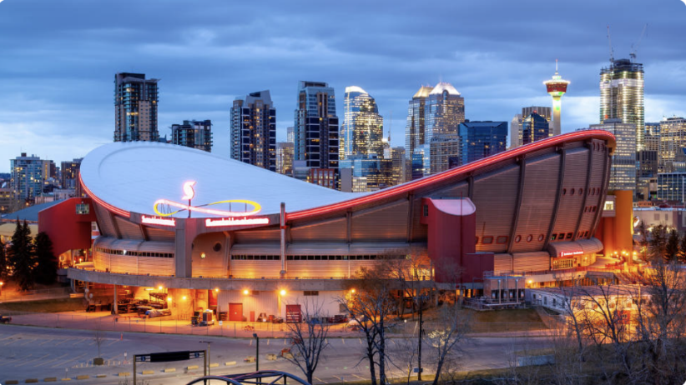
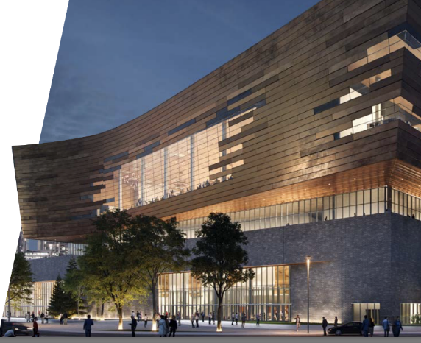
CONFERENCE VENUES
Scotiabank Saddledome
General sessions
BMO Centre
Breakout sessions, HOF…
21-25 JUNE 2025 • CALGARY, CANADA
convention.rotary.org

Slide 9
Host Hospitality Pat Neuman
Calgary ‘96 is Remembered by Rotarians for TWO things…ONE of them is HOST HOSPITALITY
We started the tradition, and it has been carried on ever since
It was premised on
“Rotarians Hosting Rotarians”
Over time, it has evolved….Check out the Promo Video
Host Hospitality Event
21-25 JUNE 2025 • CALGARY, CANADA
convention.rotary.org

Slide 10
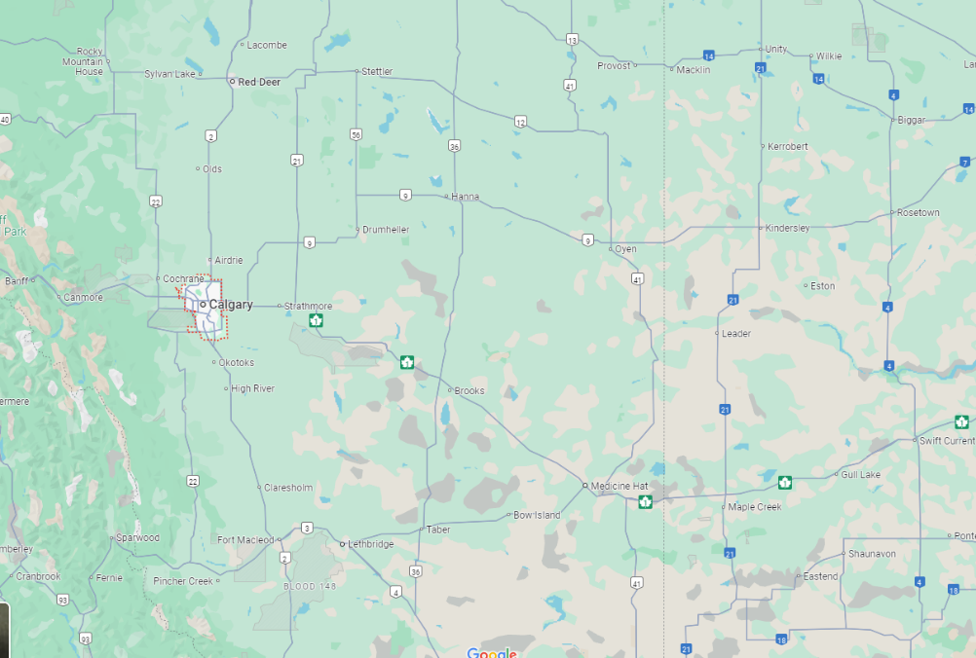
Host Hospitality Pat Neuman
Inside the Circle..
Why Not Host a Rotarian in your Home
Join Fellow Rotarians to Host a Small Group
Consider a Club Event in your community
Outside the Circle
Maybe a Club Event inside the Circle
21-25 JUNE 2025 • CALGARY, CANADA
convention.rotary.org

Slide 11
Host Hospitality Pat Neuman
Conference Attendees are charged $50 to participate in HH
These funds are used for Transportation To and From
Encourage Events to work within a 5-hour window (5pm to 10pm)
Rotarians/Rotary Clubs are encouraged to Show Their Western Hospitality by “taking care of the bill”
If you want to plan an event in Calgary, act fast…
Find a Venue: Venue Search | Tourism Calgary
Sign Up: Hosting Home Hospitality Event
Questions: Pat.Neuman@rotarycalgary2025.org
21-25 JUNE 2025 • CALGARY, CANADA
convention.rotary.org

Slide 12
Volunteering
We need 2000 volunteers from start to finish
While Conference Attendees can register for a host of Volunteer Opportunities on Campus, there are many more OFF Campus opportunities as well.
Shifts are 4 hours long, Volunteer NOW and in April 2025, choose the locations and shifts from the list of opportunities
Volunteering is a way for Calgary Rotarians, family and friends, to leverage the excitement of a global audience and to introduce Rotary to potential members
Sign Up: Volunteering
21-25 JUNE 2025 • CALGARY, CANADA
convention.rotary.org

Slide 13
Signature Events Mark Ambrose
Our Goal is to Knock Your Socks Off!!!
We’ve partnered with the Calgary Stampede to deliver a world class Welcome to Calgary 2025
You’re gonna help teach the world How to Party
We’re gonna show the world how We Come Together
We’re gonna give the world a Western Experience
Questions: mark.ambrose@rotarycalgary2025.org
21-25 JUNE 2025 • CALGARY, CANADA
convention.rotary.org

Slide 14
Something to Ponder
How Does your Club LEVERAGE Calgary 2025 to Grow Membership?
21-25 JUNE 2025 • CALGARY, CANADA
convention.rotary.org

Slide 15
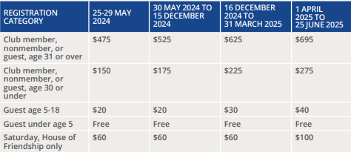
Don’t Delay… Register TODAY…
21-25 JUNE 2025 • CALGARY, CANADA
convention.rotary.org

Slide 16
You heard it here first....
Housing for District Members
District 5360 is arranging with Mount Royal University and potentially others, to provide rooming for District 5360 members traveling to the conference
Reduced rates
You will require your own transportation to get back and forth to conference
Watch the Newsletter for details and how to book.
21-25 JUNE 2025 • CALGARY, CANADA
convention.rotary.org

Slide 17
Questions / Feedback
21-25 JUNE 2025 • CALGARY, CANADA
convention.rotary.org

Slide 18
HOC Promotions and Communication Team
Miriam Mitchell-Banks (Rotary Club of Calgary Centennial)
miriam.mitchellbanks@rotarycalgary2025.org
403.630.0898
Darcy Mykytyshyn (Rotary Club of Red Deer)
darcy.mykytyshyn@rotarycalgary2025.org
403.896.6922
Linda Morris (Rotary Club of Calgary Fish Creek)
linda.morris@rotarycalgary2025.org
587.224.5958
21-25 JUNE 2025 • CALGARY, CANADA
convention.rotary.org

Slide 19
MAGIC ALL AROUND
21-25 JUNE 2025 • CALGARY, CANADA
convention.rotary.org

