Slide 1


MAGIC ALL AROUND
21-25 JUNE 2025 • CALGARY, CANADA

Slide 2

Agenda
Where are we with Registrations
Accommodations Update
Volunteer Update
Host Hospitality Update
Signature Events Update
Help Us Help You
The Websites to Bookmark
21-25 JUNE 2025 • CALGARY, CANADA
convention.rotary.org

Slide 3


Registrations Update
113 days to go!
21-25 JUNE 2025 • CALGARY, CANADA
convention.rotary.org

Slide 4
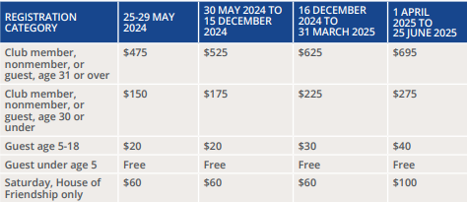

The Price – USD goes up April 1
21-25 JUNE 2025 • CALGARY, CANADA
convention.rotary.org

Slide 5
Convention Registrations
Canadian Hosted
Convention Attendance
Worldwide paid
15,135 registered and paid attendees
Worldwide Unpaid and growing
(Promotions focusing on converting)
16,526 and growing
Visa requirements
Accommodations
Year | City | Attendance
2024 | Calgary
2018 | Toronto | 25,188
2010 | Montreal | 17,909
1996 | Calgary | 24,963
1983 | Toronto | 16,250
1975 | Montreal | 12,975
1964 | Toronto | 14,661
1942 | Toronto | 6,599
1942 | Toronto | 9,173
21-25 JUNE 2025 • CALGARY, CANADA
convention.rotary.org

Slide 6
The District & Zone Goals
Canadian Hosted
Convention Attendance
District 5360
1000 attendees
Zone 28
100% of Clubs in Canada
Zone 32
1 Club / district
HOC
Best Attended Convention in Canada
Year | City | Attendance
2024 | Calgary
2018 | Toronto | 25,188
2010 | Montreal | 17,909
1996 | Calgary | 24,963
1983 | Toronto | 16,250
1975 | Montreal | 12,975
1964 | Toronto | 14,661
1942 | Toronto | 6,599
1942 | Toronto | 9,173
21-25 JUNE 2025 • CALGARY, CANADA
convention.rotary.org

Slide 7
The Numbers - 5360
As of Feb 18, 2025
Canadian Hosted
Convention Attendance
Year | City | Attendance
2024 | Calgary
2018 | Toronto | 25,188
2010 | Montreal | 17,909
1996 | Calgary | 24,963
1983 | Toronto | 16,250
1975 | Montreal | 12,975
1964 | Toronto | 14,661
1942 | Toronto | 6,599
1942 | Toronto | 9,173
Registered & Paid Rotarians (529 of 1509)
35%
Percentage of District Attendance Goal (529/1000)
53%
Clubs Represented (39 of 47)
83%
21-25 JUNE 2025 • CALGARY, CANADA
convention.rotary.org

Slide 8
Registrations - Closer to Home, by Club
As of February 19, 2025
Club Name | Reg. & Paid | Membership | % of membership Reg. And Pd.
Airdrie | 3 | 16 | 19%
Banff | 0 | 11 | 0%
Brooks | 4 | 11 | 36%
Calgary at Stampede Park | 93 | 129 | 72%
Calgary Centennial | 12 | 31 | 39%
Calgary Chinook | 12 | 45 | 27%
Calgary Connect | 4 | 12 | 33%
Calgary Downtown | 47 | 125 | 38%
21-25 JUNE 2025 • CALGARY, CANADA
convention.rotary.org

Slide 9
Club | Reg. & Paid | Membership | % of membership Reg. And Pd.
Calgary East | 11 | 29 | 38%
Calgary Fish Creek | 25 | 34 | 74%
Calgary Heritage Park | 35 | 61 | 57%
Calgary Millennium | 2 | 15 | 13%
Calgary North | 15 | 37 | 41%
Calgary Olympic | 10 | 12 | 83%
Calgary Sarcee | 0 | 6 | 0%
Calgary West | 25 | 67 | 37%
Canmore | 25 | 100 | 25%
Cardston | 1 | 20 | 5%
Chestermere | 2 | 12 | 17%
21-25 JUNE 2025 • CALGARY, CANADA
convention.rotary.org

Slide 10
Club Name | Count | Membership | % members registered & Paid
Cochrane | 12 | 46 | 26%
Cochrane Rocky Mountain | 0 | 22 | 0%
Drumheller | 3 | 22 | 14%
Fort Macleod | 0 | 7 | 0%
High River | 12 | 27 | 44%
Innisfail | 0 | 19 | 0%
Kindersley | 0 | 11 | 0%
Lacombe | 1 | 18 | 6%
Lethbridge | 20 | 78 | 26%
Lethbridge East | 8 | 23 | 35%
Lethbridge Mosaic | 0 | 9 | 0%
Lethbridge Sunrise | 8 | 34 | 24%
21-25 JUNE 2025 • CALGARY, CANADA
convention.rotary.org

Slide 11
Club Name | Count | Membership | % Members Registered & Paid
Medicine Hat | 9 | 46 | 20%
Medicine Hat (Saamis) | 1 | 23 | 4%
Medicine Hat Sunrise | 2 | 28 | 7%
Okotoks | 5 | 42 | 12%
Olds | 6 | 19 | 32%
Peace and Education | 2
Pincher Creek | 0 | 9 | 0%
Raymond | 1 | 14 | 7%
Red Deer | 13 | 92 | 14%
Red Deer East | 17 | 25 | 68%
Red Deer Sunrise | 8 | 16 | 50%
21-25 JUNE 2025 • CALGARY, CANADA
convention.rotary.org

Slide 12
Club Name | Count | Membership | % members registered & Paid
Rotaract United E-Club | 3 | 7 | 43%
Rotoract University of Calgary | 14 | 30 | 47%
Rotoract University of Lethbridge | 2 | 27 | 7%
Stettler | 1 | 19 | 5%
Swift Current | 3 | 6 | 50%
Sylvan Lake | 4 | 17 | 24%
Total District 5360 | 481 | 1509 | 32%
District 5360 no data shared – paid | 48
Total District 5360 Paid | 529 | 1509 | 35%
District 5360 Registered not paid | 10
21-25 JUNE 2025 • CALGARY, CANADA
convention.rotary.org

Slide 13
Accommodations Update
Alternative Housing for District 5360 and Zones 28/32
21-25 JUNE 2025 • CALGARY, CANADA
convention.rotary.org

Slide 14
NEW – Accommodation Alternative
SAIT Residences
We have been provided a discount code for SAIT Residences - these rooms are open to the public, so they are on a first come first serve basis
Register with a PROMO Code "CRIC2025" for the suites for bookings June 20-26.
Amenities:
- Four private bedrooms with double-sized extra-long mattresses
- Two private bathrooms, - Kitchen with an oven and stove top, full fridge/freezer combo, and microwave
- Wi-Fi internet, - Free parking for one vehicle per suite, - Complimentary Continental Breakfast at the dining center
Cost with PROMO CODE is $120 for a two bedroom, or $240 for a four bedroom
BOOK HERE
21-25 JUNE 2025 • CALGARY, CANADA
convention.rotary.org

Slide 15
District Accommodation
Mount Royal Residences
  350 Bedroom Units available, mostly 4-bedroom suites, majority with single beds.
  TELL US THAT YOU ARE BOOKING FOR THE ROTARY CONVENTION WHEN YOU CALL*
  Please note that you may have to share the townhouse/apartment with other guests. If you do not wish to do that you will need to pay for all rooms in the apartment/townhouse – please try to fill with family/friends.
  4 Bedroom Apartments/Townhouses – These have 4 individual lockable bedrooms each with a single bed, 2 full bathrooms, a full kitchen and living room. - $59.95 per bedroom per night.
  2 Bedroom East Townhouse – These have 2 individual lockable bedrooms each with a single bed, 1 full bathroom, a full kitchen and living room. - $59.95 per bedroom per night.
  30 minutes trip by Public Transit to the Convention Campus
  Great way for Rotarians to strengthen our camaraderie
  Residence Services | MRU
Act FAST….
21-25 JUNE 2025 • CALGARY, CANADA
convention.rotary.org

Slide 16
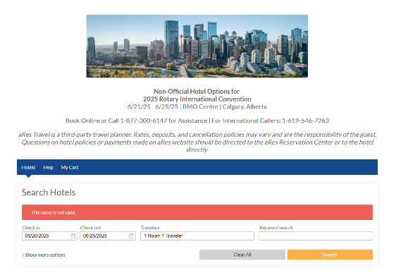
Accommodations
Rotary Room Block
Non-Rotary Room Block
  Hotels in the following areas have been added to the Convention site: Airdrie, Cochrane, Okotoks, High River, Canmore, Banff
Club Billets
  Unofficial – Felipe Guerra, Lethbridge Club
21-25 JUNE 2025 • CALGARY, CANADA
convention.rotary.org

Slide 17
Volunteer Update
February 26, 2025
21-25 JUNE 2025 • CALGARY, CANADA
convention.rotary.org

Slide 18
Volunteer Recruitment Update by Club
Total Number of Volunteers
Total Rotarians District 5360 | 323
Zone 28/32 Rotarians | 56
Other Rotarians in other Rotary Clubs | 178
Total Rotarians | 557
Non-Rotarians | 238
Insufficient Info | 113
TOTAL Volunteer Sign-ups | 908
21-25 JUNE 2025 • CALGARY, CANADA

Slide 19
Volunteer Recruitment Update by Club
Club Name | Volunteers
Airdrie | 2
Banff | 4
Brooks | 4
Calgary at Stampede Park | 46
Calgary Centennial | 13
Calgary Chinook | 13
Calgary Connect | 2
Calgary Downtown | 36
21-25 JUNE 2025 • CALGARY, CANADA

Slide 20
Volunteer Recruitment Update by Club
Club Name | Volunteers
Calgary East | 8
Calgary Fish Creek | 13
Calgary Heritage Park | 36
Calgary Millennium | 2
Calgary North | 16
Calgary Olympic | 2
Calgary Sarcee | 0
Calgary West | 30
Canmore | 8
Cardston | 0
Chestermere | 1
Cochrane | 3
Cochrane Rocky Mountain | 0
21-25 JUNE 2025 • CALGARY, CANADA

Slide 21
Volunteer Recruitment Update by Club
Club Name | Volunteers
Drumheller | 5
Fort Macleod | 0
High River | 7
Innisfail | 0
Kindersley | 1
Lacombe | 1
Lethbridge | 1
Lethbridge East | 4
Lethbridge Mosaic | 1
Lethbridge Sunrise | 3
Medicine Hat | 2
Medicine Hat (Saamis) | 0
Medicine Hat Sunrise | 0
21-25 JUNE 2025 • CALGARY, CANADA

Slide 22
Volunteer Recruitment Update by Club
Club Name | Volunteers
Okotoks | 4
Olds | 4
Pincher Creek | 1
Raymond | 4
Red Deer | 6
Red Deer East | 10
Red Deer Sunrise | 1
Rotaract Clubs | 44
Stettler | 1
Swift Current | 1
Sylvan Lake | 1
Total District 5360 | 323
21-25 JUNE 2025 • CALGARY, CANADA

Slide 23
HOC 2025 Volunteer Opportunities
None of the following HOC 2025 Volunteer Opportunities require you to register for the RI Convention
C-Train Platforms
Calgary International Airport
Calgary Pathway to Convention Campus
Convention Grounds
Hotels
Signature Events
Uniform Distribution
21-25 JUNE 2025 • CALGARY, CANADA

Slide 24
HOC 2025 Volunteer Opportunities
Convention Campus (ScotiaBank Saddledome & BMO Centre)
  Registration,
  General or Breakout sessions,
  House of Friendship
  require a paid registration to volunteer for these roles
21-25 JUNE 2025 • CALGARY, CANADA

Slide 25
Host Hospitality Update
Thanks to all the Rotarians and Clubs who have planned to host our guests! This event is one of the fondest memories many have from the 1996 RI International Convention, last time in Calgary!
21-25 JUNE 2025 • CALGARY, CANADA
convention.rotary.org

Slide 26
Host Hospitality Update
Registered Attendees (Feb. 21, 2025)
1716 attendees registered and paid and growing
Host "seats" available (Feb. 21, 2025)
2033 available spots by Hosts and growing
Cut-off April 20th, 2025
21-25 JUNE 2025 • CALGARY, CANADA

Slide 27
Host Hospitality - What type of events?
53 Home Hosted events by Rotarians and Friends
  Total 591 Guests
14 Club Hosted events
  Total 1442 guests
As of February 21, 2025
21-25 JUNE 2025 • CALGARY, CANADA

Slide 28
Host Hospitality Update
Some of the events we have heard are being planned, with anywhere from
4 to 250 guests:
Meals at members' homes,
A pig roast overlooking the Rocky Mountains,
Beef BBQs,
Calf roping,
Western games,
Dinners at local restaurants and golf clubs,
A Western shoot-out,
Line dancing lessons,
Live music,
Tours of facilities and Rotary Parks,
and most of all, good food and Western Hospitality at its best!"
21-25 JUNE 2025 • CALGARY, CANADA

Slide 29
Host Hospitality - Who is hosting?
Sum of # People
Row Labels | Grand Total
Calgary Centennial | 50
Calgary Chinook | 12
Calgary Connect | 10
Calgary Downtown | 274
Calgary East | 6
Calgary Fish Creek | 62
Calgary Heritage Park | 71
Calgary Millenium | 50
Calgary North | 4
Calgary Olympic | 6
Sum of # People
Row Labels | Grand Total
Calgary Stampede Park | 805
Calgary West | 46
Canmore | 100
Chestermere | 100
Cochrane | 55
Drumheller | 100
Friends of Rotarian | 12
High River | 50
Innisfail | 50
Olds | 50
Red Deer | 120
Grand Total | 2033
21-25 JUNE 2025 • CALGARY, CANADA

Slide 30
Signature Events Update
Get your Party on!!
21-25 JUNE 2025 • CALGARY, CANADA
convention.rotary.org

Slide 31
Signature Events
Saturday, June 21, 2025
Grandstand Spectacular
  Soft Launch for the Convention
  White Hat Ceremony, buy your WHITE HAT
  Stampede Qualifiers for the Indian Bareback Racer
  Fireworks, entertainment and more.....
Sunday June 22, 2025
Pancake for Polio Breakfast (tentative date, to be confirmed)- for registrants only
  This will be a free breakfast for all, with the appreciation of donations to Polio Eradication
New Blood with the Calgary Civic Symphony at the Jubilee (assigned seating)
Rockin' the Big Four Roadhouse – History of Canadian music by "Rock the Nation".
21-25 JUNE 2025 • CALGARY, CANADA
convention.rotary.org

Slide 32
Signature Events
Monday June 23, 2025
Host Hospitality
Home hospitality
Club organized group hospitality events
Tuesday June 24, 2025
Western Showcase
  a night filled with thrilling rodeo demos, cowboy poetry, and live entertainment, promising unforgettable memories for all!
21-25 JUNE 2025 • CALGARY, CANADA
convention.rotary.org

Slide 33
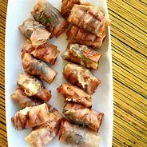
Post Convention Party
For ALL D5360 delegates and volunteers at the convention
Walking distance of Convention Campus
Hors d’oeuvres , Champaign, Cash Bar
This is your District Conference replacement.

Slide 34
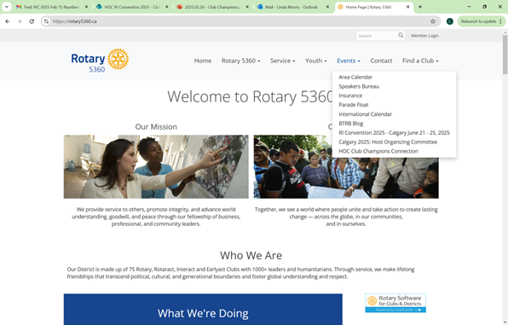

Help Us Help You
Do you know we have a District Page SPECIFICALLY FOR YOU?
CLUB CHAMPIONS CONNECT
Convention.rotary.org - updates are being added regularly:
SPEAKERS are being announced!
BREAKOUT SESSIONS are being scheduled!
21-25 JUNE 2025 • CALGARY, CANADA
convention.rotary.org

Slide 35
CALL TO ACTION – GET REGISTERED!
Convention Registration
  convention.rotary.org/registration
Volunteer Registration
  www.rotarycalgary2025.org/volunteering
Host Hospitality Registration
  www.rotarycalgary2025.org/host-hospitality-event-landing-page
Signature Events
  www.rotarycalgary2025.org/signature-events
21-25 JUNE 2025 • CALGARY, CANADA
convention.rotary.org

Slide 36
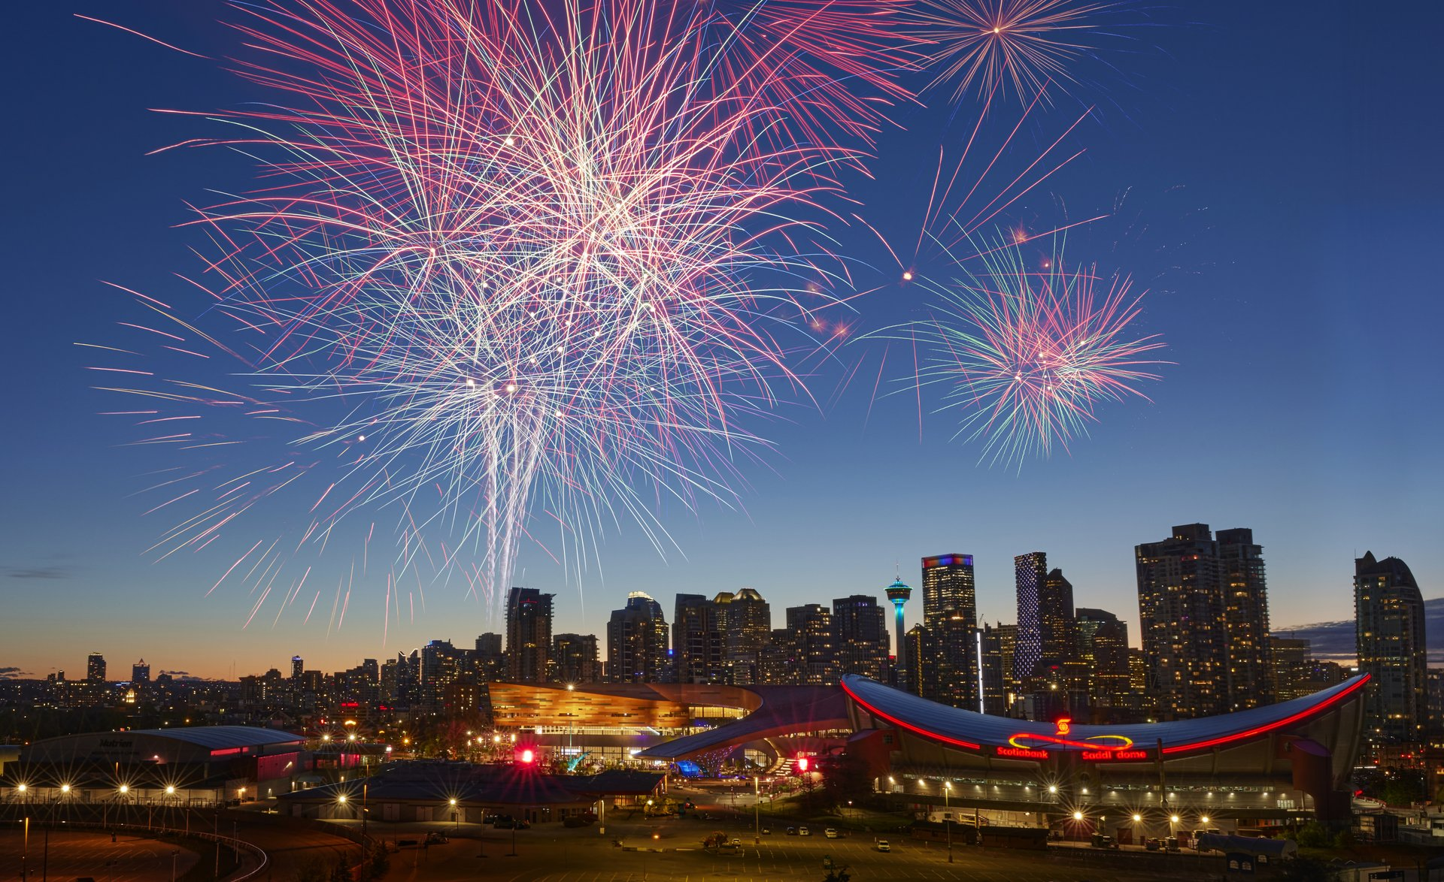
THIS IS A CHANCE OF A LIFETIME
OUR CONVENTION
OUR Moment to Shine ON THE WORLD STAGE
AS WE HOST THE ROTARY WORLD
21-25 JUNE 2025 • CALGARY, CANADA
convention.rotary.org

Slide 37
Q&A
  Volunteering
      Need more communication and Clarity on the Volunteering. People are waiting to put their hand up. For Example:
        Does everyone get a hat?
        Priority goes to those who do 2 shifts, we don't have enough for everyone.
        When do you pick up the Hats?
        A week or so before the convention.
        Can I have it for Saturday night event?
        Not unless you have down 2 shifts prior to the Saturday night event. And you might not be able to watch any event if you are volunteering for the event.
        What is the Timeline of shifts – even a rough estimate
        Breaking the day into 3 shifts 3-5 hours each.
21-25 JUNE 2025 • CALGARY, CANADA
convention.rotary.org

Slide 38
Q&A
  Volunteering
        Locations – when will volunteers know what they can sign up for.
        Airport, Transit stations, Signature events, Downtown, Convention, Hotels. Specific locations and times will be provided late May.
        What do the volunteers need to do
        It will be given to them in the training. Mostly provide guidance and show Canadian hospitality to delegates.
        Where do they pick up their stuff, and when (earliest)
        Depends on where they will be volunteering, some will be delivered ( like the airport) and some will have to get picked up from Tourism Calgary ( 1 week before) or at the Big Four during the convention.
      Cheat sheet to solicit friends and family to volunteer – they were told they would get that at the last meeting.
      The Website has everything needed about locations to volunteer. I think Rotarians know how to talk volunteering without any cheating :) Will ask Rick Istead to comment or provide something.
21-25 JUNE 2025 • CALGARY, CANADA
convention.rotary.org

Slide 39
Q&A
Registration
  How do non-Rotarians register, it was not clear.
    They need to create a "My Rotary Account"
    See FAQs on the HOC website rotarycalgary2025.org
Signature Events
  Can youth under 18 attend the Signature events
    Yes, they can go to all but the Rockin' The Big Four Roadhouse (bar).
Clarity on the Buses for Host Hospitality
  Buses will be set up to carry guests but leave a couple of seats for the Host Club hosts to ride with them. i.e. 55 seat bus, 50 guests, 2 – 3 hosts.
Clarity on the Host Hospitalty Volunteers for the event.
  These are Club volunteers and do not have to sign up to the Volunteering website. We expect Clubs to have their members and friends volunteer to pull the event off.
21-25 JUNE 2025 • CALGARY, CANADA
convention.rotary.org

Slide 40
Q&A
Accommodations
  Are their Shuttle Buses from MRU to the Convention Site
    There are no Shuttle Buses from MRU or SAIT
    Transit available – free with Badges.
  When will these accommodations be open to the Zone.
    MRU will be announced in the next Zone newsletter, and SAIT will be announced shortly after.
    MRU availability has also already been shared with 5370 and 5550
    SAIT will be shared with 4370 and 550 with the next Newsletter – going out in the next few days.
21-25 JUNE 2025 • CALGARY, CANADA
convention.rotary.org

