Slide 1
MAGIC ALL AROUND
21-25 JUNE 2025 • CALGARY, CANADA
convention.rotary.org

Slide 2
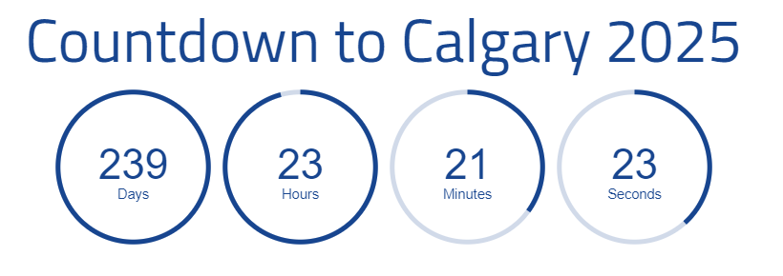
21-25 JUNE 2025 • CALGARY, CANADA
convention.rotary.org

Slide 3
Agenda
Last Month’s “Something to Ponder”
Attendance Targets (Guest Speakers)
Updates from RI
Accommodation
Volunteering
Signature Events
Host Hospitality
Post-Convention Tours
You Saw it Here First…
Questions/Feedback
Calls to Action
21-25 JUNE 2025 • CALGARY, CANADA
convention.rotary.org

Slide 4
“Something to Ponder”
How Does your Club LEVERAGE Calgary 2025 to Grow Membership?
21-25 JUNE 2025 • CALGARY, CANADA
convention.rotary.org

Slide 5
Zone and District Targets
Canadian Hosted
Conference Attendance
Year | City | Attendance
2024 | Calgary
2018 | Toronto | 25,188
2010 | Montreal | 17,909
1996 | Calgary | 24,963
1983 | Toronto | 16,250
1975 | Montreal | 12,975
1964 | Toronto | 14,661
1942 | Toronto | 6,599
1942 | Toronto | 9,173
Christina Hassan, District Governor (5360)
Marilyn Bedell, Zone 32 Promotions Ambassador
21-25 JUNE 2025 • CALGARY, CANADA
convention.rotary.org

Slide 6
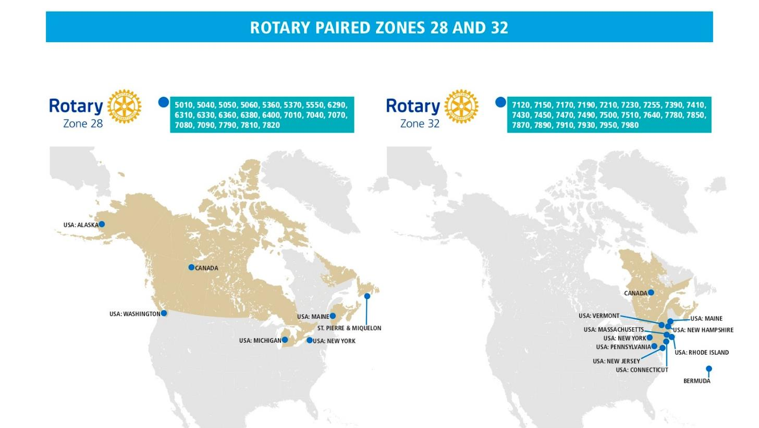
Tracey Vavrek, Rotary Club of Heritage Park
Zone 28 RIC25 Promotions Ambassador
vavrek6@gmail.com
Marilyn Bedell, Rotary Club of Lebanon (NH)
Zone 32 RIC25 Promotions Ambassador
m.k.bedell@comcast.net
21-25 JUNE 2025 • CALGARY, CANADA
convention.rotary.org

Slide 7
Promotion Update
I plan to cover:
Share Zone & District goals for registration for Calgary
Describe what District Leaders and our Promotion Team are hearing about Rotarians enthusiasm for the Convention.
Provide information about what we believe folks are hoping to experience when they come to Calgary.
Offer a few suggestions for D5360 Club Champions to deliver an awesome experience
21-25 JUNE 2025 • CALGARY, CANADA
convention.rotary.org

Slide 8
Goals
Zone 28
100% clubs in Canada will be represented
Zone 32
Every District will have more than the equivalate of 1 attendee/clubs in the District.
21-25 JUNE 2025 • CALGARY, CANADA
convention.rotary.org

Slide 9
Creator: Korisnik | Credit: laufer - stock.adobe.com
21-25 JUNE 2025 • CALGARY, CANADA
convention.rotary.org

Slide 10
Promotion Tools…We are using all of them!
Thanks for all the promotion tools that the HOC has provided:
Postcard
Roll-up banners
Website banners
Social media graphics (Facebook, Instagram, Twitter, and LinkedIn)
Convention virtual backgrounds
PowerPoint template
Flyer
Convention logos
Logos and Brand guidelines
Promotional video
Video The Videos are amazing and get people excited about Calgary.romotion ideas
21-25 JUNE 2025 • CALGARY, CANADA
convention.rotary.org

Slide 11
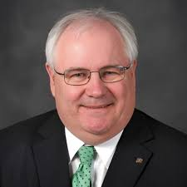
Testimonials Example:
World Polio Day on October 24, 2024, we asked Past Rotary
International Vice President and Rotary Foundation Trustee Mike McGovern, the
International Polio Plus Committee chair, why every Rotarian should attend a Rotary
convention. He replied:
“I can’t wait to go to Calgary. I’ve been to about 25 conventions and somehow I
missed the last one (1996) everyone raved about how much fun it was all they
learned and how it made them be better Rotarian so I’m looking forward to
seeing a lot of Rotary friends new and old in Calgary. And it’s important to be there because you’ll get the best speakers in the world on polio eradication, and you’ll hear the very latest news that we finally move forward to completing the task to End Polio Now.”
Take ACTION: Register
21-25 JUNE 2025 • CALGARY, CANADA
convention.rotary.org

Slide 12
New Members
21-25 JUNE 2025 • CALGARY, CANADA
convention.rotary.org

Slide 13
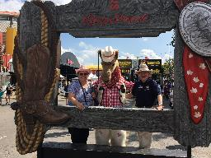
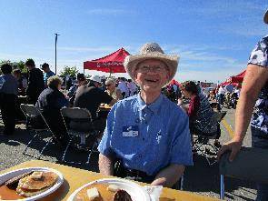
D5360 Rotarians are the BEST!
21-25 JUNE 2025 • CALGARY, CANADA
convention.rotary.org

Slide 14
White Hat

Slide 15
Updates from RI
21-25 JUNE 2025 • CALGARY, CANADA
convention.rotary.org

Slide 16
Updates from RI
RI was in Calgary last week…everything is looking GREAT!!!
CONNECTION is the reason Rotarians attend the RI Convention
Applicants for Breakout Sections closed Oct 14th, there was a record 367 applications for 70 spots.
You can find Convention news in:
Rotary Magazine
Rotary Canada Magazine
News & Features | Rotary International
New videos coming soon to help support recruitment efforts.
21-25 JUNE 2025 • CALGARY, CANADA
convention.rotary.org

Slide 17
Accommodation
21-25 JUNE 2025 • CALGARY, CANADA
convention.rotary.org

Slide 18
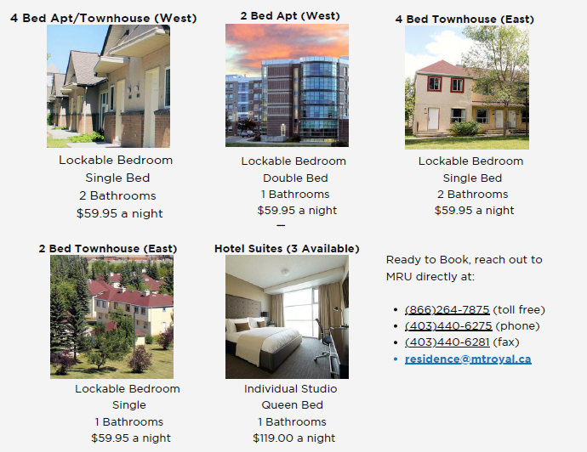
District Accommodation
Mount Royal Residences
300 Units available
30 minutes trip by Public Transit to the Convention Campus
Great way for 5360 /5370 Rotarians to strengthen our camaraderie
Residence Services | MRU
SAIT Residents
Information coming soon
University of Calgary Residences
Information coming soon
Act FAST….
21-25 JUNE 2025 • CALGARY, CANADA
convention.rotary.org

Slide 19
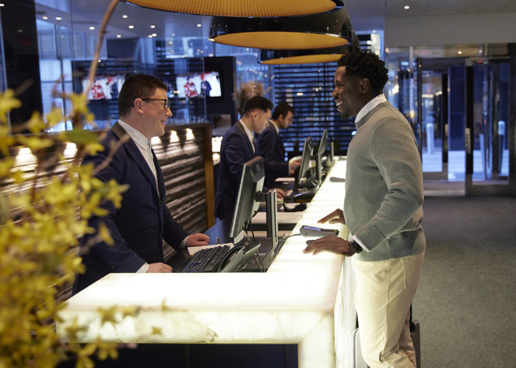
RI Room Block
Date
Oct 30th | Last Day to Reduce or Adjust Room Blocks without Penalty
Nov 13th | 2-night deposit required for each of the held rooms in a block, otherwise room released
Mar 19th | Last Day to PROVIDE names on Reserved Rooms
May 29th | Last Day to CHANGE names on reserved rooms
21-25 JUNE 2025 • CALGARY, CANADA
convention.rotary.org

Slide 20
Sponsorship Team
Community Engagement Volunteers from the Across the District
melaniedaletodd@gmail.com
Promotions and Marketing
Content creation
Social Media Management
Website development
Language Translation
promotions@rotarycalgary2025.org
Convention
Volunteering | Calgary 2025 HOC
21-25 JUNE 2025 • CALGARY, CANADA
convention.rotary.org

Slide 21
New Blood With the Calgary Symphony Orchestra
Venue Change: Jubilee Auditorium
Grandstand Show
Indian Relay Race is a qualifying event for Calgary Stampede
9 Top US teams will be competing – you are seeing the “Best of the Best”
New Promotional videos are coming to the HOC Website
Exploring Additional Food and Beverage packages as part of our Signature Events
21-25 JUNE 2025 • CALGARY, CANADA
convention.rotary.org

Slide 22
Some digits…
531 seats have been entered through the website
700 seats have been verbally committed (we need those entered on the site)
4,000 more seats is what we believe will be required to meet demand
It is VERY IMPORTANT that you register your willingness to host on the website at Host Hospitality Evening | Calgary 2025 HOC
Suggestions:
Create a signup sheet in your club of interested Rotarians
Where it makes sense, pair up Rotarians to host together
21-25 JUNE 2025 • CALGARY, CANADA
convention.rotary.org

Slide 23
Currently 7 Vocational/Fellowship Tours under consideration
Lethbridge proposing an Agriculture Tour
Olds is proposing an Agriculture Tour
Red Deer is proposing a Fellowship Tour
Calgary Economic Development is proposing 4 Tours
Deadline for Tours to be on the HOC Site is December 1st
A Third-Party Operator is being used to manage the tours
21-25 JUNE 2025 • CALGARY, CANADA
convention.rotary.org

Slide 24
You Saw it Here First…
21-25 JUNE 2025 • CALGARY, CANADA
convention.rotary.org

Slide 25
You Saw it Here First…
Home Page for Champions
Newsletter Archive
Slide Deck Archive
21-25 JUNE 2025 • CALGARY, CANADA
convention.rotary.org

Slide 26
Questions / Feedback
21-25 JUNE 2025 • CALGARY, CANADA
convention.rotary.org

Slide 27
Calls to Action promotions@rotarycalgary2025.org
Talk to your President about getting some agenda time TWICE a month to provide updates and encourage Rotarians to register
Talk to your board about setting some fun, competitive targets for club participation in Convention
Remind attendees to book their accommodation ASAP
Take the lead in organizing your Club’s Host Hospitality program
Collect questions/feedback for the HOC and share it with Miriam, Linda or Darcy
Tell us about what your club is planning with a quick synopsis
21-25 JUNE 2025 • CALGARY, CANADA
convention.rotary.org

Slide 28
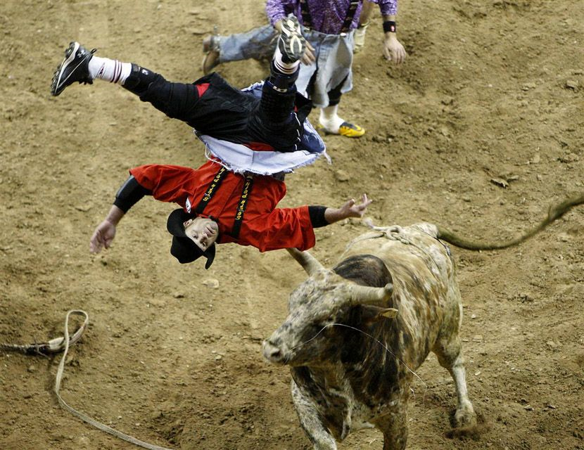
No Bull!!
Price Increases Dec. 16th!!!!!

Slide 29
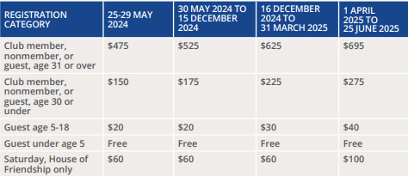
The Best Day to purchase your Registration is…TODAY
21-25 JUNE 2025 • CALGARY, CANADA
convention.rotary.org

Slide 30
Rotary Convention
Calgary 2025 HOC (rotarycalgary2025.org)
Home Page of Champions

Slide 31
HOC Promotions and Communication Team
promotions@rotarycalgary2025.org
Miriam Mitchell-Banks (Rotary Club of Calgary Centennial)
miriam.mitchellbanks@rotarycalgary2025.org
403.630.0898
Darcy Mykytyshyn (Rotary Club of Red Deer)
darcy.mykytyshyn@rotarycalgary2025.org
403.896.6922
Linda Morris (Rotary Club of Calgary Fish Creek)
info@rotarycalgary2025.org
587.224.5958
21-25 JUNE 2025 • CALGARY, CANADA
convention.rotary.org

Slide 32
MAGIC ALL AROUND
21-25 JUNE 2025 • CALGARY, CANADA
convention.rotary.org

