Slide 1
MAGIC ALL AROUND
21-25 JUNE 2025 • CALGARY, CANADA

Slide 2
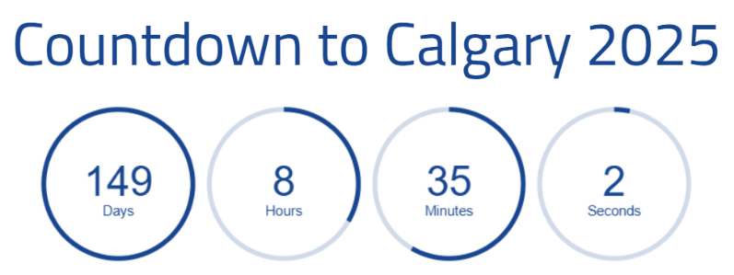
21-25 JUNE 2025 • CALGARY, CANADA
convention.rotary.org

Slide 3
Agenda
Convention Goals
Promotions Update
Accommodations Update
Volunteer Update
Host Hospitality Update
Signature Events Update
Help Us Help You
The Websites to Bookmark
21-25 JUNE 2025 • CALGARY, CANADA
convention.rotary.org

Slide 4
Convention Goals
21-25 JUNE 2025 • CALGARY, CANADA
convention.rotary.org

Slide 5
HOC Desired Outcomes Bid Document
Community Engagement:
Bring the Rotary convention experience to non-Rotarian citizens through initiatives like "Painting the Town Blue.“
Host pre-convention community events, such as festivals and fundraising activities, to increase local awareness and involvement.
Building Rotary Locally:
Use the convention to inspire a 20% membership growth within District 5360.
Launch local campaigns to raise awareness about Rotary’s mission and impact.
Organize events like “Why I am a Rotarian” to deepen connections and attract members.
21-25 JUNE 2025 • CALGARY, CANADA
convention.rotary.org

Slide 6
HOC Desired Outcomes Bid Document
Lasting Impact and Legacy Projects:
Establish a $1,000,000 Convention Legacy Fund to fund community projects.
Implement hands-on community service projects to engage attendees and locals.
Youth and Education Initiatives:
Introduce leadership curriculums in schools to promote Rotary’s values.
Develop a district-wide stay-in-school scholarship program.
Create an online platform for youth to share ideas and initiatives.
21-25 JUNE 2025 • CALGARY, CANADA
convention.rotary.org

Slide 7
HOC Desired Outcomes Bid Document
Showcase Calgary’s Strengths
Highlight Calgary’s ability to host world-class events and its culture of volunteerism.
Celebrate the city’s unique heritage through special events, such as the "World’s Largest Barbeque."
21-25 JUNE 2025 • CALGARY, CANADA
convention.rotary.org

Slide 8
HOC Desired Outcomes As things have evolved…
Legacy and Future Conventions:
Create a legacy model that other host cities can replicate.
Build frameworks for continuous improvement in future conventions
Demonstrate how local engagement can enhance the convention experience and drive attendance
21-25 JUNE 2025 • CALGARY, CANADA
convention.rotary.org

Slide 9
The Goals
Canadian Hosted
Convention Attendance
District 5360
1000 attendees
Zone 28
100% of Clubs in Canada
Zone 32
1 Club / district
HOC
Best Attended Convention in Canada
Year | City | Attendance
2024 | Calgary
2018 | Toronto | 25,188
2010 | Montreal | 17,909
1996 | Calgary | 24,963
1983 | Toronto | 16,250
1975 | Montreal | 12,975
1964 | Toronto | 14,661
1942 | Toronto | 6,599
1942 | Toronto | 9,173
21-25 JUNE 2025 • CALGARY, CANADA
convention.rotary.org

Slide 10
The Numbers As of Jan 20, 2025
Canadian Hosted
Convention Attendance
Registered Rotarians from 5360 (450 of 1654)
27%
Percentage of District Attendance Goal (450/1000)
45%
Clubs Represented (40 of 40)
100%
5360 Rotarians Representation of ZONE 28 (450/2159)
21%
Year | City | Attendance
2024 | Calgary
2018 | Toronto | 25,188
2010 | Montreal | 17,909
1996 | Calgary | 24,963
1983 | Toronto | 16,250
1975 | Montreal | 12,975
1964 | Toronto | 14,661
1942 | Toronto | 6,599
1942 | Toronto | 9,173
21-25 JUNE 2025 • CALGARY, CANADA
convention.rotary.org

Slide 11
Promotional Efforts
New Registrations
Get Ready
We’re Coming Calgary
21-25 JUNE 2025 • CALGARY, CANADA
convention.rotary.org

Slide 12
Accommodations Update
21-25 JUNE 2025 • CALGARY, CANADA
convention.rotary.org

Slide 13
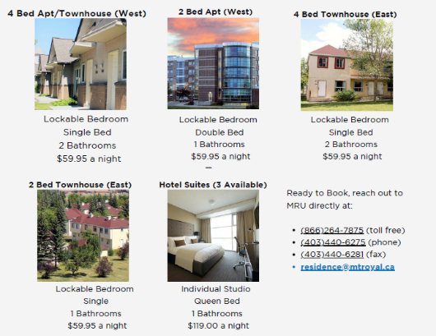
District Accommodation
Mount Royal Residences
350 Units available
30 minutes trip by Public Transit to the Convention Campus
Great way for 5360 /5370 Rotarians to strengthen our camaraderie
Residence Services | MRU
SAIT Residents
Information coming soon
University of Calgary Residences
Information coming soon
Act FAST….
21-25 JUNE 2025 • CALGARY, CANADA
convention.rotary.org

Slide 14
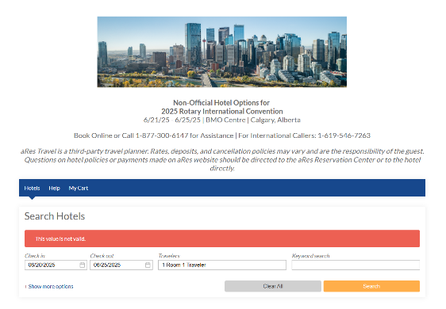
District Accommodations
Rotary Room Block
Non-Rotary Room Block
Moving Attendees from Airdrie, Cochrane, Okotoks, High River, Canmore, Banff
Club Billets
21-25 JUNE 2025 • CALGARY, CANADA
convention.rotary.org

Slide 15
Volunteer Update
21-25 JUNE 2025 • CALGARY, CANADA
convention.rotary.org

Slide 16
Volunteer Recruitment Update (17/01/25)
Estimated Volunteer Shifts
~1000
Currently 1595
Rotarian Volunteers
500
Supporting Volunteers
500
21-25 JUNE 2025 • CALGARY, CANADA

Slide 17
Volunteer Recruitment Update (17/01/25)
Rotarian Volunteers
500
Supporting Volunteers
500
District 5360 (75%)
Zone 28-32 (15%)
Other Rotarians (10%)
Local Volunteer organizations i.e. Calgary Stampede, Cenovus, Toastmasters, Bethany Care, etc.
Rotary family, friends & neighbors
21-25 JUNE 2025 • CALGARY, CANADA

Slide 18
Volunteer Recruitment Update (17/01/25)
Rotary Volunteer Sign-ups
# of District 5360 Rotary/Rotaract Clubs – 47
# of Clubs with Volunteer Sign-ups - 38 (81%)
# of District 5360 Rotary/Rotaract Club Volunteer Sign-ups – 299
# of Zone 28 Rotary/Rotaract Clubs Volunteer Sign-ups - 35
# of Zone 32 Rotary/Rotaract Clubs Volunteer Sign-ups - 17
# of Other Rotary/Rotaract Clubs Volunteer Sign-ups – 138 (28 countries)
TOTAL Rotary Volunteer Sign-ups - 489
TOTAL Volunteer Sign-ups - 800
21-25 JUNE 2025 • CALGARY, CANADA

Slide 19
Volunteer Recruitment Update (17/01/25)
Clubs with > 40 Volunteer Sign-ups (1)
Calgary at Stampede Park (42)
Clubs with > 30 Volunteer Sign-ups (2)
Calgary Heritage Park (36)
Calgary Downtown (33)
Clubs with > 20 Volunteer Sign-ups (2)
Calgary West (26)
Rotaract UofC (23)
21-25 JUNE 2025 • CALGARY, CANADA

Slide 20
Volunteer Recruitment Update (17/01/25)
Clubs with > 10 Volunteer Sign-ups (4)
Calgary North (15)
Calgary Centennial (13)
Calgary Fish Creek (13)
Calgary Chinook (12)
21-25 JUNE 2025 • CALGARY, CANADA

Slide 21
Volunteer Recruitment Update (17/01/25)
Clubs with > 5 Volunteer Sign-ups (7)
Calgary East (8)
Canmore (7)
Red Deer East (7)
Red Deer (6)
Drumheller (5)
High River (5)
Rotaract United (5)
21-25 JUNE 2025 • CALGARY, CANADA

Slide 22
Volunteer Recruitment Update (17/01/25)
Clubs with > 1 Volunteer Sign-ups (22)
Brooks, Okotoks, Olds, Raymond (4)
Cochrane, Lethbridge Sunrise (3)
Airdrie, Calgary Connect, Calgary Millennium, Calgary Olympic, Medicine Hat (2)
Chestermere, Lacombe, Lethbridge, Lethbridge East, Lethbridge Mosaic, Pincher Creek, Red Deer Sunrise, Rotaract UofL, Stettler, Swift Current, Sylvan Lake (1)
21-25 JUNE 2025 • CALGARY, CANADA

Slide 23
Volunteer Recruitment Update (17/01/25)
Other Rotary/Rotaract Volunteer Sign-ups
Zone 28 (35)
Zone 32 (17)
Other Rotaract Clubs (13)
Other Rotary Clubs (125)
21-25 JUNE 2025 • CALGARY, CANADA

Slide 24
Monthly Volunteer Recruitment Update (Internal)
Next Steps
Club Champions to continue to promote volunteer opportunities with their members;
Clubs to set volunteer sign-up goals if you haven’t already
Clubs who currently have no volunteer sign-ups
Clubs which have the potential for more volunteer sign-ups based on their goal
Encourage Calgary & Area Rotarians who have signed up to volunteer to reach out to their family, friends, neighbors, work colleagues to promote volunteer opportunities
21-25 JUNE 2025 • CALGARY, CANADA

Slide 25
Monthly Volunteer Recruitment Update (Internal)
Next Steps
Work with the Zone 28 & 32 Convention Champions to continue to promote volunteer opportunities with their members who have registered for or are planning to register for the Calgary Convention;
Volunteer shift schedules, position descriptions and training in development.
Expect to launch volunteer shift schedules in May
21-25 JUNE 2025 • CALGARY, CANADA

Slide 26
HOC 2025 Volunteer Opportunities
None of the following HOC 2025 Volunteer Opportunities require you to register for the RI Convention
C-Train Platforms
Calgary International Airport
Calgary Pathway to Convention Campus
Convention Grounds
Hotels
Signature Events
Uniform Distribution
21-25 JUNE 2025 • CALGARY, CANADA

Slide 27
HOC 2025 Volunteer Opportunities
Convention Campus (ScotiaBank Saddledome & BMO Centre)
Registration, General or Breakout sessions, House of Friendship require a paid registration to volunteer
21-25 JUNE 2025 • CALGARY, CANADA

Slide 28
Host Hospitality Update
21-25 JUNE 2025 • CALGARY, CANADA
convention.rotary.org

Slide 29
Signature Events Update
21-25 JUNE 2025 • CALGARY, CANADA
convention.rotary.org

Slide 30
Signature Events
Pancake for Polio Breakfast…more details to come
White Hat Ceremony at the Grandstand Show
Tickets are on Sale now
21-25 JUNE 2025 • CALGARY, CANADA
convention.rotary.org

Slide 31
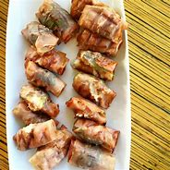
Post Convention Party
For ALL D5360 delegates and volunteers at the convention
Walking distance of Convention Campus
Hors d’oeuvres , Champaign, Cash Bar
This is your District Convention

Slide 32
Help Us Help You
Tell us what you are hearing from your clubs.
21-25 JUNE 2025 • CALGARY, CANADA
convention.rotary.org

Slide 33
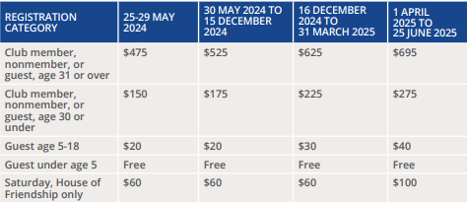
The Price
21-25 JUNE 2025 • CALGARY, CANADA
convention.rotary.org

Slide 34
Call to Action
Register TODAY
21-25 JUNE 2025 • CALGARY, CANADA
convention.rotary.org

Slide 35
How to Register
Convention Registration
convention.rotary.org/registration
Volunteer Registration
www.rotarycalgary2025.org/volunteering
Host Hospitality Registration
www.rotarycalgary2025.org/host-hospitality-event-landing-page
Signature Events
www.rotarycalgary2025.org/signature-events
21-25 JUNE 2025 • CALGARY, CANADA
convention.rotary.org

Slide 36
District Q&A With the Co-Chairs
January 29, 2025
7:00pm to 8:00pm
Please REGISTER
21-25 JUNE 2025 • CALGARY, CANADA
convention.rotary.org

Slide 37
This is OUR Moment to Shine!!!
Let’s show the WORLD how we WORK HARD, PLAY HARD, and SERVE HARD
21-25 JUNE 2025 • CALGARY, CANADA
convention.rotary.org

