Slide 1

Highlights of New Wild Poliovirus and cVDPV Positives
Reported Globally this Week
¹contacts of positive AFP cases, community, healthy children
The boundaries and names shown and the designations used in the maps in this document do not imply the expression of any opinion whatsoever on the part of the World Health Organization concerning the legal status of any country, territory, city or area or of its authorities, or concerning the delimitation of its frontiers or boundaries. Dotted lines on maps represent approximate border lines for which there may not yet be full agreement. © WHO 2023. All rights reserved
Data in WHO HQ as of 02 May 2023

Slide 2
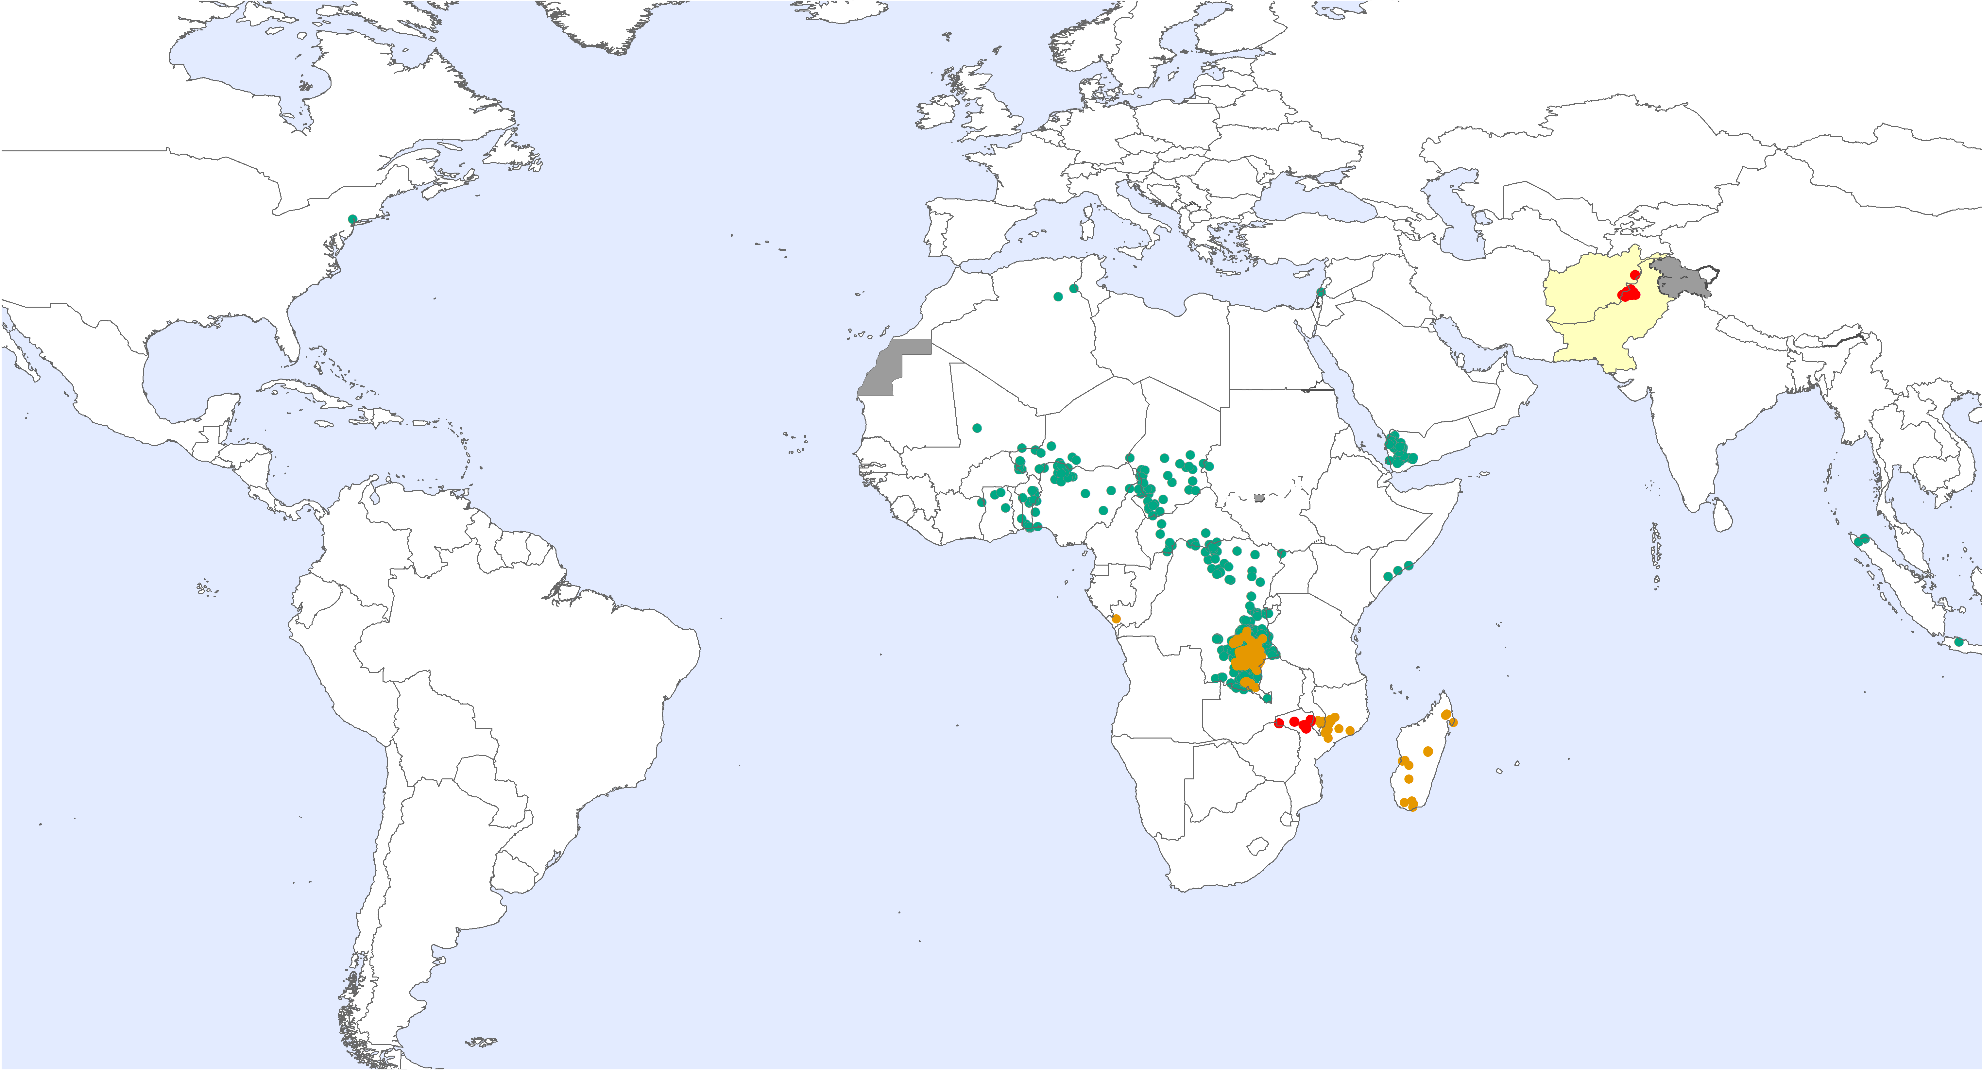
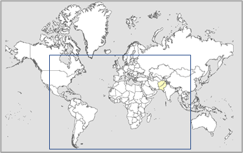
Global WPV1 & cVDPV Cases¹, Previous 12 Months²
Endemic country (WPV1)
¹Excludes viruses detected from environmental surveillance; ²Onset of paralysis: 03 May 2022 to 02 May 2023

Slide 3
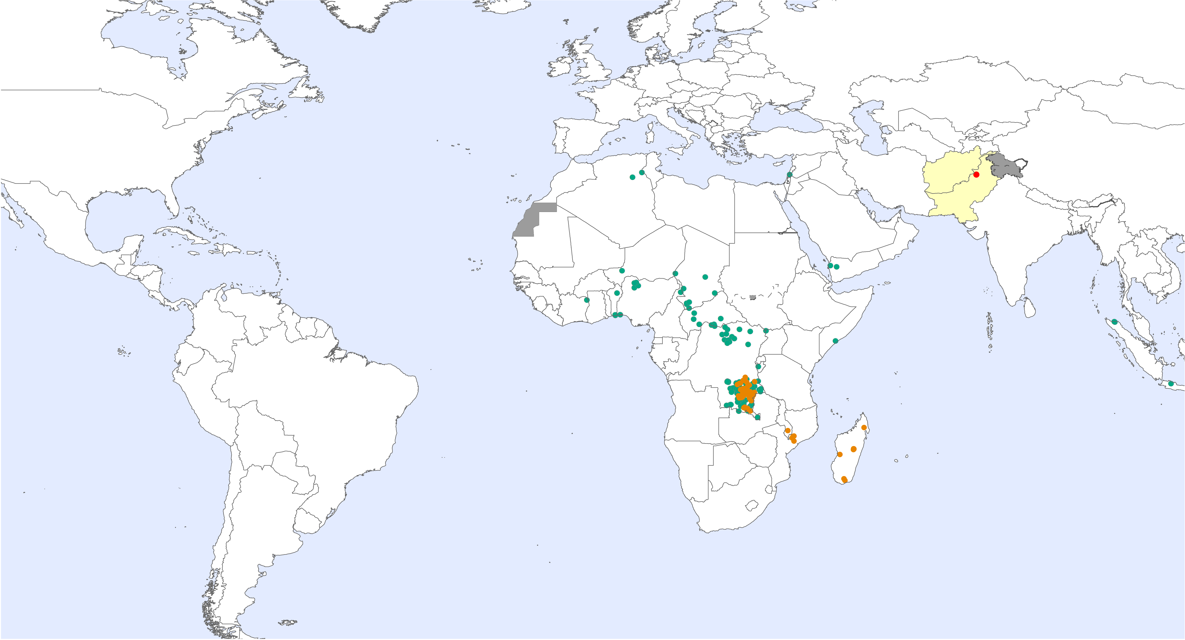
Global WPV1 & cVDPV Cases¹, Previous 6 Months²
Endemic country (WPV1)
¹Excludes viruses detected from environmental surveillance; ²Onset of paralysis: 03 Nov. 2022 to 02 May 2023

Slide 4
Global Wild Poliovirus 2017 - 2023

Slide 5
Global Circulating Vaccine-derived Poliovirus (cVDPV)^{1,2,3}
¹For cVDPV definition see http://polioeradication.org/wp-content/uploads/2016/09/Reporting-and-Classification-of-VDPVs_Aug2016_EN.pdf. ² Include contact, healthy and community samples. ³cVDPV1 and cVDPV2 isolated from three children

Slide 6

Global Surveillance Indicators: Year to Date Comparison
2022 & 2023: 01 Jan. to 02 May 2023*
¹cVDPV includes all three serotypes 1, 2 and 3. Please refer to slide 5 for the distribution of cases by serotype.
For data at country, regional and global levels from 2000 onwards, see the WHO website at https://extranet.who.int/polis/public/CaseCount.aspx
*Data for 2022 as of 03 May 2022 and for 2023 as of 02 May 2023

