Slide 1


MEMBERSHIP
GROWTH
CAMPAIGN
District 5390 - 2026
Thanks for being a
_______ Rotarian!
Notes:
Image source: AI-generated

Slide 2


Agenda
  Why does membership matter?
  Why invite someone to Rotary?
  Who makes a good Rotarian?
  Where do I find future Rotarians?
  How do I engage someone?
Notes:
Understanding Rotary Club Branding and Color Significance
Crafting an Elegant Slide Header
Designing a Distinctive Slide Footer
Creating Eye-Catching Headline Styles
Tips for Maintaining a Simple and Cohesive Template
Image source: AI-generated

Slide 3
Membership Plan
  Grow membership by __% by ____
  Find active, passionate colleagues
We currently have __ active members.
This would be an increase to __ members.
  Enhance membership growth skills
  Diversify and deepen bench

Slide 4
Membership Matters
A club with vibrant, growing membership…
  Ensures vitality
  Builds sustainability
  Amplifies impact
  Mitigates problems
  Broadens reach
  Enables Excellence

Slide 5
Rotary Trends
60
1.21M
35k
Current average age
of a Rotarian
Current # Active Rotarians
Current # Clubs
18k
64
850k
Average in 2010
Rotarians in 1980
Clubs in 1980

Slide 6
Rotary Trends
$.45B
$5B
44
RI Annual Giving
RI Endowment
Polio Cases 2025
~$50M
~$.8B
300k
Giving in 1980
Endowment in 1980
Polio Cases in 1980

Slide 7
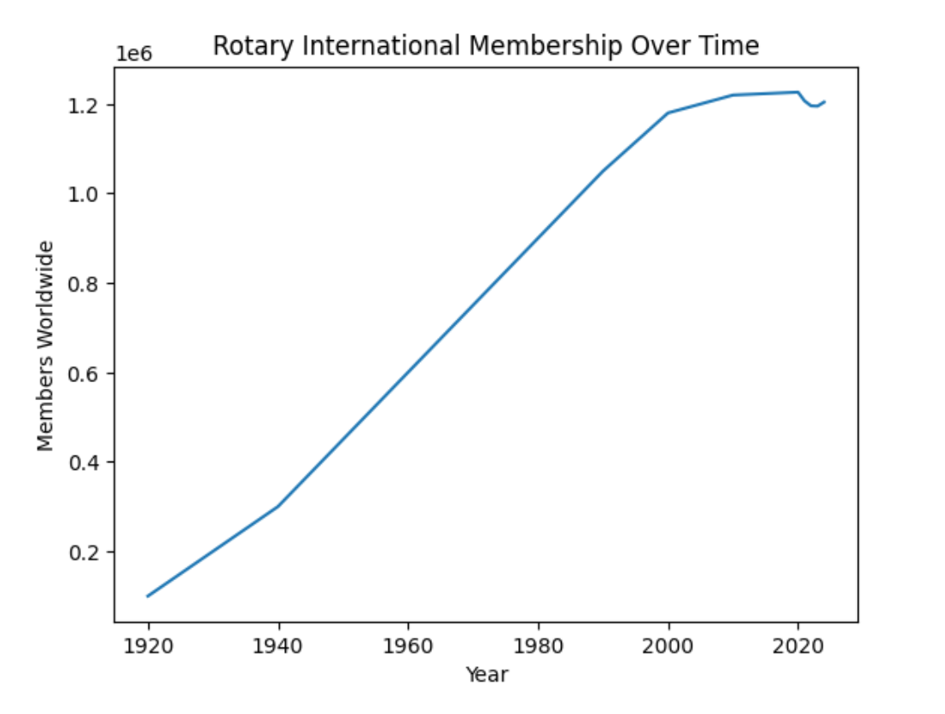
Rotary Trends
Rotary is…
Rotary Membership
  Successfully Evolving
  Increasing Momentum
$1.21 Million
Strong!
  Elevating Global Impact

Slide 8
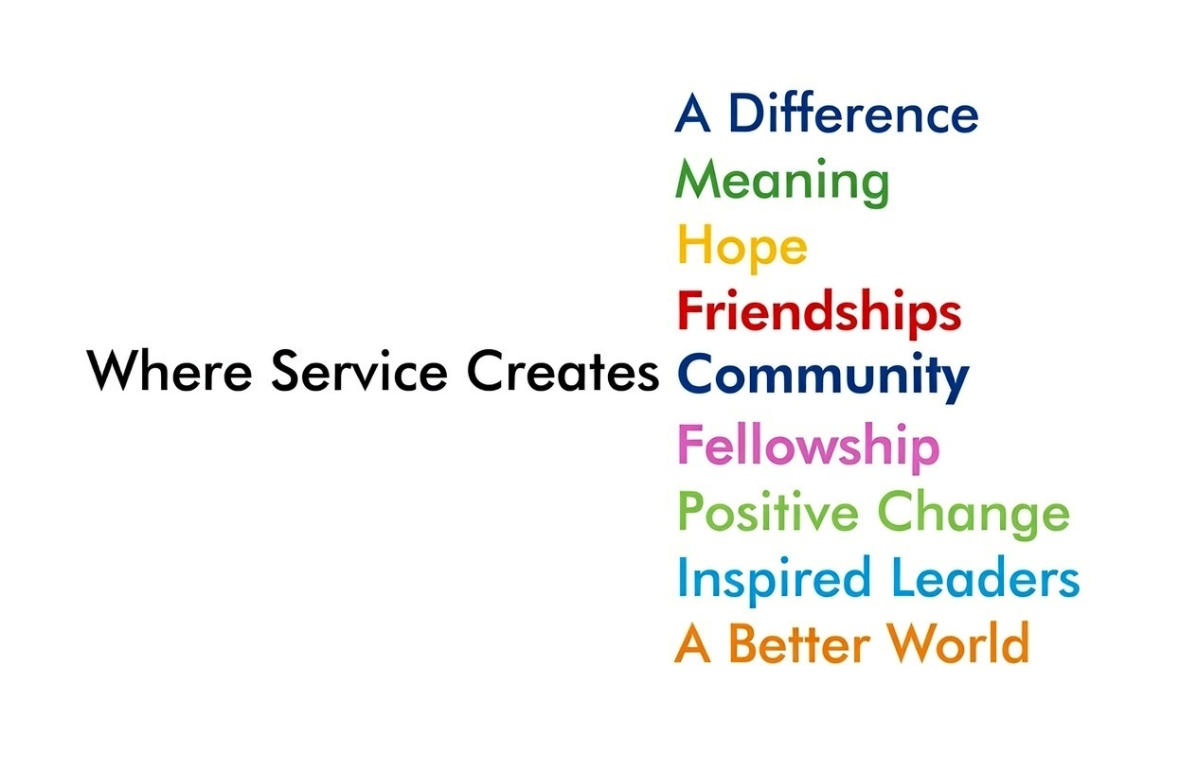

Common Theme
Meet great people.
Do meaningful things, together.
Make our World a better place.

Slide 9
Why Invite?
Rotary is a gift that helps people:
Connect with Community
Make a Meaningful Difference
Grow Personally & Professionally
Building Lasting Relationships
Be Part of Something Enduring
Have Fun & Good Fellowship
“When you serve with Rotary, you’re not just changing lives, you’re enriching your own.
Service transforms the server. ”
          John Hewko
RI General Secretary, 2011
Everyone comes to Rotary for a different reason.
Find out theirs and start there.

Slide 10

Elevator Pitch
Simple, Standard Pitch
Rotary is a group of people who come together to serve their community, build meaningful relationships, and grow personally and professionally, while having fun and making a real difference.
Everyone comes to Rotary for a different reason.
Find out theirs and start there.

Slide 11

Light Bulb Moment:
Successful marketing isn’t about talking; it’s about listening enough to understand what matters most to the other person.
“Why should you
join Rotary”
“What are you looking to build in your life right now?”
How would you like to make a bigger impact in your work or with your family?
How does service to your community play into your dreams or ambitions?
What kind of people are you surrounding yourself with to be happy and successful?
If you could envision the perfect community, what would it look like?
What would be worthwhile to learn or know about your community every week?
Have you ever felt what it is like to give selflessly?
What makes you feel most energized outside of family and work?
What would make joining Rotary a valuable investment for you?

Slide 12
Who to Invite?
Demonstrats Service Above Self: placing the needs of others and the good of the community ahead of personal gain
Commits to The Four-Way Test: a commitment that our actions be truthful, fair, constructive and of benefit to those involved.
Supports International Concepts: bringing people together to provide humanitarian service, promote integrity, and advance goodwill and peace in communities around the world.
Serves Youth At-Risk Youth: including a commitment to our programs with the Partnership for Children and supporting the Sunrise Children’s Home.
Works Toward a Common Goal: Rotary brings people together from different backgrounds and perspectives who set aside personal agendas and politics to focus on serving others and advancing shared club goals.
Has Fun: Enjoy building fellowship, forming friendships, and having fun while serving alongside others.
Has and Gives of Their Time: The ability to give time to Rotary by attending meetings and activities, including weekly morning meetings.
Ideal Rotarians come in all forms and backgrounds. We intentionally seek new members who broaden our diversity of experiences, perspectives, and knowledge.
We also recognize that Rotary requires a meaningful commitment of time, talent, and resources and that our mission resonates most strongly with individuals who share our purpose and values.

Slide 13
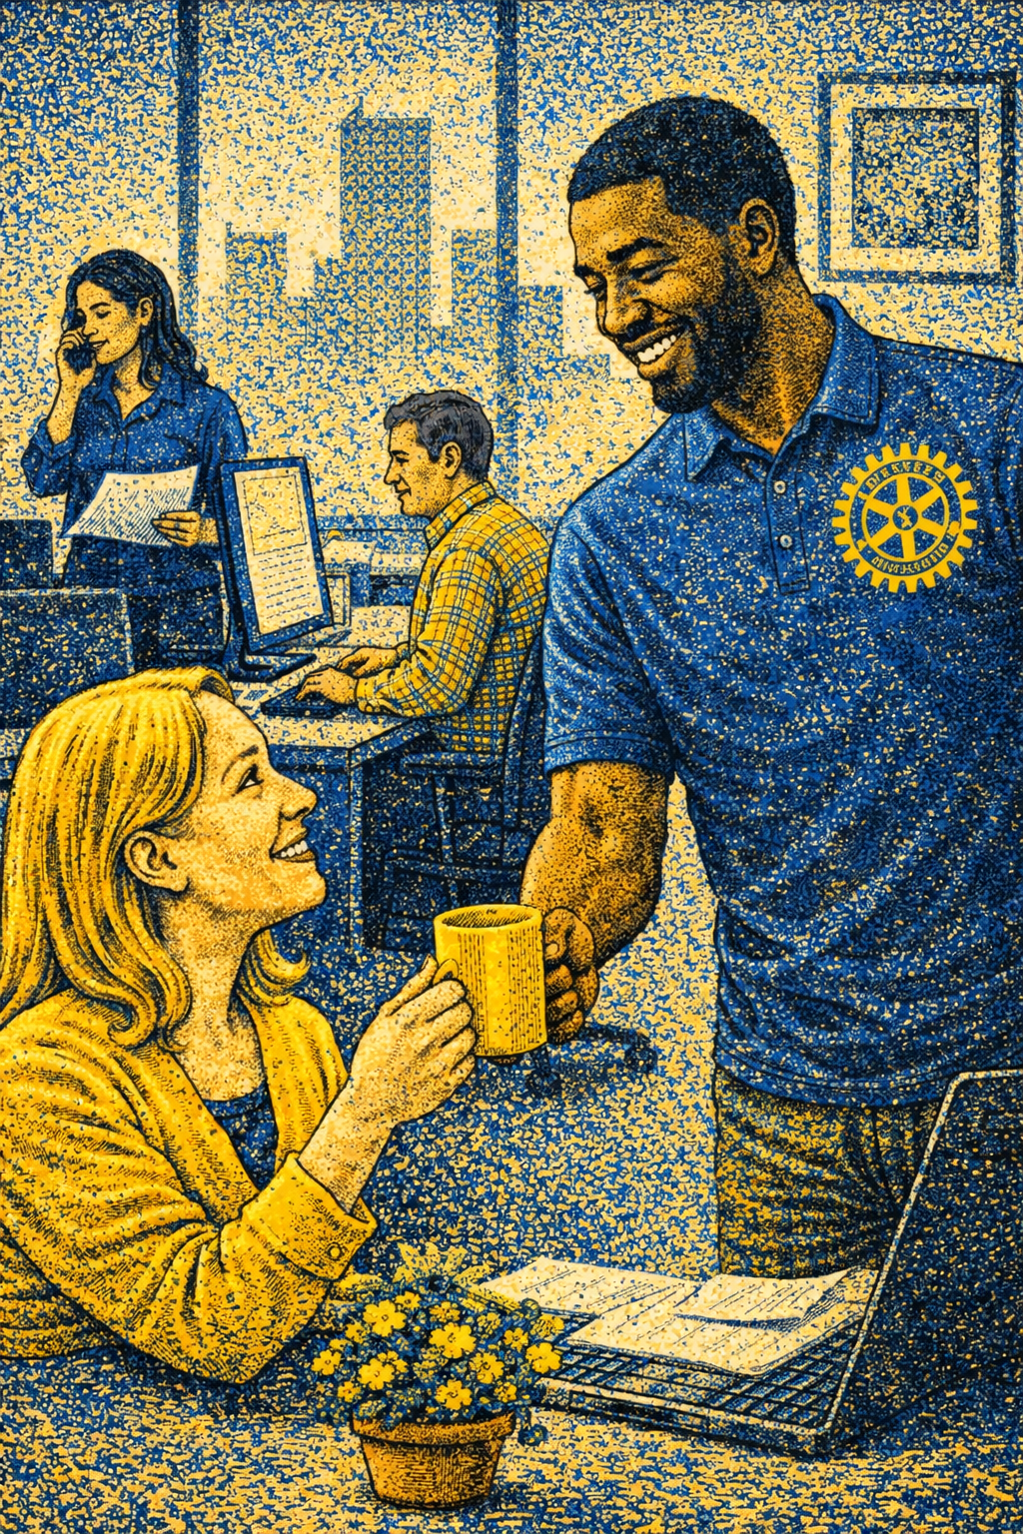
Where to look?
Friends
Family
Work Colleagues / Employees
Customers & Suppliers
Neighbors
Other Community Groups
Church
Associations & Conferences
Where else?

Slide 14
Costs
TYPE | ANNUAL COST | COMPARISON
Regular | $412.50
Associate | $182.50
Originations with Multiple Members | $825 for 2 $1108 for 3
Less than an annual
gym membership
Less than a year of
Netflix Standard (no ads)
Less than 1 day of
corporate training
Rotary is affordable and worth it!
*Associate Members Requires board review and approval

Slide 15
Personal Plan
Who are three people that would make good Rotarians?
Where are two places you could look?
Who could you ask, “What are you trying to achieve”?

Slide 16
Thank You!
We are the best because
you are the best!

