Slide 1
District 5470 Rotary Foundation Seminar
District Grants 2019-2020
Prepared by Aaron Tice
District Grants Chair – Aaron Tice
November 2019– Alamosa, CO
Notes:
Welcome to District 5470 District Grant training.
This training is part of the requirement to get your club certified to apply for grants from your District Designated funds.
District Grants are a simple way to do smaller projects focusing on the areas your club wants to support. The criteria for approval is broader than Global Grants and the approval process is faster.
The basic Rotary Foundation criteria states that District Grants must align with The Rotary Foundation Mission which is to advance world understanding, goodwill, and peace through the improvement of health, the support of education, and the alleviation of poverty.
Each District can make additional requirements based on the Disticts needs and goals.

Slide 2
District Grants: TRF Mission
The mission of The Rotary Foundation (TRF) is to enable Rotarians to advance world understanding, goodwill, and peace through the improvement of health, the support of education, and the alleviation of poverty.

Slide 3
District Grants
What are district grants?
District grants fund smaller, short-term activities that can address needs in both local and worldwide communities.
District Grant Committees choose which activities to fund.
District Grants are funded as a block grant.
Districts must be qualified to administer district grants.
Notes:
What are district grants?
District grants fund smaller, short-term activities that address needs in both your local community and communities worldwide. Each District gets to choose which activities it will fund with these grants.
You can use district grants to fund a variety of activities which will be determined by the District Grant Committee, including:
Humanitarian projects, disaster recovery efforts, scholarships for any level, length of time, location, or area of study (District Grant Committee discretion).
District Grants and funded as a block grant. This means that each year the District Grants committee will ask for grants requests from the District. This typically occurs during the last quarter of the current Rotary year for the upcoming Rotary year. Once we have a list of proposed projects that have been approved by the District Grant committee the District Grant Chair can apply for the entire annual District Grant budget.
Districts must be qualified before they can administer district grants. This means that all TRF requirements for existing grants must have been met before we can apply for the next years round of funding. A District that is not qualified cannot apply for any RF grant funding until the requirements have been met.

Slide 4
District Grants
District Grants:
Must support the MISSION of TRF, refer to previous slide
Require no minimum budget, as opposed to Global Grants
Provide a short term impact - can be local or international
International Water Grants may be subject to additional scrutiny for sustainability.
Can support scholarships for any level of study locally or internationally - this will be a committee decision.
Require active Rotarian involvement in delivering the grant.
Must adhere to grant terms and conditions (MOU).
Each Club is financially responsible for the project
All expenses must be documented or funds may have to be returned.
Notes:
All District Grant requests for initial consideration need to be submitted to the District 5470 District Grant chair by a date determined by the District, typically due in late June. The total budget for the District will be determined annually by the District Foundation committee.
The total District Grant 2016-2017 Budget is $84,000
Grants must support the MISSION of TRF: “The mission of The Rotary Foundation (TRF) is to enable Rotarians to advance world understanding, goodwill, and peace through the improvement of health, the support of education, and the alleviation of poverty.
There is no minimum budget for a grant request
Grants typically have a short term impact and can be local or international
They can support scholars for any level of study locally or internationally
Grants must have some level of active Rotarian involvement
They must adhere to grant terms and conditions. The Club is financially responsible to see that the project is completed or money will have to be returned to RI

Slide 5
District Grants
What Does The Committee Look For From Your Club?
Contributions to TRF
Active in the District
PE’s attend PETS Training
PE’s, Presidents and key Officers attend District Conferences and Assemblies
Multiple club participation
Notes:
Grants must Demonstrate cultural sensitivity, in other words they should take into account their local areas needs.
Grant activities must align with TRF stewardship guidelines for example show no favoritism or conflict of interest.
The committee may use additional information when reviewing grants for approval for example:
Does the club contribute to TRF, is the club active in the District and are multiple clubs participating in the project?

Slide 6
District Grants: Certification
All Lead Clubs must be certified annually
The club president and president elect (or club officer) must sign a MOU and send it to the District Foundation Chair
District and Clubs must have a financial plan or budget.
All documents and receipts supporting grants must be retained for 5 years by YOUR CLUB
The District may conduct a financial review of all accounts annually.
Notes:
All Clubs must be certified annually by attending an in-person district provided training or this web training
The club president and president elect (or club officer) must sign an memorandum of understanding (MOU) and send it to the Global Grants chair
District and Clubs must have a spending plan for the grants. These can be very simple.
All documents supporting grants must be retained.
All cash receipts must be kept for 5 years.
The District must have a financial review of all grants and accounts annually. This review is performed by another District to ensure objectivity.

Slide 7
District Grants
No minimum award amount for a District Grant
The District attempts to match each club’s contribution dollar for dollar. This isn’t a stand alone grant. We match Rotary Clubs 1:1
No limit to the number of grants a club can apply for.
If grant requests exceed the budget, the committee may apply a pro-rata match or meritorious ranking.
Soft cap on $/club at $5k until 12/31 each year.
Notes:
There is no minimum award amount for a District grant, regardless of activity type.
The maximum per club District Grant amount for each year will be set by the District Grant committee. If the budget allows, the District will attempt to match dollar for dollar the clubs contribution.
There is no limit to the number of grants a club can apply for however the total of all grant applications cannot exceed the club maximum amount set by the District.
If grant requests exceed budget the committee may apply a pro-rata match for example, if we have a budget of $50,000 and requests of $100,000 we might match 50% of the grant request
The District may make additional funds available for multiple club grant proposals, for example, if the club maximum set by the District is $3,000 we may increase the available funds for each additional club participating in the project. This increase has typically been an additional $1,000 per club up to three clubs total.

Slide 8
District Grants: Examples
$11,480 for SmartBoards for Middle Schools
$5,000 to purchase a food for kids backpack program.
$4,600 to provide a shoes and socks for children.
$1,000 to help buy musical equipment for children.
$1,500 for benches at local park.
$5,380 to equip a 4H club meeting space
$10,228 for dental equipment in Armenia
Potential International Grants with successful past experience
These grant amounts represent the total contributions from The Clubs, District 5470, and additional contributors combined.
Notes:
Here are some examples of past District Grants:
$11,365 for a bicycle library
$2,500 to purchase a defibrillator
$20,000 to provide a summer enrichment program.
$2,000 to start a community garden
$1,500 for computers for VITA (tax prep service)
$5,380 to equip a 4H club meeting space
$10,228 for dental equipment in Armenia
Potential International Grants with successful past experience
These grant amounts represent the total contributions from The Clubs, District 5470, and additional contributors combined.

Slide 9
District Grants: Additional Considerations
Grants will be accepted throughout the Rotary year.
RI must approve each grant
No matching funds for expenses incurred before RI approval of the grant. Once approved, you can.
Use District website for grant forms UPDATED (www.rotary5470.org/sitepage/district-grants)
Applications need to be editable files (Word docs.)
Refer to the District website each year for current grant guidelines and available funds.
Notes:
Additional considerations:
Grants can be accepted during the Rotary year. Throughout the year clubs may find that they are unable to do their project. The funds earmarked for these project could then become available for other projects within the District.
Funding for the District Account timing is important for clubs to understand. The block grant the District requests has to be approved by TRF, the District Governor, and the District Foundation chair before TRF will send funds to the District.. The District Grant committee will meet in July to review the grant requests. Once the committee has a group of approved requests the District Grant Chair submits the request online to TRF. When the block grant has been approved TRF will send a check to the District checking account to be dispersed to the clubs for their projects. The District matching contribution for the club grants should be requested at the same time that the club is ready to fund the project with their own money. Remember, District matching contributions are for matching club funds contributions only, not any other funding source.
District matching funds are only available for expenses incurred after the block grant has been approved by TRF. Any expenses incurred before that approval will not be eligible for matching funds.
Applications submitted for District grant should be preferably presented as editable files (Word docs., etc.) This makes for easier submission by the District Grant chair to TRF. These applications and the final reports will be posted annually to the District website.
Each year the budgeted amount for the District and for club projects will be posted to the District website. Please refer to the District website for updated content and guidelines.

Slide 10
IMPORTANT DATES
June 1st deadline for early District Grant Proposals.
Early July-Block Grant Submittal to RI
Mid July-Block Grant approval by RI.
Mid July- Funding of Block Grant by RI.
December 31st, opening up second round of grants, no limits per club.

Slide 11
What We Will Do
Help develop your proposal.
Welcome ALL proposals.
Promptly review your proposals.
Manage relationship with RI.
Provide links to forms (www.rotary5470.org/sitepage/district-grants)

Slide 12
Your Responsibilities
Know how grants work.
Know your project.
Become your club’s grant writer.
Join the committee
Keep your records and receipts.
File the proper forms-Correctly.
Proposal, Final Report, MOU etc.

Slide 13
District Grants: Proposal Form
Notes:
Here is a copy of the Grant Proposal form that is posted on the District website. Please download this form, fill it out with the pertinent information for your project and submit it to the District Grant chair.

Slide 14
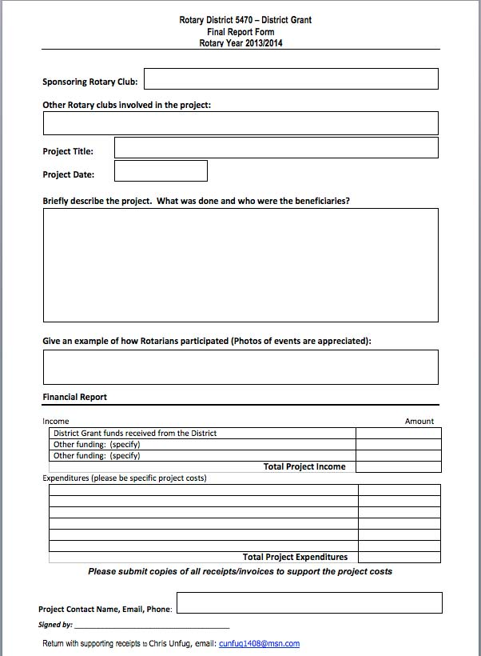
District Grants: Final Report
Notes:
Here is a copy of the Final report that is posted on the District website. This report is required to be submitted within 30 days of completing your project. If these reports are not submitted the District will not be eligible for ant type of grant funds in the future.

Slide 15
District Grants
Memorandum of Understanding (M.O.U.) Go to the District 5470 Web Page
www.rotary5470.org/sitepage/district-grants
Notes:
Here is the link to the memorandum of understanding required by all clubs requesting District funds.

Slide 16
District Grants: Committee
Aaron Tice (Chair) RC of Grand Junction
Ann Harris (District Grants Chair) RC of Roaring Fork?
Dawn Marsh RC of ?
Chris Unfug RC of Grand Junction
Chessa Gill RC of Durango
Tish Nelson RC of Pine River Valley Centennial
Cliff Anson RC of Grand Junction
YOUR NAME COULD BE HERE!!!!
JOIN THE COMMITTEE
Notes:
Here is your current District Grants committee. If you are interested in becoming a committee member please contact the District Grant chair.

Slide 17
District Grants: Questions?
District Grant Chair: Aaron Tice
360-713-3060
Aaron.Tice@gmail.com
Notes:
If you have any questions about District grants please contact the current District Grants chair. This information is updated annually.

