Slide 1
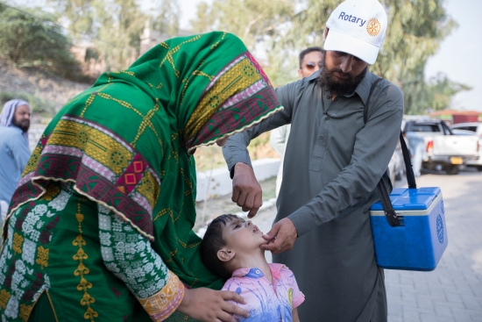
Your Rotary Foundation
Changing lives through Rotary

Slide 2
The Rotary Foundation Mission
The Rotary Foundation helps Rotarians to advance world understanding, goodwill, and peace by improving health, providing quality education, improving the environment, and alleviating poverty.

Slide 3
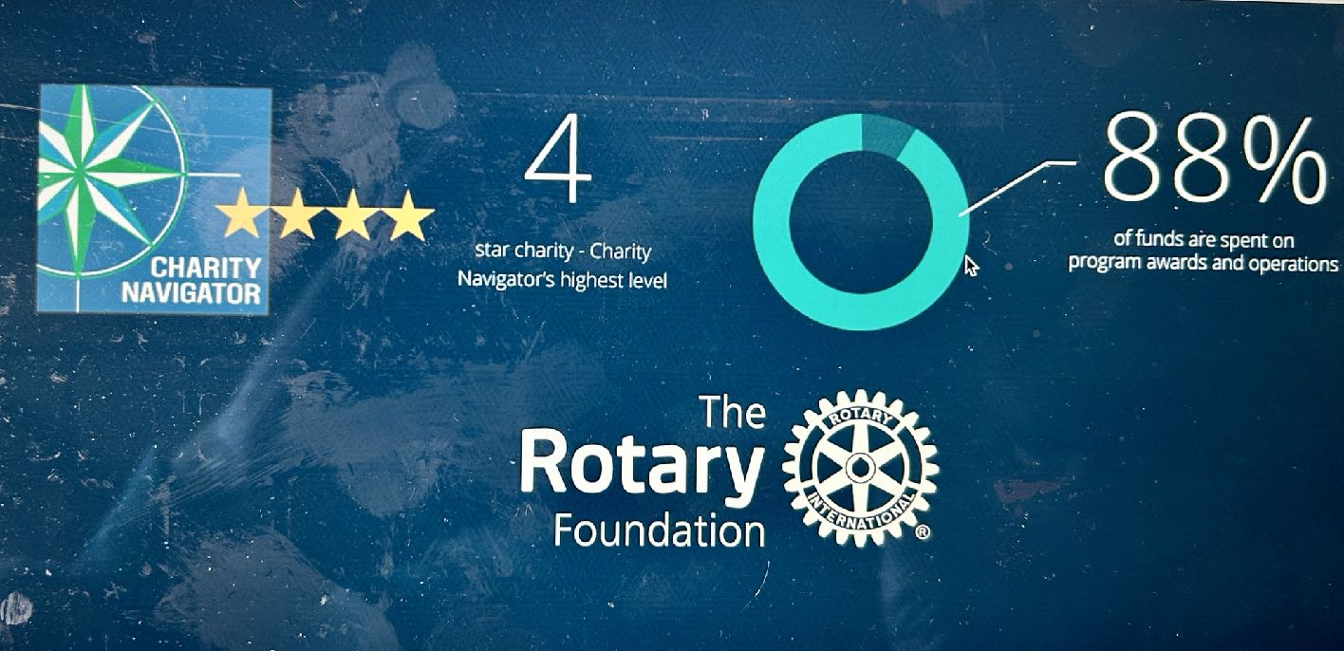

Slide 4
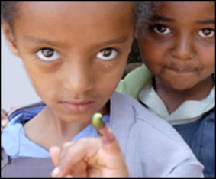
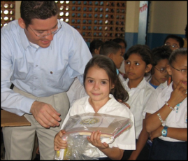
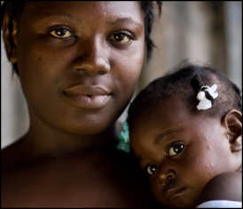
SUPPORTING THE ROTARY FOUNDATION
PolioPlus Fund
End Polio Now
Annual Fund
For support today
Endowment Fund
To secure tomorrow
Notes:
Rotarians support our Foundation through these funds:
PolioPlus Fund, dedicated to global polio eradication
Annual Fund, the primary source of funding for Foundation grants and activities
Endowment Fund, which supports the Foundation in perpetuity

Slide 6
Foundation Funds
Polio Plus
Rotary International adopts the eradication of polio as their major project in 1985 with the objective to vaccinate all children. 350,000 cases worldwide.
1988 Rotary joins WHO, UNICEF and CDC and the Global Polio Eradication Initiative was created – This year so far just seven cases of the wild polio virus in two countries.
2007 The Bill and Melinda Gates Foundation partners with Rotary International and matches Rotarian donations 2:1
2014 – 2016 Ebola outbreak Rotary polio laboratory teams assist with identification and tracking
2020 COVID-19 and Rotary is again assisting local health organizations with environmental sampling, testing and distribution

Slide 7
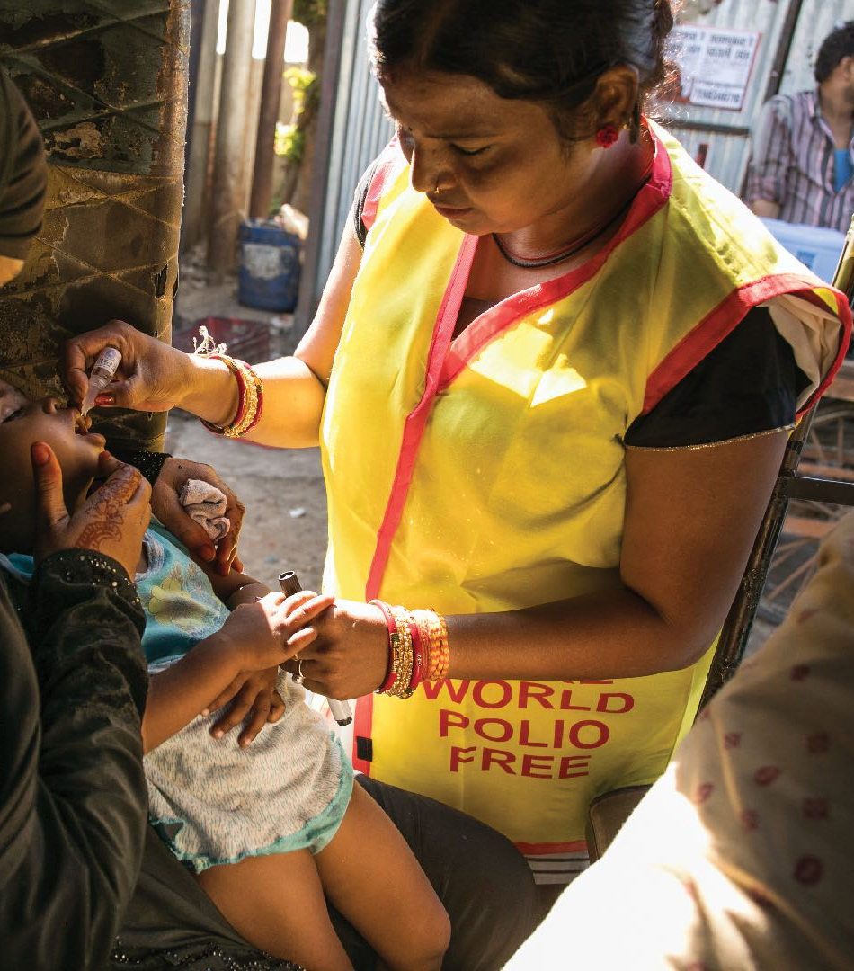
Global leaders commit $2.6 billion at the world health summit to end polio

Slide 8
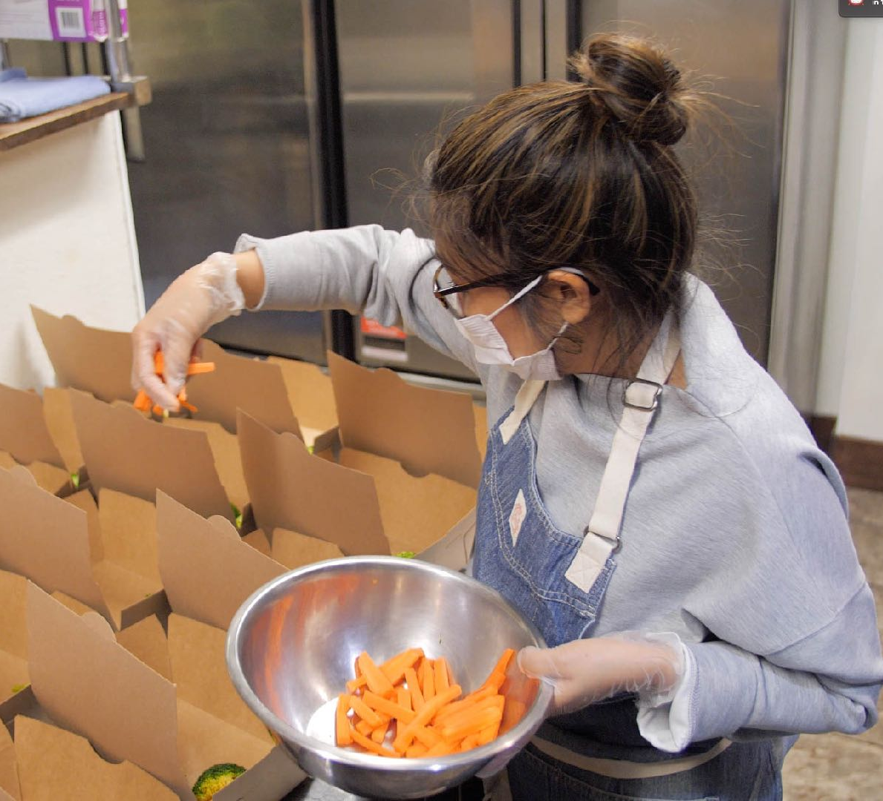
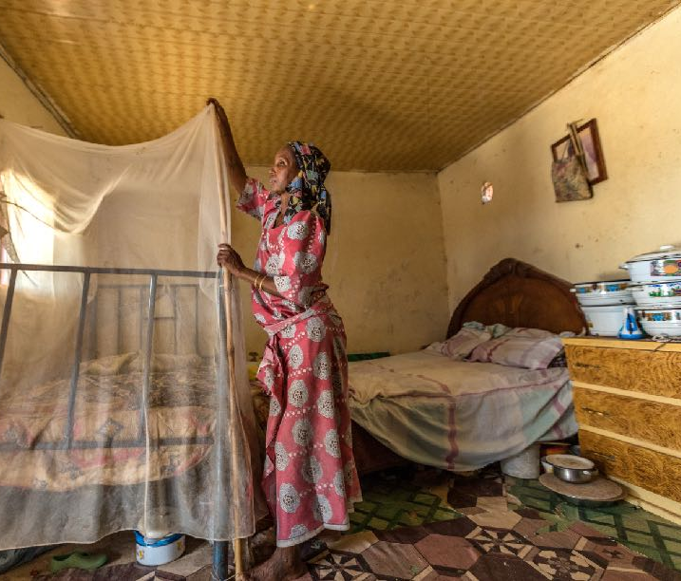
Annual Fund Provides funds for district and global grants

Slide 9
Annual fund
Donations to the Annual Fund are retained by The Rotary Foundation for three years then 47.5% of the amount donated is returned to the District. This is called District Designated Funds (DDF) The other 47.5% is held in the World Fund with 5% going to administrative costs.

Slide 10
Annual Fund Giving – DDF 3 years later
50% Annual Fund Share contributions for 2020-2021 ---- $218,960.17
50% Available Endowment Fund Share Earnings. Add $6609.43
Total available DDF for District 5470 2023 -2024 - $225,570.20
50% of DDF toward District grants --- $112,880 for 2023-2024
47.5% Annual Fund Share contributions for 2021-2022----$178,489.81
47.5% Available Endowment Fund Share Earnings---approx. $6000
Total available DDF for District 5470 2024-2025 –approx. $184,500
50% of DDF toward District grants--- $92,500 for 2024-2025
DDF toward District grants only ----$79,651 for 2022-2023 due to
decreased Annual Fund contributions during beginning of COVID.

Slide 11
DISTURBING TREND
DDF funds available for District Grants – 2020-2021. -- $104,438
DDF funds available for District Grants – 2021-2022. -- $81,117
DDF funds available for District Grants – 2022-2023. -- $79,643
DDF funds available for District Grants – 2023-2024. -- $112,880
DDF funds available for District Grants – 2024-2025. -- $92,500

Slide 12
District 5470 Annual Fund giving and DDF
Annual Fund Goal for District 5470 Rotary year 2024-2025---$360,000
Average per capita donation for each member = Approx. $200.
47.5% of 360,000 = $171,000 + approx. $6700 from Endowment Fund
yields total DDF of $177,700.
50% or $88,850 for District Grants and same amount for bucket
containing Global Grants, Global scholarships, Vocational Training
Teams, and extra money for Disaster Grants or Polio Plus.

Slide 13
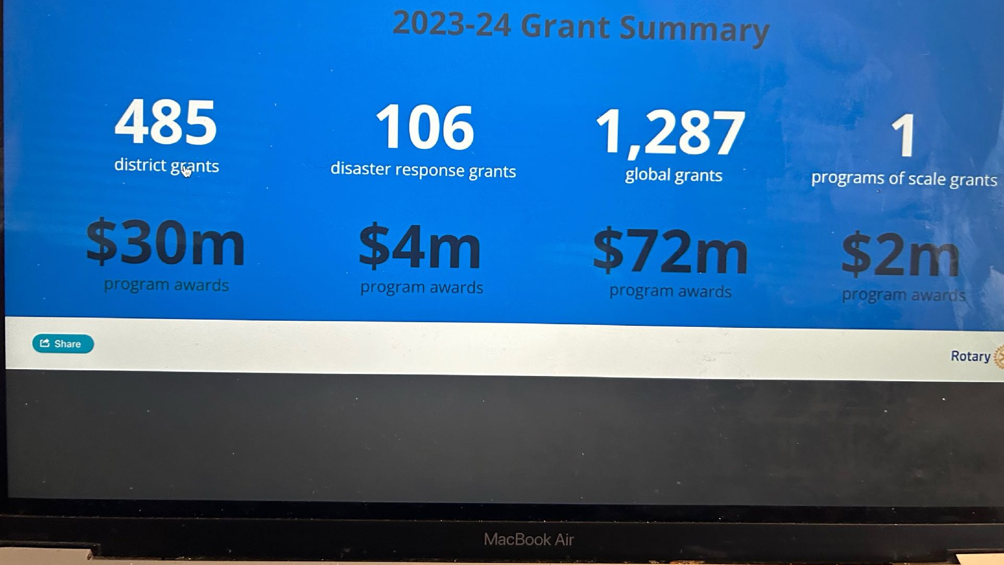

Slide 14
Foundation Funds
The Annual Fund & Disaster Response Fund
Provides funds to districts called District Designated Funds (DDF) – half of the annual DDF is designated for District Grants with the second half allocated for Global Grants.
Provides funding for the Share World Fund
Provides rapid response funding for disaster relief
Vocational Training Teams
Global Grant Scholarships

Slide 15
World Fund
District Designated Funds (DDF) used to match club contributions to a Global Grant project are matched 80% by the World Fund
District Designated Funds (DDF) allocated to any Global Grant project are matched by the World Fund at 80%
Global Grant Scholars matched 100% up to $15,000
Rotary Peace Fellow scholarships totally funded by the World Fund
Programs of Scale $2,000,000 totally funded by the World Fund

Slide 16
District Grants
Club funds for community projects are matched with funds from The Rotary Foundation using District Designated Funds.
Small scale, Short term
Local or International
Aligned with Foundation’s mission
Awarded annually
Annual Grant training, club MOU, and Minimal Annual Fund donations from Club
Funds come up to 50% DDF

Slide 17
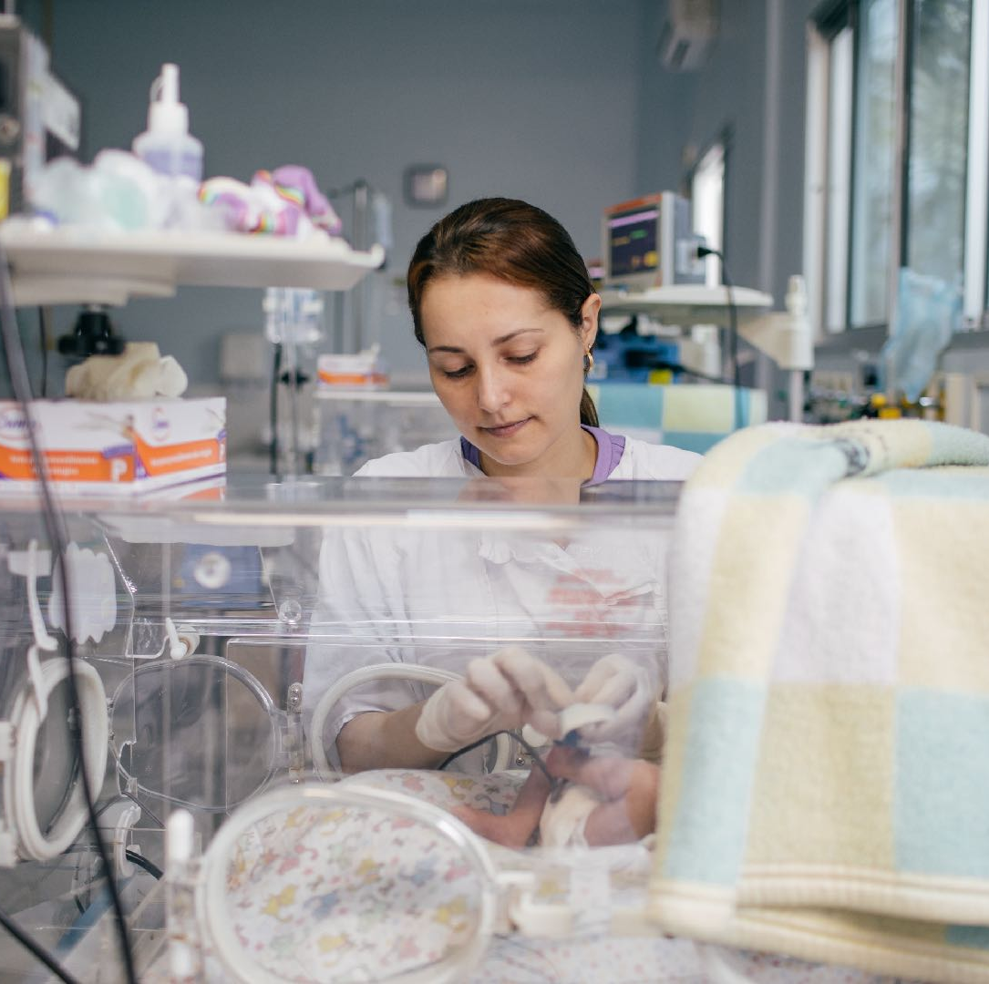
Global Grants
Are larger in scale with a minimum budget of $30,000. They must have a host club sponsor and an international sponsor. Many clubs can join the grant as international partners. Application must be accompanied by community assessment

Slide 18
The Rotary Foundation Benefits to District 5470 and the world
40 District Grants to 32 clubs over $180,000 combined club and district support to local communities
Several clubs as partners in various Global Grants over $50,000 with $62,500 from DDF and $50,000 from the World Fund
District Governor Becky Smith’s district wide Global Grant participation in the Global Partnership for Education in Zambia project. All 57 clubs contributed $27,000 matched by DDF $27,000 with $21,600 from the World Fund. A total of $75,600 well done D5470
Disaster Response DDF allocation for Ukraine $10,000 + $8,000 from the World Fund
Polio Plus DDF allocation $10,000 + $8,000 from the World Fund

Slide 19
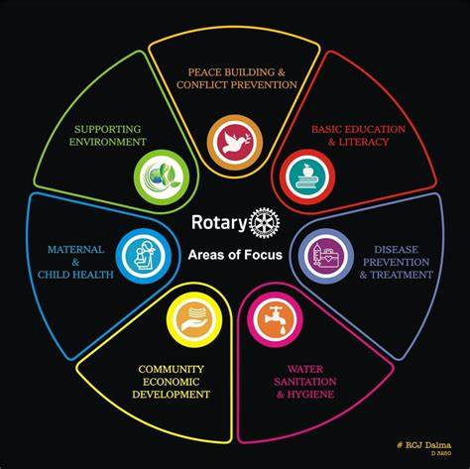
Global Grants
Global grants must be in one of Rotary’s seven areas of focus.

Slide 20
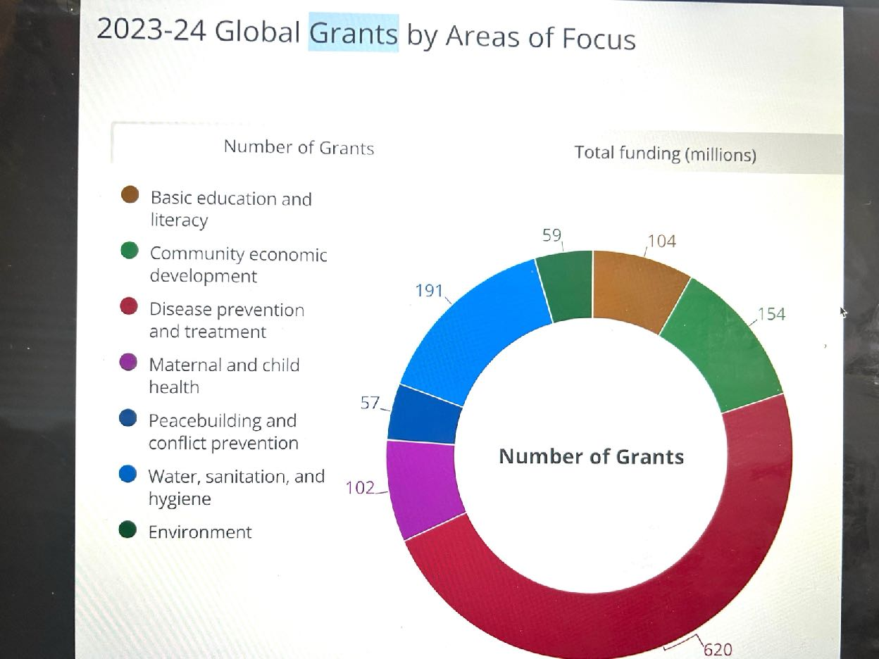

Slide 22
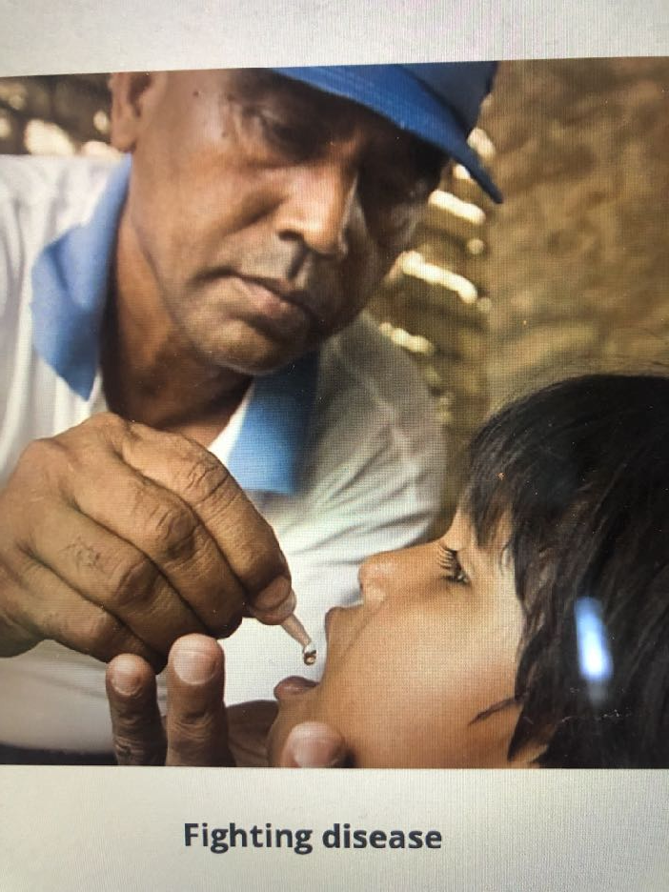

Slide 23
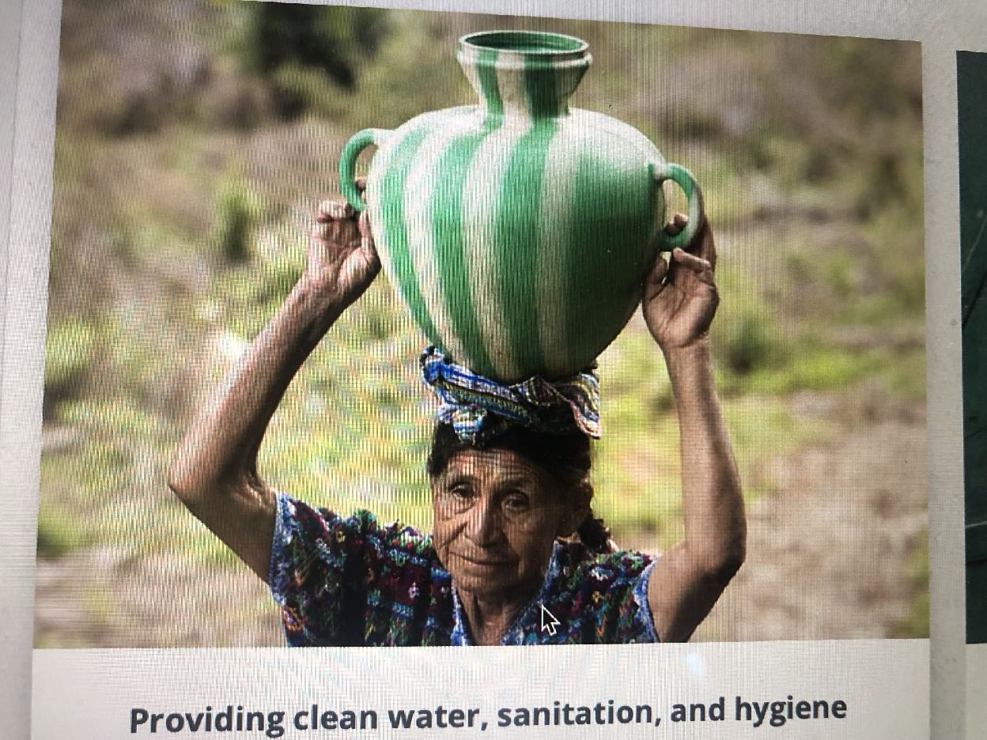

Slide 24
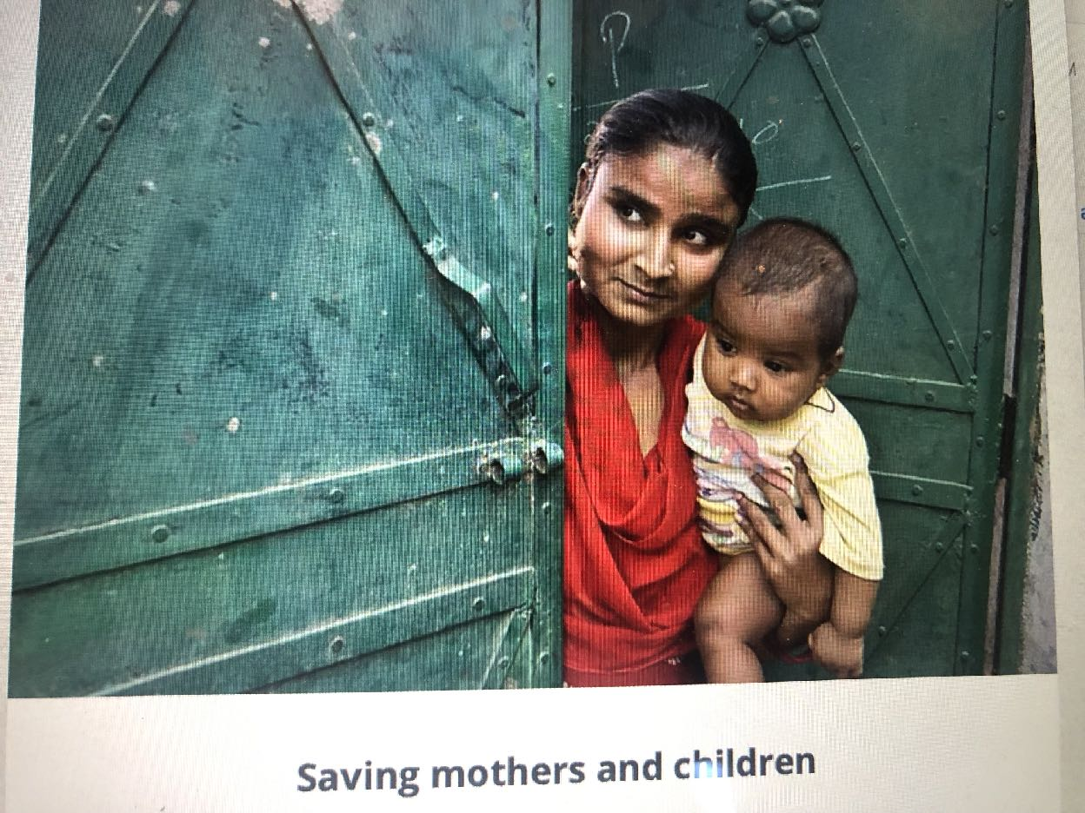

Slide 26
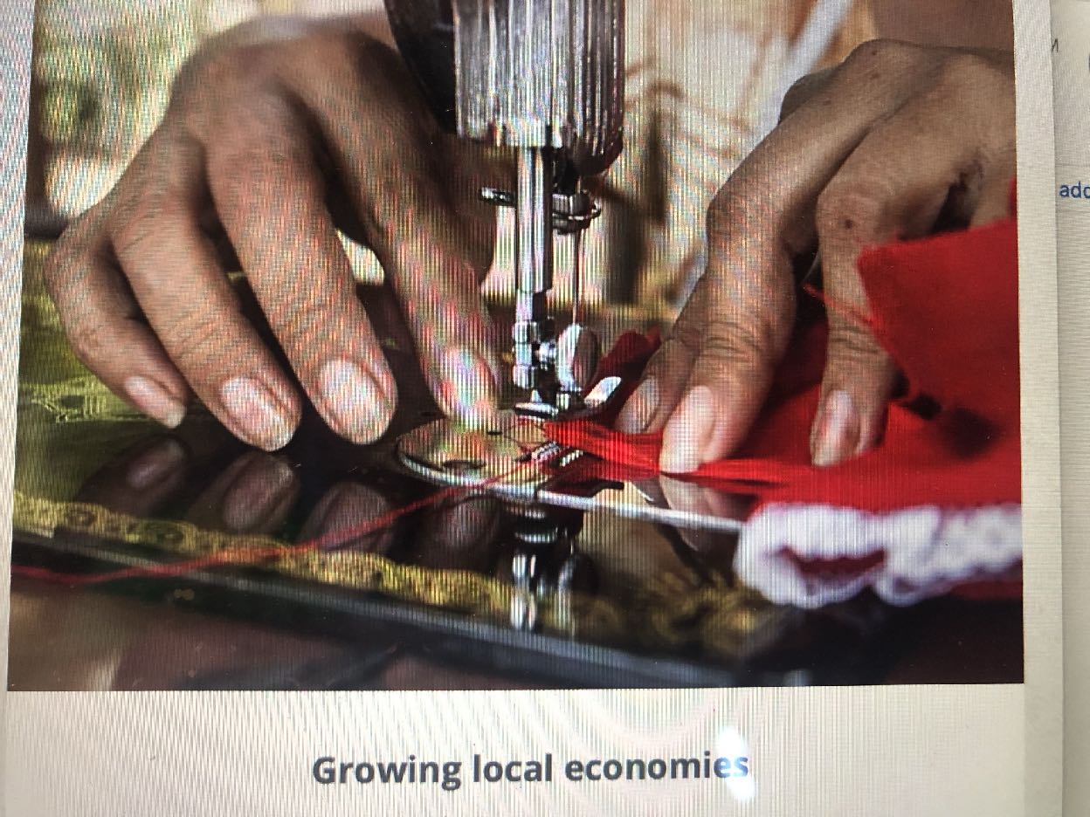

Slide 27
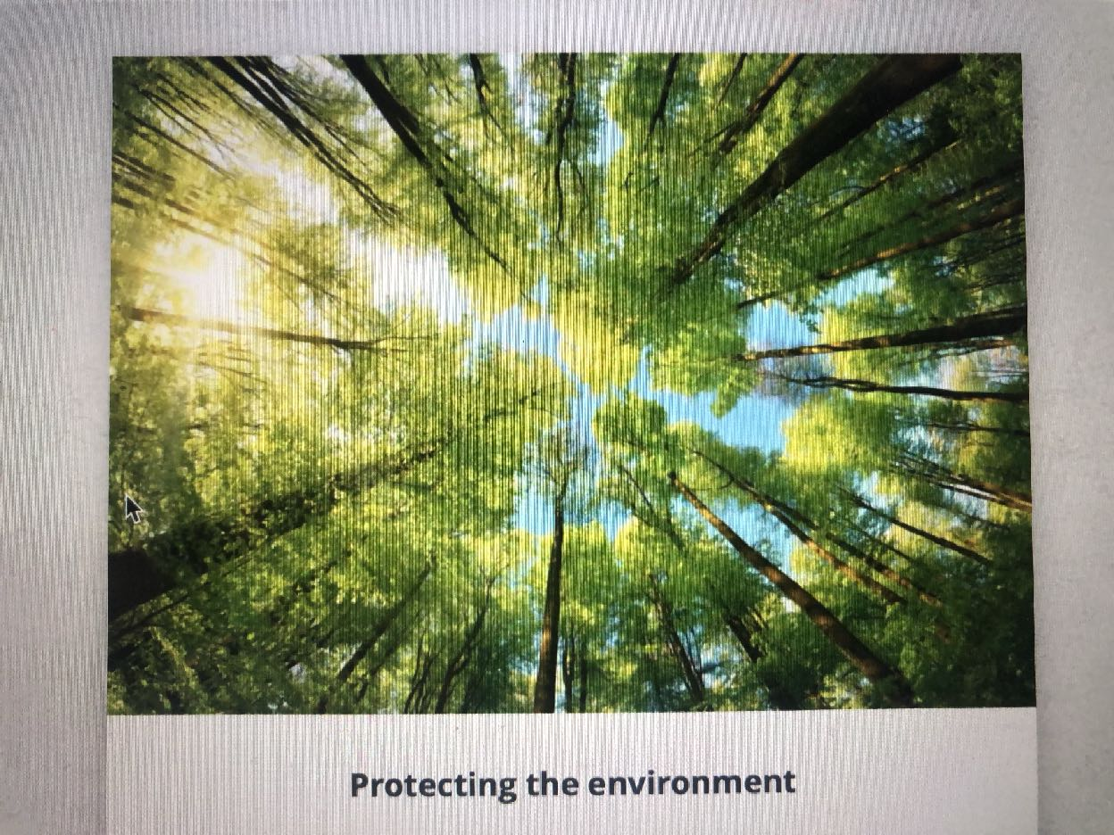

Slide 28
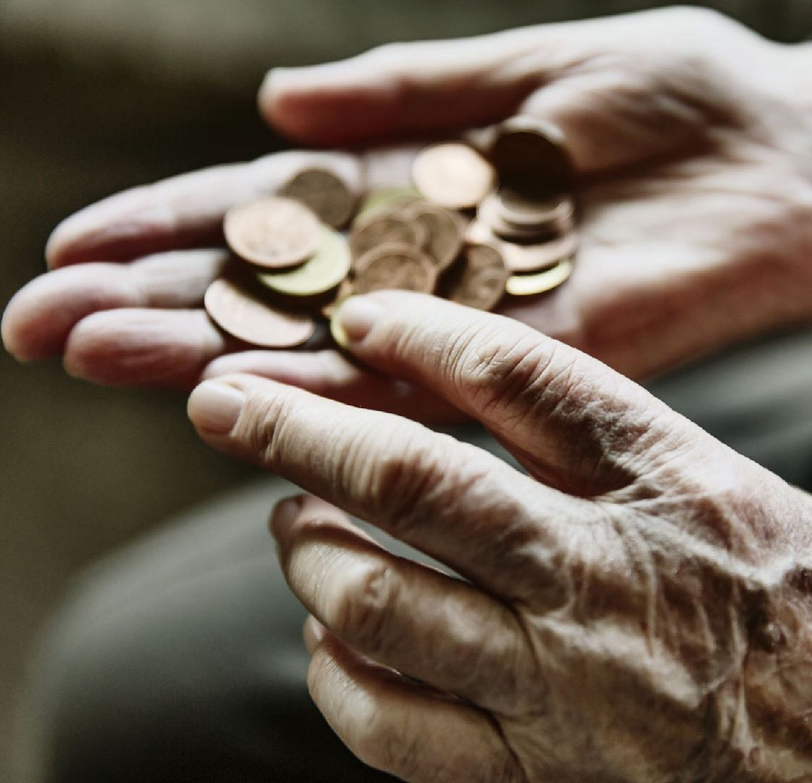
Endowment Fund

Slide 29
Foundation Funds
Endowment Fund – established 1982
Rotary Bequest Society
Rotary Benefactor
Cash Deposit to the World Fund
The Rotary foundation 2025 endowment goal is 2.025 billion

Slide 30
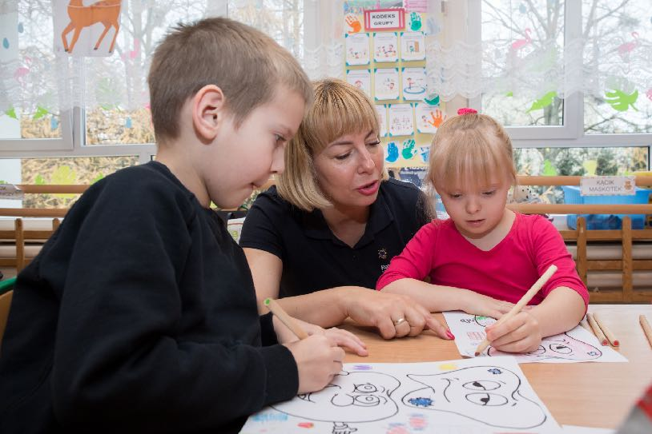
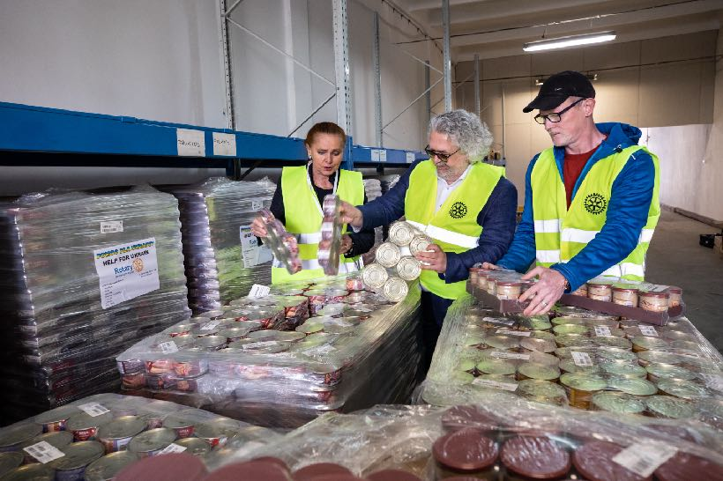
Disaster Relief
Ukrainian refuge children
Food bank in Poland

Slide 31
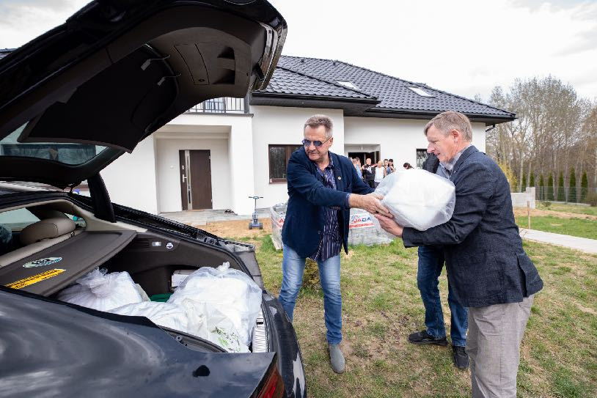
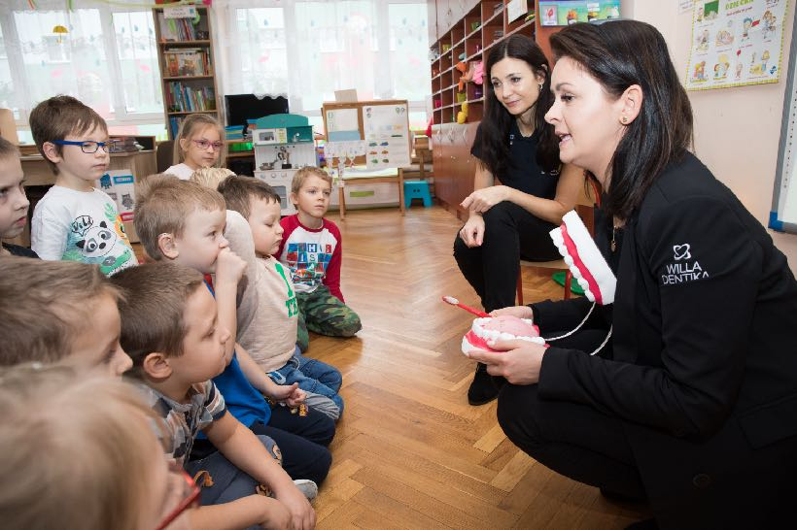
Rotary Responds
Rotarians deliver ice
Displaced Ukrainian children

Slide 32
You can make a difference and change lives

Slide 33
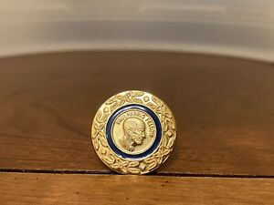
Paul Harris Fellow
A Paul Harris Fellow recognition pin is given by Rotary International to a member who has contributed an aggregate amount of $1,000.00 to The Rotary Foundation.

Slide 34
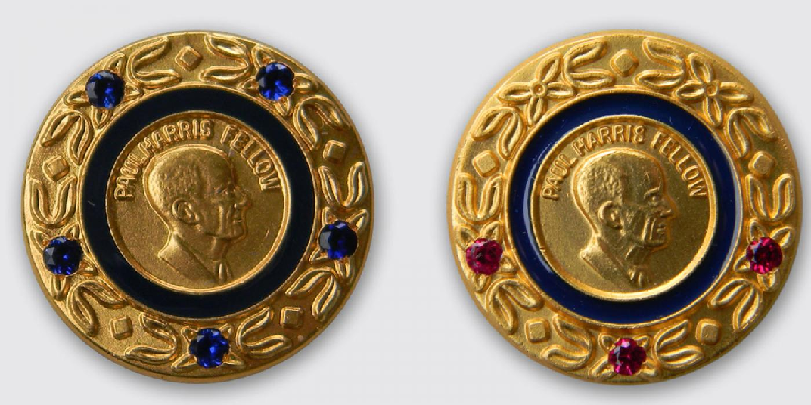
Paul Harris Fellow Multi Level recognition Paul Harris Society Committing $1000 annually.

Slide 35
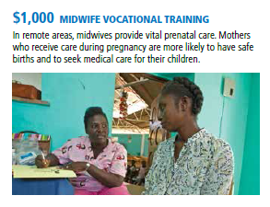
Doing good in the world through Rotary

Slide 36
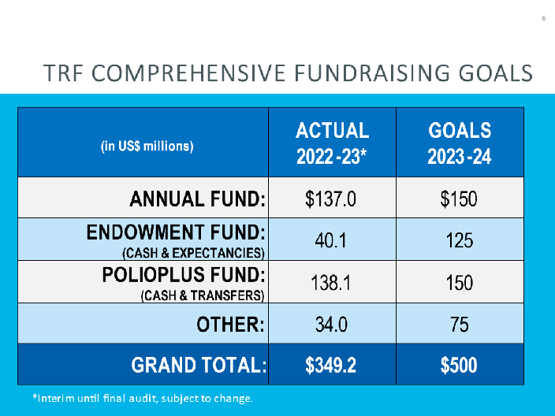
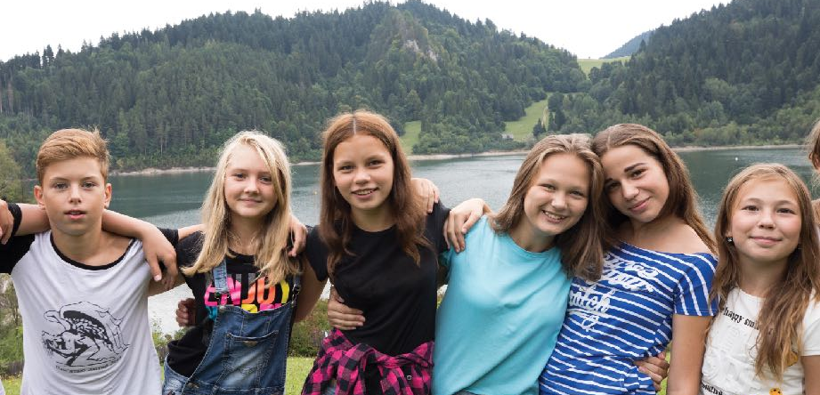
Thank You

