Slide 1
Global Grants Training
District 5470
2022
Road map for applying for a Global Grant:
https://www.rotary5470.org/SitePage/global-grants
Most of the information needed to write and carryout a Global Grant can be found at:
https://my.rotary.org/en/
Take Action...Apply for Grants...Grant Center...Apply for a Grant
Notes:
Road map provides a guide for navigating the TRF website for grant information
and information specific to our district
May need to set up a MY ROTARY account
22 files in RESOURCES has all of the information

Slide 3
Three Types of Global Grants
Humanitarian Projects
David Smith dsmith7@unl.edu
Melanie Phelps melaniephe@aol.com
https://www.rotary5470.org/SitePage/global-grants
Vocational Training Teams
Richard Dangler rdangler@hotmail.com
http://www.rotary5470.org/SitePage/vocational-training-teams-(vtts)
Scholarships
Kate Davis- katerotary1@gmail.com
http://www.rotary5470.org/SitePage/scholarships
Notes:
Although much of the information I will be presenting applies to all 3 types of GGs, I will focus on Humanitarian Projects
VTT:
Scholarship: 1 yr of support for graduate studies in any of the 6 areas of focus

Slide 4
Elements of Successful Humanitarian Projects
Align with an area of focus
Include active community and Rotarian participation
Have long-term, sustainable benefits
Have measurable results
Have a budget of at least $30,000
Notes:
TRF requirements for GGs are extensive, but, TRF considers these 5 elements particularly important.
Next several slides help to explain these requirements

Slide 5
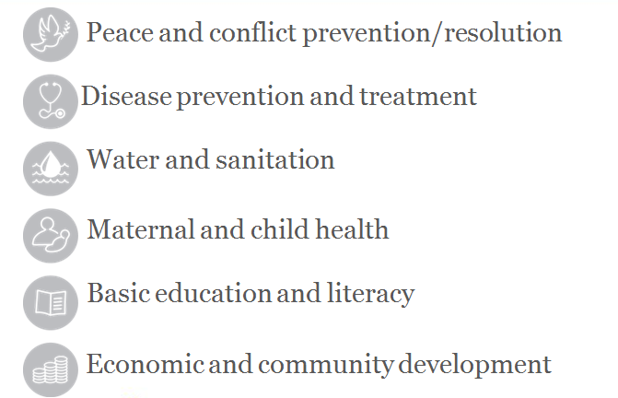
Areas of Focus for Humanitarian Projects
Environment
https://grants.rotary.org/s_main.jsp?lang=1
Areas of Focus Policy Statements
Notes:
The principal goals of all GGs must align with one of these Areas of Focus.
These 6 areas are quite inclusive.
However, it did deny an application to provide playground equipment for pre-school children
Do not pick 2 areas.
Environment will be added in July

Slide 6
Area of Focus:
BASIC EDUCATION AND LITERACY
Statement of Purpose and Goals
Strengthen capacity of communities to provide basic education
Increase adult literacy
Reduce gender disparity in education
Support teacher training
Projects that do NOT qualify
Equipment only projects
Projects that are not sustainable
Questions? Ask the TRF Program Manger for that country
https://grants.rotary.org/s_main.jsp?lang=1
Rotary Grants Staff Contact Sheet
Notes:
Supplying books, computers, desks, lab supplies, OK
Encourage more girls to stay in school, become teachers, take science curriculum
teacher training workshops
Need to include training...
Teacher training is sustainable because this activity is irreversible.

Slide 7
https://grants.rotary.org/s_main.jsp?lang=1
Rotary Grants Staff Contact Sheet
District
Notes:
Questions? Call the TRF Program Manager for your host country.
Try to develop a relationship with your Program Manager
Send a pre-proposal (no more than 1 page)
Located in Evanston, Il

Slide 8
Elements of Successful Humanitarian Projects
Rotarian Participation
International Partner Club
Host Partner Club
Each club must have 1 Primary Contact and 2 Secondary Contacts
Other clubs may contribute financial support
Notes:
Promoting a culture of working together seems to be as important as the actual project.
Consider this as you are preparing an application.
International Partner usually provides most of the money.
May include several other clubs (2,3,4...100!)
Other clubs may be in our district or in other districts ) countries.
My club has contributed to a project started in Vienna, Austria to dig a well in Niger.
Host Partner is located in receiving country
Usually manage the project and money, but this is not required
Ex Senegal I and IV

Slide 9
Elements of Successful Humanitarian Projects
Community Participation
Learn about your community
Assess community needs
See PDF: Community Assessment Tools (605en.pdf)
https://grants.rotary.org/s_main.jsp?lang=1
See MSWord: Community Assessment Results
Click on: Community Assessment Tools
Upload assessment document on application:
Supporting Documents
Notes:
New requirements emphasize working with the community to determine their needs and how best to meet these needs.
Obviously important.
Reality: Must balance what they think they need with what we (and Host Club) think they need. ex. Oscilloscope, tomato paste, toilets
TRF system is not clear...No place to submit Community Assessment Results document. Be very clear in the application, especially in Step 10, that you (or Host Club) have involved the community. You can use District Grant to travel for assessment.
Choose Grant Center in the Apply for Grants folder, which is under the
Take Action folder .

Slide 10
Elements of Successful Humanitarian Projects
Long term, sustainable benefits
Benefits must continue beyond the end of the grant
https://grants.rotary.org/s_main.jsp?lang=1
PDF File: Six Steps to Sustainability
Notes:
Water projects set up local committee to collect small fee that will be used for repairs.
Teacher training lasts.
Small equipment may be disposable.
I say we provide 3 years of chemicals. Parents or schools will replace the chemicals.
Wheel chairs need little or no repair. Train staff to lubricate wheel chairs.

Slide 11
Elements of Successful Humanitarian Projects
Have measurable results
Notes:
TRF requires measurements, but is quite flexible.
The number of teachers enrolled in a workshop.
The number of experiments/demonstrations they do during a semester.
Provide written statements from teachers and students.
Measuring long term results for education is impossible.

Slide 12
Elements of Successful Humanitarian Projects
Starting July 1, 2021: TRF matches DDF 0.8:1
Have a budget of at least $30,000
DDF to Club Match 1.25:1
International Partner Club $7,000
Another club in our district $3,000
District Designated Funds (DDF) $12,500 TRF $10,000
Total Budget $32,500
Max DDF from our district = $20,000
https://grants.rotary.org/s_main.jsp?lang=1
global_grant_calculator_en.xlsx
Notes:
30K can come from any combination of club funds, DDF and TRF (World fund).
TRF will match DDF 0.8:1
The amount that it contributes depends on club donations and DDF
Our GG Committee matches club donations 1:1.25 up to $20,000

Slide 13
Elements of Successful Humanitarian Projects
Project involving clubs in 2 districts
Starting July 1, 2021: TRF matches DDF 0.8:1
International Partner Club (our district) $7,000
2nd club in our district $3,000
District Designated Funds (DDF) $12,500 TRF $10,000
3rd club in district x $2,000
DDF from District x $2,000 TRF $1,600
Total Budget $38,100
Max DDF from our district = $20,000
https://grants.rotary.org/s_main.jsp?lang=1
global_grant_calculator_en.xlsx

Slide 14
Support a Global Grant Managed by Another Club
Many clubs in the same district or in different districts
can join to support a global grant.
Only one club will be the International Partner.
One member of the International Partner Club will be
the Primary Contact for the project.
Notes:
Describe Farmers project

Slide 15
Must Apply for DDF
Send application to our Global Grants Committee
Before “Locking” the application
MSWord file available from District website:
https://www.rotary5470.org/SitePage/global-grants
Rotary District 5470
Request for DDF.docx
PROJECT NAME: (and GG# if available)
Country in which the proposed project will take place:
and so on......
Notes:
Rational: to distribute DDF fairly; To be sure that DDF is available when the application is approved
Application cannot be changed after it has been locked by the 2 Primary Contacts. Particularly important for Financial page.
Need more details translated for applications in foreign languages.
Download the application and use Google Translate

Slide 16
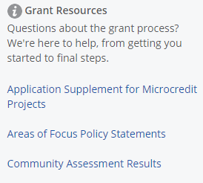
https://grants.rotary.org/s_main.jsp?lang=1
Notes:
Need to be registered with My Rotary
There are 23 files that provide all of the information required to prepare a GG application.
This is the source!
Many of these files are on our district website...They may not be current

Slide 17
Guide to Global Grants A MUST READ
CONTENTS
INTRODUCTION 4
1 MAKE A SUSTAINABLE IMPACT 8
2 PARTNER TO MAXIMIZE YOUR IMPACT 14
3 PLAN YOUR GLOBAL GRANT-FUNDED PROJECT 17
4 APPLY FOR A GLOBAL GRANT 24
5 IMPLEMENT, MONITOR, AND EVALUATE
YOUR PROJECT 28
6 REPORT YOUR PROGRESS AND OUTCOME 35
https://grants.rotary.org/s_main.jsp?lang=1
Notes:
Of the 23 files, one must read this one
40 pages
contact GG Committee or TRF Grant Manager for Host Club district

Slide 18
Clubs Must be Qualified to Participate in Grants
See P 6 of Guide to Global Grants
Two parts to Qualification
Attend a grant management seminar
Complete the club memorandum of understanding (MOU).
https://www.rotary5470.org/SitePage/global-grants
FORM - CLUB M.O.U.
Both steps must be completed each year
Grant management seminar can be renewed on-line
https://www.rotary5470.org/SitePage/district-5470-grant-management-training
Notes:
A club is “Qualified” if one member is “Qualified”.
Return Club MOU to district Foundation Chair...David Wood

Slide 19
Terms and Conditions..... Another MUST Read
WHAT WE FUND
II. ELIGIBILITY GUIDELINES
III. RESTRICTIONS
IV. HOW TO APPLY
V. TRAVEL POLICIES
VI. HOW GRANTS ARE FUNDED
VII. COOPERATING ORGANIZATIONS
VIII. PAYMENTS
IX. REPORTING REQUIREMENTS AND DOCUMENTATION
and more...
https://grants.rotary.org/s_main.jsp?lang=1
Notes:
19 pages

Slide 20
Terms and Conditions..... Another MUST Read
https://grants.rotary.org/s_main.jsp?lang=1
Page 3: Global Grants do Not fund:
Excessive support for any one community
Purchase, construction or remodeling of buildings
Fundraising activities
Activities for which the expense has already been incurred
Activities primarily implemented by an organization other than Rotary
Multiple unrelated projects under one grant
and more...
Notes:
Keep projects simple and narrowly focussed

Slide 21
Finding a Host Club and Project
https://www.rotary5470.org/SitePage/global-grants
Peter Jeschofnig’s International Service Newsletter
https://www.rotary5470.org/SitePage/international-service-committee
TRF Project Fairs (Search Rotary Project fairs)
Brazil, East Africa, Columbia, Peru
Available projects
http://www.matchinggrants.org/
Personal Contacts

Slide 22
http://www.matchinggrants.org/
# | Title | Country | Location | District | Club | Amount | Status
G-1996 | Coffee Plant Process | Colombia | Belen De Umbria | 4281 | Pereira Perla del Otún | $65,000 | Need $19,293
G-1995 | Cooperative for Recycling | Brazil | Ilha Solteira | 4480 | Ilha Solteira | $32,000 | Need $3,500
G-1994 | Safe Water for Ecuador | Ecuador | PIlopata and Romerillos | 4400 | Los Chillos Milenio | $76,094 | Fully Pledged
G-1993 | Snoezelen Room | Mexico | Guadalajara Jal. | 4140 | Guadalajara-Poniente | $32,000 | Need $21,334
G-1992 | Gift of Life kids in Monterrey | Mexico | Monterrey | 4130 | Santa Catarina | $151,300 | Need $90,867
G-1991 | Malolos Central Laboratory | Philippines | Malolos, Bulacan | 3770 | Malolos Independencia | $35,000 | Need $23,334
G-1990 | Challenge Children
Notes:
There are 546 projects listed

Slide 23
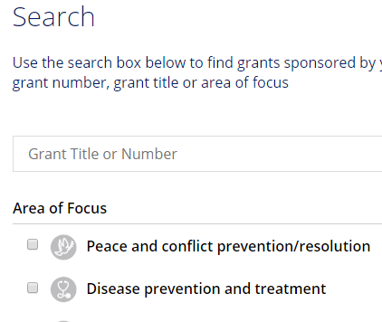
Would You Like to See a Global Grant Application?
https://grants.rotary.org/s_main.jsp?lang=1
GG1746041

Slide 24
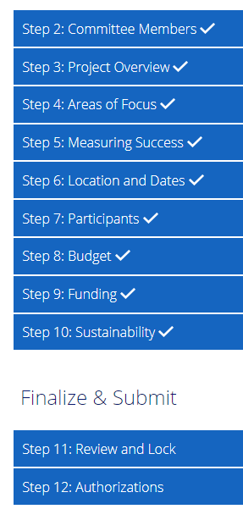
Authorization and Locking an Application
Primary Contacts cannot edit an application after they have locked it
Apply for DDF before locking an application

Slide 25
Global Grants Committee
Werner Stark Co Springs Interquest wjstark@hotmail.com
Sandy Lowell Glenwood Spgs Sunset slowell3@gmail.com
Dick Dangler Edwards rdangler@hotmail.com
Reggie O’Obrien Vail regina.obrien.pchn@gmail.com
David Smith Pagosa Springs dsmith7@unl.edu
Melanie Phelps Pueblo melaniephe@aol.com
Responsibilities
Promote Global Grants
Review requests for District Designated Funds (DDF)
Suggest ways to strengthen applications
Triage

