Slide 2
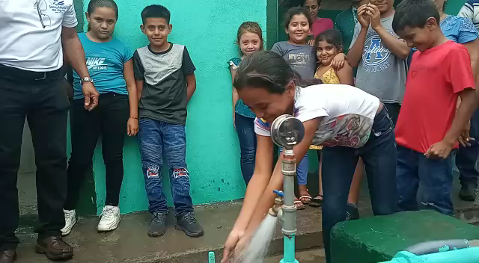

Slide 3
The Rotary Foundation's grant activities for the 2024 2025 year reflect a commitment to global impact and community
support. Here's a summary of the key highlights:
District Grants: 458 district grants totaling US$28.8 million were approved, supporting a wide range of Rotary priorities.
Global Grants: Over $56 million in global grants were awarded, focusing on humanitarian projects and other community needs.
Disaster Response Grants: 74 disaster response grants were approved, with funding totaling US$1.92 million to assist communities affected by natural disasters.
Polio Eradication: The Rotary Foundation raised more than $27 million to support efforts to eradicate polio globally.
Please support these programs by contributing.

Slide 4
Elements of Successful Humanitarian Projects
Align with an area of focus
Include active community and Rotarian participation
Have long-term, sustainable benefits
Have measurable results
Have a budget of at least $30,000
Notes:
TRF requirements for GGs are extensive, but, TRF considers these 5 elements particularly important.
Next several slides help to explain these requirements

Slide 5
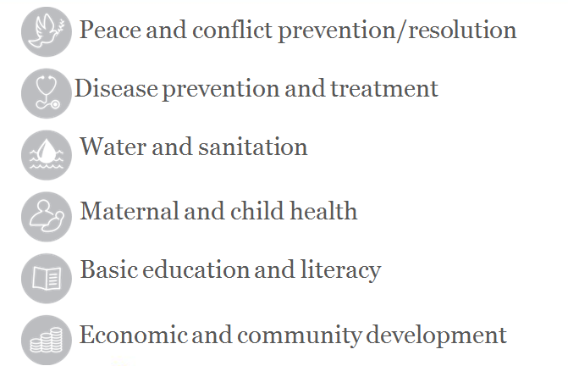

Areas of Focus for Humanitarian Projects
Notes:
The principal goals of all GGs must align with one of these Areas of Focus.
These 6 areas are quite inclusive.
However, it did deny an application to provide playground equipment for pre-school children
Do not pick 2 areas.
Environment will be added in July

Slide 7
Area of Focus:
BASIC EDUCATION AND LITERACY
Statement of Purpose and Goals
Strengthen capacity of communities to provide basic education
Increase adult literacy
Reduce gender disparity in education
Support teacher training
Projects that do NOT qualify
Equipment only projects unless for medical equipment
Projects that are not sustainable
Notes:
Supplying books, computers, desks, lab supplies, OK
Encourage more girls to stay in school, become teachers, take science curriculum
teacher training workshops
Need to include training...
Teacher training is sustainable because this activity is irreversible.

Slide 8
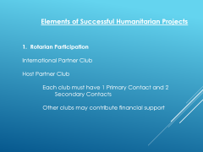

Slide 9
Elements of Successful Humanitarian Projects
1. Rotarian Participation
International Partner Club
Host Partner Club
Each club must have 1 Primary Contact and 2
Secondary Contacts
Other clubs may contribute financial support
Notes:
Promoting a culture of working together seems to be as important as the actual project.
Consider this as you are preparing an application.
International Partner usually provides most of the money.
May include several other clubs (2,3,4...100!)
Other clubs may be in our district or in other districts ) countries.
My club has contributed to a project started in Vienna, Austria to dig a well in Niger.
Host Partner is located in receiving country
Usually manage the project and money, but this is not required
Ex Senegal I and IV

Slide 10
Elements of Successful Humanitarian Projects
2. Community Participation
Learn about your community
Assess community needs
File for Community Assessment on Grant Resources page on MyRotary Website under Apply for A Grant.
Notes:
New requirements emphasize working with the community to determine their needs and how best to meet these needs.
Obviously important.
Reality: Must balance what they think they need with what we (and Host Club) think they need. ex. Oscilloscope, tomato paste, toilets
TRF system is not clear...No place to submit Community Assessment Results document. Be very clear in the application, especially in Step 10, that you (or Host Club) have involved the community. You can use District Grant to travel for assessment.
Choose Grant Center in the Apply for Grants folder, which is under the
Take Action folder .

Slide 11
Elements of Successful Humanitarian Projects
3. Long term, sustainable benefits.
Benefits must continue beyond the end of the grant
PDF File: Six Steps to Sustainability found on
MyRotary under Apply for a Grant.
Notes:
Water projects set up local committee to collect small fee that will be used for repairs.
Teacher training lasts.
Small equipment may be disposable.
I say we provide 3 years of chemicals. Parents or schools will replace the chemicals.
Wheel chairs need little or no repair. Train staff to lubricate wheel chairs.

Slide 12
Elements of Successful Humanitarian Projects
4. Have measurable results.
Example: WASH Project to get Clean Water and Sanitation – How many people are impacted? How many households will have running water and a latrine?
Notes:
TRF requires measurements, but is quite flexible.
The number of teachers enrolled in a workshop.
The number of experiments/demonstrations they do during a semester.
Provide written statements from teachers and students.
Measuring long term results for education is impossible.

Slide 13
Elements of Successful Humanitarian Projects
5. Funding
District Designated Funds DDF fund 1:1 Dollar for dollar.
TRF matches DDF 0.8:1 80%
Have a budget of at least $30,000
International Partner Club $10,000
Another club in our district $ 5,000
District Designated Funds (DDF) $15,000 TRF $12,000
Total Budget $42,000.
  Max DDF on any one grant from our district = $25,000
Global Grant Calculator on MyRotary Grants Website.
Notes:
30K can come from any combination of club funds, DDF and TRF (World fund).
TRF will match DDF 1::
The amount that it contributes depends on club donations and DDF
Our GG Committee matches club donations 1:1.25 up to $20,000

Slide 14
Elements of Successful Humanitarian Projects
Project involving clubs in 2 districts
TRF matches DDF 0.8:1
International Partner Club (our district) $7,000
2nd club in our district $3,000
District Designated Funds (DDF) $10,000 TRF $8,000
3rd club in district x $2,000
DDF from District x $2,000 TRF $1,600
Total Budget $33,600.
  Max DDF from our district = $25,000

Slide 15
Apply for DDF
Send application to our Global Grants Committee.
melaniephe@aol.com
  Before “Locking” the grant application.
MSWord file available from District website:
https://portal.clubrunner.ca./50015/SitePage/Global -Grants
Global Grants Committee will review and vote on your request
for District Designated
Funds – DDF
:
Notes:
Rational: to distribute DDF fairly; To be sure that DDF is available when the application is approved
Application cannot be changed after it has been locked by the 2 Primary Contacts. Particularly important for Financial page.
Need more details translated for applications in foreign languages.
Download the application and use Google Translate

Slide 16
Life Cycle of a Global Grant
Draft: Rotary members plan a project and build their grant application online. Apply for DDF – District Designated Funds.
Authorization: Club and District leaders review the application and authorize funding.
Submitted: The grant’s planners submit the application to The Rotary Foundation.
Approved: If the grant is approved, TRF issues payment.
Completion: Members carry out the project, reporting to the Foundation annually, until the work is completed and a final report is submitted.

Slide 17
Global Grants Training District 5470
Road map for applying for a Global Grant:
https://portal.clubrunner/ca/50015/SitePage/global-grants
Most of the information needed to write and carry out a Global Grant can be found at:
https://my.rotary.org/en/
When you log in, you will see the screen for
The Grant Center.
You will need to create an account to log in.
Notes:
Road map provides a guide for navigating the TRF website for grant information
and information specific to our district
May need to set up a MY ROTARY account
22 files in RESOURCES has all of the information

Slide 18
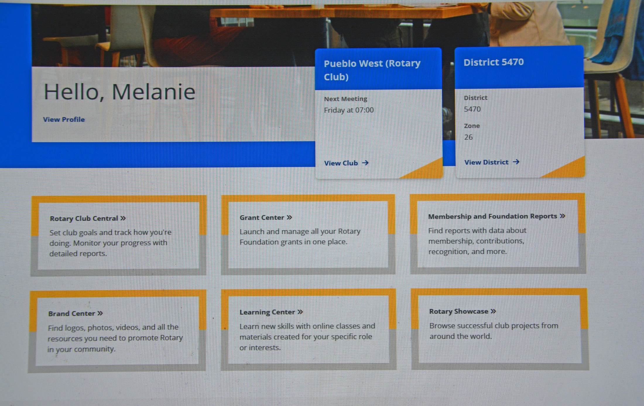

Slide 19
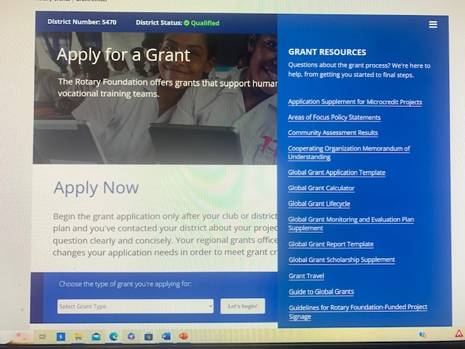

Slide 20
Guide to Global Grants – http://grant.rotary.org/s_main.jsp?lang=1
CONTENTS
INTRODUCTION 4
1 MAKE A SUSTAINABLE IMPACT 8
2 PARTNER TO MAXIMIZE YOUR IMPACT 14
3 PLAN YOUR GLOBAL GRANT-FUNDED PROJECT 17
4 APPLY FOR A GLOBAL GRANT 24
5 IMPLEMENT, MONITOR, AND EVALUATE
YOUR PROJECT 28
6 REPORT YOUR PROGRESS AND OUTCOME 35
Notes:
Of the 21 files, one must read this one

Slide 21
Clubs Must be Qualified to Participate in Grants
Two parts to Qualification
Attend a grant management seminar
Complete the club memorandum of understanding (MOU).
  https://portal.clubrunner.ca/50015
  Go to Site Pages
  FORM - CLUB M.O.U.
Both steps must be completed each year
Grant management seminar can be renewed on-line
https://portal.clubrunner.ca/50015
Scroll down left side to Site Pages. Click on District 5470 Grant Management Training. Open: Rotary Foundation Grant Management Training Test
Notes:
A club is “Qualified” if one member is “Qualified”.
Return Club MOU to district Foundation Chair...David Wood

Slide 22
Terms and Conditions.....
Page 3: Global Grants do Not fund:
Excessive support for any one community
Purchase, construction or remodeling of buildings
Fundraising activities
Activities for which the expense has already been incurred
Activities primarily implemented by an organization other than Rotary
Multiple unrelated projects under one grant
and more...

Slide 23
Finding a Host Club and Project
Rebekah Kiser’s International Service Newsletter
https://portal.clubrunner.ca/50015/sitepage
Click on Archive: D-5470 International Service Newsletters
Also on District 5470 Webpage. Site Pages:
District 5470 Clubs Seeking Project Partner
Other District Clubs Seeking Project Partners
TRF Project Fairs (Search Rotary Project Fairs)
Bistro Zoom Call.

Slide 24
Support a Global Grant Managed by Another Club
Many clubs in the same district or in different districts
can join to support a global grant.
Only one club will be the International Partner.
One member of the International Partner Club will be
the Primary Contact for the project.
GG 2681360 Two Neonatal Incubators for Ain Wazein Medical Village Center. Grand Junction with Sheree Fukai supported this grant, written by Chouf Rotary Club in District 2452.
GG 2573019 Transformada Vidas to provide orthopedic surgeries to children who have congenital club feet and hands. Pueblo West.
Supported this grant, written by Cuidad Transforma Club in District 4110. It still needs additional funding.

Slide 25


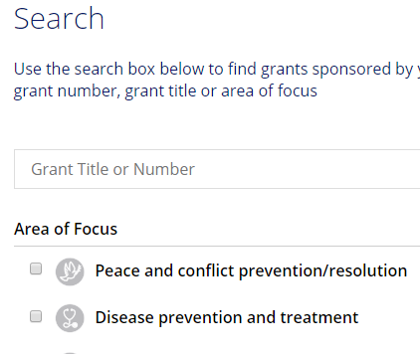
Would You Like to See a Global Grant Application?
https://my.rotary.org/en/
Take Action...Apply for Grants..
GG2014920 El Paraiso
Nicaragua WASH Project
Or email me for a pdf copy.

Slide 26
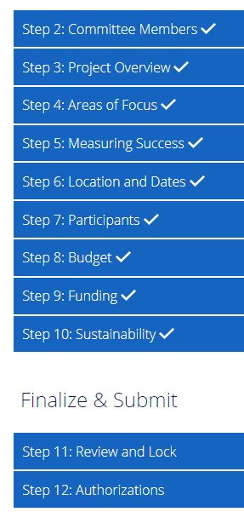
Authorization and
Locking an Application
Primary Contacts cannot edit an application after they have locked it
Apply for DDF before locking an application

Slide 27
Grant Number & Title | Club Name | Contact Person | Amount Requested | Sent in and voted by GG Committee | Funds Remaining When Approved
Beginning Funds |  |  |  |  | $65,627.65
GG 2577896 Expanding Community Based Mental Health Care in Ngoro District, Uganda | Pueblo 43 | Janice Mehle (43) 719-924-0306 Adrielle Knight (Cherry Creek) 720-474-1823 | $1250. | yes | $64,377.65
GG 2577162 Water Supply Paraguay Safe Water Thriving Communities | Vail Rotary Club | Reggie O’Brien | $6250. | yes | $58,127.65
GG 2575173 RACHEL Growing in Panama | Durango Daybreak | Walter Duhaime | $2500 | Yes | $55,627.65
GG 2574677 Dancing for Rain | Durango Daybreak | Walter Duhaime | $3100. | yes | $52,527.65
GG 2686065 Clean Water Healthy Children | Durango Daybreak | Walter Duhaime | $3100. | yes | $49,427.65
Guatemala Literacy Project | Many clubs headed by Fruita | Joni Ellis - Fruita | $10,625. | yes | $38,802.65
GG 2580217 Cleft Lip and Palate Vocational Training | Carbondale | Thomas J Fitch 704-968-5769 Tjfitch5@gmail.com | $2500 | yes | $36,302.65
GG 2681360 Two Neonatal Incubators for Ain Wazein Medical Village Hospital | Grand Junction | Sheree Fukai | $5000 | yes | $31,302.65
GG 2685268 Corazon de Ninos | District 5470 | Maile Foster and Melanie Phelps | $8000 | Yes | $23,302.65
GG 2573019 Transformado de Vidas | Pueblo West | Melanie Phelps | $3000 | yes | $20,302.65
GG 2691631 Escuela con Voz | Durango Daybreak | Walter Duhaime | $1100 | yes | $19,202.65
2024-2025 Rotary District 5470 DDF Requests
2025 -2026 Rotary District 5470 DDF Requests

Slide 28
Global Grants Committee
Melanie Phelps Pueblo West melaniephe@aol.com
Reggie O’Obrien Vail regina.obrien.pchn@gmail.com
Sandy Lowell Glenwood Springs Sunrise slowell3@gmail.com
Peter Jeschofnig Glenwood Springs pjeschofnig@gmail.com
Walter Duhaime Durango Daybreak wduhaime@gmail.com
We are looking for new members for the Global Grants Committee. If you are interested in serving with us, please contact Melanie 719-252-1789
Responsibilities
Promote Global Grants
Review requests for District Designated Funds (DDF),
Vote on them and send our recommendation to
District 5470
Suggest ways to strengthen applications

