Slide 1
Mbale Water Project, Uganda
Who What Where
When Why How

Slide 2
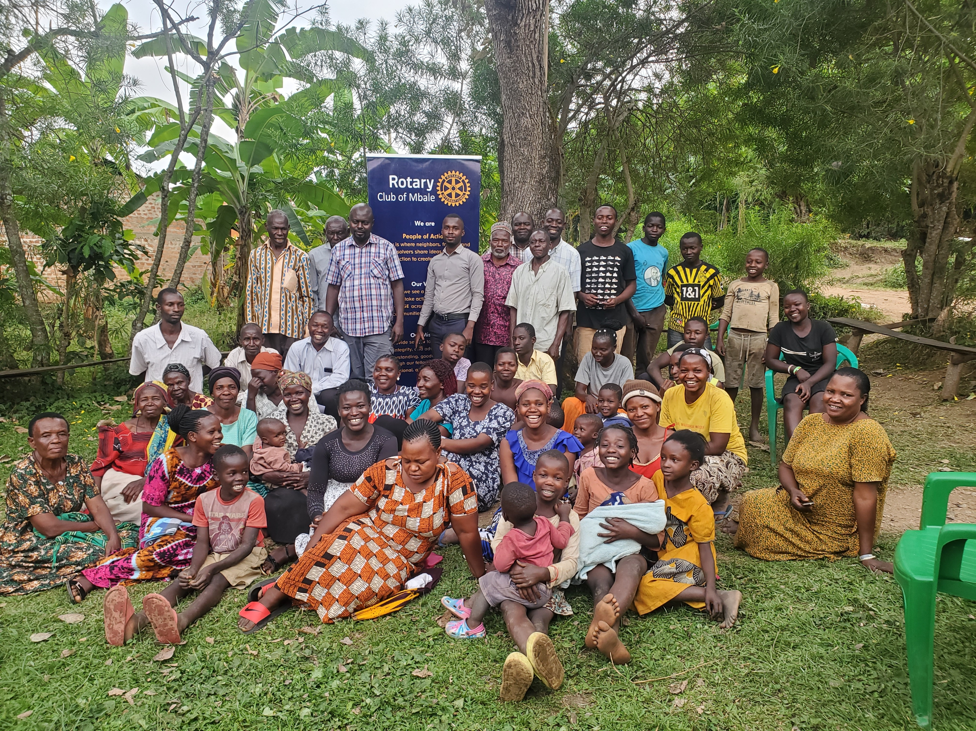
Who…Residents of Bugusege

Slide 3
Who…David Mabonga and Daughters

Slide 4
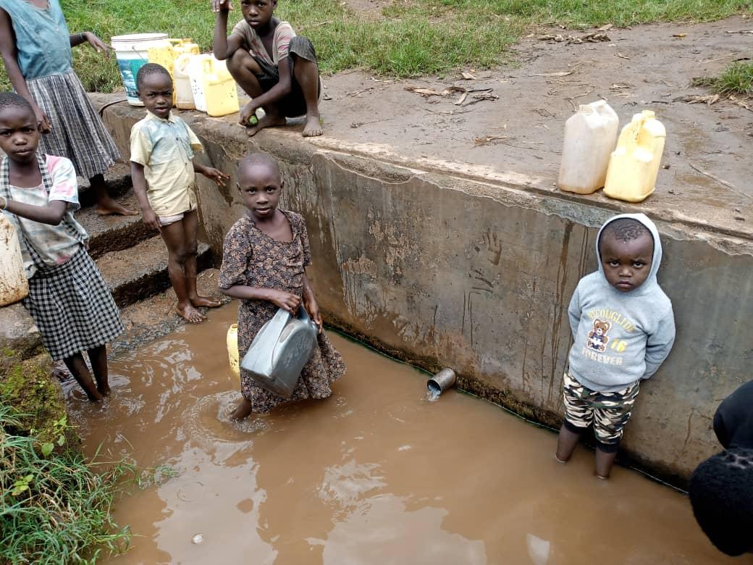
Busegese Water Project, Mbale What… they have now!

Slide 5
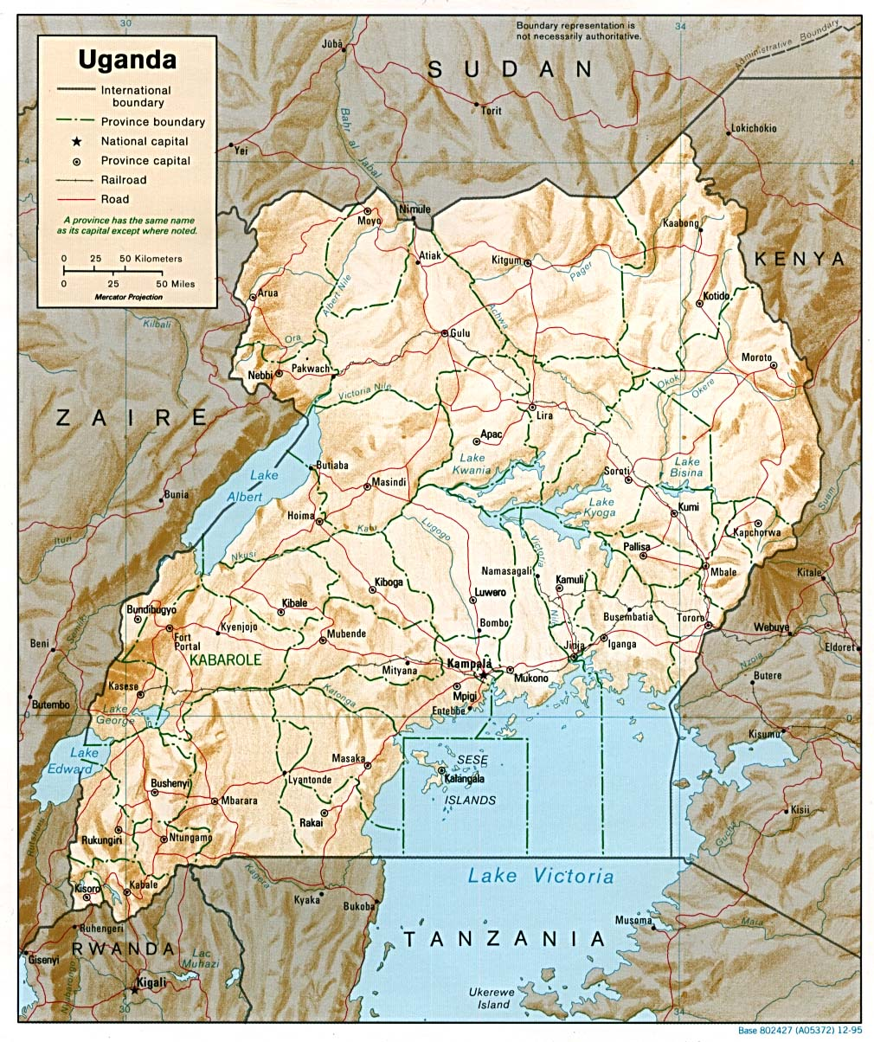
Where…
Mbale

Slide 6
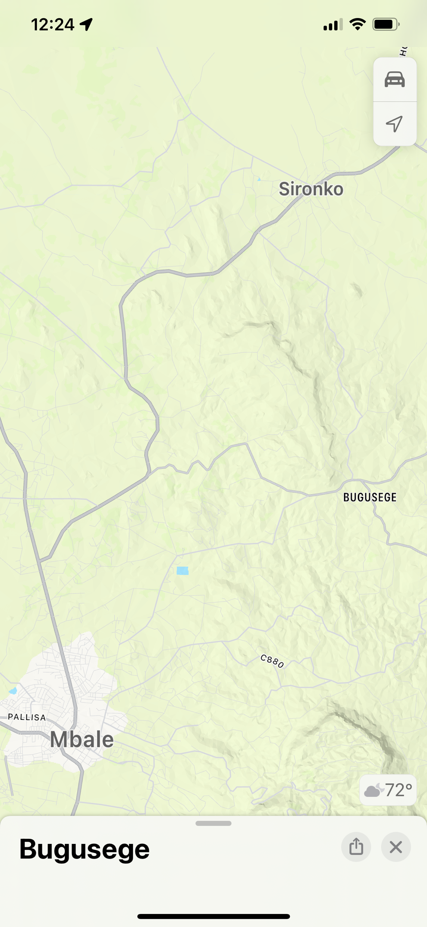
Where…More specifically

Slide 7
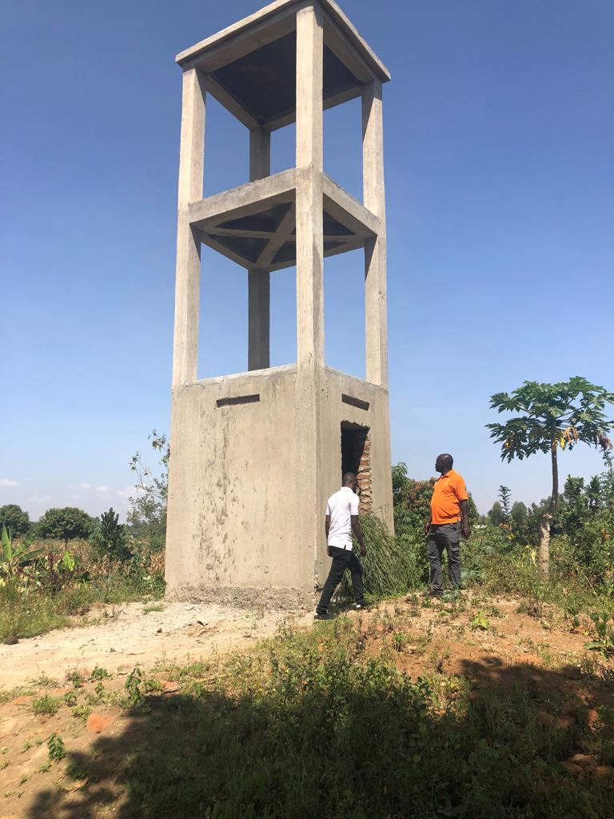
When…Within about 90 days Example of another similar project

Slide 8
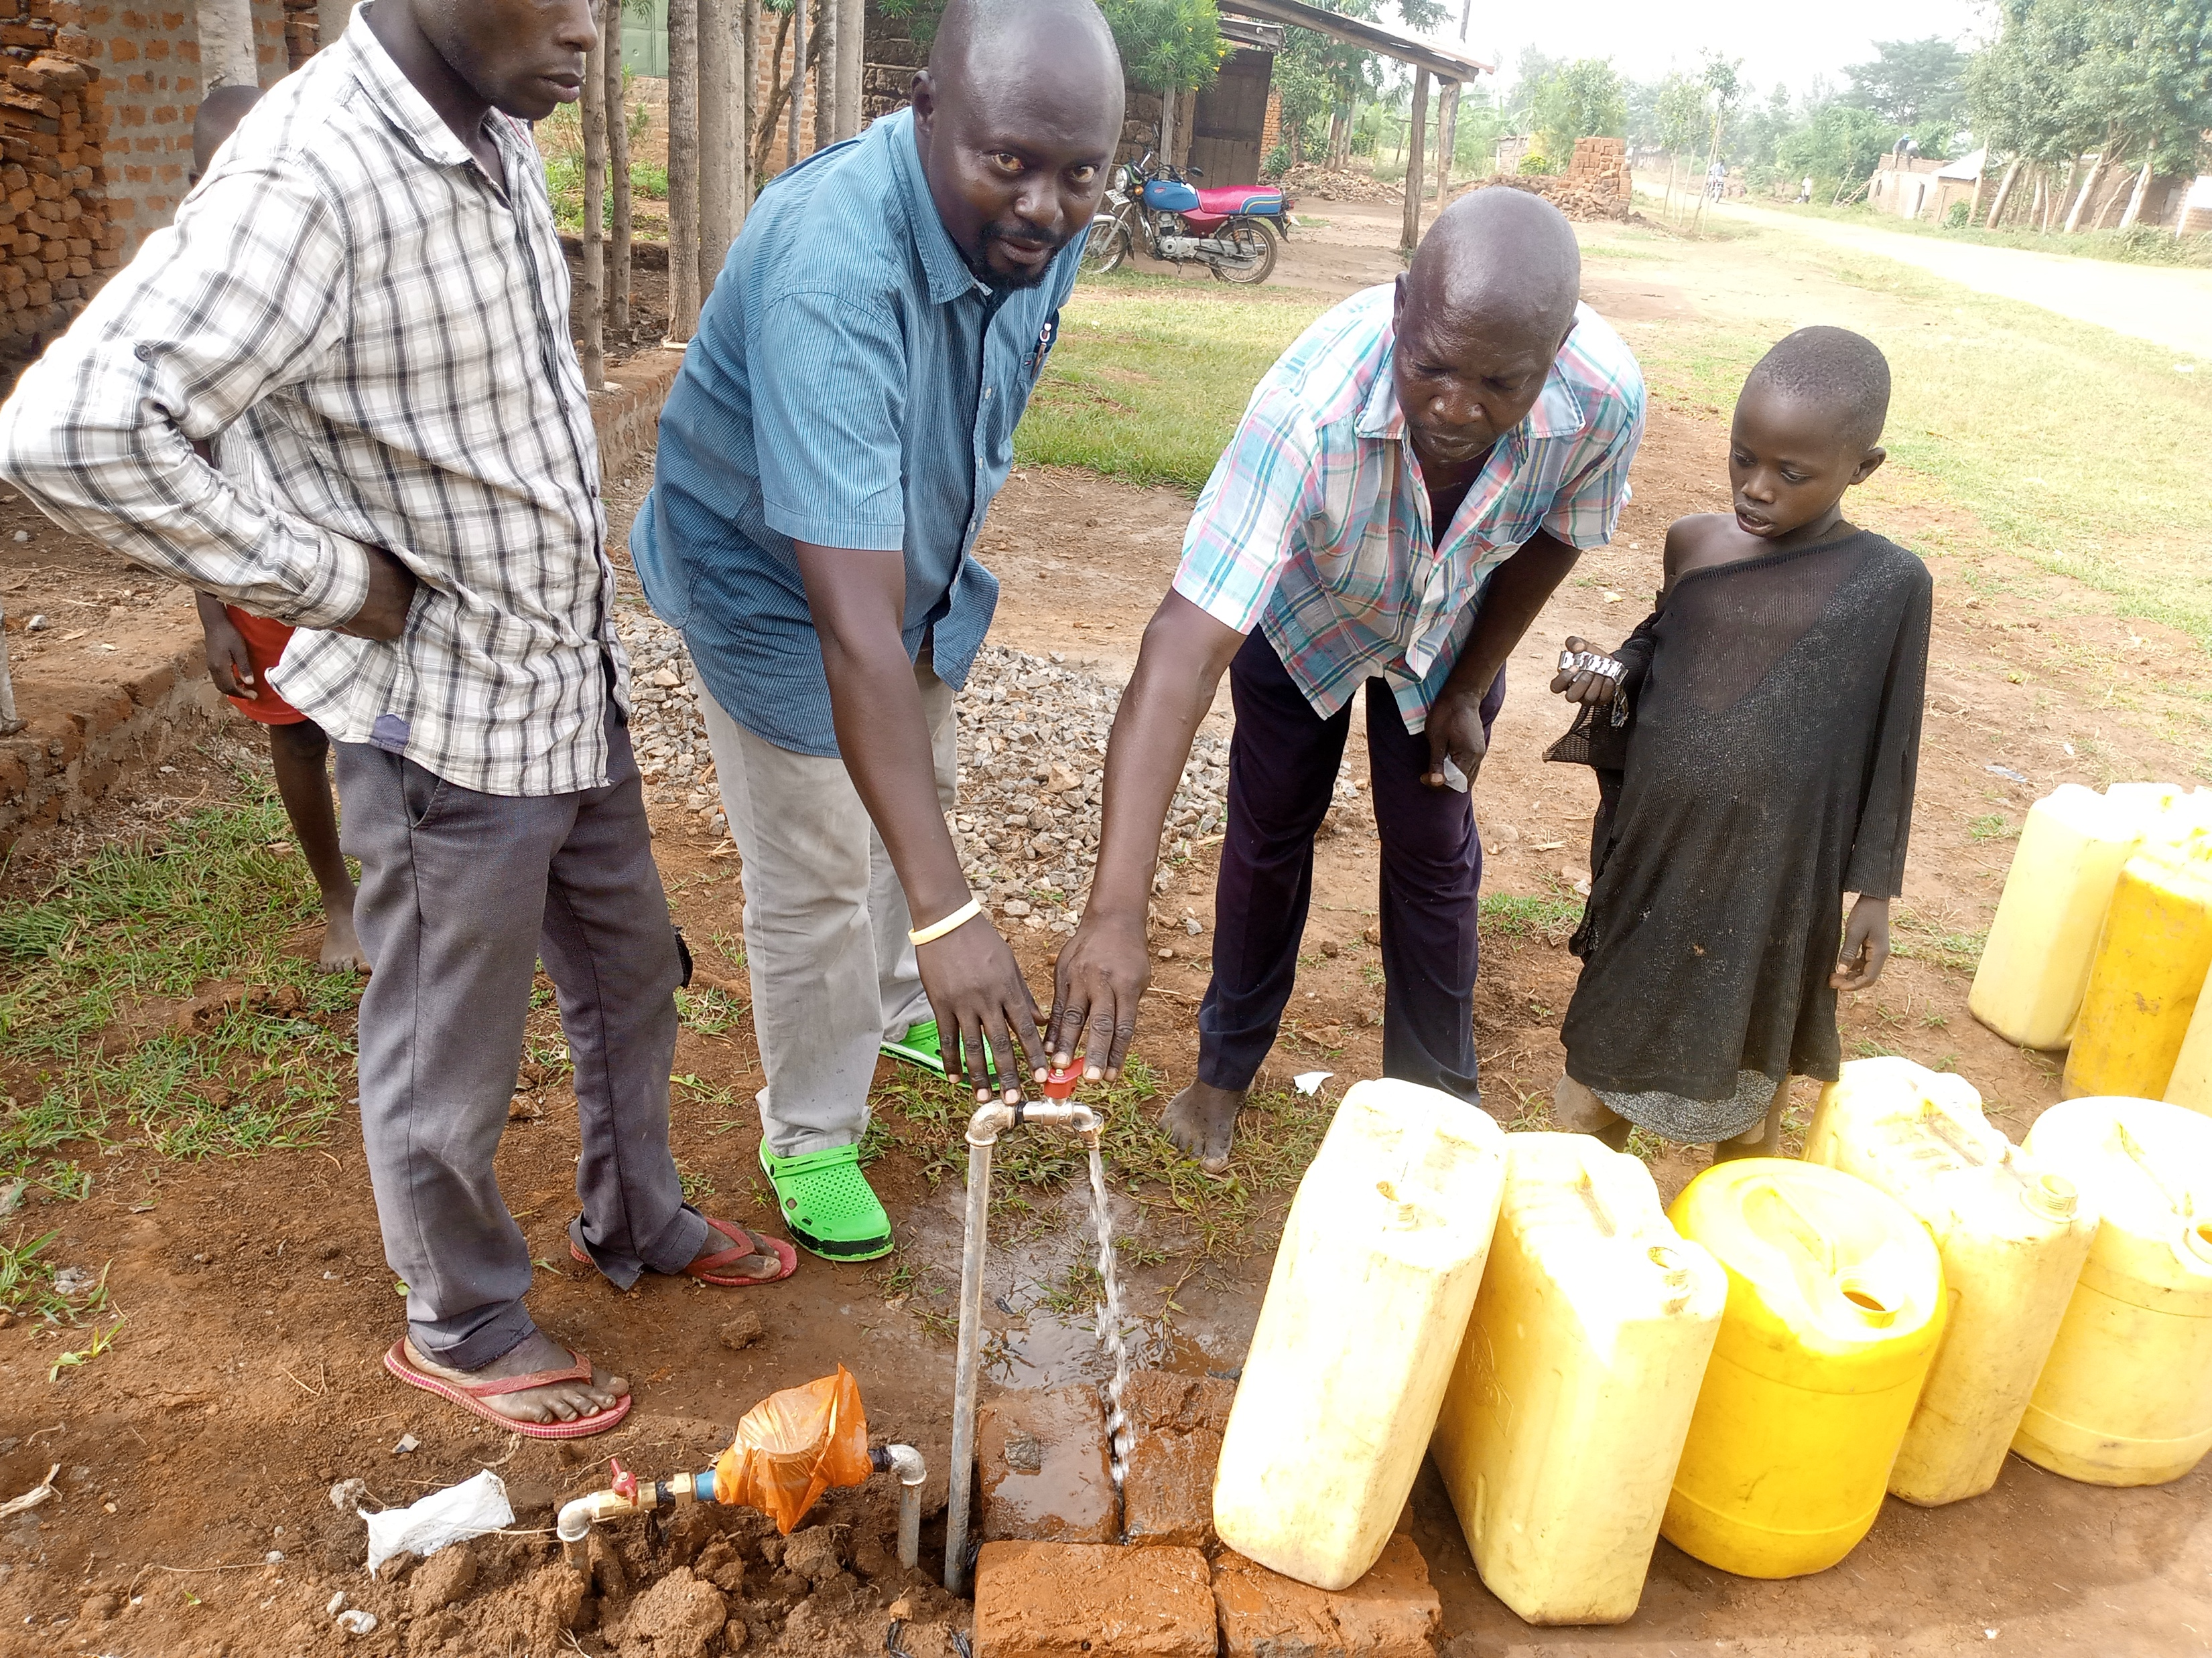
Why…To attain this

Slide 9
How: Solution / Partnership/Rotary Grant
We have sources for: Drilling, Submersible Pumps, Solar Voltaic Panels, Tanks, Piping and Standpipes.
We have David on the ground who has successfully managed 3 previous projects
We need a total of $130,000 to convert this dream to reality.
We have approval from District 5960 for a full match up to $25,000
We need: additional Rotary Clubs from multiple districts to partner with us to help this happen.
Will you join with us?
Video: https://www.youtube.com/watch?v=ye9CZq2f-PY&t=81s

