Slide 1
World Community Service
(WCS) Grant Examples
Exclusive to D5580:
$15/Rotarian/year, raising approximately $45,000/year.
Funds must be used for International Projects.

Slide 2
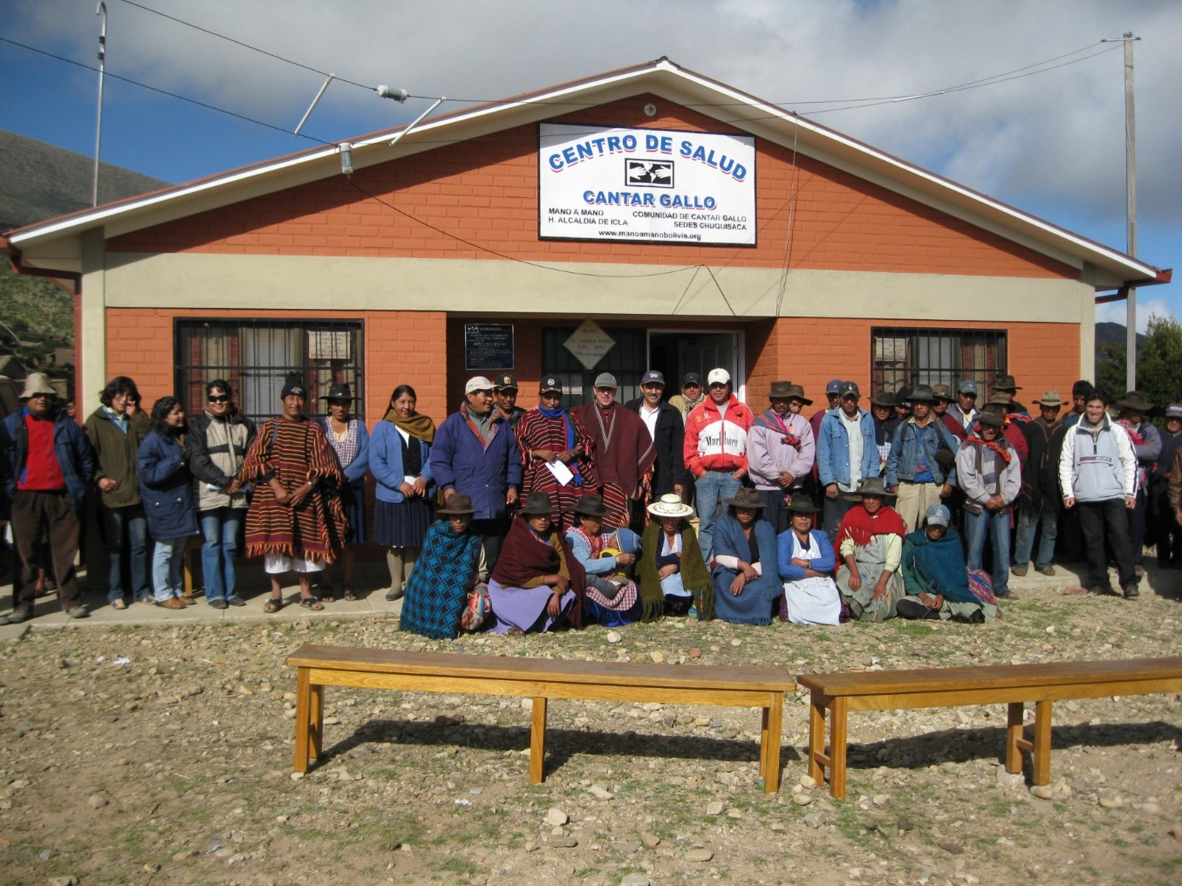
Health Clinic
Cantar Gallo, Bolivia
Notes:
Multiple club participation in cooperation with local NGO, mano-a-mano

Slide 3
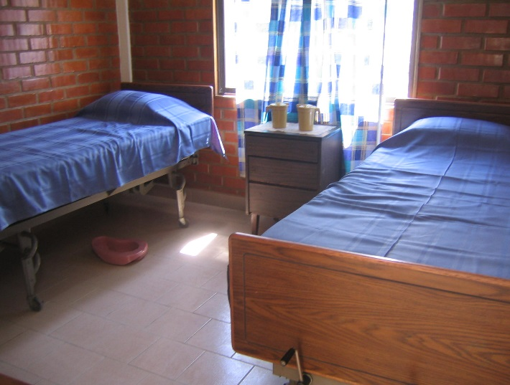
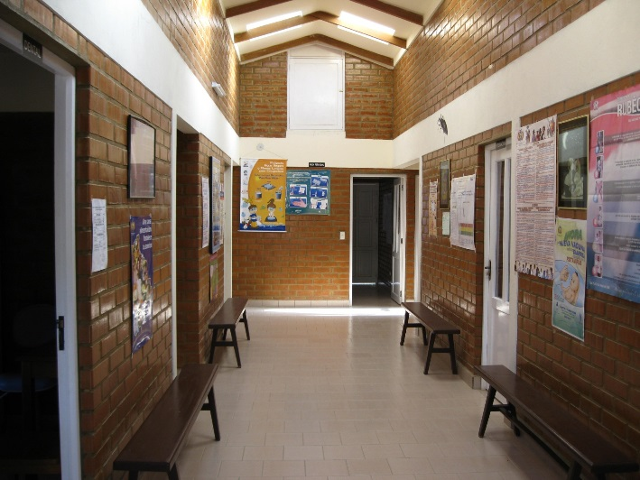
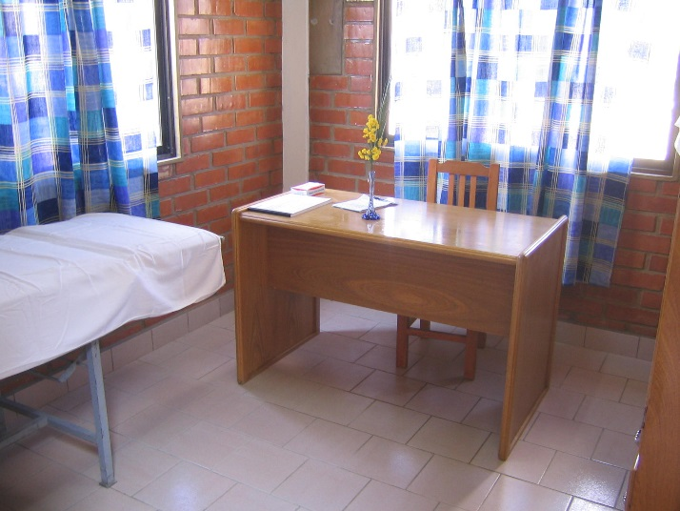
Candelaria, Bolivia
Clinic

Slide 4
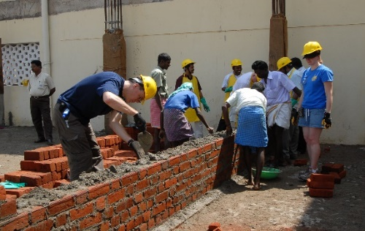
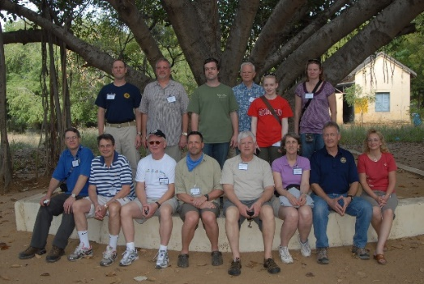
2010 WCS Grant – addition of two Class Rooms to Rotary Matriculation School

Slide 5
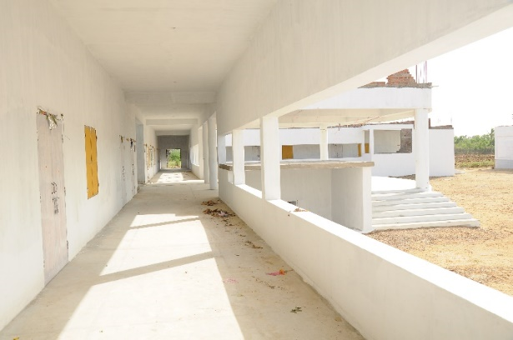
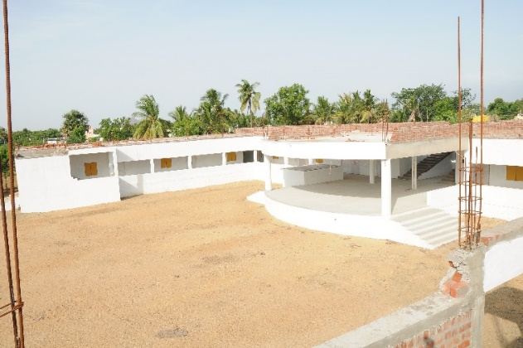
2015 WCS Grant, USA and Canada Clubs: Meenakshipuram School ($50,000 from D5580)

Slide 6
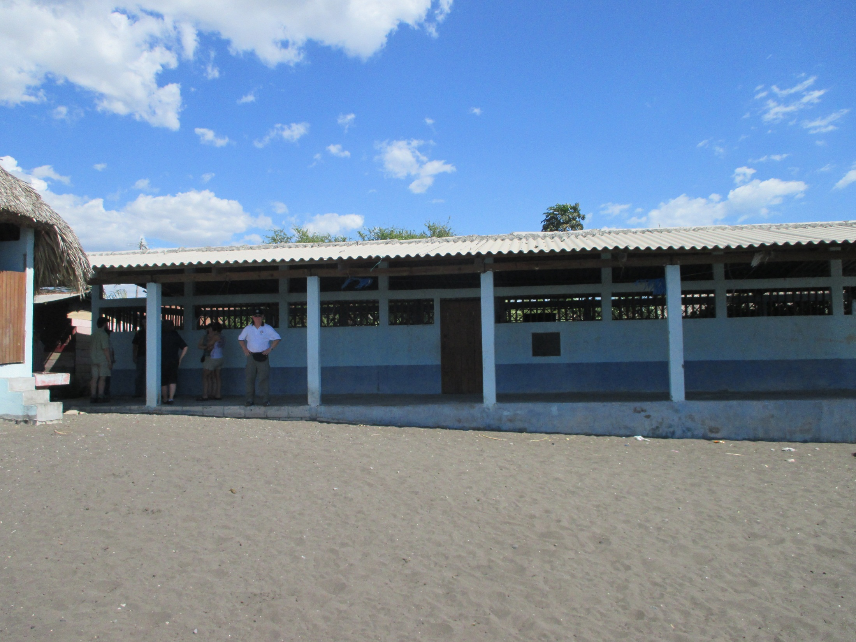
The 2011 school built at El Dormido following the 2010 Hurricane that devastated their community

Slide 7
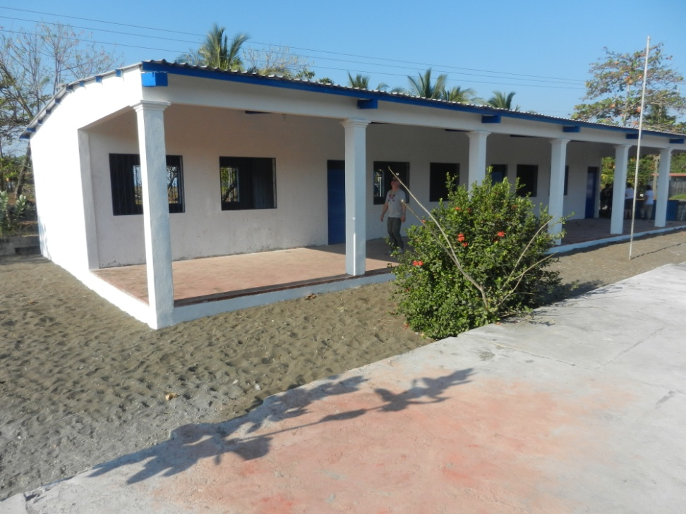
13.1.03 El Cebollito School Guatemala

Slide 8
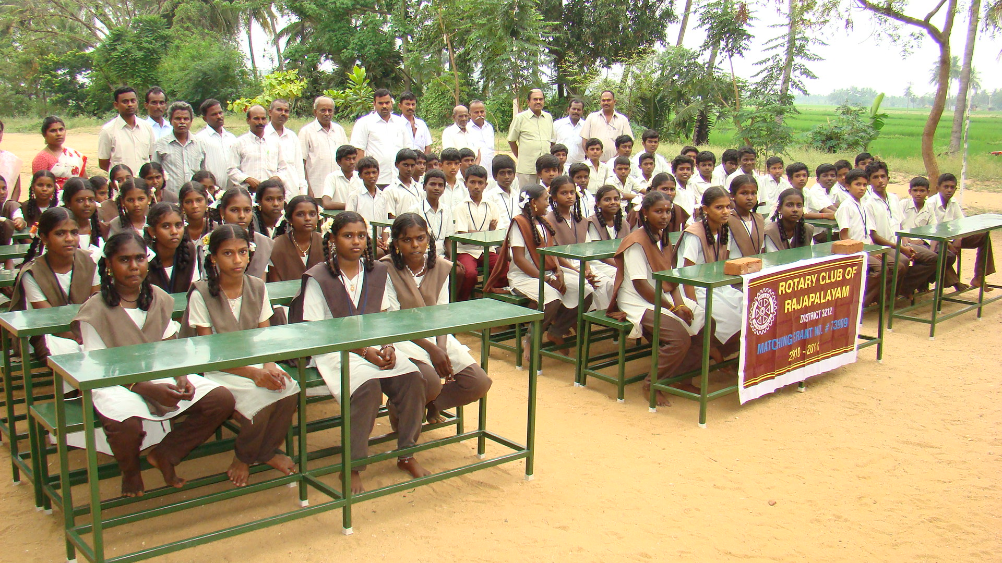
The 2012 “Mega Project” will provide 653 desks to 56 schools within a 40 Km radius of Rajapalayam @ a cost of $31,500

Slide 9
Harbortown’s Bolivia Project is a 23.75 Km = 15 mi. Road Project!

Slide 10
from goat path to road

Slide 11
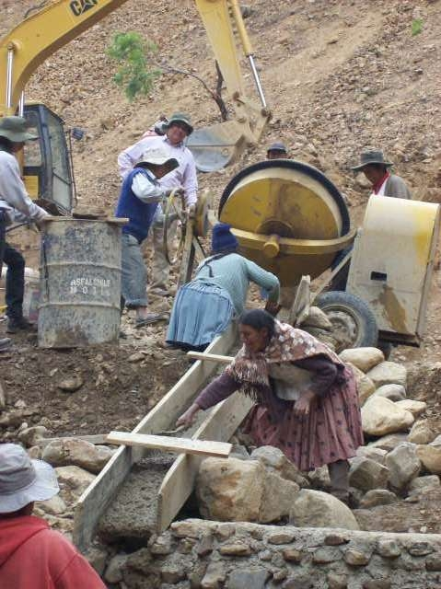
Like most high country regions this area near Cochabamba, Bolivia typically has 3 months of torrential rains and 9 months of drought annually; thus the need for this reservoir

