Slide 1
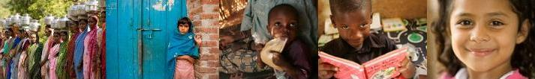


District Grants
District Grants is a tool Rotary districts utilize to support short-term, humanitarian projects that benefit the community
Funded thru District Designated Funds (DDF) to support projects locally or internationally (D5580 requests 50% of their annual DDF in District Grant funds)
Grants*
*not applicable to FV Pilot Districts
Notes:
District Simplified Grants support the short-term service activities or humanitarian endeavors of districts in communities locally or internationally. This program began in 2003-04 and more than 2207 grants have been awarded to 478 districts in 65 countries totaling more than $35 million. In 2008-09 407 District Simplified Grants were awarded totaling $7,495,098
Wow! Third Grader Schenatsar Dorvilier, 8, pictured here, learns that the longest word in the English language, a term for an enzyme has 1,909 letters, according to her new Dictionary donated by the Rotary Club of Naples Bay, FL, USA. This club and many more throughout the USA have used District Simplified Grants to provide dictionaries to local school children.
In 2007-08, 389 District Simplified grants were awarded totaling US $6.4 million.
In 2006-07 379 grants were approved. Program expenditures were $5.1 million.

Slide 2
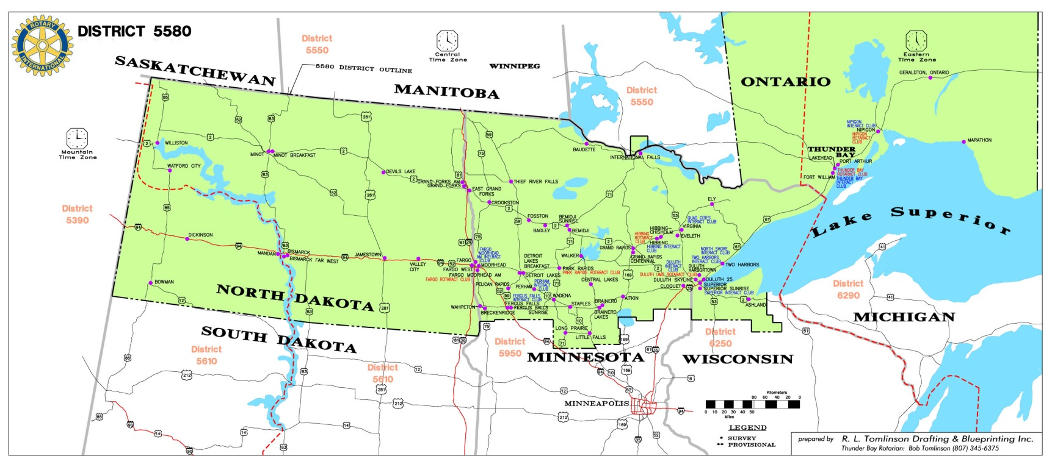
Rotary District 5580
(67 Clubs - 174,000 Sq. Miles)
Many of our D5580 clubs have their own local Rotary Foundations (501c3) to help these clubs fundraise through Rotarians and local business donations to projects.
Notes:
67 clubs
ND, MN, WI, Ontario

Slide 3
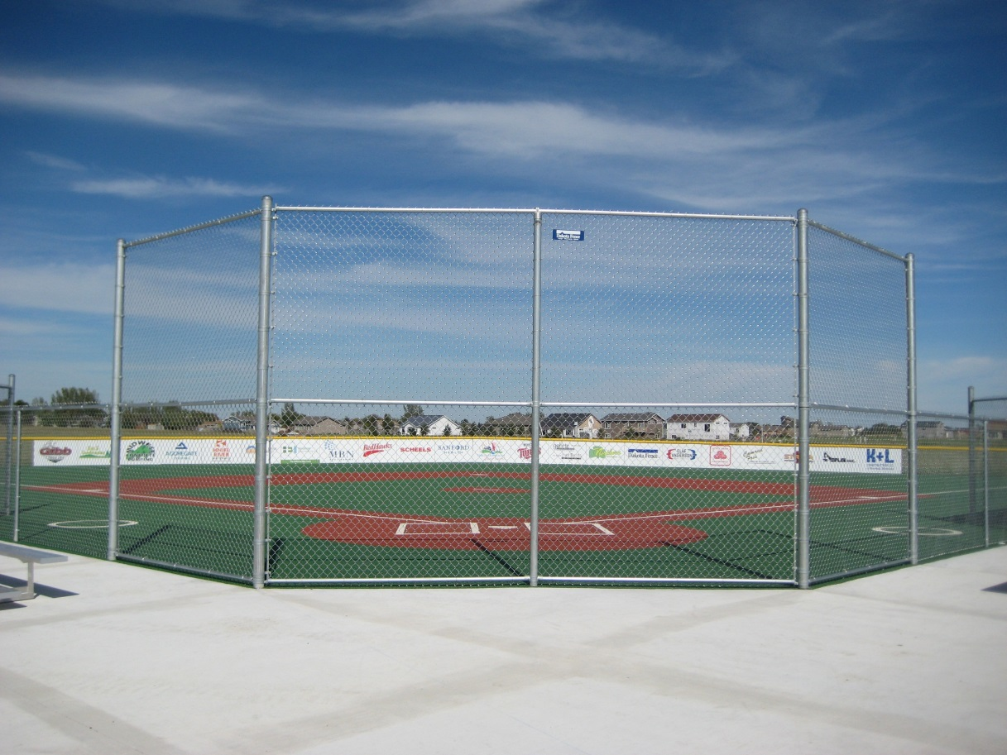
The Moorhead Miracle Field
District 5580 Presidents-Elect Training Seminar
Notes:
Success is in the planning!

Slide 4
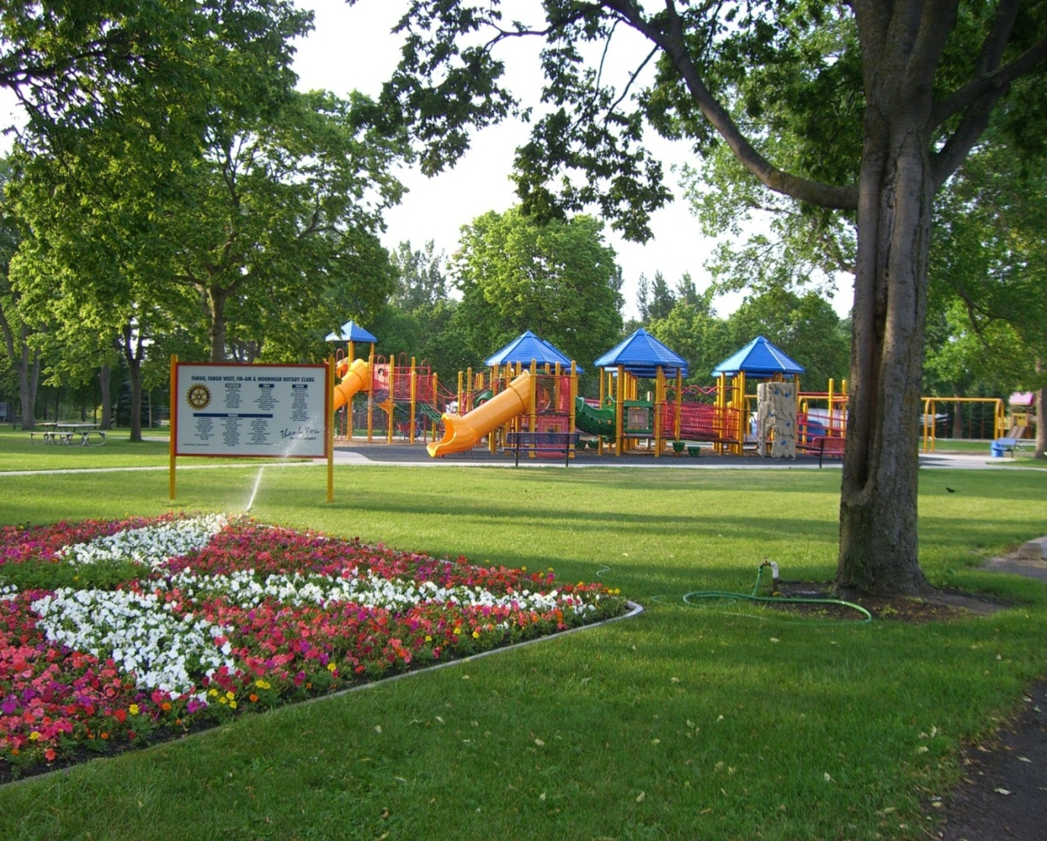
Universal Playground Project, Fargo
District 5580 Presidents-Elect Training Seminar
Notes:
Success is in the planning!

Slide 5
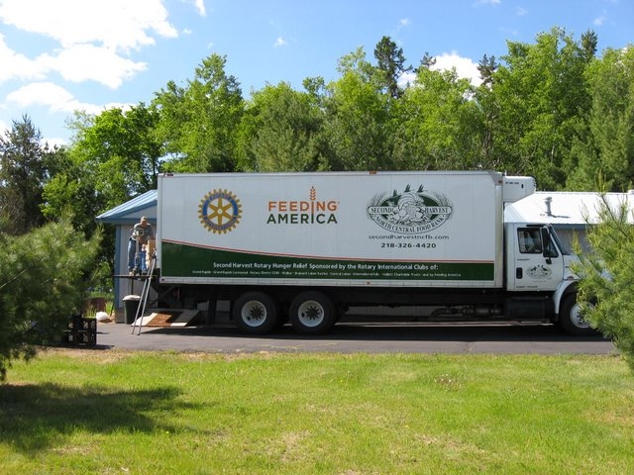
Second Harvest Food Van sponsored by: Grand Rapids, Walker, Hibbing, International Falls, Virginia, Central Lakes Rotary Clubs DSG Project 09.1.03

Slide 6
Baudette Rotary’s Ambulance project – DSG 10.2.12

Slide 7

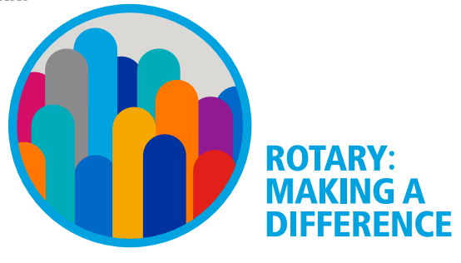

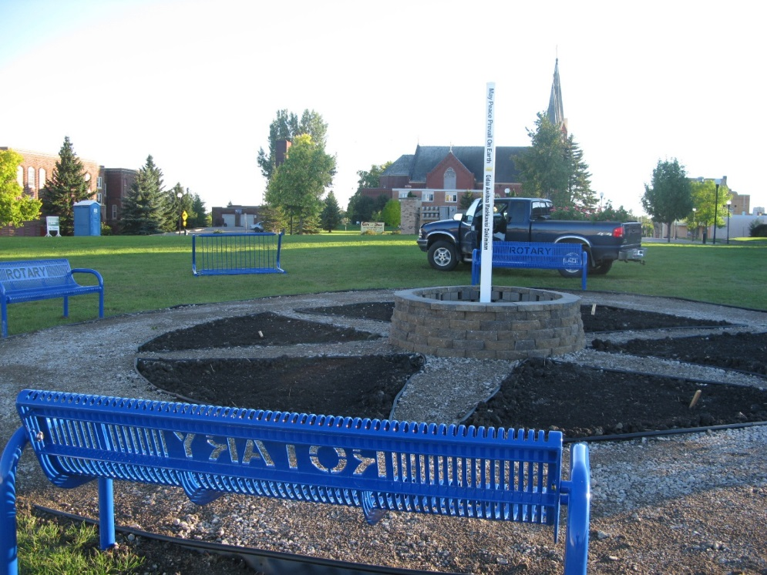
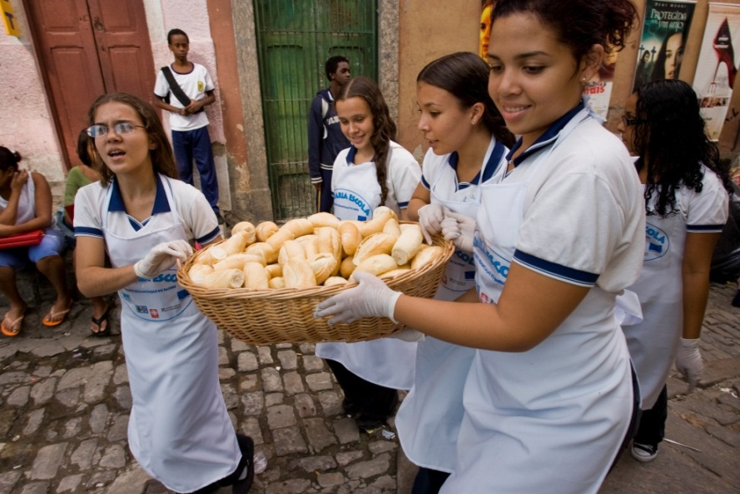
Economic & Community Development – Crookston Rotary Peace Pole Project
Notes:
Dist. 5580 Water reservoir and Road projects in Bolivia help farmers grow product to sell and allow them to get it to market.
Examples… The DL noon club provided assistance to Jamaica for improving their ability to market and sell local produce.
The DL breakfast club has helped provide micro loans to help prospective entrepreneurs to develop a business in depressed areas

Slide 8
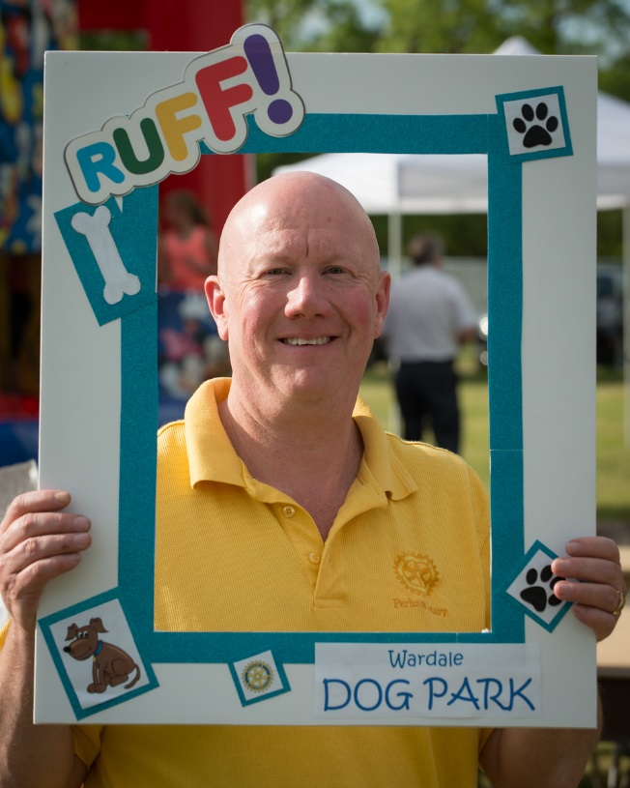
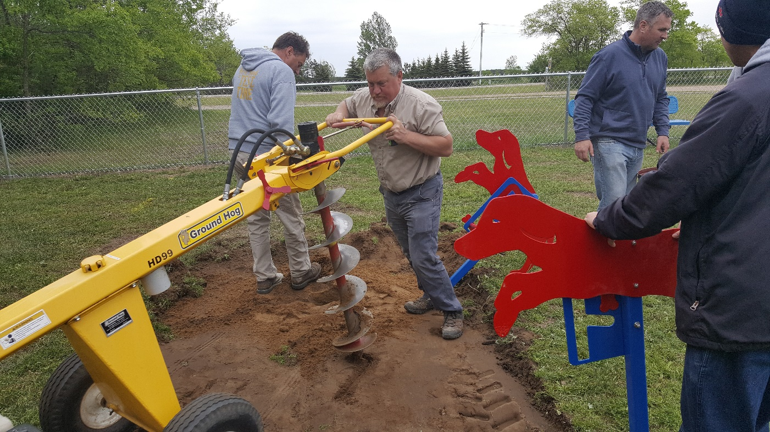
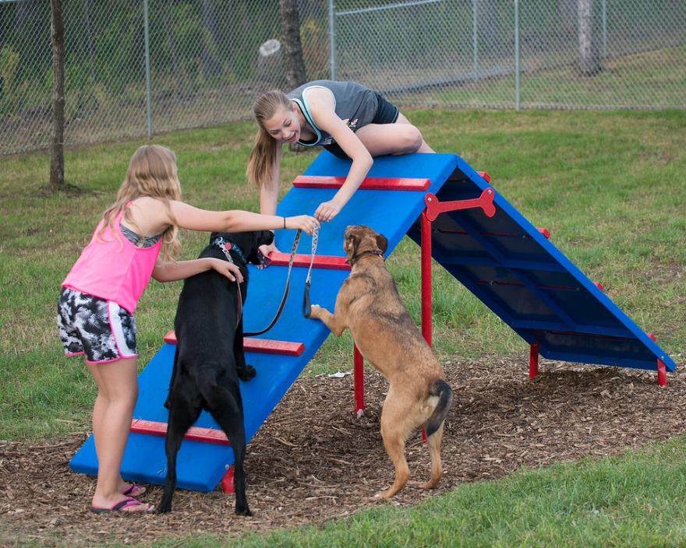
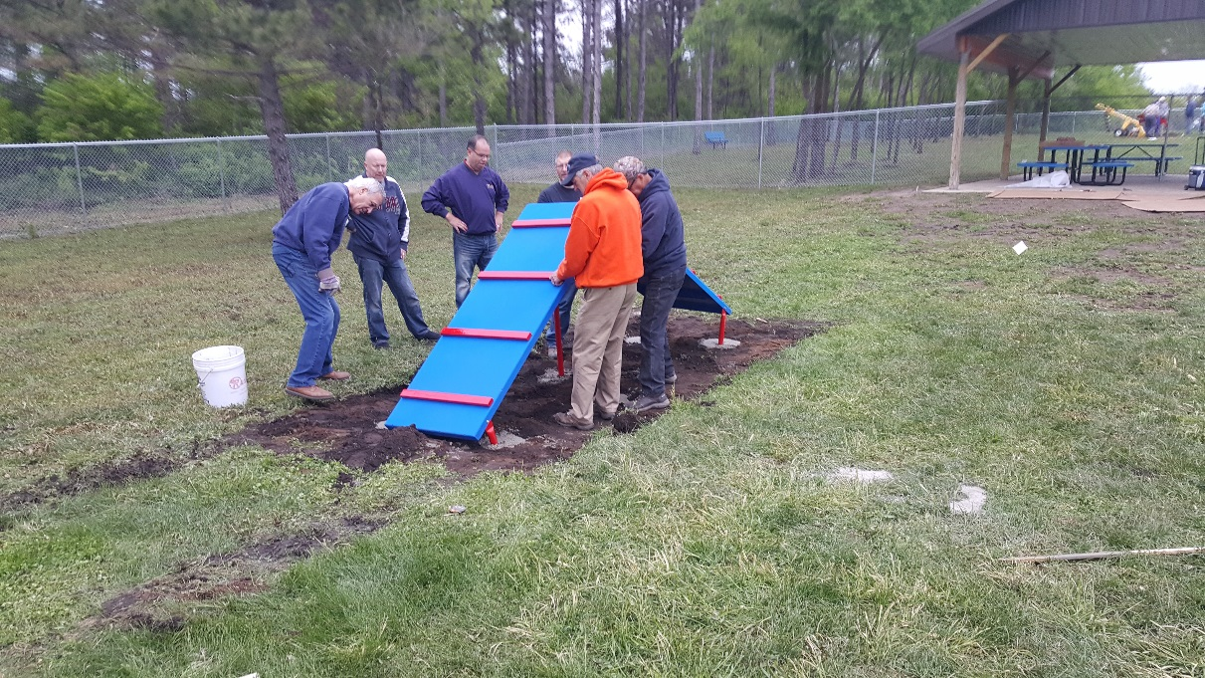
Perham Dog Park by the Perham Rotary

Slide 9
15.1.01 Peace Pole Park, Crookston
Notes:
$5000
Ed attended the dedication?

Slide 10
15.1.02 AED’s, Long Prairie
Notes:
Long prairie area
$5000
Rotarians procured the devices, distributed to 7 churches and 2 bible camps, and assisted in the training of potential users

Slide 11
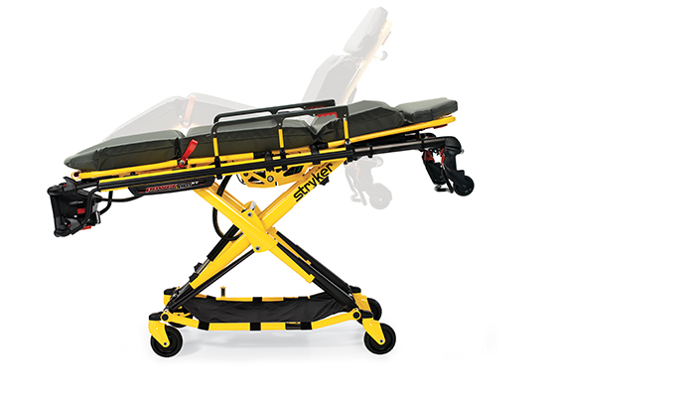
15.1.10 Baudette
Reduces EMT back injuries, allows EMT’s with smaller stature to operate,
Used for over 250 ambulance runs as of August 2015
Notes:
7500
Baudette, MN

Slide 12
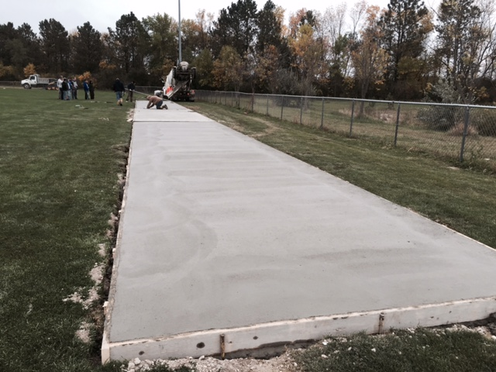
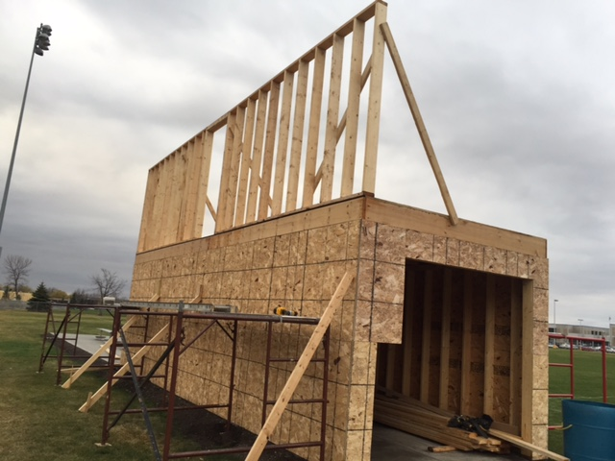
15.1.13 Soccer fielf Improvements, Jamestown
Notes:
Upgrades and improvements to the Jamestown soccer fields has allowed the community to boast what they believe is the premier field in the state of ND and to host an annual all-star game
Recent additions include the pressbox and storage building shown under construction
3250

Slide 13
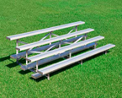
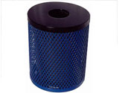
16.1.01 Baseball Field Improvements, Thief River Falls
Notes:
TRFalls
4000

Slide 14
16.1.02 Wadena Tranquility Garden, at Wellness Center
Wellness Center
Peace Pole, Landscaping Gardens, Tables, Benches, Area for outdoor enjoyment and gatherings
Sustained by city and Rotary committee
Notes:
Tornado
Completion date expected Aug 2016
4000

Slide 15
16.1.03 First Lego League
Lego Robotics kits for McKinley Elementary
Grades 4-8
STEM Education and Collaborative Problem Solving
Somewhat a precursor to High School First Robotics, or other robotics competitions and learning opportunities
Notes:
$3609

Slide 16
16.1.03 Lego Robotics Kits
Notes:
Industry, Educational volunteers
Rotary members volunteer for weekly sessions
School provided the computers
CCCTEC - Cass Cty Career& Tech Educ Consort working w/schools in ND
CCCTEC and school are responsible for sustaining after year1
Currently in progress - Sept 2015-Apr 2016

Slide 17
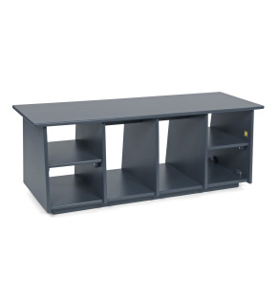
16.1.04 Cubby Benches for Low Income Housing
Notes:
50 apartments for previously homeless residents, permanent supportive residence for families, and 6 units set aside for crisis residences
Provides means for residents to organize items and keep units clean.
Rotarians assemble and distribute units
$6250

Slide 18
16.1.06 St James School Partnership ThunderBay port Arthur
School with high % First Nations, Low Income, Single parent families
Curriculum based field trips, physical activities, cultural experiences, and leadership development
3 year commitment
Rotary members and Youth Exch Students assist 1hr/wk in classroom
Notes:
2000

Slide 19


15.1.08 Dolly Parton Imagination Library
International Effort for early childhood literacy
Virtual library of books for kids 0-5
Nearly 1MM kids signed up in US
Notes:
$1828

Slide 20

15.1.09 Andy and Elmer Literacy Project
Apple dumpling Adventure Children’s Book used to illustrate the 4 way test
https://www.youtube.com/watch?v=YoV2WZy0KjU
Notes:
Rotary members…
https://www.youtube.com/watch?v=YoV2WZy0KjU
Developed by Fairborn Ohio club,
Being used/marketed throughout US
Looking to take internationally
$1299

Slide 21
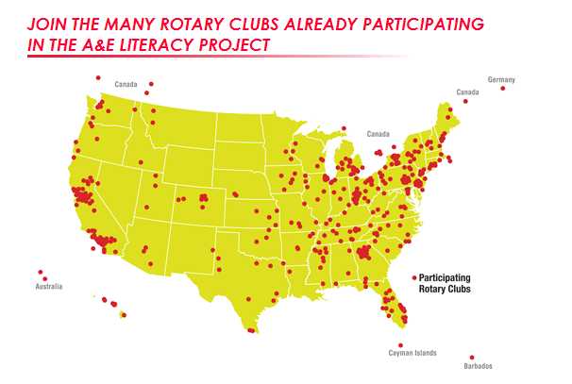
Notes:
Rotary Clubs across the U.S. and beyond are particpating in the A&E Literacy Project. There are many ways to implement the project. So, find the way that suits your club and join us in sharing the Four-Way Test.

Slide 22
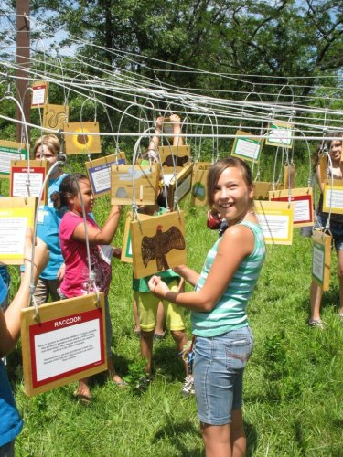
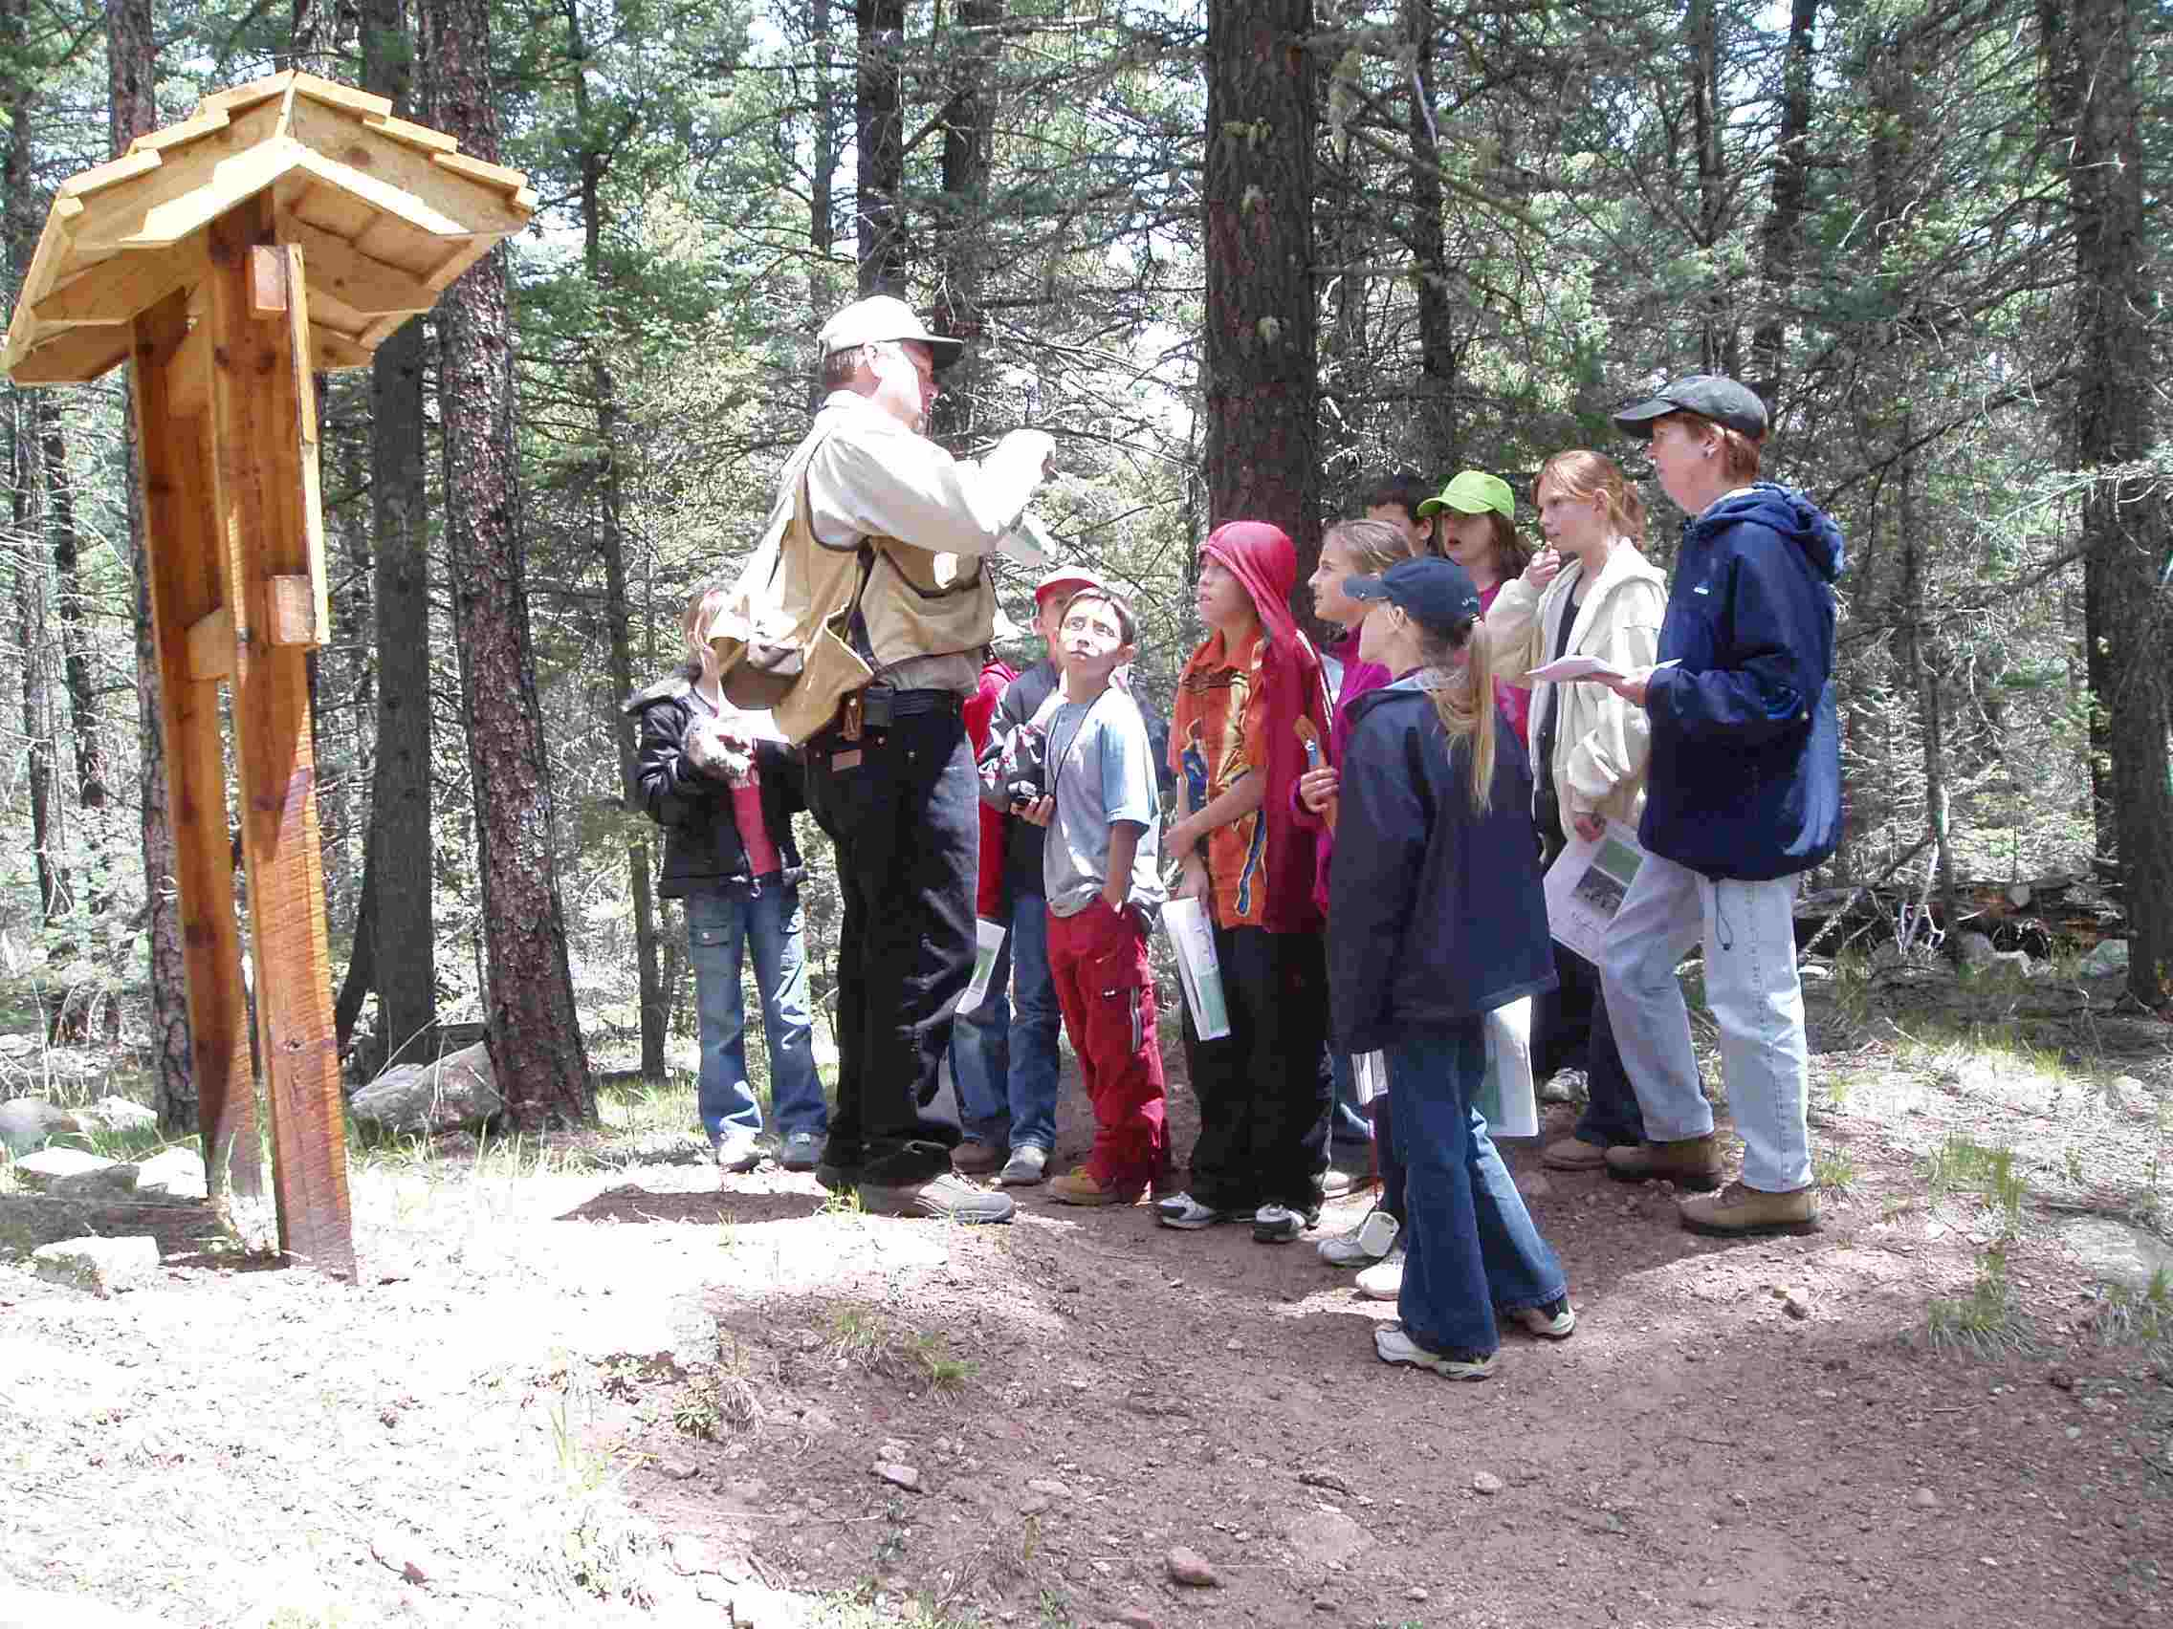
14.1.07 Learning Tree - International Falls

Slide 23
14.1.07 Project Learning Tree
For more than 30 years, Project Learning Tree has provided the training, resources and support teachers need to provide quality environmental education.
https://www.youtube.com/watch?v=c-c3orPOIUA&feature=player_embedded

Slide 24
15.1.15 Active Living Center Itasca County
Adult Day Services and Childcare areas attached to YMCA
Rotary provided furniture & VOIP phone system for the center & classrooms to provide mobility accessibility in public areas and restrooms
42 Rotarians and 2 Xchg Students participated in providing equipment
Notes:
$10,000

Slide 25
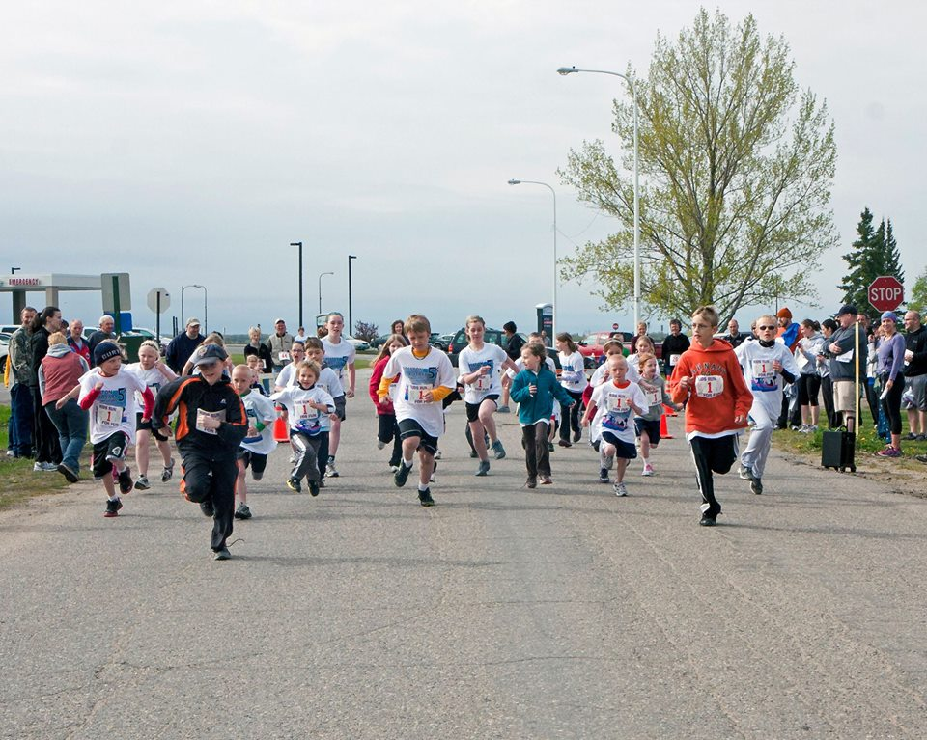
14.1.05 Fosston Inspiration Trail (Bike/Walk/Run Course)
Notes:
$5000
0.8 mile multi terrain trail for community enjoyment and health
Since its inauguration, additional features have been added –
“natural play spaces” for individual and family activities
A natural play space is a playground that uses things found in nature - the kind of things that children used to find on their own. Getting help with the design of the space will ensure that it is not only fun, but also safe, and aesthetically pleasing.

Slide 26
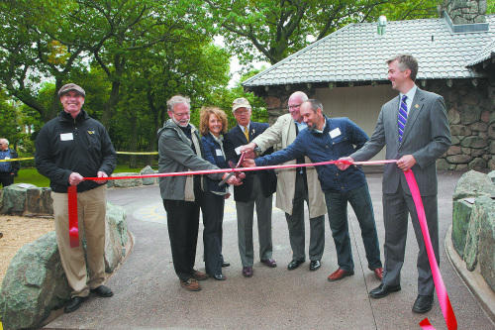
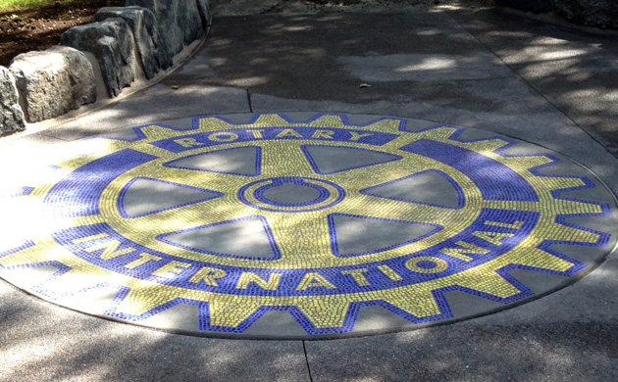
14.1.09 Duluth International Peace Plaza
Really cool rotary wheel
Ribbon cutting
Notes:
$15,000
Duluth 25 club, along with other Duluth clubs
$100,000 project, aided by donations from Westmoreland Fndtn and city
Rotary International Peace Plaza" at Enger Park

Slide 27
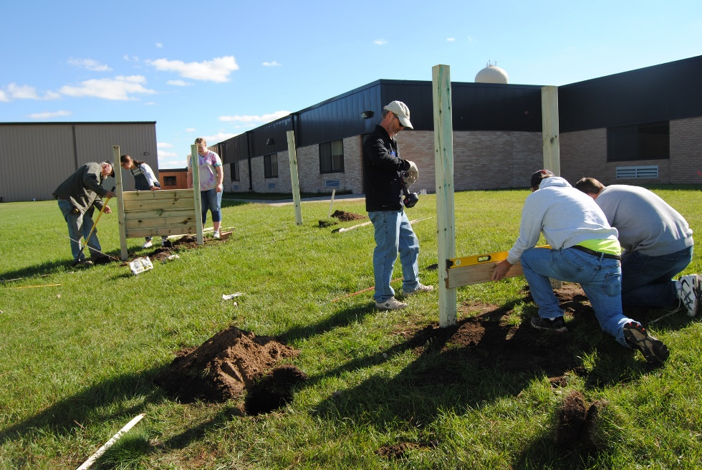

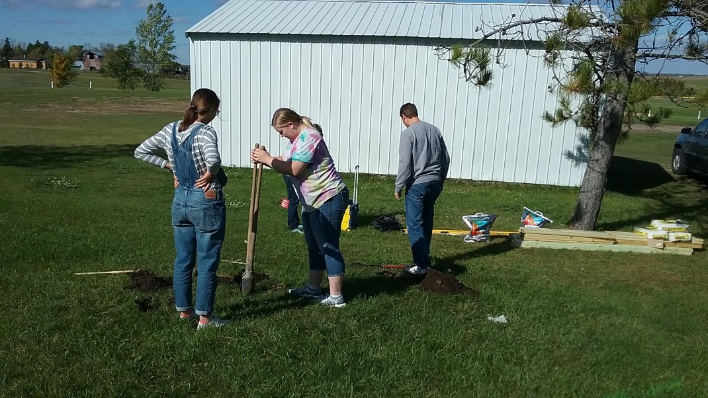
18.1.04 Outdoor Classroom & Gazebo,
Frazee - DL Noon and DL Breakfast Clubs
Gazebo being built by students
Learning Pod construction by Rotarians and School staff
Interact Students dig holes for poles

