Slide 1
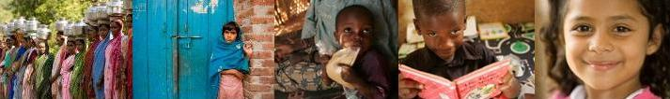
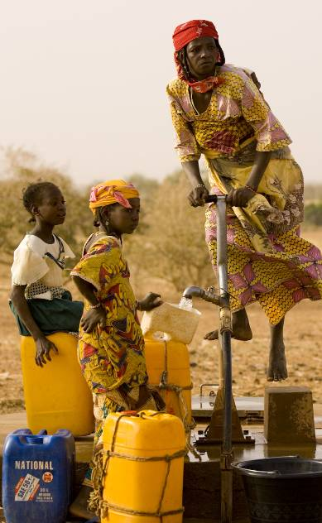
Global Grants
Formerly Matching Grants*
Matches contributions raised by Rotary clubs and districts for international service projects involving Rotary clubs between two or more countries
*
Notes:
Rotary’s Matching Grants program enables clubs in one part of the world to connect with a club or a Rotarian located a world away to combine their energies and make a difference. By working together Rotarians from Germany, Australia, Canada, The United States, Mexico, and Niger have obtained several grants for projects in Niger, the poorest nation in the world. One project helped build the well pictured here. Wells such as this one help provide clean water and will make life healthier and easier for these villagers.
Matching Grants provide matching funds for international service projects of Rotary clubs and districts. Since 1965, 30,560 Matching Grant projects in 199 countries and territories have been funded at a cost of more than $341 million. In 2008-09 1,560 Matching Grants were awarded totaling $16,632409

Slide 2
Dist 5580 Global Grants In Progress as of August 2017
GG1413321 Water Filters; Haiti
GG1421892 Health Care Equip; Timor Leste
GG1526144 Heart Valve Tissue Bank, Sri Lanka
GG1528256 Road Construction joining Villages; Sumala Bolivia
GG1528662 Leg Braces for Polio, Congo
GG1531315 Global Scholar to Ethiopia, Alicia Helion
GG1637034 Water Wells (18), Republic of Chad
GG1634888 Bone Bank; Chennai, India
GG1640987 Mobile Cancer Screening & Educ’n, Nagercoil India
GG1749520 Blood Mobile; Rajapalayam, India
GG1748867 School Addition & sustainment; Meenakshipuram, India
+4 GG in Draft Status

Slide 3
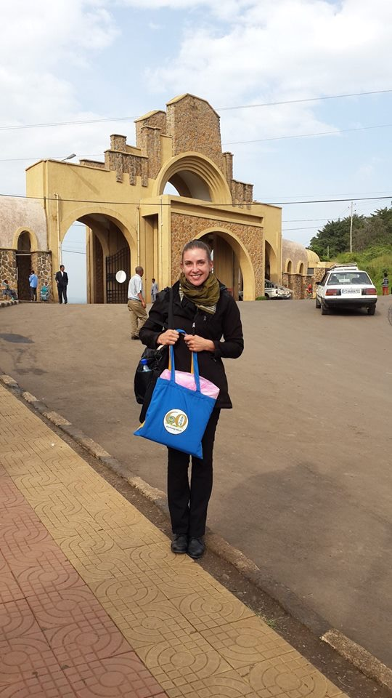

Alicia Helion
D5580 Global Scholar Alicia Helion proposed by the Williston, ND Rotary Club completed her studies in Gondar, Ethiopia.
She recently joined FM AM Rotary and is in he process of starting her own non-profit

Slide 4
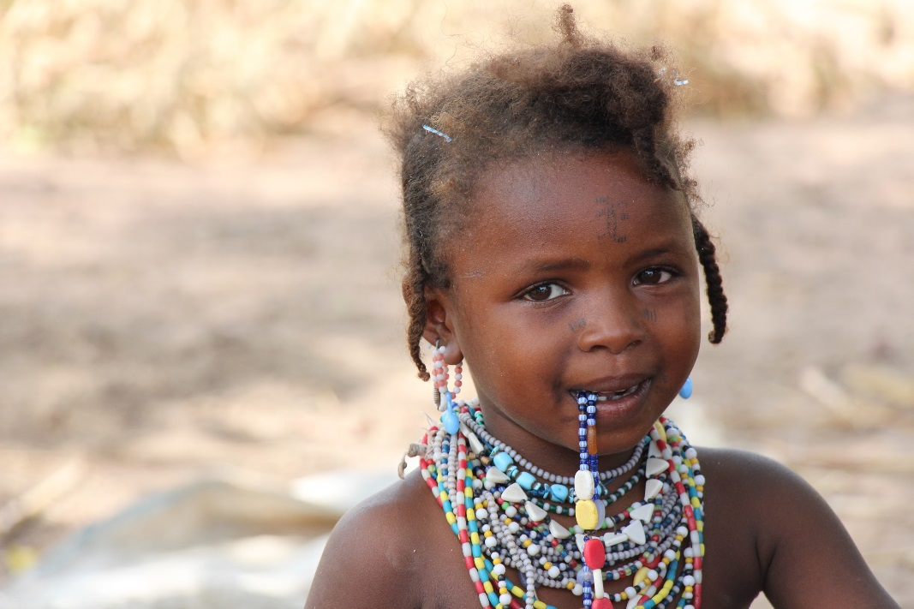
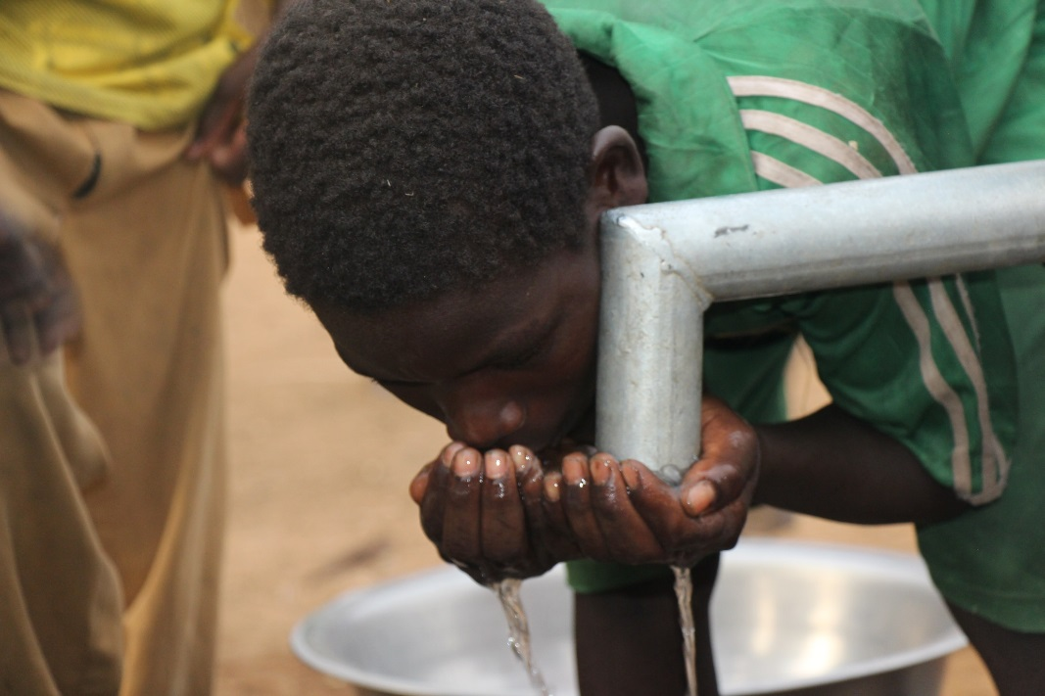
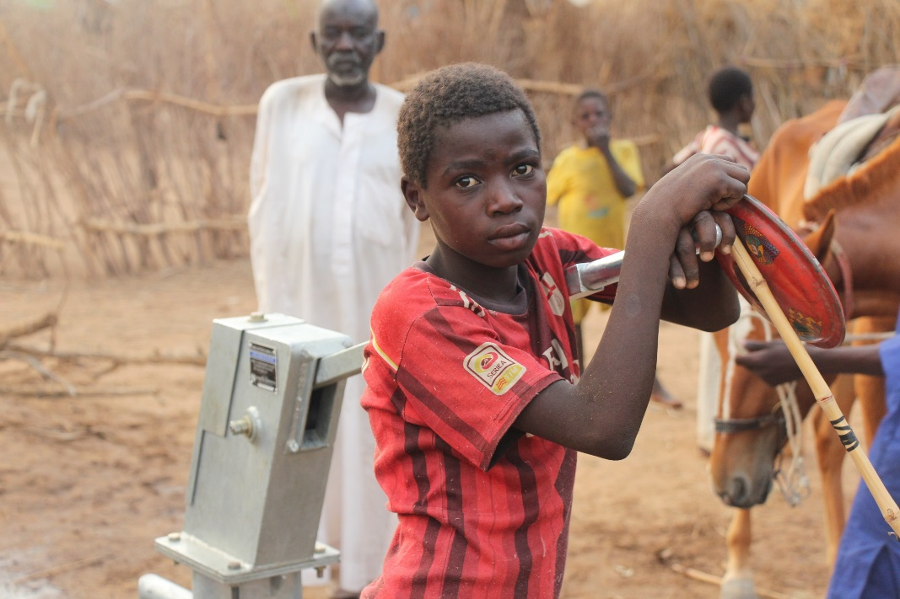
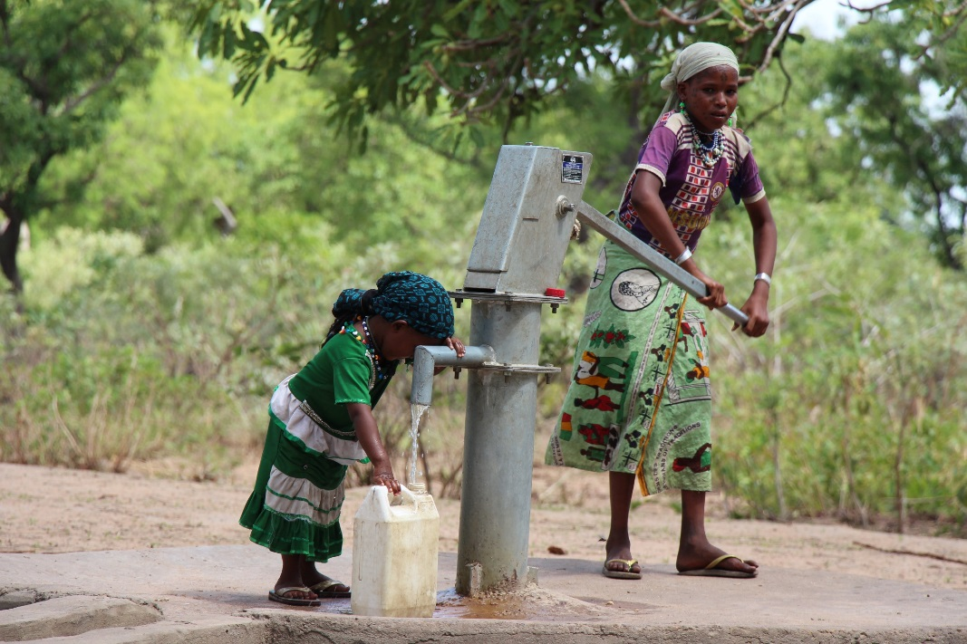
water wells near N’Djamena, Chad (approx. 18 wells)

Slide 5
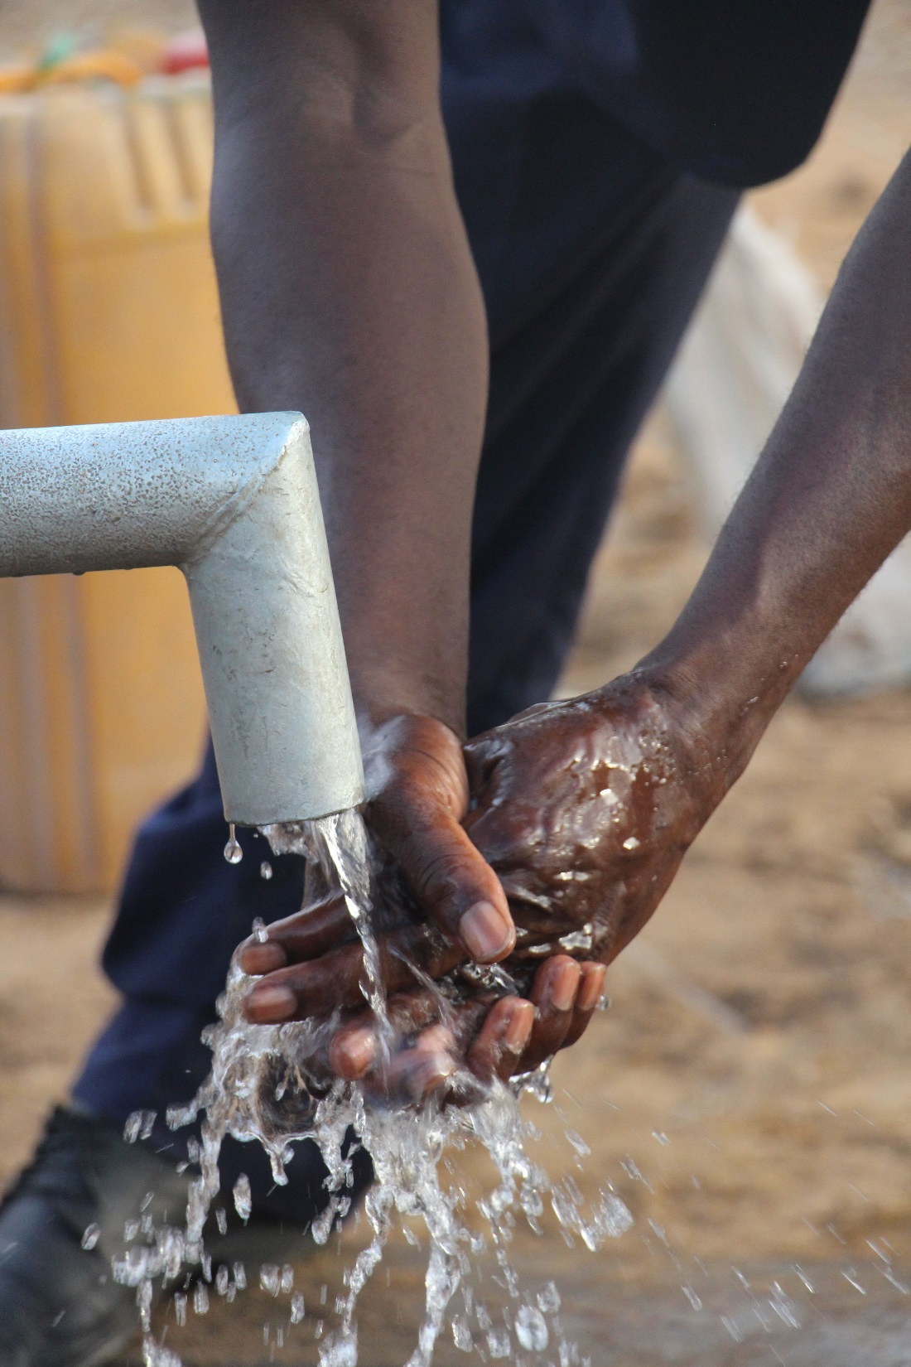
When drilling water wells, we have a responsibility to educate beneficiaries on water and sanitation (including proper hygiene) as well as the maintenance of the wells, should problems arise.
Notes:
<1M

Slide 6
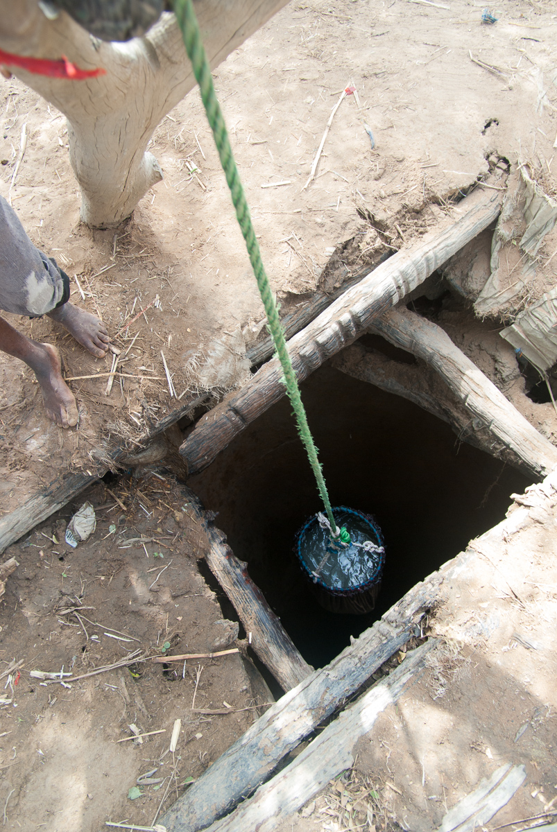
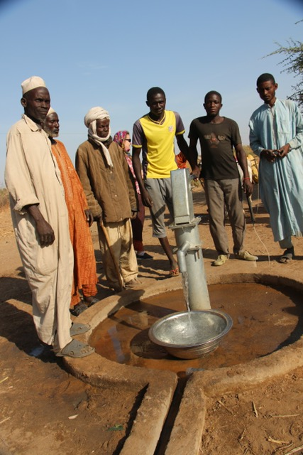
New well at Termini
Old well at Termini
Notes:
<1M

Slide 7
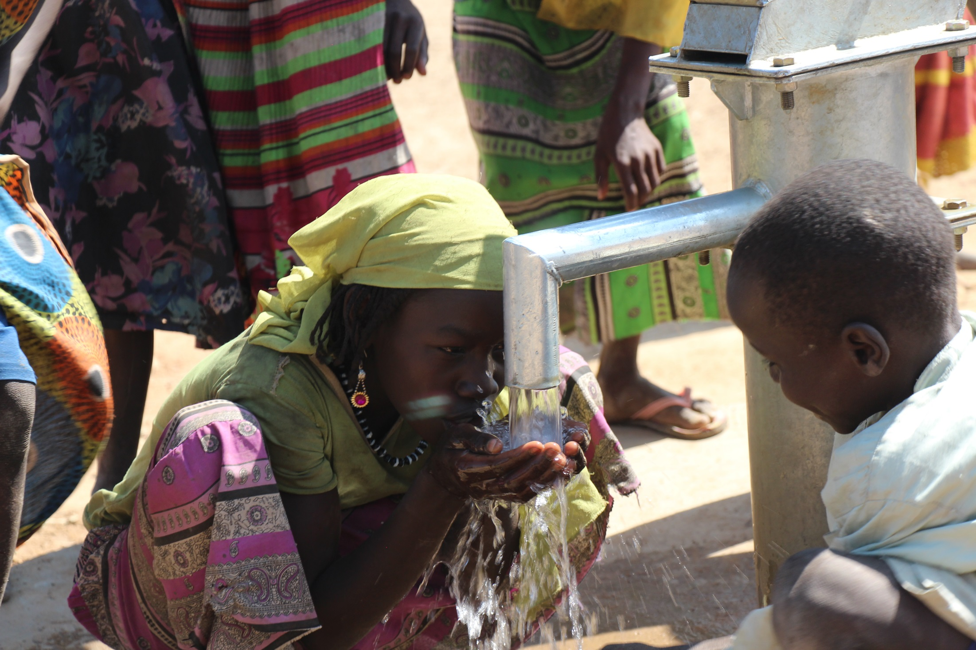
Notes:
<1M

Slide 8
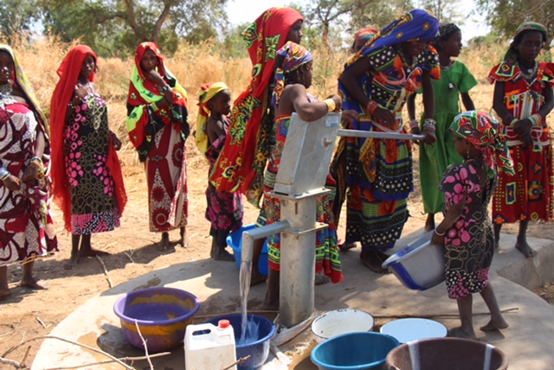
Notes:
<1M

Slide 9
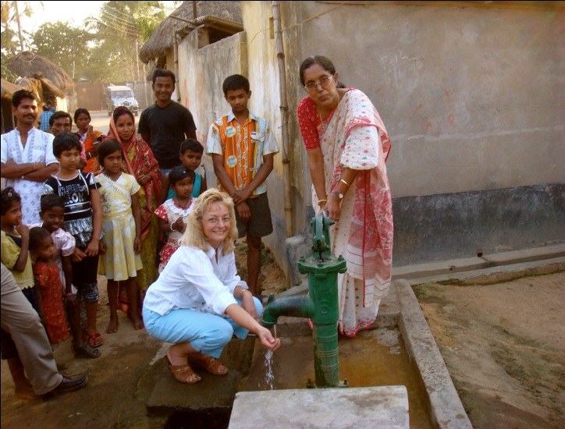
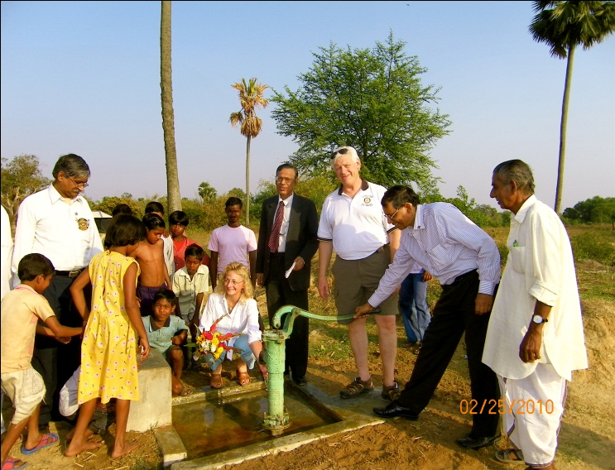
GUSKARA ~ SWEET WATER WELL PROJECT
THUNDER BAY FORT WILLIAM / GUSKARA CLUBS
Notes:
<1M

Slide 10
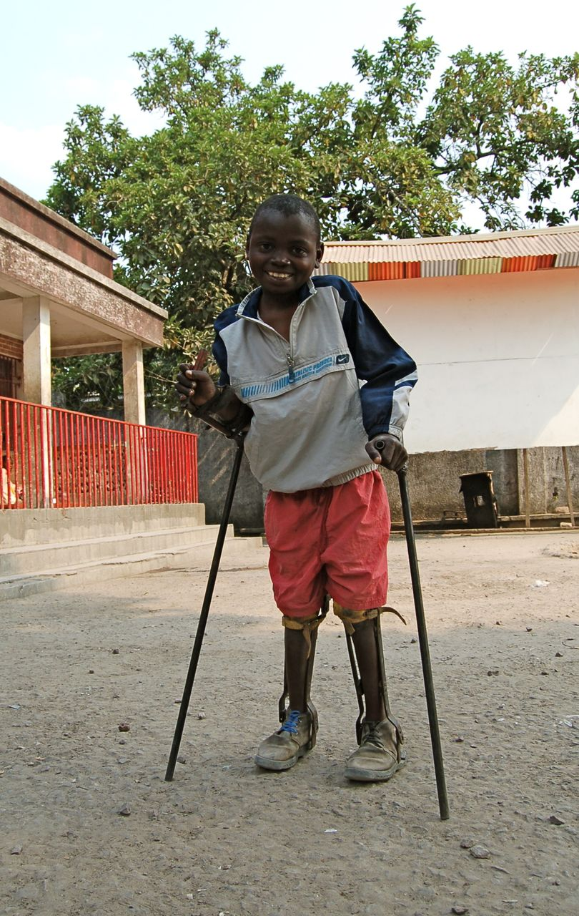
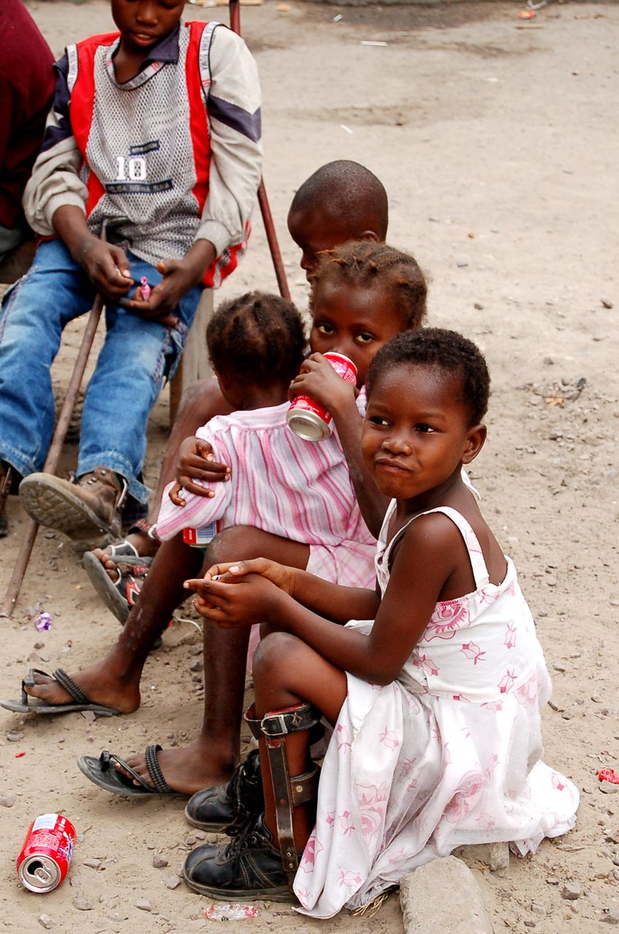
Congo Leg Brace Project working with: www.StandProud.org
Notes:
<1M

Slide 11
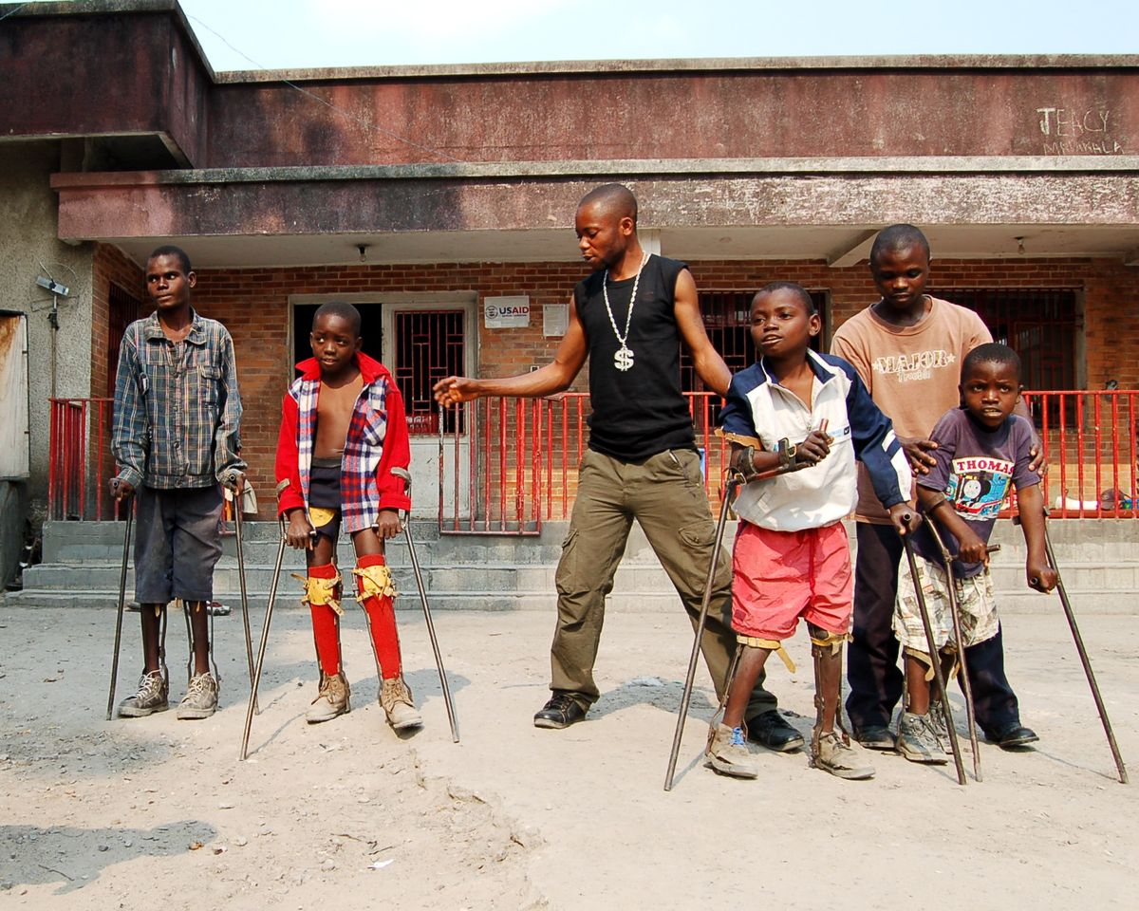
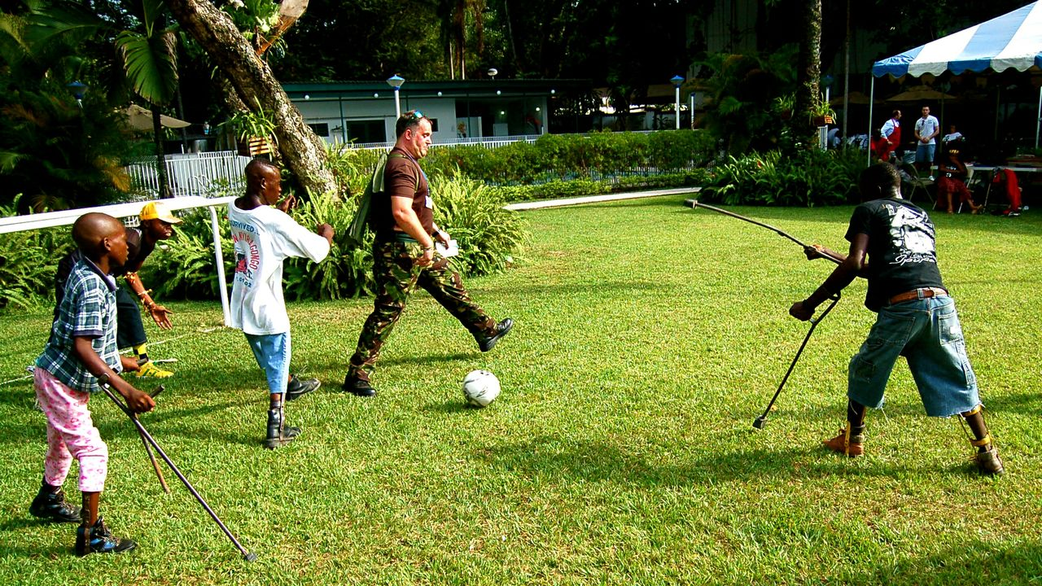
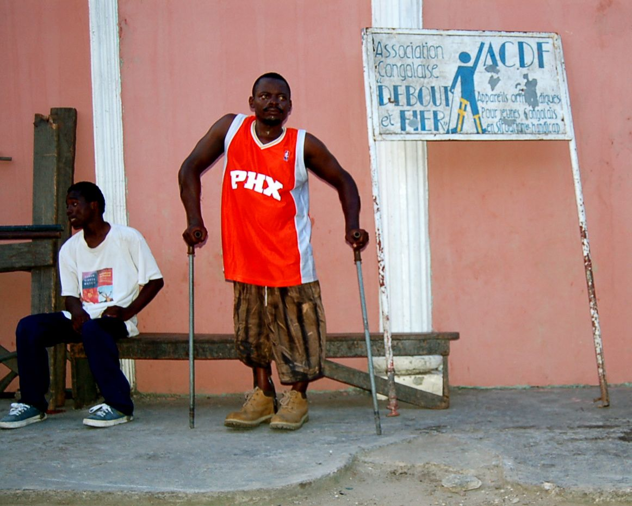
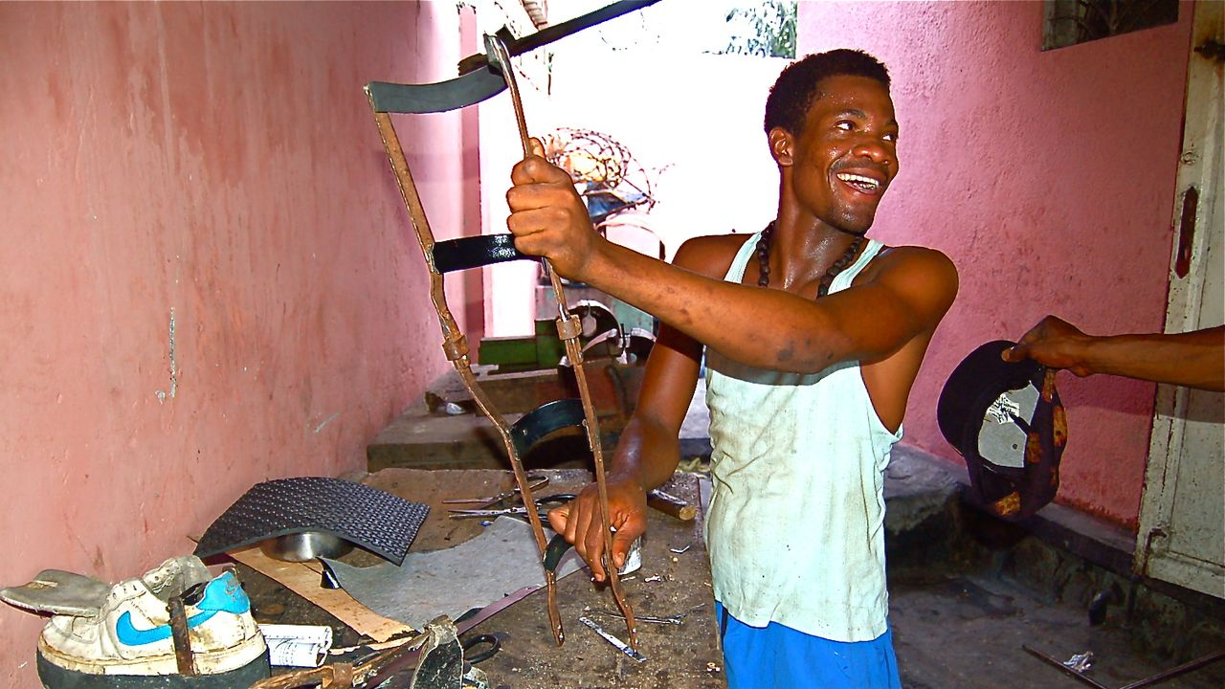
Notes:
<1M

Slide 12
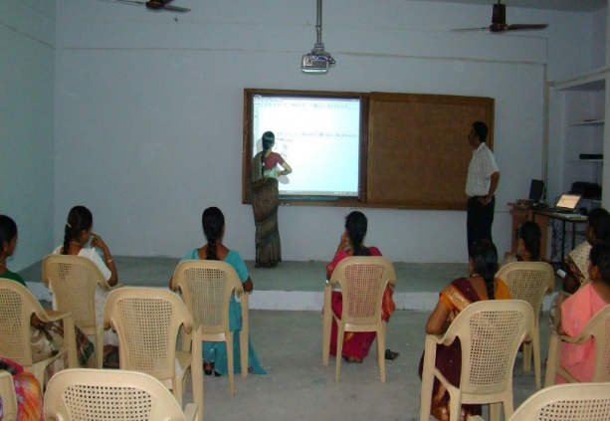
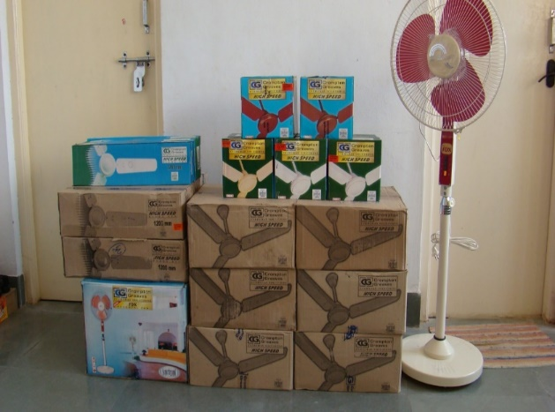
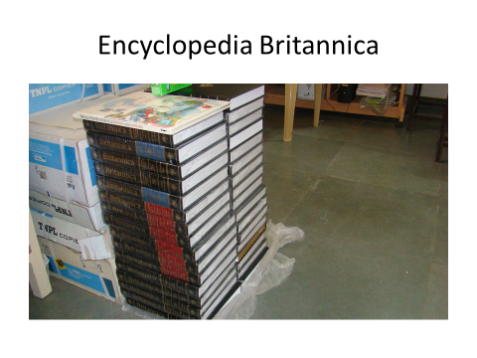
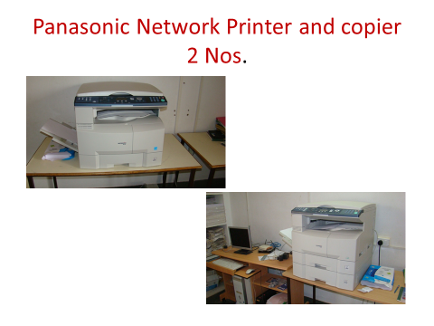
Grant to SLR Rotary School, Rajapalayam,Tamil Nadu, India

Slide 13
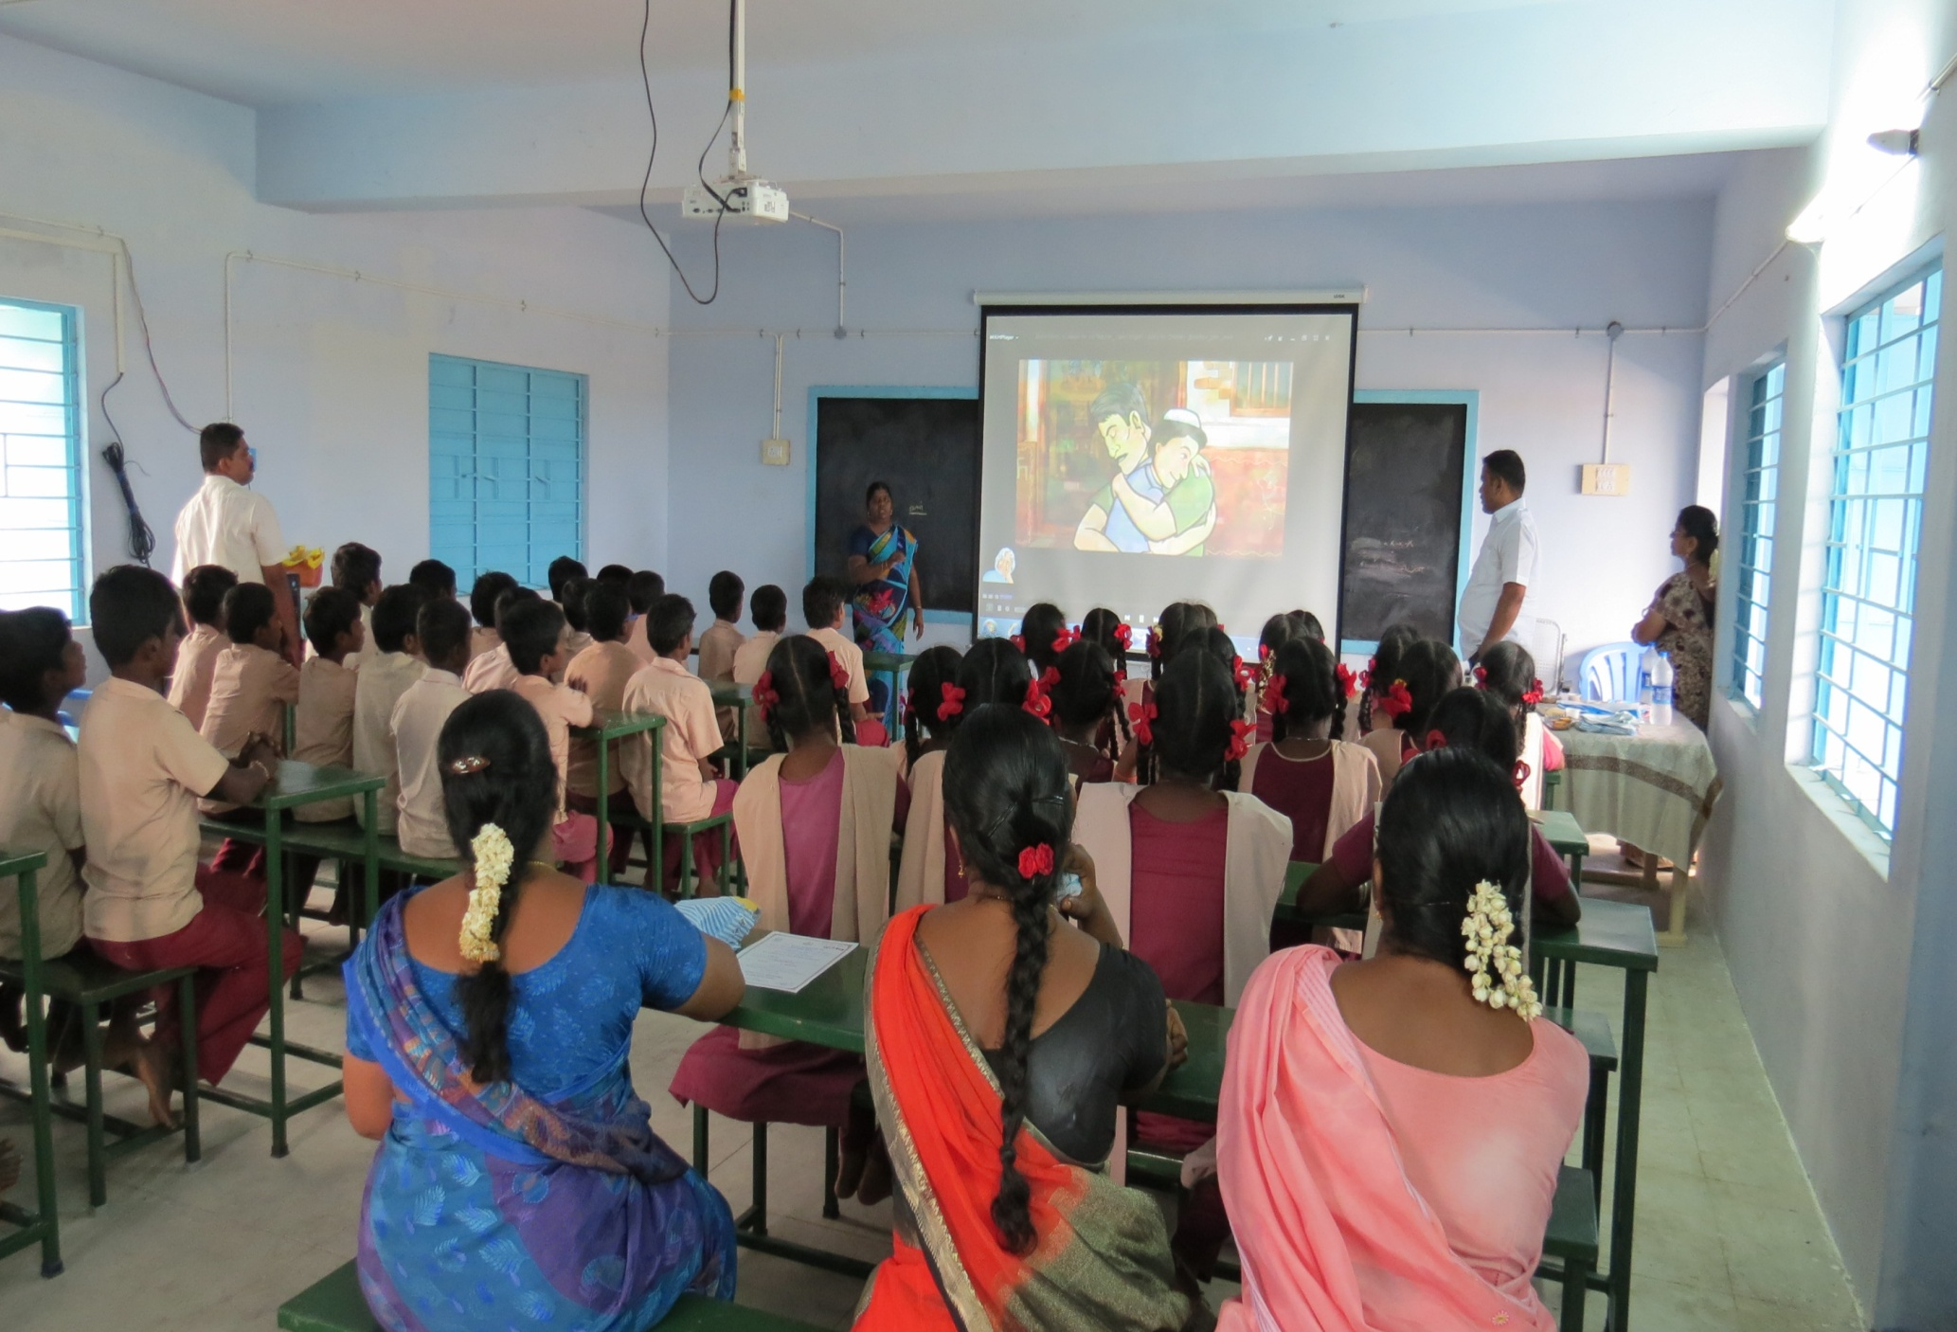

Slide 14
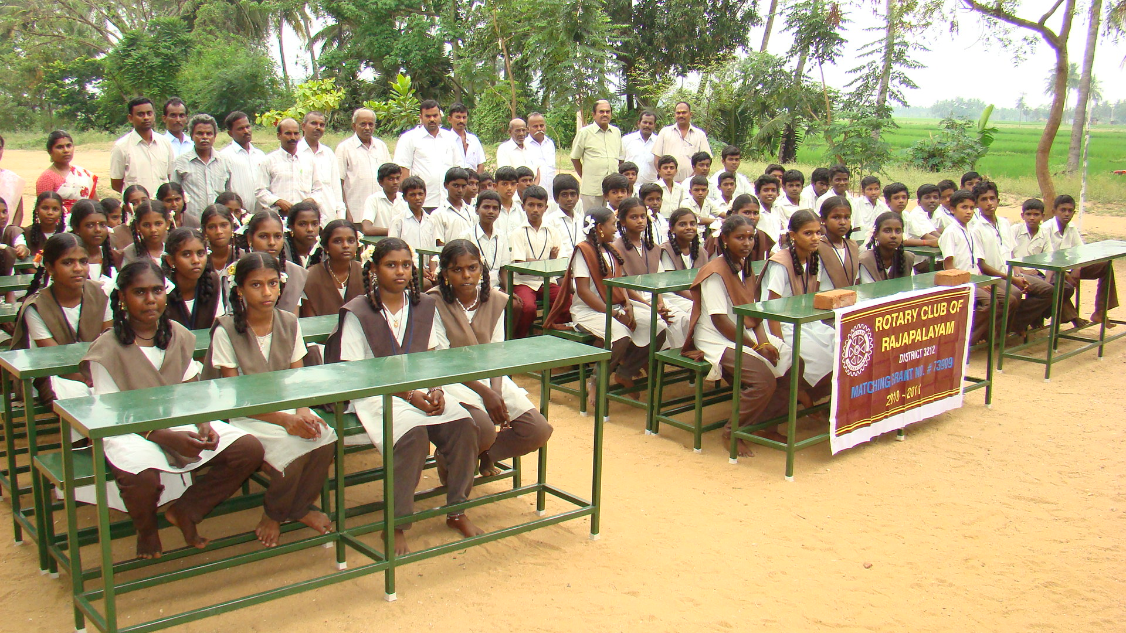
The 2012 “Mega Project” provided 653 desks to 56 schools within a 40 Km radius of Rajapalayam @ a cost of $31,500

Slide 15
GLOBAL GRANT 2016 – 2017. DG: RTN.K.VIJAYAKUMAR. Blood Donation Camp Mobile Van and
Screening van for Hypertension and Diabetes.
The Project requirements are:
A Spacious mobile van.
Omron Digital BP Apparatus 4 Nos.
One Touch Glucometer 4 Nos.
Glucometer Strips: 1500/month.
Auto Analyser for Blood and Urine Examination.
(For estimation of Hb, Urea and Creatinine, Cholesterol, Micro Albuminuria and others.
Ophthalmoscope 2 Nos.
Multichannel ECG Machine 2 Nos.
Ultrasound Scanner for abdomen and Echo Cardiogram.
Peripheral Vascular Doppler Equipment 1 No.
LED TV and Player for awareness program in the Villages
Notes:
0M

Slide 16
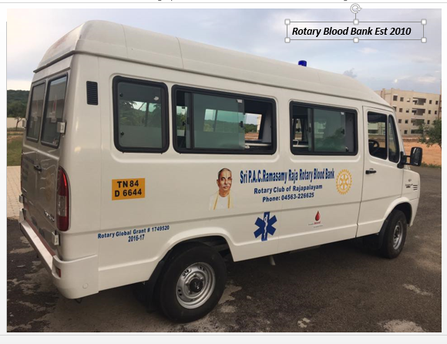
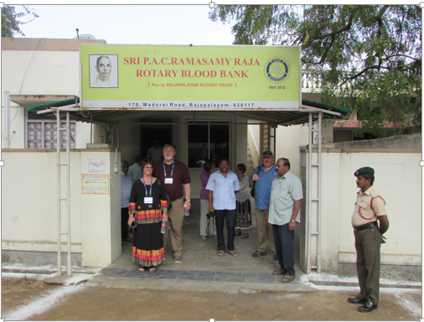
Rotary Blood Bank, est. 2010
Mobile Blood Bank, Rajapalayam
Notes:
2M

Slide 17
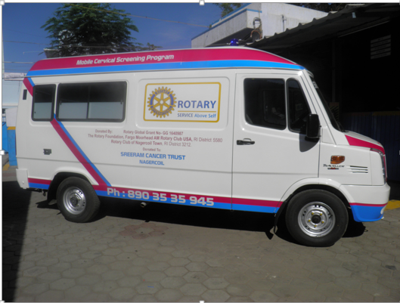
Nagercoil, India cancer screening van

Slide 18
Harbortown Bolivia Project : 23.75 Km = 15 mi. Road Project!
Notes:
<0.5M

Slide 19
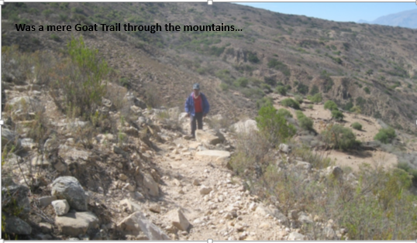
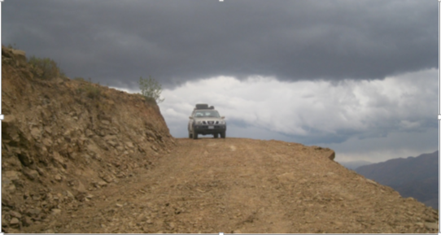
Sumala:
From Goat Path to Commerce Capable Road

Slide 20
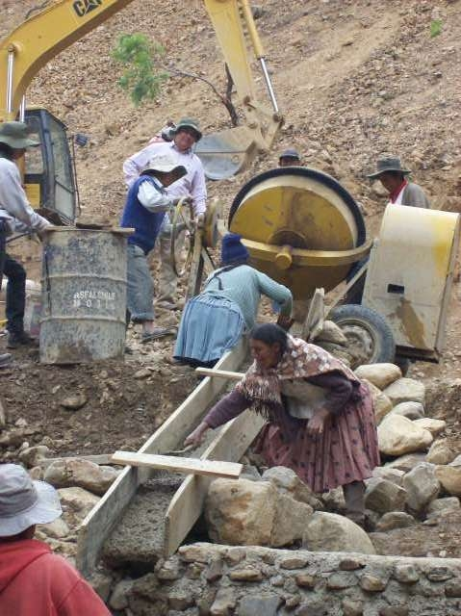
Like most high country regions this area near Cochabamba, Bolivia typically has 3 months of torrential rains and 9 months of drought annually;
thus the need for this reservoir
Notes:
4M

Slide 21
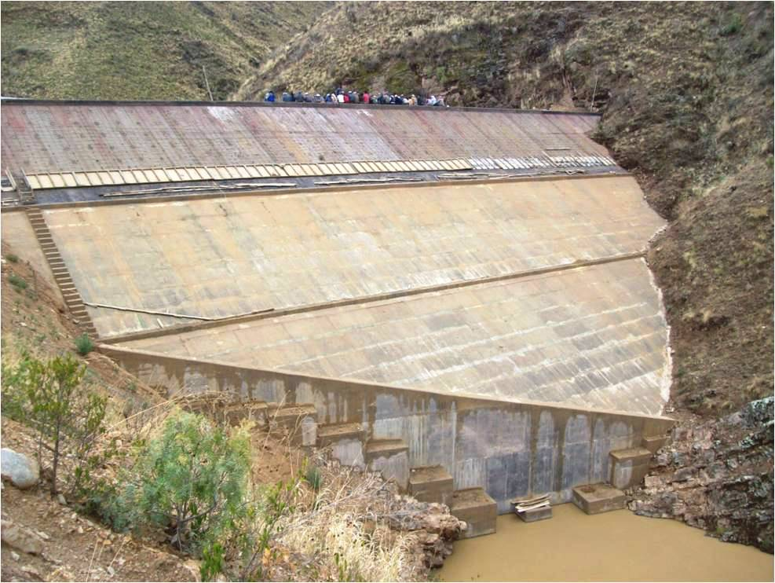
Construction started on the dam near Cochabamba in 2008 and the dam was completed in the fall of 2010

Slide 22
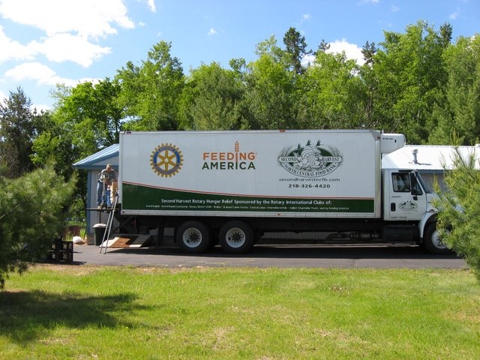

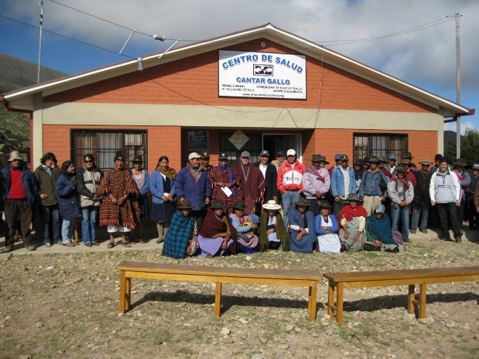

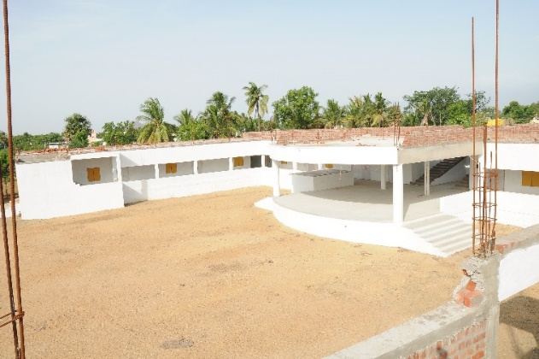

IT’S ALL ABOUT…
Notes:
Doing Good In The World…
1M

Slide 23
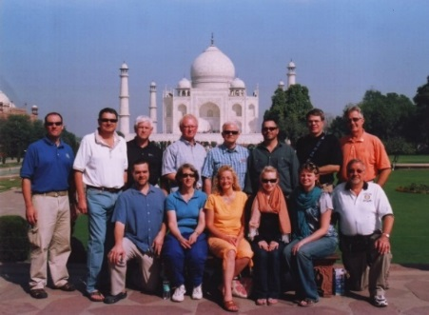
ROTARY: Facilitating Goodwill, Peace & Positive Change in the World One Project at a Time
“As Rotarians we must accept responsibility to address the problems faced by our community and other communities around the world. Rotary does not ask us to become heroes or do the impossible. Rotary is made up of ordinary people inclined to give selflessly.
By giving a little of our time, a little of our goodwill and a little of our knowledge and expertise, Rotarians can make a difference. It may not be possible for us to wipe away all the tears in the world, but we can surely try.”
Ajit Arom DG 3240 India
Notes:
<0.5M

