Slide 1
A Tool for your Club…
… An Easy-to-Use-Guide to help your club put forth an effective Public Image !!!

Slide 2
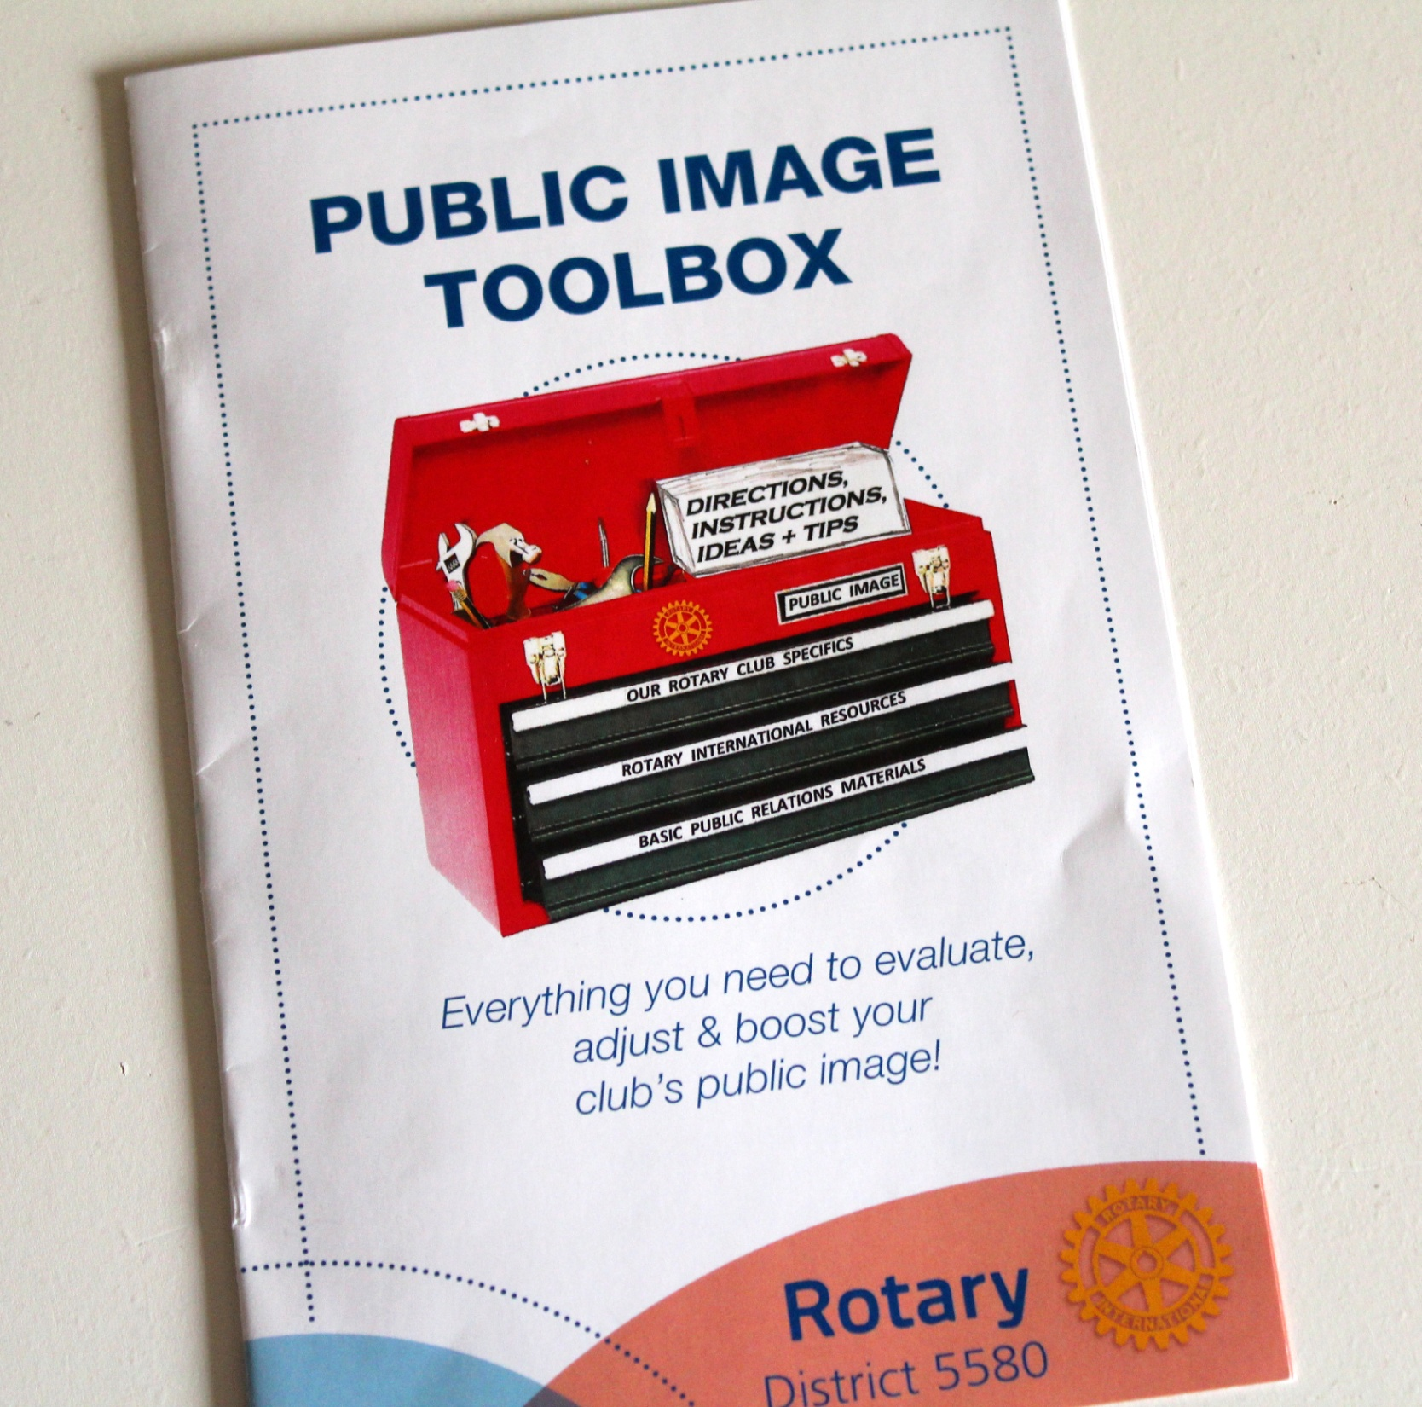

Slide 3
… Complete Instructions…

Slide 4
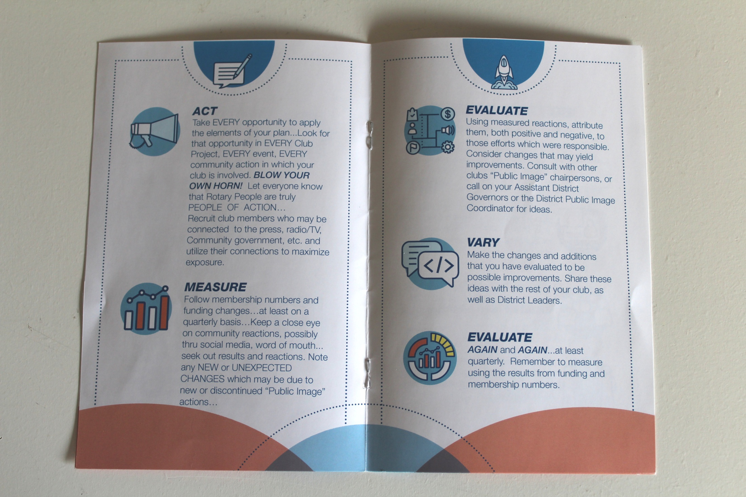

Slide 7
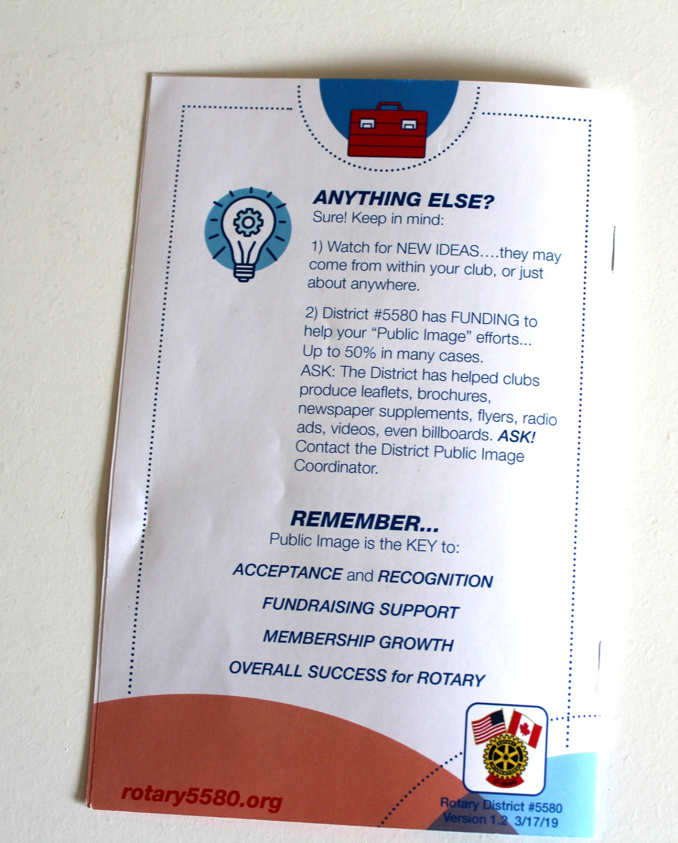

Slide 8
… Of the Three Components- Membership, Foundation, and Public Image- The one you can control- and accelerate – the most, is your club’s PUBLIC IMAGE!

