Slide 1

Your
Rotary
Foundation

Slide 2
Where do Grant $ come from?
From YOU …
as a Rotarian contributing to our Foundation
Notes:
To Understand Grants, first, you need to know where Grant funding comes from.
From all of you.
Contributing to the Annual Programs Fund and Permanent Fund.

Slide 3
Where do I contribute?
Restricted Giving
  Polio
  World Peace Scholars
  Donor advised funds
Annual Programs Fund (APF)
Permanent Fund
Notes:
How do I contribute?
EREY –
Included in club dues
Automatic deduction from checking / Savings / credit card
Via member access at rotary.org

Slide 4

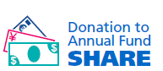


Rotary Foundation Funding
Rotarian
Contributions
Restricted Giving
TRF
Program
Funding
District
Designated
Funds(DDF)
SHARE
“Every Rotarian Every Year”
World
Fund
Gifts to Endowment Fund
Investment
Earnings
Notes:
100% of your giving goes to projects.

Slide 5
Restricted Giving
All donations immediately to program and not invested
Polio Plus – Main focus right now
There are other areas for Restricted Giving
  World Peace Scholars
  Donor advised funds

Slide 6
Annual Programs Fund (APF)
Donations made every year
Work in the Foundation for 3 years
Earnings used to run our Foundation
50% to the World Fund
  Matching Grants and others
50% to our District
  District Designated Funds (DDF)
  District Grants (DG)

Slide 7
Permanent Fund
Donations made every year
Usually larger amounts and bequests
Used to fund our Foundation in perpetuity
Earnings used to fund grants
Corpus never spent

Slide 8
Use Your Foundation Dollars
You and your club gave to the Foundation, now use it !!!
Leverage your club dollars for your project
50% of DDF available for District Grants
$70,600 in DG funding available in 2025
Some of DG can be earmarked for District Projects

Slide 9
Grants: 3 Types
Global Grants – larger international projects
District Governor – District wide projects
District Grants (DG) – smaller club projects serving the local community

Slide 10
Global Grants
Larger International Projects
Minimum total project cost $30,000
Projects can span Rotary years
Global Grants can be applied for any time
Two Countries and Two Clubs
TRF matches $.80, for each DDF’s $1
Meet Requirements, get the Global Grant

Slide 11
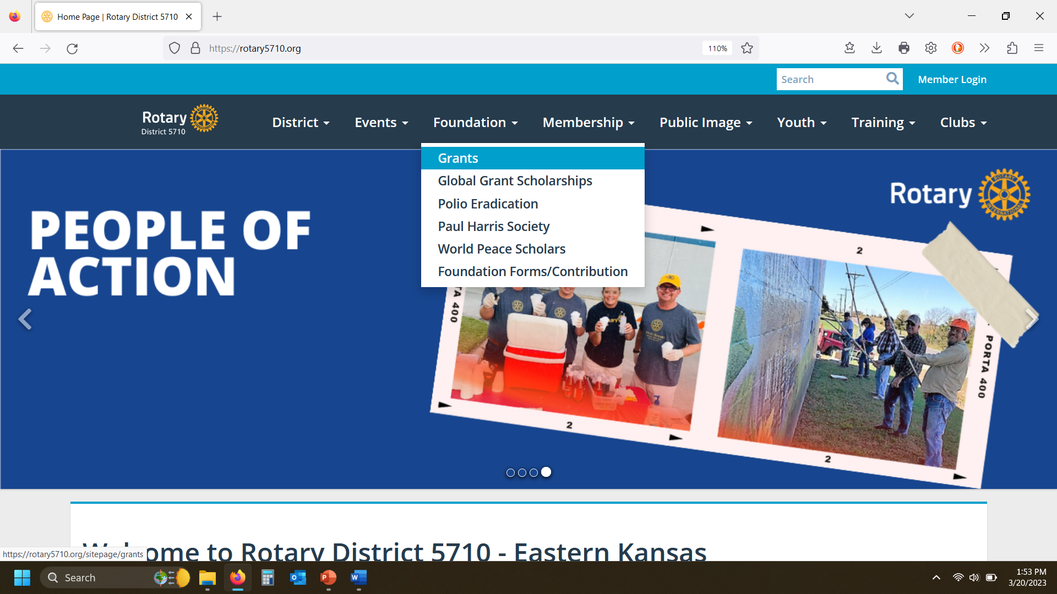
District Grants (DG)
Where to Find Grant Documents
Logon to District Website: rotary5710.org
Click on “Foundation” tab, then select “Grants”

Slide 12
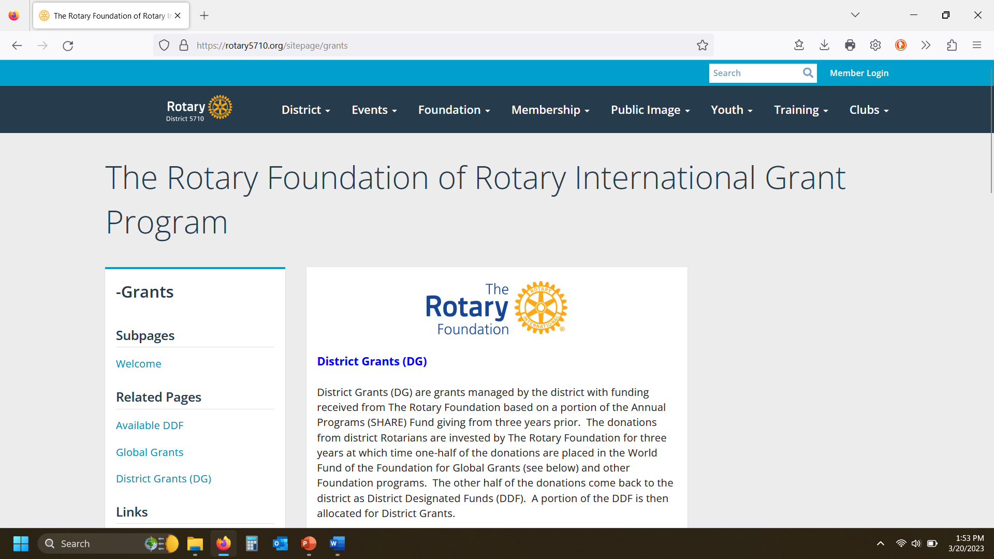
District Grants
On Grants Page scroll down the left-hand side and select “ District Grants (DG)”:

Slide 13
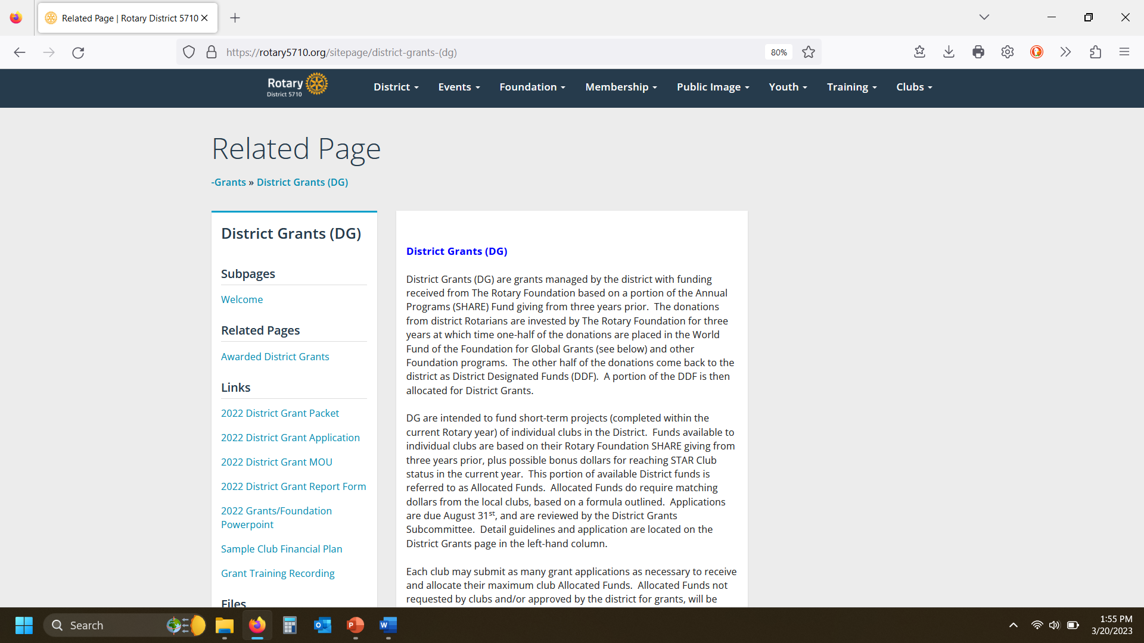
District Grants
On District Grants page, find all documents/forms

Slide 14
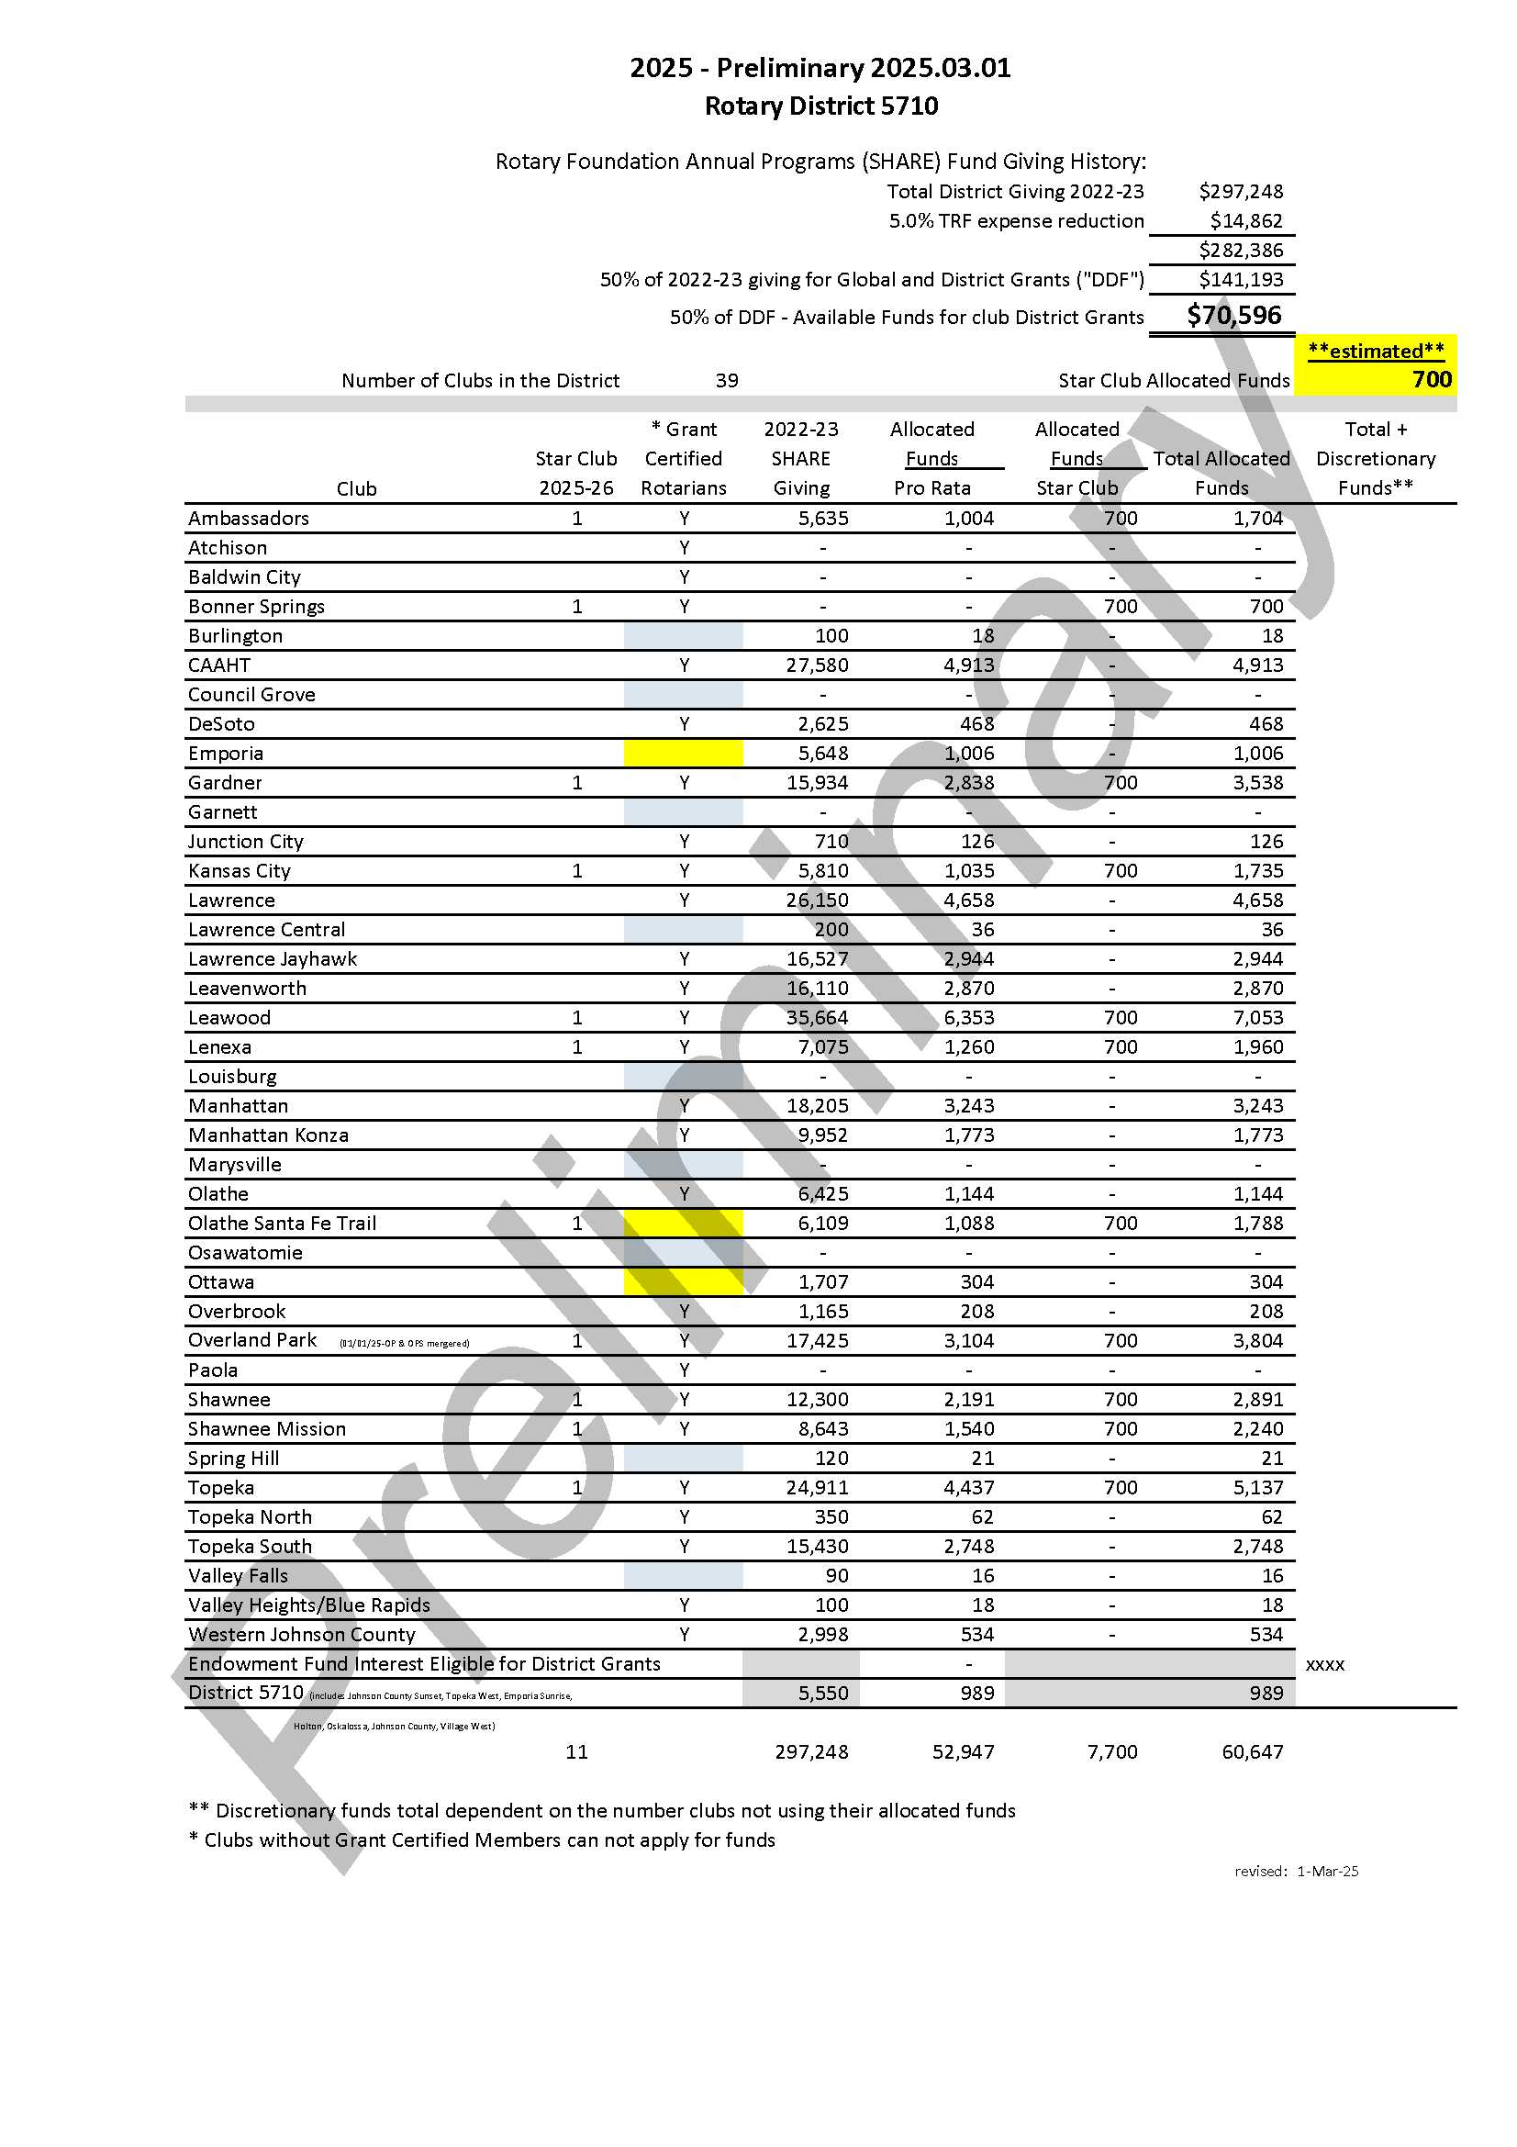
District Grants-Available Dollars

Slide 15
District Grants (DG)
Timeline
Deadline for application is August 31, 2025
- NOTE: All emailed applications will be confirmed to sender as received.
Reviewed and approved by committee in September
Approval notification by end of September - After approval, District funds cannot be used for other than approved expenditures!
Funds distributed in October - Projects cannot be started before this date!
Progress report (or Final) due by June 30, 2026
Project must be completed within 12 months from receipt of funds (approx. October 2026)
Final report due by mid-October 2026
Notes:
These grants are intended for smaller local projects.
For International projects, we recommend Matching Grants

Slide 16
District Grants (DG)
Available Funds
DG intended for local projects, International projects should consider Global Grants. There is a ‘check the box’ to support a global grant.
Last year $71,400 available ($75,100 awarded, including earnings).
This year $70,600 available. Our District is part of $25M+ in district grants from The Rotary Foundation worldwide (in 2015-2016).
Each club receives Allocated Funds, based on pro-rata Rotary Foundation giving (from 2022-23), plus Star Club Bonus (based on 2024-25 giving).
Club minimum dollar match 1:2 ($.50/club for $1.00/district).
Clubs can submit multiple grants to use their Allocated Funds.
Each club can submit one additional grant for Discretionary Funds.
Sponsoring clubs (Rotaract, Interact, Satellites) can submit one additional grant for Discretionary Funds.
Discretionary Fund grant applications will be evaluated and funded based on merit, and are held to a higher standard then Allocated.
Discretionary DG’s may be partially funded.

Slide 17
District Grants (DG)
Your Club’s Fiduciary Responsibilities (the MOU)
Funding of District Grants comes from contributions to the Rotary Foundation and clubs must provide stewardship of those funds.
By executing the Club Qualifications Memorandum of Understanding (MOU), Clubs state that they understand the financial requirements to participate in the District Grant Program and have a written Financial Management Plan for administration of grant funds (a sample Plan is on the District 5710 website).
There MUST be a separate grant project bank account for grant project(s). All project revenue and expenditures must flow through the account, including club matching funds. This includes a sponsored entity.
Clubs should pay expenses directly and avoid reimbursement of individuals and other entities.
If necessary, reimbursements of other entities (Cooperating Organizations) requires a letter restricting use.
All club members are responsible for ensuring the proper implementation of grant activities and reporting.

Slide 18
District Grants
Reporting
Grant Reporting – VERY IMPORTANT !!! If Clubs do not complete reports in a timely manner, future District Grants may be delayed
Make sure your Club Treasurer and other members involved in the grant project are aware of DG requirements
First Reports due June 30, 2026. Always include grant number on Report forms (found on the Club’s award letter)
  Progress Report- provide form only, do not include attachments
  Final Report-must provide ALL documentation, final deadline is mid-October
    Provide sufficient detail so that the Grant Stewardship Chair can report to the Rotary Foundation that all standards have been met. Include Rotarians involved in the project and number of beneficiaries
    Deposit of DG and local match funds into Grant account
      Bank statements from grant account
    Receipts from vendors
    Documentation of expenditures from Grant account
      Bank statements from grant account
    Contributions from members that don’t go through the grant account can’t be included in reports (example: a member donated funds for expenditures to mail items, which did not go through the grant account)
    Cooperating Organization letter

Slide 19
District Grants
Reporting (continued)
Closeout email will be issued once Final Report is complete
Unused funds must be returned once Closeout email is provided
All grant documentation (including receipts, checks, bank statements, etc.) must be retained by the Club for 5 years from closeout date.
The Grant Stewardship Chair will send out reminders at various times throughout the year
Contact the Grant Stewardship Chair if you have any questions. Gstew5710@gmail.com

Slide 20
Contact / Questions
Greg Shondell, Kansas City Kansas Rotary Club
District 5710 Grants Subcommittee Chair
  3905 Delmar Drive
  Shawnee Mission, KS 66208
  greg@HeathwoodOil.com
  913-956-1764

Slide 21
Grants
All Grant Forms and Information are posted on the District 5710 website.
http://www.rotary5710.org/
To open Rotary Grants web page select the above hyperlink, right click, and then select “Open Hyperlink”. Scroll down to “Grants”

