Slide 1


D5710 Membership:
Quarterly Conversation
Monday, November 14, 2022
Notes:
Welcome!

Slide 2





Before We Start
Rename yourself
With First & Last name,
and Club Name
Mute when
not talking
Turn your
camera on
Will distribute slides &
breakout notes
‘afterwards
Use the chat to communicate
questions and comments
Raise hand to contribute
or comment
Notes:
Will distribute slides and breakout notes afterwards

Slide 3
Agenda for November 14th
Quarterly Membership Conversation
Welcome All and Today’s Game Plan
District 5710 October 31, 2022 Membership Numbers compared to
our District & Club Membership Challenges
Membership Leads Program – Shari Hansen
District Membership Web Page Membership Tab Update
District Membership Packet Launch Update – Greta Bauer
Rotary Alumni Engagement Program – Andrea Norris
How One Club Mentors New Rotarians – Rick Robinson
Your Club Experience - Making Your Clubs Irresistible – Emily Tucker, RMO, RI
Follow up questions from Emily’s presentation to think and ask your club about
Closing/Upcoming Dates

Slide 4
2022-2023 Membership Challenges for Our District
Clubs have a net gain in overall membership
Increase our district member retention as compared to 2021-2022 retention
Clubs have a Membership Team Leader and set club membership goals in Rotary Club Central
Completing a membership related class in the Rotary Learning Center
Follow-up on 100 percent of membership leads

Slide 5
District 5710 Membership Numbers –
Do We Have a Net Gain In Overall Membership?
# of Rotary Clubs: | 41
July 1, 2022 | 1,956
October 31, 2022 % Change Membership Changes # of Clubs Gained Maintained Lost Members | 1,975 1.0% increase Since July 1, 2022 16 9 16
Notes:
We have 4 Rotaract Clubs in our District. They are:
Kansas State – sponsored by Manahttan?
Washburn Ubiversity – sponsored by Topeka?
KU – sponsored by Lawrence?
Western KC – sponsored by KC, Kansas
Top Three Clubs YTD in Membership Growth are:
By Percent Growth:
1. CAAHT at 70% - added satallite
2. Topeka North at 37%
3. Baldwin City at 16%
By Absolute Growth:
1. CAAHT at 14. - added satellite
2. Manahttan Konza at 7
3. Olathe at 5

Slide 6
District 5710 Membership Retention %’s
Are we increasing our retention compared with Rotary Year 2021-2023?
 | 2020 – 2021 | 2021 – 2022
Existing Members | 96.9% | 83.3%
New Members | 98.6% | 89.6% *
DO WE KNOW WHY OUR CLUBS HAVE LOST MEMBERS?
Notes:
Increase our district member retention as compared to 2021-2022 retention
Top Three Clubs YTD in Membership Growth are:
For Existing Members:
17 clubs have not lost any memebrs during the first 4 months of the Rotary year
# of Clubs who have lost a new member:
One club during the first 4 months of the Rotary year.
DO WE KNOW WHY OUR CLKUBS HAVE LOST MEMBERS?
During the year our team will continue to determine when members are leaving and why. BUT will focus more on entrance interviews vs. exit interviews. Will share findings with clubs.

Slide 7
District 5710 Clubs with Goals for ‘22 - ’23
How many clubs have set membership goals in Rotary Club Central
 | #Clubs with Goals | % of Clubs
Club Membership | 32 | 78%
Service Participation | 28 | 68%
Notes: 1. # Membership Team Leader? 2. 41 clubs in district | 18 | 44%
Notes:
78% of clubs with membership goals is outstanding – a record number in our district
Hope the remaining 9 clubs will enter a membership goal
Likewise – the 23 clubs that either have not entered their membership team leader’s name into ClubRunner or have not appointed one please do so
Why is service particpation an important goal?

Slide 8
District Membership Leads Action Strategy Plan – Update by Shari Hansen

Slide 9
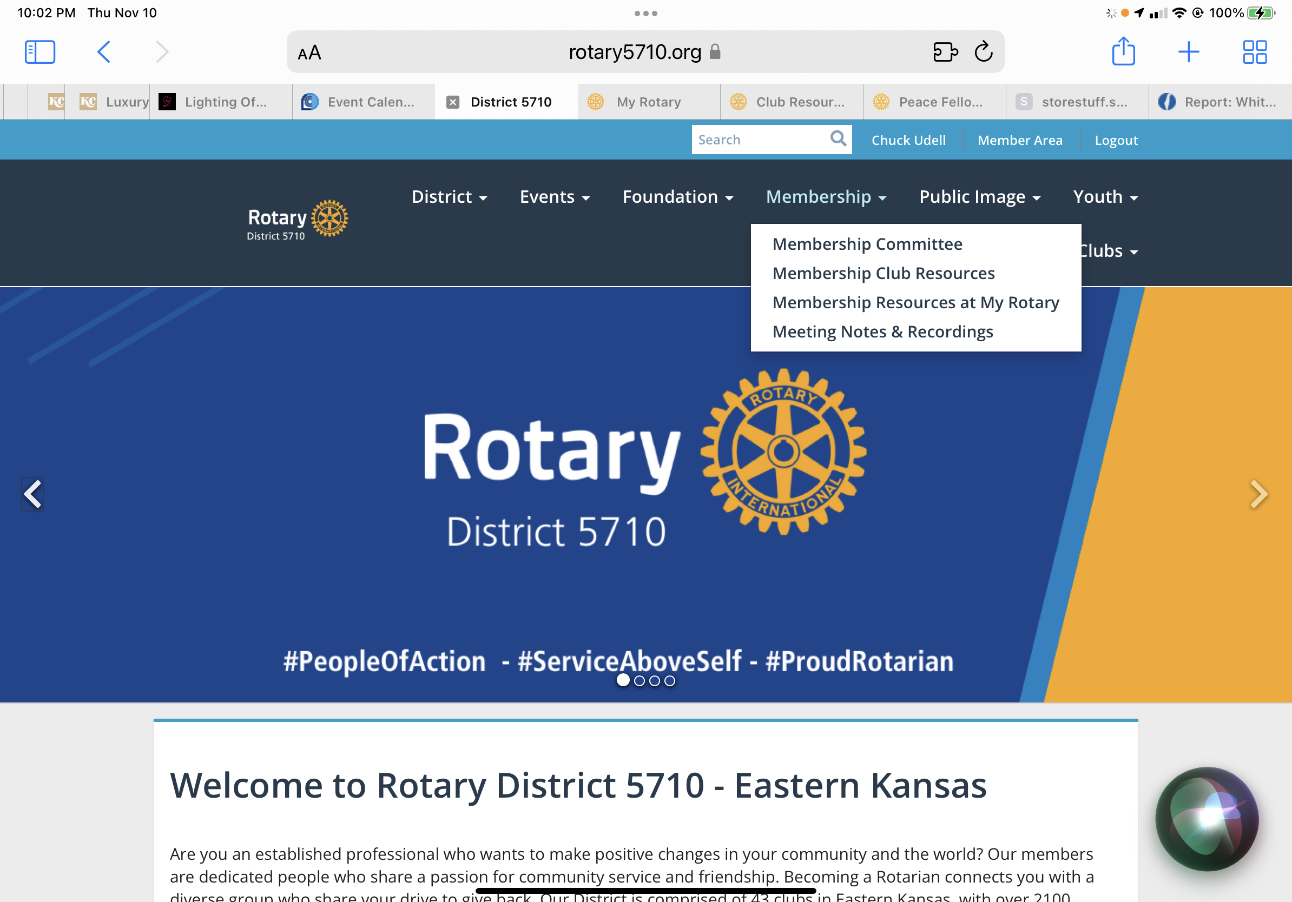
District Web-Site Membership Tab Preliminary Re-Organization
Under the Membership Tab on rotary5710.org:
- Membership Team Members
- Membership Club Resources
- Membership Resources at My Rotary
- Meeting Notes & Recordings

Slide 10
District New Member Welcome Packets Launch – Update by Greta Bauer

Slide 11
Rotary Alumni Engagement Program – Update by Andrea Norris

Slide 12
How One Club Mentors New Rotarians – Rick Robinson

Slide 13
TRADITIONAL NEW MEMBER - MENTOR ACTIVITY CHECKLIST
New Member - Mentor -
Action/Activity | Target Date | Date Completed
1. Complete the new member orientation conducted by the Club Trainer. | Within first month
2. Serve as a greeter within the first 3 months of induction, to be assigned | Within first 3 months
3. Attend all of the following club functions (participate with your mentor if able): | Within first 3 months
A. Informal or social activity
B. Board meeting (takes place at the 4th Thursday meeting)
C. Committee meeting
4, Choose a club committee on which you would like to serve. (Preferably with mentor) | Within second month
4a. Mentor to introduce new member to Committee Chairman | Within first month
5. Participate in a club service project. (With your mentor if able.) | Within first three months
6. Invite a guest to a Rotary meeting/event | Within first year
7. Volunteer to participate in the club's major fundraiser (Labor day 5K run) | Labor Day
8. Do a Vocational Talk at a club meeting. To be assigned | Within first two months
9. Optional: Attend a District Meeting. In priority of importance: | Within first year
A. Foundation seminar
B. District conference
C. District assembly
10. Give carefull consideration to becoming a Paul Harris Sustaining member and a | Within first three months
supporter of the "A Child's Tomorrow "(ACT) Leawood Rotary's foundation
12. Mentor to help new member get acclimated to weekly meetings | On going
Reach out to your mentee at breakfast meetings, get him/her engaged.
Introduce new member to current members
13. Become familiar with Rotary.org, LeawoodRotary.org web sites and Club Runner | Within first month
14. Attend a Fireside Chat (to be scheduled)
15. Create My Rotary Account

Slide 14
Your Club Experience –
Making Your Clubs Irresistible
Emily Tucker; RMO, Rotary International
Welcome to District 5710!

Slide 15

WHY IS OUR CLUB EXPERIENCE IMPORTANT?
It’s how people:
See
Feel
Experience
Utilize
Interact with Rotary
Notes:
Let’s start here – at the heart of things.
Why is our club experience the most important thing?
It’s the way people see, feel, experience, utilize, and interact and serve with Rotary.
RI President Jennifer Jones often talks the care and comfort of our members being the MOST important thing when it comes to our ability to engage and attract our members. For me - this all comes back to the club experience and culture.

Slide 16

subhead
WHAT CAN WE OFFER OUR MEMBERS?
Leadership development
Personal development
Professional development
Connections + friendship
Service opportunities
Mentoring
Networking
Fun
Notes:
This makes me think of HOME. There are many rooms in a home, all with a different purpose – but the whole package gives us that sense of belonging.
So as you absorb everything today, be thinking: What is the role your club plays in your community? Is it people’s “3rd space”? Their outlet? Is it their connection to others in an increasingly connected yet still isolating world? Is your club family? It may be many things to different members, and it’s important you think about all the roles your club plays so that you can best support and serve your members and your prospective members which could really be anyone in your community.
So what can we offer our clubs? Well, really, the sky is the limit. That’s the beauty of Rotary is that we’re so multi-faceted. The list here is not exhaustive – these are just several things we know members want.
At the virtual International Assembly, RIPE Jennifer Jones said, “For Rotary, “finding the right ‘part’ to engage each member should be our core function…It is our offer of hands-on service, personal growth, leadership development, and lifelong friendships that creates purpose and passion.”
In an essence – again, it comes down to the club experience we’re offering – the opportunities available to our members.

Slide 17

FACTORS THAT INFLUENCE
MEMBER SATISFACTION:
Comfort with other club members
Club’s positive impact in the community
Confidence in club leadership
Enjoying club meetings
FACTORS THAT INFLUENCE
MEMBER RETENTION:
1. Comfort with other club members
2. Enjoying club meetings
Notes:
Let’s take a look for a moment at some research.
In recent studies that RI has done, we have found that feeling welcomed by and comfortable with other club members is the single most important variable when it comes to both member satisfaction and member retention. People want to make a positive impact in their community. They want chances to connect with others, and they also sited wanting professional and leadership development opportunities – all contributing to their reason for joining and staying in their clubs. But, even if they got all those things, and they still didn’t feel comfortable with other members, they may not stay. So that’s why talking about the club experience is really holistic. It covers everything about your club – the whole operation.
Again, Jennifer Jones from the virtual International Assembly, she said, “For Rotary, “finding the right ‘part’ to engage each member should be our core function…It is our offer of hands-on service, personal growth, leadership development, and lifelong friendships that creates purpose and passion.”

Slide 18




subhead
WHY MEMBERS LEAVE
Club environment &
club culture
Unmet expectations
Financial &
time commitments
Notes:
Further to this point, when we ask former members why they left, many cite club experience and club culture, along with “unmet expectations.” For Rotaractors, financial and time commitments also play a role in whether a Rotaractors is likely to remain or leave their club.
Imagine being excited to be a member of your local club, only to discover that the experience you were promised isn’t what you got. Of course you would leave.
Clubs have more freedom than ever to structure themselves in ways that work for every member and to find solutions to these reasons that people leave. Accommodating the needs of our members and the community often requires flexibility.
And remember - there is a club for everyone who would like to make a difference through Rotary. And if there isn’t one, we can create one.

Slide 19

ASSESS
Survey members
HOW DO WE ENSURE A POSITIVE EXPERIENCE?
Club Health Check
Review trends
Identify who’s missing
Check culture
Get non-member feedback
Notes:
So once we understand our club experience is most important for membership retention and attraction, HOW do go about ensuring this?
First, it starts with assessment. I hope if you have one takeaway from all of today’s sessions, it’s a plan for how to connect with clubs and the knowledge to help them assess themselves in order to strengthen their membership.
So first - Surveying club members, and conducting the Rotary Club Health Check with your club’s Board depending on the size of your club.
Reviewing your club’s membership trends through reports in My Rotary.
Taking a look at current demographics of your club and census data of your community and seeing who’s missing.
Once you get that feedback and look at data, be sure to confront any aspects of your club culture that might not be working or welcoming for all people.
And be sure to get feedback from guests, friends, community members, former members, speakers.
*This applies not just to current club members, but to anyone and everyone who engages with Rotary. This sometimes takes clubs taking a very honest look at themselves and outside themselves – to imagine what it would feel like coming to your club from a completely different background or socioeconomic status or race as compared to the current make up of your club membership.

Slide 20

PLAN
HOW DO WE ENSURE A POSITIVE EXPERIENCE?
Build a team
Create a vision
Set goals
Be accountable
Notes:
Once clubs assess, it’s time to act on their findings and create their membership plan. I can’t tell you how many clubs I’ve worked with who are so grateful they actually wrote down a membership plan.
Build a team. Just like how we talked about District Membership Chairs creating a team, we want you encouraging the club leaders to create a team to support membership as well. One or two people can’t do it all. And if clubs don’t yet have a membership chair identified or reported, that’s an opportunity for you to have that conversation with them.
Creating a vision and setting goals for the next 5 years. This can and should be part of the support you’re providing to clubs. Sometimes they really need someone outside the club but still with the knowledge of their area (like you). I’ll highlight some resources that can guide you through this process.
Encourage them to enter those goals into Rotary Club Central.
Then they have a place to come back to to hold themselves accountable throughout the year.

Slide 21

DELIVER
HOW DO WE ENSURE A POSITIVE EXPERIENCE?
Implement flexibility
Offer opportunities
Check in with members
Engage community
Notes:
And of course, delivering that club experience.
Based on that assessment they do, the member feedback they get, and their vision, they may need to implement some aspects of flexibility – maybe that means switching one of their meetings to a service project or social.
A variety of opportunities to engage. People are looking for many things in their membership. Clubs should be delivering on the feedback they got from members. And providing a variety of opportunities can help them meet member needs.
Next, encourage them to check with their members periodically. Assessment is ongoing.
And last but not least, remind them to engage their community; through assessment and planning, they should have identified those folks who are missing and a plan to engage them. Maybe this looks like creating a Rotary Community Corps to bridge the gap. Maybe it’s simply about having coffee with someone.

Slide 22
THANK
YOU
Please reach out!
Emily Tucker
Emily.Tucker@rotary.org
847-866-3258
Notes:
Chuck note
Re-emphasize what Emily has said about the first part of ensuring a positive experience for our members is to ASSESS
Suggest doing all or part of the Rotary Health Check – our membership team can help you administer it.
Can also find the health check and other assessments by going to https://my.rotary.org/en/learning-reference/learn-topic/membership
In My Rotary

Slide 23
Membership Issues: to think and ask your club about
What steps have we as a club taken to ensure that all members and visitors to your club have a positive experience whether it is a meeting with a program, a service project, a social, or any other gathering?
Did everyone feel welcomed by and comfortable with other club members?
What can we do better? How can we improve?
What assessments can make sense for your club to do to determine how you can further improve upon all having an awesome club experience? To see assessments available, click on https://my.rotary.org/en/learning-reference/learn-topic/membership

Slide 24
Continue the Conversation
2022-23 Quarterly Membership Meetings
Zoom, Monday’s at 5:30 p.m.
on
Feb. 13, 2023
May 8

