Slide 1
People of Action
Kansas Rotary Mobilizing on Mental Health
Title Page Option

Slide 2
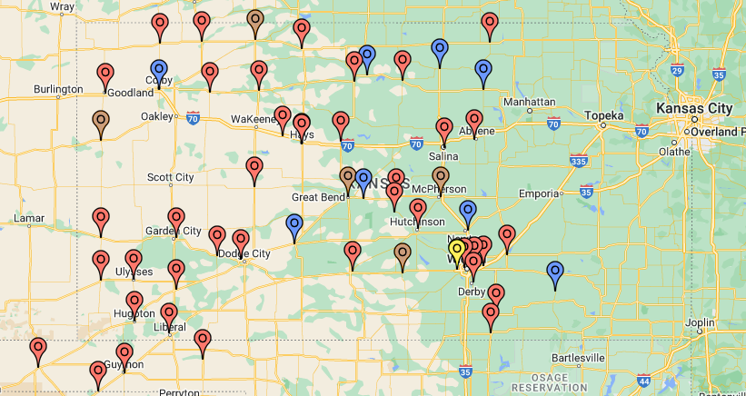
Engaging Kansas Rotarians
2
Districts
4,025
members
96
Clubs
1
Issue

Slide 3
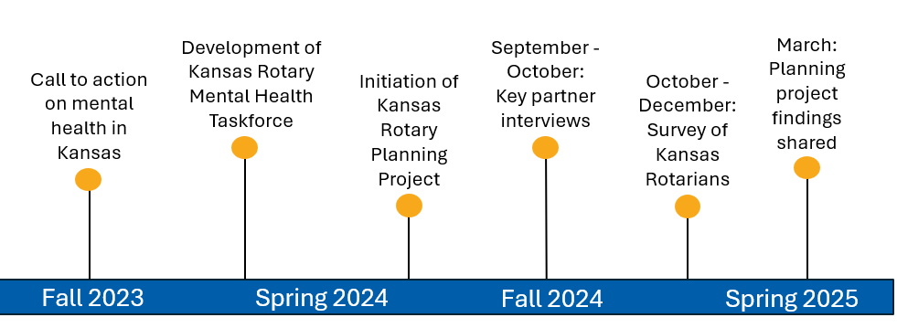
Background
Purpose: Pilot this new model of member engagement on improving mental health outcomes in Kansas.
Notes:
Robbin, Randy, Jenalea, anything to add?

Slide 4
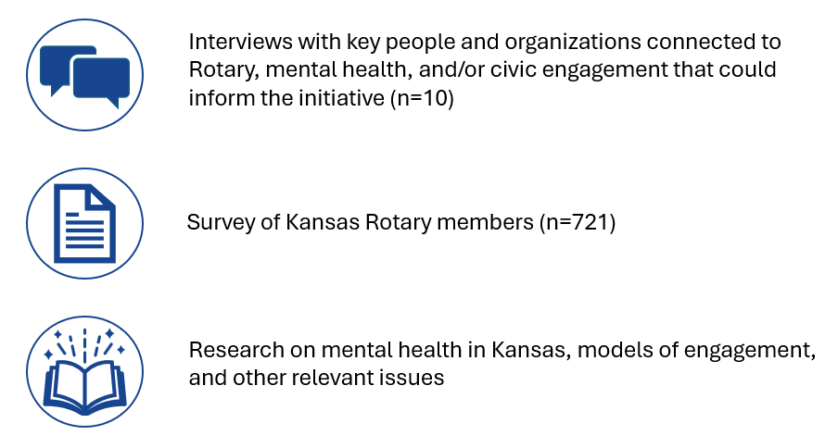
Engagement Model Development
Notes:
Model was informed by these sources

Slide 5
Engagement Model
Considered the independence and unique assets and challenges of each Rotary Club while creating space for collective action to happen.
Potential to be pointed at any issue and help Rotary spur meaningful action toward individual and shared goals.
Coming together toward a shared vision for change will result in more progress- Rotary will be able to leave a larger footprint in creating a better Kansas.
The belief in the values underpinning this effort- care, community service, and conviction.
Awareness
Action
Implement interventions
Reflection
Assess progress
Consideration
Build interest by learning together
Identify the issue to be addressed

Slide 6
Engagement Model Stages
Awareness
- Issue
- Vision
- Leadership
Consideration
- Shared learning opportunities
- Environmental scan
- Member knowledge
- Goal setting
Action
- Increasing awareness
- Increasing financial resources
- Increasing people engaged
Reflection
- Sensemaking
- Celebration

Slide 7
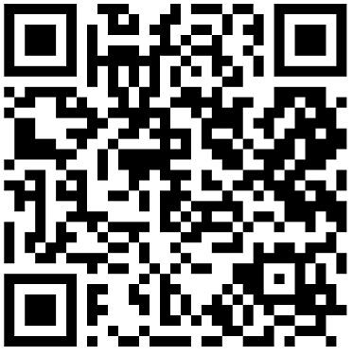
What’s Next
Ways to get involved:
Designate a club representative to lead local efforts on a mental health initiative. This person can also participate in the newly developed Kansas Rotary Action Group on Mental Health, to connect your club to efforts happening at the state level.
Utilize the resources provided to implement the engagement model at your club.
Scan here to learn more:

