Slide 1
Rotary is dedicated to six areas of focus to build international relationships, improve lives, and create a better world to support our peace efforts and end polio forever.
Promoting Peace Fighting Disease
Providing clean water, sanitation and hygiene Saving mothers and children
Supporting Education Growing Local Economies

Slide 2
PROMOTING PEACE
Rotary encourages conversations to foster understanding within and across cultures. We train adults and young leaders to prevent and mediate conflict and help refugees who have fled dangerous areas.

Slide 3
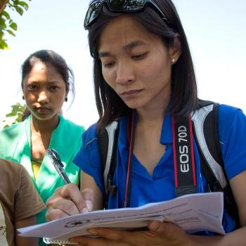
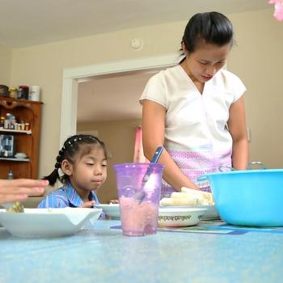
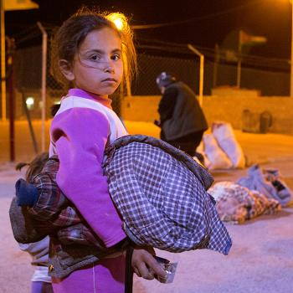

Slide 4
100 peace fellowships are offered each year at Rotary Peace Centers around the world
65 mil people are currently displaced by armed conflict or persecution
$142 mil has been raised by Rotary to support peace
1,000+ students have graduated from Rotary’s Peace Centers program

Slide 5
Rotary makes amazing things happen, like:
Improving quality of life. Rotary members founded the People for People Foundation, which has helped 10,000 families afford food, clothing, rent, utilities, medications, and other necessities.
Raising awareness of bullying. Rotaract clubs in the Philippines conduct antibullying campaigns in schools to teach children how to handle conflict peacefully from an early age.
Protecting domestic violence survivors and their families. The U.S. state of Louisiana has the fourth highest incidence of death caused by domestic violence. Local Rotary members met this issue by helping a shelter provide food, clothing, legal advocacy, and counseling to over 500 women in one year

Slide 6
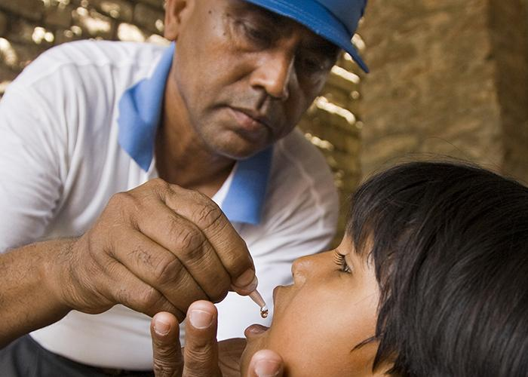
FIGHTING DISEASE
We educate and equip communities to stop the spread of life-threatening diseases like polio, HIV/AIDS, and malaria. We improve and expand access to low-cost and free health care in developing areas.

Slide 7
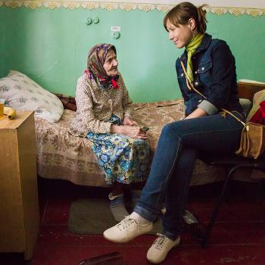
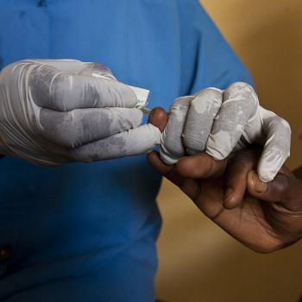
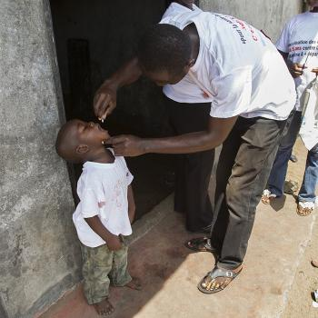

Slide 8
$65mil in grants was given by Rotary to fight disease
99.9% reduction in polio cases since our program started in 1985

Slide 9
Rotary makes amazing things happen, like:
Providing clean water: Rotary has worked with partners to provide more than 80 percent of Ghana’s people with clean water to fight Guinea worm disease.
Reducing HIV infection: In Liberia, Rotary members are helping women get tested for HIV early in their pregnancies. They used prenatal care to reduce new HIV infections in children by 95 percent over two years.
Ending polio: Rotary members have played a key role in bringing the world to the brink of polio eradication. Their efforts have not only ended polio in 122 countries but also created a system for tackling myriad other health priorities, such as Ebola.

Slide 10
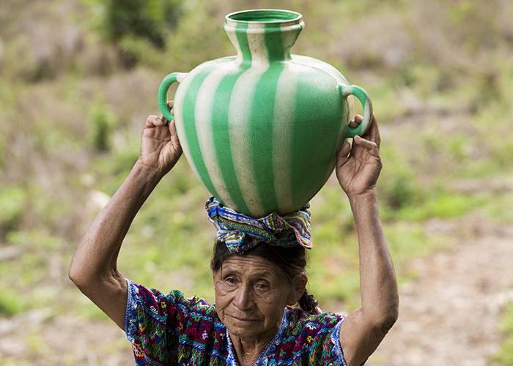
PROVIDING CLEARN WATER, SANITATION AND HYGIENE
We support local solutions to bring clean water, sanitation, and hygiene to more people every day. We don’t just build wells and walk away. We share our expertise with community leaders and educators to make sure our projects succeed long-term.

Slide 11
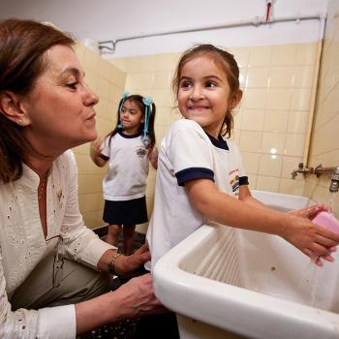
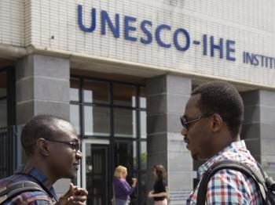

Slide 12
$24 is all it takes to provide one person with safe water
23mil people now have safe water because of Rotary
21mil people have access to sanitation and hygiene thanks to Rotary projects
2030 is the year Rotary hopes to finish providing everyone with safe water, sanitation, and hygiene

Slide 13
Rotary makes amazing things happen, like:
Strengthen the ability of communities to develop, fund, and maintain sustainable water and sanitation systems.
Provide equitable community access to safe water, improved sanitation, and hygiene.
Support programs that enhance communities’ awareness of the benefits of safe water, sanitation, and hygiene.
Support career-minded professionals’ studies related to water and sanitation.
Create tools and resources that facilitate, measure, and enhance high-quality water and sanitation projects worldwide.

Slide 14
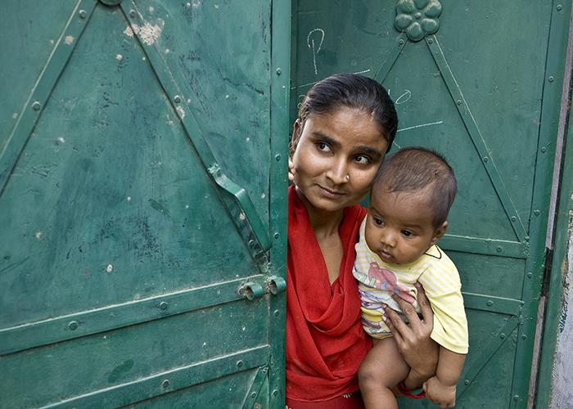
SAVING MOTHERS AND CHILDREN
Nearly 6 million children under the age of five die each year because of malnutrition, poor health care, and inadequate sanitation. We expand access to quality care, so mothers and their children can live and grow stronger.

Slide 15
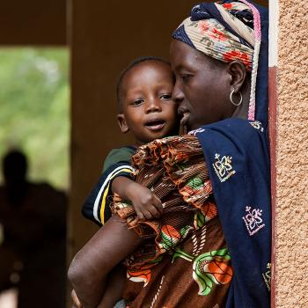
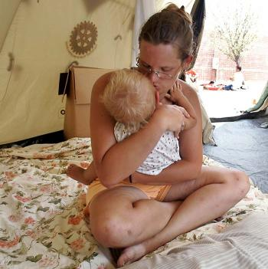
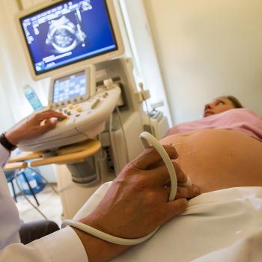

Slide 16
Rotary makes amazing things happen, like:
Mobile prenatal clinics - Haiti has the highest maternal and infant mortality rate of any country in the western hemisphere. Rotary provided a fully equipped medical Jeep to volunteers and midwives to reach mothers and children in remote areas.
Cancer screening - Rotarians provided a mobile cancer screening unit and awareness trainings around Chennai, India, where there is a high mortality rate of women with breast and cervical cancer due to late diagnosis.
Preventing injuries and deaths - Rotary members launched a $3 million, five-year pilot to save lives of mothers and children during home deliveries in Nigeria. Since 2005, they’ve also repaired 1,500 obstetric fistulas — 500 more than their initial goal — restoring dignity and hope to vulnerable mothers.

Slide 17
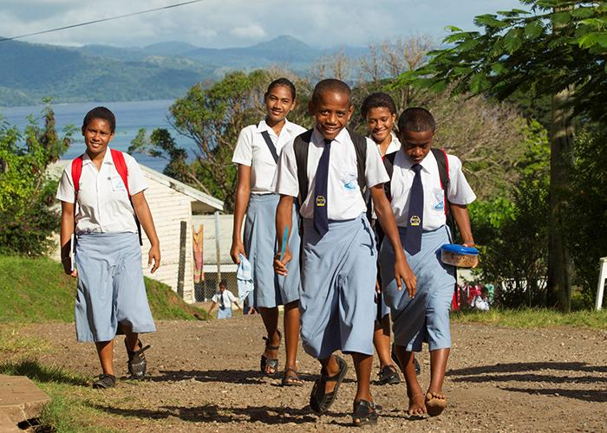
SUPPORTING EDUCTION
More than 775 million people over the age of 15 are illiterate. Our goal is to strengthen the capacity of communities to support basic education and literacy, reduce gender disparity in education, and increase adult literacy.

Slide 18
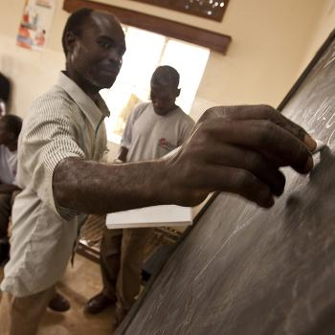
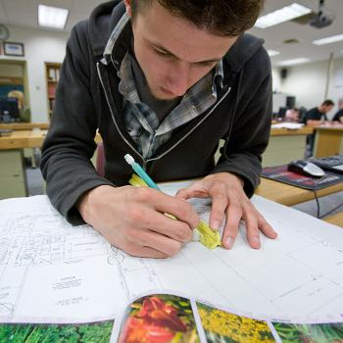
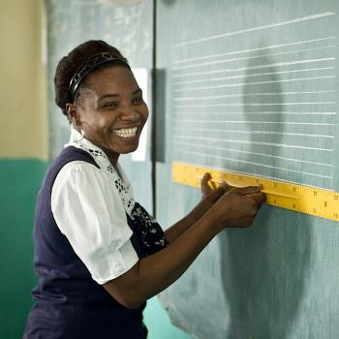

Slide 19
500 adults raised their reading levels by three grades in Detroit
$100mil in grants to get clean water in Lebanese schools

Slide 20
Rotary makes amazing things happen, like:
Opening schools: In Afghanistan, Rotary members opened a girls’ school to break the cycle of poverty and social imbalance.
Teaching adults to read: Rotary members in the United States partnered with ProLiteracy Detroit to recruit and train tutors after a study showed that more than half of the local adult population was functionally illiterate.
New teaching methods: The SOUNS program in South Africa, Puerto Rico and the United States teaches educators how to improve literacy by teaching children to recognize letters by sounds instead of names.
Making schools healthy: Rotarians are providing clean, fresh water to every public school in Lebanon so students can be healthier and get a better education.

Slide 21
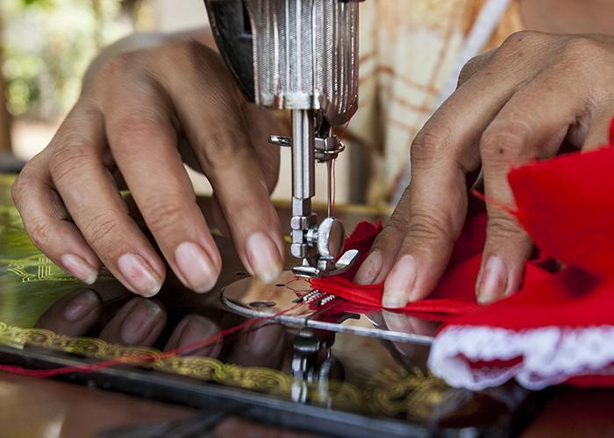
GROWING LOCAL ECONOMIES
We carry out service projects that enhance economic and community development and create opportunities for decent and productive work for young and old. We also strengthen local entrepreneurs and community leaders, particularly women, in impoverished communities.

Slide 22
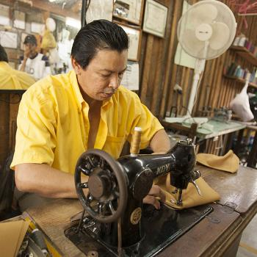
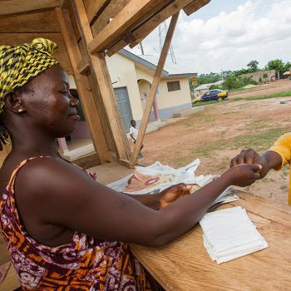
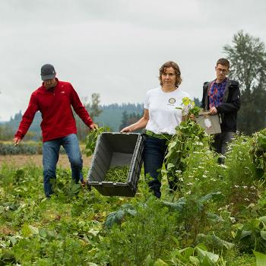

Slide 23
$9.2mil The amount The Rotary Foundation has spent to grow local economies and reduce poverty last year
795mil people — or 1 in 9 people in the world — do not have enough to eat
60% of the world’s hungry people are women and girls
70% of the world’s poorest people live in rural areas and depend on agriculture and related activities for their livelihood

Slide 24
Rotary makes amazing things happen, like:
Breaking the cycle of poverty for women: Most of the women living in rural Guatemala do not have the collateral to get loans from regulated financial institutions. The Rotary Club of Guatemala de la Ermita helped 400 local women complete financial literacy courses so they could pool their money and fund their own microlending program.
Skills development, business training: In Esmeraldas, Ecuador, Rotary members helped grant more than 250 microloans and train more than 270 community members in sewing, baking, plumbing, microcredit, business management, and leadership.
Sustainable farming: In west Cameroon, soil erosion and loss of soil fertility have significantly reduced farmers’ harvests. Rotary members gave farmers the skills they needed to improve soil fertility, control soil erosion, and market their produce. The results: increased crop yields and profits.

