Slide 1
Your Rotary Foundation

Slide 2
Where do Grant $ come from?
From YOU …
as a Rotarian contributing to our Foundation
Notes:
To Understand Grants, first, you need to know where Grant funding comes from.
From all of you.
Contributing to the Annual Programs Fund and Permanent Fund.

Slide 3
Where do I contribute?
Restricted Giving
Polio
World Peace Scholars
Donor advised funds
Annual Programs Fund (APF)
Permanent Fund
Notes:
How do I contribute?
EREY –
Included in club dues
Automatic deduction from checking / Savings / credit card
Via member access at rotary.org

Slide 4
Rotary Foundation Funding
Rotarian
Contributions
Restricted Giving
TRF
Program
Funding
District
Designated
Funds(DDF)
SHARE
“Every Rotarian Every Year”
World
Fund
Gifts to Endowment Fund
Investment
Earnings
Notes:
100% of your giving goes to projects.

Slide 5
Restricted Giving
All donations immediately to program and not invested
Polio Plus – Main focus right now
There are other areas for Restricted Giving
World Peace Scholars
Donor advised funds

Slide 6
Annual Programs Fund (APF)
Donations made every year
Work in the Foundation for 3 years
Earnings used to run our Foundation
50% to the World Fund
Matching Grants and others
50% to our District
District Designated Funds (DDF)
District Grants (DG)

Slide 7
Permanent Fund
Donations made every year
Usually larger amounts and bequests
Used to fund our Foundation in perpetuity
Earnings used to fund grants
Corpus never spent

Slide 8
Use Your Foundation Dollars
You and your club gave to the Foundation, now use it !
Leverage your club $$ for your project
50% of DDF available for District Grants
$75,000 in DG funding available in 2018
Some of DG can be earmarked for District Projects (VTT, etc.)

Slide 9
Grants: 3 Types
Global Grants – larger international projects
District Governor – District wide projects
District Grants (DG) – smaller local club projects

Slide 10
Global Grants
Larger International Projects
Minimum total project cost $30,000
Projects can span Rotary years
Global Grants can be applied for any time
Two Countries and Two Clubs
DDF match $1 for $1
Club match $.50 for $1
Meet Requirements, get the Global Grant

Slide 11
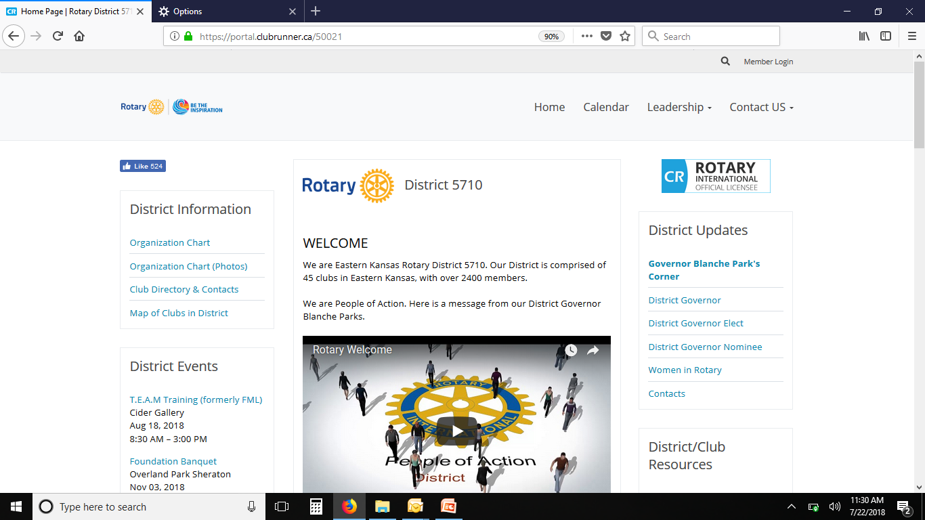
District Grants (DG)
Where to Find Grant Documents
Logon to District Website: rotary5710.org

Slide 12
District Grants
On Home Page scroll down the right-hand side to “Grants”:

Slide 13
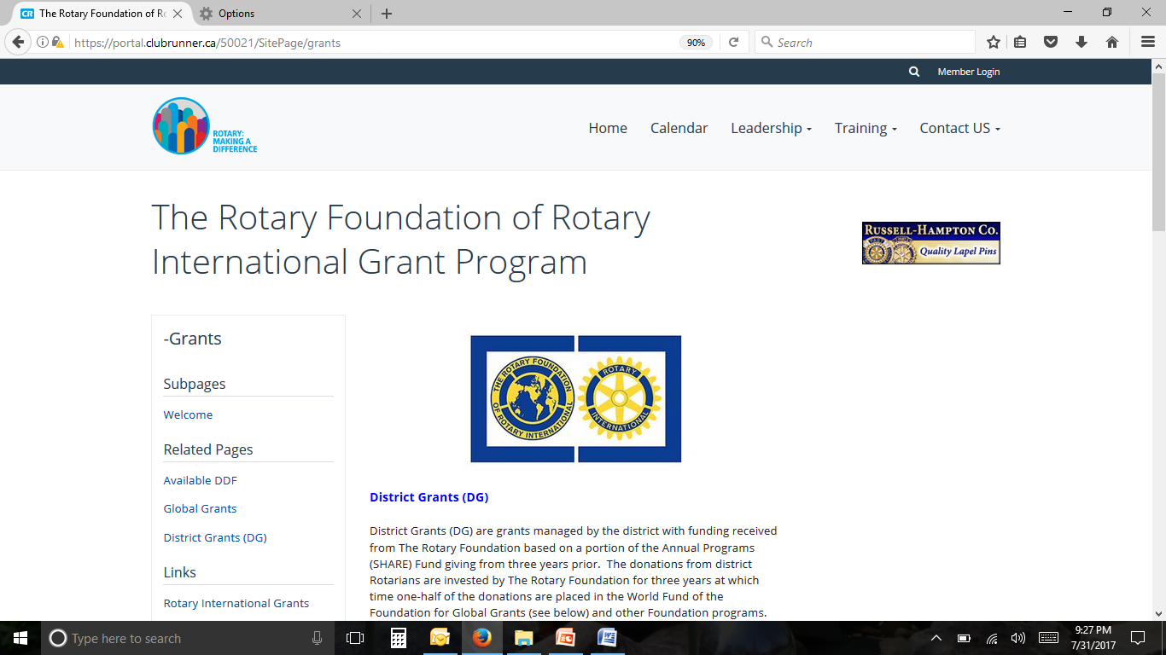
District Grants
On Grants page, scroll down left-hand side to “District Grants (DG)” :

Slide 14
District Grants
On District Grants page, find all documents/forms

Slide 15
District Grants-Available Dollars

Slide 16
District Grants (DG) Timeline
Deadline for application is August 31, 2018
Reviewed and approved by committee in September
Approval notification by end of September - After approval, District funds cannot be used for other than approved expenditures!
Funds distributed in October - Projects cannot be started before this date!
Progress report (or Final) due by June 30, 2019
Project must be completed within 12 months from receipt of funds (approx. October 2019)
Final report due by mid-October 2019
Unused funds must be returned with Final report
Notes:
These grants are intended for smaller local projects.
For International projects, we recommend Matching Grants

Slide 17
District Grants (DG) Available Funds
DG intended for local projects, International projects should consider Global Grants. There is a ‘check the box’ to support a global grant.
Last year $75,000 available ($78,600 awarded to clubs, included additional interest).
This year $71,000 available (plus $4,000 for a District project). Our District is part of $25.5M in district grants from The Rotary Foundation worldwide (in 2015-2016).
Each club receives Guaranteed Funds, based on pro-rata Rotary Foundation giving (from 2015-16), plus Star Club Bonus (based on 2017-18 giving).
Club minimum dollar match 1:2 ($.50/club for $1.00/district).
Clubs can submit multiple grants to use their Guaranteed Funds.
Each club can submit one additional grant for Discretionary Funds.
Discretionary Fund grant applications will be evaluated and funded based on merit, and are held to a higher standard then Guaranteed.
Discretionary DG’s may be partially funded.

Slide 18
District Grants (DG) Your Club’s Fiduciary Responsibilities (the MOU)
Funding of District Grants comes from contributions to the Rotary Foundation and clubs must provide stewardship of those funds.
By executing a MOU, clubs state that they have a written financial management plan for administration of grant funds (a sample plan is on the District 5710 website).
There MUST be a separate grant bank account for grant projects.
All grant documentation (including receipts, checks, bank statements, etc.) must be retained by the club for 5 years.
Reporting must be done timely and provide sufficient detail so that the District Stewardship Chair can review all projects and report to The Rotary Foundation that all standards have been met.
All club members are responsible for ensuring the proper implementation of grant activities and reporting.

Slide 19
District Grants (DG) Requirements
A club representative must have attended a Grants Training Seminar (at FML or TEAM) in the past 3 years
Projects must have active Rotarian participation.
If partnering with other club(s), call/email grants chair
Clubs must provide MOU and current IRS Form 990.
Project descriptions should be clear and concise.
Income and expenses need to match.
Funds cannot be used for salaries, stipends or to pay Rotarians.
Grant Reporting – VERY IMPORTANT !!! - If the District does not have our Grants reported, the District does not receive future funding until they ARE reported.
Keep receipts/disbursement documents and send with report.
Application, MOU and Report must be physically signed.
Ask questions – contact the grants chair, but give your club name

Slide 20
Contact / Questions
Greg Shondell, Kansas City Kansas Rotary Club
District 5710 Grants Subcommittee Chair
3905 Delmar Drive
Shawnee Mission, KS 66208
greg@HeathwoodOil.com
(C) 913-956-1764

Slide 21
Grants
All Grant Forms and Information are posted on the District 5710 website.
http://www.rotary5710.org/
To open Rotary Grants web page select the above hyperlink, right click, and then select “Open Hyperlink”. Scroll down to “Grants”

