Slide 2
TEAM Rotary Training
August 17, 2019
Jason Leib, District Governor 2019-2020

Slide 3
New Vision Statement
Together, we see a world where people unite and take action
to create lasting change –
across the globe, in our communities and in ourselves.

Slide 4
Priority 1: Increase our Impact
• Eradicate polio and leverage the legacy
• Focus our programs and offerings
• Improve our ability to achieve and measure our impact

Slide 5
Priority 2: Expand Our Reach
• Grow and diversify our membership and participation
• Create new channels into Rotary
• Increase Rotary’s openness and appeal
• Build awareness of our impact and brand

Slide 6
Priority 3: Enhance Participant Engagement
• Support clubs to better engage their members
• Develop a participant-centered approach to deliver value
• Offer new opportunities for personal and professional connection
• Provide leadership development and skills training

Slide 7
Priority 4: Increase Our Ability to Adapt
• Build a culture of research, innovation, and willingness to take risks
• Streamline our governance, structure and processes
• Review governance to foster more diverse perspectives in decision-
making

Slide 8
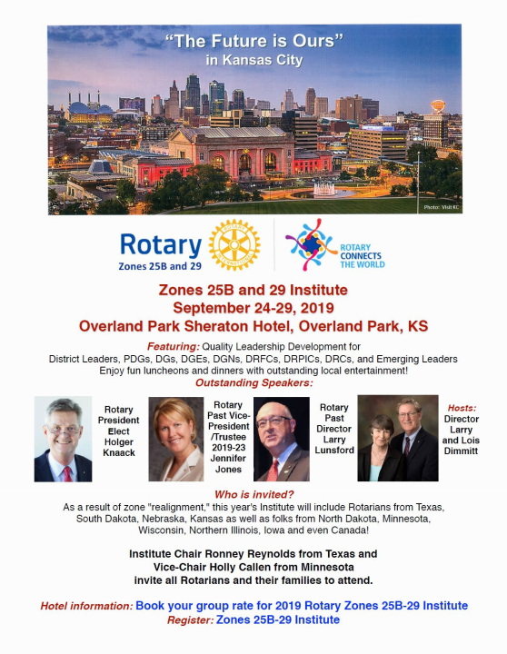
Zones 25B & 29
Institute
September 27-28

Slide 9
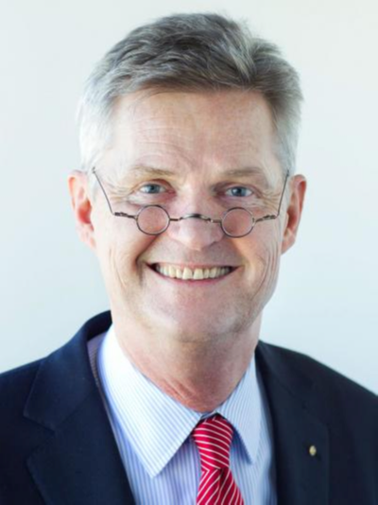
Rotary President-Elect Holgar Knaack

Slide 10
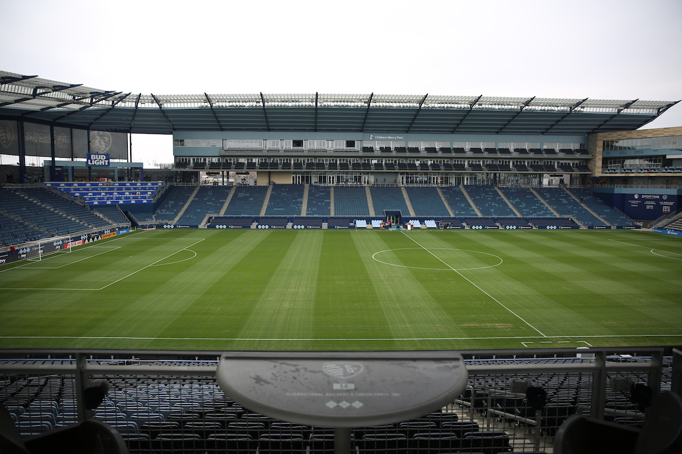
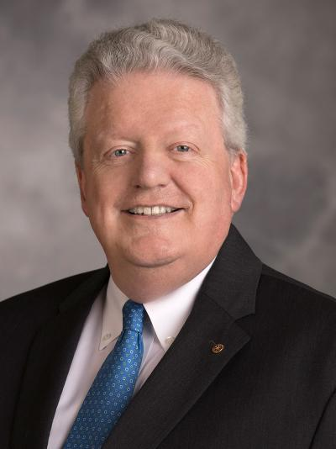
Foundation Banquet
New Date!
Rotary International President
Mark Maloney
Sporting KC Player - TBD
Friday, November 1st
Location: Sporting KC Shield Club

