Slide 1
Fundraising &
Service Projects
Building Lasting Impact for Our Communities
Rotary District 5830 · 2026 District Assembly
Presented for Club Presidents & Leaders

Slide 2
Today's Agenda
FUNDRAISING
SERVICE PROJECTS
BRINGING IT TOGETHER
▸ Why fundraising is central to your mission
▸ How to identify the right project
▸ International projects & District grants
▸ Types of fundraising: events, grants, donors
▸ Rotary's 7 Areas of Focus
▸ Discussion: sharing your best experiences
▸ Planning, budgeting & financial transparency
▸ Planning, implementation & evaluation
Rotary District 5830 · 2026 District Assembly

Slide 3
Why Fundraising Matters
Every dollar raised
Core Principle
is a dollar directed toward your community's greatest needs.
Fundraising is not an end in itself — it is how we sustain the work that matters.
Strong fundraising
builds your club's credibility and attracts new members.
Your club's fundraising capacity directly determines the scale of your service impact.
Larger budgets
unlock international projects and District grant eligibility.
Rotary District 5830 · 2026 District Assembly

Slide 4
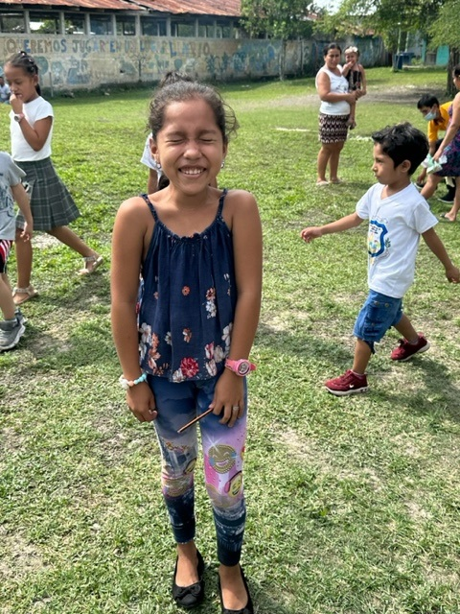
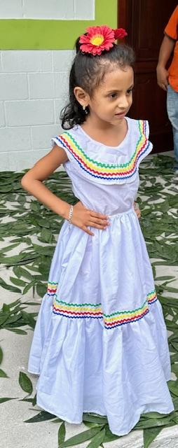
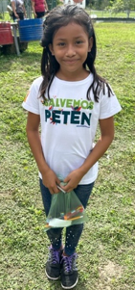
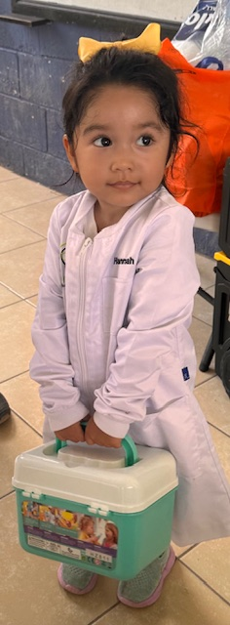
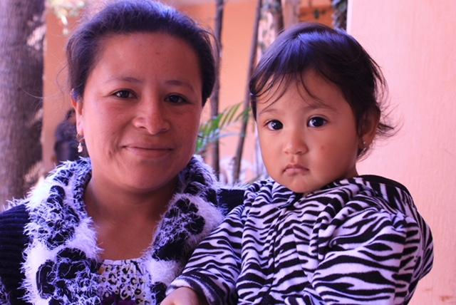
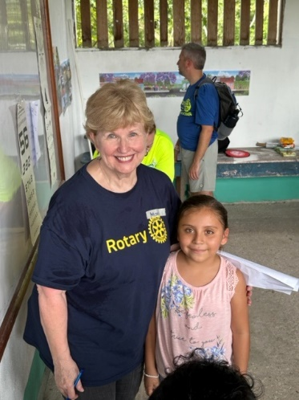

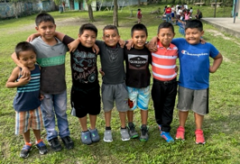

Here are some reasons why our hearts are forever changed by our work in Guatemala!

Slide 5
Types of Fundraising for Rotary Clubs
SIGNATURE EVENTS
COMMUNITY CAMPAIGNS
Annual galas, golf tournaments, auctions, or dinners that become your club's identity. High visibility + member engagement.
Food drives, raffles, fun runs, or holiday appeals that engage the broader public and build community goodwill.
CORPORATE PARTNERSHIPS
GRANTS & FOUNDATIONS
Sponsorships and matching-gift programs from local businesses. Can multiply the impact of every dollar raised.
Rotary Foundation District Grants, Club Project Grants, and external foundations. Requires planning and reporting discipline.
Rotary District 5830 · 2026 District Assembly

Slide 6
Planning a Successful Fundraiser
1
Set a Clear Goal
Define a specific dollar target tied to a specific project or need. Vague goals produce vague results.
2
Know Your Audience
Who are your donors? Members, businesses, the public? Tailor your approach and messaging accordingly.
3
Assemble a Committee
Assign a chair and team with clear roles: logistics, communications, donor outreach, and finance.
4
Build a Budget
Estimate costs upfront. A fundraiser that costs more than it raises damages morale and credibility.
5
Communicate Early & Often
Promote widely before, during, and after. Share outcomes — donors want to see their impact.
Rotary District 5830 · 2026 District Assembly

Slide 7
Financial Stewardship & Transparency
Trust is your most valuable asset
Donors give again when they trust how their money is used. Every club must hold itself to a high standard.
Separate Accounts
Budget vs. Actual Reporting
Keep fundraising proceeds in a dedicated account, clearly separate from general operating funds.
Present a budget-to-actual report at every board meeting. Track revenue and expenses in real time.
Donor Acknowledgment
Year-End Summary
Send written acknowledgment within 48 hours of every gift. Include a note on how funds will be used.
Publish a simple annual impact report: money raised, projects funded, lives touched.
Internal Controls
District Compliance
Require two signatures for expenditures above a threshold. No one person should control all funds.
If using District grants, follow all reporting requirements. Non-compliance affects the whole district.
Rotary District 5830 · 2026 District Assembly

Slide 8
From Fundraising to Service
How the money you raise becomes the impact you make
RAISE
PLAN
SERVE
Identify needs, run events, secure donors & grants
Select project, build team, set measurable goals
Implement, track, report, celebrate impact
The most effective clubs treat fundraising and service planning as a single, continuous cycle — not two separate activities. Your fundraising strategy should be built around your service goals.
Rotary District 5830 · 2026 District Assembly

Slide 9
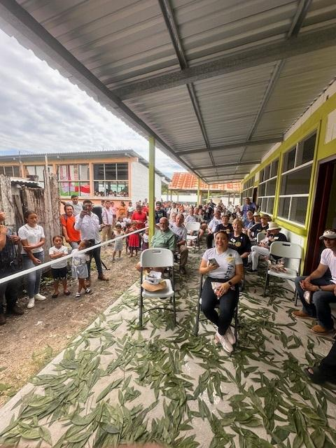
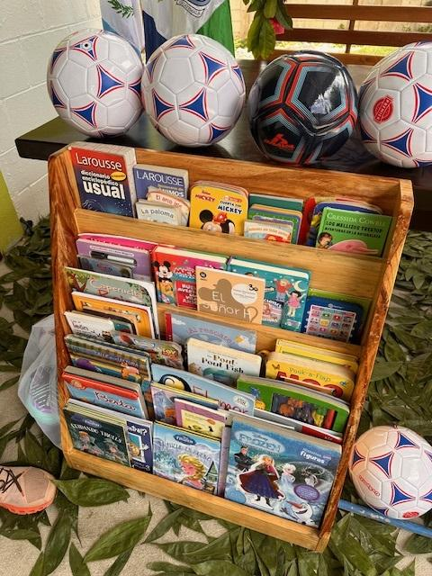
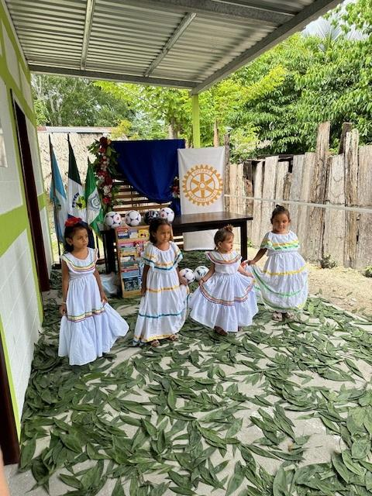
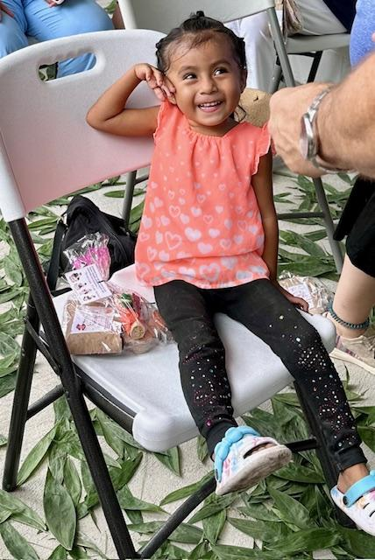

Ribbon Cutting Ceremony
We brought soccer balls….you would have thought we were “Rock Stars!”
Local Rotarians supplied children’s books for the school
Villagers all crowded around, and we were seated up front like royalty!

Slide 10
Where to Start a Service Project
Great projects don't come from guesswork. Start with a structured discovery process.
1
Engage Active Members
Bring together several engaged members who represent a range of interests and skills.
2
Talk to Community Leaders
Ask local officials, nonprofits, and schools: What do you need most right now?
3
Explore Rotary Showcase
Browse rotary.org/rotaryshowcase for proven project models from clubs worldwide.
4
Anchor to Areas of Focus
Ground your idea in one of Rotary's 7 humanitarian areas to maximize impact and grant eligibility.
5
Build a Needs Assessment
Synthesize all inputs into a short written summary: the need, the gap, the opportunity.
Rotary District 5830 · 2026 District Assembly

Slide 11
Rotary's 7 Areas of Focus
Promoting Peace
Clean Water & Sanitation
Disease Prevention
Conflict resolution & peacebuilding
Safe water & hygiene infrastructure
Eradicating and treating disease
1
2
3
Maternal & Child Health
Education & Literacy
Economic Development
Saving mothers and children
Supporting global learning
Growing local economies
4
5
6
Environment
Climate & environmental solutions
7
Rotary clubs are also increasingly engaged in Disaster Relief worldwide.
Rotary District 5830 · 2026 District Assembly

Slide 12
Developing Your Project Concept
Once a need is confirmed, narrow your focus — then build your project around it.
Narrow the Focus
Build on Existing Strengths
From your needs assessment, identify what is important, immediate, and high impact. What is actionable with a clear start and end?
The best projects leverage what your club already does well. Passion + skill = sustainable commitment.
Appoint a Leader & Team
Define Goals & Budget
Name a project chair early. Assemble a planning team — recognize that planning and implementation require different skills.
Set measurable success metrics. Identify all resources needed and build a realistic budget before seeking approval.
Get Leadership Buy-In
Communicate Progress
Involve club leadership at every step. A project without board support rarely survives past the first obstacle.
Set a regular reporting cadence. With input comes buy-in — keep members informed and engaged throughout.
Rotary District 5830 · 2026 District Assembly

Slide 13
Implementation & Accountability
PLAN
EXECUTE
EVALUATE
CLOSE
Name implementation committee. Kick off the project team. Confirm roles & responsibilities.
Track spending vs. budget. Monitor progress weekly. Communicate milestones to club.
Course-correct as you learn. Document lessons in real time. Report to club board regularly.
Post-mortem: what worked? Capture lessons for next time. Celebrate and recognize team.
"With input, comes buy-in." Keep members informed at every phase — silence breeds skepticism.
Rotary District 5830 · 2026 District Assembly

Slide 14
International Projects
International projects follow the same core principles — but require additional partners, accountability, and coordination.
Key Requirements
District Contacts
▸ Identify a qualified international partner — a local Rotary club, a Rotary-related organization, or an established NGO with regional experience.
District Foundation Director
Pamela Walters
▸ Ensure partner has project management experience and can account for funds spent in-country.
TRF International Service
▸ Set clear measurable goals, timelines, and deliverables from the start.
PDG Ted Huffhines (Heart-to-Heart, Mexico)
▸ For Club Project Grants: involve District Foundation Chair and International Projects Chair early — they know the deadlines and expectations.
TRF Stewardship / Guatemala
PDG Carroll Greenwaldt
▸ Meet all project reporting requirements. Failure to report can affect the entire district's standing with The Rotary Foundation.
District Grants
PDG Jack Welge
Rotary District 5830 · 2026 District Assembly

Slide 15
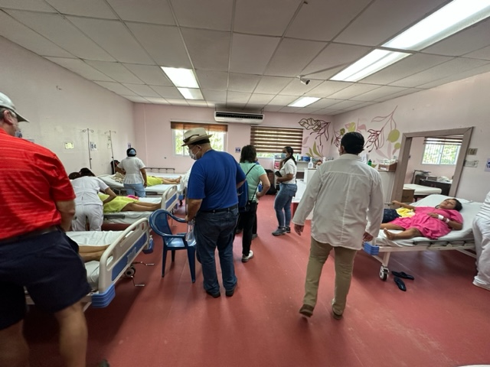
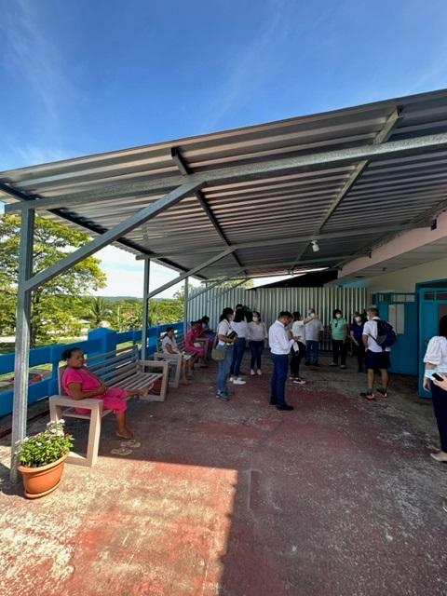
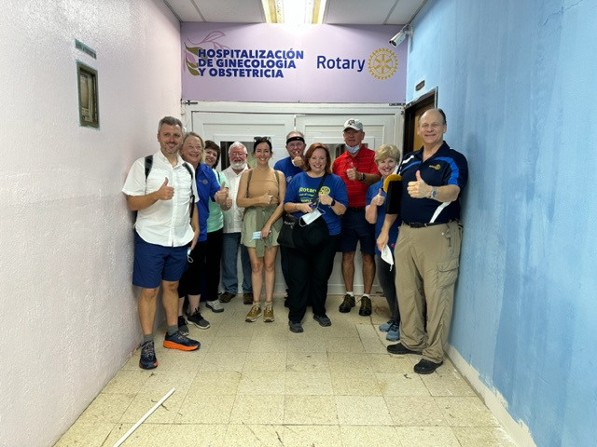
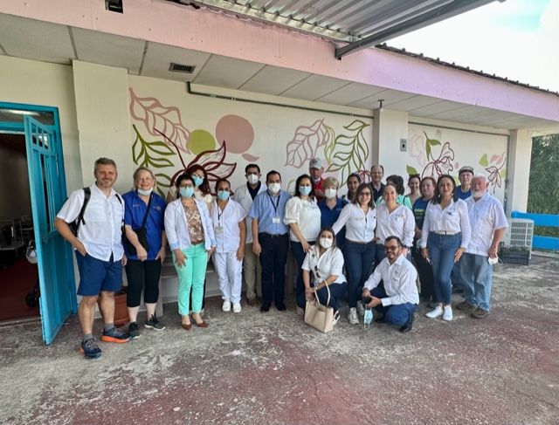
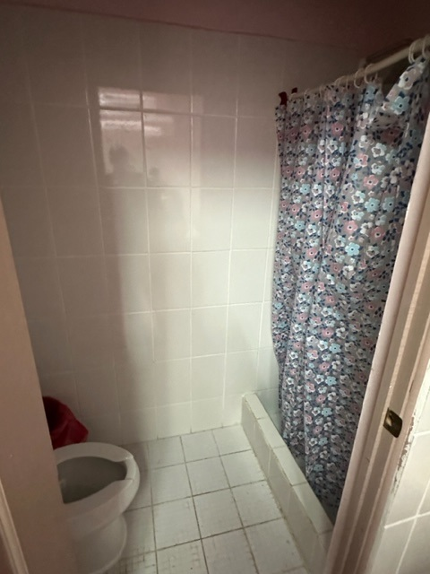
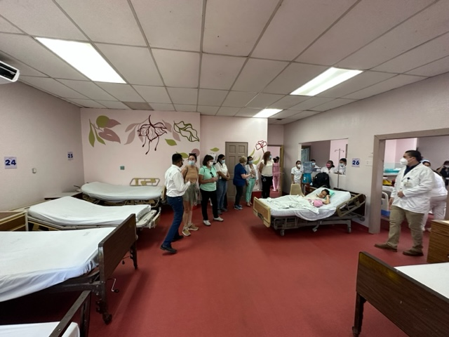
Inside the Hospital’ de San Benito New Maternity Ward!
Newly refurbished, air- conditioned wards, new restroom facilities & outside sitting area

Slide 16
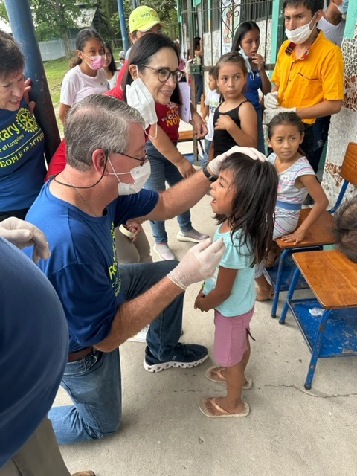
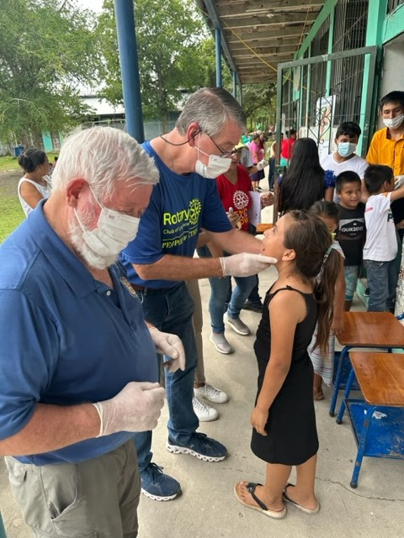
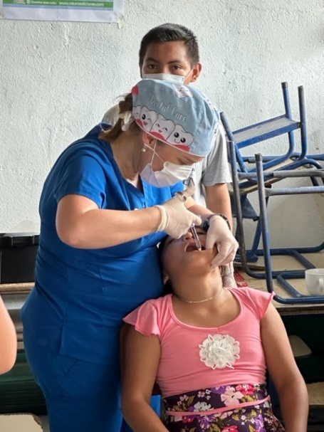
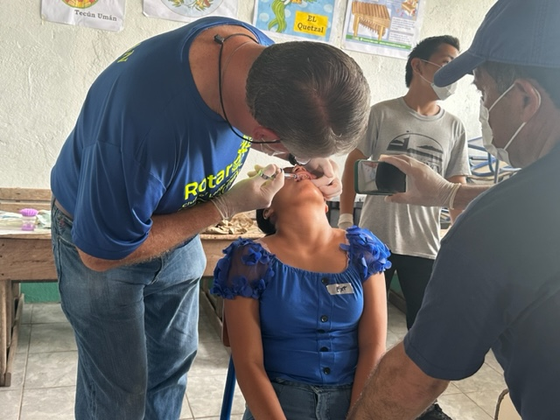
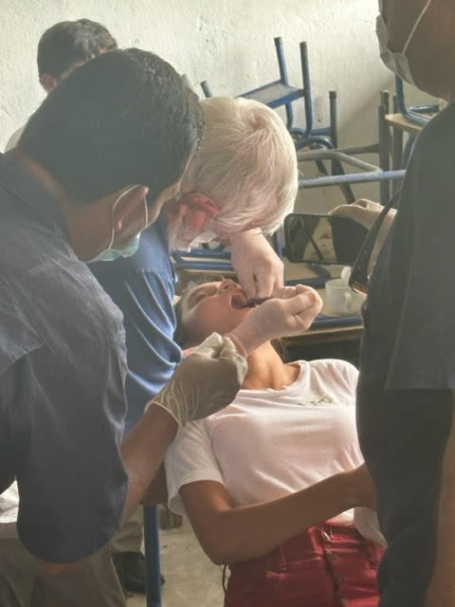
Dental Evaluations and Treatment
We have excellent dental care…they do not!

Slide 17
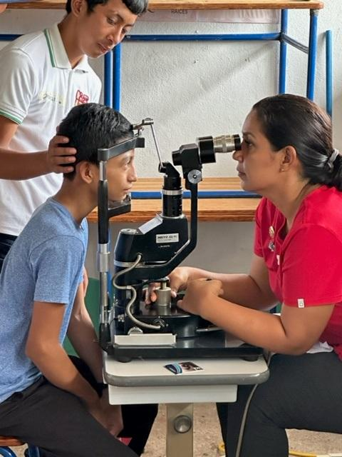
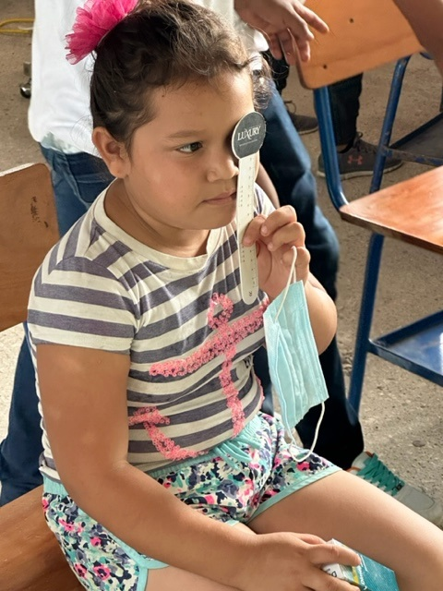
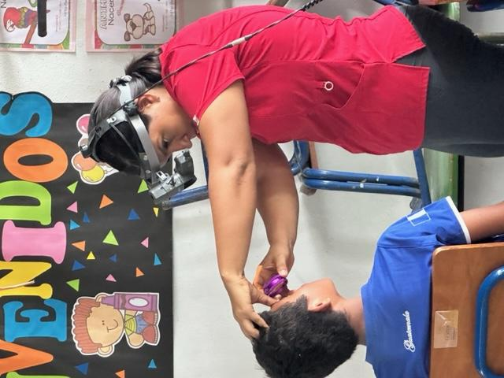
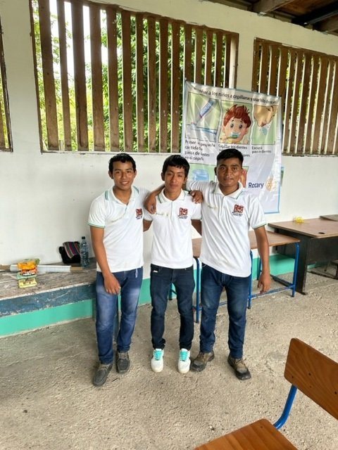
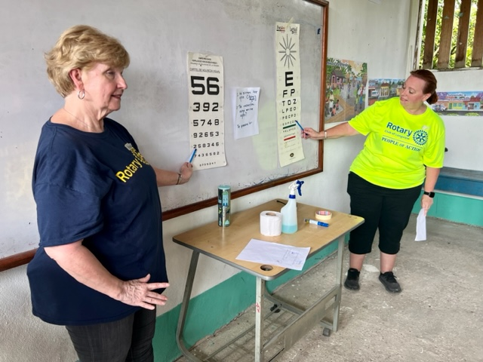
Eye Clinic for Children: Dr. Iveth Marroquin, assisted by Team Rotarians
Several children now have glasses and can see 20:20.

Slide 18
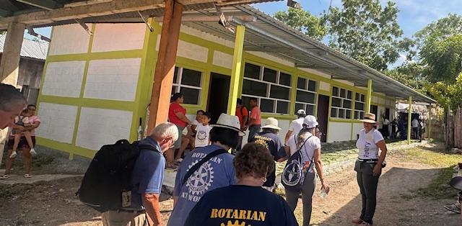
What They’ve Built with our Help

Slide 19

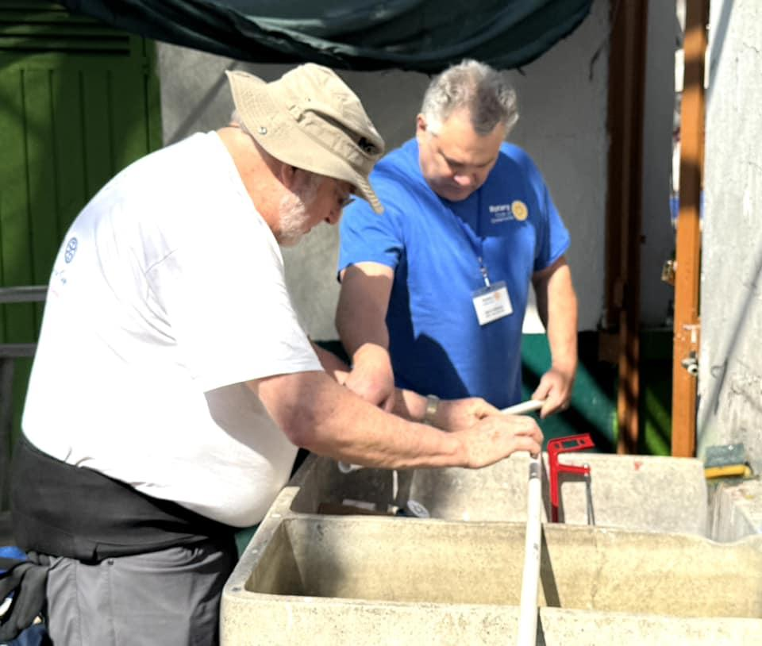
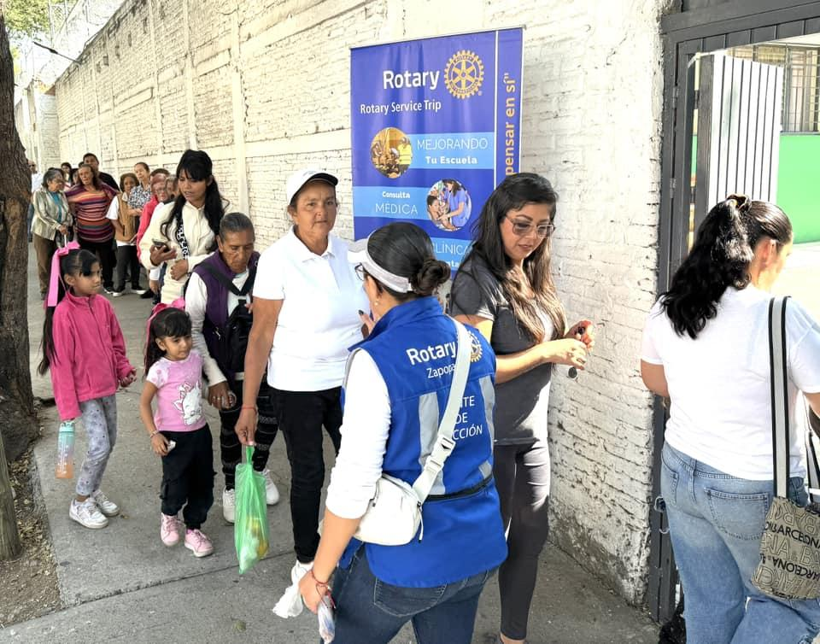
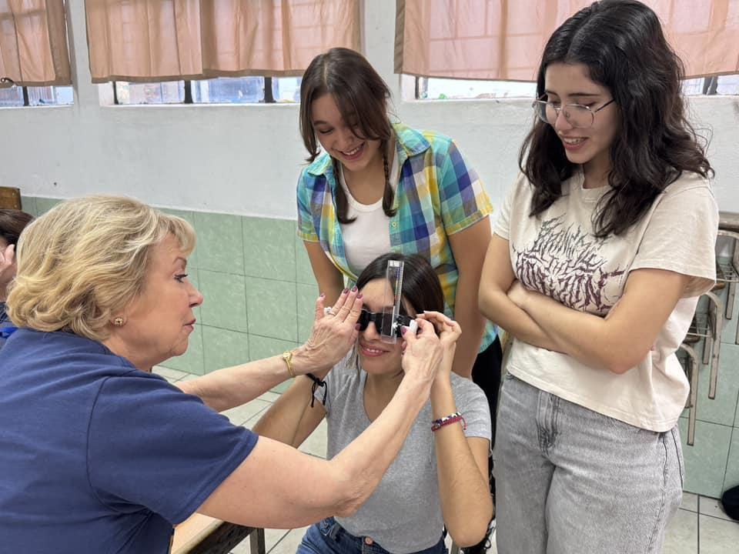
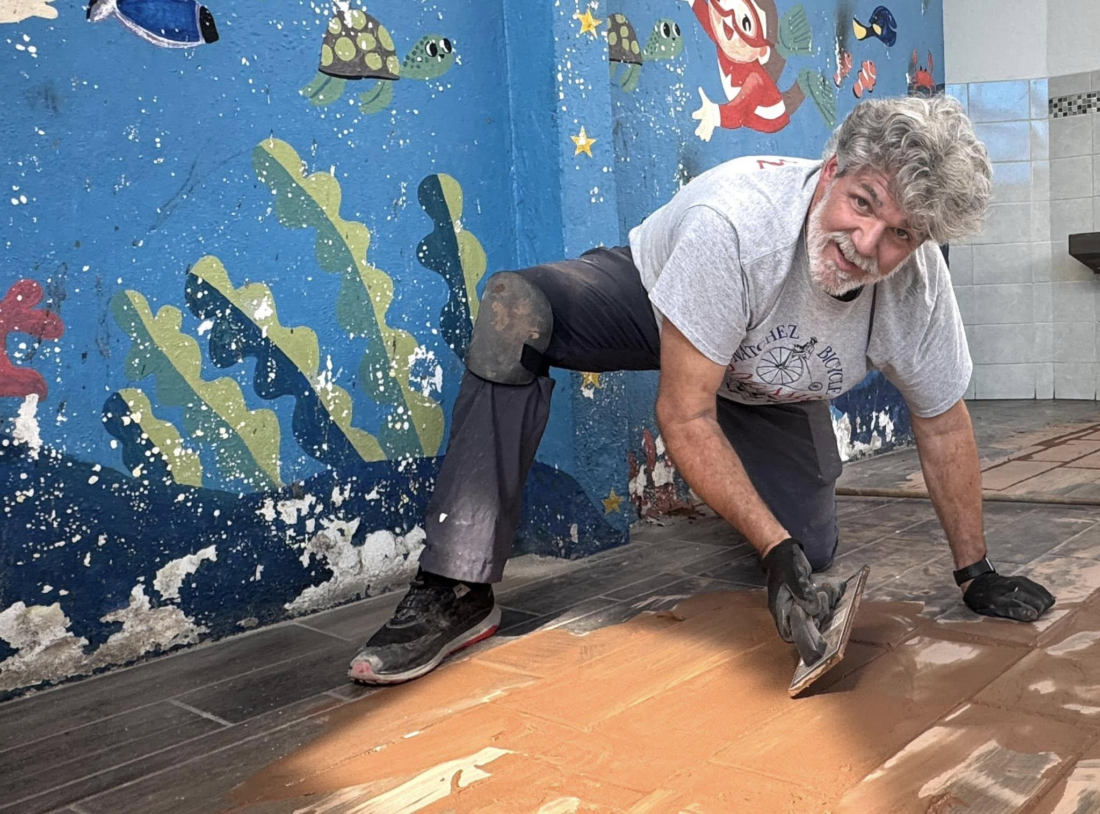
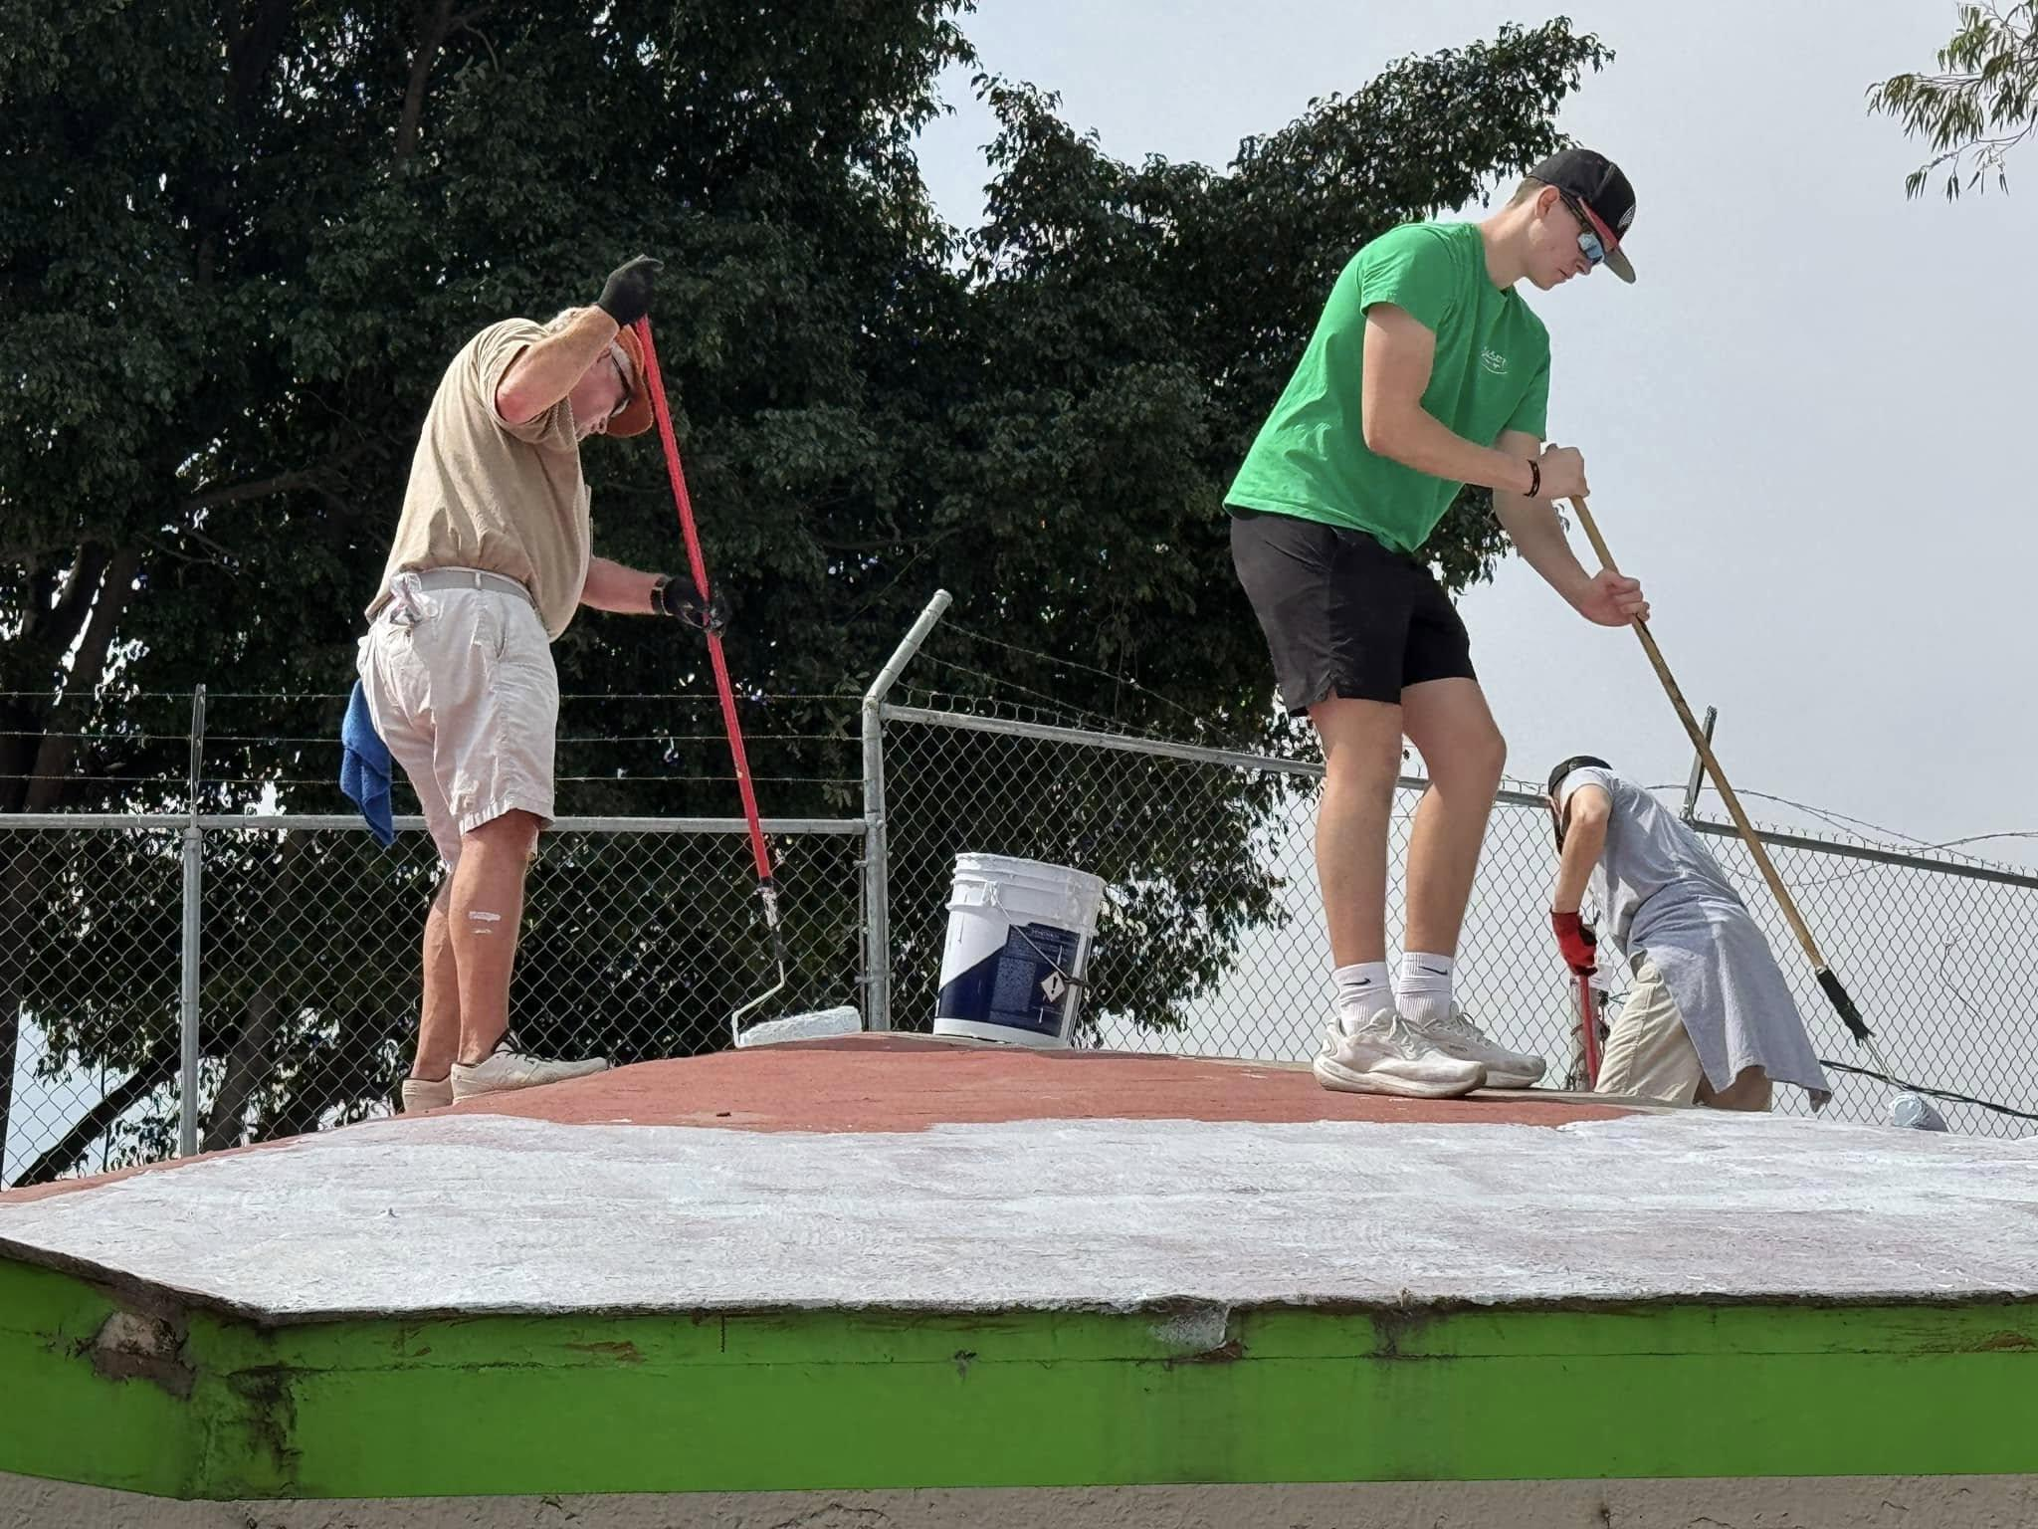
Work Day 1 Jardin de Ninos 507

Slide 20
Discussion
Learning from each other's experience
Your Best Project
Fundraising That Worked
What service project are you most proud of? What made it successful?
What fundraising approach has generated the most impact for your club?
Lessons Learned
Advice for Others
What would you do differently? What surprised you in implementation?
What's the one piece of advice you'd give a club starting a major project?
Rotary District 5830 · 2026 District Assembly

Slide 21
Key Takeaways
Rotary District 5830 · 2026
1
Fundraising and service are one cycle — build your fundraising strategy around your service goals.
2
Transparency and stewardship build donor trust, which makes future fundraising easier.
3
Great projects start with a real needs assessment and strong club buy-in — not just a good idea.
4
Involve District resources early: Foundation Chair, Grant Administrator, and experienced PDGs.
5
Measure, document, and share your results — your outcomes inspire future donors and members.
6
Whether local or international, communication and accountability are what separate great projects from good intentions.

