Slide 1
PAUL HARRIS SOCIETY
Bringing positive change to communities around the world
Notes:
Rotary has a more than 100-year record of serving communities here at home and around the world. Your continued support of The Rotary Foundation brings lasting and positive change to communities in need and inspires others to join our efforts to do good in the world.

Slide 2
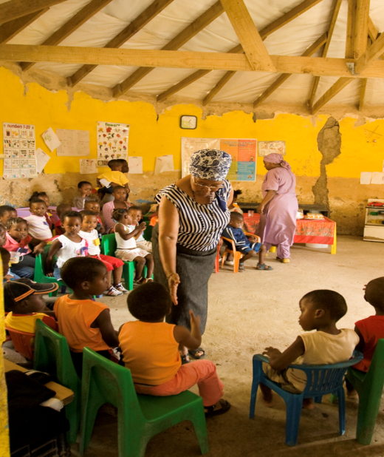
WHAT IS THE PAUL HARRIS SOCIETY?
US$1,000 every year
Annual Fund
PolioPlus Fund
Approved Foundation grants
Notes:
Named after Rotary’s founder, the Paul Harris Society (PHS) recognizes Rotary members and friends of The Rotary Foundation who make individual contributions of $1,000 or more each year to the Annual Fund, PolioPlus Fund, or approved Foundation global grants. This recognition was administered by districts until the Paul Harris Society became an official Rotary Foundation recognition program in July 2013. Its purpose is to identify, engage, and recognize members who have the ability and desire to make substantial annual gifts to help communities around the world.
The Paul Harris Society was created in 1999 by Past District Governor Wayne Cusick from District 5340. Cusick realized that giving US$1,000 annually to the Foundation was not possible for every Rotarian, but many could be encouraged to contribute at this level or above. He introduced the Paul Harris Society program to encourage and recognize these donors. The idea gained momentum and quickly spread to other districts throughout the world.

Slide 3
WHY JOIN THE PAUL HARRIS SOCIETY?
Doing so helps ensure the continued good work of Rotary members.
Notes:
The Rotary Foundation works to improve communities by putting grassroots expertise to work and forging lifelong partnerships in the process. Donations at the Paul Harris Society level are crucial in order for us to continue making a positive impact — from local projects to our continued efforts to rid the world of polio.
When you join the Paul Harris Society, you are committing to help advance world understanding, goodwill, and peace by supporting activities such as:
• Providing vocational training for teachers who are establishing an early childhood education center in South Africa
• Supplying water filters, toilet blocks, and hygiene training to prevent fluorosis in a community in India
• Funding a scholarship for a medical professional in Italy to research treatments that minimize mortality rates among premature babies
• Offering peace-building seminars to 200 teachers and 1,300 students in Uganda
• Distributing treated mosquito nets and offering medical services that help prevent malaria in Mali
And do not forget Rotary’s No. 1 priority: eliminating polio from the world. Imagine the number of immunizations — and the impact on hundreds of children — that you can provide by donating US$1,000 each year.
A small percentage of donors who contribute at or above the Paul Harris Society level represent over 1/3 of contributions to the Foundation’s Annual Fund.

Slide 4
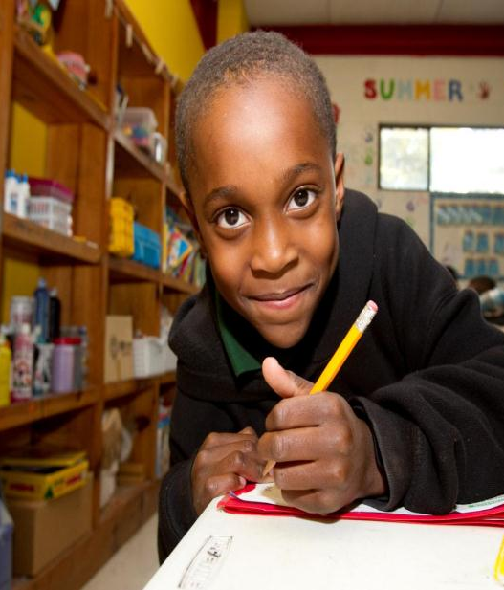
JOINING THE PAUL HARRIS SOCIETY
Become a member
Join online.
Complete the brochure
Call the Rotary Support Center
Notes:
By joining the Paul Harris Society, you are committing to contribute at least $1,000 or more to the Annual Fund, PolioPlus, or an approved Foundation grant each year. You can join the Paul Harris Society without having any history of contributing US$1,000 or more to the approved funds and you do not need to make an immediate $1,000 contribution when you enroll.
You can fulfill your Paul Harris Society giving gradually over the Rotary year through any combination of giving to the Annual Fund, PolioPlus, or an approved Foundation grant. For example, making a monthly contribution of $85 through Rotary Direct to PolioPlus and the Annual Fund would amount to $1,000 in contributions in one year, and thus would honor your Paul Harris Society giving goal.
To join, you can:
Complete the online sign-up form found on the PHS page of Rotary.org.
Contact Rotary’s Support Center at rotarysupportcenter@rotary.org or call 1-866-9ROTARY (976-8279).
Fill out the Paul Harris Society form and mail it to One Rotary Center or your international office.
Outside of North America, email or call the Rotary International office that serves your area, and ask to join.

Slide 5
ROTARY DIRECT
Recurring giving
Choose your designation
Set amount & frequency
Monthly
Quarterly
Annually
Enroll online: www.rotary.org/give
PHS membership is automatic
Notes:
Rotary Direct, Rotary’s recurring giving program, provides a safe, secure, and easy way to join the Paul Harris Society. It allows the Foundation to process a recurring contribution by charging a credit or debit card at the amount and frequency that are most convenient for you.
And you can enroll online, using any of 13 currencies, while preserving local tax benefits in most cases. For example, a Canadian Rotarian can donate via Rotary.org in Canadian dollars and receive a tax receipt from the Canadian Associate Foundation.
With recurring contributions of $1,000 annually, $85 per month, or $250 per quarter, Rotarians and friends can honor their Paul Harris Society membership easily and regularly.
Optional: Rotary’s website accepts online contributions in the following currencies: Argentine pesos (ARS), Australian dollars (AUD), British pounds (GBP), Canadian dollars (CAD), Danish kronen (DKK), euros (EUR), Japanese yen (JPY), New Zealand dollars (NZD), Norwegian kronen (NOK), South African rand (ZAR), Swedish kronor (SEK), Swiss francs (CHF), and United States dollars (USD). In most cases recurring giving can be set up in these currencies as well, check with the Support Center or the International Office that serves your area.

Slide 6
PAUL HARRIS SOCIETY RECOGNITION
Notes:
Members of the Paul Harris Society are eligible to receive wearable recognition to show their yearly commitment to Doing Good in the World. The chevrons can be worn with other pins, including the Paul Harris Fellow pin, Major Donor pin, Bequest Society pin, and Arch Klumph Society pin.
Rotary districts are encouraged to honor new members of the Paul Harris Society in a way that is appropriate in that culture and comfortable for each member. This can include presenting them with a certificate or insignia at a district or club event. Paul Harris Society coordinators and district leaders can order Paul Harris Society chevrons from The Rotary Foundation at no cost by writing to annualfund@rotary.org or contact the appropriate International Office that serves your area.

Slide 7
QUESTIONS?
Thank you for your time, commitment, and support.
Notes:
Thank you for trusting Rotary to use your contributions to make a lasting difference.

