Slide 1
MEMBERSHIP MATTERS
OFFERING MULTIPLE MEMBERSHIP TYPES

Slide 2
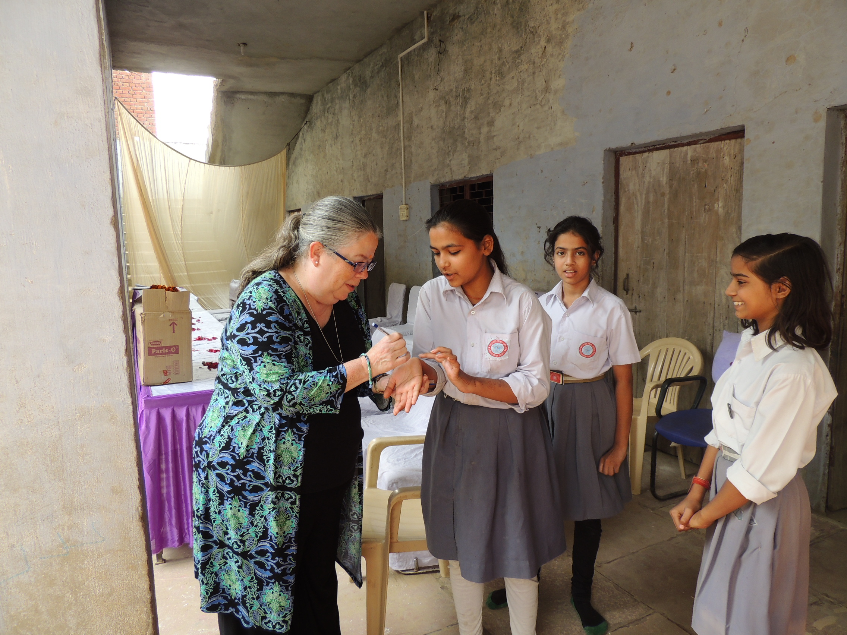
And, at the end of the day, no matter how many lives you reach out to change, the life that will change the most will be your own
Ron Burton, RI President 2013-2014

Slide 3
Who is missing from your Rotary Club?
FAMILY MEMBERS
CORPORATIONS
BANKS
LOCAL NONPROFITS
YOUNGER PROFESSIONALS
FORMER YOUTH EXCHANGE STUDENTS AND PARENTS
FORMER GROUP STUDY PARTICIPANTS
FRIENDS AND NEIGHBORS

Slide 4
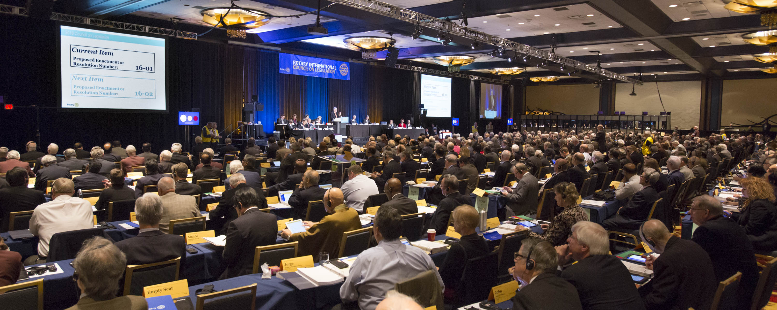
Council On Legislation 2016
Notes:
The Council on Legislation (COL) is the body of Rotarians authorized by the RI Constitution and Bylaws to amend the “constitutional documents” of RI.

Slide 5
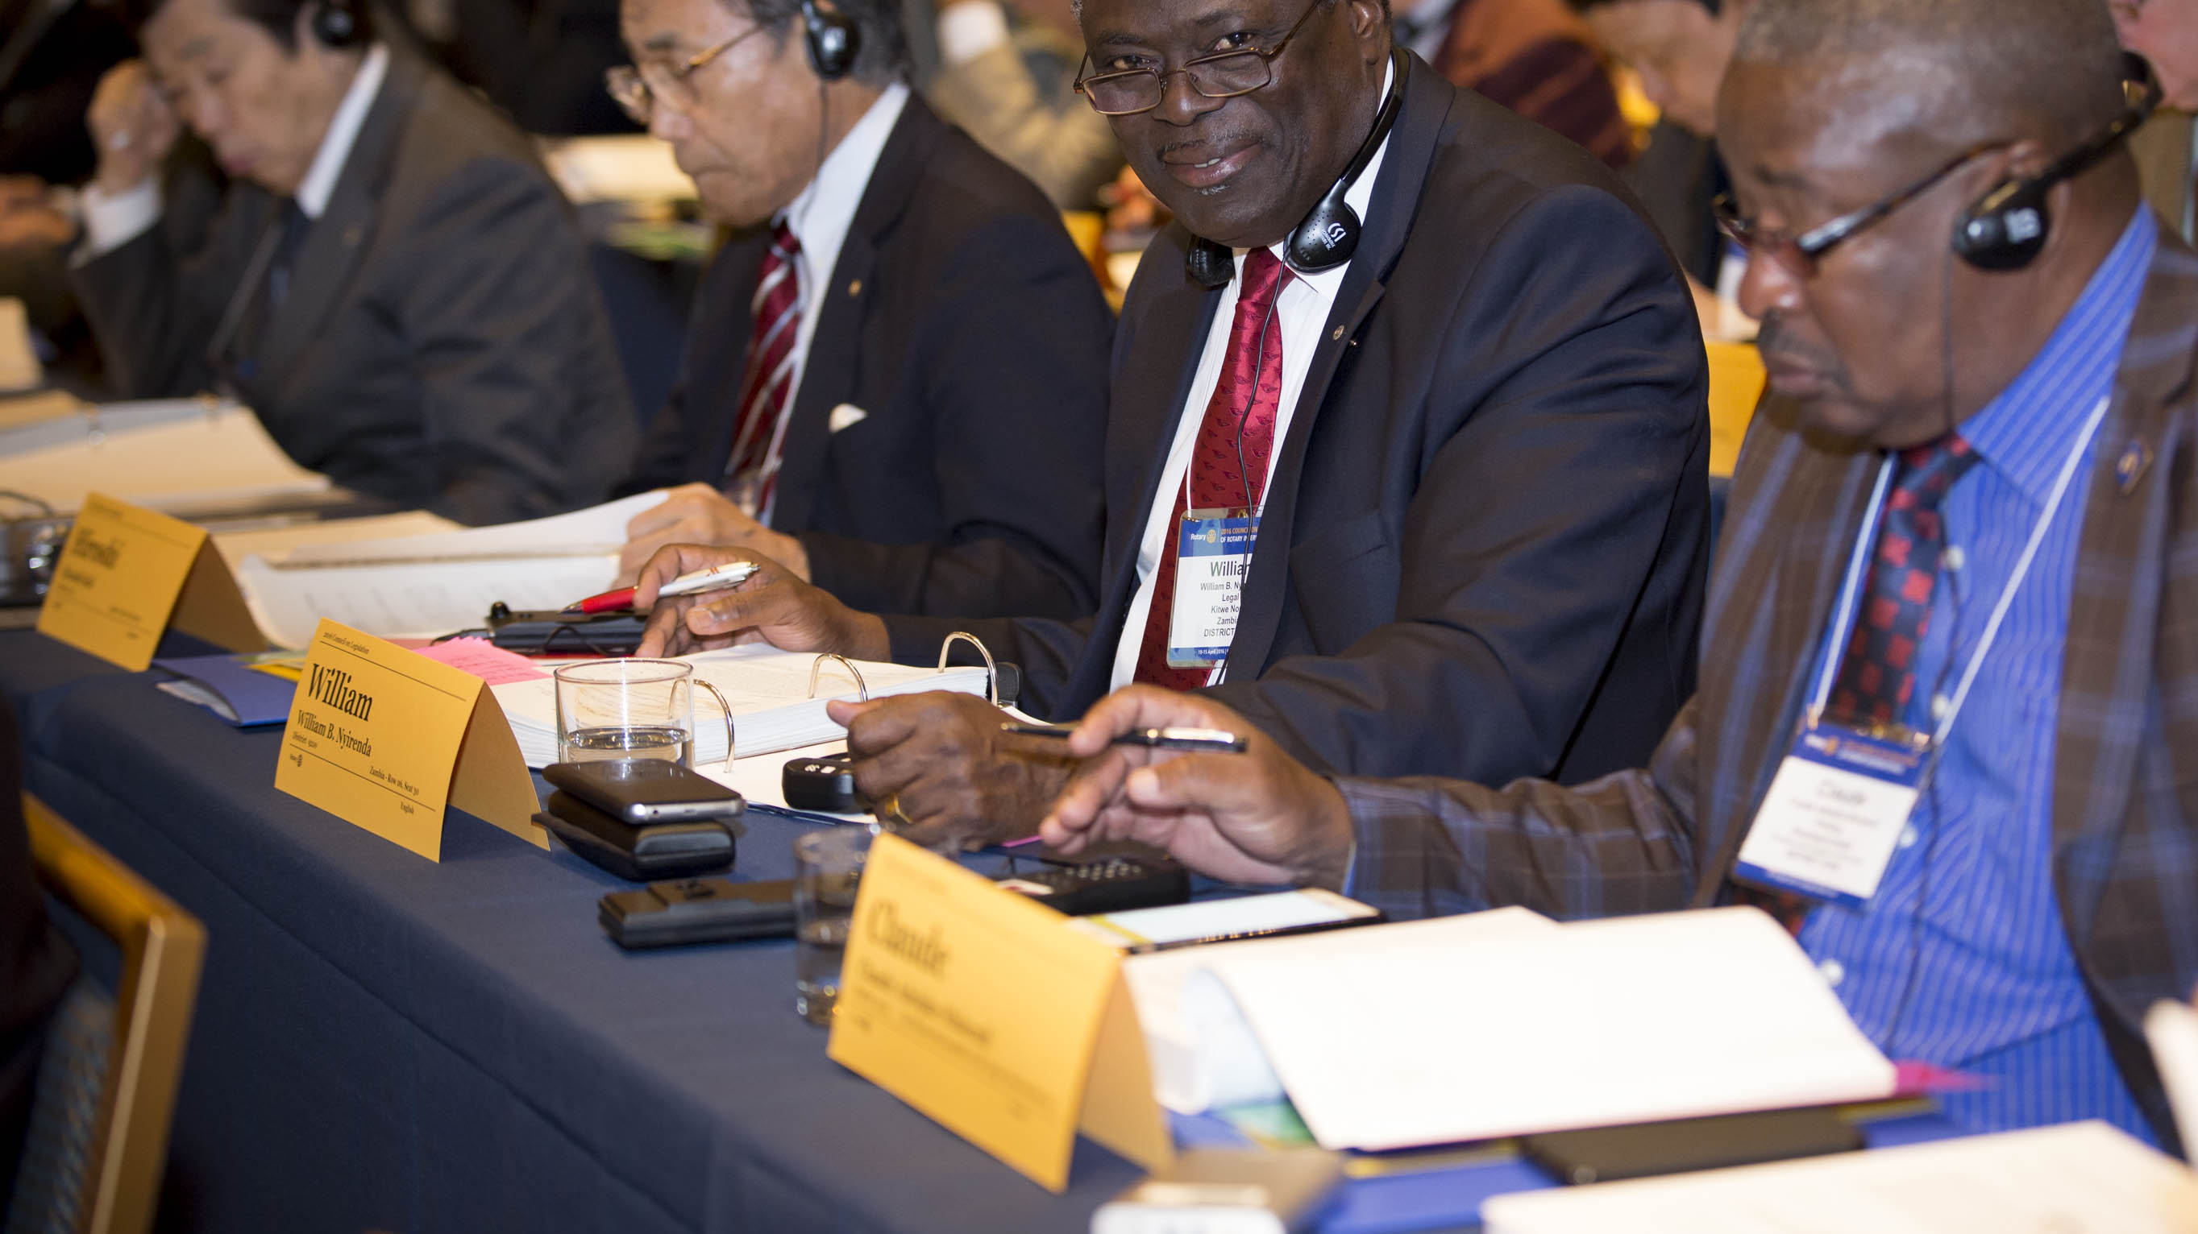
16-36 To allow for flexibility in membership
Gives clubs flexibility in setting certain membership requirements, including
The types and structure of a club’s membership;
How former, transferring or honorary members are managed and accepted by the club
Club chooses to keep the requirements in the RI Bylaws and Club Constitution or modify the requirements to meet the needs of their members
Notes:
This enactment gives clubs the option of adopting rules or requirements that may not be in accordance with the RI Constitution, the RI Bylaws, and the Standard Rotary Club Constitution regarding club composition, so as to allow for more flexibility in attracting and retaining members.
New Club Membership Types – Clubs may offer additional membership types such as Associate, Corporate, Family, etc. Clubs offering these additional types would report these individuals to Rotary International as Active for inclusion on the club invoice. Other financial obligations (club dues, meal costs etc.), attendance requirements and service expectations are determined by the club. Rotary only records Active members in its database and only Active , dues-paying members may be considered for office and counted for election voting credentials. (16-36)
Additional Background Pertaining to 16-38 - Membership Qualifications Streamlined definition of Rotarians: must be “adults who have demonstrated good character, integrity and leadership; have a good reputation in their business, profession and community; and are willing to serve in their community and around the world.” The additional definitions previously detailed in subpoints 1 – 6 have been removed. Clubs may choose to include some or all of these subpoints in their bylaws. (16-38)

Slide 6
16-38 To revise the provisions for membership
Provides flexibility in qualifications for membership and composition of clubs
Maintains focus on a balance among members by encouraging clubs to mirror the composition of their community relative to:
Business
Professions
Community organizations
Notes:
This enactment simplifies the qualifications in the RI Constitution and the Standard Rotary Club Constitution for membership in a Rotary club and returns control of defining membership qualifications to individual clubs through their club constitutions and bylaws.
Streamlines definition of Rotarians: must be “adults who have demonstrated good character, integrity and leadership; have a good reputation in their business, profession and community; and are willing to serve in their community and around the world.” The additional definitions previously detailed in subpoints 1 – 6 have been removed. Clubs may choose to include some or all of these subpoints in their bylaws.

Slide 7
WHAT DO “NEW” MEMBERSHIP TYPES MEAN TO ROTARY

Slide 8
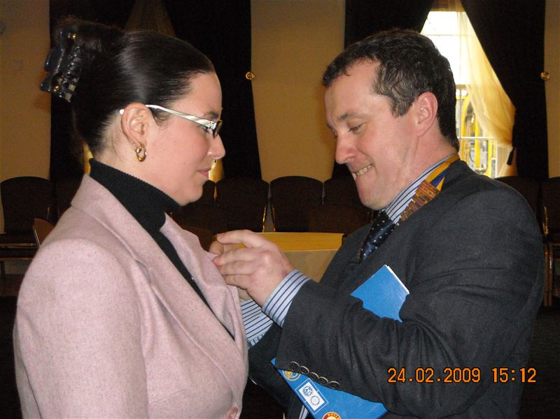
INDIVIDUAL ACTIVE MEMBERSHIP
NO CHANGES TO
CLUB BYLAWS REQUIRED
Traditional membership

Slide 9
CORPORATE MEMBERSHIP
The BUSINESS supports the club

Slide 10
CORPORATE MEMBERSHIP
REQUIRES CHANGE TO CLUB BYLAWS
COSTS FOR THE TEAM BASED ON NUMBER OF REPORTED MEMBERS (based on District Dues, RI Dues, Club Operations)
TEAM JOINS THE ROTARY CLUB and shares attendance, service project participation
VOTING RIGHTS ONLY FOR NAMED MEMBERS OF THE TEAM

Slide 11
FAMILY MEMBERSHIP
REQUIRES CHANGE TO CLUB BYLAWS
COSTS FOR THE FAMILY BASED ON NUMBER OF REPORTED MEMBERS (based on District Dues, RI Dues, Club Operations)
FAMILY JOINS THE ROTARY CLUB and shares attendance, service project participation
VOTING RIGHTS ONLY FOR NAMED MEMBERS OF THE FAMILY

Slide 12
ASSOCIATE MEMBERSHIP
REQUIRES CHANGE TO CLUB BYLAWS
COSTS FOR THE ASSOCIATE MEMBER (based on District Dues, RI Dues, Club Operations)
ASSOCIATE MAY BE FOR A LIMITED TIME; MAY HAVE SERVICE EXPECTATIONS;
VOTING RIGHTS IF MEMBER IS NAMED AS ACTIVE MEMBER TO RI
For those people interested in getting to know the club better

Slide 13
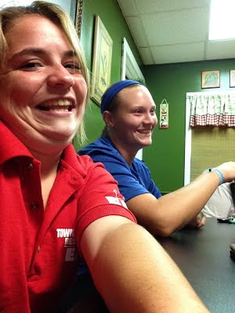
JUNIOR MEMBERSHIP
REQUIRES CHANGE TO CLUB BYLAWS
COSTS FOR THE JUNIOR MEMBER (based on District Dues, RI Dues, Club Operations)
CLUB MAY WAIVE MEAL COSTS; MAY HAVE SERVICE EXPECTATIONS; CLUB MAY PROVIDE “SCHOLARSHIP” FUNDING FOR THIS MEMBERSHIP
VOTING RIGHTS IF MEMBER IS NAMED AS ACTIVE MEMBER TO RI
A more affordable membership

Slide 14
NONPROFIT MEMBERSHIP
REQUIRES CHANGE TO CLUB BYLAWS
COSTS FOR THE ORGANIZATION (based on District Dues, RI Dues, Club Operations for the number of Active Members named)
CLUB MAY WAIVE MEAL COSTS; MAY HAVE SERVICE EXPECTATIONS; “IN KIND” MAY OFFSET DUES
VOTING RIGHTS FOR NUMBER OF MEMBERS NAMED AS ACTIVE MEMBERS TO RI
A symbiotic relationship
Notes:
A mutually beneficial relationship between the 2 organizations – may be structured somewhat like a corporate membership, but with a different financial structure

Slide 15
WHAT DO “NEW” MEMBERSHIP TYPES MEAN TO ROTARY

Slide 16
It isn’t about the numbers – it’s about the lives we change!
Thank you!

