Slide 1
Best Practices for Engaging Members

Slide 2
Why did YOU join Rotary?
How soon did you get “engaged”?
Why are you still in Rotary?

Slide 3
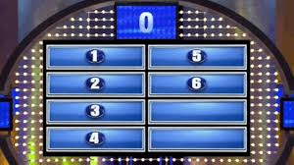
Survey Says:
Join for ___________ Stay for ___________
Answers: Service opportunities, friendships

Slide 4
What does it mean…. To “engage” members

Slide 5
Types of Members
Uber engaged
Adequately engaged
Low engagement (in peril)*
One foot already out the door*

Slide 6
Focus on
*Low
*OFOTD

Slide 7
Important Numbers
2 years
1 friend
Most people, if they are going to leave, do so in the first 2 years.
Most people will stay if they have at least one good friend in the club.

Slide 8
The Warning Signs
This Photo by Unknown Author is licensed under CC BY-SA
This Photo by Unknown Author is licensed under CC BY-SA

Slide 9
-Theodore Roosevelt
Before I care how much you know
I must know how much you care.

Slide 10
Abraham Maslow Heirarchy of Needs
Food, clothing, shelter, safety, love
Belonging
Achievement
Respect of & by others
Creativity, problem solving
Helping others
We win cause we provide ALL these!

Slide 11
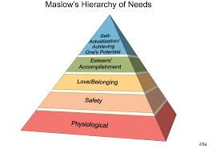

Slide 12
Belonging
In the club
In the committee
In Rotary International

Slide 13
Achievement
Responsibility
Autonomy
Acceptance
Support
If you give responsibility, then don’t micromanage. If you give autonomy, then don’t diss their ideas. Accept their ideas even if you don’t like, agree, or know of a better way, unless you can lead them to discover it. Support their ideas enthusiastically.

Slide 14
Respect
… of others
… by others

Slide 15
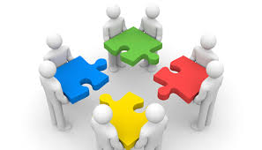
Creativity &
Problem Solving

Slide 16
Helping Others
How do they want to help?
Who do they want to help?
Assume nothing! *
Ignore what they say.
*may say don’t want to do X but finds it rewarding after all b/c of people.

Slide 17
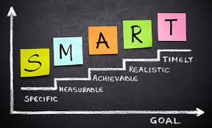
Make a plan for your LOWS & OFOTDs

Slide 18
Examples of SMART Goals for engaging members:
Specific
Measurable
Actionable
Relevant
Timely
I.e. Bill, member for 7 months has missed 50% of meetings so far this year, never been to a service project. Can SMART be useful here?

Slide 19
Dale Carnegie
“How to Win Friends and Influence People”

Slide 20
Relationships need face time
Genuine interest
Positive expectations
Easy yeses to start
Appreciation
Recognition
Most can be done at your meetings!

Slide 21
Opportunities
Parking lot
Foyer
Table
Podium
Departing
Personal invite to service
Friendly invite (birthday lunch)
Small thoughtful acts
Facebook “Likes”
Helpful introductions

Slide 22
The answer to engagement is:
Simple
Easy
Enjoyable
Possibilities for:
Business development
Deep friendship
Learning

Slide 23
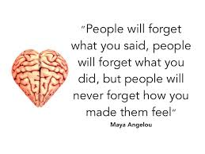

Slide 24
Resources:
Rotary.org website, Membership Resources
District 5890 website, Cookbook Approach link
Your club Area Membership Chair, your AG
Abraham Maslow, “Toward a Psychology of Being”
Dale Carnegie, “How to Win Friends and Influence People”

