Slide 1

Public Image

Slide 2
PUBLIC IMAGE AGENDA
  What is Public Image?
  Branding and your Club
  Social Media and Websites
  Helpful Tools

Slide 3
District 6000 Public Image Team
d6000publicimage@gmail.com

Slide 4
What is Public Image?

Slide 5



Public Image is…EVERYTHING!
Community Involvement
Members
The “VIBE” of your Club
Projects
Fundraisers
Location/Food & Speakers
Online Presence
Voice & Visual Identity
Everyone has a role
in Public Image!

Slide 6
Public Image
Membership
Foundation

Slide 7

$100
Public Image Grant
  Assign a PI Chair that completes the Learning Center Public Image track
  Ensure the club is following RI Brand Guidelines
  Have an active Club digital footprint
  Participate in the PI Training – DATE TBD
  Submit a club story for the District Bulletin
  Submit a grant request to help cover costs related to Public Image

Slide 8

As we head into a break, could we have all of the women come to the front for a quick picture?

Slide 9


Slide 10
What does that video have to do with Rotary?

Slide 11

Branding Your Club &
Inviting Your Community!

Slide 12

Before you can brand…you MUST know your club!
What is the Brand of your Club?
What makes your Club different from other Service Clubs
FIND YOUR CLUB’S …. Areas of Passion - Have they Changed?
Youth services?
Seniors?
Exchange programs?
Clean Water?
Peace & Conflict Resolution?
Polio?
What about doing a Community Survey?
Consider a Club Survey – (ask the hard questions)
NEXT WEEK - Attend with the EYES of a VISITOR

Slide 13
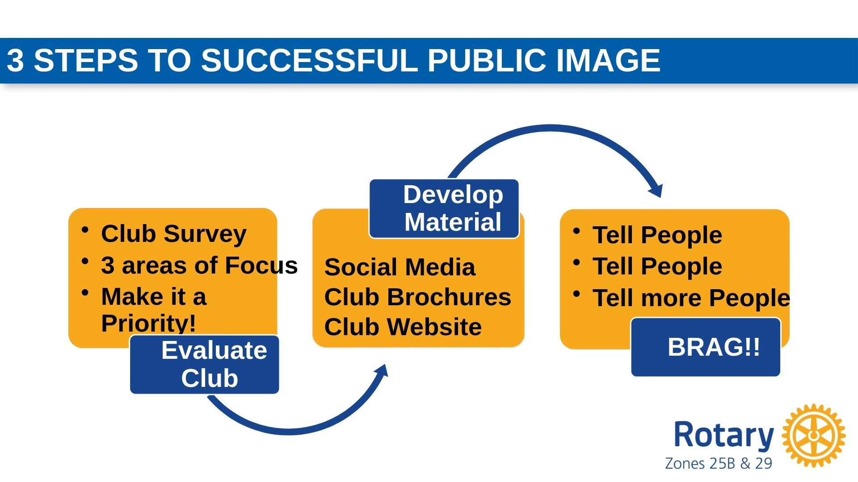
3 Steps to Successful Public Image

Slide 14

BRANDING YOUR CLUB AS…
THE #CENTEROFSERVICE
of your community
ROTARY IS THE #1 SERVICE ORGANIZATION ON THE PLANET! •Your community leaders should want to be a part of your club.
YOUR CLUB SHOULD BE WHERE THE COMMUNITY TURNS TO….
•Both for TRIUMPH & TRAGEDY
OTHER ORGANIZATIONS COME AND GO BUT
•ROTARY IS ROOTED IN THE COMMUNITY!
WHAT ARE THE COMMUNITY’S NEEDS?
•The INNOVATIVE members of your club will lead to
that local assessment.

Slide 15

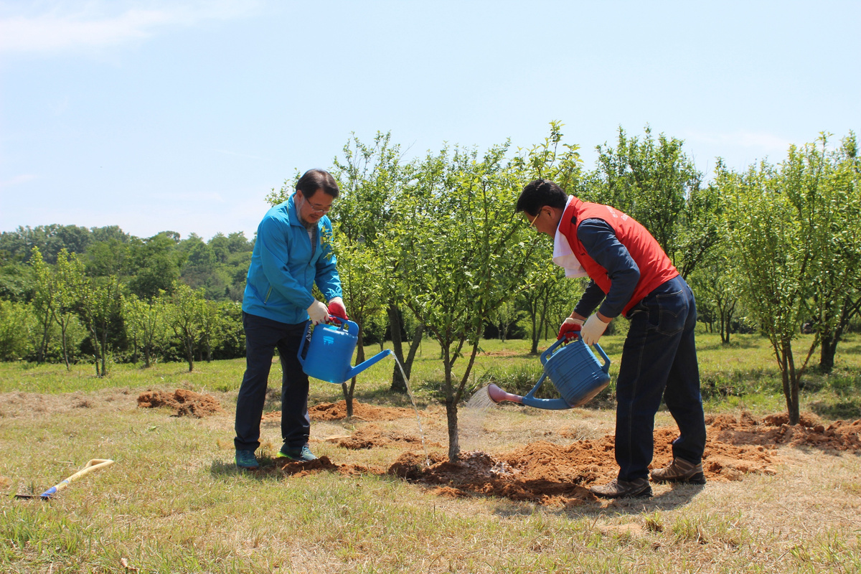
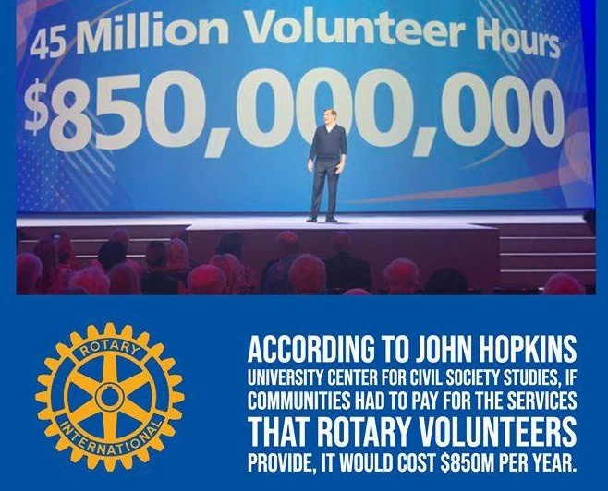










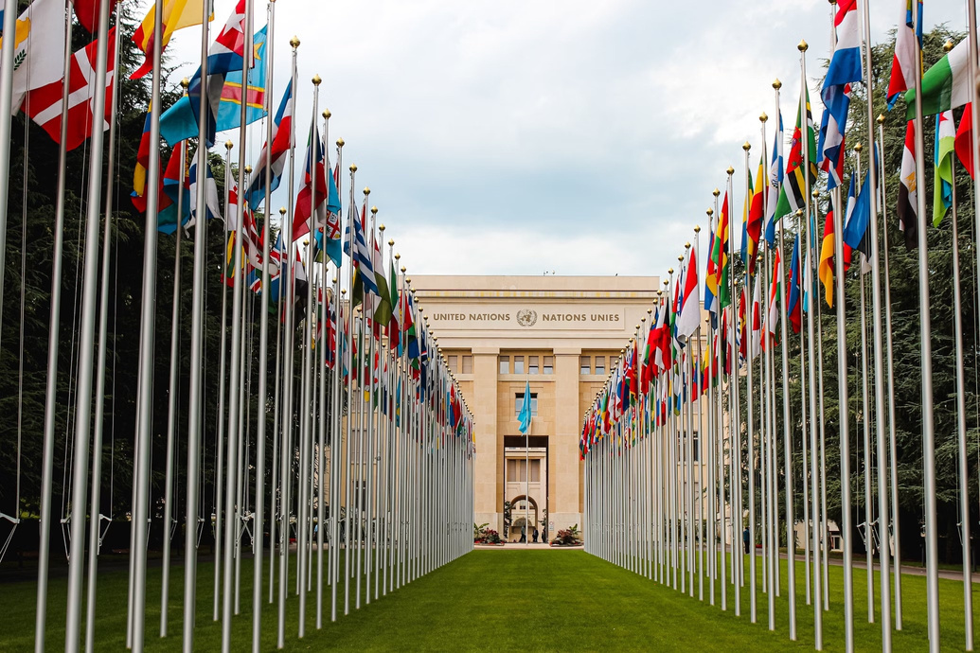











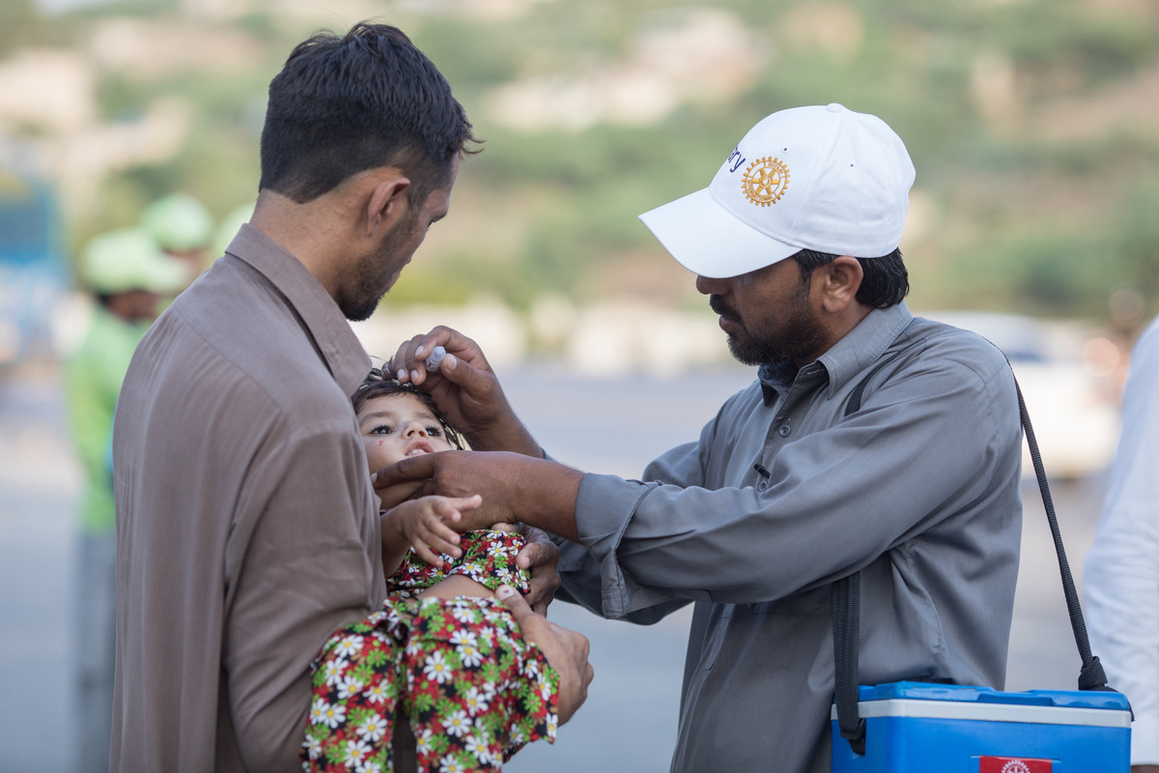











Rotary Talking Points
#1 Service Organization on THE PLANET
Relationships that GET THINGS DONE …from the ground up!
Instrumental in the CHARTER OF THE UNITED NATIONS
Meetings allow innovators to connect, get work done, be accountable, and be guided by the 4 Way Test.
We are "this close" to eradicating
1.4 million members in over 200 counties!
POLIO FROM THE WORLD
(and many have never even heard of Polio)

Slide 16
WELCOME
Allyson Walter
Public Image Chair
- Job Description

Slide 17


Public Image Club Chair Descriptions
ACTION ITEM!
Appoint a Club PI Chair
  Someone other than YOU!
  Included in your Notebook
  Survey to be sent in a few weeks
    PI Chair Name
    Club Website Info
    Club Social Media

Slide 18

Rotary Year Checklist
Website Audit
Social Media
  Update Club Logo & RI Theme
  Fresh content to the Home Page weekly
  Update your Profile and Cover Photo with Proper Club Logo & New Presidental Message
  Check your about us page for accuracy
  Know your Admins and have multiple members assigned
  Ask your members to go Like/Follow.
  Tag (@) Members, Pages, Partners
  Use Hashtags (#PeopleOfAction #ServiceAboveSelf, etc.)
  Help your members understand the importance of interacting with your Club's Content
  Commit to posting weekly/regular content about your Club
Printed & Other
  Brochure Leave Behind / Flyer / Rack Cards Business Cards
  Email Signatures
  Ensure all members have an updated email in MyRotary and ClubRunner
  Visit your Club as a guest!

Slide 19

Let’s Tour Your Resources…
District 6000
Public Image Webpage
  Club Logos
  Facebook Removal
  Logo Do’s and Don’ts

Slide 20

Social Media & Online Presence

Slide 21


Slide 22
What does that video have to do with Rotary?

Slide 23
Social Media & Online Presence •New Year Checklist
•What does your club “look like” online?
•Building your audience
•Content – Content – Content
•Getting more reach!
•How often should I post?
•The “art” of posting.
•Boosting a post
•More interaction!

Slide 24
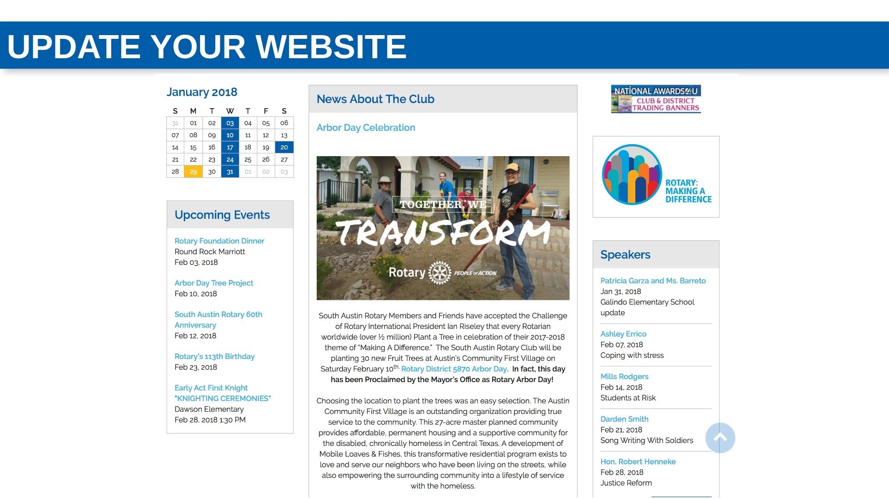

Slide 25
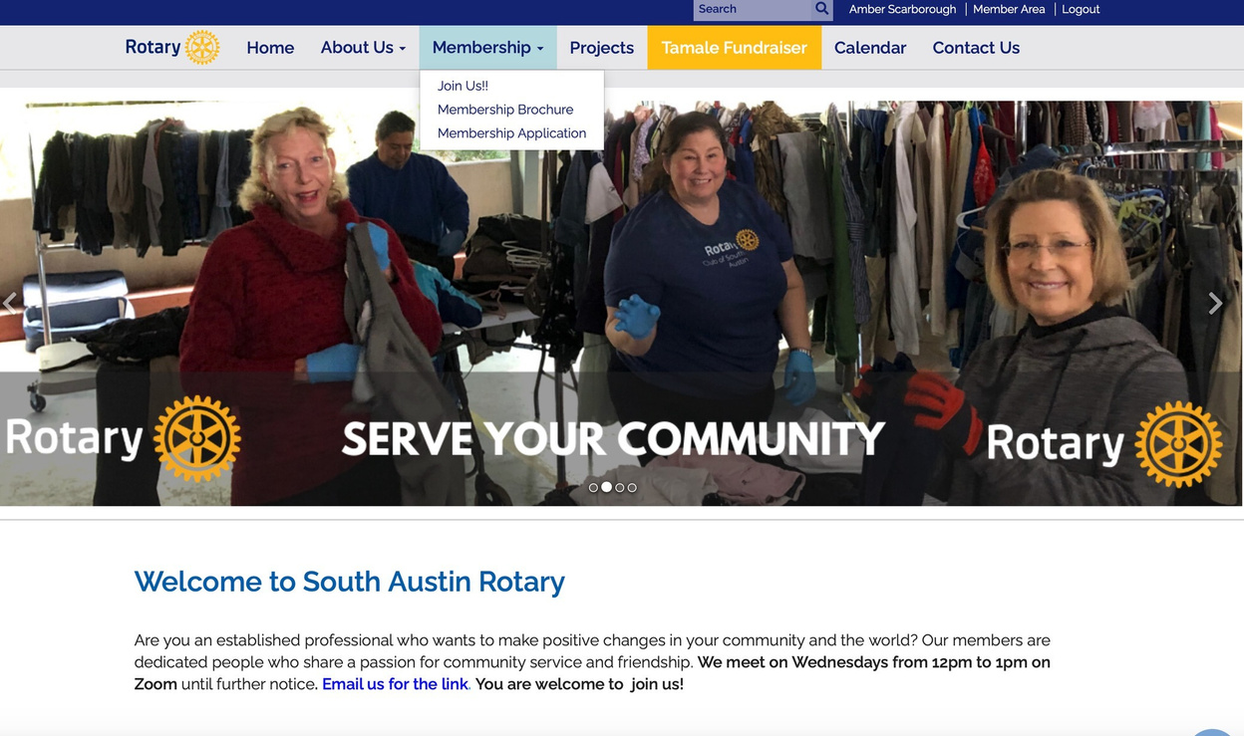

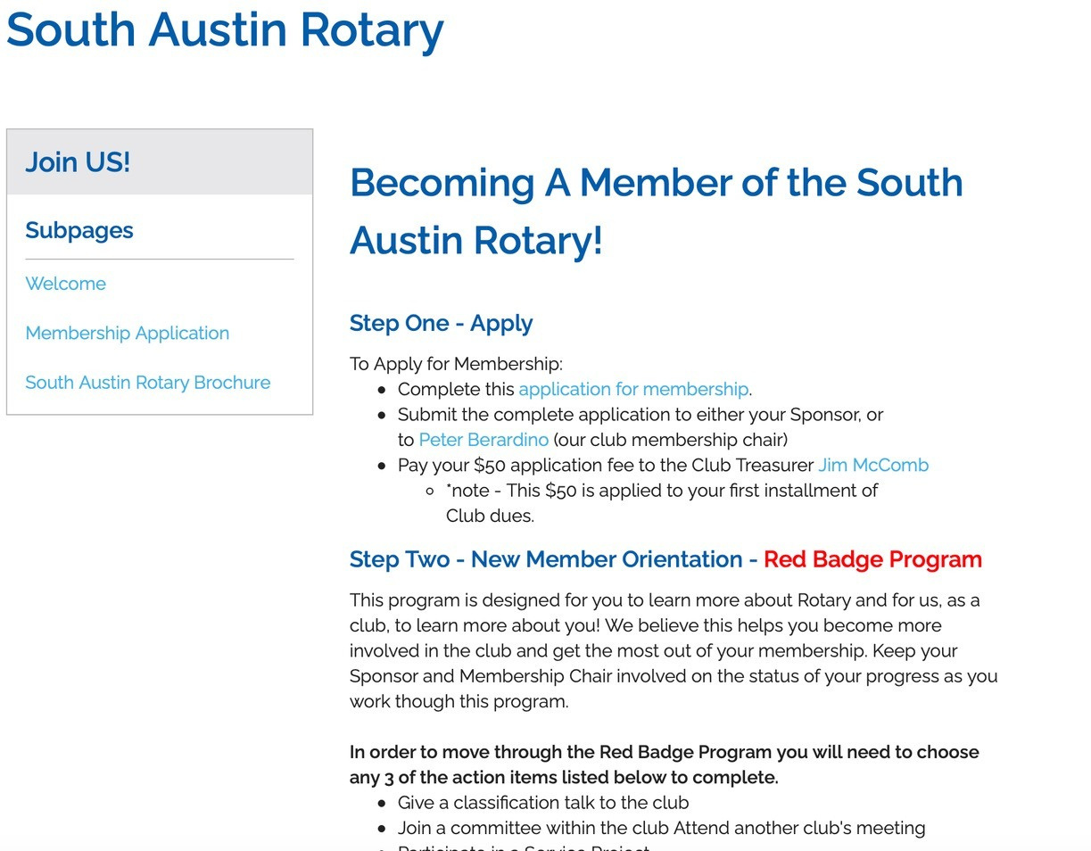
Create a JOIN US page on your Club Website!
Consider adding to your JOIN US page
Application LINK New Member Process (Red
Badge)
Installation Process
Obligations of Membership
Dues & Financial Obligations
Attendance
Transfers

Slide 26
The Art of Posting

Slide 27
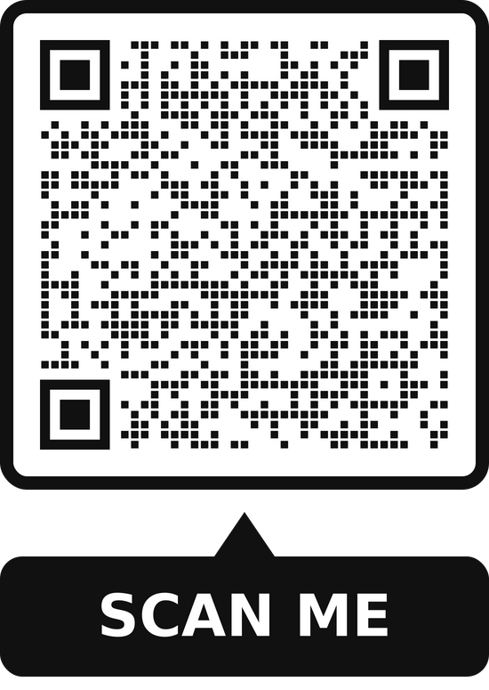
IF YOU ARE ON FACEBOOK...
  Take out your Phone
  Go to FACEBOOK
  Search for Rotary District 6000 Iowa
  FOLLOW and LIKE our page

Slide 28
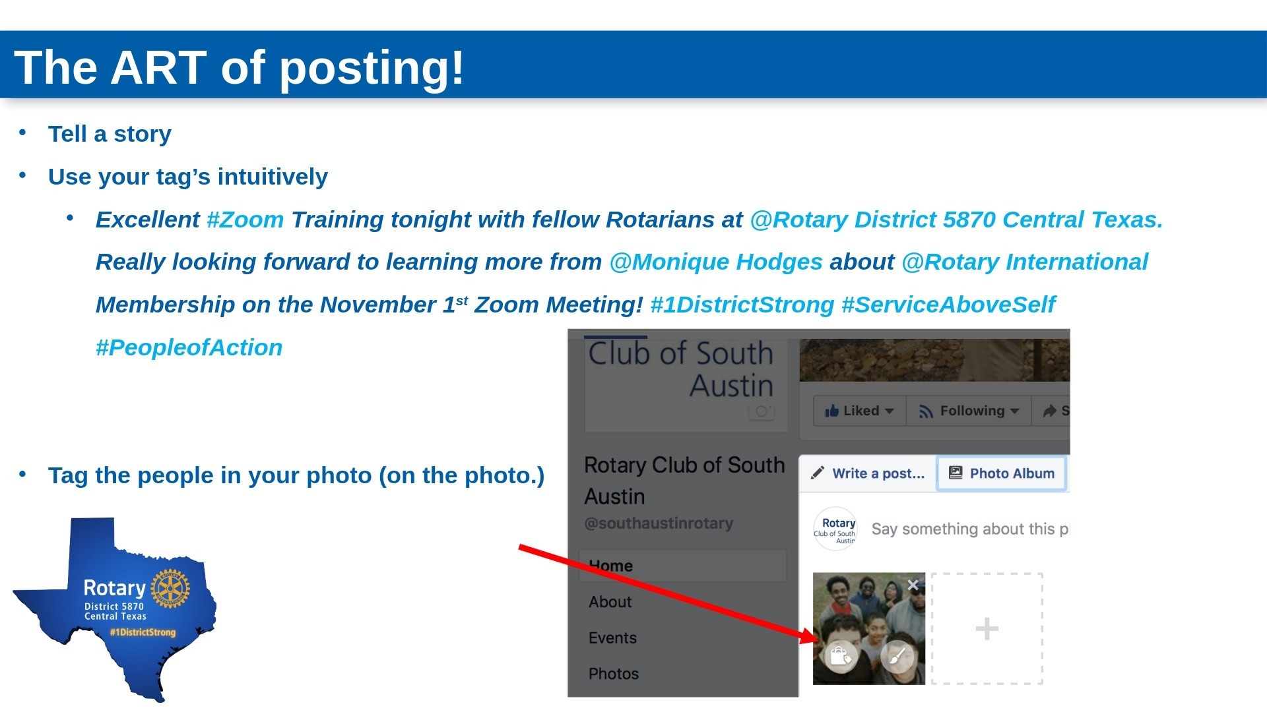
#FindYourWhy
#RotaryDistrict6000

Slide 29
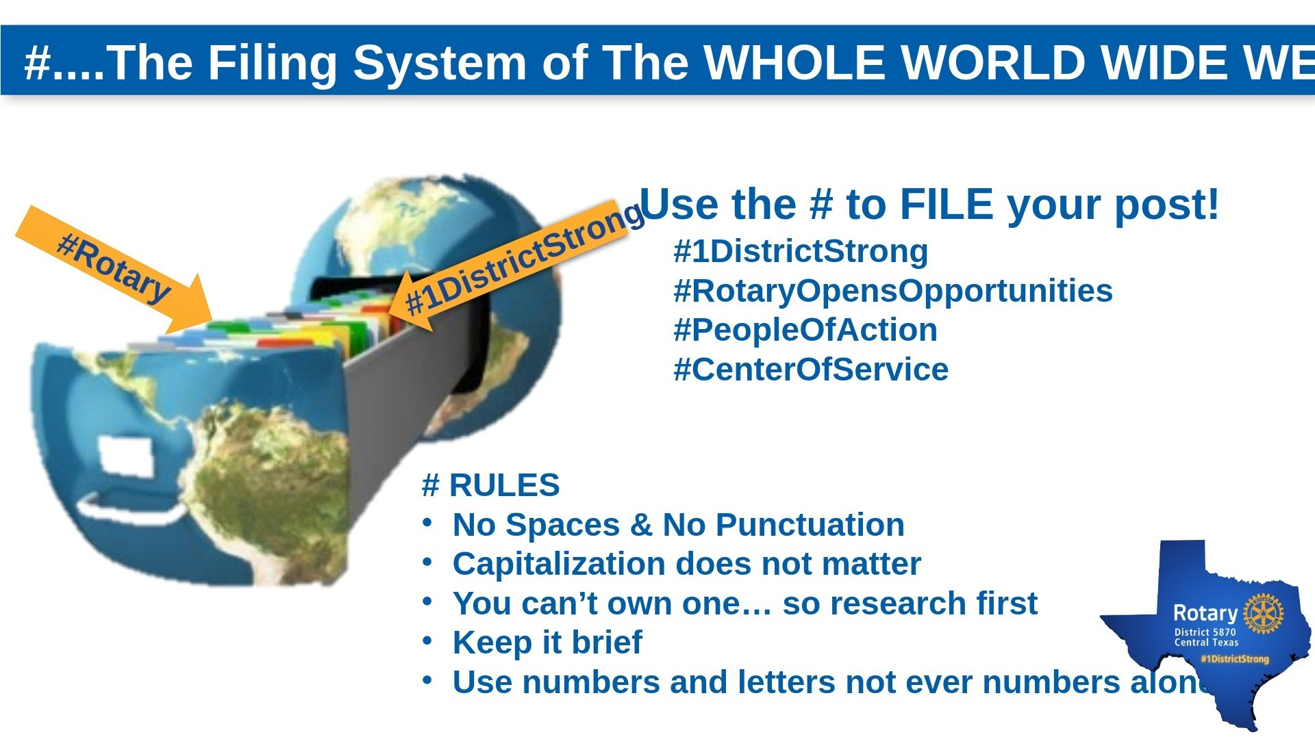

Slide 30
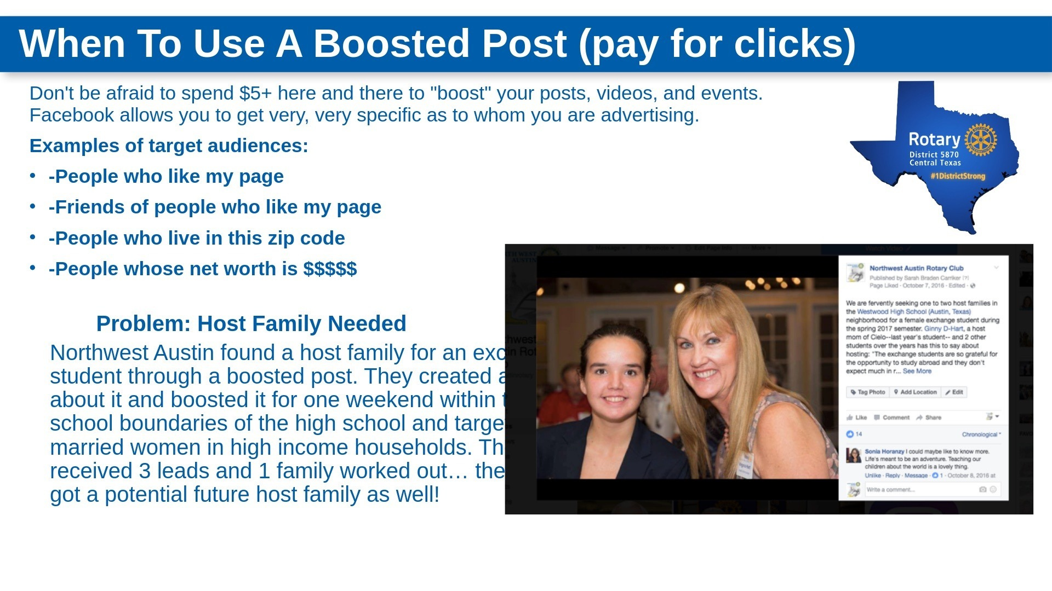

Slide 31
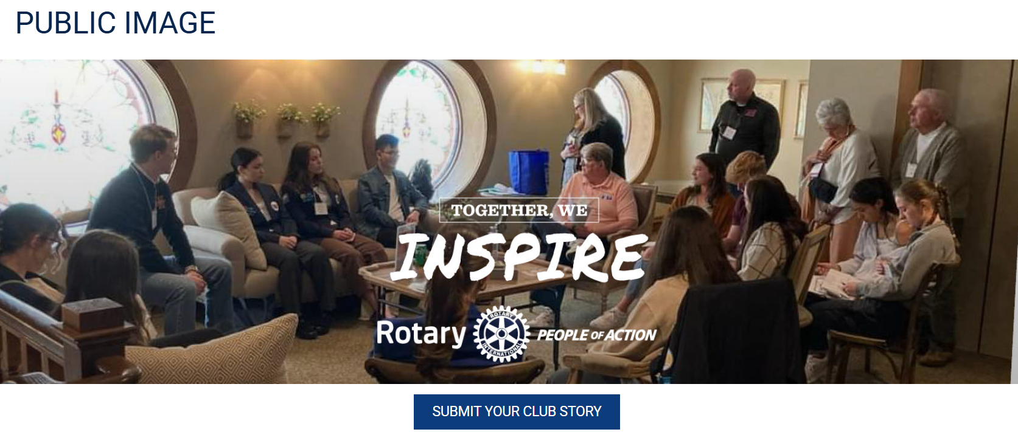
People of Action

Slide 32


Slide 33
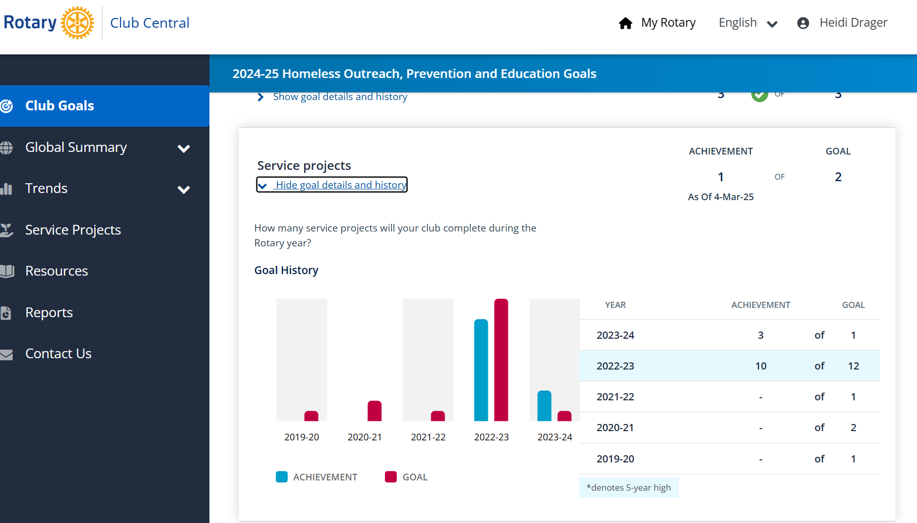
Service
Project
Center

