Slide 1

District 6000 Community Service Grant Management Learning Seminar
February 22, 2025– West Liberty
March 29, 2025 – West Des Moines
Title Page Option

Slide 2
Where Do Funds Come From?
How to submit grant and steps from start to finish
Local Rules
Scoring Info
MOU Details
TELL YOUR STORY!!!!
D6000 Website Info
OVERALL Lifecycle of CSG
How community service grants work
Mistakes to avoid = ASK Questions
D6000 Community Service Grant
What do you need to know?

Slide 3
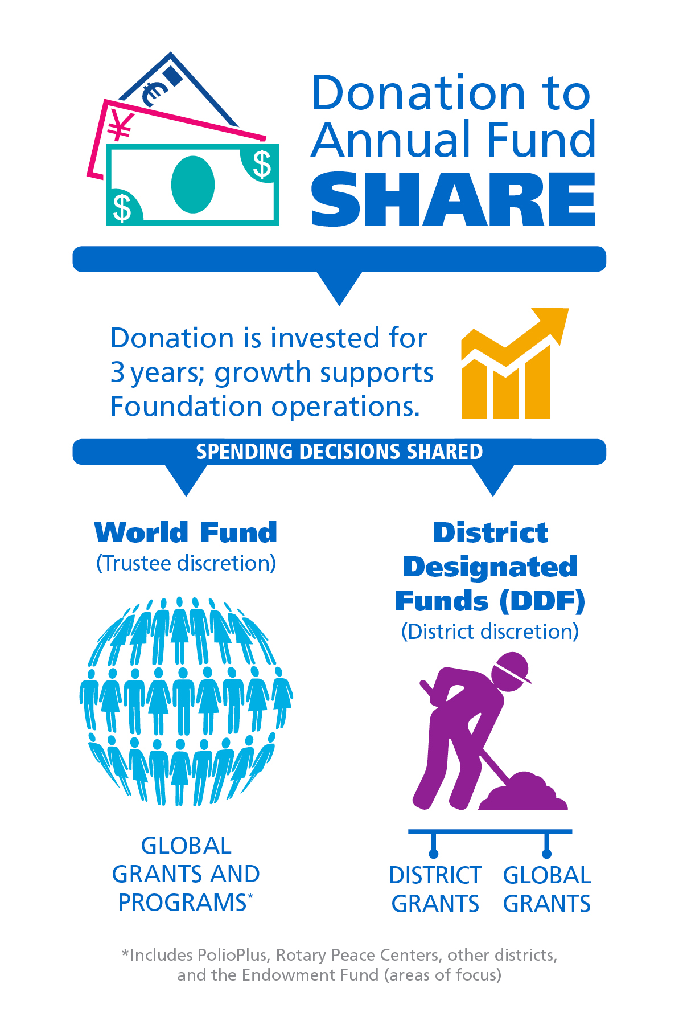
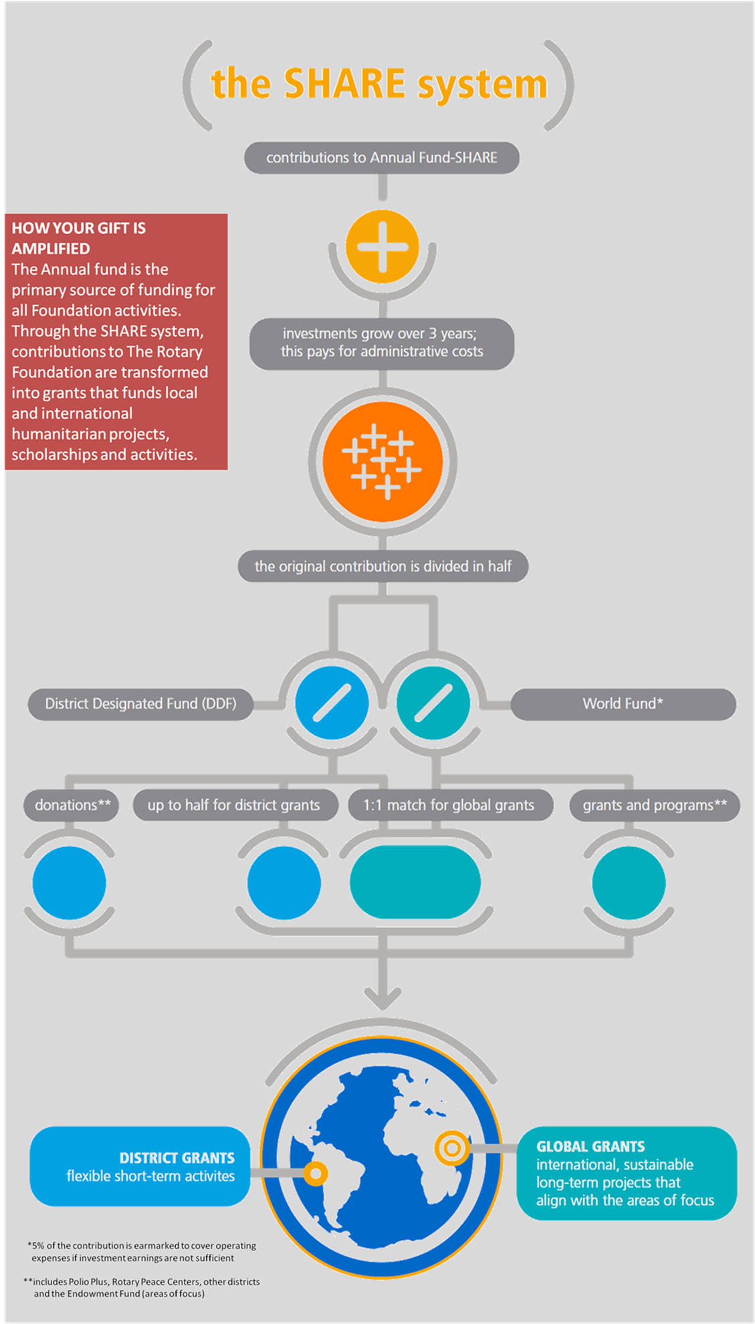

Slide 4
INFORMATION on CSG for D6000
Each club will need to go to the D6000 website (www.Rotary6000.org ) to:
Community Service Grant Page (left-hand side column bar)
District-Grant Rules-Scoring-MOU-2025-2026
Steps to get to Grant Portal
Videos (coming!)
Presentations from GMLS seminars (to be posted from trainings)
Contact Gretchen and Todd via email D6000CSG@gmail.com for question or concerns

Slide 5
INFORMATION on CSG for D6000
Reminders: (ALL DONE THRU GRANT PORTAL)
Application for a Community Service Grant for 2025-2026 – reminder due June 1, 2025
MID-YEAR Check-in Report – due Dec 31, 2025
Final Report Community Service Grant for 2025-2026 along with ALL Required Documents – reminder due June 1, 2026
Contact Gretchen and Todd via email D6000CSG@gmail.com for question or concerns

Slide 6
1. Clubs submit applications via Grant Portal on D6000 website to D6000 CSG co- Chairs by June 1, 2025.
2. Grant applications reviewed by D6000 CSG Co-Chairs and review committee June 14, 2025
4. Clubs cannot start projects/grants UNTIL D6000 CCSG Co Chairs notify on funds being received and sent due to waiting on TRF/RI to remits funds to D6000 for distribution. Date TBD (6-10 weeks)
5. Funds distributed to clubs for approved grant projects. – NOTE ONLY IF THE PREVIOUS YEARS GRANT IS FINALIZED
6. Clubs manages grant details thru the life of the project via Grant Portal on D6000 Website
8. Clubs submits final report and ALL REQUIRED documentation thru Grant Portal on D6000 website to D6000 CSG Co Chairs due June 1, 2026*
7. MID YEAR Check in report due December 31, 2025 via email
D6000 CSG Co-Chairs communicate to clubs if grant has been approved by the committee. BUT NOT APPROVED BY TRF/RI yet.
3. D6000 CSG Co-Chairs and review committee approves and submits funding request to TRF/RI by July 1, 2025
CSG Process
Steps…..

Slide 7
D6000 Local Rules
For any club in D6000 to receive District Designated Funds (DDF) for District Grants, the club must be qualified.
Before applying for a Community Service Grant, a club must be qualified by completing the following steps set up by D6000 CSG Co-Chairs:
Attend a GMLS (Grant Management Learning Seminar) offered by the D6000 CSG Committee.
Signed MOU by all required parties of club, uploaded to Grant portal site and communicate to D6000 CSG Co-Chairs BY JUNE 1, 2025.
Club must submit the following 3 annuals goals: Membership, The Rotary Foundation Annual Fund Giving, and PolioPlus Giving BY JUNE 1, 2025.
Projects must take place within the geographical boundaries of District 6000.
Be current on its Rotary International and District 6000 dues, and be in good standing with the District 6000, Rotary International, and The Rotary Foundation.
A club may fund up to 25% of the project budget with sweat equity.
A club may apply for a maximum of $7,500.
A club must match grant funds 1:1 with club funds (or equivalent)

Slide 8
D6000 Community Grant Program Score Breakdown
Benefit to Others (1-30 points total)
Community Benefit (1 - 20 points)
Sustainable Positive Impact on the Local community.
Describe the POSITIVE IMPACT to the Local community.
Community Underserved / Disadvantaged (1 – 10 points)
Defined as providing a need or service to those who otherwise would not have the opportunity to attain or enjoy the benefit provided by the club project.
How will the project impact those individuals in the community? How will the community impact be measured? Is the project tangible and is it sustainable?
Rotary’s Public Image (1-20 points)
Temporary / Permanent
Two categories provide the club with credit for projects which may not be able to utilize permanent signage while emphasizing the positive long-term impact for those projects where it is an alternative.
ENSURE your project has prominent and visible signage, indicating Rotary’s support of the project. Rotary logos should be of the correct colors and the correct Rotary wheel should be used (www.brandcenter.rotary.org.)

Slide 9
D6000 Community Grant Program Score Breakdown
Club Engagement (1 – 20 points)
Monetary Contribution / Member Engagement (includes sweat equity)
Two categories provide the club with credit for projects whereby there is not a potential for member involvement while also providing credit for a club that contributes through member participation for community awareness.
Encourage Club Members to get involved in the project through sweat equity. By getting Club Members involved, it can generate excitement and buy in among Club Members.
Club Support to TRF Annual Fund (1 – 30 points)
Rotary suggests that Every Rotarian Every Year (EREY) contribute $100 annually to The Rotary Foundation to support local and international projects to benefit third parties.
Encourage Club Members to donate regularly to the Rotary Foundation. These funds come back to District 6000 through DDF, District designated funds. (i.e.) Think of contributions to your personal checking account. You have to make deposits in order to make withdrawals.
It becomes a point of emphasis that without “some” contributions to the foundation, club’s grants will not be fully funded or there will not be grant funds available to award individual clubs. Clubs with higher rates of contributions to TRF score better in this category that Clubs that do not support TRF.

Slide 10
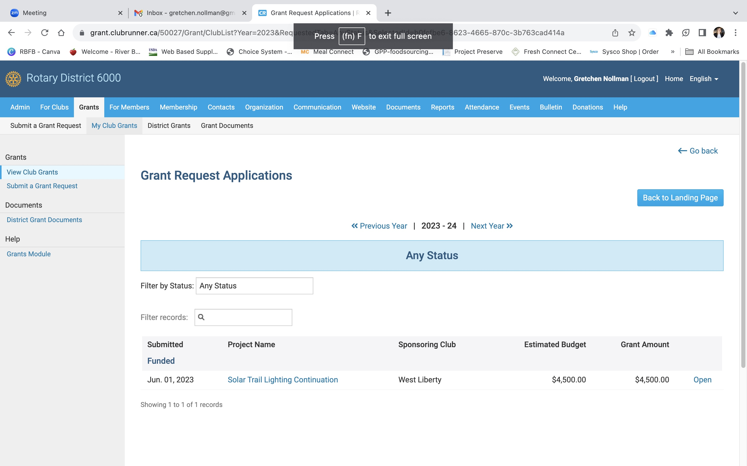

Slide 11
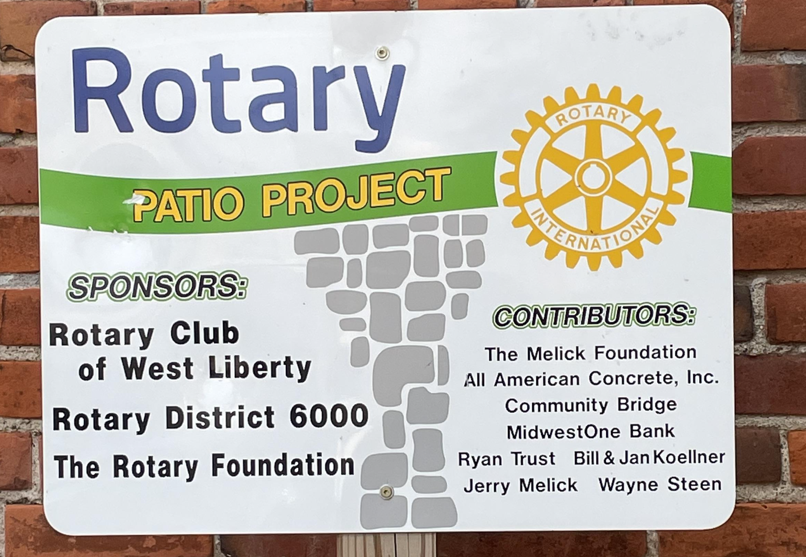
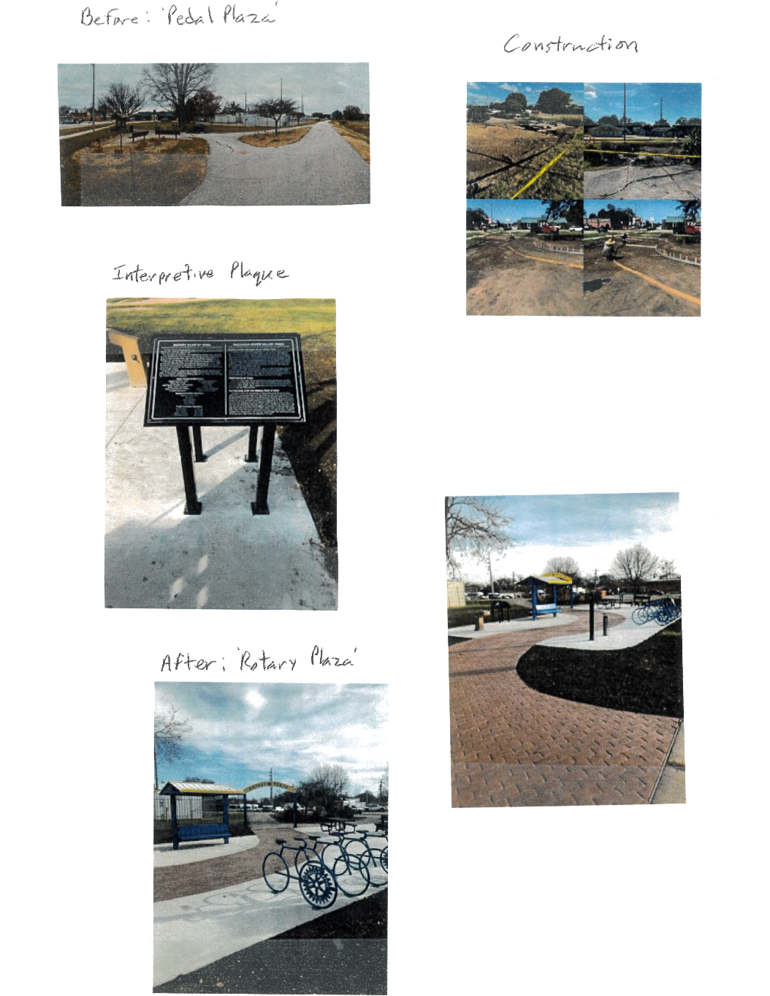
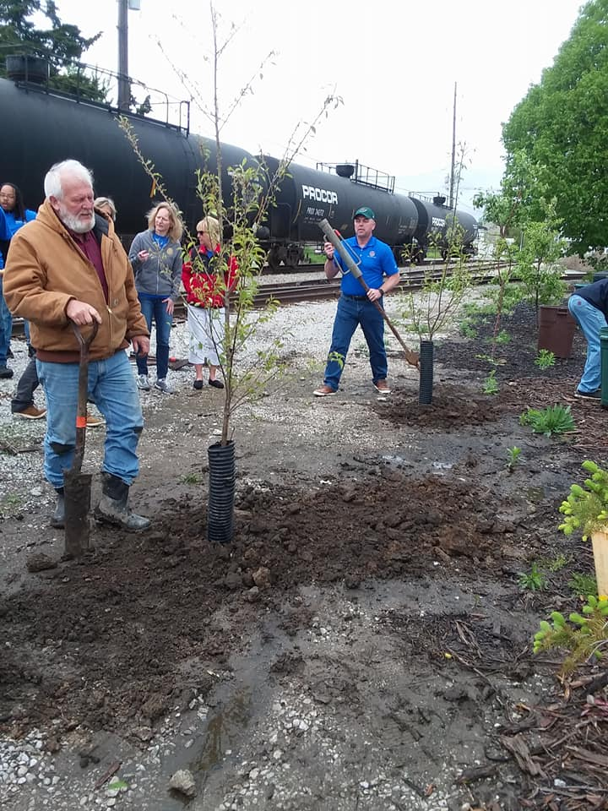
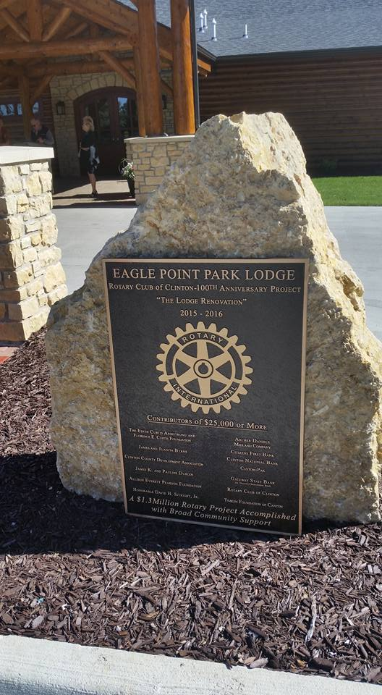
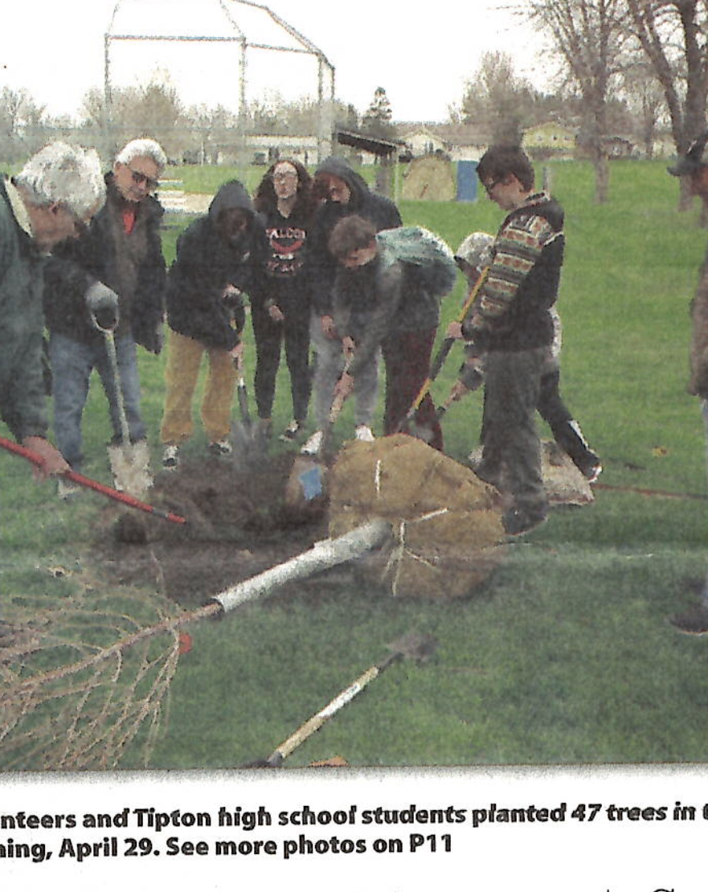
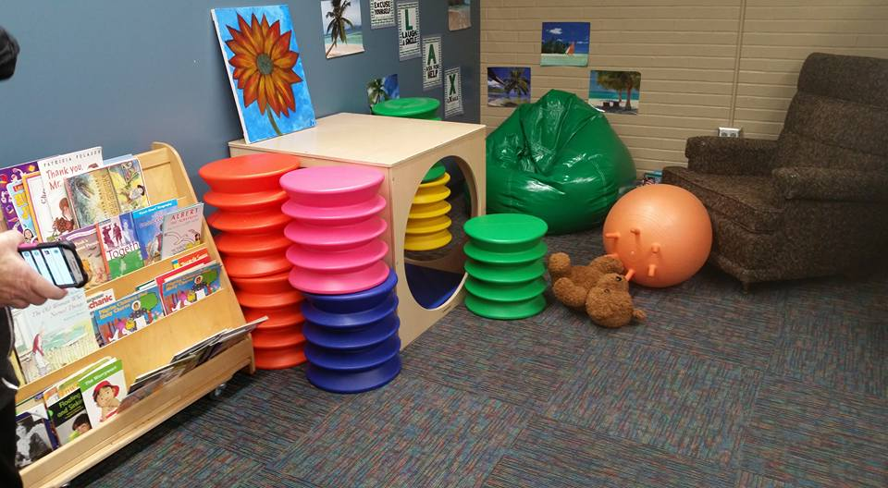
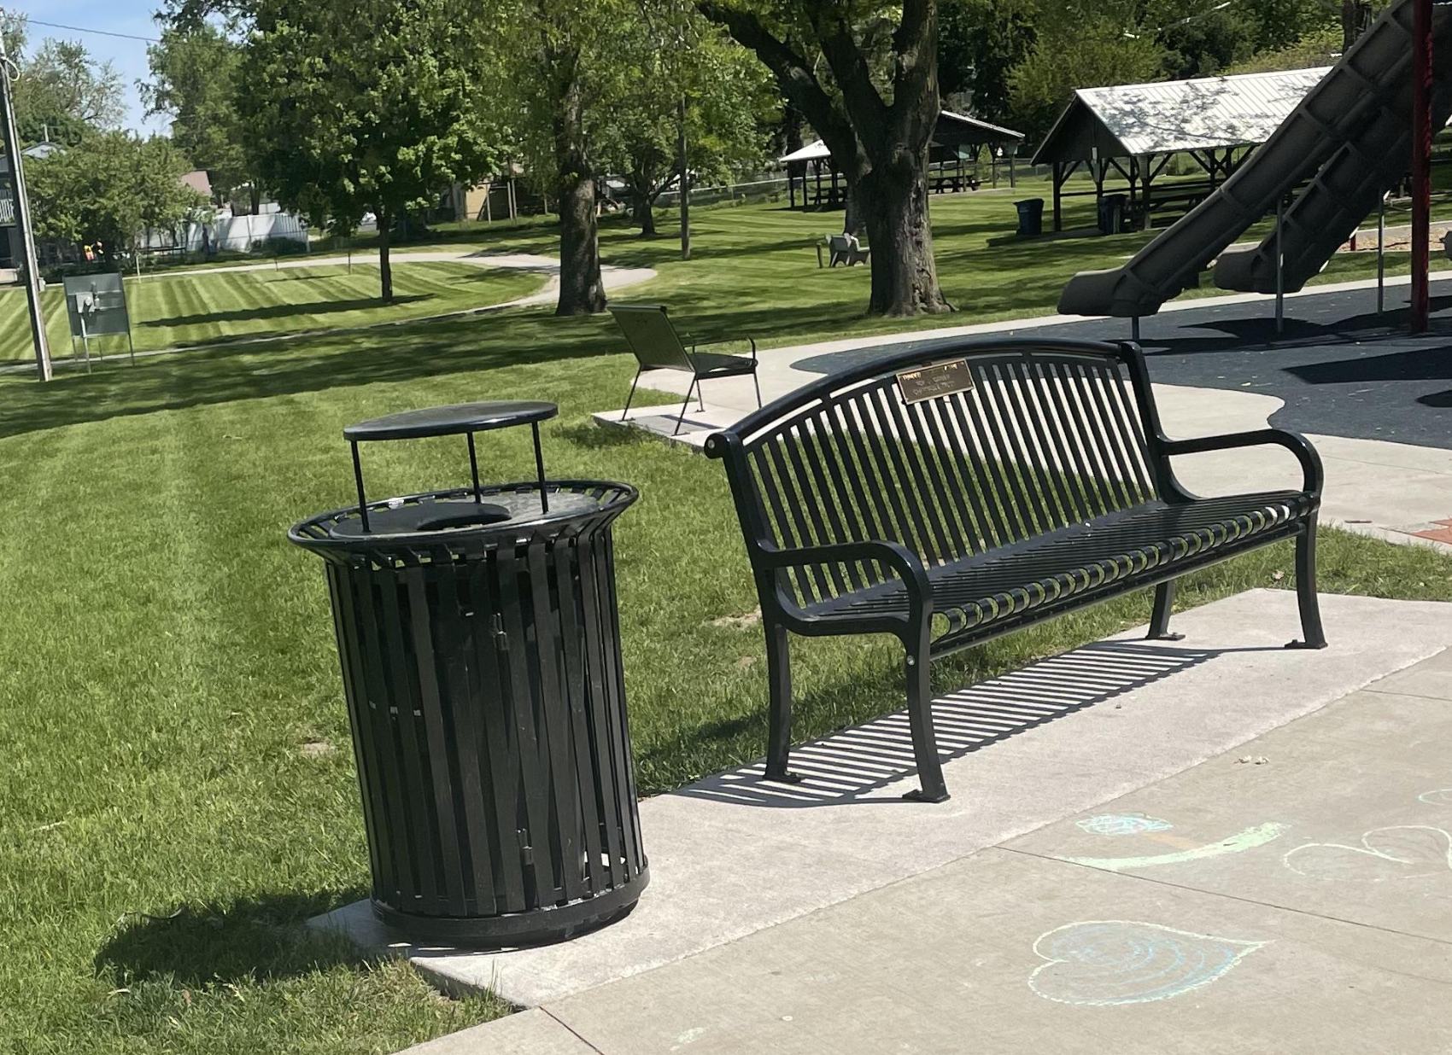
Do the project, be amazing…remember your PUBLIC IMAGE… tell the STORY!!!!!!

Slide 12
REMINDERS on Applying for a CS Grant
Applications MUST be submitted BY June 1, 2025 @ MIDNIGHT
Absolutely NO exceptions to this
Ask questions well in advance!
What we have on June 1 is what will be submitted to the committee.
Receive confirmation of receipt within 24 hours from CSG Co-Chairs D6000CSG@gmail.com OR please contact us to ensure application was received!
AGAIN - Ask if you have any questions, we’re happy to help!

Slide 13
REMINDERS –
Reporting electronically Only
Use the Grant Rules and Grant Score Sheet
ASK QUESTIONS
If you have any questions or concerns throughout the year, please contact us for help!
D6000CSG@gmail.com
Gretchen Nollman Todd Wheeler
Chair D-6000 Co-Chair D-6000 Co-Chair
319-541-1462 (cell) (515) 344-1476 (cell)

