Slide 1

DISTRICT 6000 COMMUNITY SERVICE GRANT MANAGEMENT LEARNING SEMINAR
March 28,2026 – West Des Moines
Title Page Option

Slide 2
Mistakes to avoid = ASK Questions
Where Do Funds Come From?
D6000 COMMUNITY SERVICE GRANT
D6000 Website Info
TELL YOUR STORY!!!!
What do you need to know?
How community service grants work
Local Rules
Scoring Info
MOU Details
How to submit grant and steps from start to finish
OVERALL Lifecycle of CSG

Slide 3
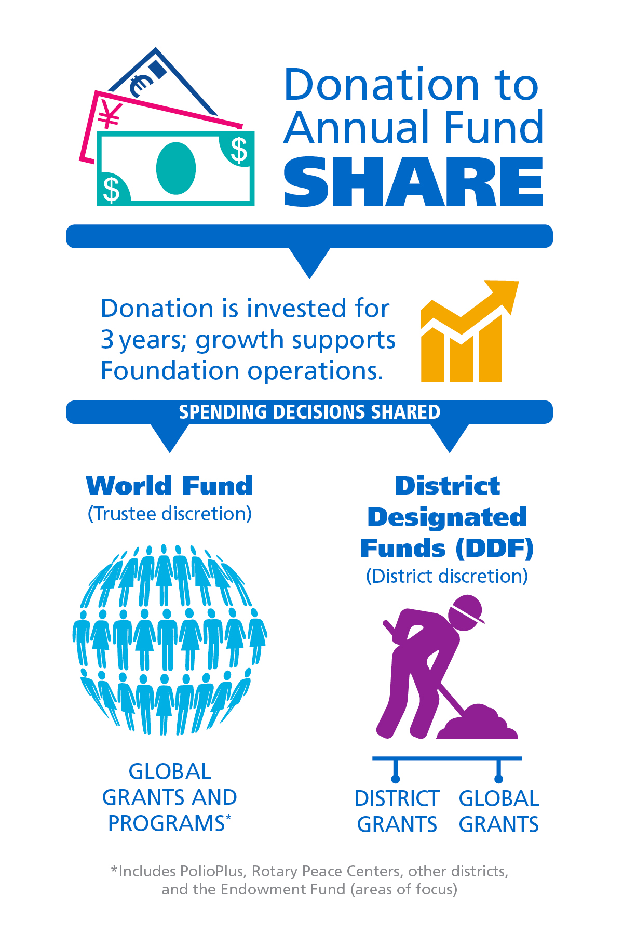
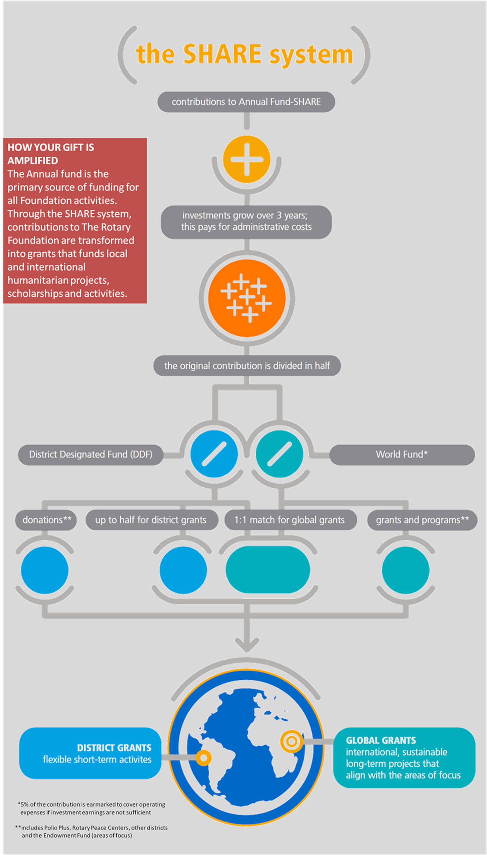

Slide 4
INFORMATION ON CSG FOR D6000
Each club will need to go to the D6000 website (www.Rotary6000.org ) to:
Community Service Grant Page (left-hand side column bar)
District-Grant Rules-Scoring-MOU-2026-2027
Steps to get to Grant Portal
Videos (coming!)
Presentations from GMLS seminars (to be posted from trainings)
Contact via email D6000CSG@gmail.com for question or concerns

Slide 5
D6000 LOCAL RULES
For any club in D6000 to receive District Designated Funds (DDF) for District Grants, the club must be qualified.
Before applying for a Community Service Grant, a club must be qualified by completing the following steps set up by D6000 CSG Co-Chairs:
Attend a GMLS (Grant Management Learning Seminar) offered by the D6000 CSG Committee.
Signed MOU by all required parties of club, uploaded to Grant portal site and communicate to D6000 CSG Co-Chairs BY JUNE 1, 2026.
Club must submit the following 3 annuals goals: Membership, The Rotary Foundation Annual Fund Giving, and PolioPlus Giving BY JUNE 1, 2026.
Projects must take place within the geographical boundaries of District 6000.
Be current on its Rotary International and District 6000 dues, and be in good standing with the District 6000, Rotary International, and The Rotary Foundation.
A club may fund up to 25% of the project budget with sweat equity.
A club may apply for a maximum of $7,500.
A club must match grant funds 1:1 with club funds (or equivalent)

Slide 6
Rotary International - TERMS AND CONDITIONS FOR ROTARY FOUNDATION DISTRICT GRANTS
2. INELIGIBLE ACTIVITIES AND SPENDING
District grant-funded activities may not:
A. Discriminate against any group
B. Promote a particular political or religious viewpoint
C. Perform purely religious functions
D. Provide continuous or excessive support to any one person, entity, or community
E. Establish a foundation, permanent trust, or long-term interest-bearing account
F. Create financial liability for The Rotary Foundation or Rotary International that is greater than the grant
funding
G. Include fundraising activities
H. Transport vaccines over national borders without prior approval of government and regulatory authorities
in the originating and receiving countries
I. Require anyone to work without pay. (Projects should strive to uphold labor rights and fair wage practices;
if the people who will benefit are required to volunteer on the project, their explicit consent is required.)
J. Require work by anyone below the country’s legal working age or, if the law doesn’t specify, anyone under
age 16

Slide 7
Rotary International - TERMS AND CONDITIONS FOR ROTARY FOUNDATION DISTRICT GRANTS
2. INELIGIBLE ACTIVITIES AND SPENDING - CONT.
District grant funds also may not be used to pay for:
K. Expenses that are incurred, or activities that are in progress or already completed, before the grant is
approved
L. Contributions to The Rotary Foundation, PolioPlus, or another Foundation grant
M. Purchases of land or buildings
N. Weapons or ammunition
O. Military assistance
P. Expenses related to Rotary events such as district conferences, conventions, institutes, anniversary
celebrations, entertainment events, or project ceremonies
Q. Public relations initiatives, unless they are essential to completing the project
R. Project signage that costs more than US$1,000
S. The operating, administrative, or indirect program expenses of another organization
T. Unrestricted cash donations to a person or cooperating organization
U. COVID-19 vaccines
V. Immunizations that administer only the polio vaccine

Slide 8
Rotary International - TERMS AND CONDITIONS FOR ROTARY FOUNDATION DISTRICT GRANTS
2. INELIGIBLE ACTIVITIES AND SPENDING - CONT.
District grant funds also may not be used to pay for:
W. Travel to National Immunization Days
X. Abortions or procedures that are undertaken solely for sex determination
Y. Study at a university that hosts a Rotary Peace Center in the same or a similar academic program as Rotary
Peace Fellows
Z. International travel for anyone under age 18, unless they are accompanied by a parent or guardian or are
participating in the Rotary Youth Exchange program
AA. Loan guarantee systems
BB. Items that would then be owned by a Rotary district, a Rotary or Rotaract club, or a member. If items
bought with grant funds are no longer needed or functional, the organization designated in the grant
application as the benefiting entity is responsible for disposing of or selling them and will receive any
proceeds. No Rotary district, Rotary or Rotaract club, or their members can receive any income from the
disposal or sale of the items.
CC. The detection and removal of land mines or the purchase of equipment to remove land mines

Slide 9
D6000 COMMUNITY GRANT PROGRAM SCORE BREAKDOWN
Community Benefit (1 - 20 points)
Sustainable Positive Impact on the Local community.
Describe the POSITIVE IMPACT to the Local community.
Community Underserved / Disadvantaged (1 – 10 points)
Defined as providing a need or service to those who otherwise would not have the opportunity to attain or enjoy the benefit provided by the club project.
How will the project impact those individuals in the community? How will the community impact be measured? Is the project tangible and is it sustainable?
Benefit to Others (1-30 points total)
Temporary / Permanent
Two categories provide the club with credit for projects which may not be able to utilize permanent signage while emphasizing the positive long-term impact for those projects where it is an alternative.
ENSURE your project has prominent and visible signage, indicating Rotary’s support of the project. Rotary logos should be of the correct colors and the correct Rotary wheel should be used (www.brandcenter.rotary.org.)
Rotary’s Public Image (1-20 points)

Slide 10
D6000 COMMUNITY GRANT PROGRAM SCORE BREAKDOWN
Monetary Contribution / Member Engagement (includes sweat equity)
Two categories provide the club with credit for projects whereby there is not a potential for member involvement while also providing credit for a club that contributes through member participation for community awareness.
Encourage Club Members to get involved in the project through sweat equity. By getting Club Members involved, it can generate excitement and buy in among Club Members.
Club Engagement (1 – 20 points)
Rotary suggests that Every Rotarian Every Year (EREY) contribute $100 annually to The Rotary Foundation to support local and international projects to benefit third parties.
Encourage Club Members to donate regularly to the Rotary Foundation. These funds come back to District 6000 through DDF, District designated funds. (i.e.) Think of contributions to your personal checking account. You have to make deposits in order to make withdrawals.
It becomes a point of emphasis that without “some” contributions to the foundation, club’s grants will not be fully funded or there will not be grant funds available to award individual clubs. Clubs with higher rates of contributions to TRF score better in this category that Clubs that do not support TRF.
Club Support to TRF Annual Fund (1 – 30 points)

Slide 11
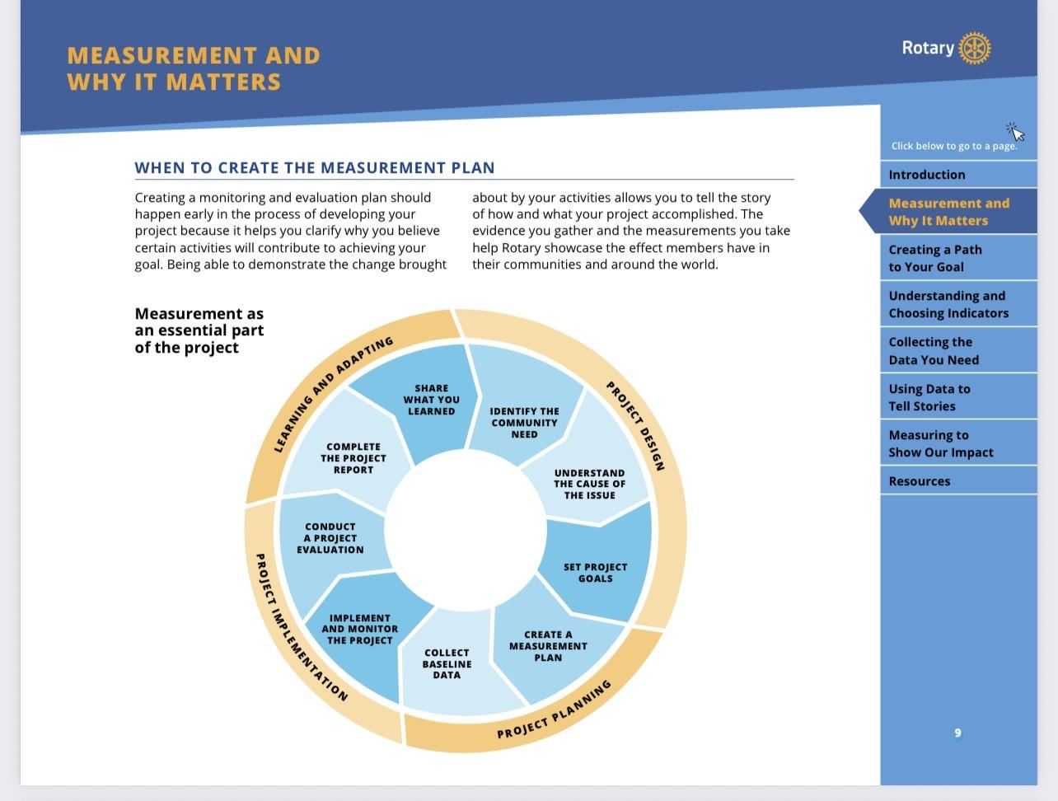
IMPACT

Slide 12
Service Project Center
The Service Project Center (formerly Rotary Showcase) is a dynamic and feature-rich hub for all Rotary service projects. This new online tool is part of our ongoing efforts to enhance participant experience and increase our impact.
The new Service Project Center (SPC) is faster, more streamlined, and has better tools and functionality to help you manage your projects, empowering you to make an even greater impact in your communities. This is just the beginning; look for information about additional improvements and features on this page.
Below, you’ll find information to help you as you begin using the Service Project Center:
Service project data previously added to Rotary Showcase will now appear on the SPC.
Adding a project: Any active Rotary or Rotaract member can post projects in the Service Project Center.
Editing, copying, and deleting projects: These functions can be done by the member who posted the project, members added as project contacts, and current club officers.
Project location: You’ll be able to add more precise location information to new and edited projects as we continue to improve the way we collect Rotary service data.
Interactive map: You can now search for and review projects in a list or on a map.
My Club Projects: To view or search for your club’s service projects posted on the SPC, click on My Club Projects at the top of the page.
The intention of the Service Project Center to support your club’s efforts in serving communities locally and around the world. As this online tool continues to evolve, updates regarding resources, relevant information, and new features to better assist your club’s service will be shared on this page.

Slide 13
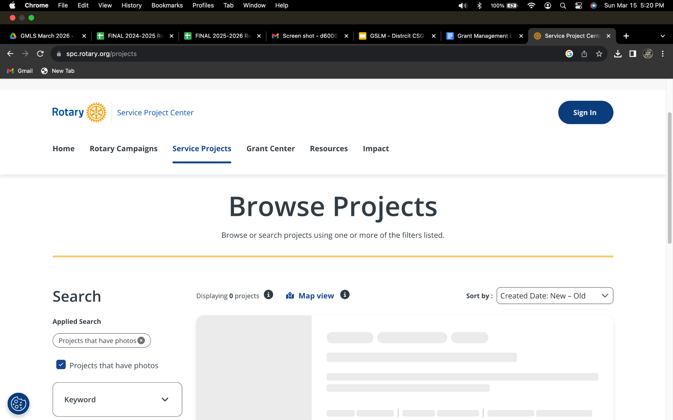
Service Project Center

Slide 14
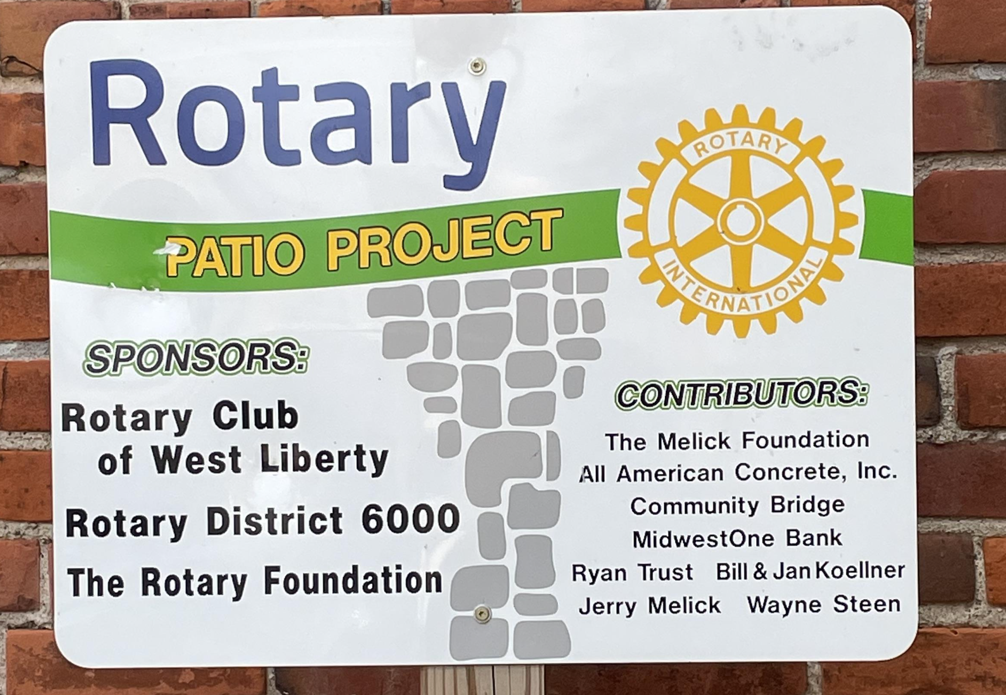
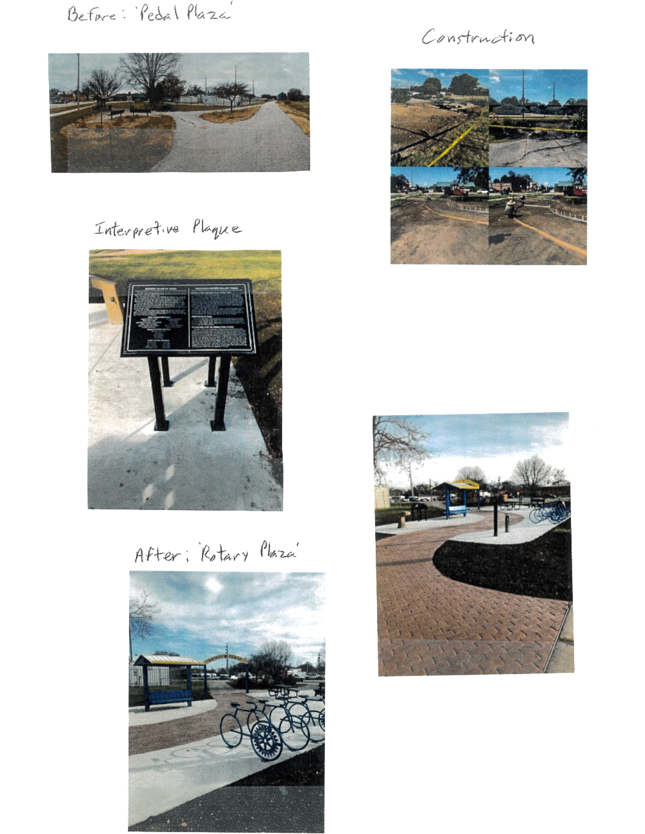
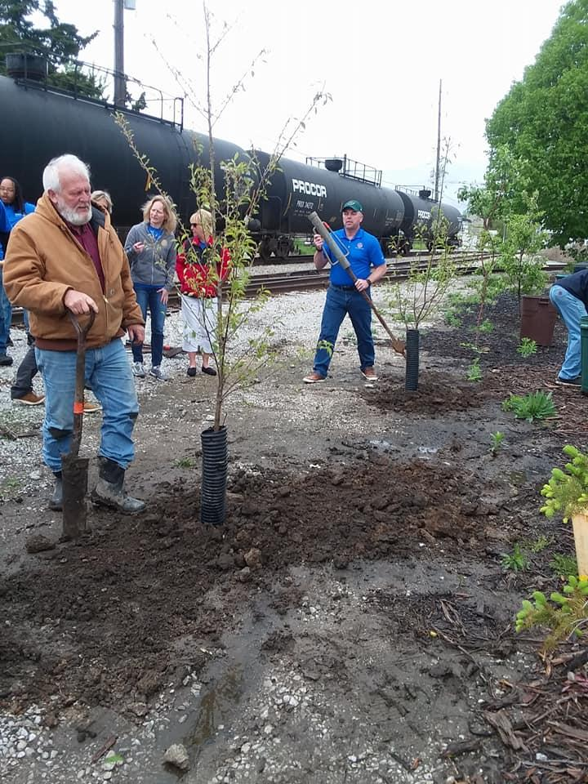
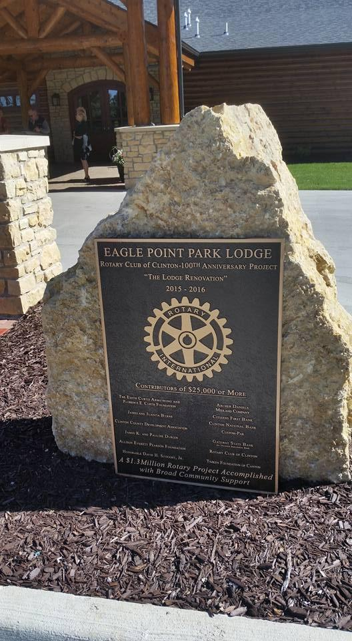
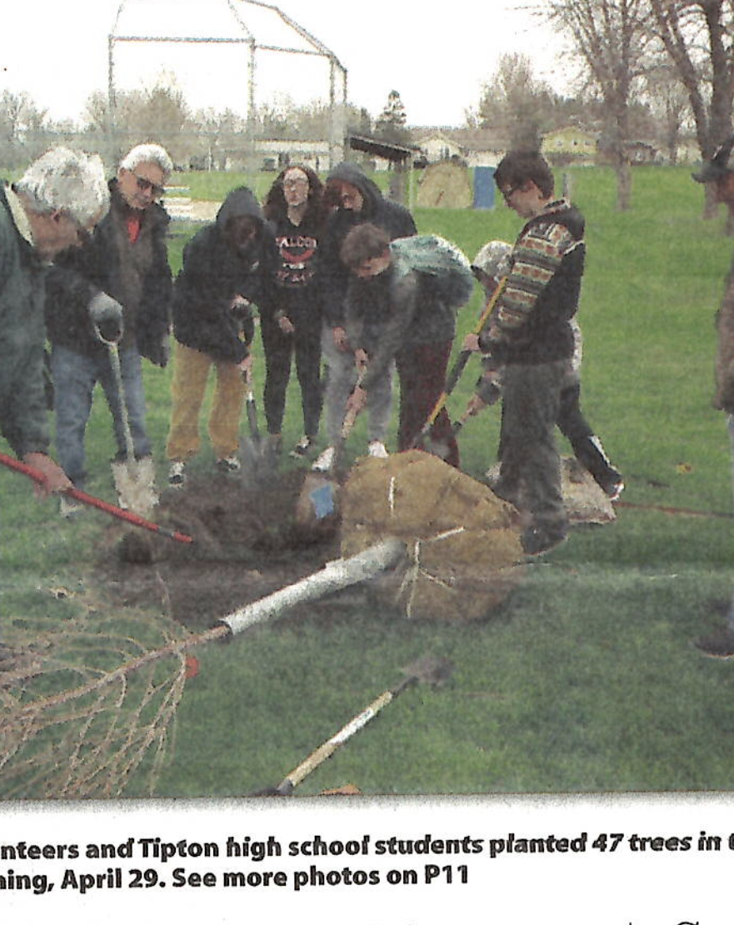
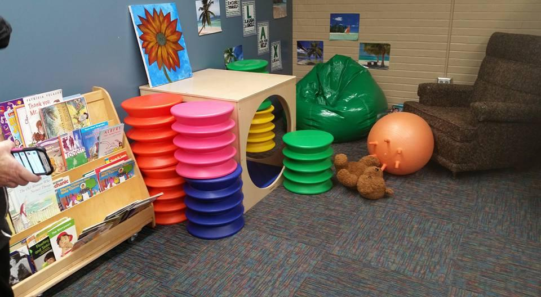
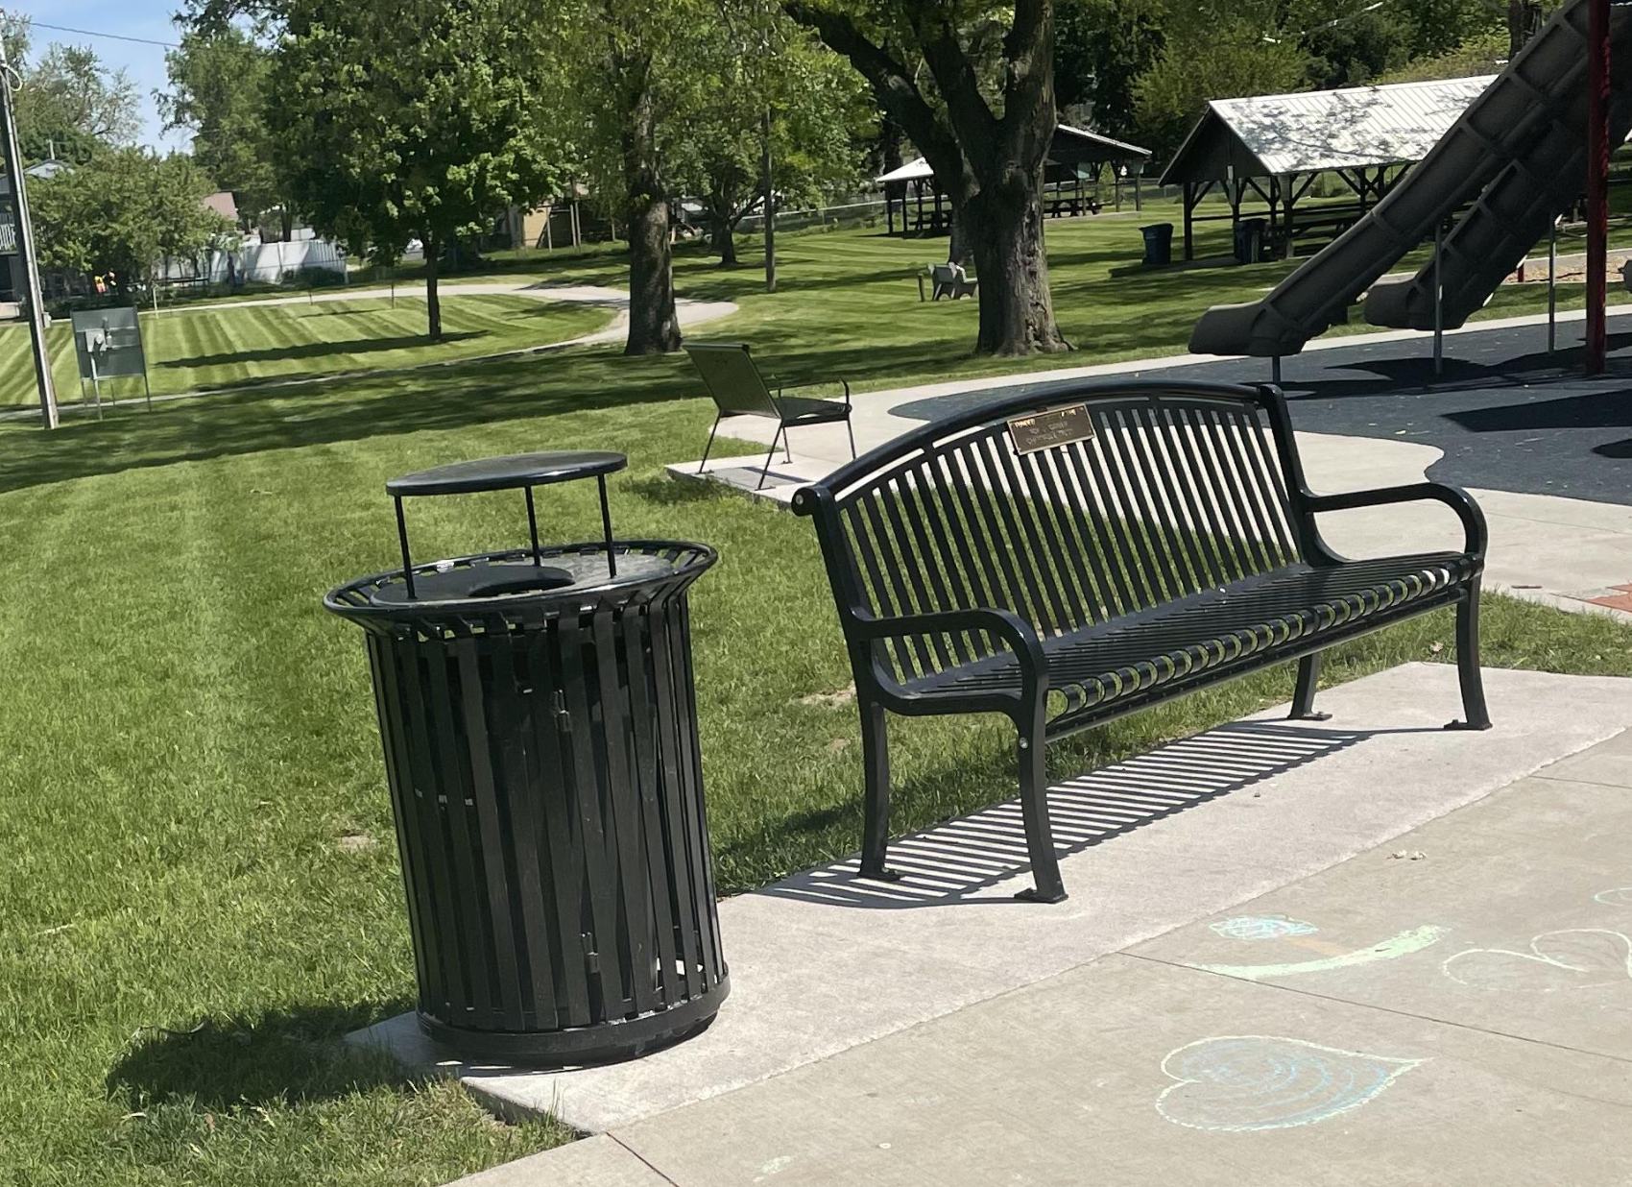
Do the project, be amazing…remember your PUBLIC IMAGE… tell the STORY!!!!!!

Slide 15
5. Funds distributed to clubs for approved grant projects. – NOTE ONLY IF THE PREVIOUS YEARS GRANT IS FINALIZED
6. Clubs manages grant details thru the life of the project via Grant Portal on D6000 Website
1. Clubs submit applications via Grant Portal on D6000 website to D6000 CSG co- Chairs by June 1, 2026
CSG PROCESS
4. Clubs cannot start projects/grants UNTIL D6000 CCSG Co Chairs notify on funds being received and sent due to waiting on TRF/RI to remits funds to D6000 for distribution. Date TBD (6-10 weeks)
7. MID YEAR Check in report due December 31, 2026 via email
2. Grant applications reviewed by D6000 CSG Co-Chairs and review committee June 14, 2025
Steps…..
8. Clubs submits final report and ALL REQUIRED documentation thru Grant Portal on D6000 website to D6000 CSG Co Chairs due June 1, 2027*
D6000 CSG Co-Chairs communicate to clubs if grant has been approved by the committee. BUT NOT APPROVED BY TRF/RI yet.
3. D6000 CSG Co-Chairs and review committee approves and submits funding request to TRF/RI by July 1, 2026

Slide 16
REMINDERS ON APPLYING FOR A CS GRANT
Reminders: (ALL DONE THRU GRANT PORTAL)
Application for a Community Service Grant for 2025-2026 – reminder due June 1, 2026 - BY 11:59pm
Absolutely NO exceptions to this
MID-YEAR Check-in Report – due Dec 31, 2026
Final Report Community Service Grant for 2026-2027 along with ALL Required Documents – reminder due June 1, 2027
Ask questions well in advance!
What we have on June 1 is what will be submitted to the committee.
Receive confirmation of receipt within 24 hours from CSG Co-Chairs D6000CSG@gmail.com OR please contact us to ensure application was received!
AGAIN - Ask if you have any questions, we’re happy to help!

Slide 17

REMINDERS –
Reporting electronically Only
Use the Grant Rules and Grant Score Sheet
ASK QUESTIONS
If you have any questions or concerns throughout the year, please contact us for help!
D6000CSG@gmail.com

