Slide 1
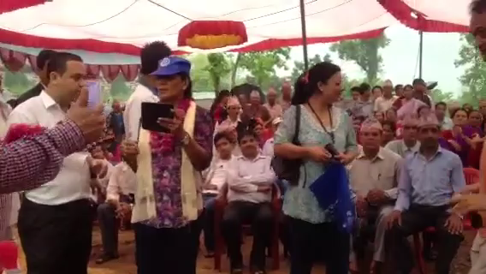
Rotary Foundation Global Grants
TITLE
in District 6000
for Rotary Year 2025-26
Notes:
1
The inauguration of a global grant project, when the completed project is handed over to the impoverished community that will own and maintain it, is probably the most emotional and humbling experience in Rotary. You share the celebration with Rotarians from another land and you experience the appreciation of people whose lives will be forever improved In the clip, Mt Pleasant Rotarians Rachel and Cal Litwiller, Davenport Rotarian Brock Earnhardt and I had that experience in a rural village in Nepal where we joined with hundreds of villagers and our Nepali Rotary partners. We were there to celebrate completion of a community water supply project financed by a Rotary Foundation global grant. Until you’ve had a similar experience, you cannot fully understand the power of Rotary to do good in the world.
This project was so successful – so well received by the beneficiaries, so well managed by the Rotary Club of Narayani Mid Town and such strong friendships developed between Rotary clubs – that the Rotary Club of Fairfield has undertaken and completed two more community water supply projects with the same Nepali club. Today, the three projects are providing clean, disease-free water piped to the homes of more than 25,000 people.
Rotary clubs transform lives with global grants.
We do that by
By developing water and sanitation systems,
By supporting basic education and literacy,
By bringing better health care to mothers and children,
By providing low-cost health care,
By developing opportunities for decent and productive work,
By protecting the environment, and
By promoting peace.
Perhaps just as importantly, while we’re developing these projects, we build relationships with Rotarians on the other side and help advance the Foundation's mission to enhance world understanding, goodwill, and peace.

Slide 2


THE ROTARY FOUNDATION
District Grants / Community Service Grants
Global Grants
Notes:
District Grants and Global Grants are two of the programs The Rotary Foundation employs to do good in the world.
Each year TRF awards a District Grant to District 6000. District 6000, in turn, awards those funds as community service grants to clubs in our district. Clubs apply to the district for community service grants, following guidelines developed by our District leaders to carry out programs and projects here at home. Gretchen and Todd will talk (talked) about CSGs in the second (first) half of this seminar.
This session will focus on global grants. For global grants, Rotary clubs and Rotaract clubs can apply to The Rotary Foundation, after approval by District 6000, following guidelines developed by the TRF.
2

Slide 3
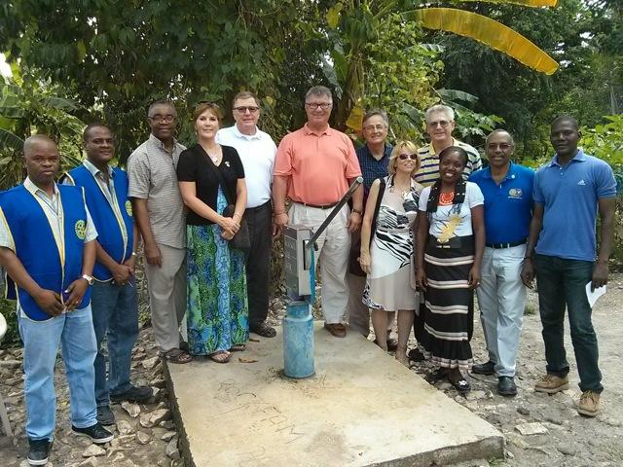
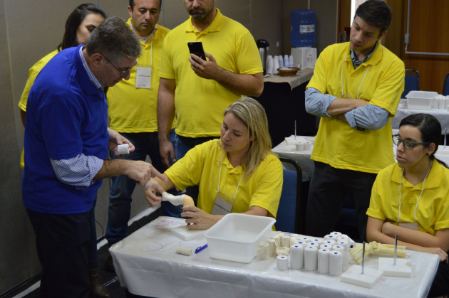
GLOBAL GRANTS
Large
International
Long term, high-impact
7 areas of focus
Club-created
Sustainability
Scholarships
Vocational Training Teams (VTTs)
Humanitarian Grants
District Web Site: Guide to Global Grants
Notes:
Rotary Foundation Global Grants support large international activities with sustainable, long-term, high-impact outcomes in one or more of seven areas of focus. Clubs create their own global grants to support activities they select and design. District 6000 Rotarians designed the global grant project pictured here - Iowa City Rotarian Dr. José Morcuende has experienced the satisfaction of participating in a number of global grants. Here he is instructing a group of orthopedic surgeons in São Paulo, Brazil on the procedure to treat clubfoot disability with the Ponseti Method that was developed at the University of Iowa. In all, José taught 65 Brazilian orthopedists through the grant.
As Gretchen and Todd will tell you later (have told you) , the largest community service grant is $5,000. The smallest global grant The Rotary Foundation will approve is $30,000.
3

Slide 4
GLOBAL GRANTS
Qualifications & Prerequisites
Attend Grant Management Seminar
Host partner (sponsor) in the project country
International partner (sponsor) outside project country (Us)
Both partners are “qualified” (unless a “contributor”)
Sign TRF Memorandum of Understanding & D-6000 Addendum
Both partners are current with grant reports
Notes:
Clubs are required to “qualify” to receive Rotary Foundation grant funds. The process is intended to ensure that clubs are aware of all Foundation requirements before they apply for a grant. Qualification - what we’re doing here today - is intended to provide what you need to successfully design and manage Rotary Foundation projects and be awarded these generous grants.
At least one club member from the host partner, the club in the country where the project will be carried out, and one club member from the international partner, us, must have attended their respective district’s grant management seminar for the year when the application is submitted. However, a Rotary club can be a “contributor” to a project without having to go through this qualification process; only the primary sponsor clubs need to be qualified.
Each club’s president-elect for 2023-24 and president-elect nominee for 2024-25 have to sign the club memorandum of understanding, agreeing to its conditions. The MOU explains the Foundation’s requirements for managing grants. Also, your two future presidents have to sign the District 6000 Addendum to the MOU acknowledging district expectations. So, throughout the Rotary world we are all operating under the same grant policies and guidelines.
Also, both clubs must be up to date with their grant reports.
4

Slide 5
GLOBAL GRANTS
Terms of Qualification
Valid for one year
Club responsibility for grant funds
Disclose conflicts of interest
Cooperate with all audits
Use grant funds properly
Implement the club MOU
Notes:
Once a club completes the qualification requirements, it receives qualified status for one Rotary year.
Rotary considers both clubs equally responsible for the success of the project and for use of grant funds. That’s an important point: Rotary expects members of both the host club and the international club to participate in the grant project. However, Rotary does limit the financial responsibility to the club that has control of the bank account.
Club members are expected to disclose any conflicts of interest in the implementation of the project.
The clubs are expected to cooperate with any site visits, reviews, and audits conducted by TRF staff.
Misuse of grant funds or failure to follow the MOU could result in a loss of eligibility for grants which is particularly impactful to clubs in developing countries where these grants are especially important.
5

Slide 6
GLOBAL GRANTS
Are sponsored by
“host” Rotary club in the project country and
“international” Rotary club outside the project country
Align with an area of focus
Respond to a community need – Needs Assessment
Include active community and Rotarian participation
Rotaract clubs as of July 1, 2022
Notes:
Regardless of the type of global grant - scholarship, VTT or humanitarian project – the characteristics are the same. They are projects and activities that:
Are sponsored by a host Rotary club in the country where the project is located and an international Rotary club outside the project country
Align with one of Rotary's seven areas of focus
Respond to a NEED the benefiting community has identified
Include the active participation by the people of the benefitting community
Include the active participation of Rotarians
Since last year, Rotaract clubs are eligible to be host and international sponsors of global grants so long as they have previously worked with a Rotary club on a global grant-funded project and participated in the district’s grant management seminar.
6

Slide 7
GLOBAL GRANTS
Strengthen knowledge, skills, resources
Have long-term, sustainable benefits
Have measurable results
Have a budget of at least $30,000
Notes:
Rotary project and activities are expected to
Strengthen the knowledge, skills and resources of the people of the community the project is benefitting and to
Be designed to enable the community to address its own needs after the Rotary club has completed its work
(As the Foundation’s grants officers evaluate applications, they look for strong education, training and self-help components in the projects.)
The foundation also expects that our projects will have measurable results
The minimum project budget to qualify for a global grant is $30,000. We’ll talk later about how a global grant project budget is funded.
7

Slide 8

SEVEN AREAS OF FOCUS
Peacebuilding and conflict prevention
Disease prevention and treatment
Water, sanitation and hygiene
Maternal and child health
Basic education and literacy
Community economic development
The Environment
Notes:
I’ve mentioned areas of focus a couple times. What are they? Rotary has seven:
Peacebuilding and conflict prevention
Disease prevention and treatment
Water, sanitation and hygiene
Maternal and child health
Basic education and literacy
Community economic development and,
The environment
Global grants must support at least one of the seven areas of focus.
On the district website, you can find a Rotary publication called Area of Focus Policy Statements. It contains the Foundation’s expectations and requirements to qualify for grants in each area.
Often projects can impact more than one area of focus. (eg: WASH would potentially impact all AoFs) I suggest you choose the one primary area. If you select multiple areas of focus, you compound your project’s reporting requirements since each area of focus has goals to be achieved and discussed in the project completion report.
8

Slide 9
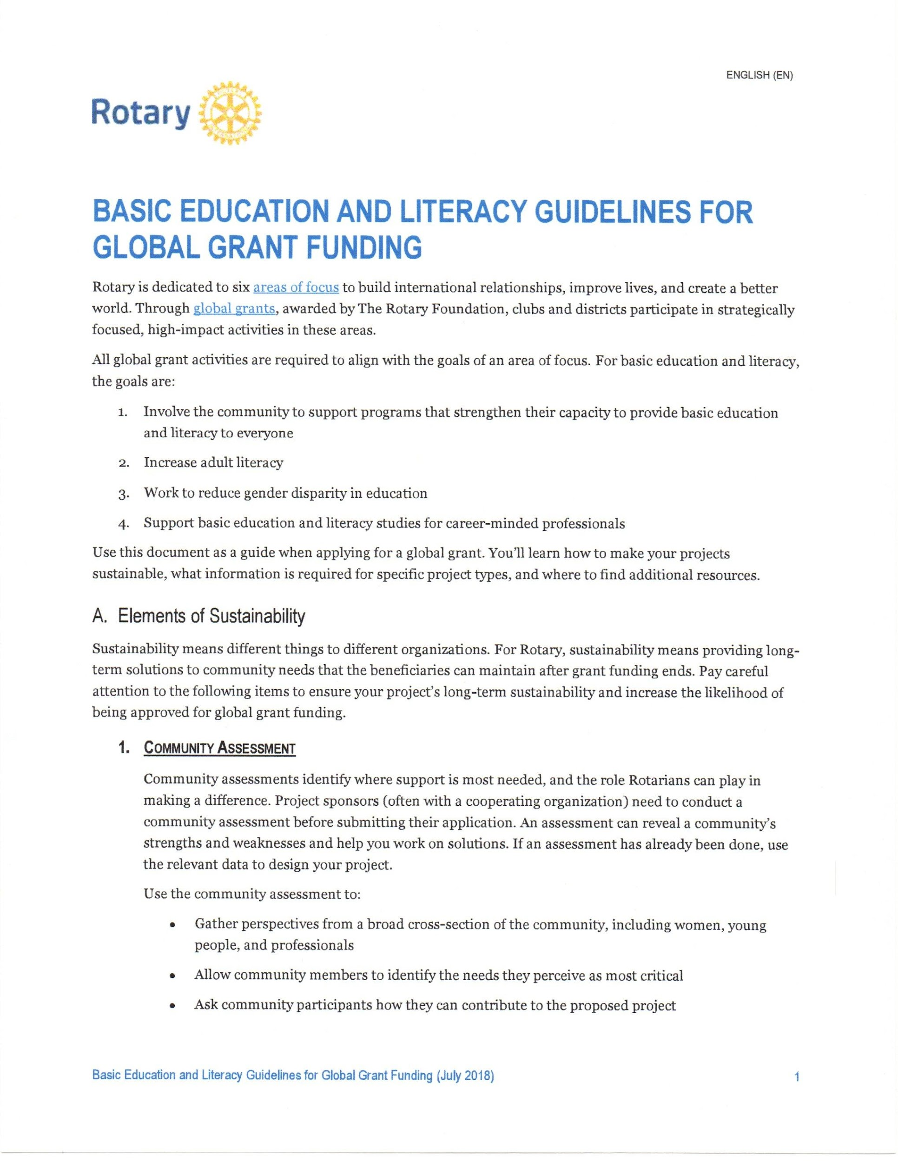
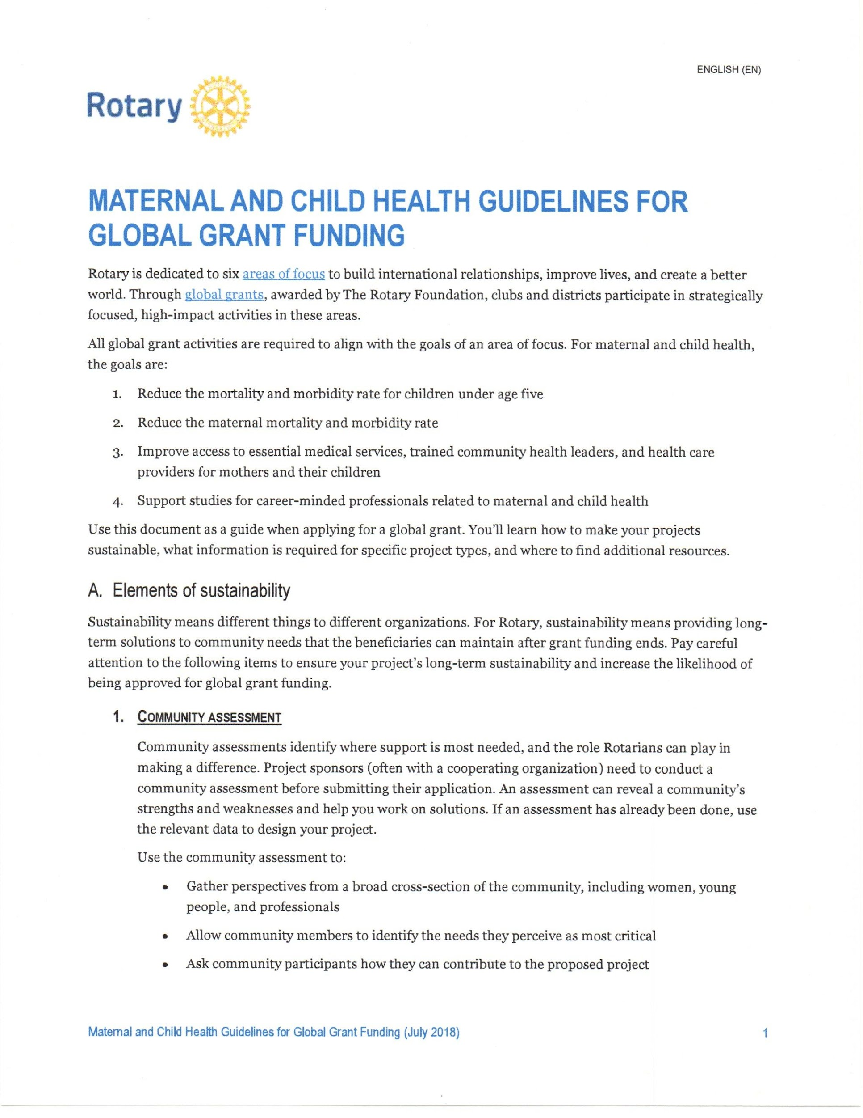
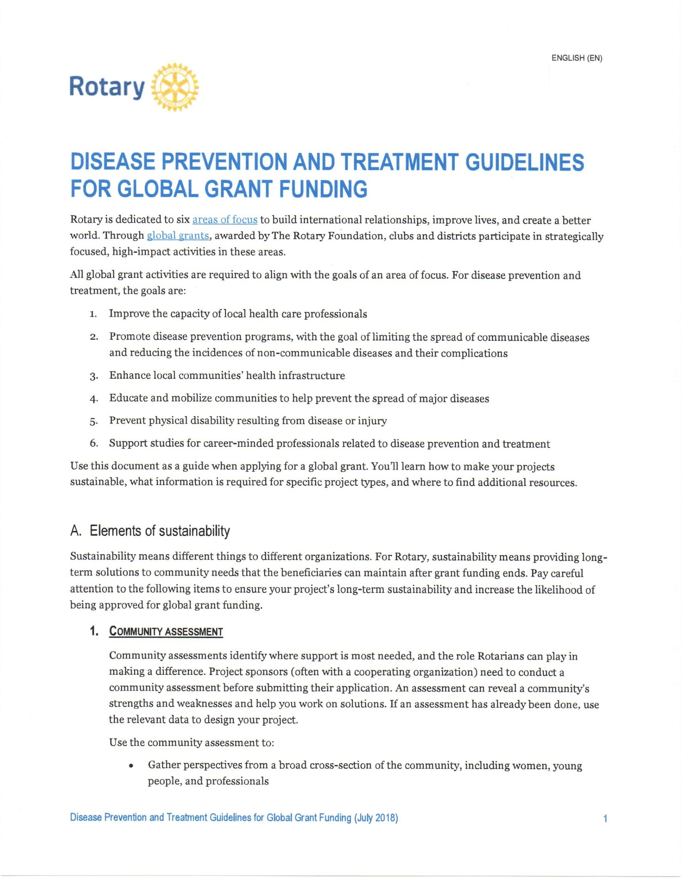
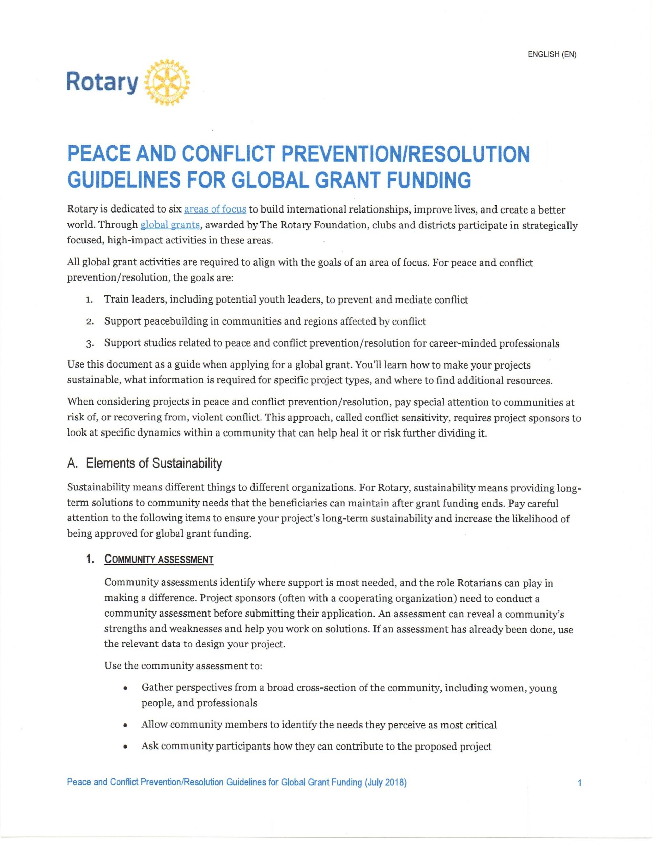
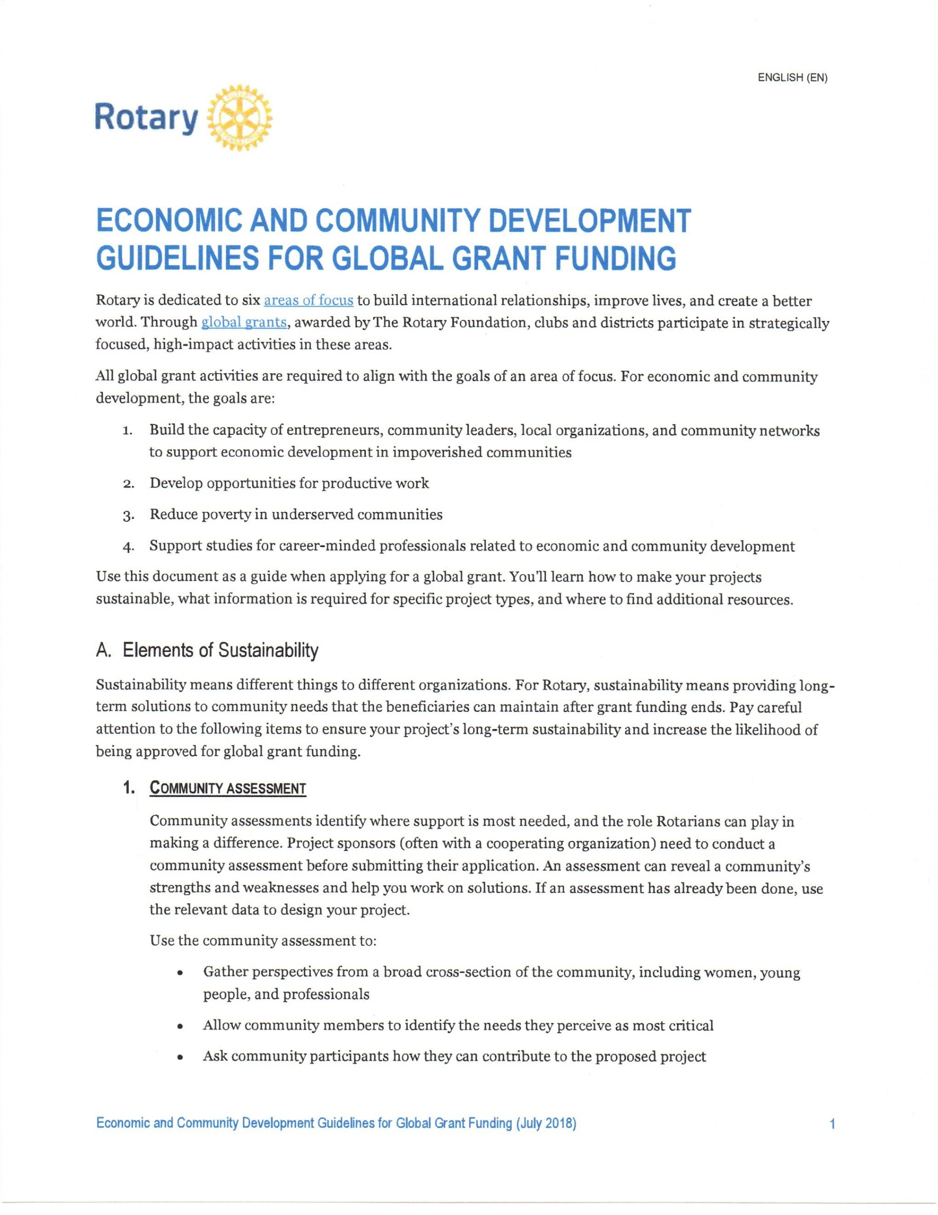
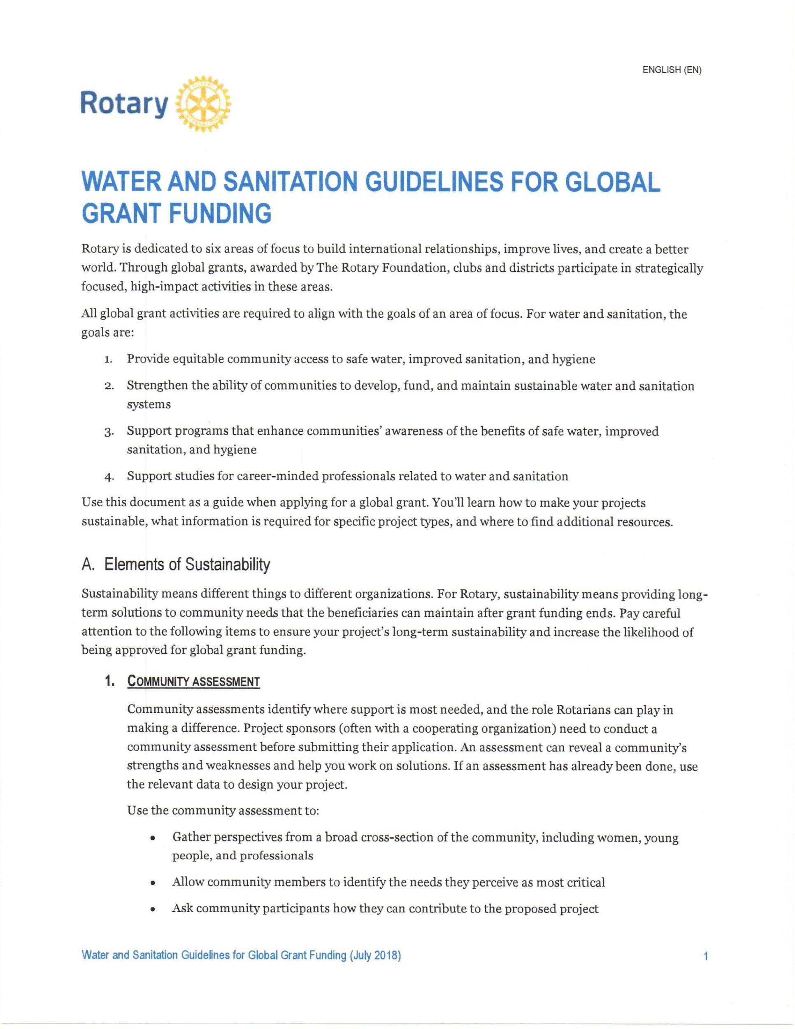
AREAS OF FOCUS
https://rotary6000.org/SitePage/global-grants
STUDY ‘EM!
Notes:
The Foundation has guidelines for development of projects in each area of focus. The guidelines:
List the goals that the Foundation expects each project to achieve;
Describe how to conduct a needs assessment;
Suggest ways to meet the goals and assure project sustainability;
Describe the different types of projects that Foundation grants will support; and
Provide a bibliography of sources for additional information.
As the growth in applications for Rotary grants has exceeded the growth in contributions to the annual fund, global grants have become more competitive. Approvals are harder to get. The guidelines in these publications are not merely suggestions but rather the standards by which your application will be approved or rejected. [click again] I recommend you STUDY the guidelines publication for your project’s area of focus. We’ve posted them on the district website,
9

Slide 10
GLOBAL GRANTS
Successful Global Grant Projects
Meet community needs
Include frequent partner communication
Have realistic implementation plans
Are sustainable
Maintain proper stewardship of funds
Notes:
Successful Global Grant Projects meet community needs. That means:
They address a real need that the community itself has identified. This is Human Nature 101: you’re more likely to participate, support and maintain a project that you want and need.
Projects shouldn’t be imposed by international partners. Ideally they should be designed by the benefitting community and the host partner with input and support by the international partner.
The best projects – and you’ll find the most satisfying projects - have frequent partner communication
Rotarians should partner with the community and with organizations that have technical expertise; however, the Foundation expects that projects will be managed by Rotarians.
Working together is more than financial participation; it is also using each partner’s expertise to plan and implement the project.
Stay in touch via email. Ask your partner to send photos. Club members and contributors really appreciate seeing the progress of the project.
Several of our projects have used Facebook group pages to maintain communications and document progress.
The Foundation expects that our projects will be sustainable; that is, the benefits continue long after the funds have been spent.
TRF expects that we will practice good stewardship and oversight of grant funds.
10

Slide 11
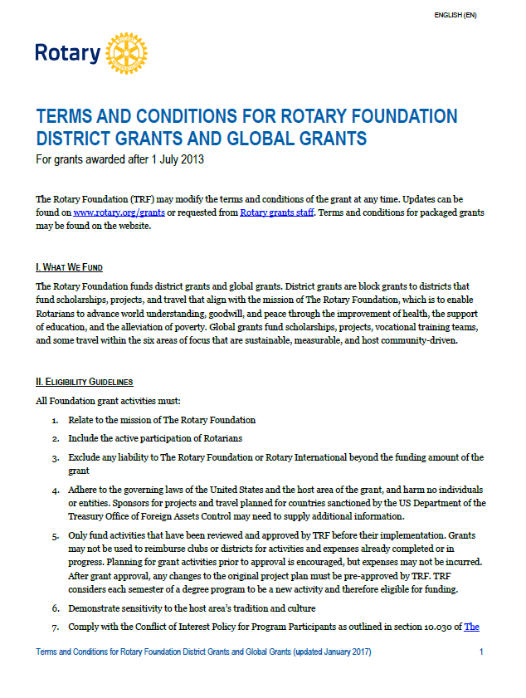
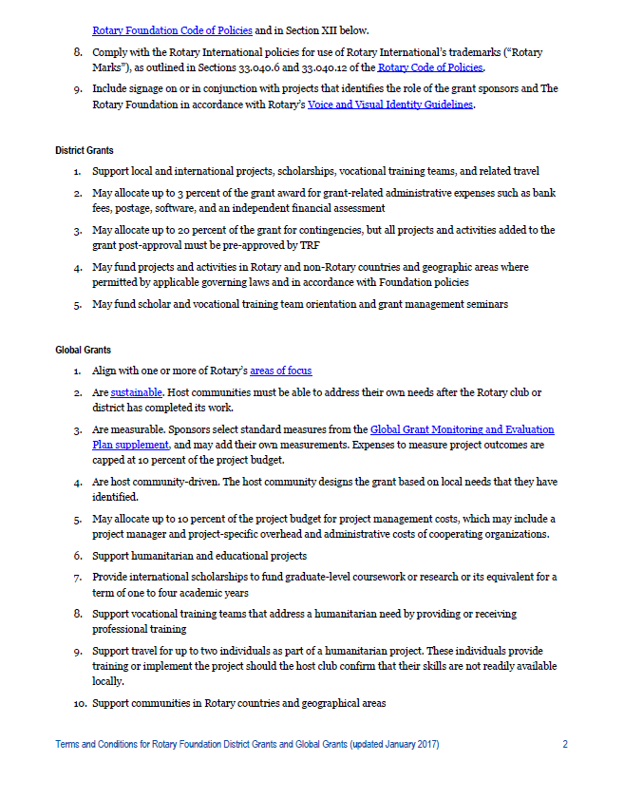
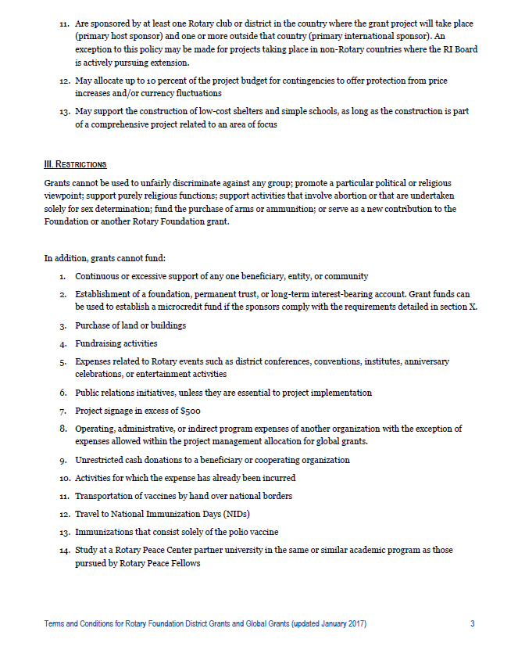
Eligibility & Restrictions
TERMS AND CONDITIONS FOR ROTARY FOUNDATION DISTRICT GRANTS AND GLOBAL GRANTS
Notes:
In general, The Rotary Foundation funds scholarships, vocational training teams and humanitarian projects that enable us to advance world understanding, goodwill, and peace through improvement of health, support of education, and alleviation of poverty within the seven areas of focus – the mission of the Foundation.
Specific guidelines for and restrictions against the uses of grant funds are given in “Terms and Conditions for Rotary Foundation District Grants and Global Grants.” It is important for you to review Terms and Conditions before you start drafting your application. It is updated several times every year and we keep a current version on the district website in both grants sections.
11

Slide 12
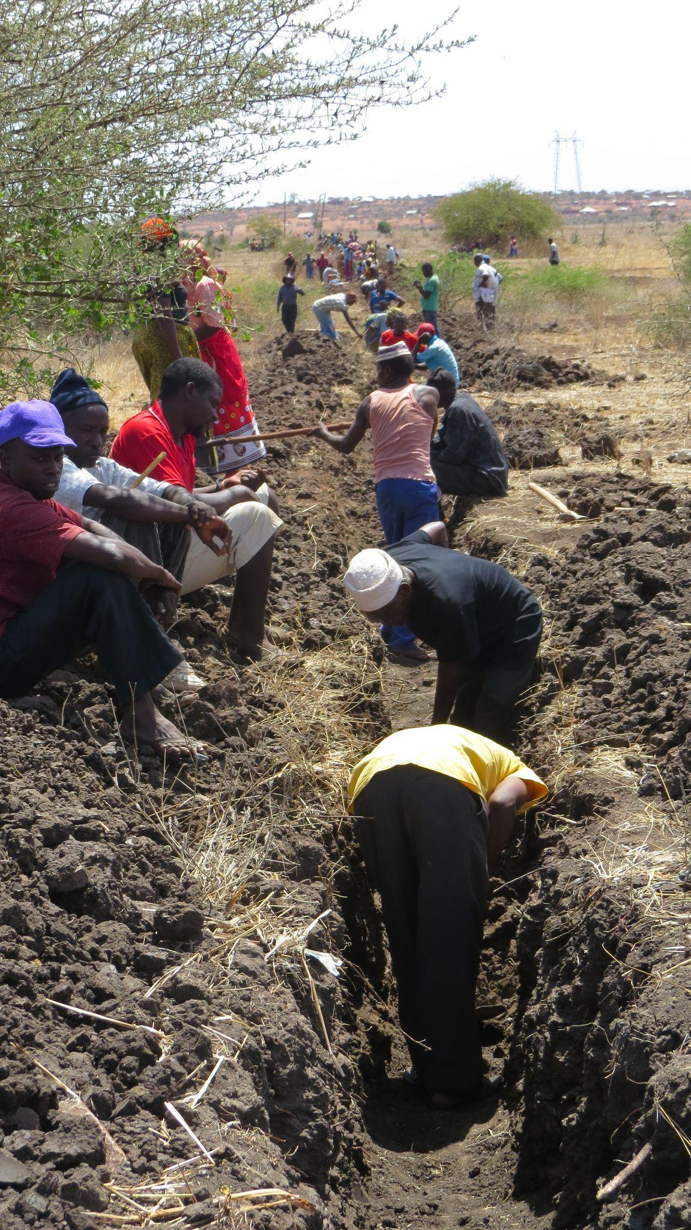
GLOBAL GRANTS
Sustainable Projects
Creating Sustainable Projects
Give a community the skills and knowledge to maintain project outcomes for the long term, after grant funds have been expended
Community participation
Materials and technology
Funding
Knowledge
Motivation
Evaluation
Notes:
Earlier I said that global grants are intended to create sustainable projects, sustainable meaning that Rotary Foundation global grants are able to continue to have an impact long after the grant funds have been spent.
How is sustainability accomplished? Think of the proverb: Give a person a fish and they’ll eat for a day. Teach them to fish and they’ll eat for a lifetime. Again, the grants officers look for strong education, training and self-help components in the projects.
Examples of methods to assure projects are sustainable are given in the Guidelines publications I mentioned earlier.
The grant application will ask for a detailed explanation of your sustainability plan.
12

Slide 13
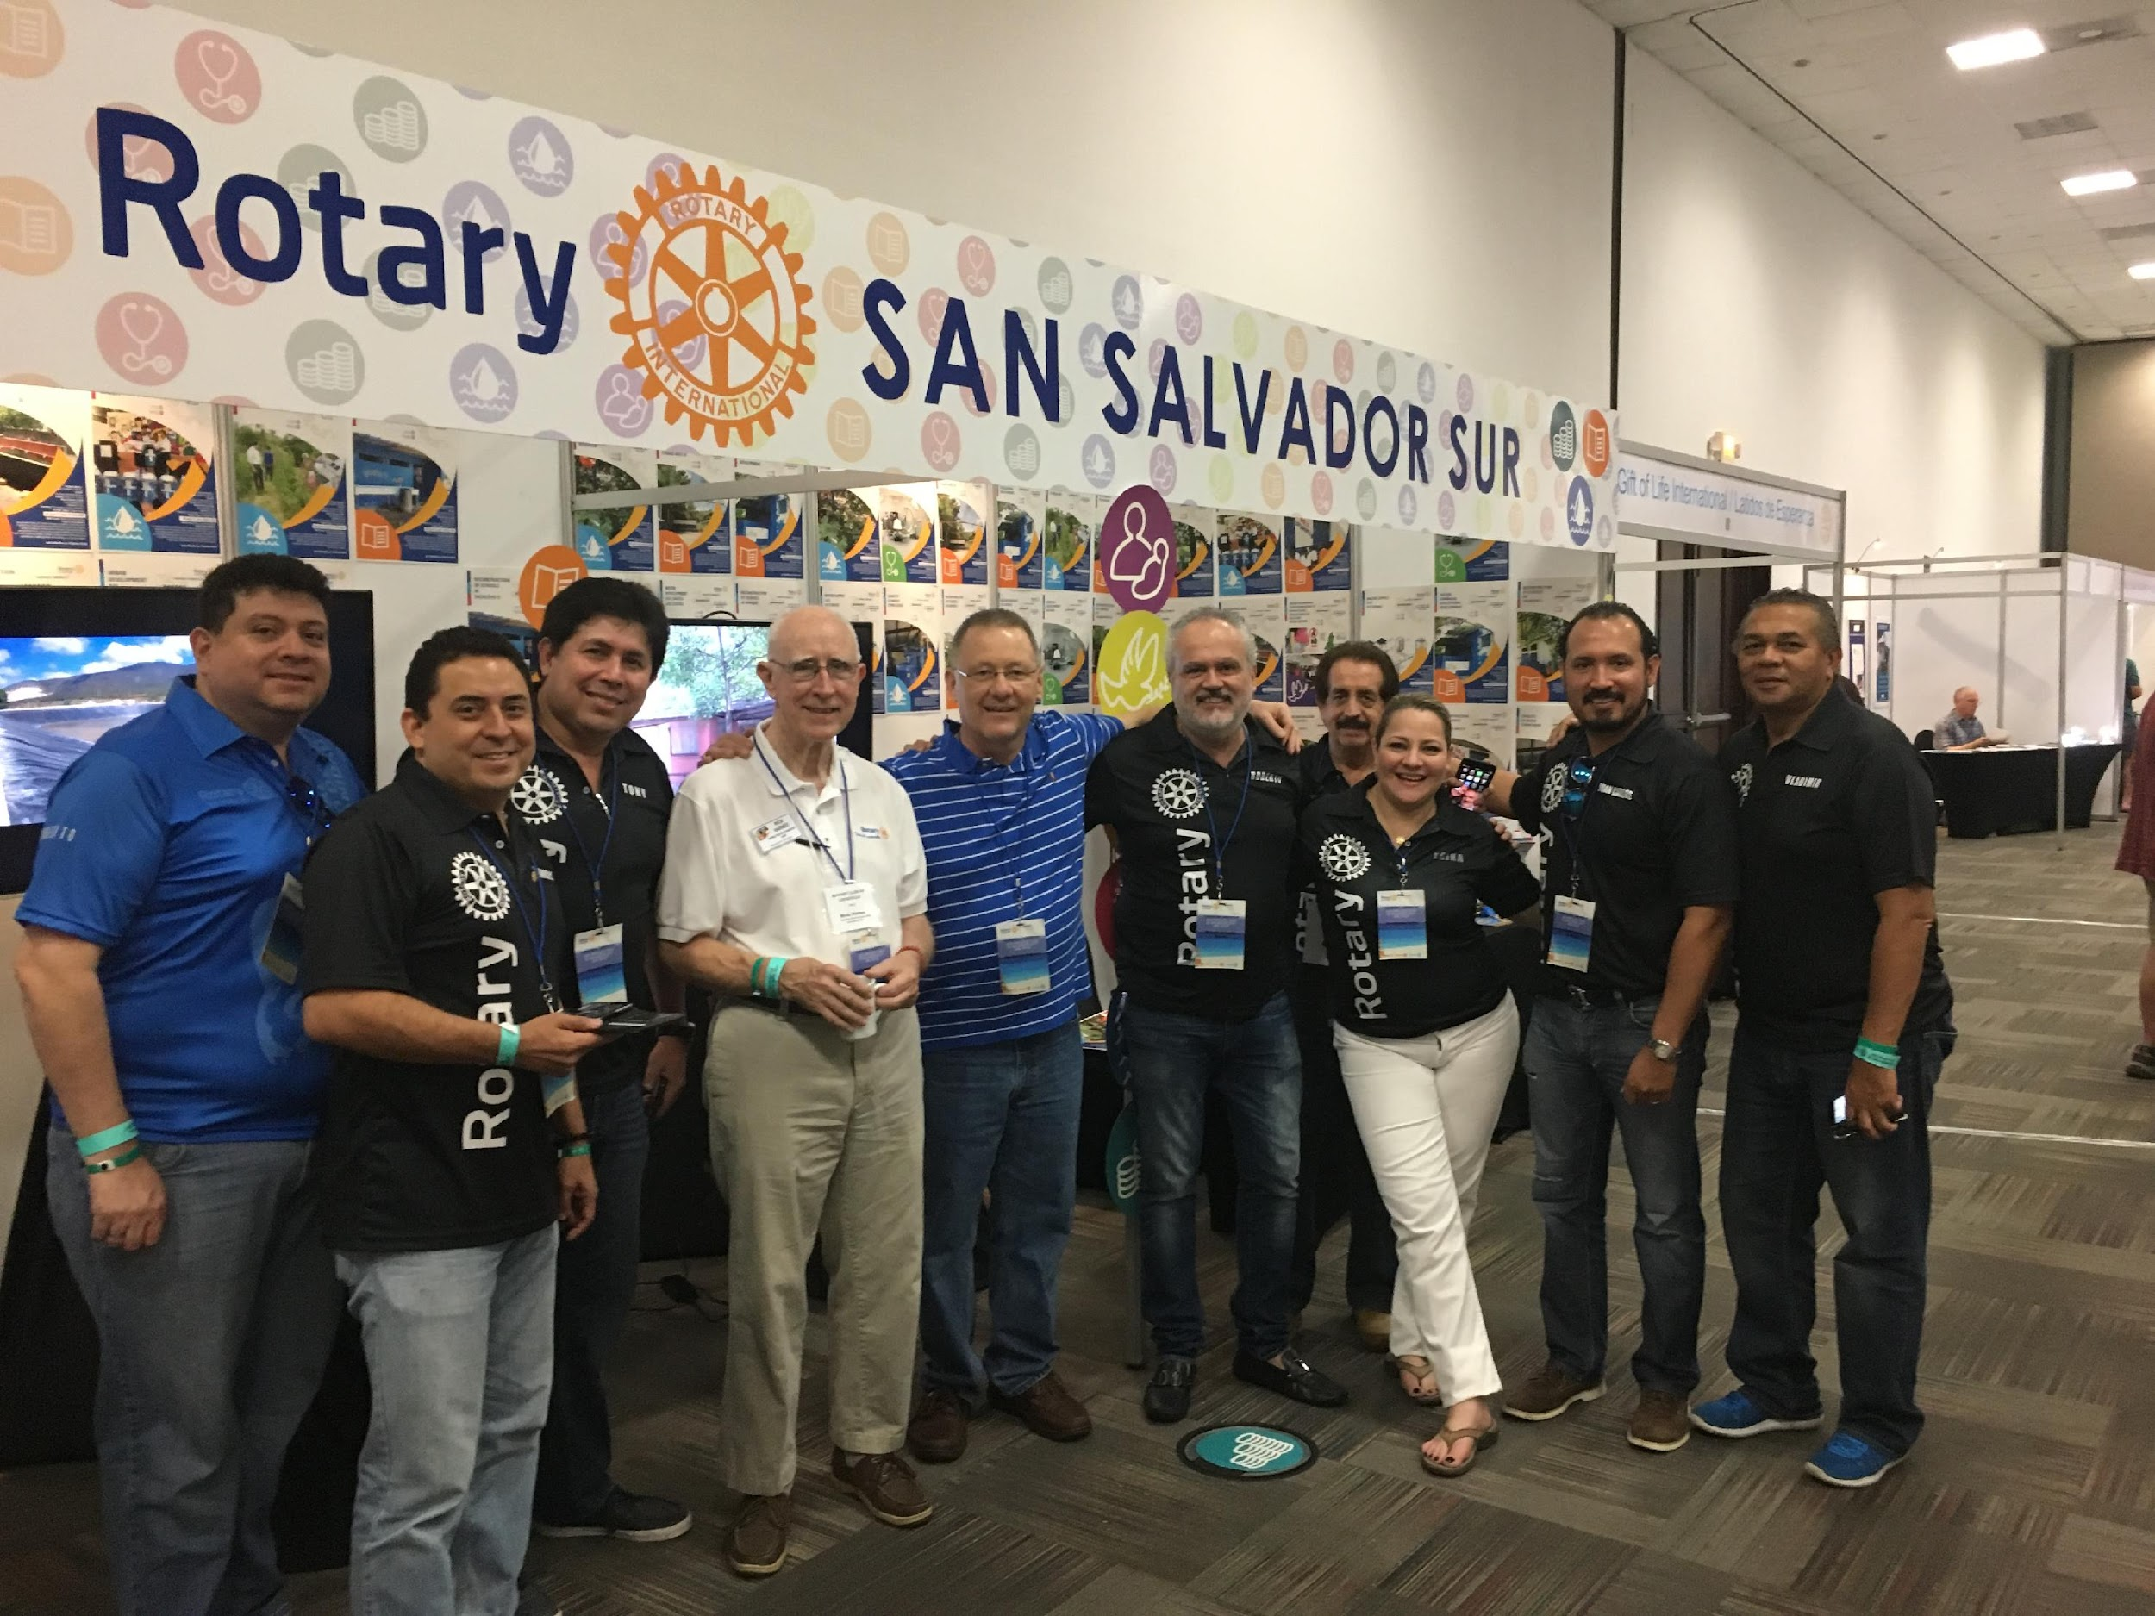
SUCCESSFUL PROJECTS PARTNERS
Rotary Project Fairs
International meetings
District conferences
Travel
Exchanges
Social Media
Showcase
Notes:
Where do you find partners for a successful global grant?
There are a number of project fairs every year in Mexico, Central America, Colombia, Ecuador, Africa and India. They are organized to encourage Rotary friendships and to develop partnerships. They bring Rotarians from around the world who want to sponsor humanitarian service projects together with Rotarians from developing countries who have planned projects to benefit poor people in their communities.
The International Convention provides opportunities to meet Rotarians from different countries and develop partnerships.
District conferences, ours and others.
Attend Rotary meetings while travelling internationally on business or on vacation.
Rotary Youth Exchanges and Friendship Exchanges have created many long-lasting relationships and project partnerships.
Rotary clubs all over the world have Facebook pages. My Rotary has a section for project sponsors looking for partners.
However you find your project partner, acquaintance is the key to trusting relationships and successful projects.
13

Slide 14
Global Grant Timeline
Pre-grant Application Submission
MOU
Community needs assessment
Develop a Budget, Collect Prices
Raise Funds
Develop Timeline
Global Grant Approval
District Approval
Host and International Sponsors
Each Contributing District
The Rotary Foundation Approval

Slide 15
Global Grant Timeline, Continued
Global Grant Project Begins
Contractors
Community Volunteers
Post-Grant Completion
Community Survey at Project Turnover
Community Survey at 18 months Post Turnover
Community Survey at 36 months Post Turnover
TRF will Issue Notice of the Grant Closure

Slide 16
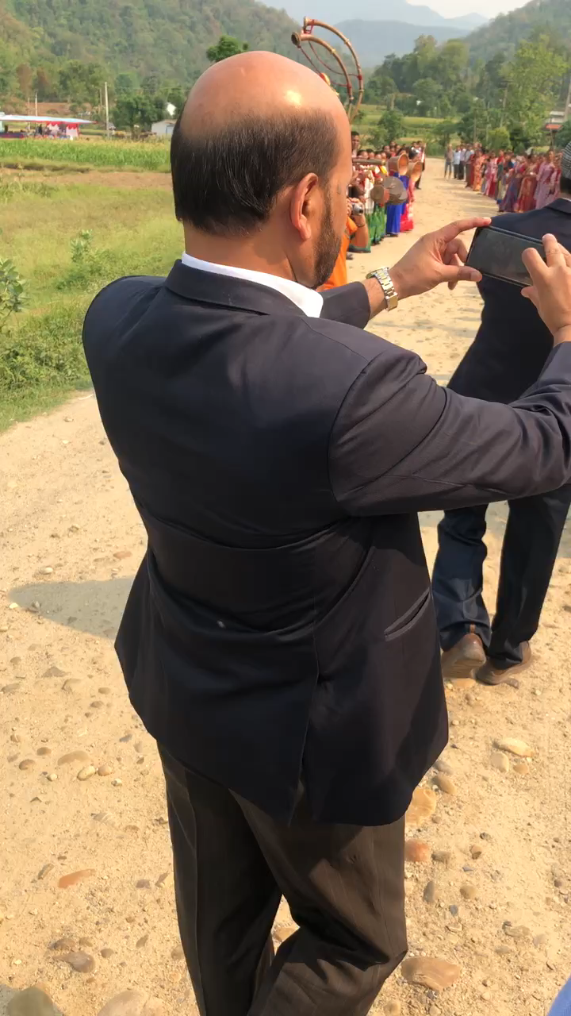
APPLYING FOR GLOBAL GRANTS
Online application:
https://my.rotary.org/
Rotary Grant Center
Any time,
no deadline
Notes:
A Nepali musical interlude.. The musicians led the way as as we were honored in a parade through the village where we had completed the second of the three community water supply projects. The guy doing the photobombing was the District 9232 District Governor. D9232 has 156 clubs in Nepal and Bhutan. The DG told us that he had visited most of his clubs three time when we were there in May 2019.
Back to grant management: The Rotary Foundation only accepts global grant applications submitted through its online grant application system, the Rotary Grant Center.
There is no deadline for global grant applications. They are reviewed as they are received and approved throughout the year. However, district designated funds and The Rotary Foundation’s World Fund are finite and are granted on a first come, first served basis so filing early in the Rotary year is recommended.
16

Slide 17
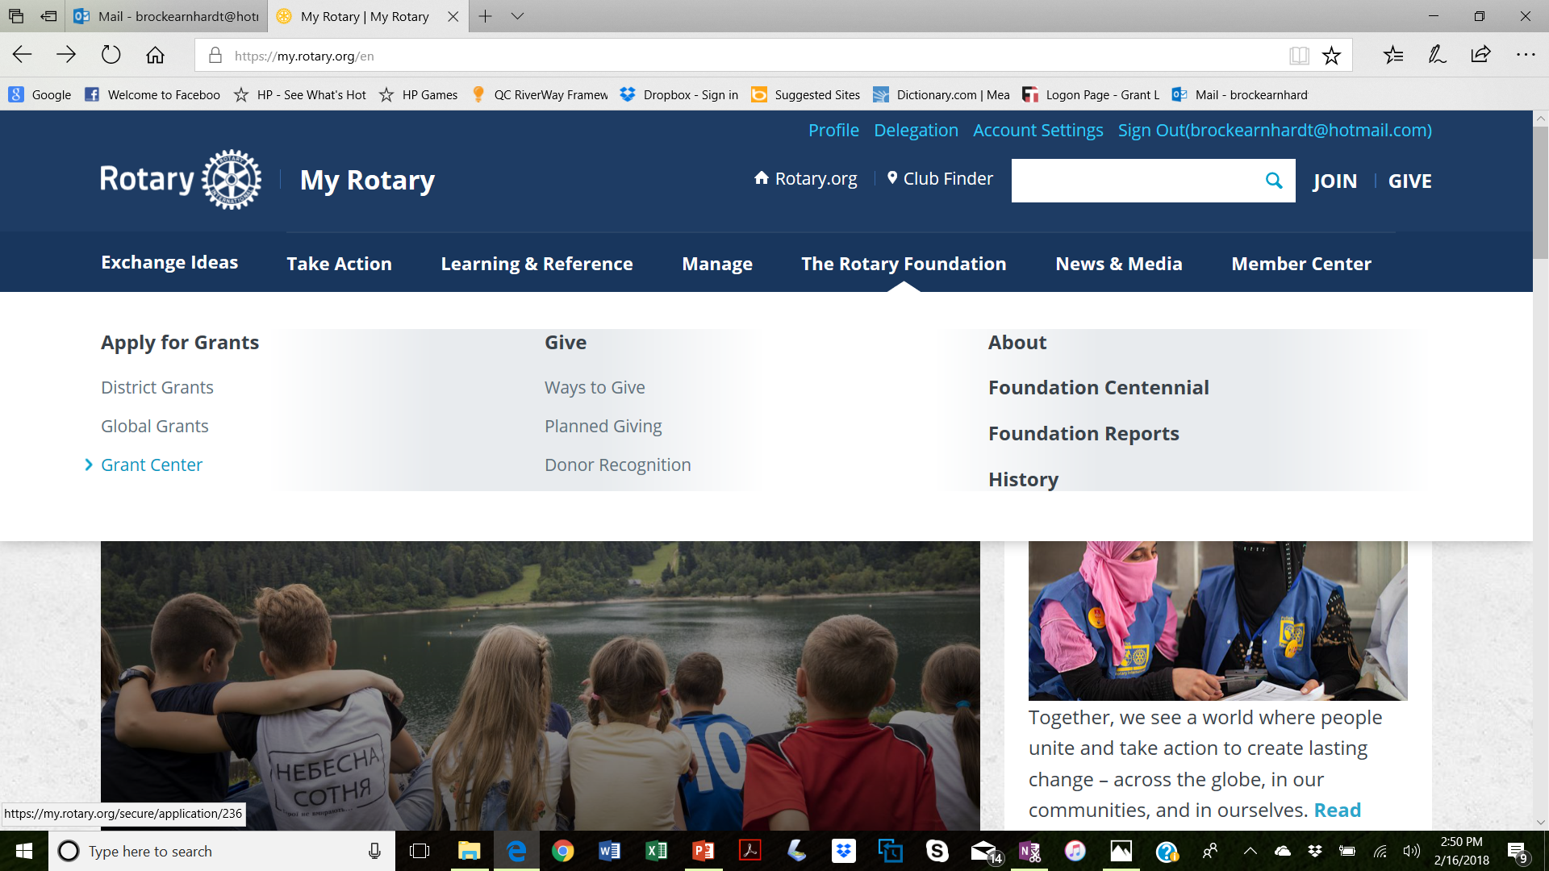
APPLYING FOR GLOBAL GRANTS
Notes:
Back to the online application, you access it by going to www.Rotary.org and signing in to “My Rotary”.
When you are signed into My Rotary, select “The Rotary Foundation” menu. Under the “Apply for Grants” section on the left, click on “Grant Center”.
17

Slide 18
APPLYING FOR GLOBAL GRANTS
Regional Grant Coordinators
Asia – Rachel Litwiller
Latin America & Caribbean – Jim Peterson
Africa & Europe – Glen Rippke
Notes:
The District 6000 international grants team has a unique organizational structure and terrific resources to assist our clubs. Our three Regional Grant Coordinators: Rachel Litwiller for Asia, Jim Peterson for Latin America and the Caribbean and Denny Skinner for Africa and Europe have travelled extensively in the regions they represent and have good Rotary acquaintances there. Please contact the coordinator for your region early in your application process. They can provide their experience with their respective regions, their expertise with grant applications and confirm whether there will be DDF available to match your contribution.
Feel free to contact any member of the global grants committee for help. We all have experience developing international projects and grant applications.
18

Slide 19
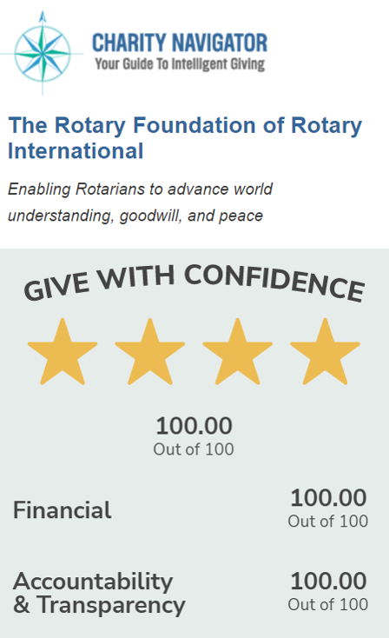
GLOBAL GRANT MANAGEMENT
Ensure that projects
Have proper financial control
Adhere to technical standards
Meet the needs of
the beneficiaries
Fulfill objectives
Safeguard funds
Notes:
The Rotary Foundation is one of the most highly regarded foundations in the world. For the 15th consecutive year it received the highest rating – 4 stars – from Charity Navigator, the independent evaluator of charities in the U.S. In the most recent evaluation the Foundation was awarded a perfect 100 overall score for financial responsibility, accountability and transparency.
We have a fiduciary responsibility to The Rotary Foundation. When we manage our projects with tight financial controls, high technical standards and assure beneficiaries’ satisfaction, we maintain and enhance the Foundation’s great reputation.
The Foundation provides oversight of our projects by requiring regular reports during and after completion of projects and by conducting on-site reviews and audits.
19

Slide 20
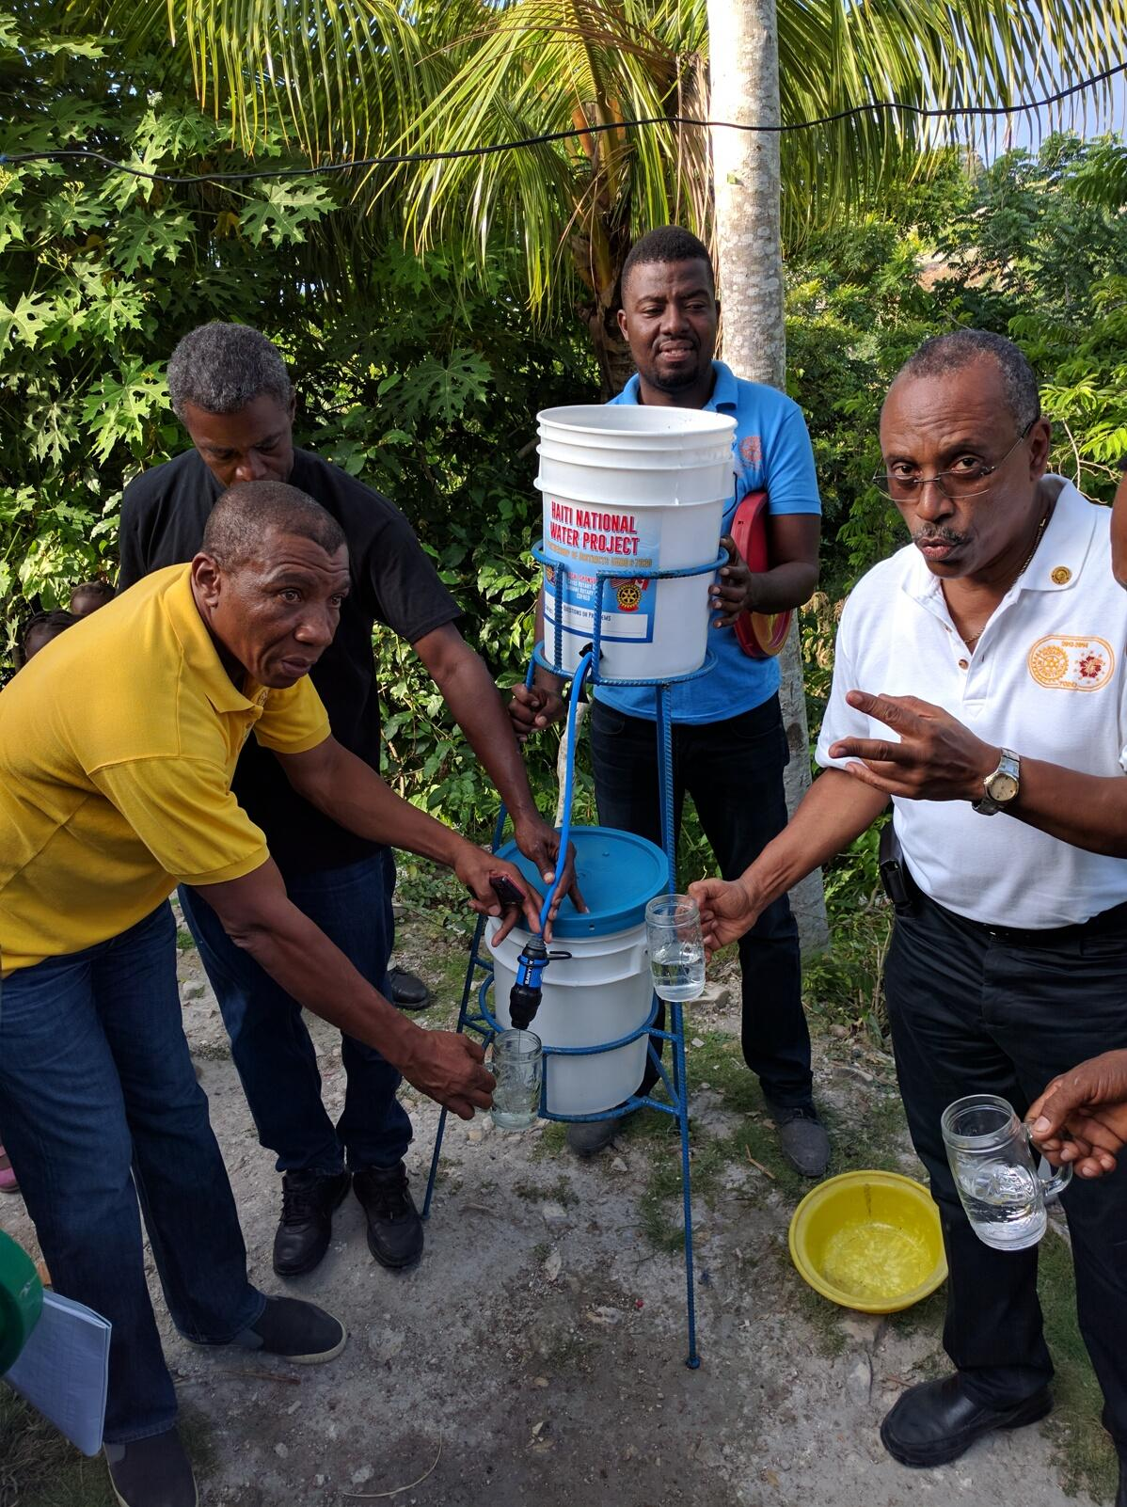
GLOBAL GRANT MANAGEMENT
Stewardship: responsible management and oversight of grant funds
Rotarian supervision
Financial records review
Oversight of funds
Reporting irregularities
Timely reporting
Notes:
In global grants as in everything in Rotary, we are guided by The Four-Way Test. This is best accomplished by our host partners actively supervising the projects’ implementation, maintaining meticulous financial records, assuring reliable control systems, promptly reporting any misuse of grant funds to TRF and to us, and by submitting timely, complete and accurate reports. District 6000 wants our host partners to accept primary responsibility for interim and final project reports. That’s because they are closer to the project site and usually have control of the banking records. We ask our clubs to keep in touch with their host partners and remind them when reports are due. Also, we international partners need to promptly review, comment and authorize all reports. When the project banking account needs to be in the U.S., we give exceptions to the host partner reporting policy.
20

Slide 21

THANK YOU!
Notes:
President Elect Gordon McInnaly, in his Presidential Theme announcement, urges us to “Restore hope…help achieve lasting change.”
In the eleven years since Rotary adopted the current grants model, 50 District 6000 clubs – 3/4 of our clubs - have participated in global grants for 57 projects in 25 countries. Because of District 6000 Rotarians, more than 420,000 poor people in need are enjoying better health, have experienced economic improvement, are realizing educational opportunities, are drawing water from new wells, or have had their disabilities lessened so they can earn a living. With donations of our time and about $200 per D6000 Rotarian, we leveraged almost $6.6 million in humanitarian benefits.
Our Rotary Foundation global grants have restored hope and helped achieve lasting change for 420,000 people. With global grants we have the power to change lives – even save lives. But I promise, however much your project changes the lives of the beneficiaries, it will change and enrich your life even more.

