Slide 1
Rotary District 6000 Membership
Welcome
&
Introductions
Title Page Option

Slide 2
Rotary District 6000 Membership
Subjects to be Discussed
Attracting Members
Engaging Members
Retaining Members
Alternative Meetings
Membership Olympics
Membership Leads Management System
Title Page Option

Slide 3
Rotary District 6000 Membership
Attracting Members
By D6000 Membership Tri-Chair
Jennifer Chittenden
Title Page Option

Slide 4
Rotary District 6000 Membership
Highlight the Value Proposition
We Are People of Action
Gain Leadership and Connection
Have Local and Global Impact
Title Page Option

Slide 5
Rotary District 6000 Membership
Share About Community Impact
Tour Club Projects
Describe Rotary International Causes
Invite to Hands-On Service
Title Page Option

Slide 6
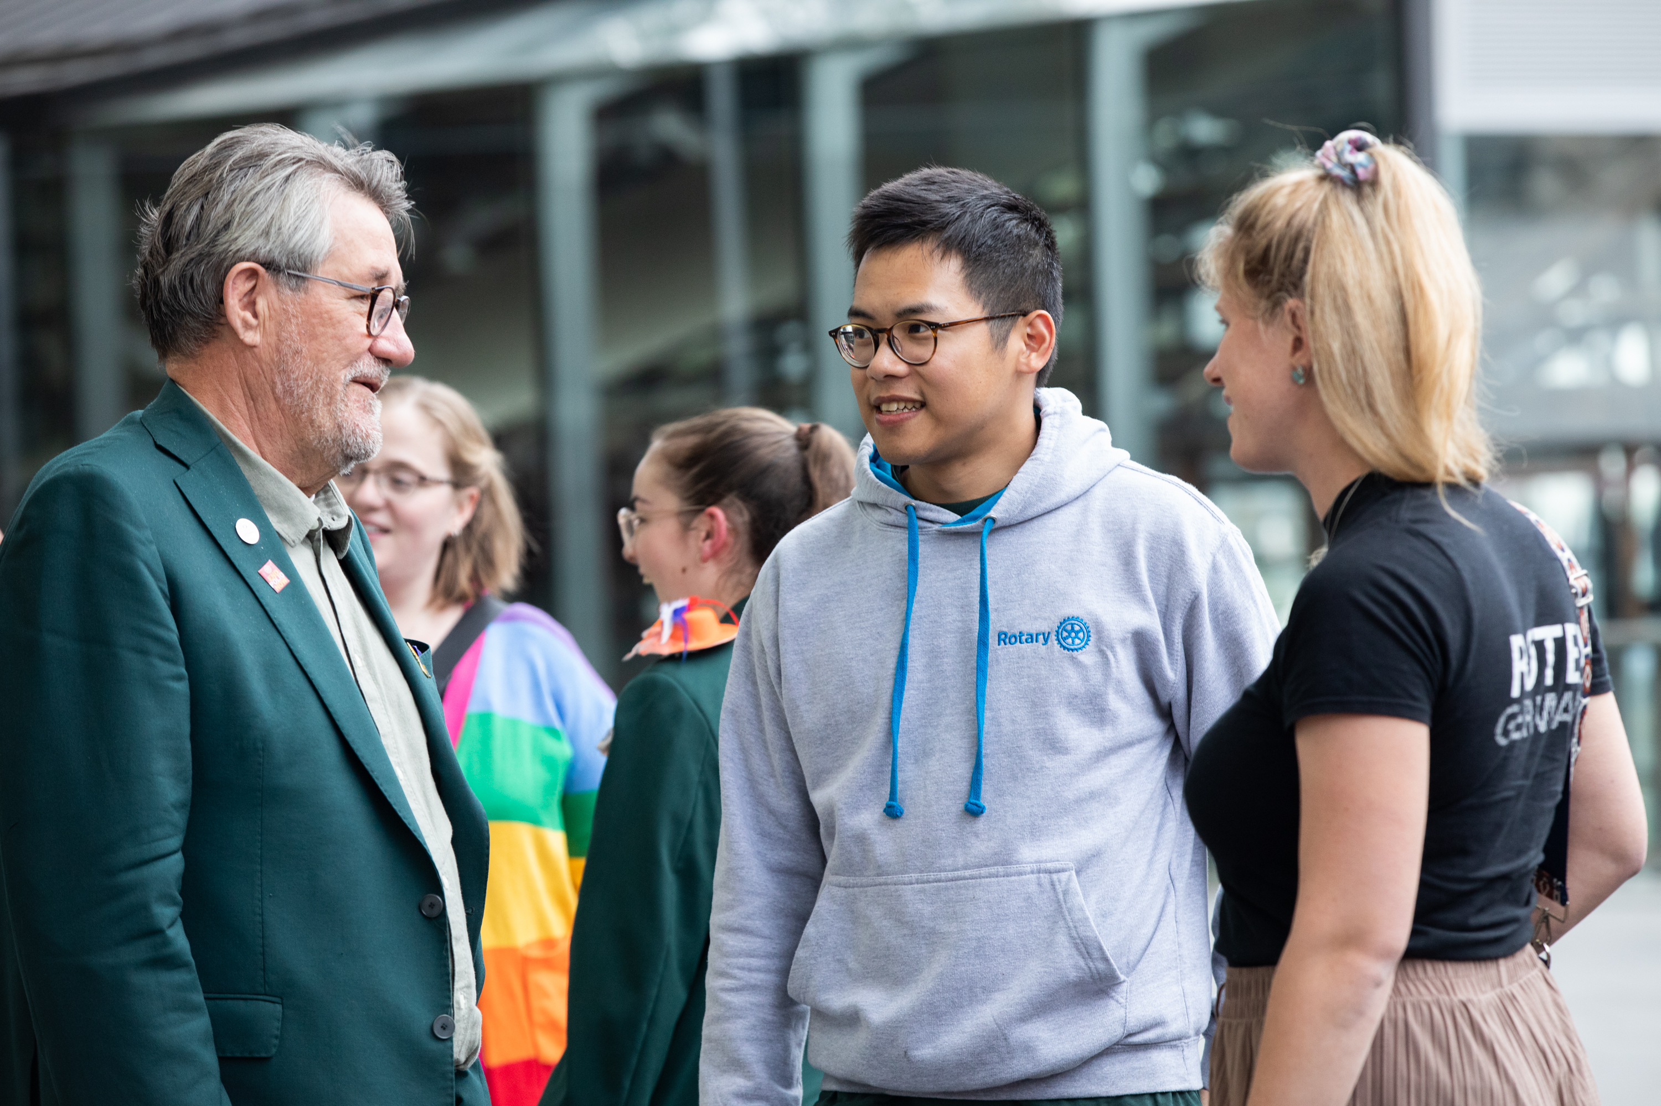
Rotary District 6000 Membership
Find Members Where They Already Are
Seek From a Variety of Events
Be Present in Diverse Communities
Ask About Young Professionals Looking to Grow
Title Page Option

Slide 7
Rotary District 6000 Membership
Offer Options for Involvement
Meetings
Service Projects
Socials
Committees
Events and Learning
Virtual (where applicable)
Title Page Option

Slide 8
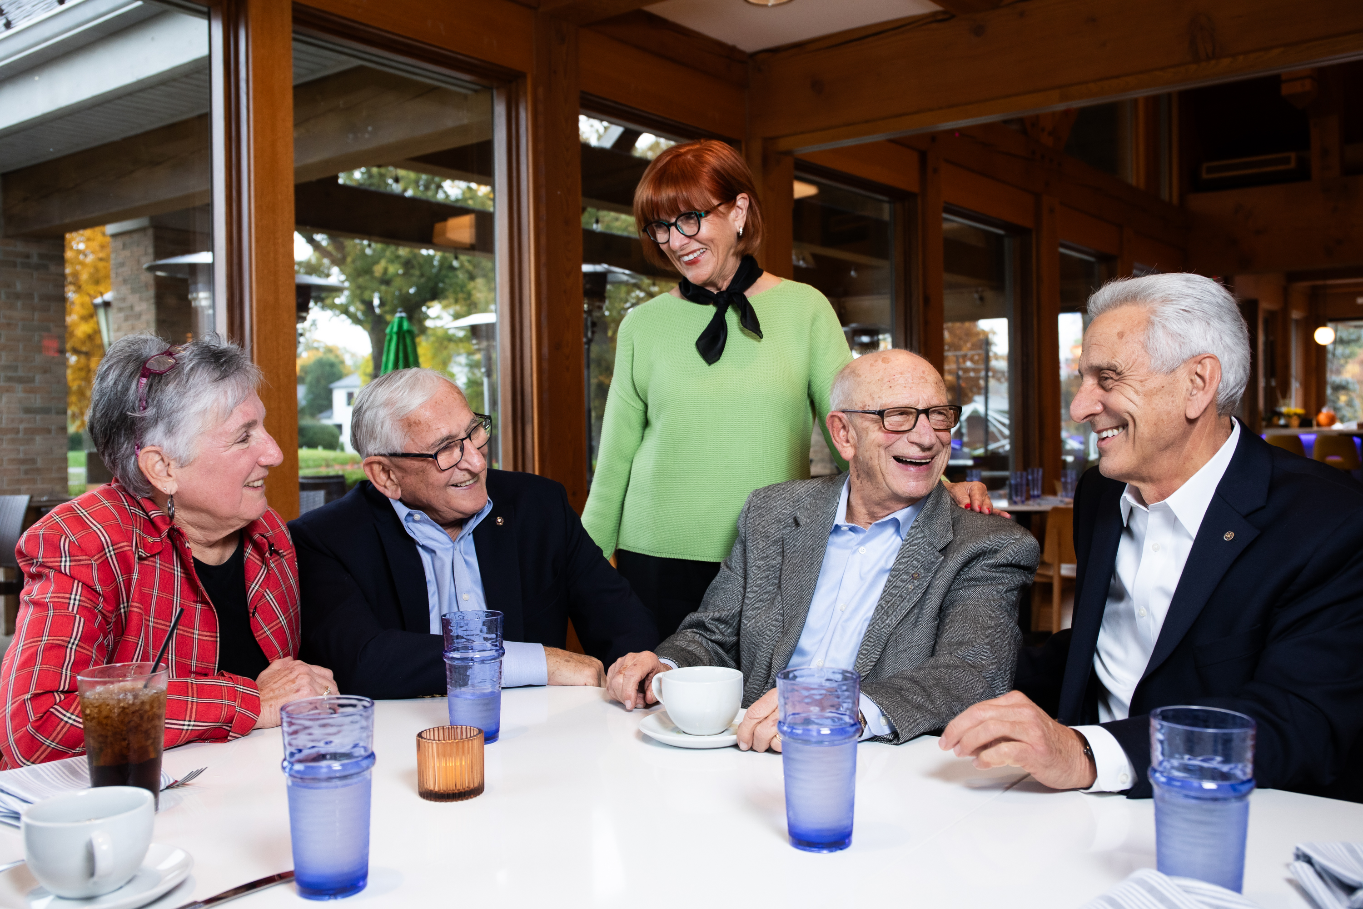
Rotary District 6000 Membership
Create a Welcoming Culture
Communicate Logistics in Advance
Plan for First Impressions
Facilitate the Introductions
Thank and Follow-Up
Title Page Option

Slide 9
Rotary District 6000 Membership
Connect to Rotary’s Global Reach
Over 1.2 Million Members
Share Stories of Global Impact
Explain Local, District and International
Title Page Option

Slide 10
Rotary District 6000 Membership
Communicate the Why
Learn What Appeals to Them About Rotary
Share How They Make a Difference
Talk About Service Above Self
Title Page Option

Slide 11
Rotary District 6000 Membership
Engaging Members
By D6000 Membership Tri-Chair
Larry Thein
Title Page Option

Slide 12
Rotary District 6000 Membership
What is an engaged member?
Why does it matter if members are engaged?
How can you tell if a member is engaged?
Why do people remain serving in Rotary?
Rotary helps members get what they want/need
Fellowship, Service, Networking, Pride, Sense of belonging
Title Page Option

Slide 13
Rotary District 6000 Membership
Why do clubs want engaged members?
Actively engaged members make the club stronger.
Actively engaged members are happier, more focused, and willing to do more.
Actively engaged members stay longer.
Title Page Option

Slide 14
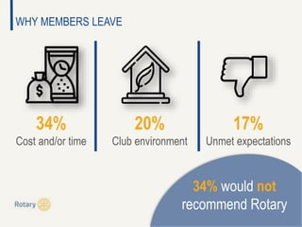
Rotary District 6000 Membership
Why do members leave?
Job Change
Relocation
Death
Dissatisfied with what the club has not delivered on
Their employer stopped paying dues
Many new members leave within the first couple of years
Title Page Option

Slide 15
Rotary District 6000 Membership
How can we create more irresistible clubs that members will not want to leave?
Ask and/or appoint new members to serve on a committee
Implement a Mentorship Program
Red Badge Program/Fireside Chat within the 1st 6 months
Conduct member spotlight (Identify members periodically to talk about themselves) Make this fun!
Small group social interaction outside of the regular meeting (coffee, cocktails, lunch, or dinner) Become friends outside of Rotary
Title Page Option

Slide 16
Rotary District 6000 Membership
Alternative Meetings
Membership Olympics
Membership Leads Management System
By D6000 Membership Tri-Chair
Steve Wieneke
Title Page Option

Slide 17
Rotary District 6000 Membership
Rotary Club Extensions and Cause Based Opportunities
Rotary Club Extension Best Practices
Use creativity and imagination to think outside the box
Don’t be afraid to try something new to attract excitement that new prospective members may find irresistible to be part of
Think of prospective members that we may have discriminated against in the past
Title Page Option

Slide 18
Rotary District 6000 Membership
Meet people where they are at, that is more convenient for their lifestyle
How can we make what we are offering more appealing?
Dates/Times/Places and What prospective members are passionate about (What Jazzes them up)
Costs savings when members have the option of NOT paying for a meal
Title Page Option

Slide 19
Rotary District 6000 Membership
Cause and/or Interest Based Clubs
CLUB MODELS – What approach serves your members best?
Homeless, Outreach, Prevention, & Education (HOPE)
VETERANS
MENTAL HEALTH
PASSPORT
District and/or International Online
Title Page Option

Slide 20
Rotary District 6000 Membership
HYBRID
COMMUNITY CORPS
CORPORATE
ALUMNI BASED
SERVICE BASED
Title Page Option

Slide 21
Rotary District 6000 Membership
Club Membership Olympics Challenge
Appoint a Club Membership Chair
Appoint a Club Membership Committee
Conduct a New Member Orientation/Fireside Chat Program
Submit an Annual Club Membership Goal
New Members assigned to a mentoring sponsor
Title Page Option

Slide 22
Rotary District 6000 Membership
Club Membership Olympics Challenge
Survey Club Members
Conduct Fun Member Engagement Activity
Conduct Program to Address Retention of Members
2 Bonus Rounds
Complete Membership Basic Learning Plan
Sponsor and nurture a Club Extension, Interact, & Rotaract Club
Title Page Option

Slide 23
Rotary District 6000 Membership
Redesign of the RI Membership Leads Management System
How does the current member leads management system operate
Roles and responsibilities of club and district leaders in the current system
Reasons why a redesign of a member lead management system is needed
Action steps to be taken now by current club and district leaders
Action steps club and district leaders are responsible for after redesign goes live
Title Page Option

Slide 24
Rotary District 6000 Membership
Title Page Option

