Slide 1
Play
for
Polio
(

Slide 2
What is Polio?
Attention: Those born after 1970
Polio is a crippling – and fatal – disease primarily effecting children under 5 years
Prior to 1985, polio killed or crippled more than 1,000 people a day in the developing world
In 1985, RI launched “PolioPlus,” a multimillion dollar campaign to immunize the world’s children against polio
In 1988, Rotary formed a partnership with the World Health Organization, UNICEF and the CDC and announced its goal to eradicate polio

Slide 3
What is Polio?
Attention: Those born after 1970
More than 2.5 billion children have been immunized
17,400,000 children have been saved from the paralysis of Polio since 1988
In 2017, less than 25 cases worldwide
Polio cases have been reduced by 99.9% since 1988
The Bill and Melinda Gates Foundation matches $2 for every $1 raised by Rotary to fund Polio eradication

Slide 4
Campaign to eradicate Polio (cont.)
Today, polio is endemic in only three countries – Pakistan, Nigeria and Afghanistan
Rotary wide 2017-2018 Polio fundraising goal is $50 Million + Gates Foundation match
District 6040 raised $83,900 in Rotary year 2016-2017 to eradicate Polio
Total paralysis cases | Year-to-date 2018 | LY to D 2017 | Total 2017 | Total 2016 | Total 2015
Globally | 3 | 3 | 22 | 37 | 74
- in endemic countries: | 3 | 3 | 22 | 37 | 74
- in post-endemic countries: | 0 | 0 | 0 | 0 | 0

Slide 5
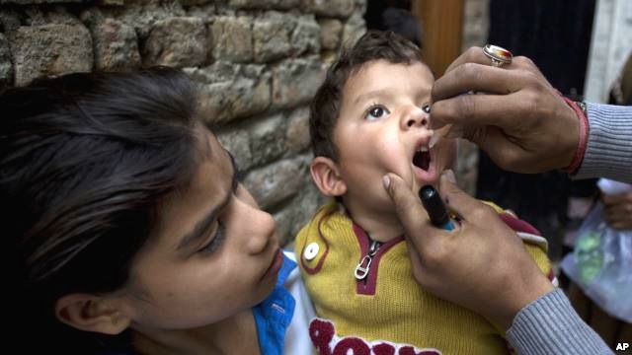
Raise money to help eradicate Polio

Slide 6
Play (Pars or anything) for Polio
District GOAL 2019-20: $40,000.00
District Goal of $40,000 = $16 per Rotary member in District 6040!
District 6040 raised over $83,900 last year for Polio
District 6040 has raised over $100,000 through the Pars vs. Polio golf marathons and $300,000 in total since Pars vs. Polio’s inception with the help of the Gates Foundation match

Slide 7
In Play for Polio –
Rotarians Conduct Local Marathons
Rotarians choose the game:
Bowling (frames bowled)
Softball (Pitches thrown, Swings taken)
Pickelball Dove Hunt (shots taken, Doves harvested
Poker, Bridge, Cribbage Marathons (Hands played, won)
Golf (Holes played)
Soccer Basketball (baskets made from 3pt line)
Songs danced to (a wedding coming up?)
Bean bag toss (maybe at a tailgate party)
Individuals in a club can play at the same time or individually; the same game or different

Slide 8
Conduct Local Marathons
Each club designates a Play for Polio Champion
Schedules a day for a club event and gets club members to identify the games they’ll play (or members play on their own schedule)
Identify club members to get pledges from Rotarians and non-Rotarians friends and family for the number of holes played, doves shot, frames of bowling, pitches thrown, base hits, swings taken, hands of poker played, songs danced to, bean bags tossed, ……..

Slide 9
Promote, Promote, Promote
All club members are promoters
Rotary newsletters, meetings, events
Local media outlets
All forms of social media
Through local golf clubs, dance clubs, bowling leagues, soccer clubs, poker clubs
Ask Non-Rotarian friends for pledges, do an email campaign (by the way, why aren’t they Rotarians?)
Join with another Rotary Club

Slide 10
Raising Funds
Each club set a fundraising goal
Request all members contribute something
Tell the Rotary/Polio story: This Close
Give potential donors a polio fact sheet
Ask for pledges per hole or lump sum

Slide 11
Raising Funds, (cont.)
Create a PGA Championship pool – sell squares
Club competitions
Play most holes, frames bowled, innings pitched
Raise most money
Set up a competition with another club

Slide 12
Raising Funds (cont.)
Advise donors they can make checks to “The Rotary Foundation” – a charitable donation
Checks should be mailed to the Club Champion for their deposit on the Multiple Donor Form of The Rotary Foundation.
Contact the club secretary or treasurer or Play for Polio Coordinators

Slide 13
Most Importantly
Get Creative
Get Out, Get Active, Socialize
Eradicate Polio EVERYWHERE
HAVE FUN!!!

Slide 14
Submit Funds to TRF
Deadline is March 30, 2020 for games to be completed.
Collect money and submit to TRF
Club Secretary or Treasurer should be familiar
Send total to Jim Bergman to tally for District wide effort
Jim_bergman@chs.net

