Slide 1
District 6040 International
District Grant Scholarships and Global Grant Scholarships
Title Page Option

Slide 2
District Grant Scholarships and Global Grant Scholarships
District Grant Scholarships provide a stipend of $2,500 for one or two semesters of undergraduate or graduate level coursework abroad.
  https://my.rotary.org/en/take-action/apply-grants/district-grants
Rotary District 6040 Global Grant Scholarships awards range from $30,000-$70,000 and fund graduate level coursework or research for one to four academic years at an educational institution in another country.
  https://my.rotary.org/en/take-action/apply-grants/global-grants

Slide 3
District Grant Scholarships and Global Grant Scholarships
The number of grants available vary from year to year
  Typically include one to three District Grant Scholarships and one Global Grant Scholarship of $70,000 (or two scholarships of $35,000 each per year).
  The number of scholarships funded is dependent upon Annual Fund/SHARE contributions from clubs and individuals three years prior to the current Rotary year.

Slide 4
District Grant Scholarships and Global Grant Scholarships
Scholar applicants must reside in District 6040 or be currently enrolled and attending or a graduate of a higher education institution at a campus in District 6040.
  Applicants for district grant scholarships must have completed at least one year at a higher education institution prior to grant-funded study.
  Residency within District 6040 is determined by where the applicant pays income tax or where applicant’s parents reside if the applicant is considered a deduction on their parent’s income tax return.
  Applicants must be sponsored by a D6040 Rotary Club that is Grants Qualified during the application year and study year.

Slide 5
District Grant Scholarships
Application for Study
Rotary District 6040 Grant Scholarships are in the amount of $2,500.00 and can be used to fund one or two semesters of undergraduate or graduate study at an international institution.
  Students and their families should plan on district grants being a reimbursement after study is completed. Scholarships are awarded in one Rotary year and may be funded in the next Rotary year. The District will make every attempt to reimburse students and their families as quickly as possible. Funds should be available by late September or before but cannot be guaranteed.
  Deadlines:
    March 1, of the travel year – application submitted to sponsoring Rotary Club
    April 1, of the travel year – application submitted to District Scholarship Subcommittee Chair

Slide 6
District Grant Scholarships
Application for Study
Applicants must provide written proof of university admission to the District Grant Scholarship Sub-Committee (the Sub-Committee) Chairperson prior to grant approval and funding.
  Applicants may submit a District Grant Scholarship Application to a Rotary Club in District 6040 with written proof of university admission pending.
Reside in District 6040 or be currently enrolled and attending, or a graduate of a higher education institution at a campus in District 6040.
  Applicants must have completed at least one year of study at a higher education institution prior to grant-funded study.
  If not currently enrolled or a graduate of a District 6040 educational institution, residency within District 6040 is determined by where the applicant pays income tax or where the applicant’s parents reside, if the applicant is considered a deduction on their parent’s income tax return.

Slide 7
District Grant Scholarships
Application for Study
Not be Rotarians or Honorary Rotarians
  See outline for details
District Grant Scholarships cannot be used for unsupervised research, medical internship or residency or for employment on a full-time basis in the host country. District Grant Scholarships may be used only for the program outlined in the application.
Applicants must study outside their home country. District 6040 reserves the right to limit foreign study to areas considered safe by the U.S. Department of State.

Slide 8
District Grant Scholarships
Application for Study
Have area of study and professional goals in an area of humanitarian service in one of TRF’s Seven Areas of Focus:
  Peace and conflict prevention and/or resolution
  Disease prevention and treatment
  Water and sanitation
  Maternal and child health
  Basic education and literacy
  Economic and community development.
  Protecting the environment
Submit a budget showing anticipated expenses and anticipated sources of funds with this application.
Complete the coursework and any humanitarian project described in this Application.
  Failure to complete the coursework and any project for reasons outside of scholar’s or scholar’s immediate family member’s serious illness or death may result in request for reimbursement of the grant.
  Any such request shall be at the discretion of the District 6040 Governor, Foundation Chairperson and Sub-Committee Chairperson.

Slide 9
District Grant Participants
Academic Year 2018-2019
Name | School | Level | Local Club | Location
Clayton Mansel | William Jewell | Undergrad | Liberty | Oxford
Riley Martin | William Jewell | Undergrad | Liberty | Oxford
Riley Garrett | University of Arkansas | Undergrad | Liberty | South Africa
Academic Year 2019-2020 – Beginning of COVID
Name | School | Level | Local Club | Location
Drew Zeba | Truman State University | Undergrad | Kirksville North Star Club | Asociacion Pop Wuj, Quetzaltenango, Guatemala
COVID Break

Slide 10
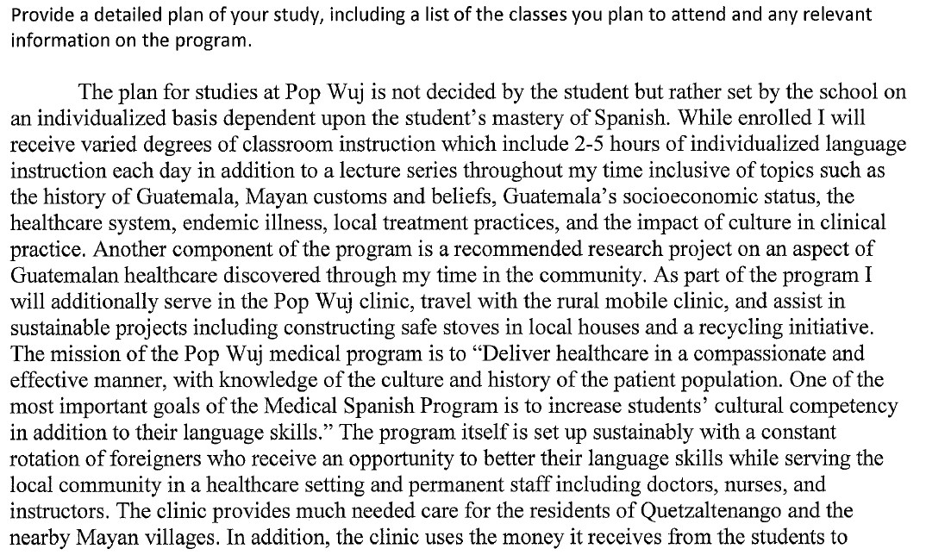
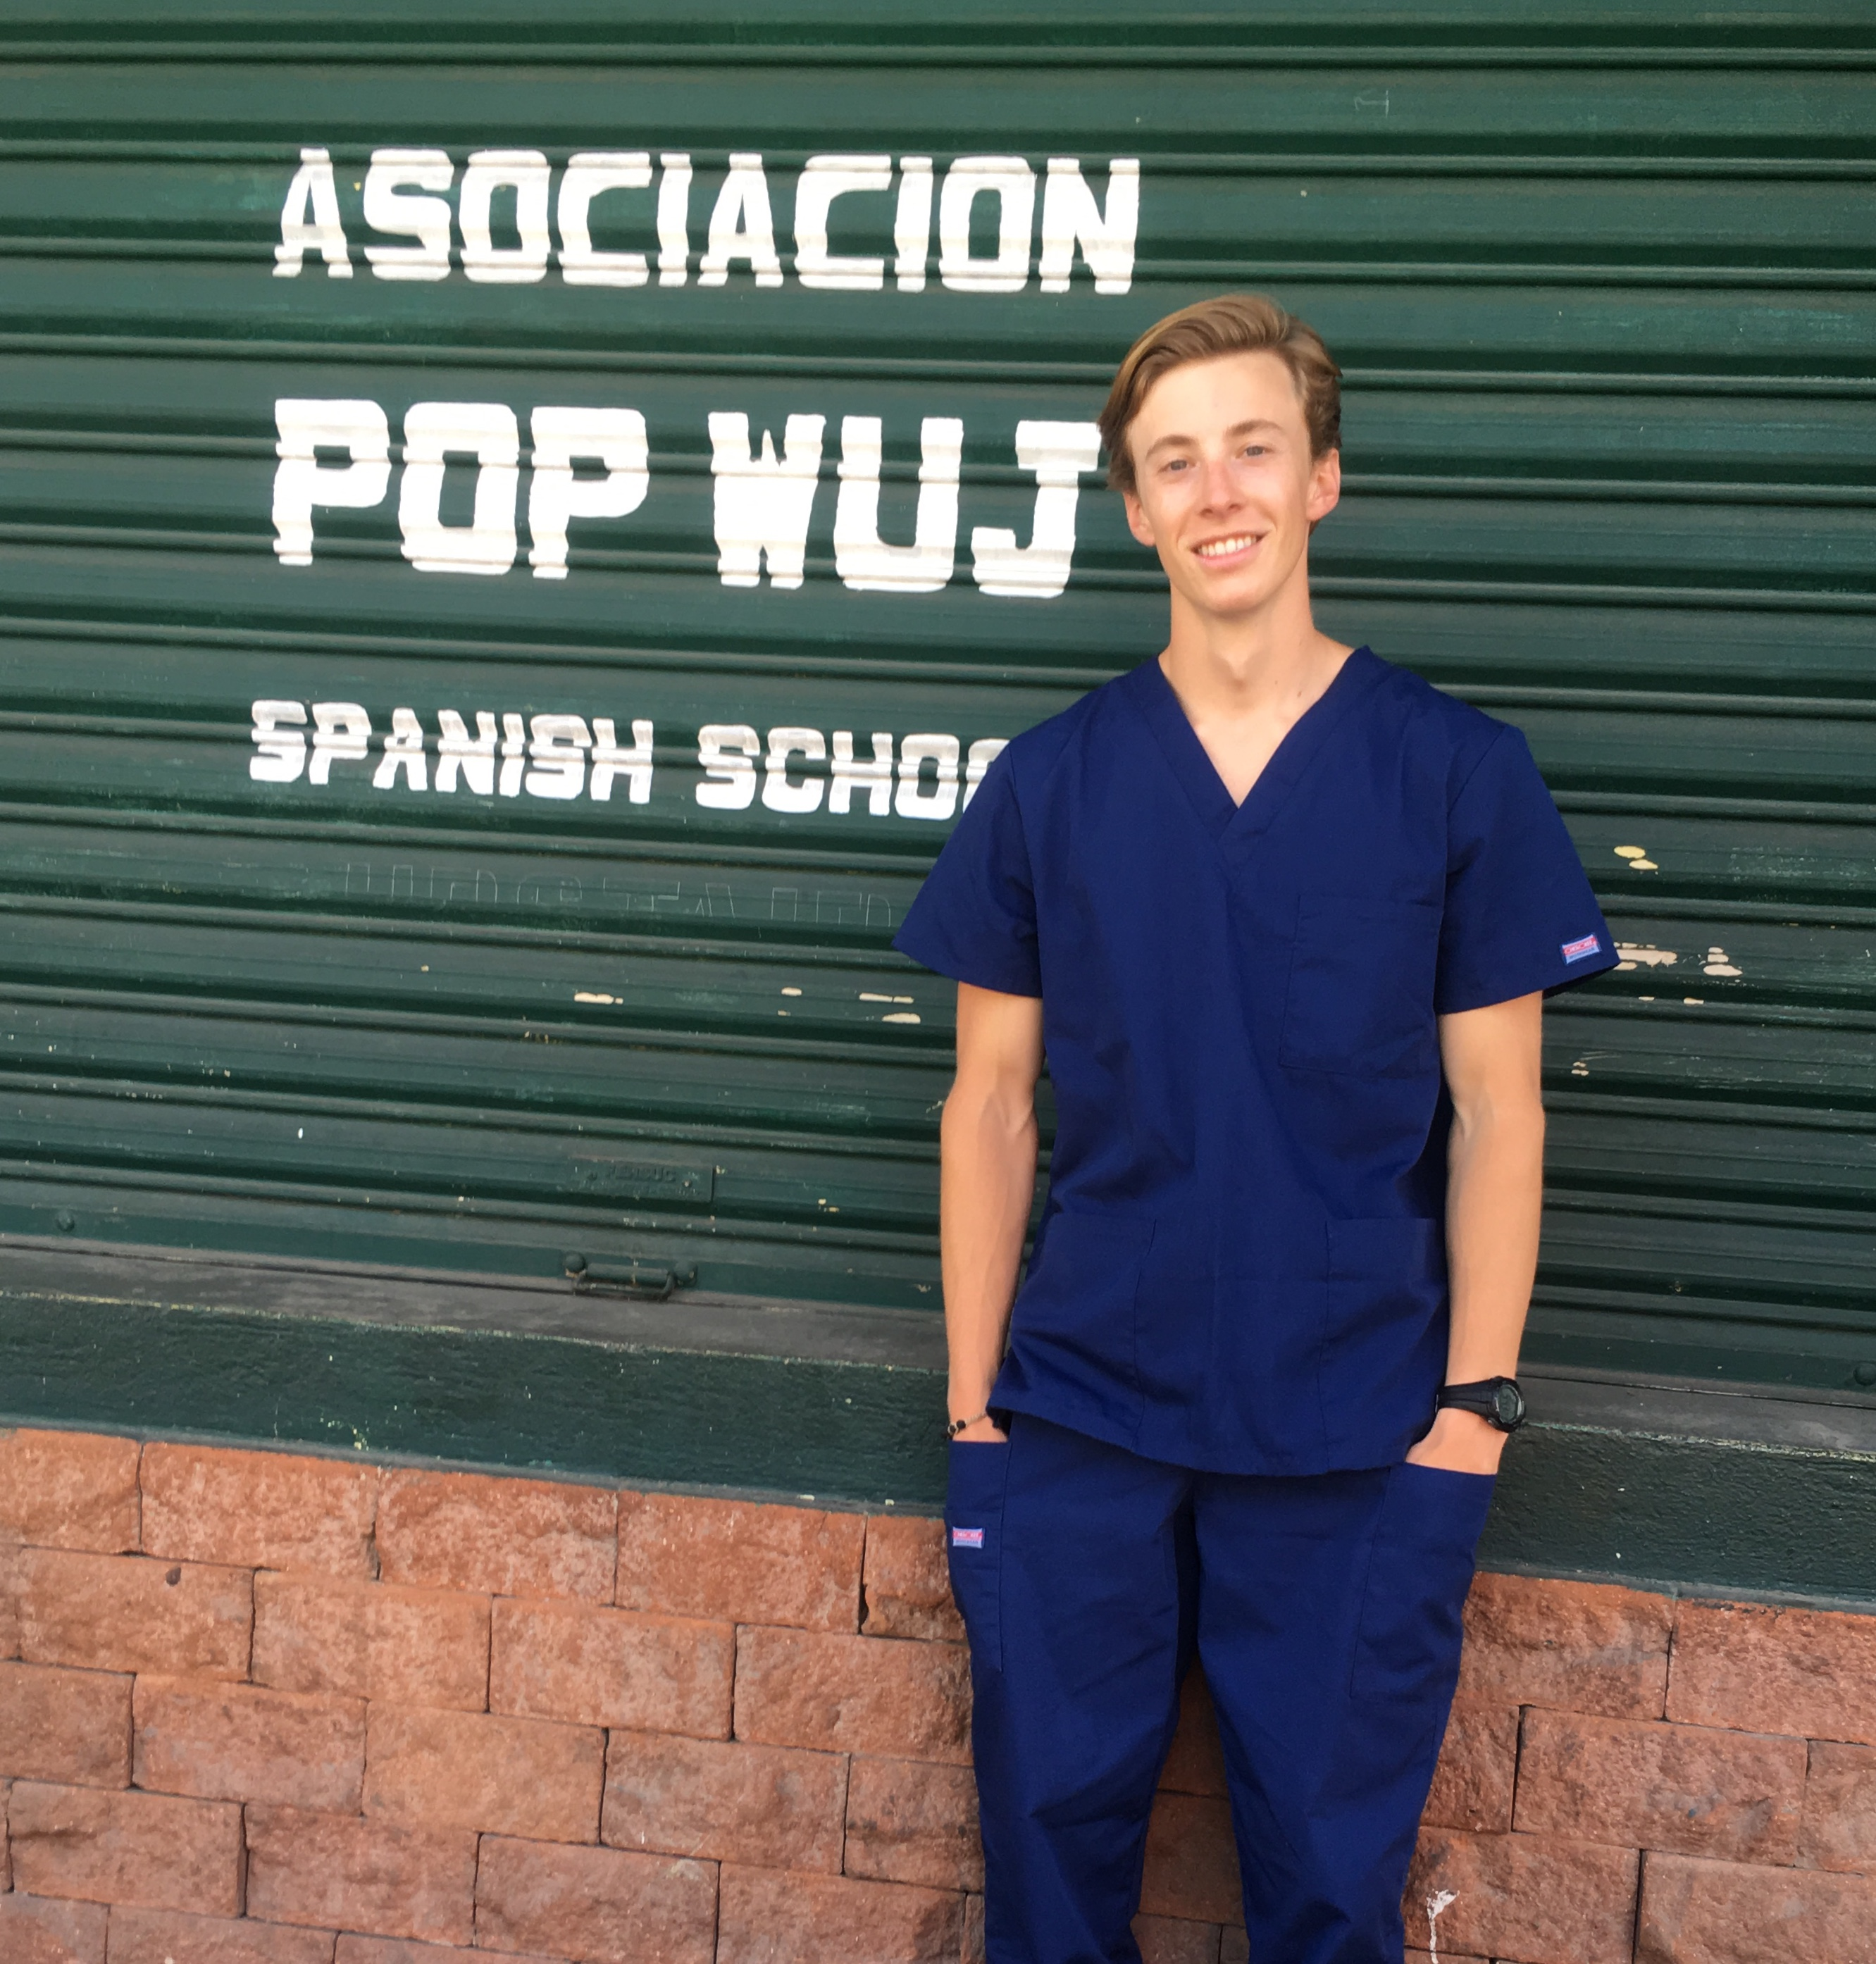
Name | School | Level | Local Club | Location
Drew Zieba | Truman State University | Undergrad | Kirksville North Star Club | Asociación Pop Wuj, Quetzaltenango, Guatemala
Academic Year 2019-2020 – Beginning of COVID

Slide 11
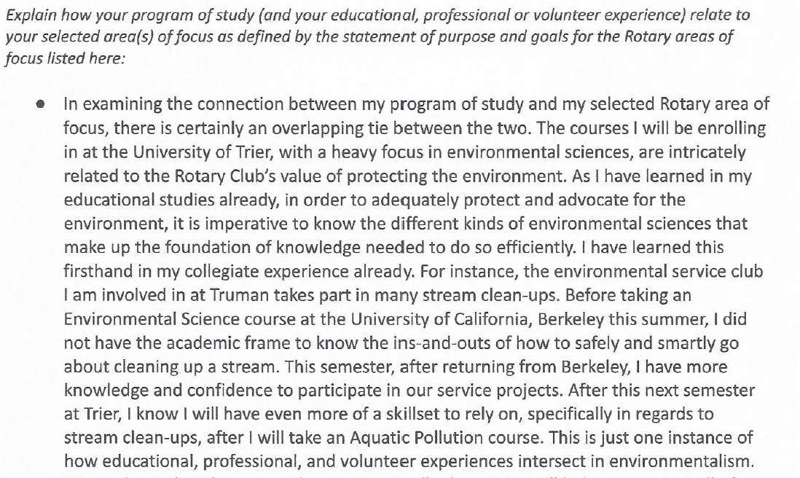
Name | School | Level | Local Club | Location
Drew Arends | Truman State | Undergrad | Kirkville, Thousand Hills | Trier Germany
Academic Year 2020-2021 COVID Hold
Academic Year 2022-2023

Slide 12
Global Grant Scholarships
Rotary District 6040 Global Grant Scholarships awards range from $30,000-$70,000 and fund graduate level coursework or research for one to four academic years at an educational institution in another country.
  Global Grant Scholarships are not awarded until The Rotary Foundation (TRF) approves applicant’s online grant application.
  Applications may be submitted on a rolling basis throughout the year, subject to the below timeline.

Slide 13
Global Grant Scholarships
Applicants must submit the completed Global Grant Scholarship Preliminary Application to a club in District 6040. (Do not forward this application to TRF.)
  Submission to a Rotary Club must occur at least five months prior to applicant’s anticipated study departure date i.e. for applicants with an anticipated departure date on or about August 1, submission to a Rotary Club must occur no later than March 1.
See outline for details of approval flow.

Slide 14
Global Grant Scholarships
Upon selection by the D6040 Scholarship Committee, submit an online application to TRF at least three months prior to applicant’s anticipated study departure date i.e. for applicants with an anticipated departure date on or about August 1, submission of the online application must occur no later than May 1.
Reside in District 6040 or be currently enrolled and attending or a graduate of a higher education institution in District 6040. If not currently enrolled or a graduate of a higher institution with the district, residency will be determined by where the applicant pays income tax or where the applicant’s parents reside if the applicant is considered a deduction on their parent’s income tax return.

Slide 15
Global Grant Scholarships
Applicants must not be Rotarians, including Honorary Rotarians
  See outline for details.
Applicants must study outside their home country. District 6040 reserves the right to limit foreign study to areas considered safe by the U.S. Department of State.

Slide 16
Global Grant Scholarships
Applicants must have an area of study and professional goals in one of TRF’s Six Areas of Focus:
  Peace and conflict prevention and/or resolution
  Disease prevention and treatment
  Water and sanitation
  Maternal and child health
  Basic education and literacy
  Economic and community development.
  Protecting the environment
Include the following with the application
  A detailed budget that includes anticipated sources of funding
  A detailed plan of study
  Complete the course work and any humanitarian project specifically described in this application.
Global Grant Scholarships cannot be used for unsupervised research, medical internship or residency or for employment on a full-time basis in the host country.
Submit a final written report to The Rotary Foundation by August 1 of each year. If studies continue beyond the August 1 deadline, an interim report is required.

Slide 17
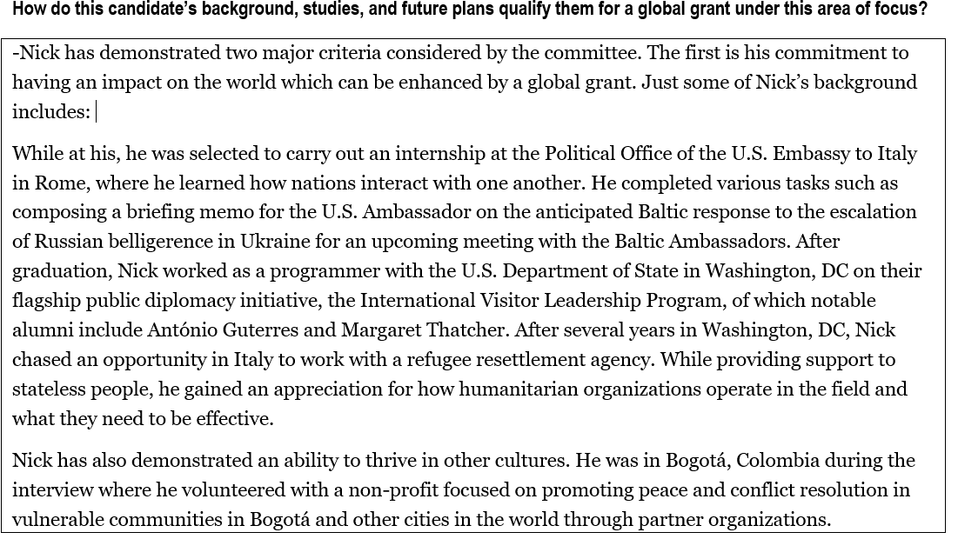
Name | Program | Location
Nick Wehner | MSc Conflict Studies | London School of Economics and Political Science
Academic Year 2019-2020 Delayed one year due to COVID

Slide 18
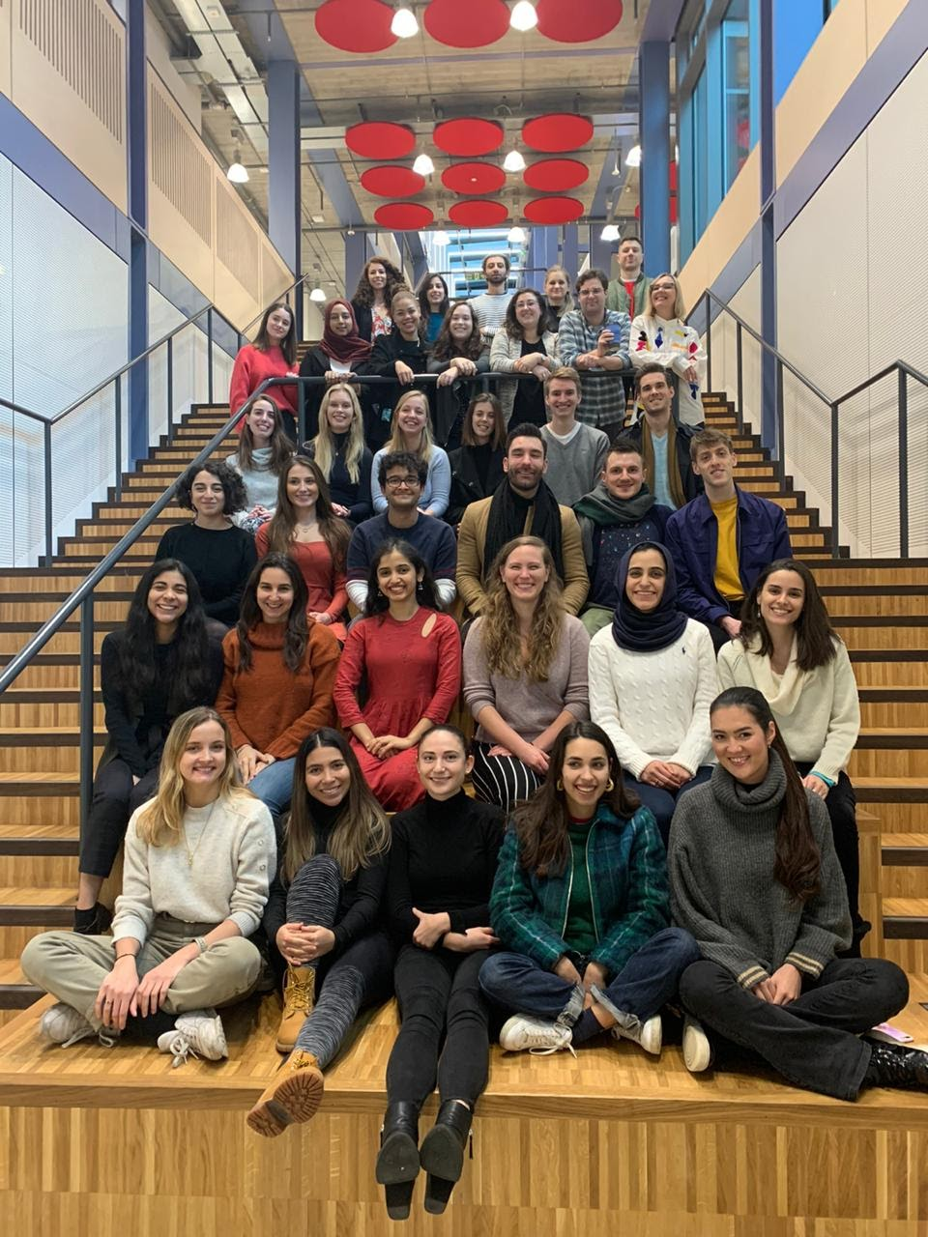
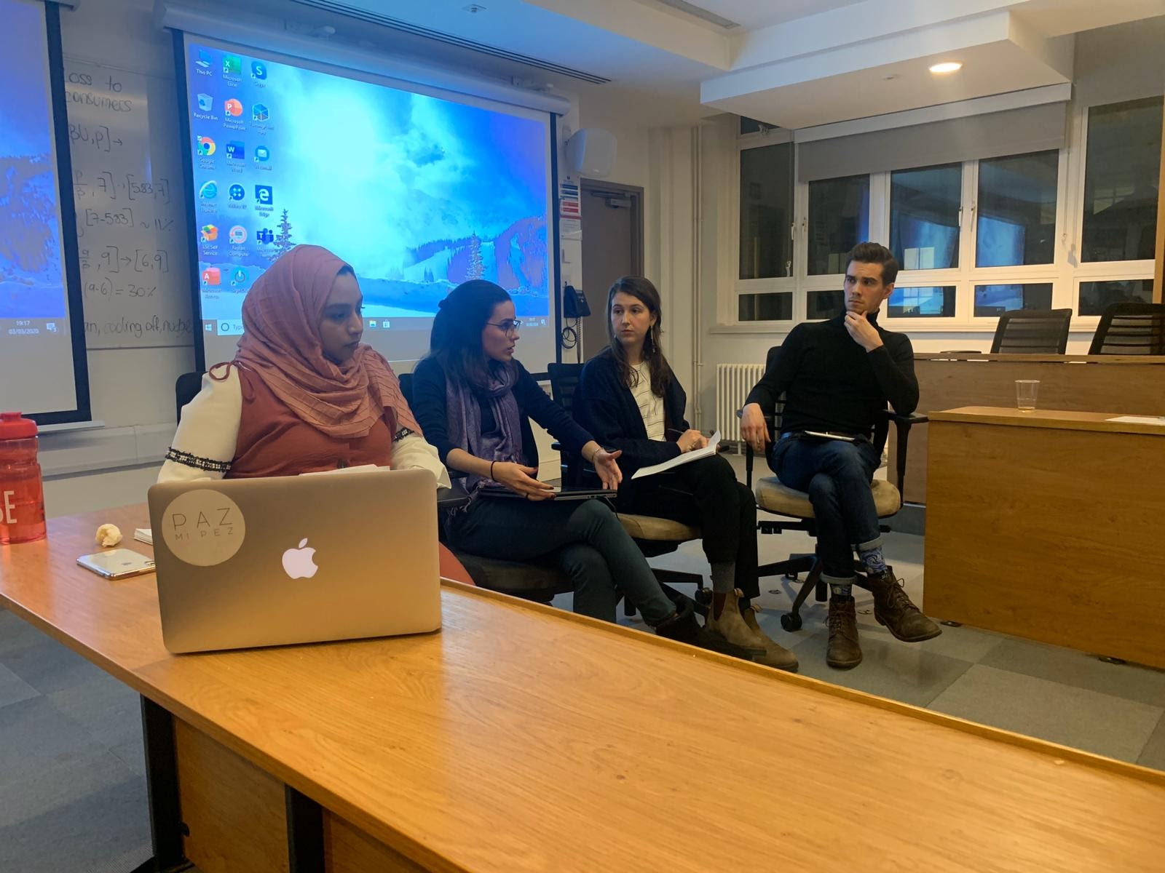
Nicholas M Wehner
Name | School | Level | Local Club | Location
Nick Wehner | Truman State University | Undergrad | Kirksville North Star Club | London School of Economics and Political Science
A few classmates and I started a panel series in which those with professional experience in our master's program would gather and discuss our work. In this picture I'm moderating a discussion panel on working with migrants and refugees.
This is the 2019/20 Conflict Studies MSc program cohort.

Slide 19
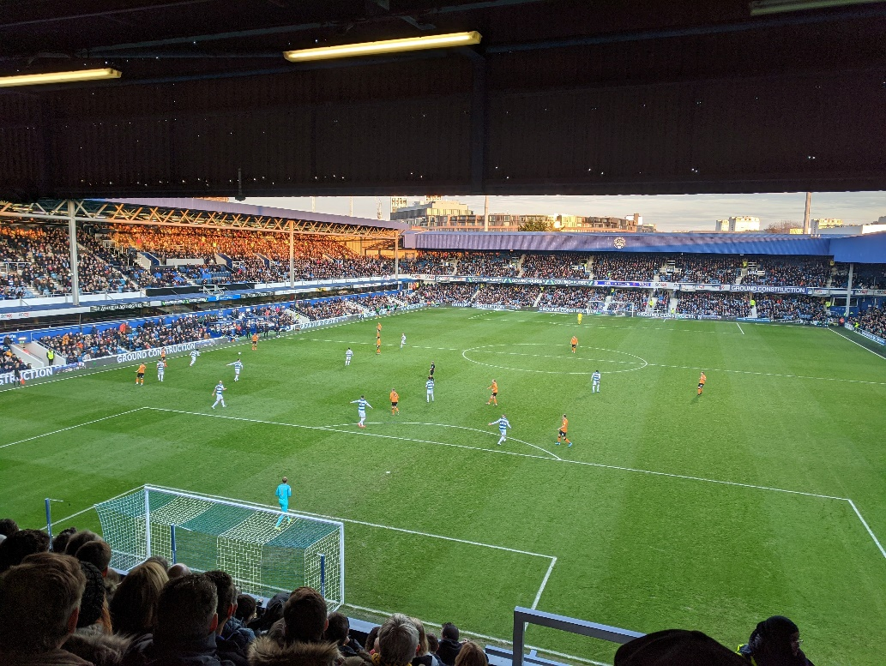
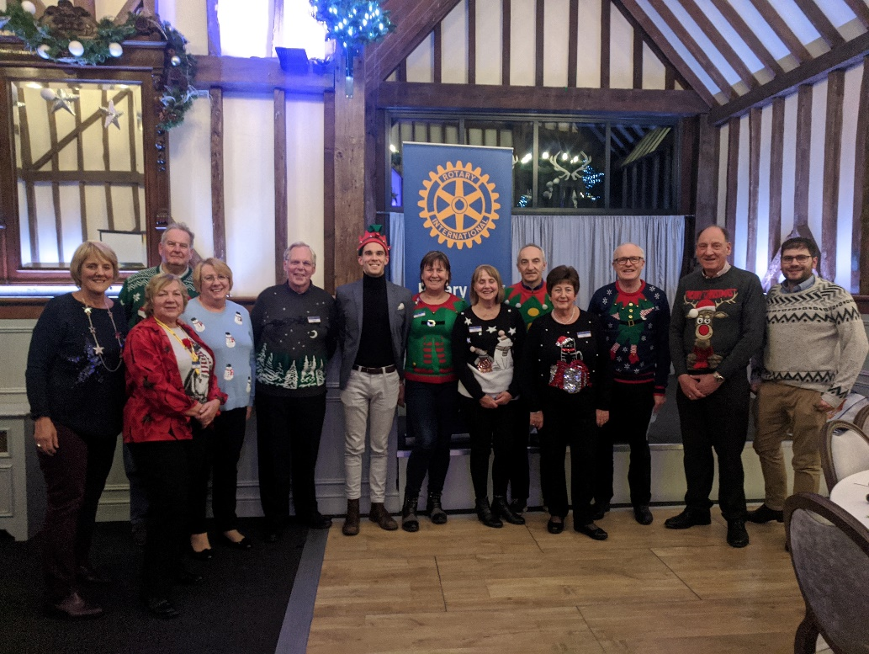
Nicholas M Wehner
I grew quite close to Neil Kirby, the Rotary member who volunteered to act as my Host Councilor from Rotary Club of Brookmans Park. He is an avid fan of the footballer team Hull City (where he's from). So as a Christmas present he took me to a Hull City game when they came to London to play the Queens Park Rangers. (Hull City won!)
I attended many club meetings outside of London, several at my host club (Brookmans Park). One that I attended was near Christmas, for which the club members donned their best ugly Christmas sweaters. Alas I had left mine at home, so Neil was kind enough to lend me his hat!)

Slide 20
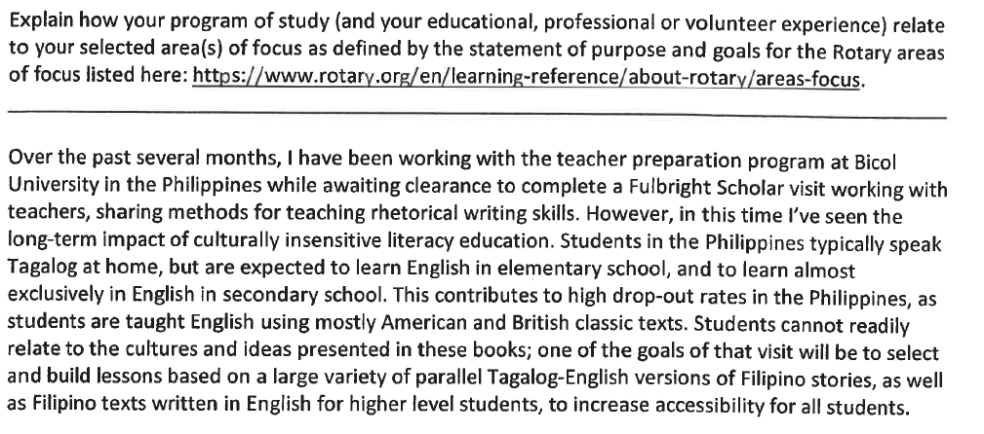
Name | Program | Location
Jillian Schleiden | Combined Mphil/ PhD Program in Education: Critical Approaches to Children’s Literature | University of Cambridge
Academic Year 2021-2022

Slide 21
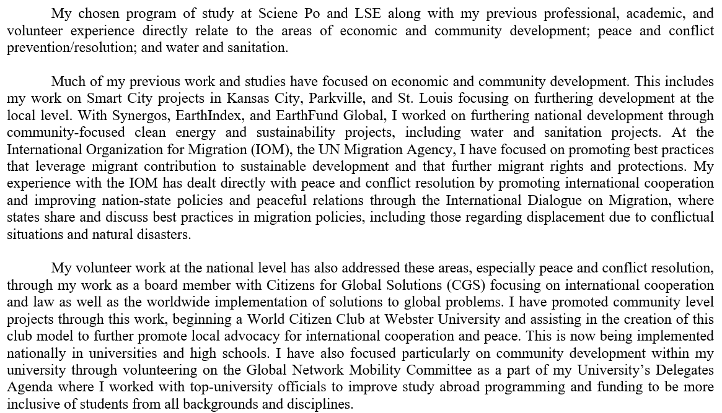
Name | Program | Location
Hannah Emerson | Year Once:, Environmental Policy; Development Management Year Two:, MSc in Development Management | Sciene Po Paris London School of Economics and Politics
Academic Year 2021-2023

Slide 22
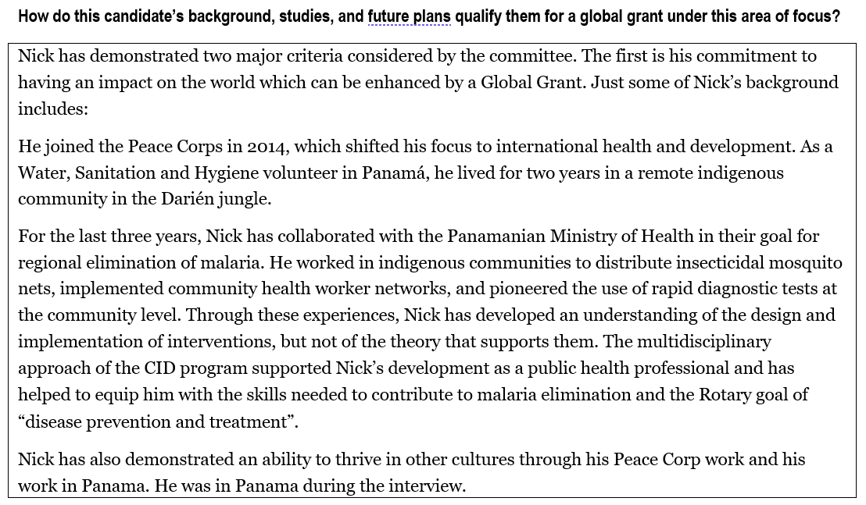
Name | Program | Location
Nicholas Presley | MSc Control of Infectious Diseases | London School of Hygiene and Tropical Medicine
Academic Year 2021-2022

Slide 23
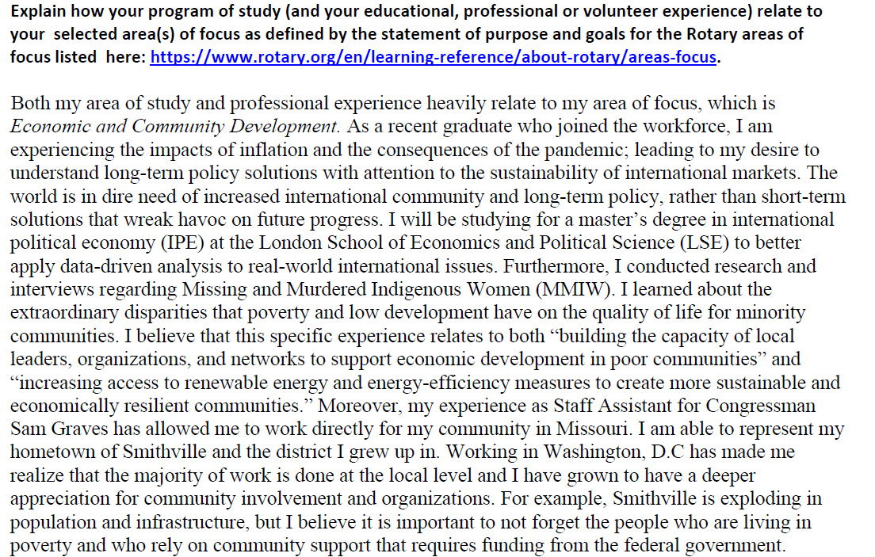
Name | Program | Location
Mira Bannwarth | International Political Economy | London School of Economics and Political Science
Academic Year 2023-2024

Slide 24
Where Are They Now
Name | District Grant Recipiants
Clayton Mansel | MS2 MD/PhD student at the University of Kansas Medical Center. My current focus is building a solid foundation in medicine and pursuing my research interests in neurology as I choose a lab for my dissertation.
Riley Martin | Clinical Research Coordinator at University of Kansas Medical Center
Riley Garrett | Working at the crossroads of environmental advocacy, education, and the built environment.
Drew Zieba | Student at University of Missouri- Kansas City School of Dentistry, Ensign at US Navy

Slide 25
Where Are They Now
Name | Global Grant Recipiants
Nick Wehner | Public Policy Specialist, Buenos Aires
Jillian Schleiden | Learning Strategy and Instructional Technology Integration Leader University of Cambridge, Cambridge, England
Hannah Emerson | Year 2 of Global Grant, London School of Economics
Nicholas Presley | Research Coordinator, Trachoma Control Program The Carter Center, Atlanta, GA

Slide 26
How To Motivate Applicants
Some individuals are self motivated for international travel and experiences
  Most likely the person has had previous experience with international travel.
For individuals who have not lived outside of the U.S.
  Need to see a benefit in leaving behind current tracks
    Interference with graduation timeline
    Costs
    Fear of the unknown
    Convincing family to support travel and living abroad
Need advocate at educational institution

Slide 27
Scholarships Timeline
Item | Date
Inform presidents of local clubs about this opportunity | August
Visit clubs in region to reinforce members should inform students of the opportunities | September
Inform key influencers at colleges and universities about this opportunity | September
Identify and send key contacts at colleges and universities to committee chair
Inform students of the opportunity and application process | October
Identify student’s who may be interested and send contact information to committee chair
Global Grant Scholarship Preliminary Application to a District 6040 Club. | March 1
Applications selected for sponsorship by a District 6040 Rotary Club must be forwarded to the District 6040 Scholarship Sub-Committee | April 1
Committee will assist Global Grant Scholars in writing Global Grant May
Upon selection by the D6040 Scholarship Committee, submit an online application to TRF | May 1
Announcement of the 2018-19 scholars (to study in 2019-2020) in May.

Slide 28
Student’s Timeline
District Grants | Key Dates
Student identifies opportunity for international program. Often sponsored by the university. | Typically fall semester in advance of summer or following fall travel.
Student needs to know about Rotary district scholarship. | Application time March 1, develop application January and February.
Global Grants | Key Dates
Student identifies opportunity for international graduate degree program. | Typically fall semester in advance of summer or following fall travel.
Student needs to apply to a program and be accepted. Student should be committed to the program without the scholarship. | At least a year in advance.
Student needs to know about Rotary district scholarship. | Application time March 1, develop application January and February.

Slide 29
Resources
Rotary International Global Grant Scholarships
  https://www.rotary.org/en/our-programs/scholarships
Global Scholarship Grants
  https://rotary6040.org/Stories/global-scholarship-grants
District Scholarships
  https://rotary6040.org/sitepage/trf-scholarships/scholarships

Slide 30
Rotary Peace Fellows
Rotary Peace Fellowship covers tuition and living expenses for students in a 15 to 24 month program at one of Rotaries five Rotary Peace Centers at leading partner universities. The Fellowship also covers expenses to increase the capacity of existing leaders to prevent and resolve conflict through academic training, field experience, and professional networking.
The spike in regional and local conflicts around the globe has boosted the need for peace and development leaders skilled in building positive social change.
Up to 100 fellows are selected every year in a globally competitive process based on personal, academic, and professional achievements. Fellows earn either a master’s degree or a professional development certificate in peace and conflict studies at one of the Rotary Peace Centers, located within seven leading universities around the world. More than 1,200 program alumni are working in over 100 countries as leaders in national governments, NGOs, social enterprises, the military, law enforcement, and international organizations such as the United Nations.
(https://www.rotary.org/en/our-programs/peace-fellowships)

Slide 31
Rotary Peace Fellow Master’s Degrees
15-24 month program at one of our 5 Rotary Peace Centers at leading partner universities (https://www.rotary.org/en/our-programs/peace-fellowships)
50 fellows selected annually to earn a master’s degree in fields related to peace and development. Each university offers interdisciplinary curricula with research-informed teaching
2-3 month self-designed applied field experience to develop practical skills
Fellows connect with an international cohort of peace fellows, thought leaders, and a global network of Rotarians

Slide 32
Rotary Peace Fellow
Professional Development Certificates
3 month professional development program at our Rotary Peace Center in Bangkok, Thailand (http://www.rotarychula.org/)
Intended for social change leaders with extensive experience working in peace-related fields
50 fellows selected annually to earn a professional certificate in peace and conflict studies
Diverse interdisciplinary program includes 8-weeks intensive classroom study with guest lecturers and up to 3weeks of field studies.

Slide 33
Rotary Peace Fellows
Eligibility: Take the eligibility quiz. (https://rotary.qualtrics.com/jfe/form/SV_bxsthkafvzV5aRv?Q_JFE=qdg)
Qualified candidates have:
  For the master’s program, a bachelor’s degree or equivalent, plus 3 years of related work experience, and proficiency in a second language (strongly recommended)
  For the certificate program, a strong academic background, plus 5 years of related work experience
  Proficiency in English
  Excellent leadership skills
The academic term deadline is 31 May 20XX. Begin by watching our Application Checklist Video (https://vimeopro.com/rotary/rotary-peace-fellow-application-checklist) and review the application process online. (https://my.rotary.org/en/peace-fellowship-application)
Please contact us at rotarypeacecenters@rotary.org with questions. (mailto:rotarypeacecenters@rotary.org)

