Slide 1
2026 District 6290
Grant Management Seminar
District Local &
District International Grants
Notes:
Welcome to District 6290 Rotary Foundation Grant Management Seminar

Slide 2
Rotary Foundation Mission
The Mission of the Rotary Foundation is to enable Rotarians to advance world understanding, goodwill and peace through the improvement of health, the support of education and the alleviation of poverty.

Slide 3
95% of our donations to the Annual Fund are used to fund matching grants
Matching grants leverage club projects from GOOD to GREAT!
Rotarian donations fund the club projects that change lives and build better communities around the world.
Rotary Foundation size and reach make Rotary club projects the most significant force for doing good in the world.

Slide 4
Rotary Foundation SHARE System
Available
ailable
Notes:
THIS IS THE MOST IMPORTANT PART OF OUR DISCUSSION TODAY
How your donations to the Annual Fund are handled when they arrive at The Rotary Foundation, and then how they are turned into matching funds for your grant requests: THIS IS IMPOSSIBLE TO READ. Please be sure you have a handout to follow along and take notes.
First they sit in a bank account earning interest for three years. At the end of three years the interest earned goes to TRF to run their business and all the money we gave is divided in half:
Our half is called District Designated Funds and they come back to us to match club’s grant requests for three kinds of grants: District Local and District International Grants and Global Grants (more on these in a minute).
The half other half is deposited in the World Fund and are available to match Global Grants from all club requests worldwide
Voila! All your donations from three years ago are now available to become matching funds for club grant requests! Here is the important lesson: the more we donate to the Annual Fund, the more is available to go back to clubs to turn good projects into great projects. That is the only thing our donations are used for!
The 50% set aside for the DDF gets further broken down by the District Rotary Foundation committee
Up to half can be used to match club requests for District Local and District International grants the other half is used to match Global Grant requests by 6290 clubs
It is the matching formulas that make this grant program so significant, leveraging your money into twice and even 3.5 times greater than the initially available funds at your club level. Here is how this works:
District grants: both local and international get matched at the rate of up to 1:1 ($2500 in club funds becomes $5,000 in project funds
Global Grants get matched like this:
DDF matches club funds at up to 1:1 ($10,00 from club gets another $10,00 from DDF)
The World fund matched DDF funds at 1:1 ($10,00 DDF gets another $10,00 from World Fund)
The World Fund matches club funds at .5:1 (Club $8,500 gets another $4,250 from World Fund)
$10,00 in club funds becomes $35,000 in project funds
Where can you go to leverage your funds at a better rate,? And all this is available BECAUSE of the donations you and we and all Rotarians made to the Rotary Foundation Annual Fund three years previously.

Slide 5
Five components of the Rotary matching grant program

Slide 6
Before Applying for matching grant Funds from 6290 DDF
Each Club Must:
Sign and return the MOU and Addendum
Attend the Grant Management Seminar.
Pay district and RI dues on time.
Meet the per capita giving requirements
Submit all final project reports from last year’s grants on time.

Slide 7
Focus on One or More of the Seven Areas of Focus
Promoting Peace
Fighting Disease
Providing Water, Sanitation and Hygiene
Saving Mother and Child
Supporting Education
Growing local economies
Protecting the environment

Slide 8
Grant Management Stewardship
Sign and return the Memorandum of Understanding (MOU) and district addendum before applying for a grant.

Slide 9
Sustainability
“Host Communities must be able to address their own needs after the Rotary club or district has completed it’s work.”

Slide 10
2026 District 6290
Grant Management Seminar
District Local and International Grants

Slide 11
APPLYING FOR DISTRICT LOCAL AND INTERNATIONAL GRANTS
Type of Grant | Number Allowed per Year | Individual or Collaborative | Range of Grant Awards
District Local | One | Individual | $500 - $2,500
District Local |  | Collaborative | Only if funds are available X-dollars per qualified club
District International | One | Individual, collaborative only if funds are available | $1,000 - $5,000 per qualified club participating,

Slide 12
DISTRICT GRANT REVIEW PROCESS
Grant applications accepted – 7/1 – 10/15 2026
Preliminary Grant reviews from – 10/16 –10/31/2026
Final grant review– participation required – the second Tuesday of November – November 10, 2026
Application to TRF 11/15 – 12/15/2026
Expected check from TRF – not before 12/31/2026
Checks mailed to clubs – By 1/15 – 2/15 2027
Final/Progress reports – One year from funding or within 30 days of completion

Slide 13
DISTRICT LOCAL GRANTS
Signer MUST have taken GMS
Project Chair MUST have taken GMS
Read the Terms and Conditions in the grant application and document booklet
Complete the check-list included in the grant application. In-complete applications will be rejected

Slide 14
DISTRICT INTERNATIONAL GRANTS
What is eligible and what is not? This information is included in the grant applications
Funding limits
Four steps to success
  Find a partner in the host country who is developing a project
  Select project committee members
  Budget expenses and funding must match
  Complete the check list included in the grant application

Slide 15
STEWARDSHIP AND FINAL REPORTING
Club qualification
Club officer responsibilities
Report on use of grant funds
Report misuse of grant funds
Return and report unused funds

Slide 16
USE THE DISTRICT WEBSITE AS YOUR PRIMARY RESOURCE

Slide 17
2026 District 6290
Grant Management Seminar
Applying for Global Grants
Notes:
Play Calling All Angels as the group gathers
Start on time!!
Welcome to District 6290 Rotary Foundation Grant Management Seminar

Slide 18
ELEGIBLE ACTIVITIES FOR GLOBAL GRANT FUNDS
HUMANITARIAN PROJECTS that provide sustainable, measurable outcomes and address real community needs.
VOCATIONAL TRAINING that builds skills within a community through targeted educational programs.
SCHOLARSHIPS that fund international graduate-level study by people seeking a career within an area of focus.

Slide 19
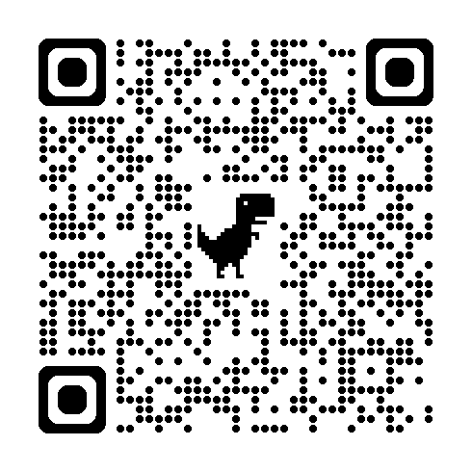
Online GMS Quiz

