Slide 1


Slide 2
“When you hear club administration, what is the first thing that makes you think, ‘I’m not really sure how that works’?”
What are the president’s responsibilities versus the secretary’s and treasurer’s?
What happens when your club membership records don’t match RI’s records?
What records does a club need to keep – and for how long?
What deadlines can cause a club real problems if they’re missed?
When do we need to update our bylaws?
Who do I contact at the District when I don’t know the answer?

Slide 3
Club President | Club Secretary | Club Treasurer
Leads the club | Keeps the club organized | Manages the club's money
Presides over club and board meetings | Maintains accurate club/member records | Manages club funds
Sets direction and priorities with the board | Records/maintains official club information | Collects dues and fees
Appoints committee chairs and members | Helps report current/incoming officers to RI | Pays bills, including RI obligations
Conducts club assemblies | Keeps membership information current | Reports regularly on club finances
Works with committee chairs to keep goals moving | Handles records, notices, correspondence and administrative documentation | Helps prepare/manage the budget
Works with the AG, DG and District | Helps ensure RI/ClubRunner records are accurate | Works with The Rotary Foundation on contributions
Oversees club finances with the board/treasurer, including budgeting and annual audit | Supports continuity from one Rotary year to the next | Provides financial records for review/audit
President = leads,
Secretary = records/reports,
Treasurer = finances.
There is some overlap—Rotary gives several officers access to update club/member data and handle certain administrative functions—but their primary responsibilities are distinct.
ALWAYS UPDATE IN CLUBRUNNER FIRST
PRESIDENT: “Are we doing what we need to do?”
SECRETARY: “Is it recorded, reported and up to date?”
TREASURER: “Is it paid, accounted for and financially sound?”

Slide 4


Slide 5
Records-Retention Best Practice
Michigan law specifically requires the corporation to maintain accounting books and records, minutes of member/board/executive committee proceedings, and membership records.
Record | Suggested retention
Charter, articles of incorporation, constitution & bylaws + amendments | Permanent
IRS tax-exempt determination/application documents | Permanent
Board and official club meeting minutes | Permanent
Major board resolutions/policies | Permanent
Historical officer lists / significant club records | Permanent
Annual financial statements | Permanent or at least 7 years
Bank statements, deposit records, canceled checks | 7 years
Receipts, invoices and expense documentation | 7 years
General ledgers/accounting records | 7 years
Filed tax returns / Form 990 series | Permanent is safest
Contracts and agreements | Term of contract + 7 years
Grant records and supporting documentation | Follow grant requirement; 7 years is a good club minimum
Insurance policies and claims | Permanent for policies/major claims when practical
Employment/payroll records | At least 4 years for federal employment-tax records; 7 years is a useful club policy
Routine correspondence / administrative material | 3–7 years depending on importance
Routine event paperwork with no tax/legal/historical value | 3 years

Slide 6

DEADLINES THAT MATTER
JAN 1 & JULY 1
👥 Is your membership correct?
RI CLUB INVOICE
💰 Has it been paid?
WITHIN 30 DAYS
💻 Have membership changes been reported?

Slide 7
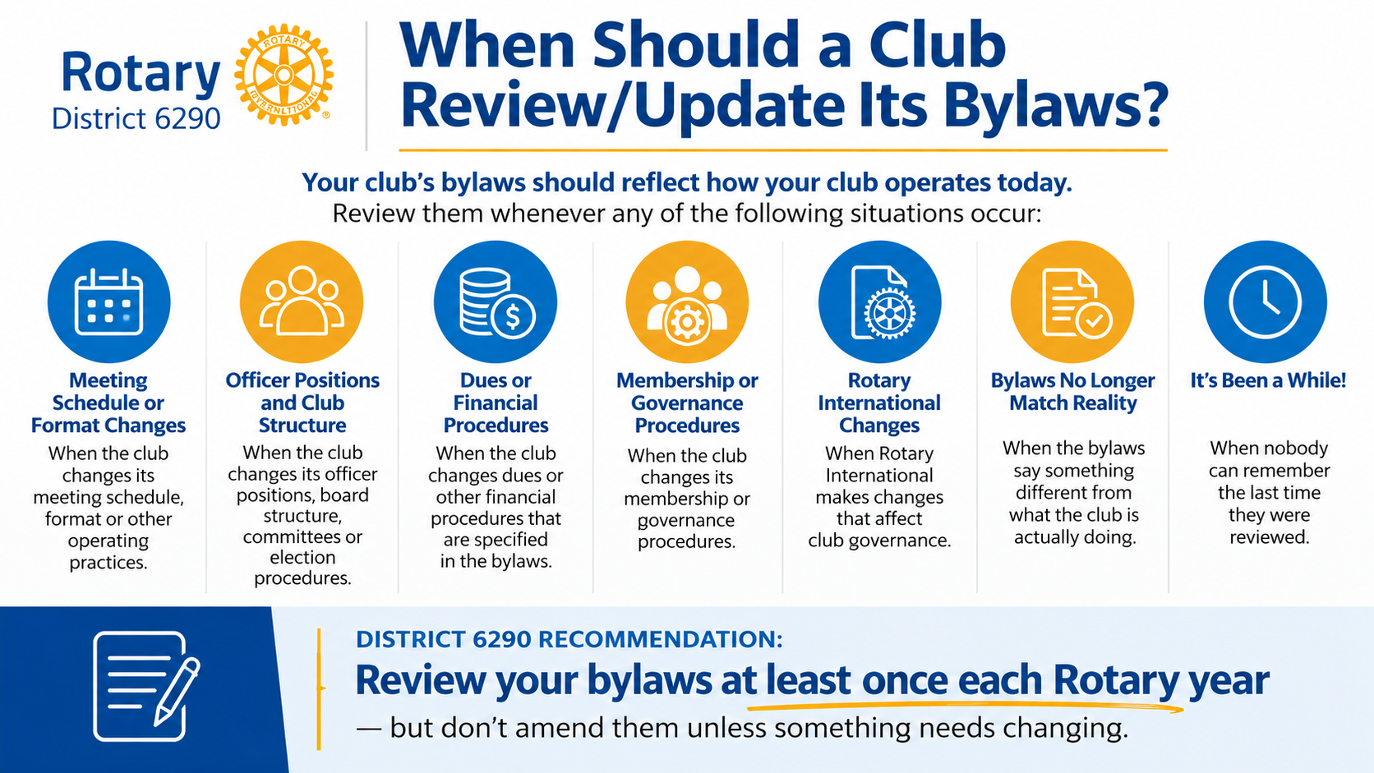

Slide 8


Slide 9

“If your secretary resigned tonight, would anyone else know where your club's records are?”

Slide 10


Slide 11


Slide 12


Slide 13


