Slide 1
Building international peace through global scholarship

Slide 2

GLOBAL SCHOLARS
District 6290 sponsors 1 Graduate student studying abroad with $30k in scholarship, per year
Area of study must fit within Rotary’s Seven Areas of Focus
1 – 4 years of support, evaluated annually
Applicants cannot have family member(s) in Rotary; past members must be more that 36 past termination of membership

Slide 3
District 6290: Past Global Scholars’ Projects Masters & doctorate
Water-Food-Energy Resource Tools for Sustainability Management – Cologne Technical University
Economic Policy in Global Marketing – Central European University, Vienna
Basic Education in Lesson Planning for Students Related to Historical Research and Artifacts – University of Oxford
Outdoor-Based Model for Elementary Education – niversity of Edinburgh

Slide 4
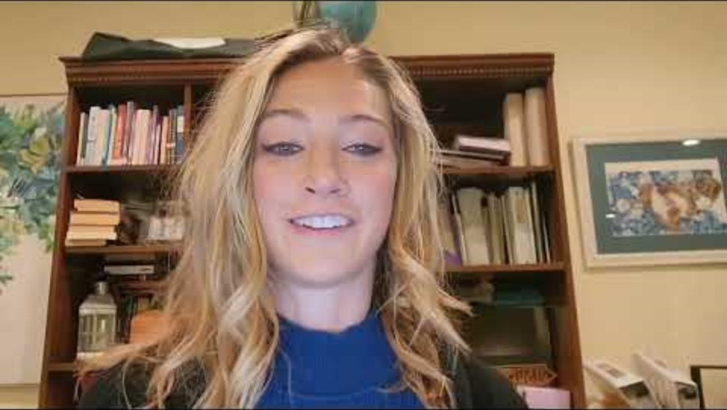
Our most recent global scholar dr. ariel dempsey 4 years of support at Oxford University, England

Slide 5
GS Application Process Overview
Identify students currently applying to or accepted in a Graduate program overseas
Complete Preliminary Application
Screening interview
Invitation to complete Formal Application
Committee interview
1 Global Scholar selected

Slide 6
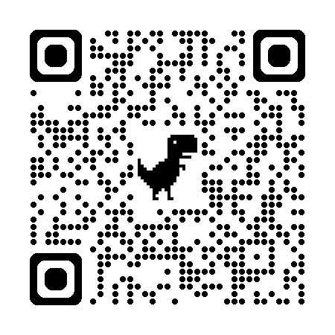
Please help Spread the word in district 6290!
Will the 2026-2027 District 6290 Global Scholar come from YOUR community? Just think how exciting that would be!
Please help the Global Scholars Committee find another fantastic, positive, make-the-world-a-better-place change agent to support financially while (s)he conducts graduate study at a university outside the United States. This Global Scholar, while in graduate school with our support, will also develop a deep relationship with Rotary International right where (s)he studies! District 6290 is very proud of our Global Scholars program and the incredible, purpose-driven talent we have supported over the years. Please help us find our next Global Scholar!
THE ASK - 1
Please share with your club:
District 6290 is actively recruiting students or professionals who will be going to graduate school in another country, studying something that dovetails with one of Rotary’s Seven Areas of Focus.
District 6290 provides up to $30,000 per year for one Global Scholar.
Support is renewable for up to 4 years of graduate school.
While in graduate school, the District 6290 Global Scholar will design and execute a sustainable project meeting an identified need within the host Rotary community.
Candidates cannot be Rotarians or related to active Rotary members.
Check out our new logo, QR code, and webpage! Address: https://ridistrict6290.org/sitepage/scholarships
Application materials, program information, contact information, and past Global Scholar highlights are all available on the webpage.
THE ASK – 2
Challenges for you and your Club:
Create a Club newsletter piece about our District’s Global Scholars program; here is a ready-made paragraph for you to use:
“District 6290 is proud to sponsor one Global Scholar each year with up to a $30,000 scholarship for graduate study in one of Rotary’s Seven Areas of Focus at a University outside the United States! Our past Global Scholars have been incredible, and we are so excited to see where the next one will come from – will it be your community? The Global Scholars Committee is happy to announce that our District is actively recruiting and hopes to identify some incredible candidates in the next few weeks. We have a bold ask for a bold purpose; we are asking every club member in District 6290 to visit the new District 6290 Global Scholars webpage (https://ridistrict6290.org/sitepage/scholarships) – or use the QR code below! – to learn about the program, eligibility, and timelines for recruiting and the application process. WHY? So our District can support excellence in academic leadership and in community service, and foster new, long-term relationships with Rotary that will yield heightened awareness of the needs of Rotarians out After perusing the webpage, please feel free to reach out to the District 6290 Global Scholars Chair, Dr. Rachel Sytsma-Reed, if you have any questions (rachel@greatlakescfa.org). YOU are critical to our recruiting, so thank you in advance for your help in spreading the word about this very special scholarship opportunity!”
Get that cute QR code (see below) out there as much as possible, as many ways as possible.
In the next few weeks, use the Power Point presentation accessible through the webpage to lead a 5-8 minute presentation to your club about the District 6290 Global Scholars Program.
Talk about this incredible District-level program to at least three people outside Rotary – and challenge your Club members to do the same!
After exploring the webpage, email or call the District 6290 Global Scholars Chair, Rachel Sytsma-Reed (contact below), if you have questions or would like to discuss anything about this program.
The District 6290 Global Scholars Committee thanks you for your help and can’t wait to see who YOUR COMMUNITY sends us to consider as the 2026-2027 Global Scholar from District 6290!
Talk to students in their senior year of undergrad or students who have been in the work world but are considering overseas grad study
Direct prospective students to Dr. Rachel Sytsma-Reed, Global Scholar Chair, at:
rachel@greatlakescfa.org
Preliminary Applications due January 19, 2026
Formal Applications due March 1, 2026
Learn More!

Slide 7
In a world that doesn’t always lean into the power of knowledge to connect us and build pathways to peace, Thank you for supporting rotary global scholars.

