Slide 1
Introduction to The Rotary Foundation
Notes:
The next item on our agenda is “The Big Picture” – a general overview of what the Foundation is and how it works.
As Rotarians, the Rotary Foundation is “our foundation”.
I like to think that it is, or at least should be, every Rotarian’s charity of choice.
The Rotary Foundation transforms our gifts into service projects that change lives both close to home and around the world.
From modest beginnings over 100 years ago - the Foundation has spent over $3 billion on life-changing, sustainable projects.
We start with a video from The Rotary Foundation…. <<click on video to play>>
So – what does that mean to us locally? In my opinion, the Rotary Foundation defines what Rotary is.

Slide 2
The Rotary Foundation Simplified
Donations
Annual Fund
Endowment Fund
Grants
District Grants
Global Grants
Areas of Focus
Notes:
Rotary is a complex organization – The Rotary Foundation is also complex.
The main reason for that is that Rotary clubs are different – there are some commonalities to be sure, but, each club determines its own priorities and how it works to achieve them.
Let’s try to simplify the Foundation – there’s 2 main areas of concern – money in – and – money out for project grants.
With respect to money in – there are a number of different funds in the Foundation – the Annual Fund and the Endowment Fund are the primary 2 funds that receive most of the donations.
Annual Fund contributions help support our humanitarian activities, from local service projects to global initiatives.
Our Endowment Fund ensures a strong future for the Foundation. Spendable earnings from the fund supplement the Annual Fund and support Rotary’s highest priorities in perpetuity.
With respect to money out – there are similarly a number of different grant possibilities – District Grants and Global Grants are the 2 primary opportunities for club projects.
Regarding District Grants – Our District uses a portion of the grant given to us to fund our District Grants. Our District Grants are grants to clubs in our District in support of their local and international projects.
Your club will be certified to apply for one, or more, of these grants by your attendance here today.
Global Grants fund large-scale international humanitarian projects, vocational training teams, and graduate and postgraduate scholarships that have sustainable, measurable outcomes in one or more of Rotary’s areas of focus – we’ll talk about the areas of focus later.
Global grants offer clubs and districts opportunities to participate in strategically focused, larger scale, high-impact activities.
I hope this makes sense and if not yet, I hope it will by the end of the sessions today.

Slide 3
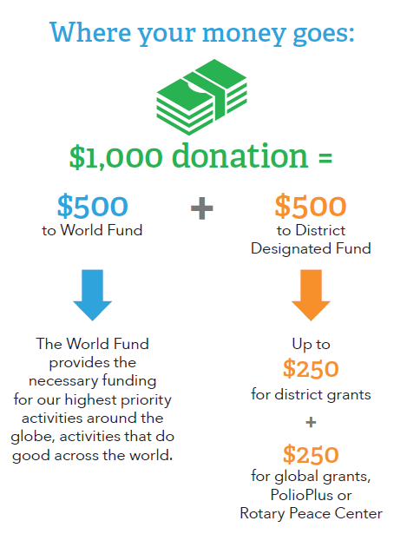
Where Does The Money Go?
Annual Fund – SHARE
Fifty percent is credited to the World Fund.
Fifty percent is credited to the District Designated Fund.
Notes:
So, where does your donation go – and how is it used?
Most donations go towards the Annual Fund – we’ll start there.
Every Rotary year, contributions to the Annual Fund-SHARE from all Rotary clubs are directed into two funds:
Fifty percent is credited to the World Fund.
Fifty percent is credited to the District Designated Fund.
The Foundation uses the World Fund portion to pay for the worldwide grant and program opportunities available to all Rotary districts.
Our district uses the District Designated Fund portion (often referred to as the DDF) to fund the Foundation grants and programs of its choice.
Our district usually uses 50% of the DDF each year to fund our District Grants – by the way – this 50% allocation is the maximum allowable by the Foundation rules.
The other 50% is used by our District Foundation Committee to fund Global Grants and other special funds such as Polio Eradication.

Slide 4
Where Does The Money Go?
Endowment Fund
A percentage is directed annually to Foundation grants and programs.
Notes:
The other major fund is the Endowment Fund
Contributions to the Endowment Fund are invested in perpetuity. The earnings, a percentage of the total value of the fund, are directed annually to Foundation grants and programs.

Slide 5
Where Does The Money Go?
Polio Plus
Donations are designated directly to Rotary’s primary philanthropic activity.
Notes:
Where does the Polio Eradication Fund fit into this?
Essentially, it doesn’t – it’s not part of either the Annual or Endowment Fund – Polio Plus is one of the specialized funds in the Foundation.
PolioPlus activities are funded by grants from the general PolioPlus Fund and District Designated Fund contributions.
Think of Polio Plus as a flow-through fund – funds are generally used very quickly with all donations being applied directly to polio eradication activities.

