Slide 1
Rotary Community Corps
Notes:
Rotary Community Corps

Slide 2
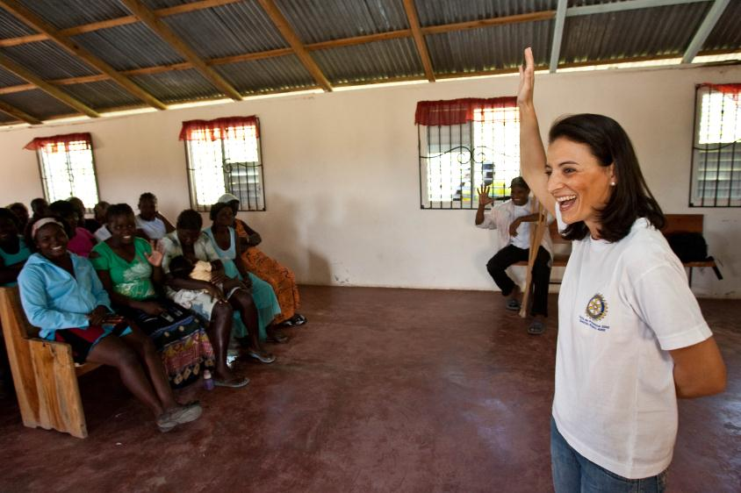
Rotary Community Corps
What are RCCs
Goals of RCC
Activities
Project Examples
Guidelines
How to Organize
Rotary Club Support
Resources
Notes:
A Rotary Community Corps (RCC) is a team of non-Rotarian men and women who are committed to their community’s long-term economic development and self-sufficiency. RCCs are active in urban and rural communities in both developed and developing countries. Remember that no matter where you are, even if it is a developed country, there are always underserved groups and communities in need of assistance. RCCs can help identify—and address—these service opportunities.

Slide 3
What are Rotary Community Corps?

Slide 4
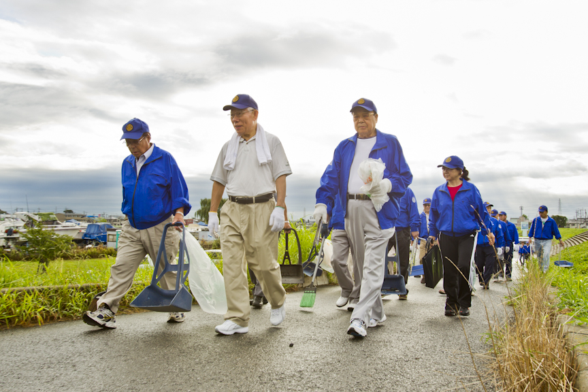
What are Rotary Community Corps
A Rotary Community Corps (RCC) is a team of non-Rotarians who are flexible partners in service for Rotary clubs.
Community Solutions | Community Issues
Notes:
An RCC is sponsored by a Rotary club and, like Rotaract and Interact, the Rotary club acts as its partner in service for community development projects. As representatives of the community being served, RCC members bring enthusiasm, creativity, and sustainability to the projects they design and implement. In other words, they offer community solutions for community issues.

Slide 5
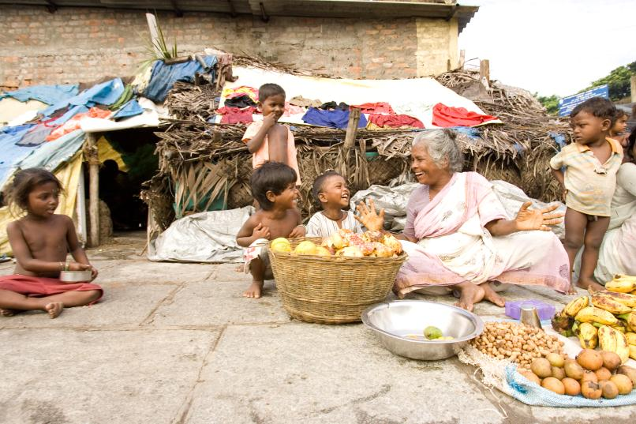
What are Rotary Community Corps?
RCCs can implement creative and sustainable solutions to meet a wide array of needs in their community, such as illiteracy, lack of safe water, hunger, pollution, inadequate housing or vocational skill development.
Notes:
Some RCCs are founded to address a specific project, while others attempt to tackle larger, more entrenched problems in the community. The goals of an RCC will depend on its community’s specific needs.

Slide 6
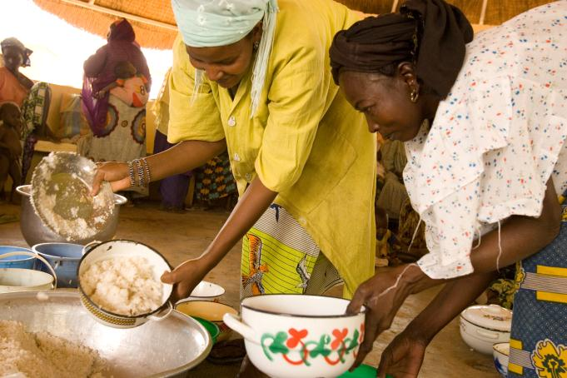
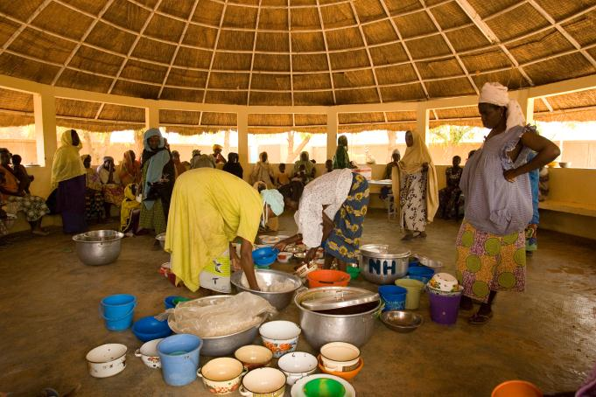
Who can join a Rotary Community Corps?
Members can comprise an entire village, neighborhood, or community association that wants to work together, or a diverse group of service-minded individuals. RCCs also offer disadvantaged and underrepresented groups an opportunity to empower themselves and their community.
Notes:
Membership in an RCC is open to any non-Rotarian adult in the community who shares Rotary’s commitment to service. Members can come from any walk of life. Joining an RCC is not intended to be a path to Rotary membership, but it does expand opportunities for members to collaborate with Rotarians and develop leadership skills that will allow them to better participate in their community in an active and meaningful way. The partnership between an RCC and its sponsoring Rotary club is mutually beneficial, as it enhances Rotary’s image and impact in the community.

Slide 7
Goals of Rotary Community Corps

Slide 8
Goals of Rotary Community Corps
Encourage individuals to take responsibility for the improvement of their community.
Recognize the dignity and value of all useful occupations.
Mobilize self-help activities and collective work to improve quality of life.
Encourage the development of human potential to its fullest, within the context of the local culture and community.
Notes:
RCCs enable community members to personally address problems in their community while recognizing their inherent dignity and value, no matter what their occupation or social standing may be. This environment helps to foster and encourage the development of human potential to its fullest.

Slide 9
Activities

Slide 10
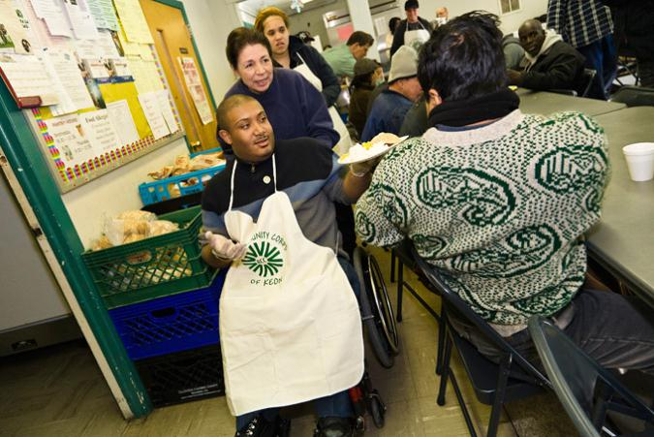
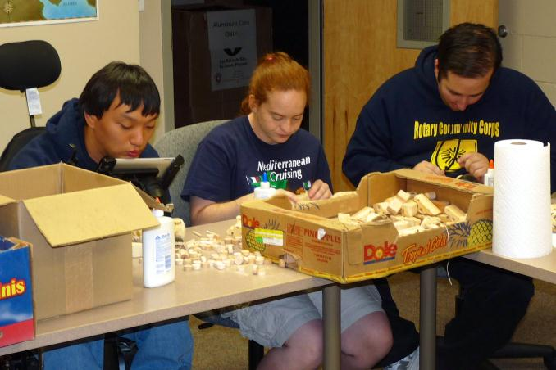
Project Examples - Underrepresented Groups
Examples
Special Needs Adults
At Risk Youth
Alzheimer’s Patients
Impoverished or Homeless
Veterans
Single parents
Elderly
RCC of Keon, USA
RCC of Parker, USA
Notes:
Every community has groups that have been historically left out of the development or decision making process. RCCs can help to provide a voice to those groups. Ask intermediary community organizations to help identify leaders or advocates of underrepresented groups in your community and then develop partnerships with them.
Increasing underrepresented groups’ participation can tremendously improve the opportunities for project success. For example: two Rotary clubs in the United States have sponsored RCCs for adults with special needs (pictured here). Through their RCCs, these members are learning about service and contributing to the improvement of their community through a variety of projects. What underrepresented groups exist in your community?

Slide 11
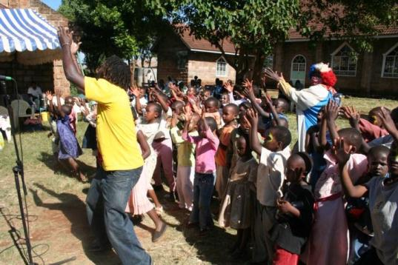
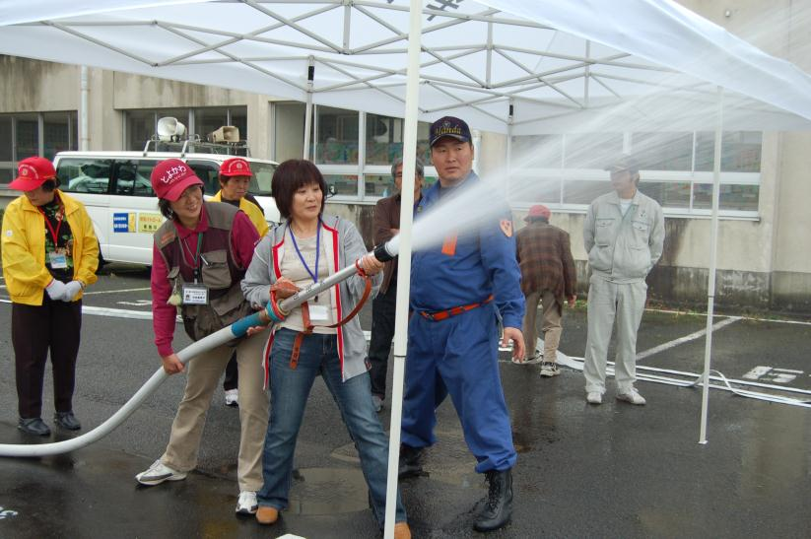
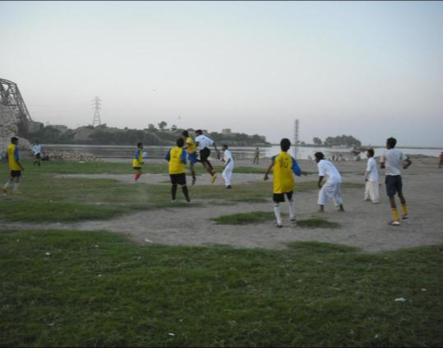
Project Examples - Community Focused
RCC of Cura, Kenya
RCC of Handa, Japan
RCC of Gizri, Pakistan
Notes:
A community’s power to transform itself exists foremost with its residents, who have firsthand knowledge about the most pressing local problems. Developing service projects to address those problems can unite and empower the community at the grassroots level, and expose more community members to the power of Rotary.
In an effort to decrease the crime rate in the community, the RCC of Gizri, Pakistan arranged a community-wide soccer tournament to establish positive activities. More than 72 registered soccer clubs entered the tournament, which helped to unite the community through spirited competition and gain support for community development. The RCC of Handa, Japan works with local schools to organize disaster prevention classes for youth of all ages in the Handa city area. These classes take place in nursery, elementary, and secondary schools and at the university level. Class activities include first aid, building portable toilets, and emergency food preparation. The RCC of Cura, Kenya, which is near Nairobi, established a home for children, some of them HIV positive, whose parents have died from AIDS. The home has been able to take in more than twice the number of children it could originally support, thanks to donations from international Rotary clubs, the Arya Vedic Interact Club, and local organizations.

Slide 12
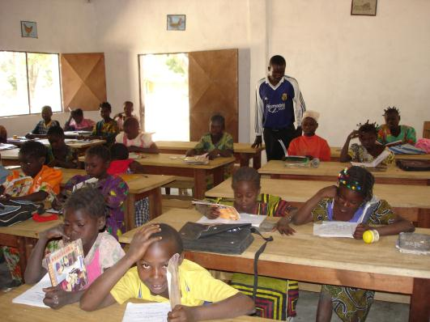
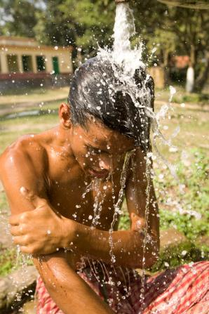
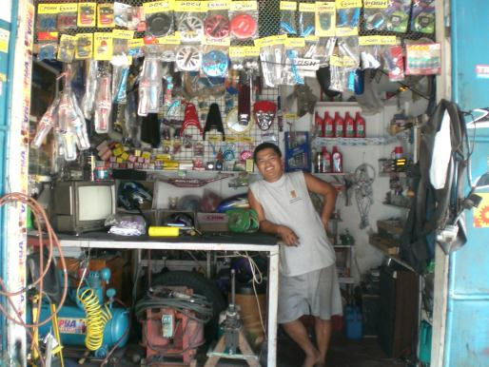
Areas of Focus
RCC of Paranaque
Notes:
While Rotarians can serve in countless ways, Rotary has focused its efforts in six areas, which reflect some of the most critical and widespread humanitarian needs. RCCs can be part of any Rotary club’s “Tool-Kit” to help address projects in the following areas:
• Peace and conflict prevention/resolution
• Disease prevention and treatment
• Water and sanitation
• Maternal and child health
• Basic education and literacy
• Economic and community development
All Rotarians planning new service projects are encouraged to consider these areas and the many opportunities for innovative projects.

Slide 13
Guidelines

Slide 14
Basic Guidelines
Membership is open to non-Rotarian men and women who reside, are employed, , or study near the RCC community. 10 members are required to start.
RCCs should meet at least once per month.
RCCs are encouraged to undertake two major projects annually.
Any membership dues should be nominal.
More Guidelines at rotary.org/rcc
Notes:
The process for setting up a RCC is relatively straightforward, and if you ever have questions you can always ask your district’s RCC Chair, or RI staff.
Membership: Clubs are encouraged to recruit adults with good character and leadership potential. Membership is open to men and women who are residing, employed, or studying in or near the community
Meetings: An RCC must meet at least once per month, at a time and place suited to the convenience of the members. The leadership group of the RCC should meet at least twice per month. Projects: Each RCC should undertake at least two projects annually.
Dues: Any fees, dues, or assessments to be paid by the membership of the RCC must be nominal and for the sole purpose of meeting administrative costs. Funds for activities and projects must be raised separately.

Slide 15
Organize an RCC

Slide 16
Role of Rotary clubs and districts
Create awareness for the RCC program at the club and district level
Research the need for and feasibility of establishing an RCC and identify potential RCC members
Guide the process of forming an RCC once the club(s) has agreed to sponsor one
Provide ongoing guidance and support to the RCC in developing its service projects
Publicize RCC success stories (and share them with RI)
Find documents and application materials at: www.rotary.org/rcc
Notes:
Clubs and districts are encouraged to establish RCC committees with the objective of promoting greater participation and collaboration in all types of community service activities. These key steps are critical for creating and maintaining an effective RCC:
Create awareness for the RCC program at the club and district level
Research the need for and feasibility of establishing an RCC and identify potential RCC members
Guide the process of forming an RCC once the club(s) has agreed to sponsor one
Provide ongoing guidance and support to the RCC in developing its service projects
Publicize RCC success stories and share them with RI

Slide 17
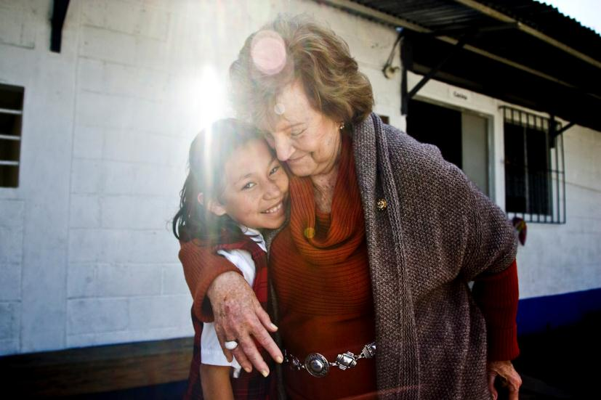
Key takeaways
A Rotary Community Corps (RCC) is a team of non-Rotarians who are flexible partners in service for Rotary clubs.
RCCs offer Community Solutions for Community Issues
Members can come from a variety of backgrounds
Notes:
Talk with fellow Rotarians about RCCs, remembering these key points:
A Rotary Community Corps (RCC) is a team of non-Rotarians who are flexible partners in service for Rotary clubs.
RCCs offer Community Solutions for Community Issues
Members can come from a variety of backgrounds

Slide 18
Contact Rotary International
Rotary Service Connections
Phone: 1-847-866-3244
Email: rotaryservice@rotary.org
Notes:
If you have questions about RCCs or success stories to share, please contact Rotary staff.

